Slide 1
Predictive Analysis: Classifying URLs
Using Machine Learning
Robert A. Dwan Jr. and Alex M. Tavares
MQP Final Presentations
October 8, 2019
DISTRIBUTION STATEMENT A. Approved for public release. Distribution is unlimited.
This material is based upon work supported under Air Force Contract No. FA8702-15-D-0001. Any opinions, findings, conclusions or recommendations expressed in this material are those of the author(s) and do not necessarily reflect the views of the U.S. Air Force. © 2019 Massachusetts Institute of Technology. Delivered to the U.S. Government with Unlimited Rights, as defined in DFARS Part 252.227-7013 or 7014 (Feb 2014). Notwithstanding any copyright notice, U.S. Government rights in this work are defined by DFARS 252.227-7013 or DFARS 252.227-7014 as detailed above. Use of this work other than as specifically authorized by the U.S. Government may violate any copyrights that exist in this work.

Slide 2
Problem Statement
Traces of cyber attack planning may be in open source data
Traces could signal future attacks
Determine useful indicators for predicting and preventing

Slide 3
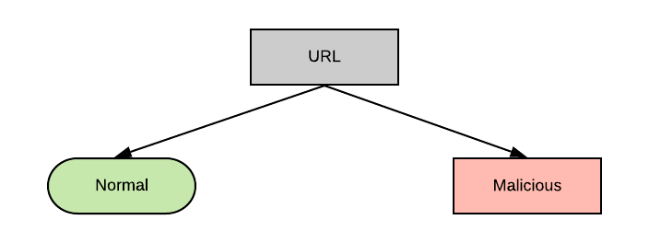
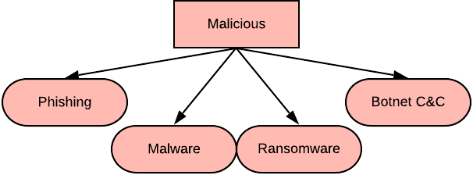
Our Work

Slide 4
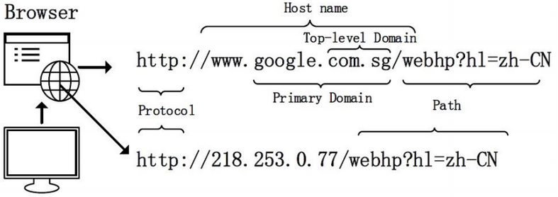
What is a Uniform Resource Locator (URL)?

Slide 5
What are Malicious URLs?
Phishing – URLs intended to mimic legitimate URLs and coerce users to divulge private information such as passwords.
  E.g. http://facebookservice.ter321.com/bws/
Malware – URLs that download malware to the users computer
  E.g. http://arash.tcoqianlong.watchdogdns.duckdns.org/sure/vbc.exe
Ransomware – URLs that lock users out of their system until a ransom is paid to the attacker
  E.g. cerberhhyed5frqa.sdfiso.win
Botnet C&C – URLs that download malware to the system and allow the device to be used in a bot network
  E.g. teamtosh.xyz/mym/panelnew/admin.php

Slide 6
Machine Learning
“Machine learning is a core branch of AI [Artificial Intelligence] that aims to give computers the ability to learn without being explicitly programmed” (Samuel, 2000).
Types:
Supervised
Semi-supervised
Unsupervised
Artificial Intelligence
Machine Learning

Slide 7


Algorithms
Decision Boundary Classifiers
Linear Classifiers
Support Vector Machine (SVM)
  Linear Kernel
Logistic Regression
Non-Linear Classifier
SVM
  Radial Basis Function Kernel

Slide 8
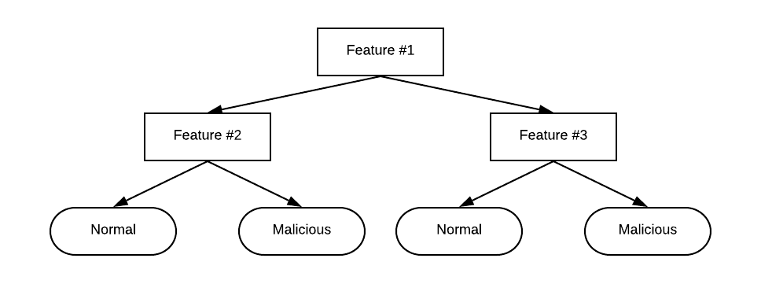
Ensemble Methods
Decision Trees

Slide 9
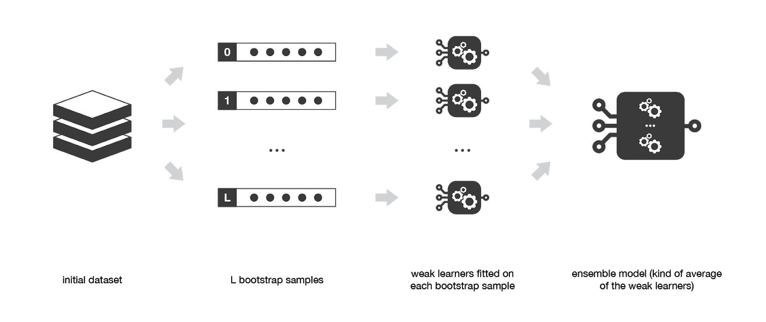
Ensemble Methods
Bagging - fits several weak algorithms to subsets of the training data and creates a strong classifier that averages the results of the weaker ones.
Algorithms:
Random Forest
Extra Trees
Initial Dataset
‘L’ Sub-datasets
Decision Trees fitted to subsets
Ensemble Model (Average of weak models)

Slide 10
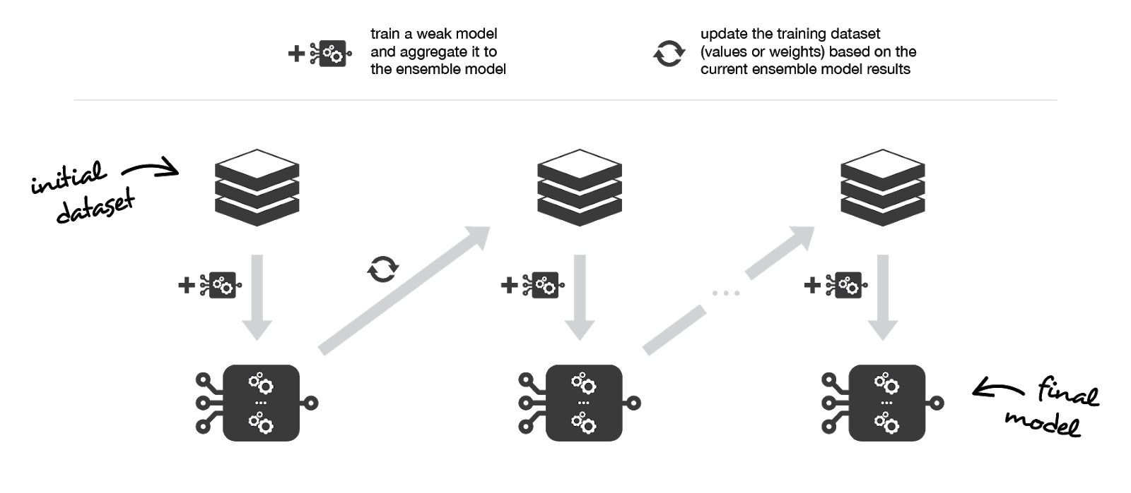
Ensemble Methods
Boosting - runs algorithms sequentially, with each model learning from the previous one.
Algorithms:
AdaBoost
Initial Dataset
Ensemble Model

Slide 11
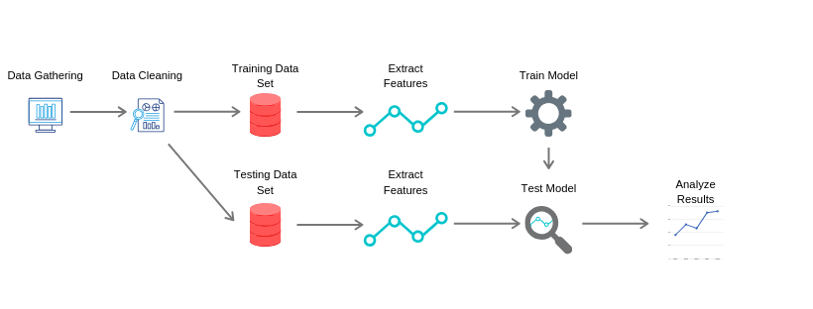
Methodology

Slide 12
Data Gathering
Class | Source | Date Retrieved | Description
Normal | Canadian Institute for Cybersecurity (CIC) | August 20, 2019 | Normal web pages gathered by the CIC
Normal | Frantsek Strasak | August 20, 2019 | Normal web pages from an independent study
Phishing | PhishTank | July 30, 2019 - August 20, 2019 | Blacklist for phishing URLs
Malware | URLhaus | May 22, 2019 - August 20, 2019 | Blacklist for malware URLs
Ransomware | rasomwaretracker | May 16, 2019 - August 20, 2019 | Blacklist for ransomware URLs
Botnet C&C | CyberCrime | August 20,2019 | Blacklist for botnet c&c URLs

Slide 13
Features
Lexical: Features of the URL text itself (e.g. length of URL, number of digits in URL)
Host-based: Features of the domain and where the URL is hosted (e.g IP address, WHOIS information)
Content-based: Features of the web page itself, the actual content on the page (e.g. embedded links)

Slide 14
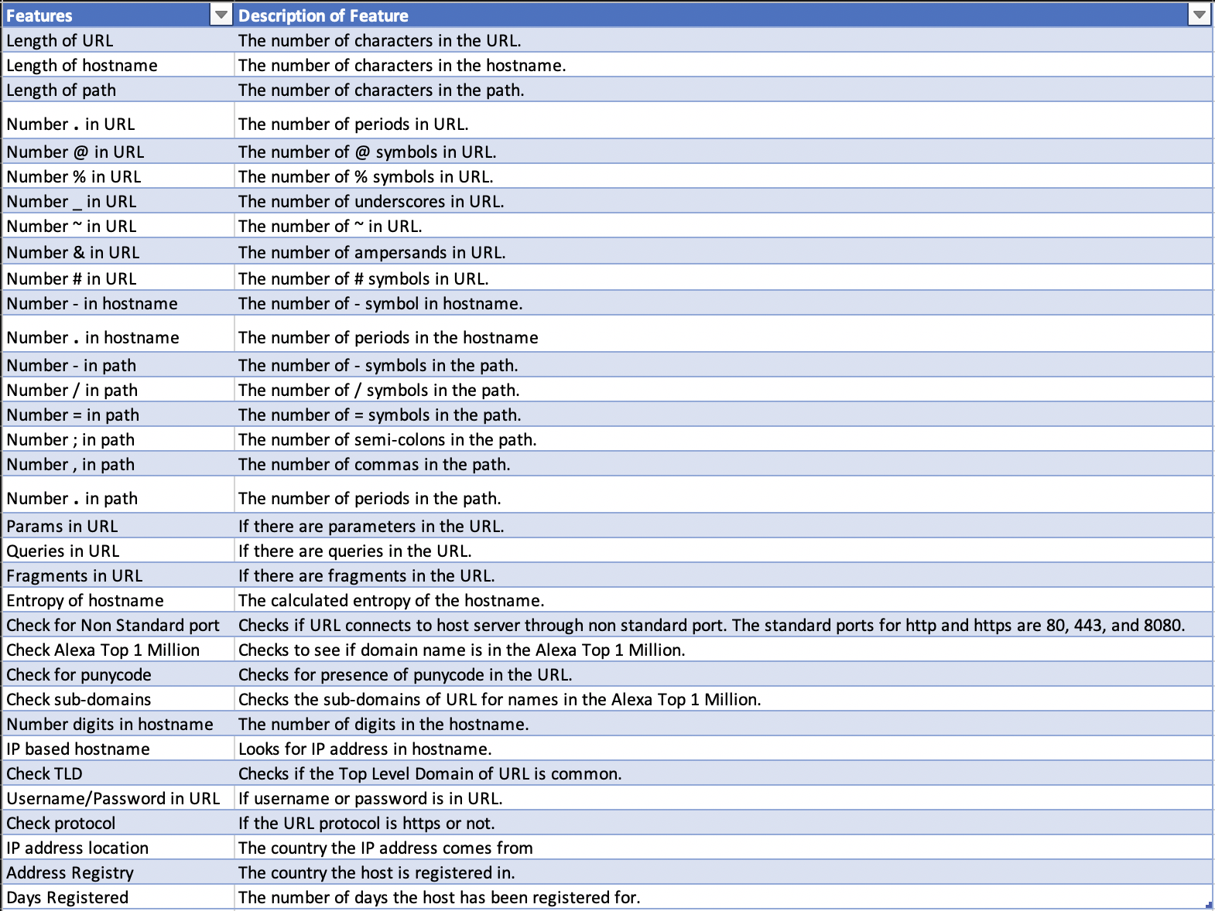
Features Extracted

Slide 15
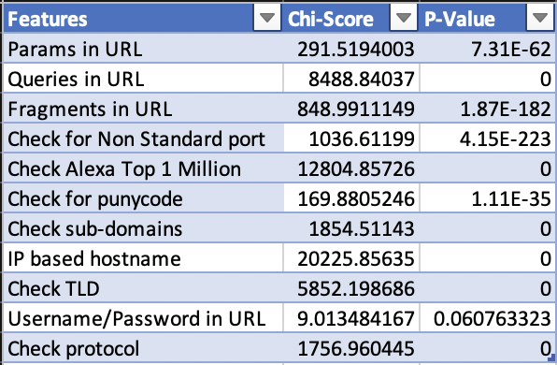
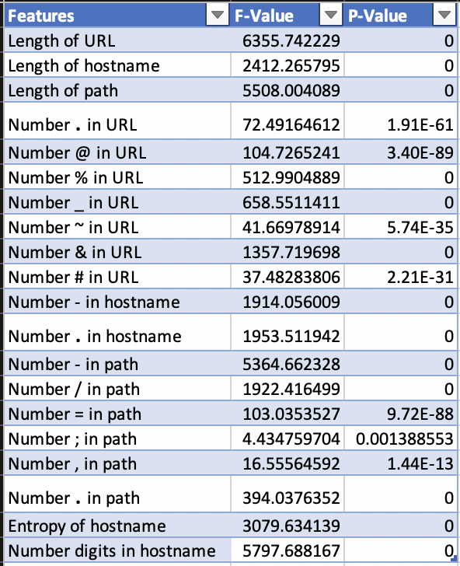
Feature Results
Chi-Squared Test Results
ANOVA F-value Test Results
H₀: The feature is independent of the class label
H_{a}: The feature is dependent on the class label

Slide 16
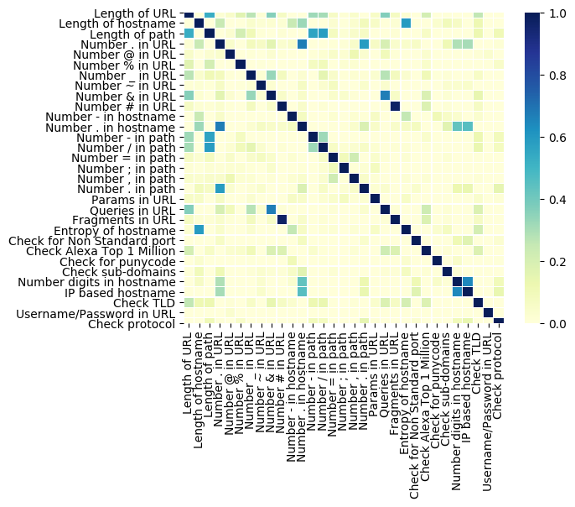
Feature Correlation Heatmap

Slide 17
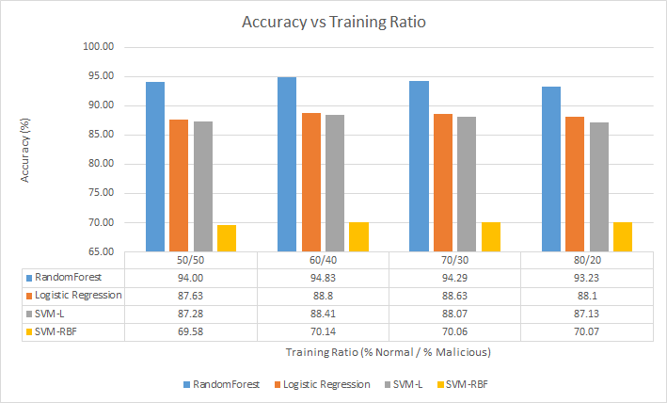
Algorithm Results

Slide 18
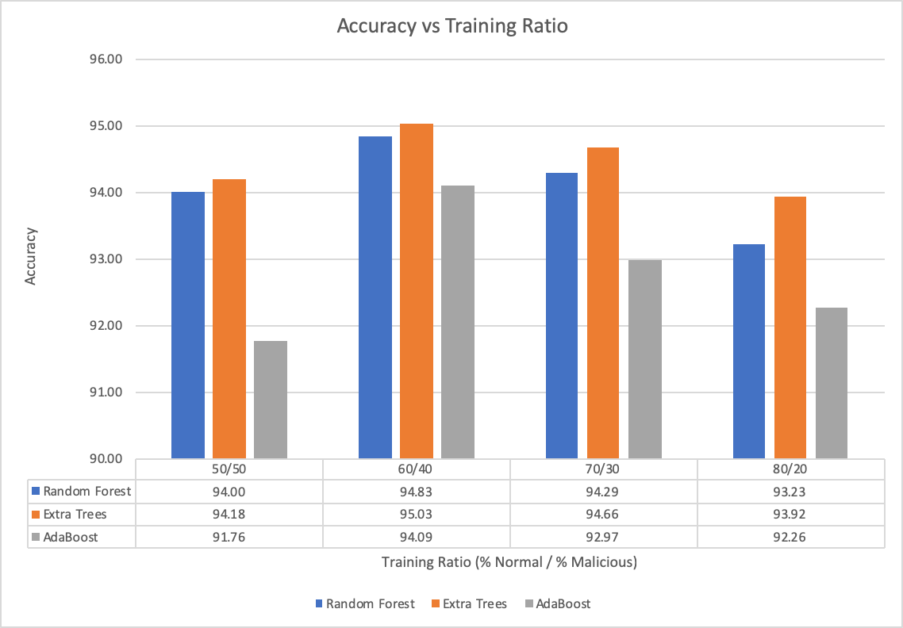
Ensemble Algorithm Results

Slide 19
Future Work
Implement Semi-Supervised Algorithms
Further analysis of ensemble algorithms
Extraction and analysis of host/content-based features
Develop new supervised algorithms

Slide 20
Conclusion
Developed scripts to create, train, and test models
Developed a feature extraction tool
Analyzed several different supervised machine learning algorithms
Acknowledgments
WPI Advisor
Professor George Heineman
Sponsor
Leslie Shing
Kimberly Holmgren
Group 57
MIT Lincoln Laboratory

Slide 21
References
Sahoo, D., Liu, C., & Hoi, S. C. H. (2017). Malicious URL detection using machine learning: A survey Retrieved from https://www.openaire.eu/search/publication?articleId=od________18::28e41a0b8b48aee3824dfa74f6fbcf9d
Rocca, J. (2019). Ensemble methods: Bagging, boosting and stacking. Retrieved from https://towardsdatascience.com/ensemble-methods-bagging-boosting-and-stacking-c9214a10a205
Patel, S. (2017). Chapter 2 : SVM (support vector machine) — theory. Retrieved from https://medium.com/machine-learning-101/chapter-2-svm-support-vector-machine-theory-f0812effc72

