Slide 1
FRASIER Presentation
Lucine Bahtiarian (RBE), Cameron Canale (ME), Loan Chau (PSS), Vanderlei Cunha Jr. (RBE), Helei Duan (ME/RBE), Farhat Kohistani (ME), Kristina Walker (ECE)
Notes:
Lucine
(Fostering Resilient Aging with a Self-efficacy and Independence Enabling Robot)

Slide 2
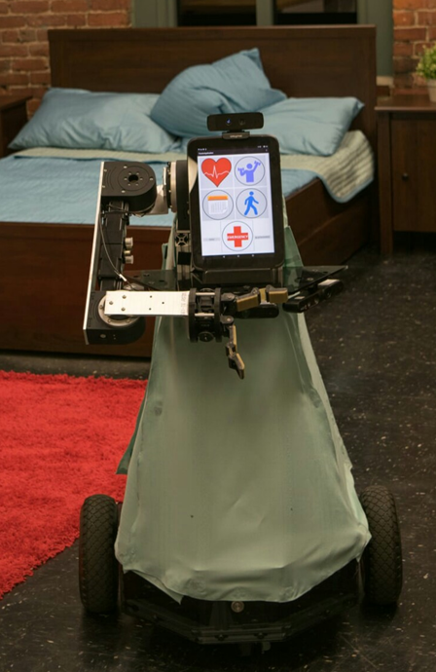
Meet FRASIER
Fostering
Resilient
Aging with a
Self-efficacy and
Independence
Enabling
Robot
Notes:
Lucine

Slide 3
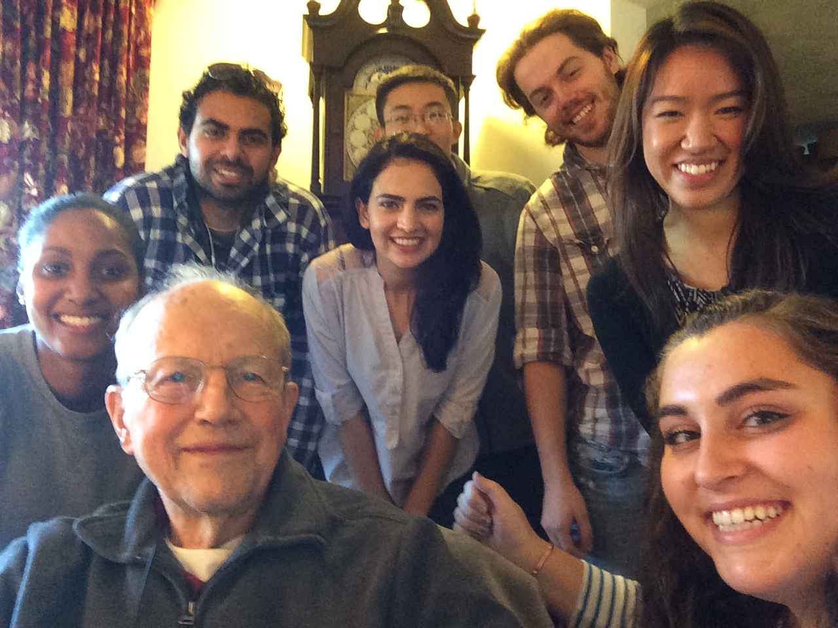
FRASIER 2015
Notes:
Lucine
-Introduce Jim Archer
-Met with him to get ideas on how to help him with tasks in his daily live
-He took from experience with age related disabilities
-Mention we want to develop a robot to … define FRASIER= Fostering Resilient Aging with a Self-efficacy and Independence Enabling Robot
-therefore we wanted to gain more insight from other possible users with challenges living independently

Slide 4
FRASIER Goals
Determine functions, features and aesthetics based off user studies results
Apply a systems engineering approach to design
Interact with the environment through sensors and actuators
Develop an active user interface
Evaluate user robot interaction feedback
Notes:
Farhat
determine
design interface and evaluate
design functionalities

Slide 5
User Studies
Pre-Design Studies:
Interviewed residents in assisted living facilities (Study 1)
Surveyed more general population (Study 2)
Design Stage
Robot designed based on results from interviews and surveys
Post-Design Study
Prototype evaluated by potential users (Study 3)
Notes:
LOAN

Slide 6
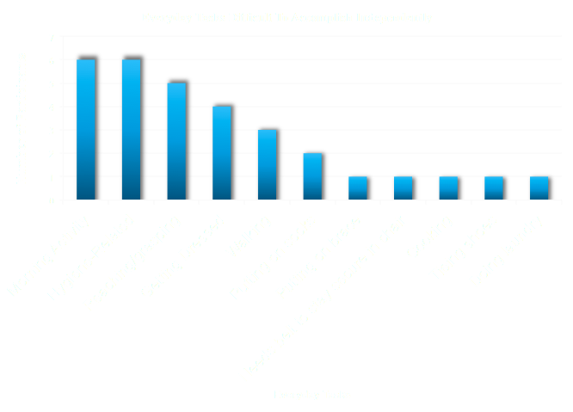
User Studies Study 1 Interviews
Notes:
LOAN
In order to determine possible functions and features we wanted to determine what tasks were most difficult to accomplish independently. This way, it would help us think about what kinds of features would be useful to help the user. As it can be seen from the results, morning activities such as getting in and out of bed in the morning, hygiene related tasks like using the bathroom and cleaning, reaching and grasping objects, getting dressed, and walking were the highest among the list of difficult tasks. The least common tasks that were difficult to accomplish independently included putting on socks, cooking, doing laundry, and so on. These results suggested that we include features that helps the user get in and out of bed in the morning, help with hygiene related tasks, help retrieve objects, getting dressed and so on.

Slide 7
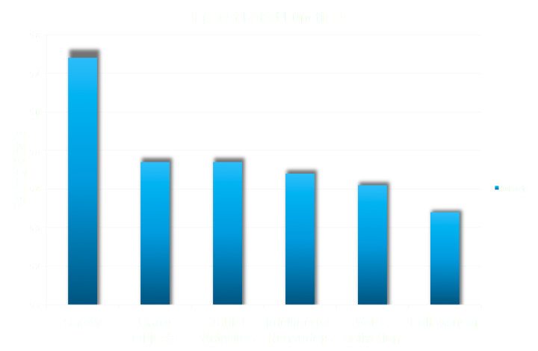
User Studies Study 2 Survey
Notes:
LOAN
Even though we had an idea of what kinds of features could be incorporated into our robot from the difficult tasks results from our interviews, we wanted to solidify our data through obtaining online surveys. We wanted to recruit participants from a wider age distribution, specifically from the wpi psychology participant pool and an online database on amazon called mechanical turk. We asked participants what possible features could be integrated into our robot. As it can be seen from the graph of averages, safety features like emergency detection and safety monitoring was definitely something that should be a capability of the robot.

Slide 8
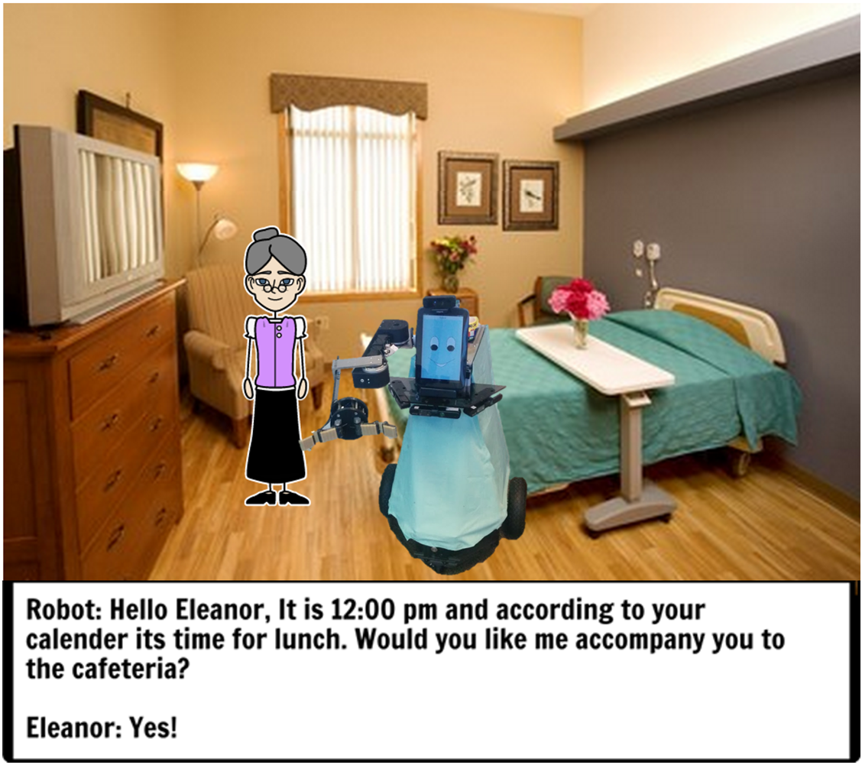
Our Story Board
Notes:
Farhat

Slide 9
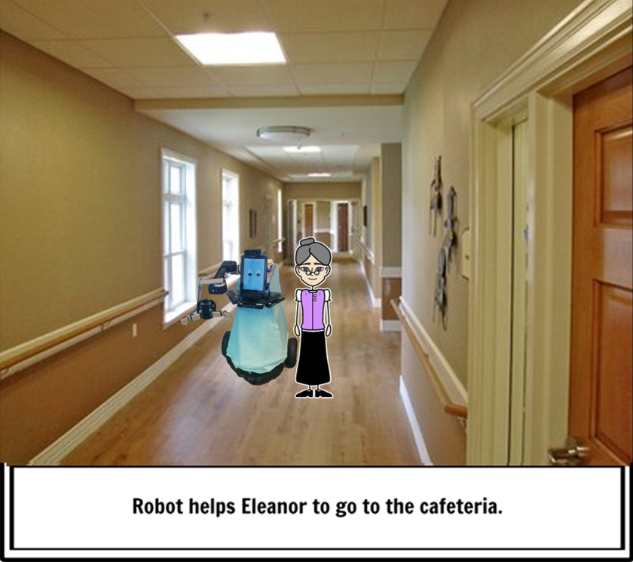
Our Story Board
Notes:
Farhat

Slide 10
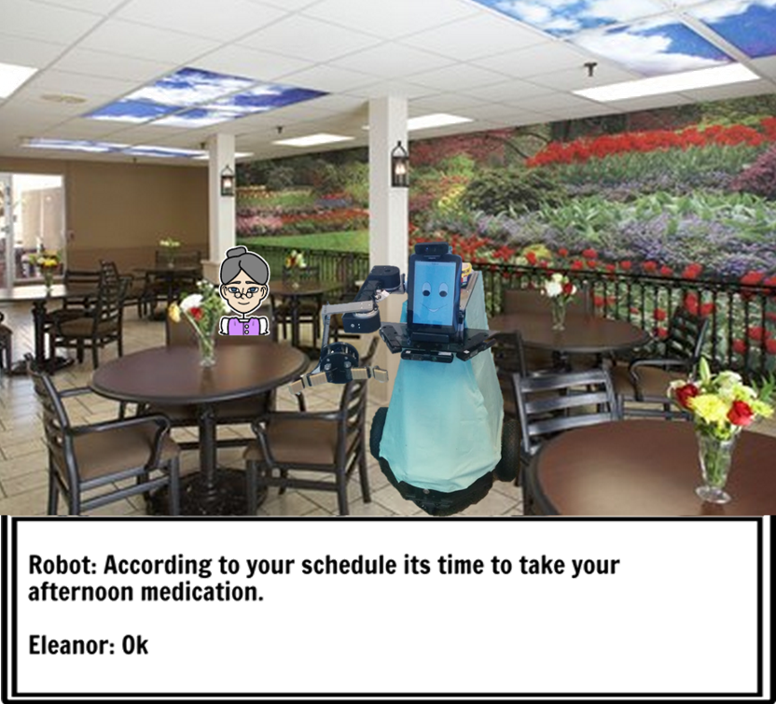
Our Story Board
Notes:
Farhat

Slide 11
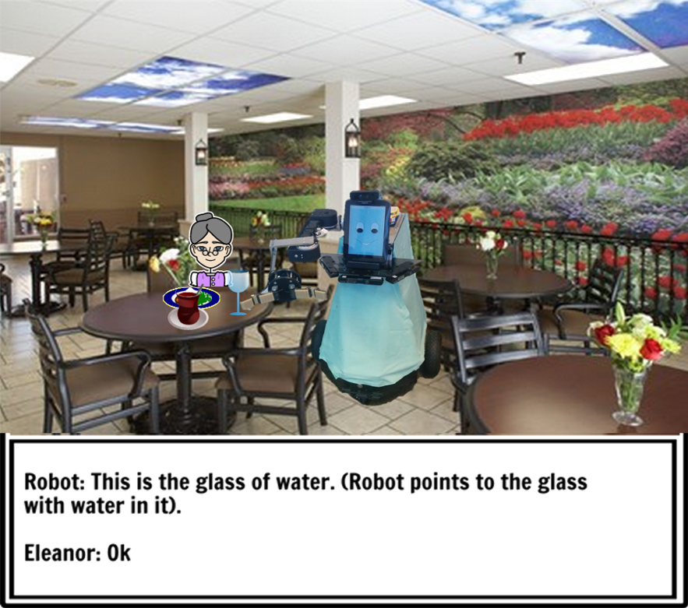
Our Story Board
Notes:
Farhat

Slide 12
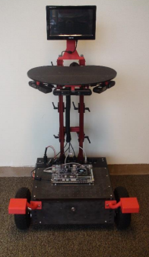
From PARbot to FRASIER
Notes:
CAM

Slide 13
FRASIER Final Design
Object Detection & Recognition
Graphical User Interface
Robot Indoor Localization/Navigation
Robotic Manipulator
Modular Robot Base
Notes:
CAM

Slide 14
User Studies Study 3 Preliminary Feedback
Majority of Participants felt comfortable and safe around the robot
Importance of functions:
Intelligence Reminders
Suggestions:
Pill dispenser
Major Concerns:
Cost
http://positivefocusproductions.com/wp-content/uploads/2012/05/calendar-reminder.png
http://blogs-images.forbes.com/steveodland/files/2012/02/37e32-costs-stack-up.jpg
Notes:
LOAN

Slide 15
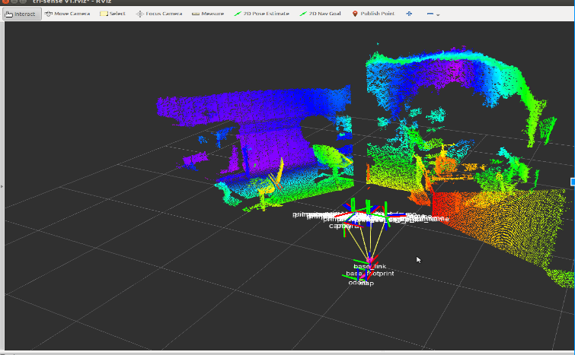
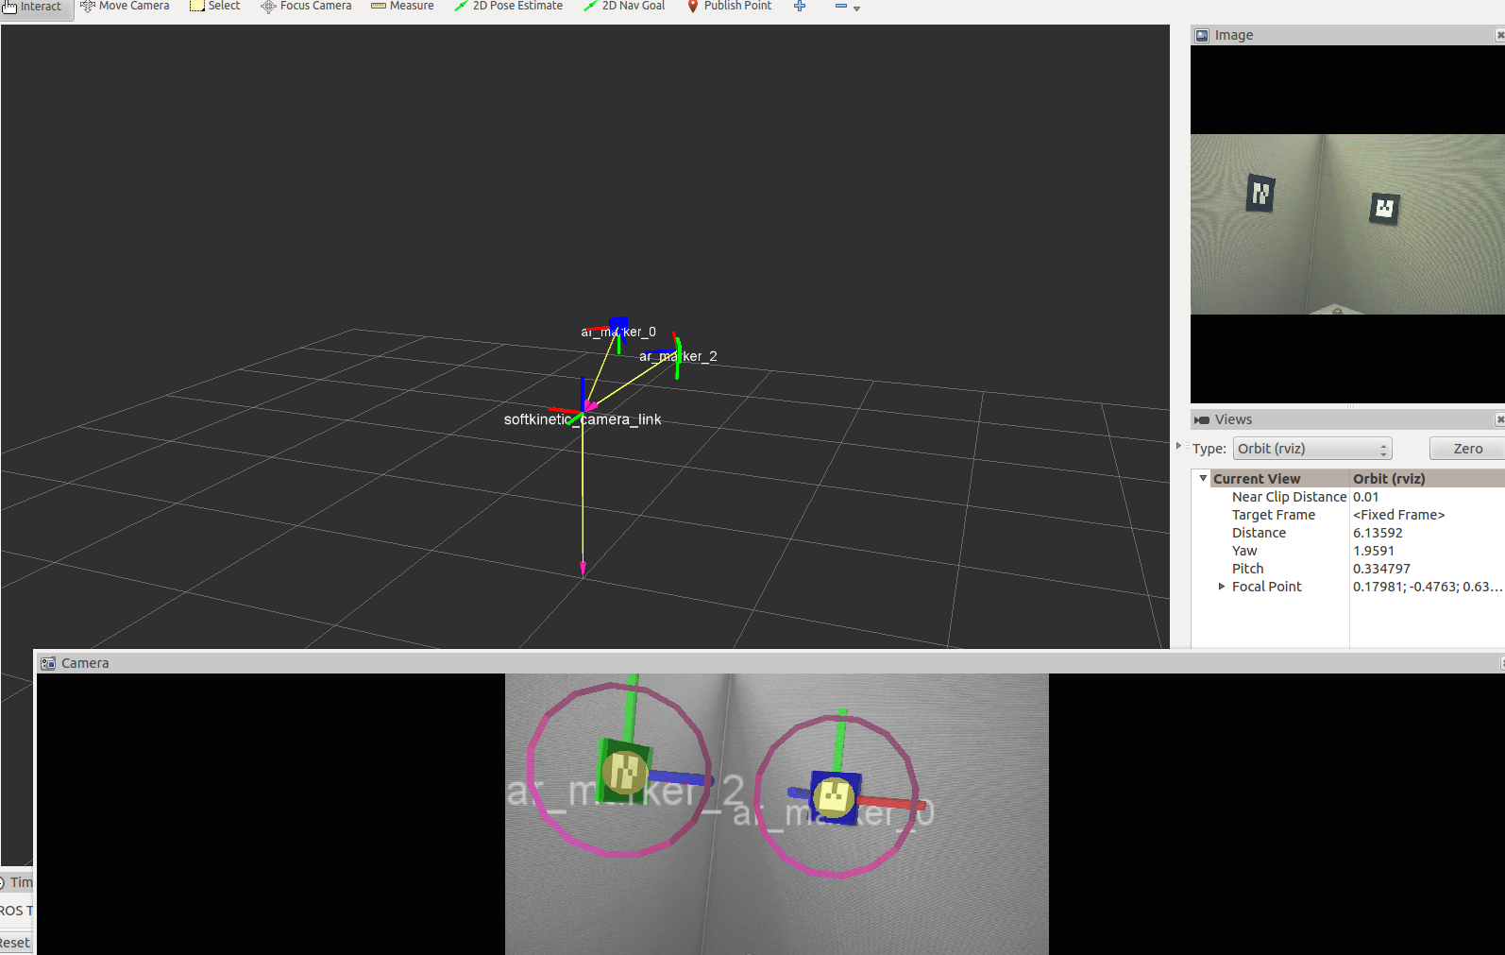
How FRASIER Sees the World - Navigation
Notes:
J
Put a picture the room
picture of room through frasier’s eyes
New picture will be added

Slide 16
How FRASIER Sees the World
Notes:
J

Slide 17
How FRASIER Sees the World
SENSOR POSE
TABLETOP MODEL
FITTING 2.5D
PLANE
SEGMENTATION
DEPTH
DESIRED OBJECTS
EXTRACTION
OBTAIN OBJECT
COORDINATES
Notes:
Kristina

Slide 18
How FRASIER Sees the World
Detecting the number of objects
Recognizing the location of the object
Notes:
Kristina

Slide 19
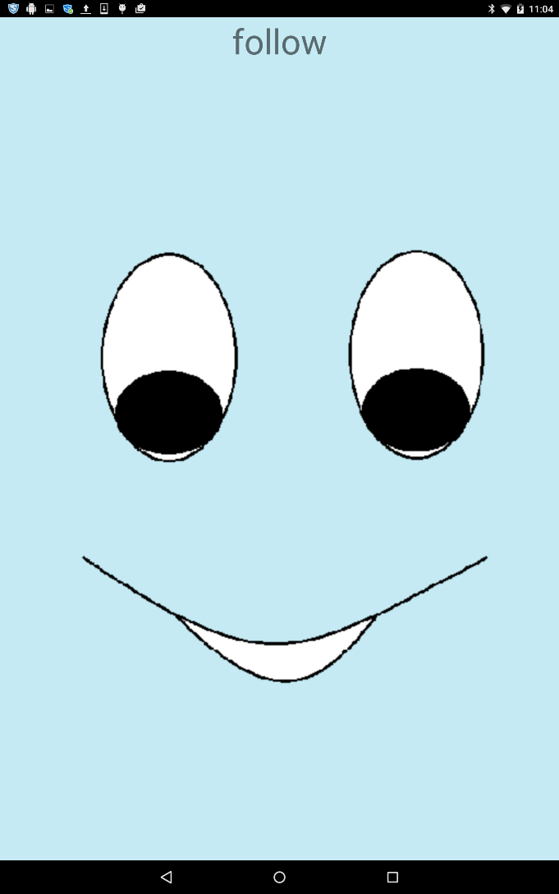
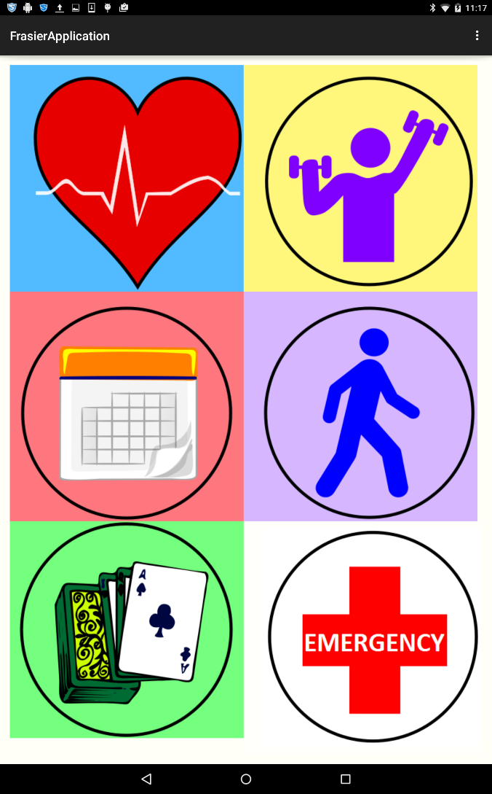
How You Talk to FRASIER
Functionalities:
Heartrate Monitor
Physical Therapy
Calendar Events
Follow
Leisure Activities
Solitaire
Skype
Emergency
Notes:
LUCINE
this can be personalized based on each user's needs—emphasize (Padir’s comments)

Slide 20
How FRASIER Interacts with the World
Manipulator Control:
igus Robolink D joint
Worm drive gearbox
Serial communication over USB
Video Speed 2x
Notes:
Dave
Script:
3 Degrees of Freedom (DOF)
each joint by igus Robolink D steppers motors
Each joint has worm gearbox to prevent back-driven, giving the manipulator ability to hold an object at specific position.
Aluminum joint connection between each joint
The video shows the manipulator is moving by Joint control.
Because this is part of FRASIER, the manipulator keeps listening to the main system by subscribing to the messages from users.
Once messages received, the programming node will send signals through motor drivers to each joint to a position.

Slide 21
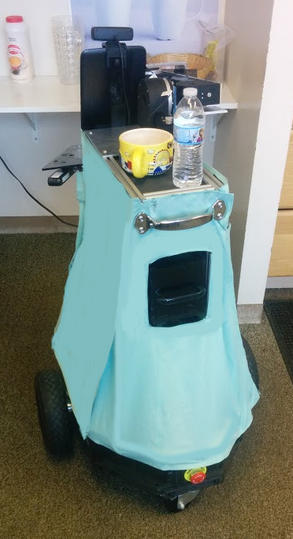
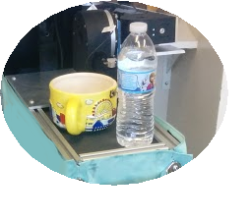
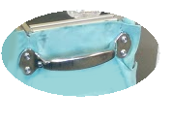
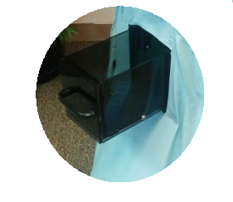
Additional Features
TRAY
HANDLE
STORAGE
DRAWER
EMERGENCY BUTTON
Notes:
Farhat
talk bout different options of color (Padir’s Comment)

Slide 22
Recommendations
OVERALL
Add additional degrees of freedom to the arm
Integrate Home sensors into robot
Modify outer design
Further robot control through GUI
USER-STUDY
Perceptions of technology
Interview more participants living independently at home
Obtain more user-robot interaction feedback
Notes:
Kristina

Slide 23
Conclusion
Robot designed from User Studies
Object Detection & Recognition
User Friendly Application
Joint Control of the Manipulator
Narrow Passage Navigation
ARTags for localization
Cost effective
Notes:
Kristina

Slide 24
The FRASIER Team Acknowledges
Taskin Padir
Jeanine Skorinko
Fred Looft
Robert Boisse
Robert Brown
Joe St. Germain
Tracey Coetzee
Velin Dimitrov
Dimitry Sinyukov
Russell Toris
Nandan Banerjee
Nicholas Otero
Rohit Bansal
Members of the PARbot team
User Study Participants
The National Science Foundation
Notes:
Kristina

Slide 25
Questions & Comments
Notes:
Kristina
Put Overall Video in this slide

