Slide 1
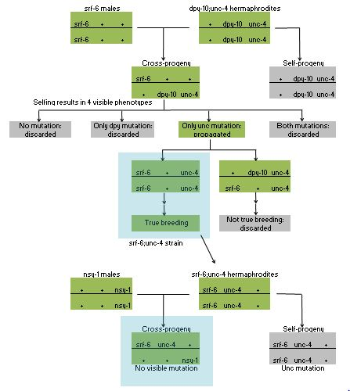
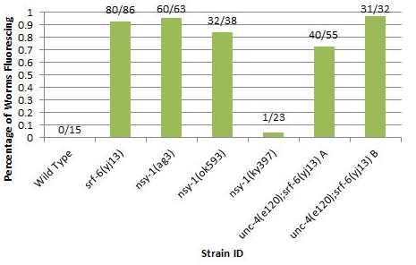
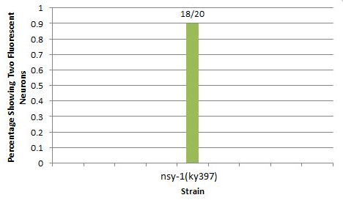
Caenorhabditis elegans: Exploring the Relationship Between srf-6 and nsy-1
Randi Isenhart (Biology and Biotechnology)
Advisor: Professor Samuel Politz (Biology and Biotechnology)
Abstract
Parasitic nematodes may cause biomedical and agricultural problems by avoiding host immune systems through changes in surface composition during infection, a process we call surface antigen switching. C. elegans is a free-living nematode serving as a model organism for antigen switching. srf-6 mutations change the developmental timing of surface protein expression, and previous evidence suggests that srf-6 may be identical to the MAPKKK gene nsy-1. Complementation tests between srf-6 and nsy-1 were conducted to support the hypothesis that srf-6 and nsy-1 affect the same genetic function.
Methods/Process
Create and identify srf-6 unc-4 mutant for complementation test.
Results
Each strain was tested for the srf-6 phenotype by antibody staining.
Background
Previous study identified nsy-1 as a potential candidate for srf-6 location
srf-6 controls expression of a surface antigen on the cuticle detected by mAb M37
nsy-1 regulates stochastic arrangement of AWC chemosensory neurons
The double heterozygote cross progeny were tested for the nsy-1 AWC phenotype.
Cross srf-6 unc-4 mutants with nsy-1 mutant marked with pstr-2:GFP in AWC neurons.
Test double heterozygotes for nsy-1 phenotype using fluorescent microscopy to see GFP.
Top panel: Some, but not all, nsy-1 mutants show the srf-6 antibody stain phenotype.
Bottom panel: The results of the complementation test using the AWC neuron marker experiments support the hypothesis that srf-6 and nsy-1 are the same gene.
The results should be extended to test whether
srf-6 and nsy-1 fail to complement for the M37 antibody staining phenotype.
Project Goal
The goal of this project was to create a srf-6 / nsy-1 heterozygote for complementation testing.
Future Experiments
Generate new strain of srf-6 / nsy-1 heterozygotes and test for srf-6 phenotype.
Test srf-6 mutants for nsy-1 phenotype.

