Slide 1
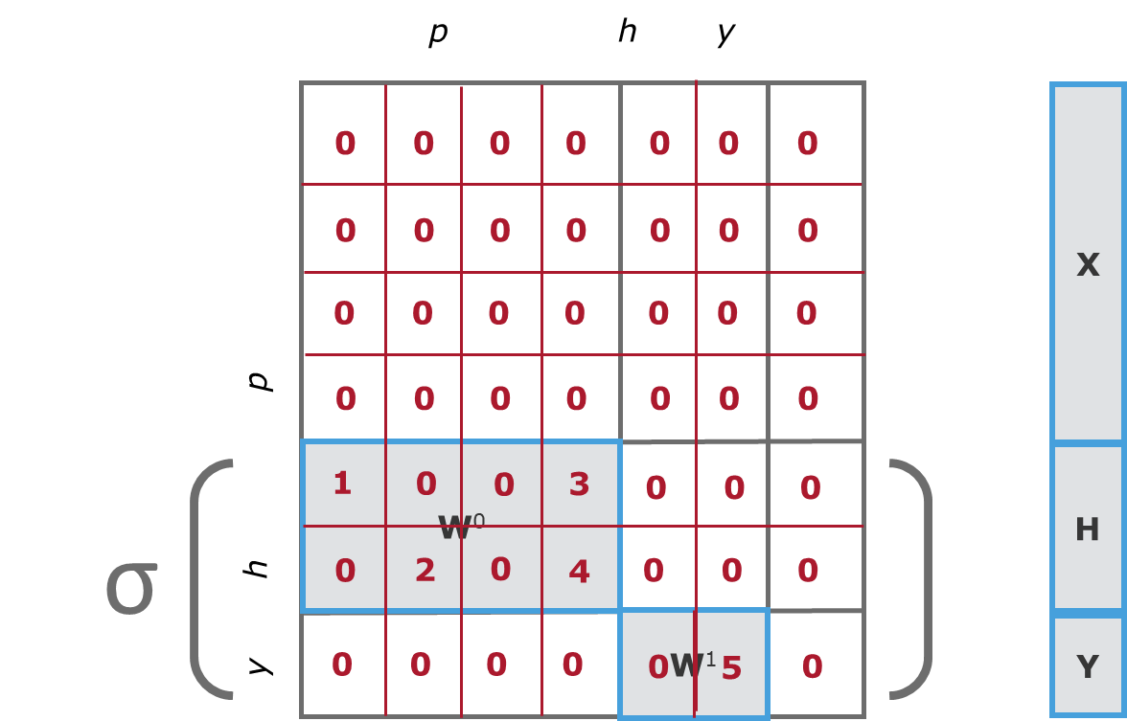
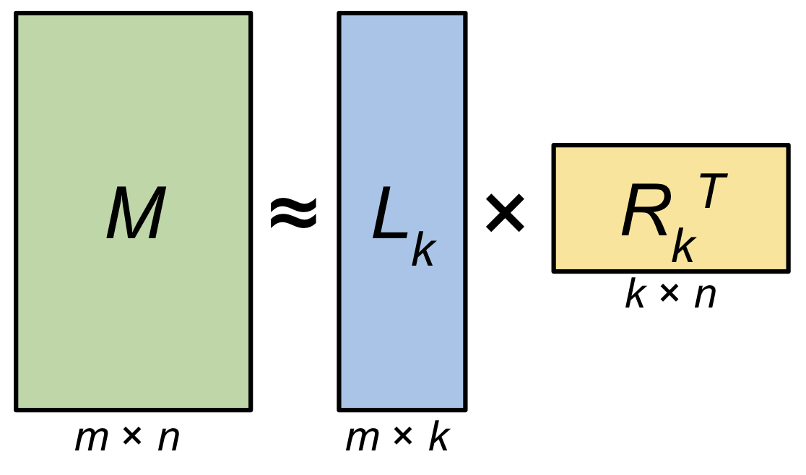
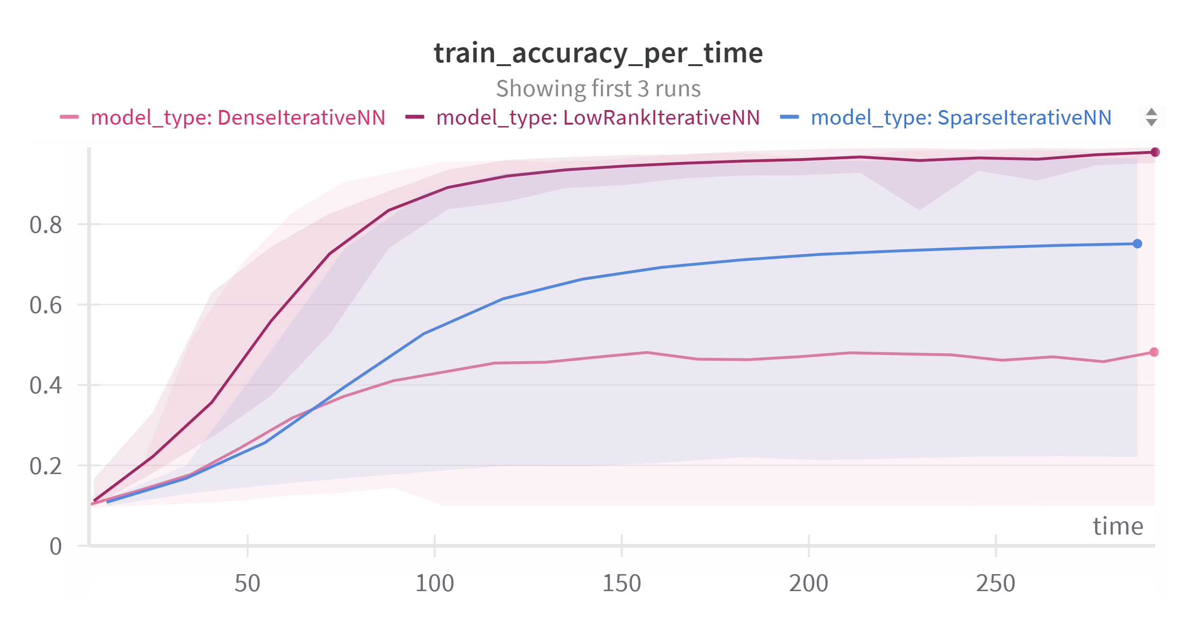
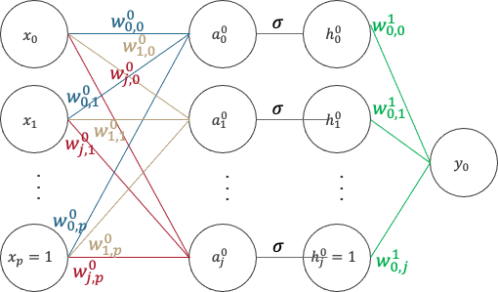
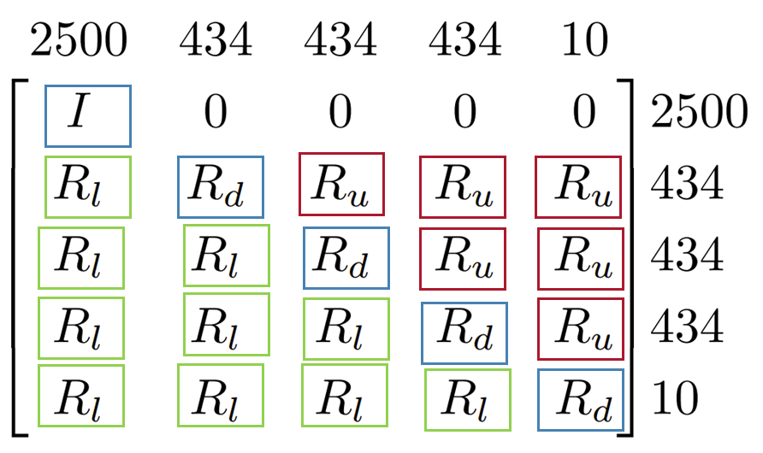
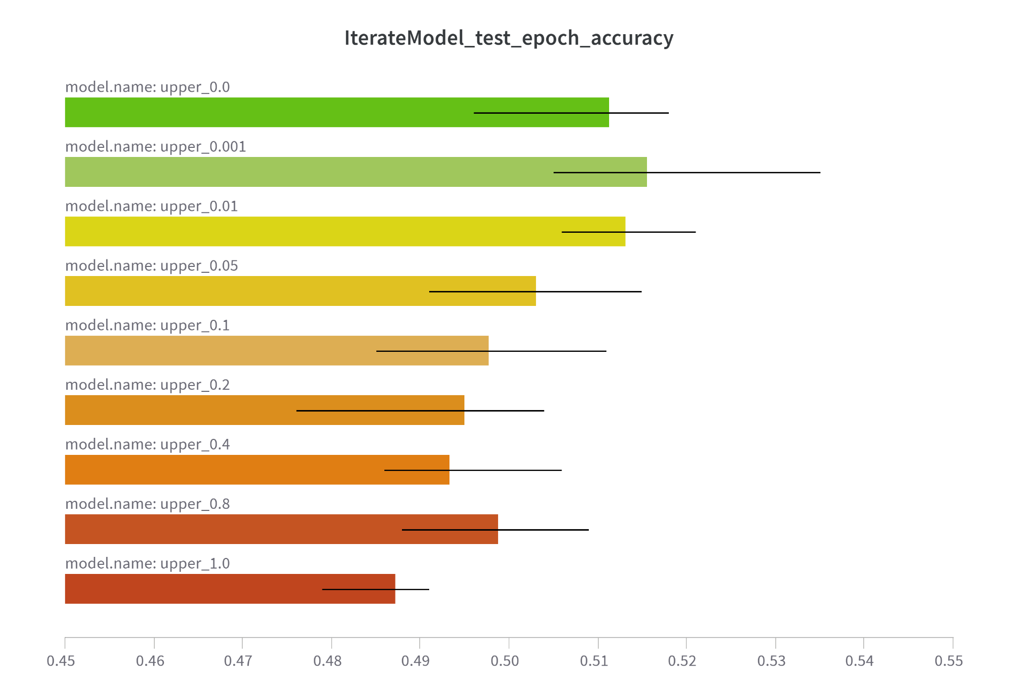
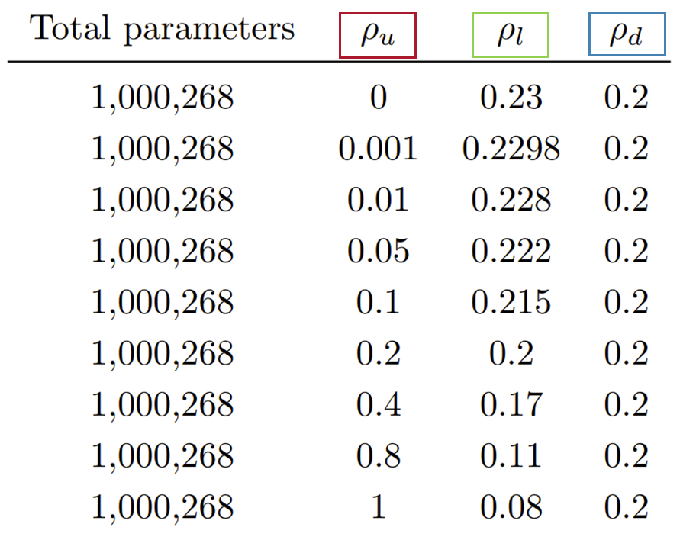
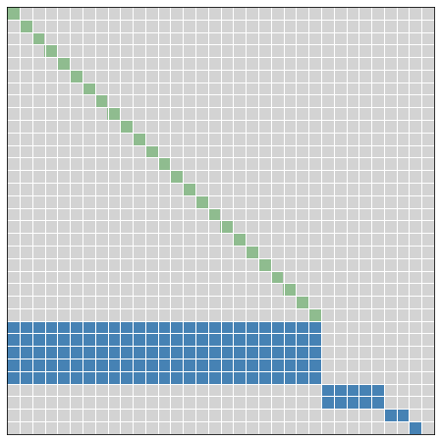
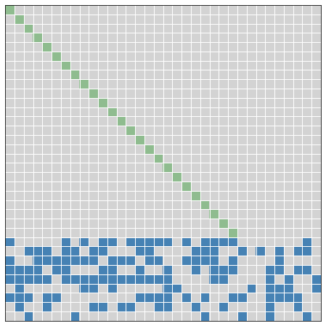
Dynamical Systems Approaches for Deep Learning
Neil Kale (CS/MA)
Advisor: Professor Randy Paffenroth (MA/CS/DS)
x h y
Abstract
Sparse Matrices in INNs
Low-Rank Matrices in INNs
This study examines iterative neural networks (INNs) and the Sequential2D framework, which optimizes INNs using left matrix multiplications for better efficiency. We analyze the impact of sparse and low-rank matrices on performance using the MNIST Random Anomaly Task. Our findings show that low-rank matrices enhance compute speed while also improving test accuracy, advancing our knowledge of INNs, Sequential2D, and the importance of matrix representations in refining neural network designs for better performance and efficiency.
NOT OPTIMIZED FOR GPUS
Let $M∈ ℝ^{2000×1000},$
Val x y
“Sparsity” | k | m*k + k*n
0.001 | 1 | 3000
0.01 | 7 | 21,000
0.05 | 33 | 99,000
0.1 | 67 | 201,000
0.2 | 133 | 399,000
0.5 | 333 | 999,000
1 | 667 | 2,001,000
y h x
1
1
5
➔
2
2
6
3
4
5
4
4
6
5
6
7
Introduction
Low-Rank and Sparse INN Performance
Iterative Neural Networks (INNs) reimagine traditional neural network architectures by utilizing iterated functions. [1]
MNIST Random Anomaly Task
$f^{\left(2\right)}(f^{\left(1\right)}\left(x,θ_{1}\right),θ_{2}$ ➔ $f\left(f\left(x,θ\right)\right)$
Baseline: Resized 50x50, Normalized
The Sequential2D framework simplifies INNs by representing them as 2D matrix operations. [2] For example, for a two-layer MLP, [3]
x h y
Transformed: Baseline + Random Perspective Transform + Random Erase
y h x
0
0
0
x
➔
$$E= \frac{\text{\# }\text{of} \text{trainable} \text{params} }{\text{total} \text{matrix} \text{size} }$$
Note, E is always 100% for dense but varies for sparse and low-rank.
Figure. Low-rank weights with E=20% outperform dense and sparse weights (left). The improvement is proportional to effective weight percentage (right).
σ
W⁰
0
0
h
0
W¹
0
y
Sparse and low-rank matrices within INNs could optimize performance.
Dense (25) | Sparse (12) | Low-Rank (20)
0 | 4 | 0 | 0 | 0
3 | 0 | 0 | 0 | 0
0 | 5 | 6 | 0 | 0
0 | 0 | 0 | 0 | 0
0 | 0 | 0 | 0 | 0
Val | 3 | 4 | 5 | 6
Row | 1 | 0 | 2 | 2
Col | 0 | 1 | 1 | 2
0 | 2
1 | 0
0 | 1
0 | 0
0 | 0
0 | 2 | 0 | 0 | 0
3 | 0 | 0 | 0 | 0
$$∘$$
Recurrence in INNs
Figure. Multiplication speed for E = 1% (left), E = 0.1% (center), and E = 0.01% (left).
Figure. Low-rank matrices are faster than dense matrices for E < 10%. Sparse matrices are faster than dense matrices for E < 1%.
Networks with more feed-forward connections train slower but overfit less.
Generalizing to More Complex NNs
Conclusions and Future Work
The Simple Recurrent Unit (SRU) involves light recurrence and highway networks, [4]
Low-rank weight matrices can make INNs faster, use less parameters, and improve performance. If INNs can be optimized to perform on par with traditional neural networks, it paves the way for widespread use.
Future directions could include building INNs that combine sparse and low-rank weight matrices and experimenting with alternate sparse matrix representations (i.e. CSC, CSR).
$f_{t}=σ\left(W_{f}x_{t}+v_{f}⊙c_{t−1}+b_{f}\right)$ | $r_{t}=σ\left(W_{r}x_{t}+v_{r}⊙c_{t−1}+b_{r}\right)$
$c_{t}=f_{t}⊙c_{t−1}+\left(1−f_{t}\right)⊙\left(Wx_{t}\right)$ | ${ h}_{t}=r_{t}⊙c_{t}+\left(1−r_{t}\right)⊙x_{t}$
Forward information leap
Memory at current layer
Reverse information flow
The SRU is equivalent to the INN below.
 | I | 0 | 0 | 0 | 0 | 0 | 0 | 0 | 0 | 0 | 0 | 0 | 0 | 0 |  | x_{t} |  | 0 | 0 | I | 0 | 0 | 0 | 0 | 0 | 0 | 0 | 0 | 0 | 0 | 0 |  | x_{t}
 | 0 | 0 | 0 | 0 | 0 | 0 | 0 | 0 | I | 0 | 0 | 0 | 0 | 0 |  | c_{t-1} |  | 0 | 0 | I | 0 | 0 | 0 | 0 | 0 | 0 | 0 | 0 | 0 | 0 | 0 |  | c_{t-1}
 | 0 | 0 | I | 0 | 0 | 0 | 0 | 0 | 0 | 0 | 0 | 0 | 0 | 0 |  | 1 |  | 0 | 0 | I | 0 | 0 | 0 | 0 | 0 | 0 | 0 | 0 | 0 | 0 | 0 |  | 1
σ ( | W_{f} | v_{f} | b_{f} | 0 | 0 | 0 | 0 | 0 | 0 | 0 | 0 | 0 | 0 | 0 | ) | f_{t} |  | 0 | 0 | I | 0 | 0 | 0 | 0 | 0 | 0 | 0 | 0 | 0 | 0 | 0 |  | f_{t}
 | 0 | 0 | I | –I | 0 | 0 | 0 | 0 | 0 | 0 | 0 | 0 | 0 | 0 |  | 1-f_{t} |  | 0 | 0 | I | 0 | 0 | 0 | 0 | 0 | 0 | 0 | 0 | 0 | 0 | 0 |  | 1-f_{t}
 | W | 0 | 0 | 0 | 0 | 0 | 0 | 0 | 0 | 0 | 0 | 0 | 0 | 0 | × | Wx_{t} | ⊙ | 0 | 0 | I | 0 | 0 | 0 | 0 | 0 | 0 | 0 | 0 | 0 | 0 | 0 | × | Wx_{t}
 | 0 | 0 | 0 | I | 0 | 0 | 0 | 0 | 0 | 0 | 0 | 0 | 0 | 0 |  | c_{t1} |  | 0 | I | 0 | 0 | 0 | 0 | 0 | 0 | 0 | 0 | 0 | 0 | 0 | 0 |  | c_{t1}
 | 0 | 0 | 0 | 0 | I | 0 | 0 | 0 | 0 | 0 | 0 | 0 | 0 | 0 |  | c_{t2} |  | 0 | 0 | 0 | 0 | 0 | I | 0 | 0 | 0 | 0 | 0 | 0 | 0 | 0 |  | c_{t2}
 | 0 | 0 | 0 | 0 | 0 | 0 | I | I | 0 | 0 | 0 | 0 | 0 | 0 |  | c_{t} |  | 0 | 0 | I | 0 | 0 | 0 | 0 | 0 | 0 | 0 | 0 | 0 | 0 | 0 |  | c_{t}
σ ( | W_{r} | v_{r} | b_{r} | 0 | 0 | 0 | 0 | 0 | 0 | 0 | 0 | 0 | 0 | 0 | ) | r_{t} |  | 0 | 0 | I | 0 | 0 | 0 | 0 | 0 | 0 | 0 | 0 | 0 | 0 | 0 |  | r_{t}
 | 0 | 0 | I | 0 | 0 | 0 | 0 | 0 | 0 | –I | 0 | 0 | 0 | 0 |  | 1-r_{t} |  | 0 | 0 | I | 0 | 0 | 0 | 0 | 0 | 0 | 0 | 0 | 0 | 0 | 0 |  | 1-r_{t}
 | 0 | 0 | 0 | 0 | 0 | 0 | 0 | 0 | 0 | I | 0 | 0 | 0 | 0 |  | h_{t1} |  | 0 | 0 | 0 | 0 | 0 | 0 | 0 | 0 | I | 0 | 0 | 0 | 0 | 0 |  | h_{t1}
 | 0 | 0 | 0 | 0 | 0 | 0 | 0 | 0 | 0 | 0 | I | 0 | 0 | 0 |  | h_{t2} |  | I | 0 | 0 | 0 | 0 | 0 | 0 | 0 | 0 | 0 | 0 | 0 | 0 | 0 |  | h_{t2}
 | 0 | 0 | 0 | 0 | 0 | 0 | 0 | 0 | 0 | 0 | 0 | I | I | 0 |  | h_{t} |  | 0 | 0 | I | 0 | 0 | 0 | 0 | 0 | 0 | 0 | 0 | 0 | 0 | 0 |  | h_{t}
References
[1] Q. Hershey, “Exploring neural network structure through iterative neural networks: Connections to dynamical systems,” master’s thesis, Worcester Polytechnic Institute, Worcester, MA, 3 2023. Advisor: Professor Randy Paffenroth, Reader: Professor Seyed Zekavat.
[2] H. N. Pathak, R. Paffenroth, and Q. Hershey, “Sequentia12d: Organizing center of skip connections for transformers,” in 2023 International Conference on Machine Learning and Applications (ICMLA), pp. 362–368, 2023
[3] F. Rosenblatt, “The perceptron: A probabilistic model for information storage and organization in the brain,” Psychological Review, vol. 65, pp. 386–408, 1958
[4] T. Lei, Y. Zhang, S. I. Wang, H. Dai, and Y. Artzi, “Simple recurrent units for highly parallelizable
recurrence,” 2018.
The SRU INN trains slower than the SRU. It needs improvements for sparsity and parallelization like those proposed here.

