Slide 1
Assessing Community Perceptions of Hydrogen as a Fuel for Domestic Heating
Eric Aimone, Cece Daniele,
Donovan Joyce, Sean Obert
Sponsored by:
Tom Collins, Worcester Bosch
Katy Boom, University of Worcester
Peter Robinson, Heart of Worcestershire College
1
Notes:
Cece
Add logos

Slide 2
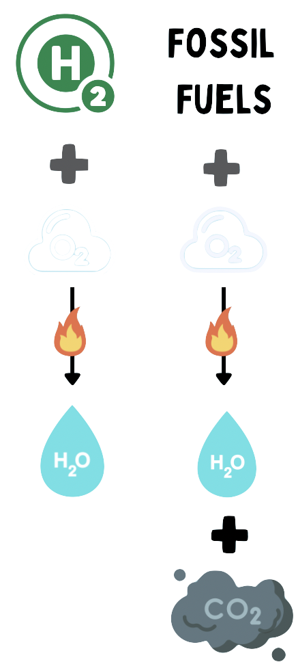
Background
Hydrogen as an Alternative
Zero carbon emissions
Uses existing gas infrastructure
University Hydrogen Project
Installing a hydrogen boiler on campus
Figure 1: Hydrogen VS Fossil Fuels Combustion Reaction
2
Notes:
Donovan
UK government effort to reduce greenhouse gases
21% of emissions are from domestic heating
Hydrogen as an alternative because…
Hydrogen combustion
Natural gas combustion
Use and changes of existing gas infrastructure
As a result of the UK’s efforts to reduce greenhouse gas emissions, domestic heating has been identified by numerous studies as a large contributor to carbon emissions. In 2017, it was found that domestic heating for space and tap water resulted in 21% of the nations carbon emissions. As a result, decarbonizing domestic heat has been a major focus. Hydrogen is being explored as a leading alternative because unlike natural gas that produces carbon dioxide during combustion, hydrogen only produces water vapor and heat. One benefit to hydrogen compared to other alternatives is that they may be able to adapt a lot of the existing natural gas piping for distributing the fuel to homes.
The UW would like to investigate hydrogen as an alternative to another zero-carbon system, an air source heat pump. The University is looking into using the Ability House and the Forensic House on campus to install both systems. Additionally, as a long-term goal of this project, the University would like to use these houses as a teaching site for plumbing and heating technicians to learn about the new alternatives.
Donovan looking at a point in space, pick a balanced spot.

Slide 3
Goal Statement
Assess public opinion of the University students and UK residents about the use of hydrogen for domestic heating.
3
Notes:
Donovan

Slide 4
Objectives
Research
Document
Create
Source
Safety
Comparison
Infrastructure
Transition Cost
Educational tool
Recommendations
Current opinions
Current knowledge
4
Notes:
Eric
We planned to research
Source (where it comes from)
Comparison to natural gas
Infrastructure requirements
Cost of transition
Document current opinions and knowledge
UW students and UK residents
Create an educational tool
To achieve our goal, we developed three objectives.
We first planned to research these five topics, which we anticipated to be concerns of our populations. For source, we wanted to look into where hydrogen currently comes from. How safe the technology is. The comparison between hydrogen boilers to other home heating systems. We wanted to look into the infrastructure requirements and what is able to be reused. Finally we wanted to look into the transition costs. This includes the initial installation costs as well as recurring costs such as maintenance and the fuel itself.
Next, we intended to document how people currently felt and their current knowledge about hydrogen.
Finally, we wanted to develop educational tools and recommendations. These would help our sponsors continue the pilot project and address concerns that may prevent progress for future hydrogen efforts and student projects.

Slide 5
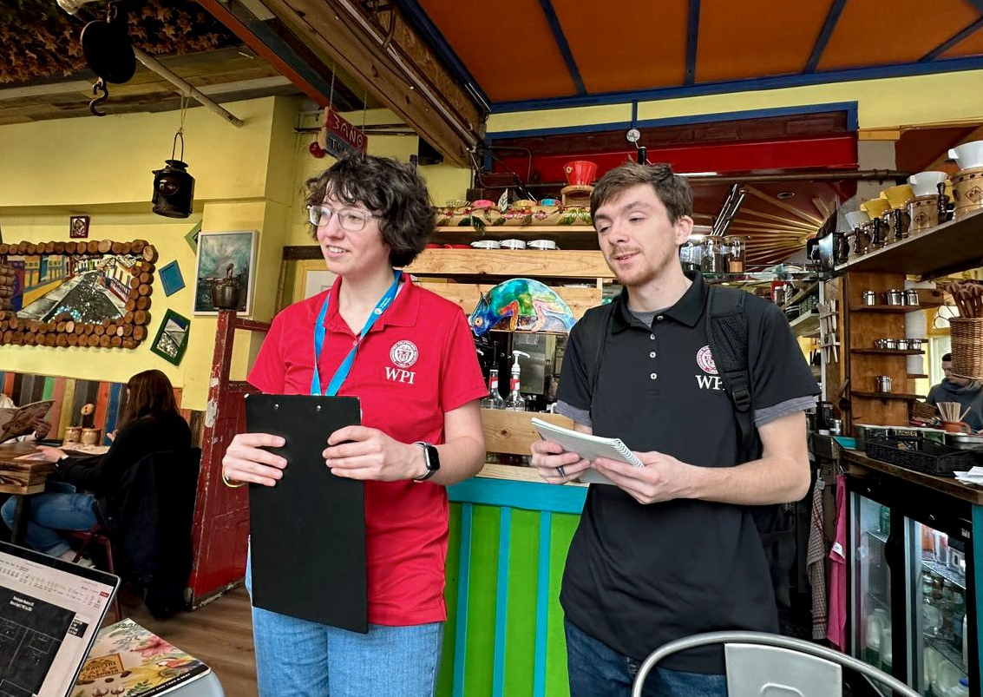
Methods
Photo Credits: Fred Looft
Research
Public Survey
Educational Resource
Figure 2: Cece and Eric Surveying at Francini Cafe de Colombia
5
Notes:
Eric
Researched topics using multiple databases
Help facilitate conversations
In-person open-ended survey
Local establishments
Developed resource based on findings
In order to achieve our objectives, we used three methods.
First we researched topics of interest using databases to gather opinions about hydrogen technology. This helped facilitate conversations during our survey.
In this survey, we targeted two populations, the residents of Worcester England, and students at the University. For the residents of Worcester, we went to local coffee shops and pubs and engaged in conversation using a list of open-ended survey questions. The questions were left open ended to encourage uninfluenced opinions. For the student population, we used public meeting places on campus like the café. To encourage student participation we offered the opportunity to win trolley tokens, sweets, or a drinks voucher redeemable at any on campus location.
Finally, we developed educational resources using the information gained through our survey. This information included the topics and concerns that people brought up and were interested in learning more about.

Slide 6
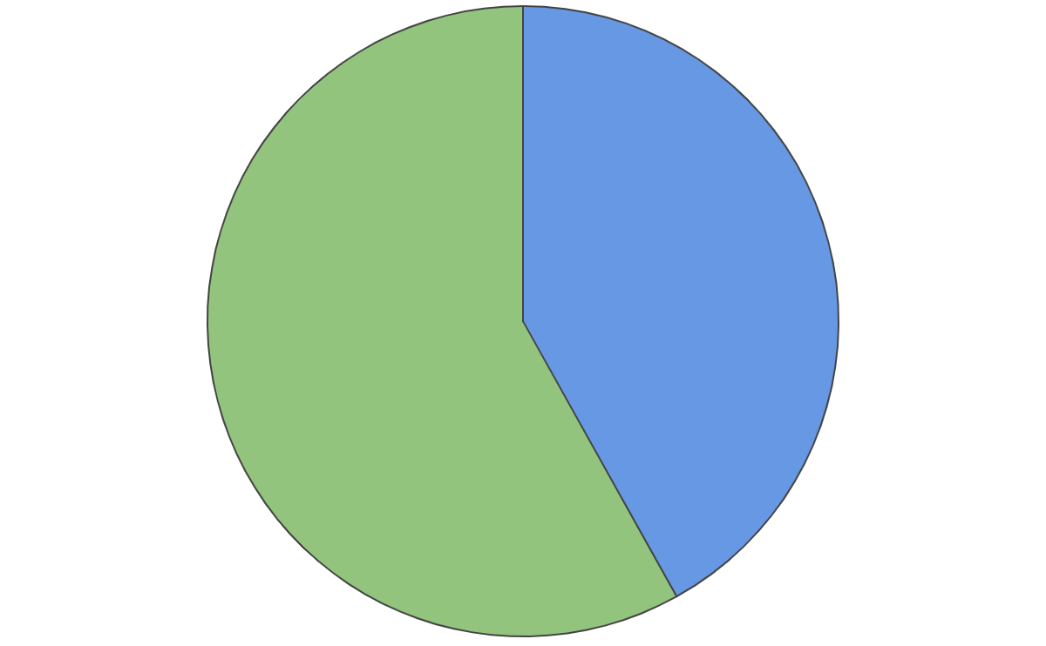
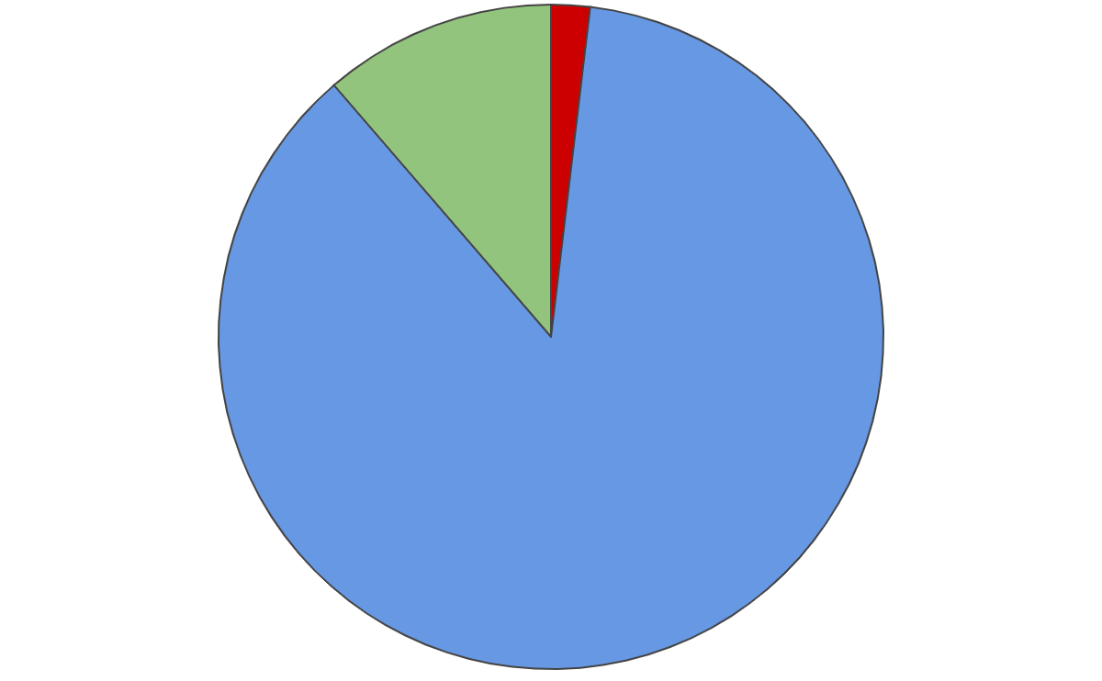
Overall Opinion of Hydrogen:
Residents
Students
Positive
11%
Negative
Positive
58%
2%
Neutral
42%
Neutral
87%
Figure 3: Resident Opinions (n=107)
Figure 4: Student Opinions (n=53)
6
Notes:
Cece
Asked 5 questions: results from overall opinion
58% UK positive
42% neutral
Lack of knowledge
87% of students
1 negative result, was safety, common result

Slide 7
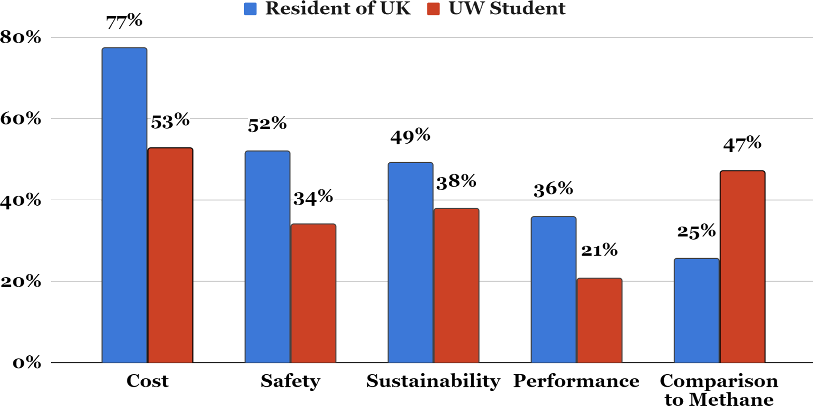
Hydrogen Topics of Interest
Figure 5: Distribution of Interests about Hydrogen between
Residents (n=106) and Students (n=53)
7
Notes:
Cece
Classified responses, allowed for multiple responses
Top 5 common categories between both
Residents
Cost
Saftey
Students
Cost
Comparison to methane
Never making the decision

Slide 8
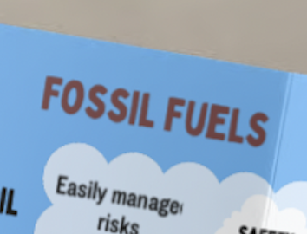
Educational Resource
Resources developed for:
Students
Residents
Natural Gas ≠ Natural
“Fossil Fuels”
Figure 6: Render of the brochure draft
8
Notes:
Cece
Resources developed from data
3 resources
Brochure covering top 5 topics discussed
Poster for students
Door hanger for UK residents
Information at their door
Student topic mentioned
Eliminate misconception
Make a zoom in bubble

Slide 9
Recommendations
Short term
Long term
Develop a public education campaign
Continue with UW hydrogen pilot project
Perform a cost analysis
Promote Worcester as a leader in alternative heating
9
Notes:
From our results, we developed several short and long term recommendations.
Public education
Most people generally accepting
Need education in the topics we described
Use the material we developed in the beginning
Use updated resources when available
Cost Analysis
Cost is the biggest concern
Plenty of aspects of hydrogen implementation is still in the air
Continue UW Project
Prove as proof of concept in Worcester
Comparison of alternative heating methods
Allow for a technical program with the HOWC to teach interested technical staff about alternative heat
Promote Worcester as alternative heating
People are accepting of hydrogen
People are willing to accept hydrogen into their homes even with a premium provided a benefit
Immediate proximity to Worcester Bosch aids troubleshooting for the roll out

Slide 10
Conclusions
The Worcester population is hydrogen ready
Education efforts should emphasise hydrogen:
Costs
Safety
Compared to methane
Figure 7: Team Visiting Worcester Bosch
10
Notes:
Sean
Reiterate that the Worcester population is hydrogen ready provided education in the key topics

Slide 11
Acknowledgements
Katy Boom, the Director of Sustainability at the University of Worcester
Tom Collins, Hydrogen Lead at Worcester Bosch
Peter Robinson, Vice Principal of Heart of Worcestershire College
Fred and Linda Looft, advisors from Worcester Polytechnic Institute
Rosemary Taylor, professor from Worcester Polytechnic Institute
11

Slide 12
Thank you
Any questions?
gr-we24-hydro@wpi.edu
12
CREDITS: This presentation template was created by Slidesgo, and includes icons by Flaticon, and infographics & images by Freepik
Notes:
Experts on topics:
Donovan – Source
Eric – Chemistry/Safety of Hydrogen
Sean –
Cece -

