Slide 1
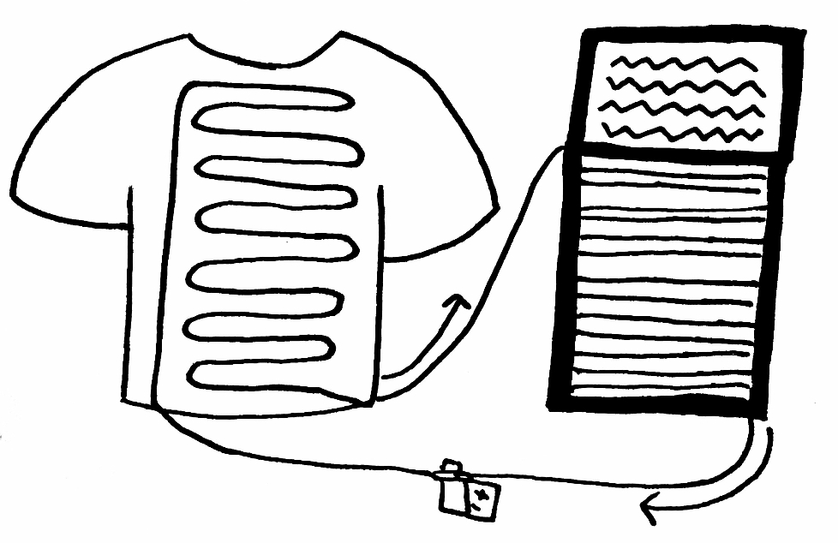
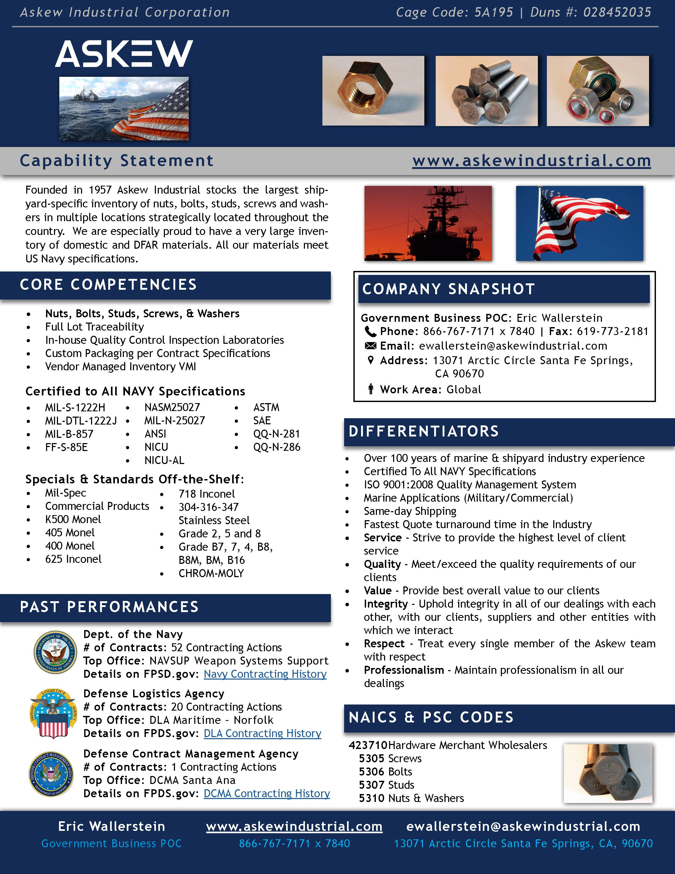
Designing Capability Statements to Win Federal Contracts
Kristen Bender (PW, ME)
Advisors: Ryan Madan (PW), John Sullivan (ME), Ahmet Sabuncu (ME)
Project Goals
Components of a Capability Statement
The primary goal of this project was to investigate and understand the writing practices in federal contracting documentation and provide insight for businesses to enter the complex and lucrative contracting process competitively.
Essential
Nonessential
Core Competencies
Qualifications/Credentials
Differentiators
Corporate Data
What impacts decision making in federal contract awards?
What role do capability statements play?
What are the best practices of capability statement writing?
Areas of expertise, basic types of work and products provided
Socioeconomic certifications, industry licenses, security clearances
Business background, customer testimonials, awards, anticipated growth
Wild card, anything to prove uniqueness
Federal codes, contact information,
location, size
Government Purchasing
Genre Analysis
Usability Review
Expanding into government contracting can increase networking and potential growth of a business. Nearly a quarter of total federal contract funds are dedicated as small businesses set-asides. The FAR provisions outline how the government purchases to maximize value and meet public policy objectives.
I classified document components while considering the process and purpose of these features. Each of these literary components are tailored to the way information is accessed and used by contracting officials. The expectations of the contracting officials combined with the guidance of preexisting capability statements form a specific expected style and format. Below is a sample annotated analysis.
PTAC
ACO/PCO
CO
Sample A
Format focused
Key Personnel
Facilities
Logos
Micro-Purchases
brute labor, lowest bidder <$3000
Most referenced codes easy to reference location
Sealed Bidding
IFBs, lowest bidder to fulfill requirements
Relevant header pictures
Sample B
Company Profile
Expertise
DSNs
Short introduction
Repetitive, breaks space or acts as filler
Content focused
Contract Negotiations
technical products, RFPs/RFQs >$100,000
Highlights main product line and specifications, almost too much detail
Quick reference information repetitive
Federal
Acquisition
Regulation
Consolidated Purchases
negotiable, similar goods & services single vendor
Claims experiences, reiterates quality, highlights company values
Conclusions
Validation through prior contract work
The federal contracting system is not taken advantage of due to a lack of knowledge about the process, which could be improved by increasing awareness of current programs in place, along with greater mentorship and patience. The process of procurement lends itself to the design of capability statements as a referential, yet attention grabbing, quick access document within otherwise bland paperwork. If a company does not follow this format, they run the risk of losing the contract award competition. Shedding light on this topic opens the gate to future research into the communications of contract work outside of the structured process.
Simplified Bidding
set-asides to level market, bid matching
Categorical codes labeled and defined clearly
FedBizOpps
Primary contracting databases: searchable marketing tools all businesses must enroll in
Personal POC, multiple contact methods
CCR
G-WACs
GSA
Best Practices
Clean, readable formatting with a simplistic color scheme and logo
Contains all “essential” elements
Labeled or “call-out” sections for quickly and commonly referenced information
Minimal text without removing or skimping on pertinent information
Relevant, high- quality figures, diagrams, images
NAICS
6 digits identify product category
Acknowledgements
DUNS
CAGE
5 characters classify facility
I would like to thank Laura Robinson, Bruce Derksen, MaryAnn Pinto, Stuart Loosemore, and Grace Otta for their guidance and invaluable insight throughout this project. Last but not least, many thank you’s to Ryan Madan for directing and developing my project with the utmost patience over the past year.
9 digits identify business and physical location

