Slide 1
Reservation Systems at Many Glacier and Two Medicine
Dominic, Kelsey, Ryan, Natalie, and Steven

Slide 2
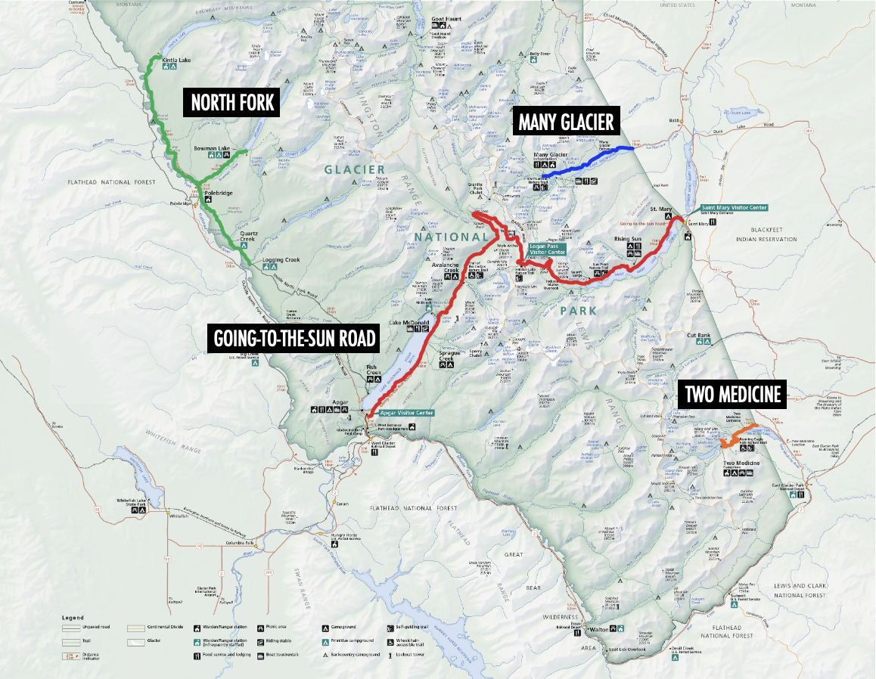
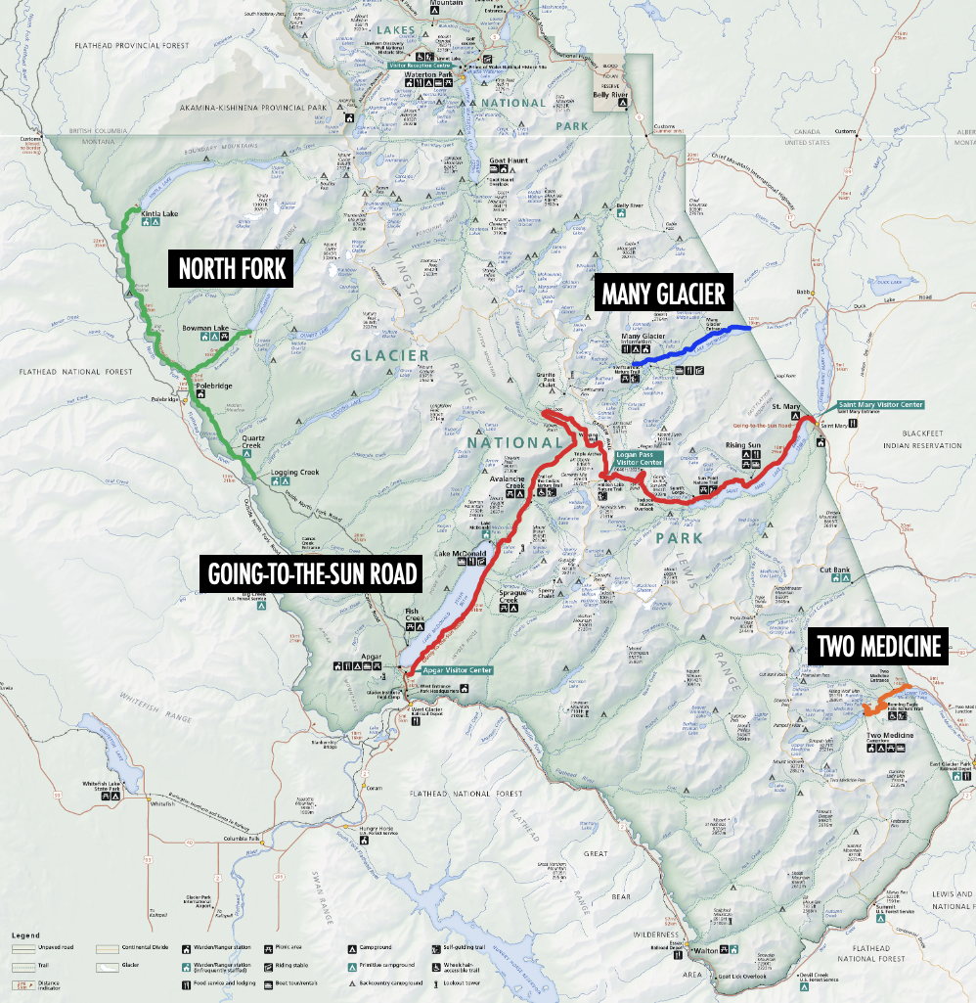
Compare reservation system options for MG and TM to maintain Glacier National Park’s mission
“Preserve the scenic glacially carved landscape, wildlife, natural processes, and cultural heritage at the heart of the Crown of the Continent for the benefit, enjoyment, and understanding of the public”
Project Goal
Mission Statement
Areas of Interest

Slide 3
Objectives
1
Gather information about current conditions at MG and TM
2
Identify the impacts of current reservation systems at NF and GTSR
3
Consider implementation design of proposed reservation systems at MG and TM
4
Compare reservation system types for MG and TM and give additional recommendations

Slide 4
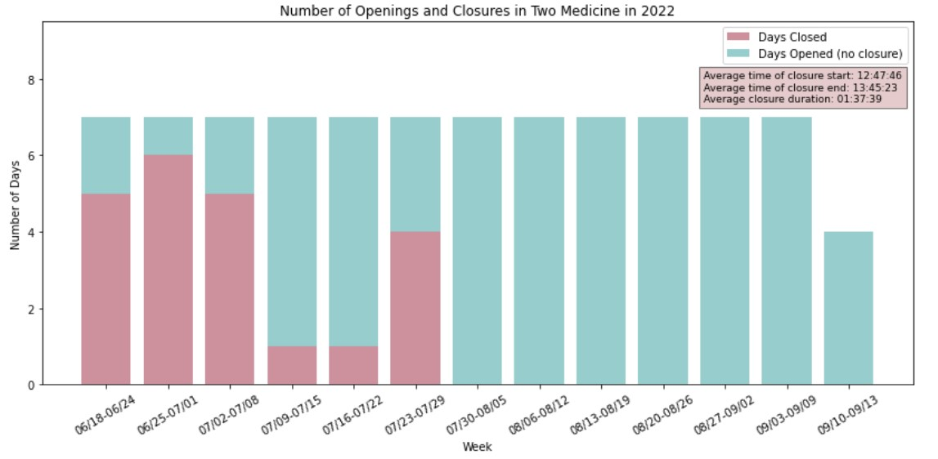
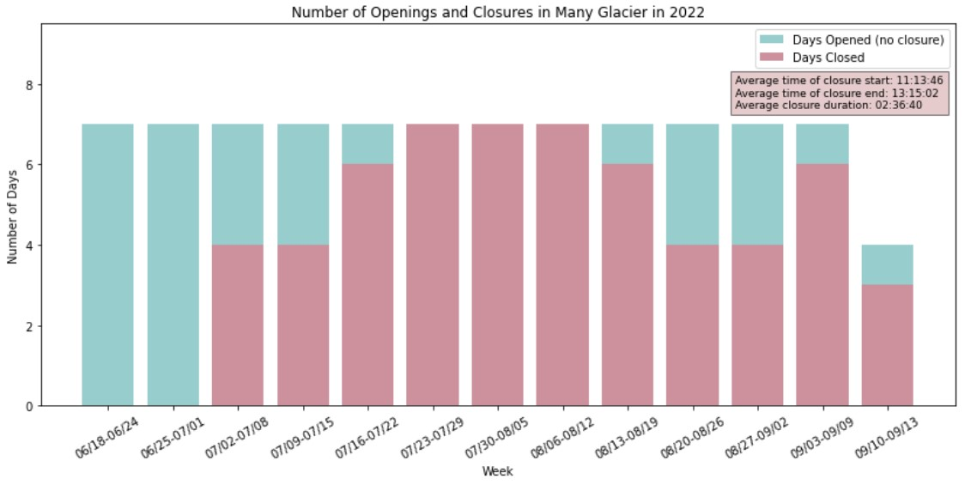
Current Conditions at Many Glacier and Two Medicine
Closures
Visitor frustration
Staff frustration
Trail and roadside vegetation loss
“We ruin vacations one car at a time”
“We are greatly exceeding our carrying capacity. A reservation system would help us get back to a positive visitor experience.”
“I got my pass, let me in, you guys suck”
“Each and every year we give up more, and a little bit more, and a little bit more”
“Lots and lots of congestion”
“Just make it through summer”
“When we’re not around, people will park in bushes, on wildflowers, on the mountain”

Slide 5
Components of a Reservation System
Staff
Monitoring:
- Measure roadsides
- Upkeep parking
Communication:
- Recreation.gov
- Signage
- Entrance stations
Communication
Monitoring
Reservation System
Visitors
Natural Resources
Trails and roadsides
Trails and roadsides
- Quantifiable parking
- Less congestion and overuse

Slide 6
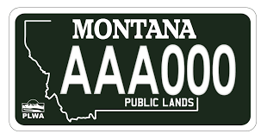
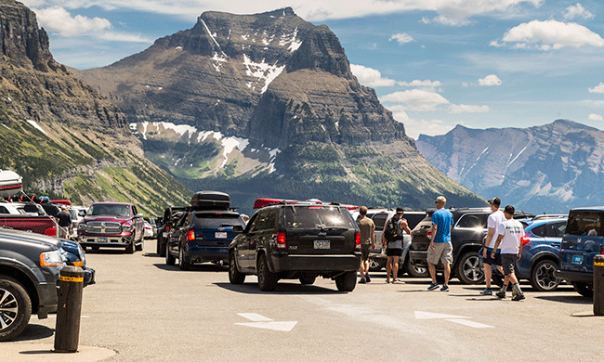
Types of Reservation Systems
Ticketed
License
Timed
Lottery
No System

Slide 7
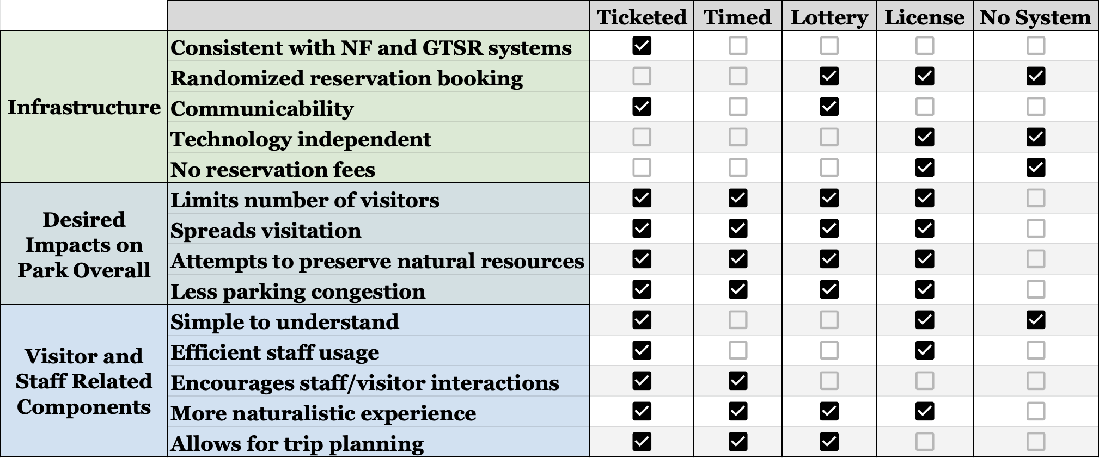
Comparison of Reservation Systems

Slide 8
Reservation System Finding
Interviewed staff believe a ticketed reservation system should be implemented at MG and TM.

Slide 9
Ticketed Entry
Pros:
Support from staff
Prevents visitor confusion because it’s the same res. type as GTSR and NF
Easy to implement because it already exists in the park
Fewer visitor incidents at valley entrances
Cons:
Cannot spread out visitation throughout the day
Staff must turn away those without reservations

Slide 10
Other Recommendations
Resource Conservation
Park Staff
Visitors

Slide 11
Recommendations for Ticketed Reservation Design
Time of Year
Same as NF and GTSR
“Make times consistent across valleys”
Time of Day
Consistent with NF
“Keep consistency with NF and GTSR, in a way”
Ticket Duration
1 day pass
“Simplest to understand”

Slide 12
Recommendations for Further Research
Define the success of reservation systems:
Consider + and - of extending the reservation season
Assess booking windows
Identify possible extenuating circumstances where reservation systems would fail
Create long term plans and goals

Slide 13
Thanks!
Any questions?

Slide 14
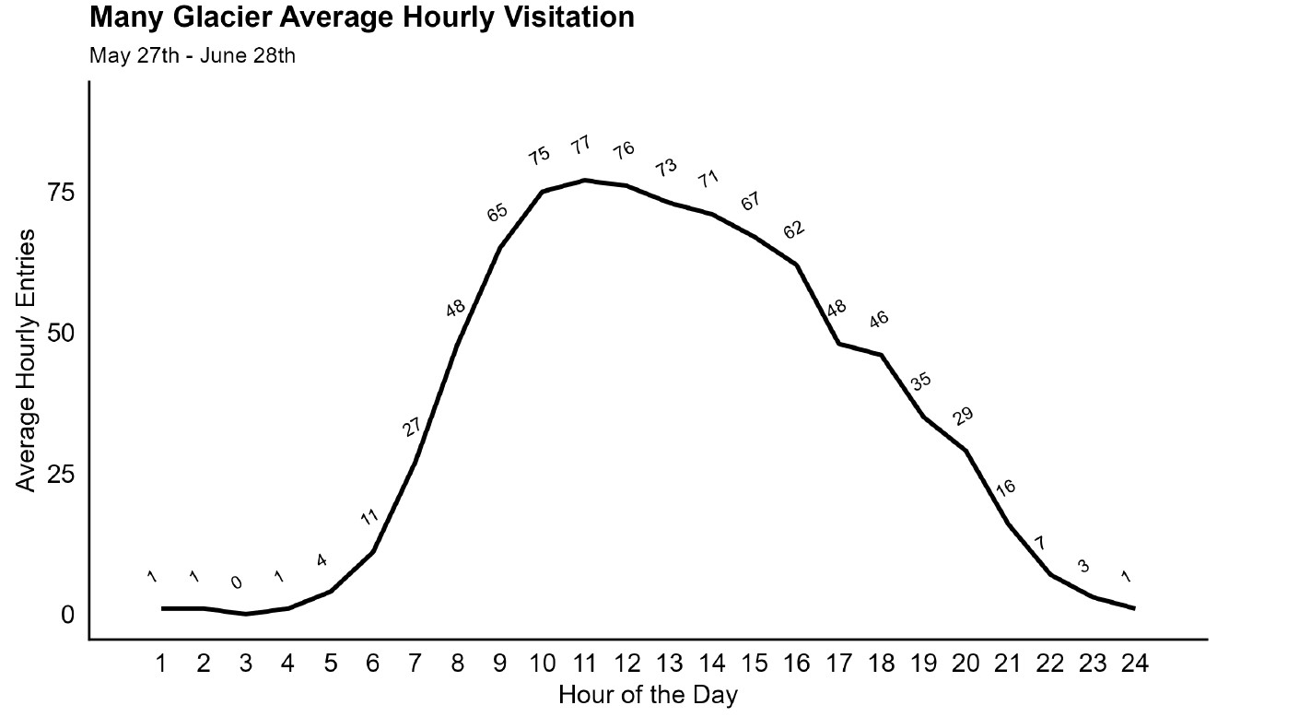
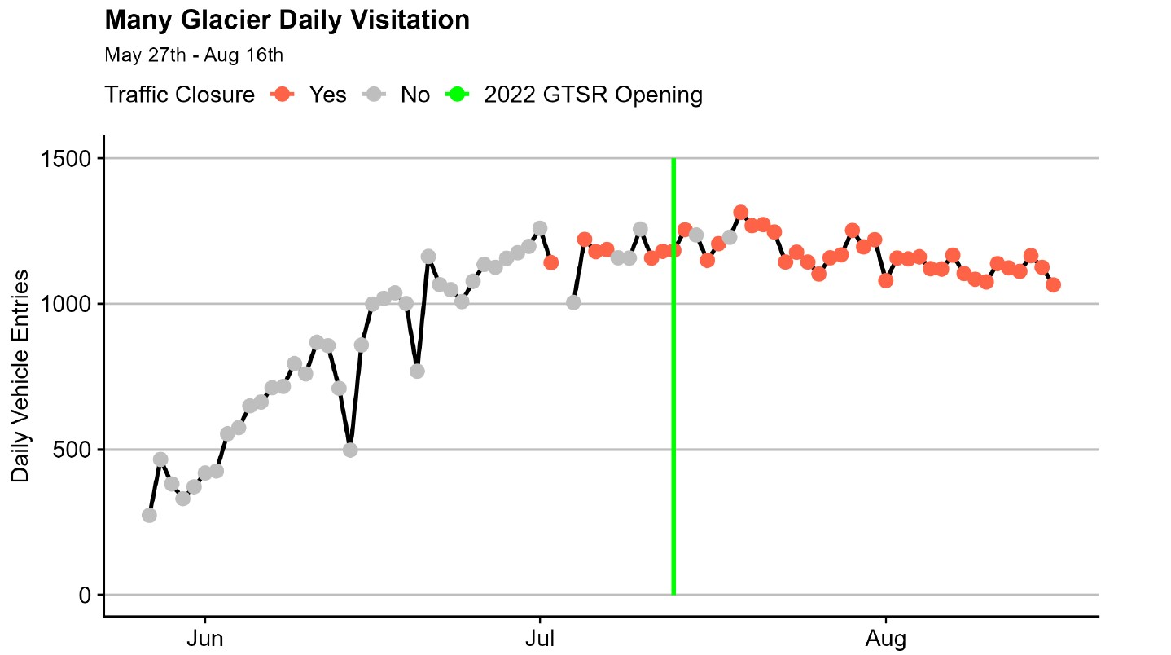
Many Glacier Hourly and Daily Visitation Graphs

Slide 15
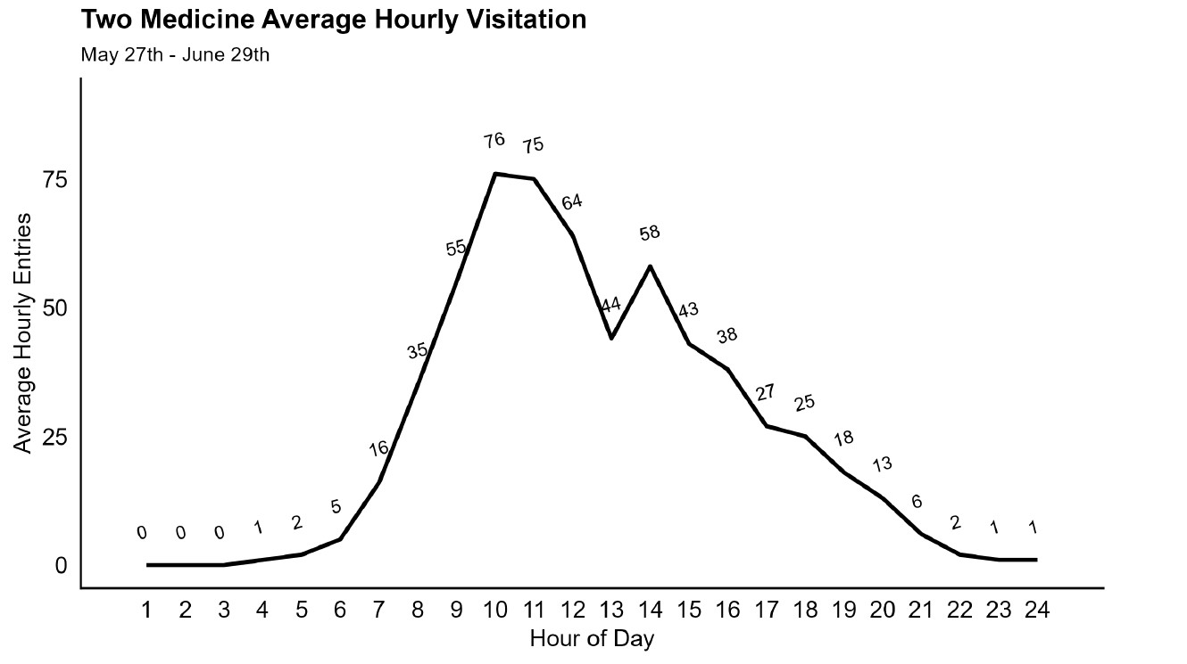
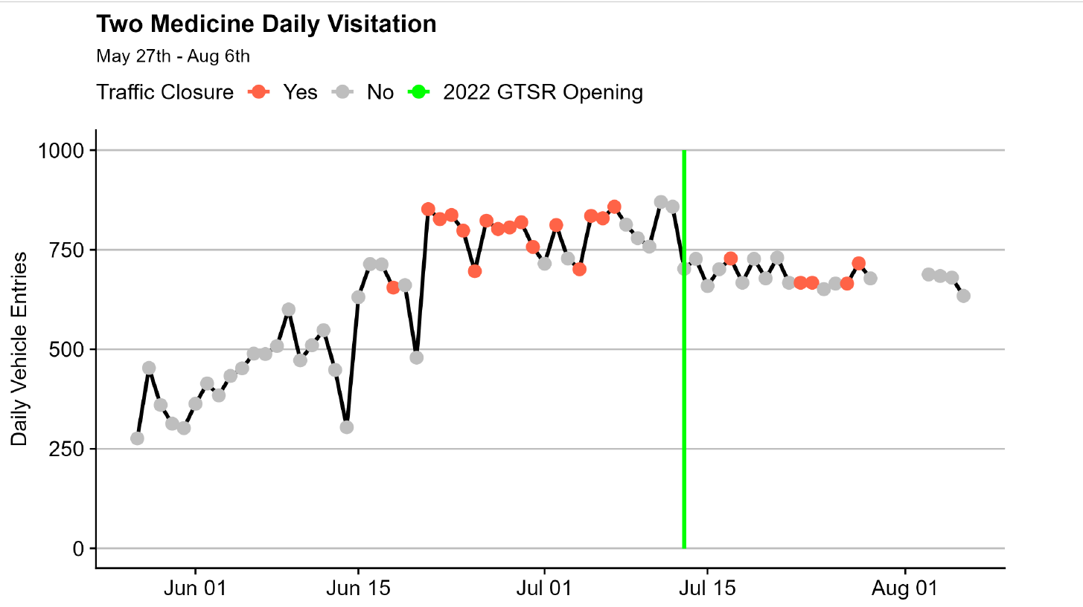
Two Medicine Hourly and Daily Visitation Graphs

Slide 16
Types of Visitors
Day Hikers
Campers
Picnickers/Restaurants
Arrive early
Stay for majority of day
Majority of visitors
Stay multiple nights (average = 3)
Go for hikes in the area during their stay
Stay for couple hours
Arrive around mid-day
Natives
Flathead/Glacier Counties
Backpackers
Have unrestricted access to park
Have year round access to the park
Difficulty understanding reservation systems
Stay multiple nights
Service Users
“Gawkers”
Arrive around service time
Most only stay for their service
Very short stays Want to see park from their car
Relatively new type of visitor

Slide 17
Interview Questions
Congestion
Staffing
Congestion issues
Current management strategies
Job roles
Staffing issues
Reservation Systems
Types of systems
Impacts of systems
Confusion from systems

Slide 18
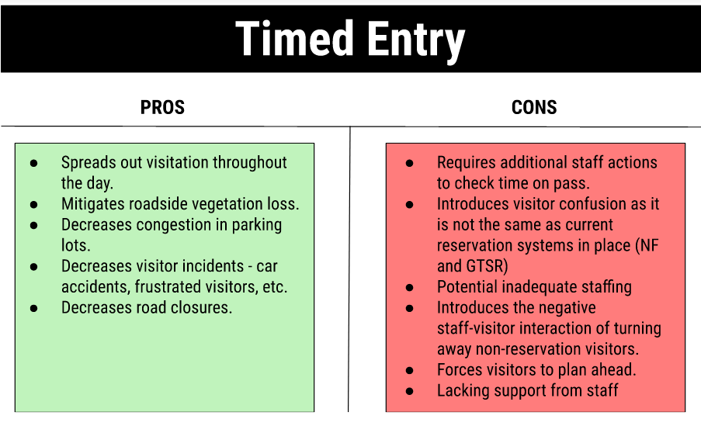
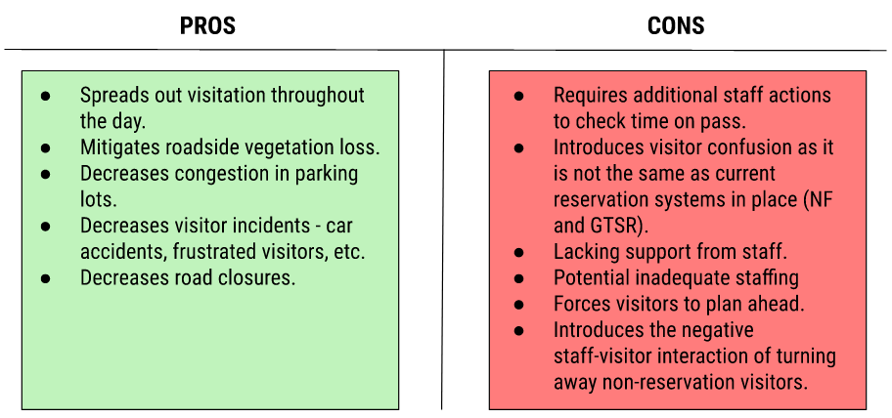
Timed Entry

