Slide 1
Warm-up: Solve: -16c + 24 = -28c (Show your steps and check)
Notes:
🍐 This is a Pear Deck Drawing Slide
🍐 To edit the type of question, go back to the "Ask Students a Question" in the Pear Deck sidebar.

Slide 2
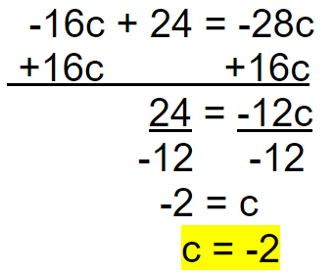
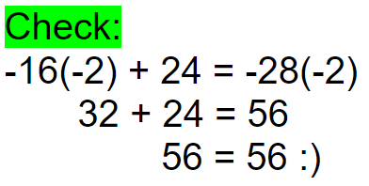
Warm-up: Solve: -16c + 24 = -28c (Show your steps and check)
1

Slide 3
Warm-up: Solve: -16c + 24 = -28c (Show your steps and check)
0

Slide 4
Warm-up: Solve: -16c + 24 = -28c (Show your steps and check)
0

Slide 5
Warm-up: Solve: -16c + 24 = -28c (Show your steps and check)
0
1

Slide 6
Warm-up: Solve: -16c + 24 = -28c (Show your steps and check)
0
1

Slide 7
Warm-up: Solve: -16c + 24 = -28c (Show your steps and check)
0
1

Slide 8
How many terms are in the following expression?:
64f - w + 20f +11
Notes:
🍐 This is a Pear Deck Multiple Choice Slide. Your current options are: A: 1, B: 3, C: 4, D: 6,
🍐 To edit the type of question or choices, go back to the "Ask Students a Question" in the Pear Deck sidebar.

Slide 9
How many terms are in the following expression?:
64f - w + 20f + 11
1
2
3
4

Slide 10
How to solve a 2-step equation when there are variable terms on both sides and 1 constant
Check:
-14(-5) = -25 - 19(-5)
Equation: -14a = -25 - 19a
0
70 = -25 + 95
70 = 70 ✔️
-14a = -25 - 19a
Opposite to both sides: +19a +19a
1
5a = -25
5 5
a = -5
Notes:
Move to following week - variable term on both sides, constant on one

Slide 11
Video - Variable on both sides and 1 constant

Slide 12
How to solve a 2-step equation when there are variable terms on both sides and 1 constant - Extended
Check:
-14(-5) = -25 - 19(-5)
Equation: -14a = -25 - 19a
0
-14a = -25 - 19a
Opposite to both sides: +14a +14a
70 = -25 + 95
70 = 70 ✔️
0
0 = -25 - 5a
+25 +25
1
25 = -5a
-5 -5
-5 = a
a = -5
Notes:
Move to following week - variable term on both sides, constant on one

Slide 13
Video - Variable on both sides and 1 constant - Extended

Slide 14
Solve: 7x - 121 = 18x (Show your steps and check)
C)
Answer:
Notes:
🍐 This is a Pear Deck Drawing Slide
🍐 To edit the type of question, go back to the "Ask Students a Question" in the Pear Deck sidebar.

Slide 15
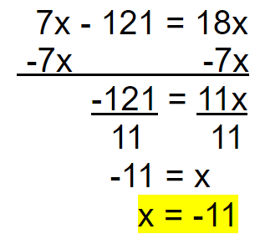
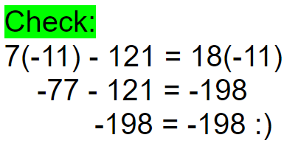
Solve: 7x - 121 = 18x (Show your steps and check)
+
1

Slide 16
Solve: 7x - 121 = 18x (Show your steps and check)
0
+

Slide 17
Solve: 7x - 121 = 18x (Show your steps and check)
0
+
1

Slide 18
Solve: 7x - 121 = 18x (Show your steps and check)
0
+
1

Slide 19
Solve: 7x - 121 = 18x (Show your steps and check)
0
+
1

Slide 20
Solve: 7x - 121 = 18x (Show your steps and check)
0
+
1

Slide 21
Solve: -10h = 64 - 8h (Show your steps and check)
B)
Answer:
Notes:
🍐 This is a Pear Deck Drawing Slide
🍐 To edit the type of question, go back to the "Ask Students a Question" in the Pear Deck sidebar.

Slide 22
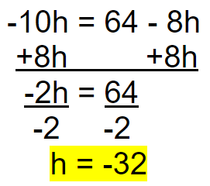
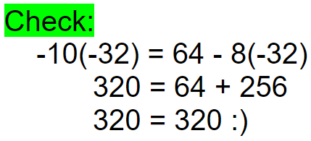
Solve: -10h = 64 - 8h (Show your steps and check)
0
1

Slide 23
What is the coefficient of the 3rd term?:
64f - w + 20f +11
Notes:
🍐 This is a Pear Deck Multiple Choice Slide. Your current options are: A: -1, B: 1, C: 11, D: 20, E: 64,
🍐 To edit the type of question or choices, go back to the "Ask Students a Question" in the Pear Deck sidebar.

Slide 24
What is the coefficient of the 3rd term?:
64f - w + 20f + 11

Slide 25
How to solve a 2-step equation when there is no solution
Equation: a = a + 25
Statement:
There is _________, because __ = __.
0
0
a = a + 25
Opposite to both sides: -a -a
There is no solution, because 0 = 25.
0 = 25
No solution
Notes:
Move to following week - variable term on both sides, constant on one

Slide 26
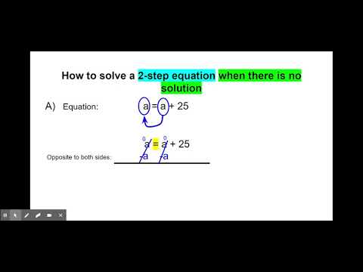
Video - No solution

Slide 27
Solve: -2n = 130 - 2n (Show your steps and check)
B)
There is ____________, because ___ = ___.
Answer:
Notes:
🍐 This is a Pear Deck Drawing Slide
🍐 To edit the type of question, go back to the "Ask Students a Question" in the Pear Deck sidebar.

Slide 28
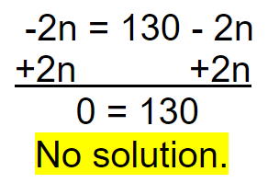
Solve: -2n = 130 - 2n (Show your steps and check)
Statement:

Slide 29
Solve: -2n = 130 - 2n (Show your steps and check)
Statement:
0
0

Slide 30
Solve: -2n = 130 - 2n (Show your steps and check)
Statement:
0
0

Slide 31
Solve: -2n = 130 - 2n (Show your steps and check)
Statement:
0
0

Slide 32
Solve: -2n = 130 - 2n (Show your steps and check)
Statement:
0
0

Slide 33
Solve: 17k - 277 = 17k (Show your steps and check)
C)
There is ____________, because ___ = ___.
Answer:
Notes:
🍐 This is a Pear Deck Drawing Slide
🍐 To edit the type of question, go back to the "Ask Students a Question" in the Pear Deck sidebar.

Slide 34
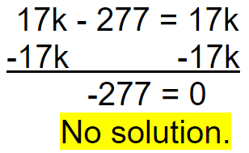
Solve: 17k - 277 = 17k (Show your steps and check)
Statement:
+

Slide 35
Solve: 17k - 277 = 17k (Show your steps and check)
Statement:
0
0
+

Slide 36
Solve: 17k - 277 = 17k (Show your steps and check)
Statement:
0
0
+

Slide 37
Solve: 17k - 277 = 17k (Show your steps and check)
Statement:
0
0
+

Slide 38
Solve: 17k - 277 = 17k (Show your steps and check)
Statement:
0
0
+

Slide 39
Solve: 17k - 277 = 17k (Show your steps and check)
Statement:
0
0
+

Slide 40
What is the coefficient of the 2nd term?:
64f - w + 20f +11
Notes:
🍐 This is a Pear Deck Multiple Choice Slide. Your current options are: A: -1, B: 1, C: 11, D: 20, E: 64,
🍐 To edit the type of question or choices, go back to the "Ask Students a Question" in the Pear Deck sidebar.

Slide 41
What is the coefficient of the 2nd term?:
64f -1w + 20f + 11

Slide 42
Solve: 28m = 13m - 45 (Show your steps and check/statement)
C)
Answer:
Notes:
🍐 This is a Pear Deck Drawing Slide
🍐 To edit the type of question, go back to the "Ask Students a Question" in the Pear Deck sidebar.

Slide 43
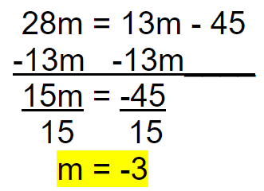
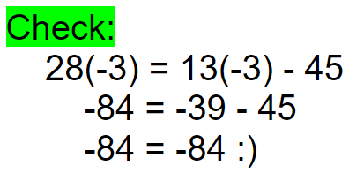
Solve: 28m = 13m - 45 (Show your steps and check/statement)
+
1

Slide 44
Solve: 28m = 13m - 45 (Show your steps and check/statement)
0
+

Slide 45
Solve: 28m = 13m - 45 (Show your steps and check/statement)
0
+

Slide 46
Solve: 28m = 13m - 45 (Show your steps and check/statement)
0
+
1

Slide 47
Solve: 28m = 13m - 45 (Show your steps and check/statement)
0
+
1

Slide 48
Solve: 28m = 13m - 45 (Show your steps and check/statement)
0
+
1

Slide 49
Solve: 11c = -8 + 11c (Show your steps and check/statement)
C)
Answer:
Notes:
🍐 This is a Pear Deck Drawing Slide
🍐 To edit the type of question, go back to the "Ask Students a Question" in the Pear Deck sidebar.

Slide 50
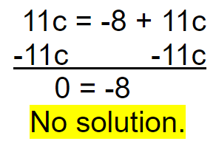
Solve: 11c = -8 + 11c (Show your steps and check/statement)
Statement:

Slide 51
Solve: 11c = -8 + 11c (Show your steps and check/statement)
Statement:
0
0

Slide 52
Solve: 11c = -8 + 11c (Show your steps and check/statement)
Statement:
0
0

Slide 53
Solve: 11c = -8 + 11c (Show your steps and check/statement)
Statement:
0
0

Slide 54
Solve: 11c = -8 + 11c (Show your steps and check/statement)
Statement:
0
0

Slide 55
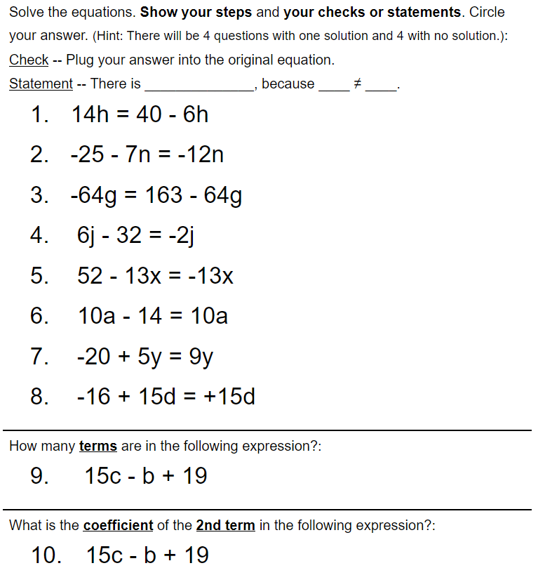
Homework:
Notes:
3,3,3 - 1 diff

Slide 56
Additional help videos

