Slide 1
From Macro to Micro: Social Determinants of COVID-19 & Nasopharyngeal Features Associated with Disease Progression A Study of COVID-19 in Worcester, Massachusetts
Christopher Tocci Biology/Biotechnology & Professional Writing
Advisors: Brenton Faber (WPI), Reeta Rao (WPI), John Haran (UMass), Evan Bradley (UMass)

Slide 2
COVID-19 is a Global Crisis
148,329,348 confirmed cases*
3,128,962 deaths*
983,410,283 vaccine doses have been administered^
*: Globally, as of 5:16pm CEST, 28 April 2021, as reported by WHO
^: As of 28 April 2021
Notes:
Source: https://covid19.who.int/

Slide 3
COVID-19 Dramatically Hit Worcester
Approximately 10% of Worcester’s Population
Notes:
Source: http://www.worcesterma.gov/announcements?pn=1 Be sure to clarify dot proximity

Slide 4
Is Your Health In Your Hands?
IS YOUR HEALTH IN YOUR HANDS?
Genetics
Microbiome
Environment
Genetics
Environment
Behavior
Medical Care
Social Factors
Behavior
Medical Care
Social Factors
Notes:
Environment, Genetics, Microbiome, Behavior, Medical Care, Social Factors

Slide 5
To Examine the Social Factors Correlated to COVID-19 Prevalence in Worcester, MA
Primary Research Goal

Slide 6
Social Factors Associated With Health Outcomes Are Connected & Compounding
Housing
Transportation
Education
Crime
Nutrition
Income
Notes:
Determined the most prominent social factors associated with global public

Slide 7
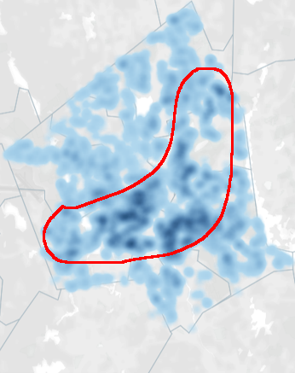
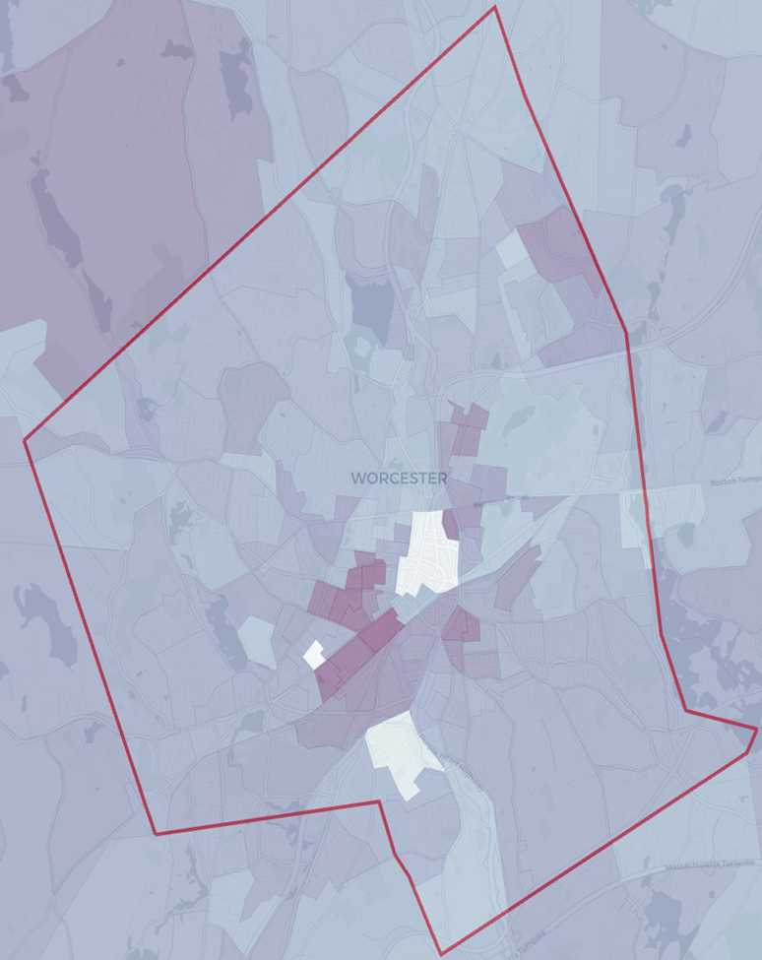
Average Family Size
Notes:
Best Schools by Proximity

Slide 8
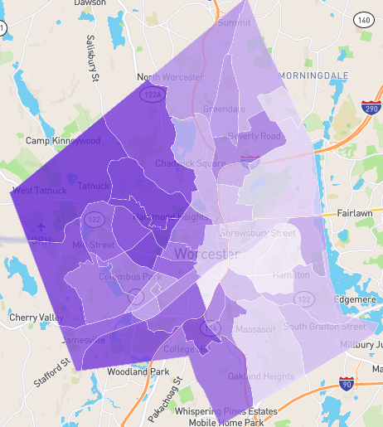
Best Schools by Proximity
Notes:
Best Schools by Proximity

Slide 9
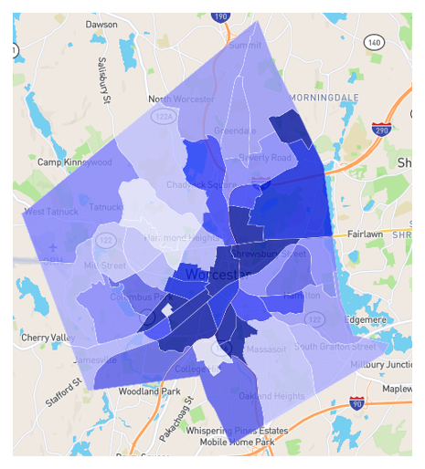
Crime Rate
Notes:
Crime Rate

Slide 10
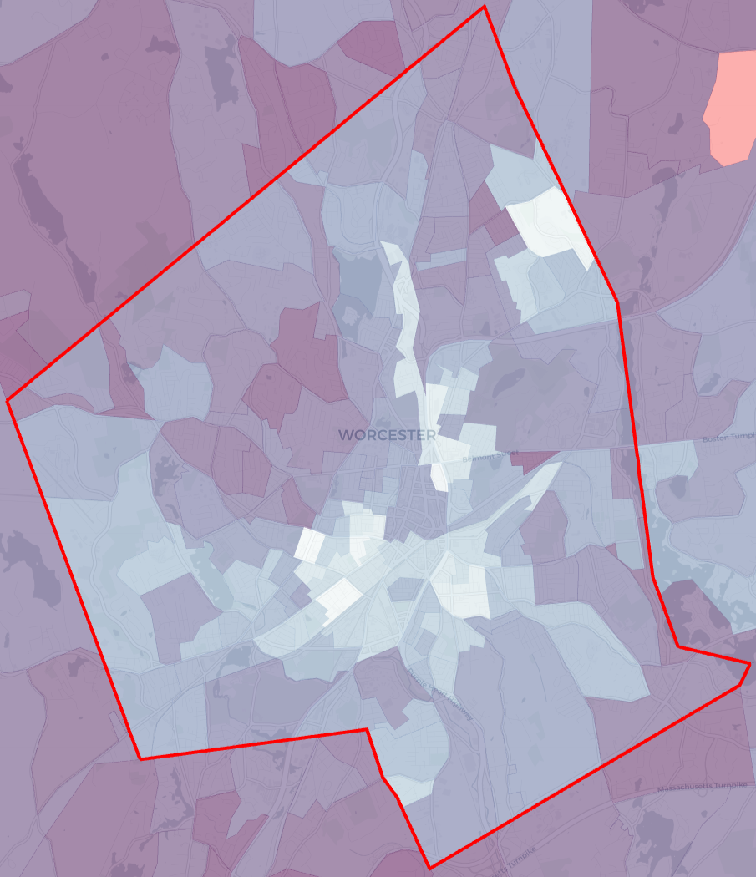
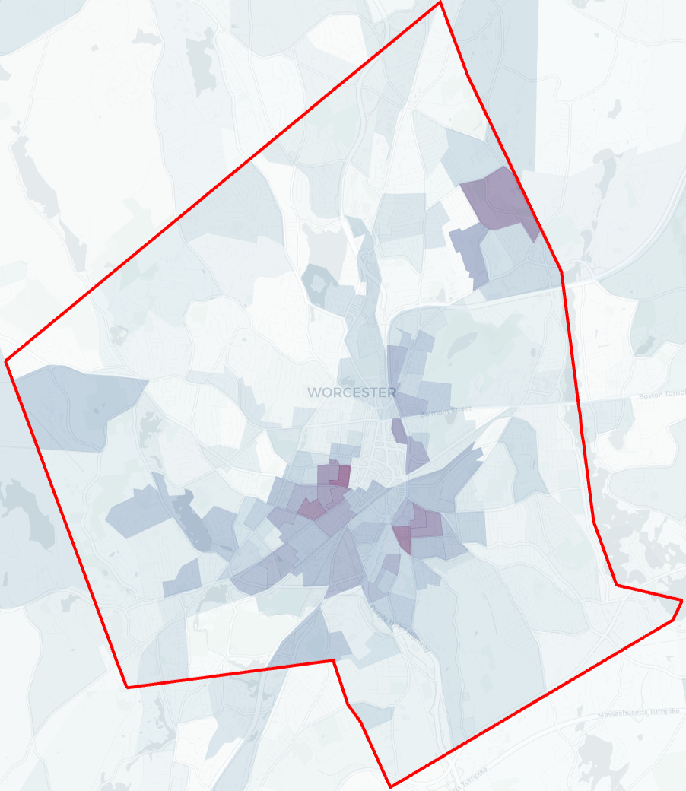
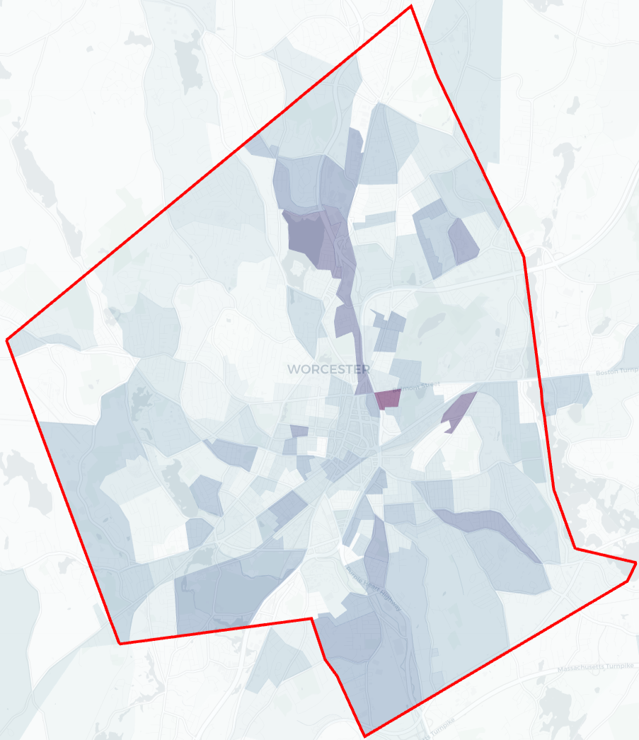
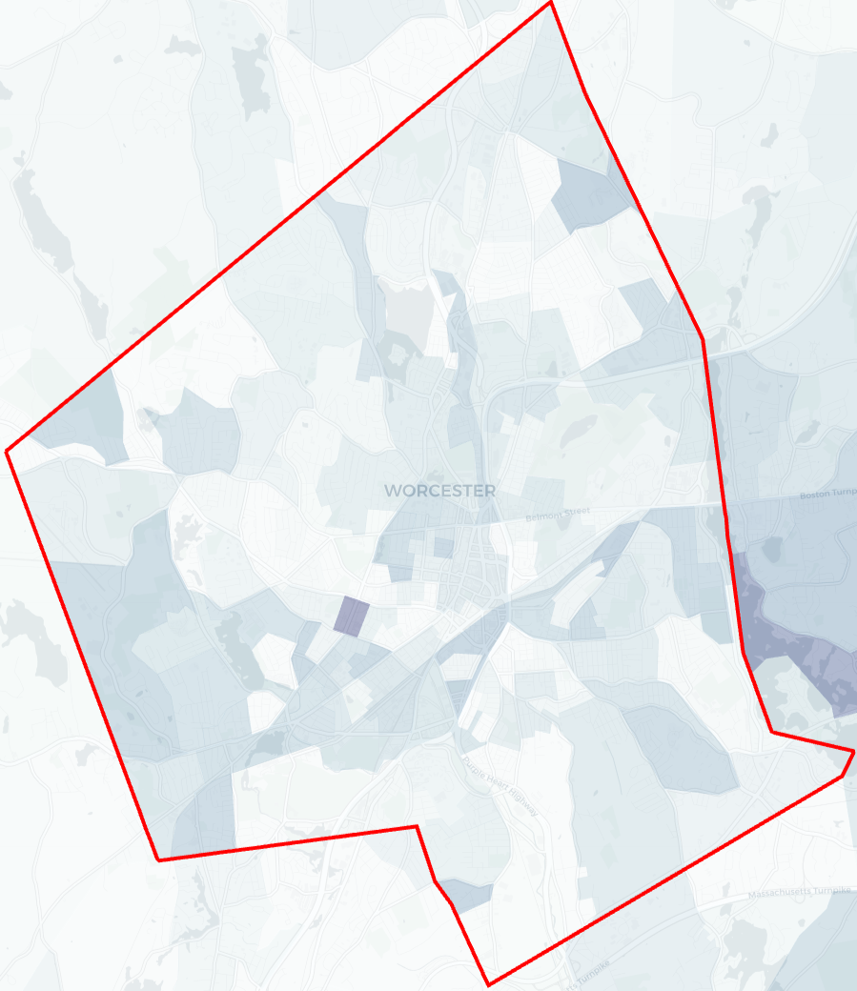
Demographics
Hispanics
Whites
Blacks
Asians
Notes:
Demographics -
TL- Whites
TR- Hispanics
BL- Blacks
BR- Asians

Slide 11
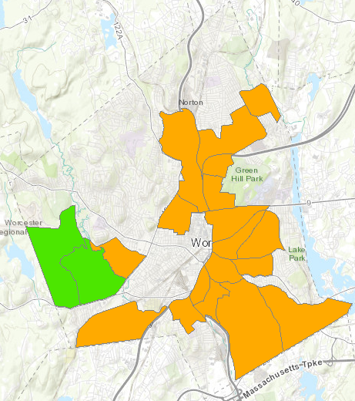
Food Desert
Notes:
Food Desert

Slide 12
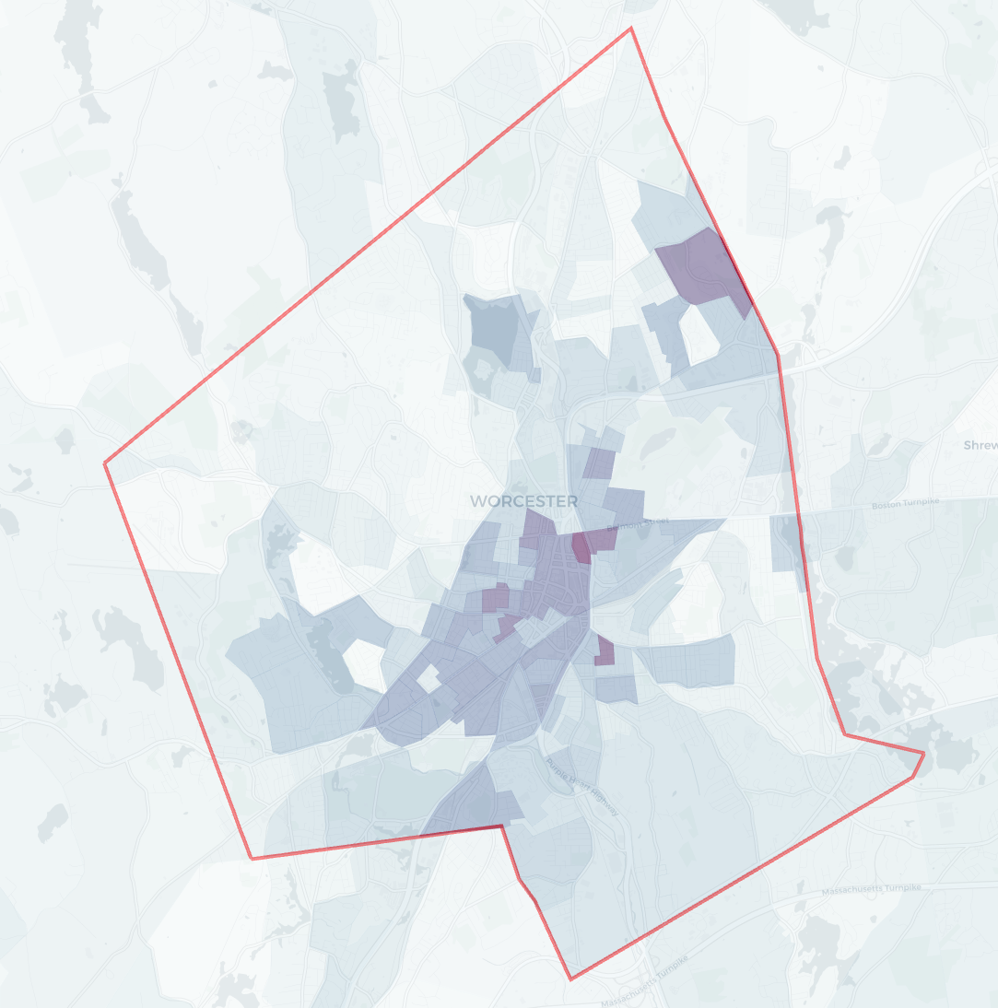
Income Below Poverty
Notes:
Income Below Poverty (%)

Slide 13
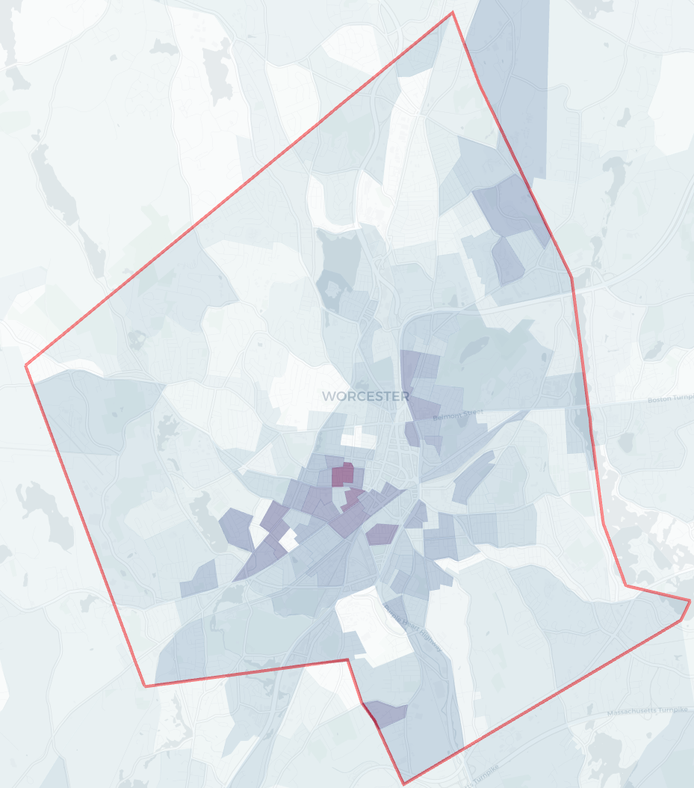
Less than High School Education
Notes:
Less then Highschool Education

Slide 14
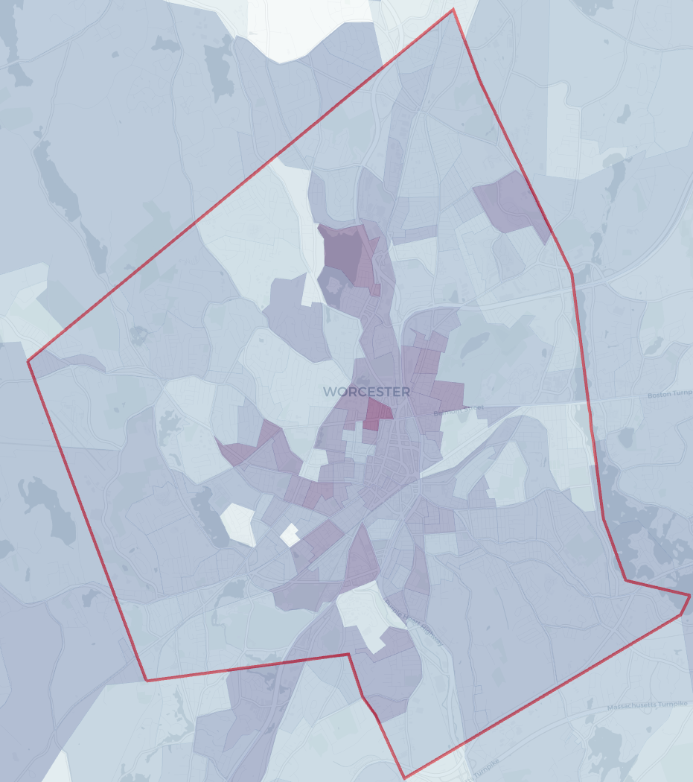
Meals from Fast Food Per Week
Notes:
Meals from Fast Food Per Week (#)

Slide 15
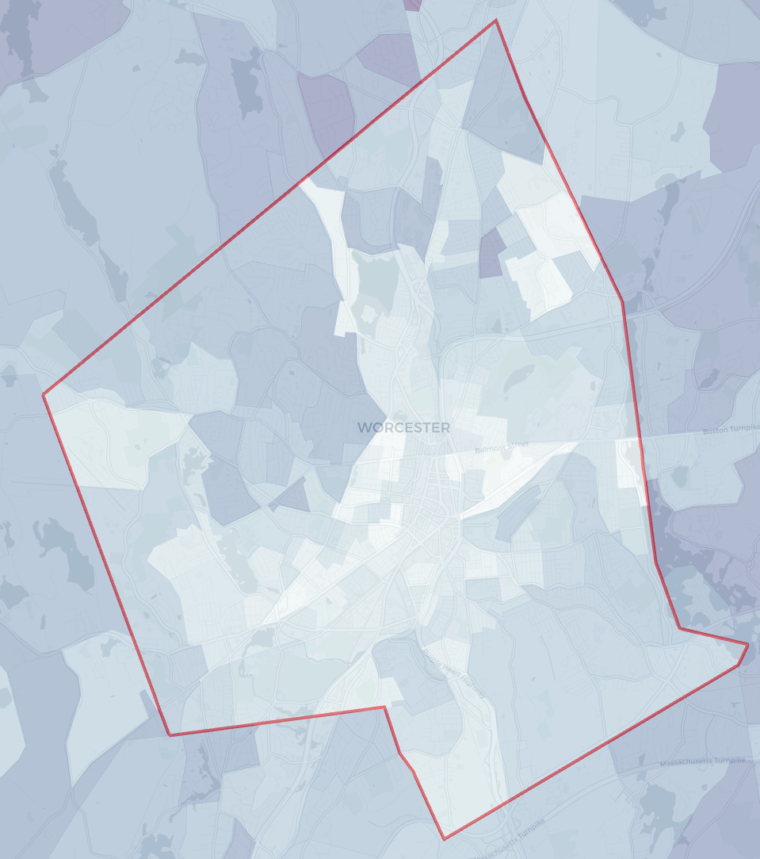
Median Household Income
Notes:
Median Household Income

Slide 16
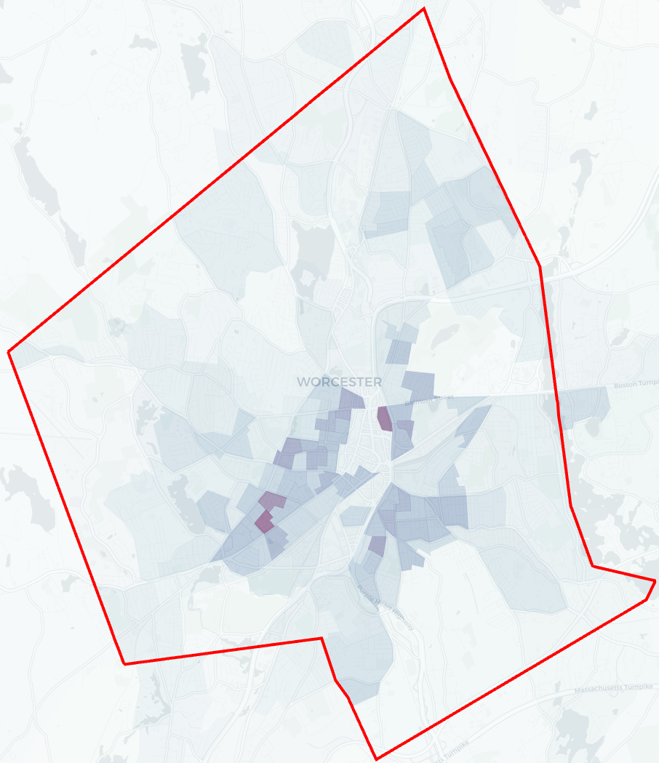
Population Density

Slide 17
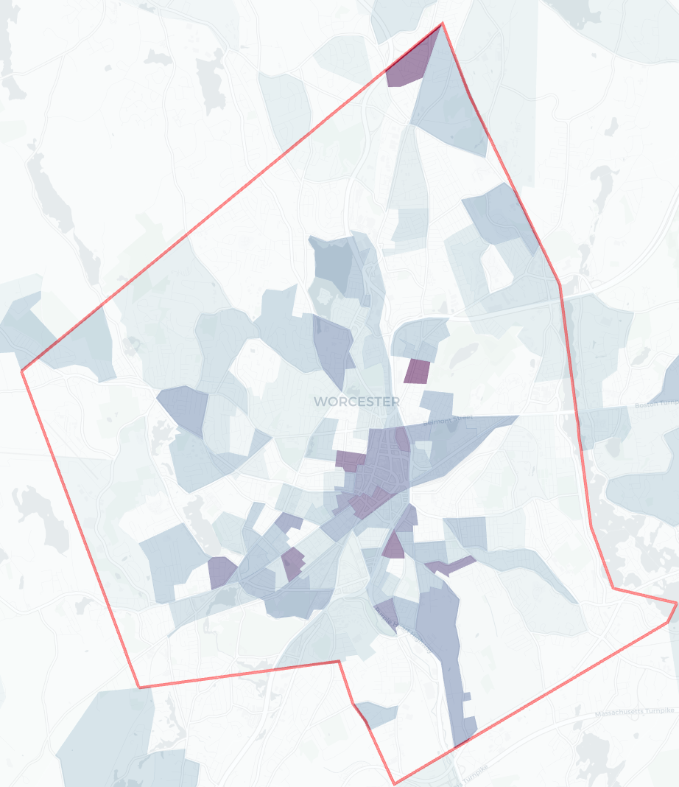
Usage of Public Transportation
Notes:
Usage of Public Transportation

Slide 18
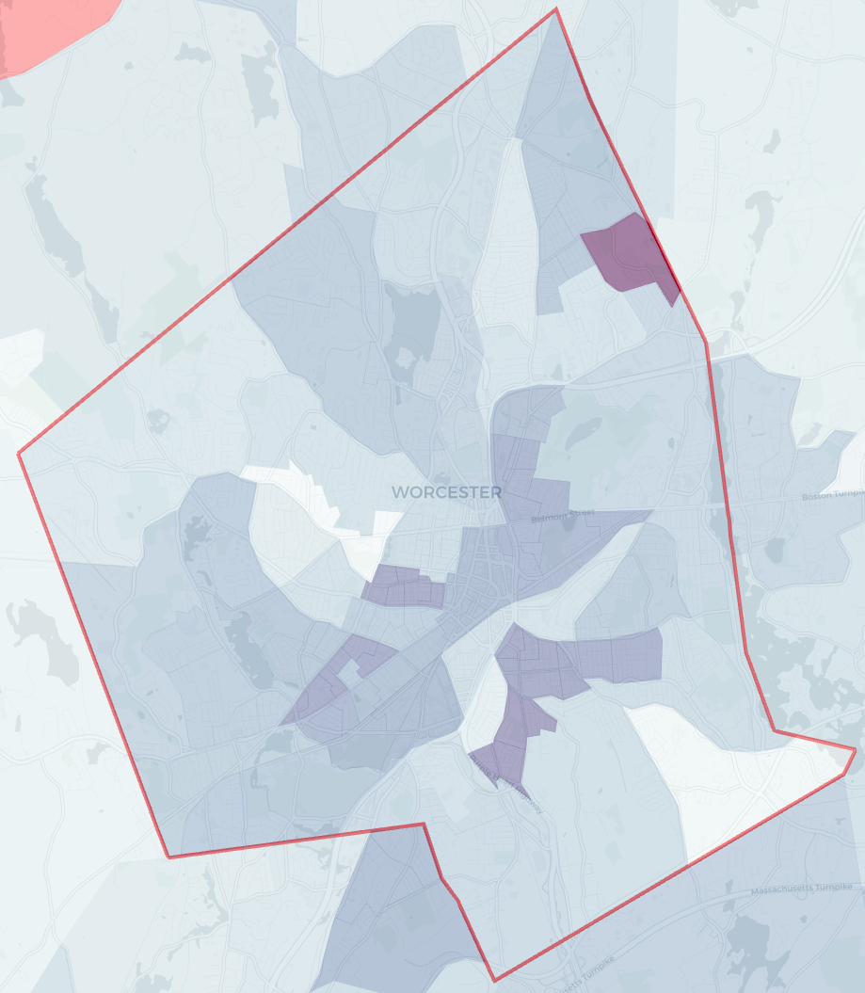
Unemployment Rate
Notes:
Unemployment

Slide 19
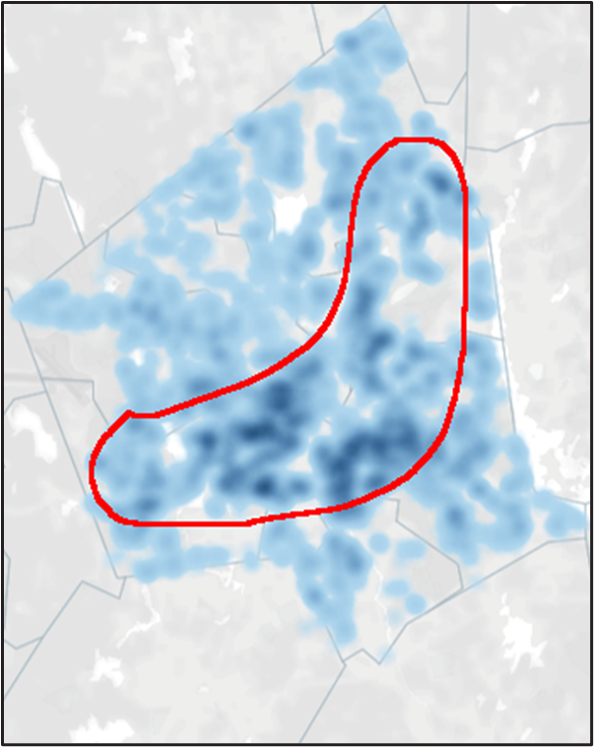

Slide 20
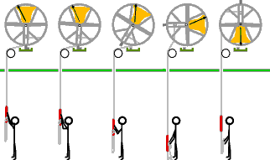
Bell Ringers Model
Crime
Education
Income
Nutrition
Transportation
Notes:
Source: http://www.bio.utexas.edu/faculty/bryant/personal/campanology.html

Slide 21
Rhetoric is to Audience as Health & Medicine are to Social Factors
Housing
Writing about Disease and Public Health
Transportation
Research Methods
Education
Research Methods in Writing
Cross-Cultural Communication
Crime
Medical Writing
Nutrition
Teaching Writing
Income

Slide 22
Thanks!
Questions?

