Slide 1
Developing Management Recommendations for La Playuela
Tyler Tao • Austin Rose • Tim Marschall
Notes:
Hello everyone
- Tim Marschall, Management Information Systems
Tyler Tao, Mechanical Engineering
Austin Rose, Computer Science

Slide 2
La Playuela
“ The site is […] exceptionally scenic. ”
- National Natural Landmarks Program
Notes:
Tim:
What is La Playuela
Where isit
Why it is important
What is happening there

Slide 3
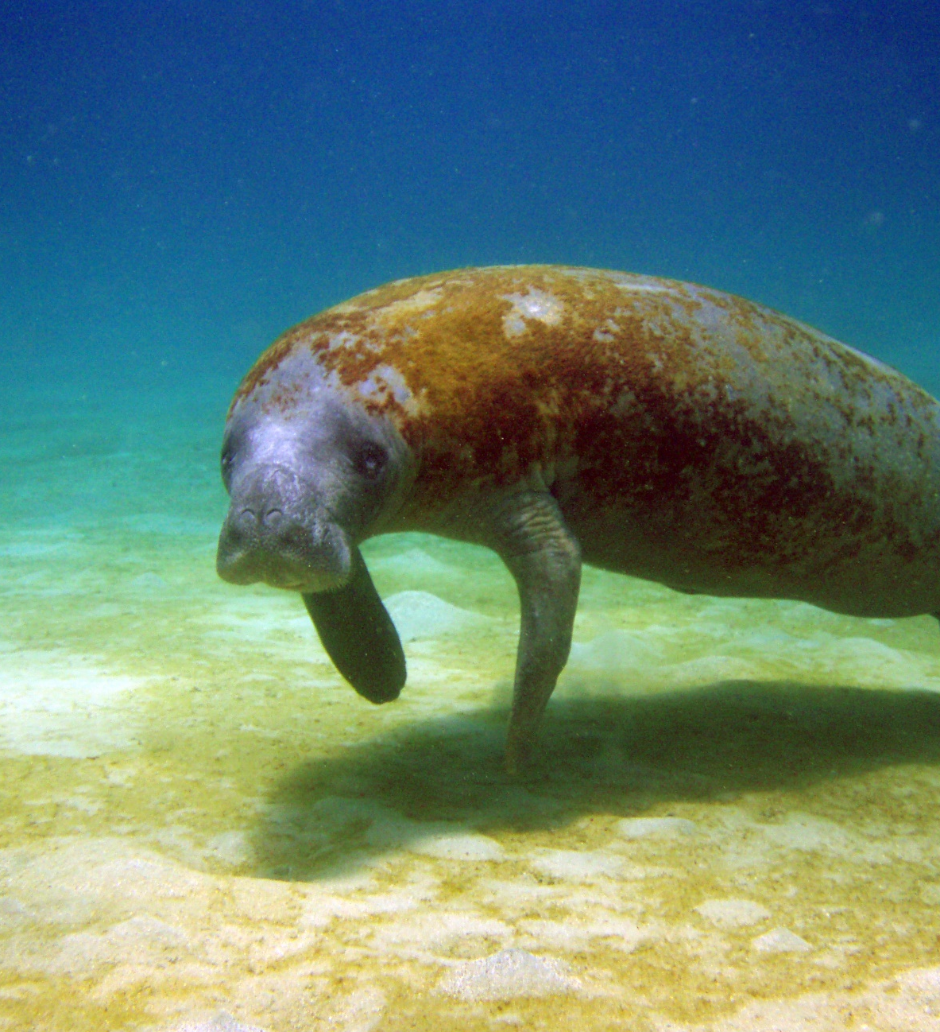
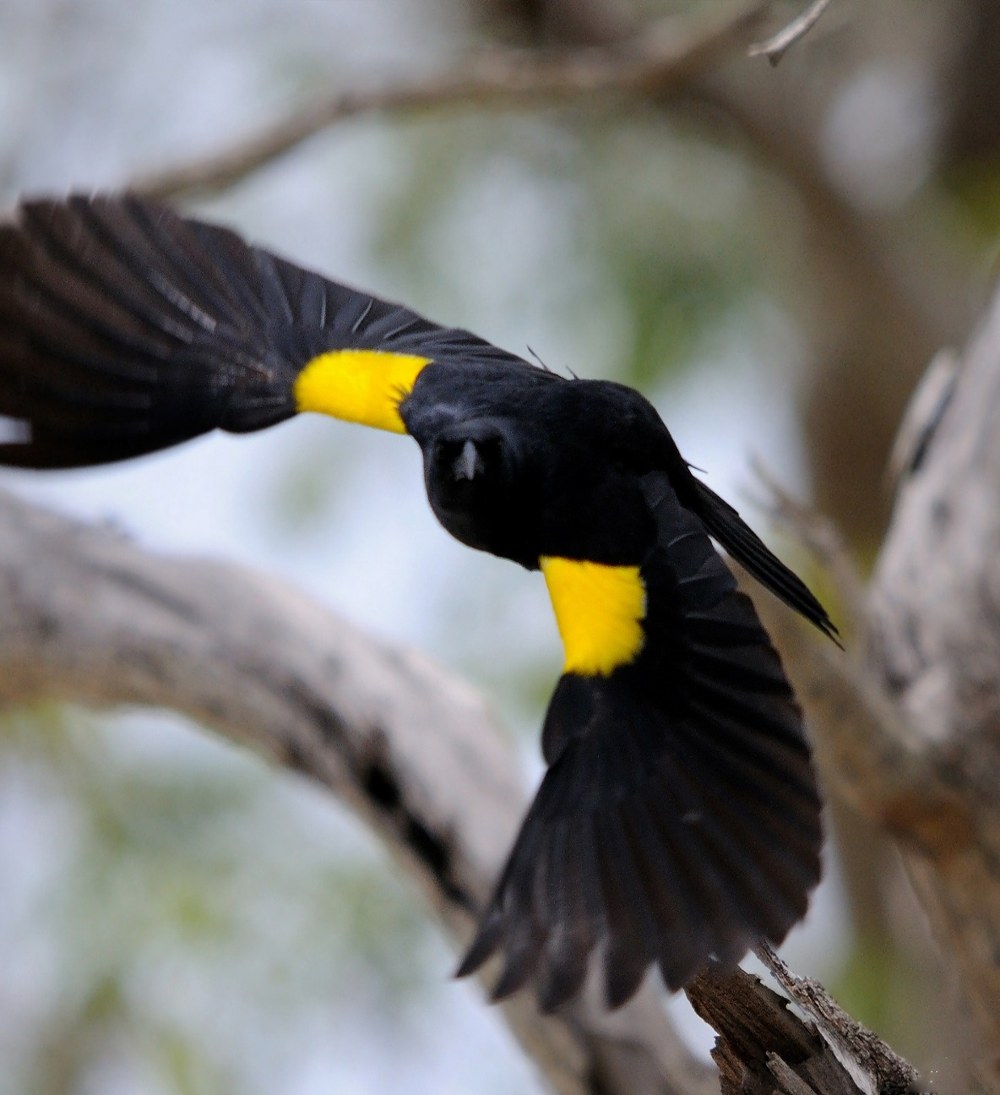
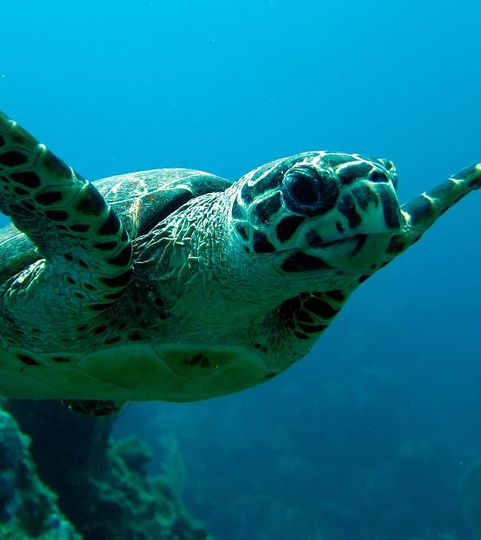
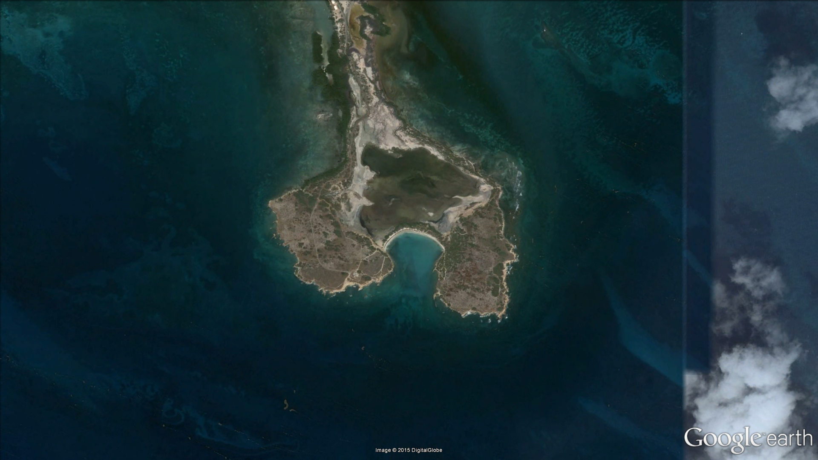
What is La Playuela? Why is it important?
Notes:
located on the southwestern tip of Puerto Rico.
It is part of the Boquerón State Forest and thereby a natural protected area.
It is geographically interesting, as the site is composed of two islets, which are joined to each other and the mainland by sand spits, forming what is called a tombolo. The sand spit encloses a salt water lagoon.
It is the habitat of several endangered and threatened species.
Click: Bay is roamed by the Antillean Manatee.
Click: The land area is home to the yellow-shouldered blackbird, an endangered endemic bird species. It is generally an area for seabird nesting.
Click: And even the beach itself is used by hawksbill sea turtles to lay their eggs.
All these factors, alongside with the mangroves that grow there, the sharp cliffs and the dry forest, make the area not only unique, but also extremely scenic, gaining it recognition as a National Natural Landmark by the National Park Service. It is considered American National Heritage.

Slide 4
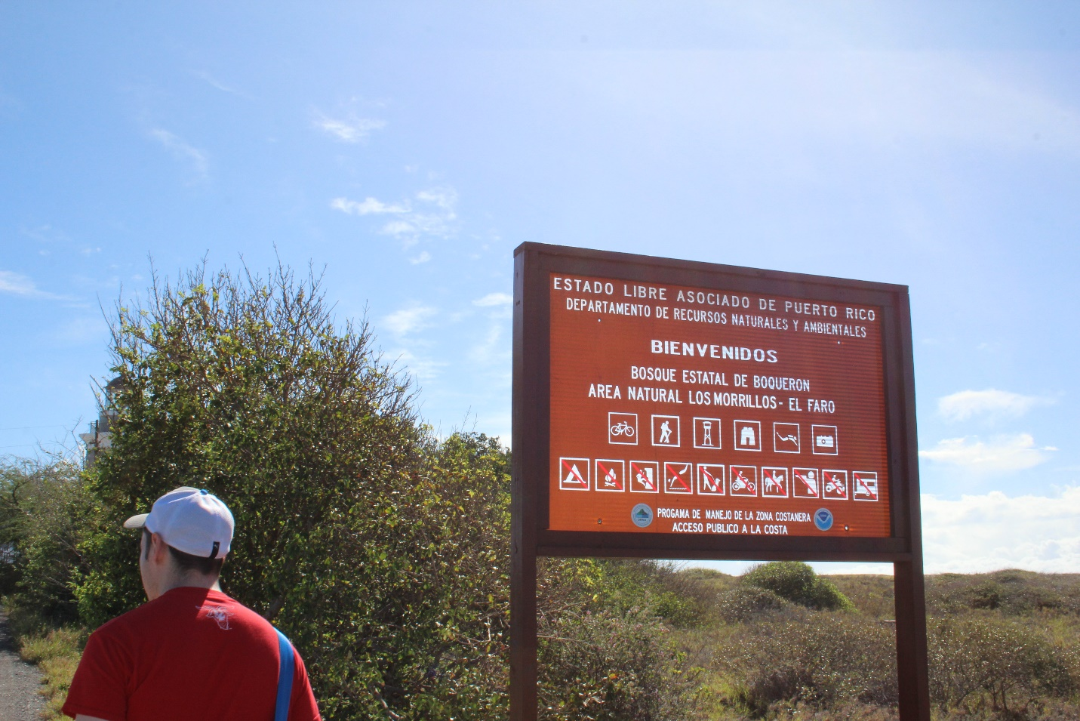
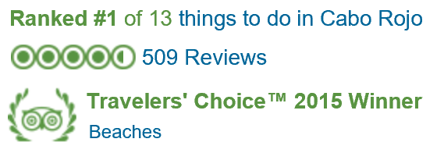
What is the problem?
-- TripAdvisor Award
Notes:
Austin:
- Despite some signs, people don’t always know that it’s a protected area.
- But people are widely aware that it’s one of the most scenic beaches in Puerto Rico.
- Too often, La Playuela is treated as if it were any other public beach.
- In the past few years especially, it has gotten a lot of publicity as a tourist attraction.
- Websites like puertoricodaytrips.com, caborojopr.com, or tripadvisor.com all have full articles with very positive reviews, that fail to mention that it’s a sensitive area.
- Just this year, TripAdvisor gave it a travelers choice award for being the #1 thing to do in Cabo Rojo.
- This imbalance in the problem with La Playuela, leading to severe ecological degradation.
- We want people to be able to enjoy the natural beauty of Puerto Rico.
- But people also must understand that this is not a public beach, and they can’t treat it like one .

Slide 5
Our Approach
Tackling the issue of ecological degradation
Notes:
Tyler:
We utilized three primary data sources over the course of this project, each offering a different perspective on the issues at La Playuela. Interviews with employees of the DNER and Fish and Wildlife Service, surveys gathering public opinion, and historical data in the form of satellite photographs all gave us a slightly different look at the challenges La Playuela has been facing over the past few decades.

Slide 6


In Person
Online via Email
Notes:
Tyler
One of the best ways to learn about La Playuela was speaking to some of you, professionals from the DNER and the Fish and Wildlife Service. Many people we spoke to have seen the changes in ecology there firsthand. Others offered invaluable insight into the development of management plans. We came to understand that La Playuela is in danger like never before; the increase in popularity has led to an increase in litter and forest fires. The mangroves are shrinking as visitors using them for shade. Due to the multiple issues, we concluded La Playuela is in dire need of a new management approach. A comprehensive plan for La Playuela involves not only limiting visitors, but also taking action to restore the area. Though the Limits of Acceptable Chance, or LAC, model has been implemented successfully in the past, we determined that it is not currently the best structure for the area. It simply requires too much personnel and funds to be feasible. Therefore, we will go on to instead propose specific management strategies to improve the general health of the area. Tim will let you know how we did so.

Slide 7



Surveying on the Beach
Gather information on who comes to the beach and how they behave
Assess how people perceive the beach
Find out how likely visitors are to participate in programs to help the beach
Notes:
Tim:
As we heard earlier, the major problem is that to many people come and don’t treat the area like it is supposed to be.
We designed and administered a survey to beachgoers. It had three major goals:
CLICK: 1. We wanted to know who the visitors are and how they behave by asking questions about their residency, how often they come, how big the groups and so on
CLICK: 2. Also we wanted to know how satisfied they are with their experience and whether they have seen a change when it comes to mangrove density and trash
CLICK: 3. Lastly and possibly most important, we had to find out just how willing visitors are to participate in different measures to enhance the natural environment at La Playuela, so we could find educational gaps and effective strategies.
We went out on a weekend in November and got responses from 28 groups. We always asked one representative of the group to take our survey. Here is what we found.

Slide 8

Who are the Visitors?
Lives on the Island (89.29%), but not in Cabo Rojo (72%)
Visits less than once a month (19.05%)
Is in a group of roughly 4
Spends either 2-4 hours on the beach, or stays the whole day
Comes in July to September (76.19%)
Knows that the area is protected (85.71%), but does not know why
Believes plant life has stayed about the same
Thinks that the trash situation has gotten better
Is satisfied with their experience (76.19%)
Notes:
Puerto Rican, however not from Cabo Rojo, which led us to believe that people actually incur a relatively long drive just to visit the area.
Together with the fact that most people visit less than once a month, this suggests that a visit of the beach is a special occasion and planned in advance.
2-4 hours at the beach or stay the whole day, which means that at the peak time between July and September, more people come in than go out, so they compound on the beach.
In terms of experience and knowledge,
most people do in fact know that the area is protected, but a lot of comments we got told us that they don’t really know why.
They believe that the plant life stayed about the same, which unfortunately is not the case, so there is an educational gap here.
Also, they think that the trash situation has actually enhanced with the infrastructure changes the DRNA made since the beach first got popular, which our interviews suggested as well.
Nicely, most
people, roughly 3/4, are actually satisfied with their experience on the beach.
Now that we know a little more about our visitors, I want to talk about the programs they are willing to participate in.

Slide 9







 | Cleaning up own trash when leaving Bring trash home if trashcans are full | Volunteer to clean up trash
 |  |  | Visiting another beach when gate is closed Using a shuttle service from Boquerón
 |  | Staying on the beach and avoiding the tree areas Adhering to existing paths | Avoiding feeding animals
 | Following posted regulations | Not smoking or cooking on the beach Encourage others to follow posted regulations
Notes:
What you see here is a categorized table and I will talk about each row separately.
92% are willing to clean up their trash
82% are even willing to take it home when the trashcans are full.
People are less likely to clean up after others, but still more than half is willing to do so
Only 42% were willing to turn around, and excluding first time visitors only 33% are willing to turn at a closed gate .
Shuttle Service
In terms of nature,
57% were willing to avoid the shady mangrove area and
64% were willing to adhere to existing paths.
-> Not enough respect
Lastly, most people are willing to follow regulations, so they need to be made very clear to them, and a decent amount, roughly 60%, is willing to encourage others to do the same.

Slide 10
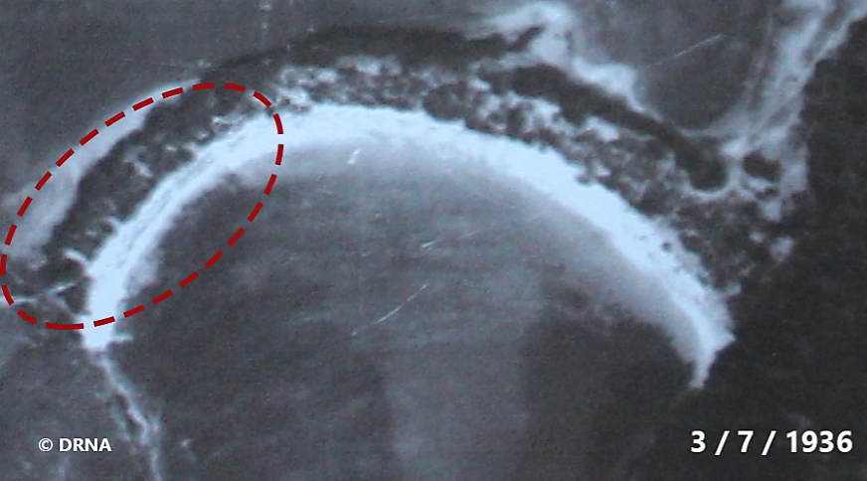
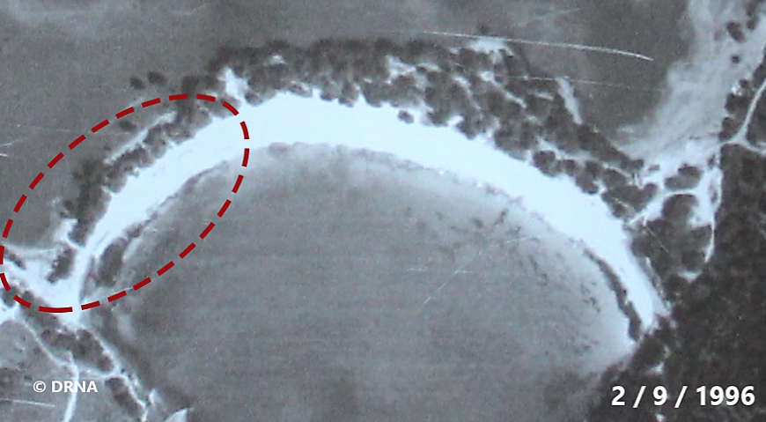
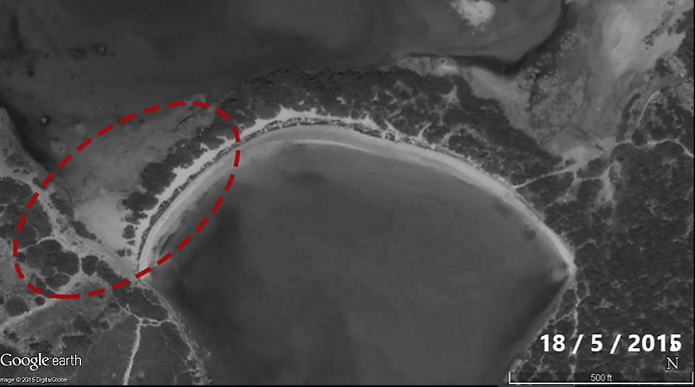
Historical Photos
Notes:
Austin:
- Another part of our approach involved analyzing any historical data we could get, to see, empirically, what are the problems.
- Analysis of historical satellite photos corroborates the observations from interviews that the mangroves have been degrading.
- In these three photos, from 1936 to 1996 to 2015, it’s especially obvious in the highlighted area near the entrance. The mangroves are getting sparser every year.
- Which is no surprise – beachgoers are using the mangroves to shade themselves, hanging bags from their branches, and leaving their trash. They’re bound to deteriorate.
- This is unfortunate. The mangroves are an important part of the ecology.
- They are a habitat for the hermit crabs, and the yellow shouldered blackbird.
- As they degrade, more and more trash travels through them from the beach to the refuge beyond .

Slide 11
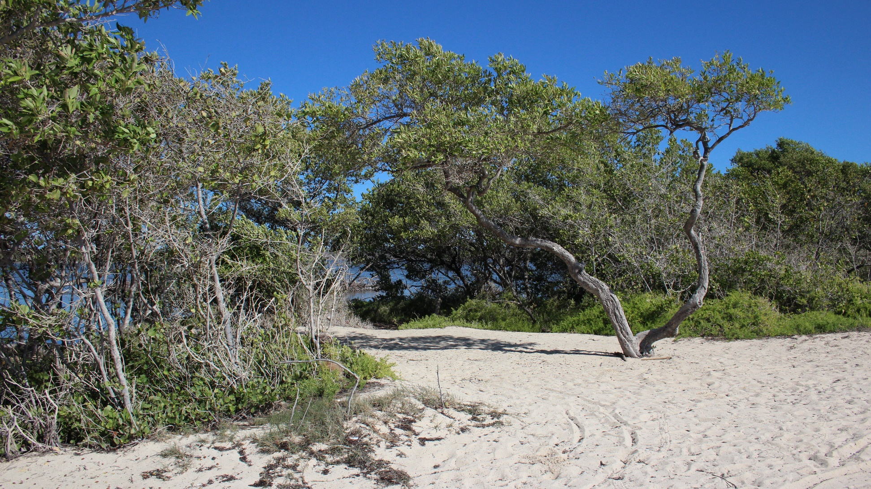
Notes:
Austin:
- So it is our primary recommendation that the strip of mangrove lining the beach be declared a restoration zone: explicitly prohibiting the public from occupying the area.
- Of course, if we’re going to reduce the physical space available for beachgoers to use, we need to consider what this means for the number of people that can occupy the beach at one time.
- There has to be a limit. At some point, if too many people are allowed on the beach, then it is physically impossible for them to avoid being inside the mangroves.

Slide 12
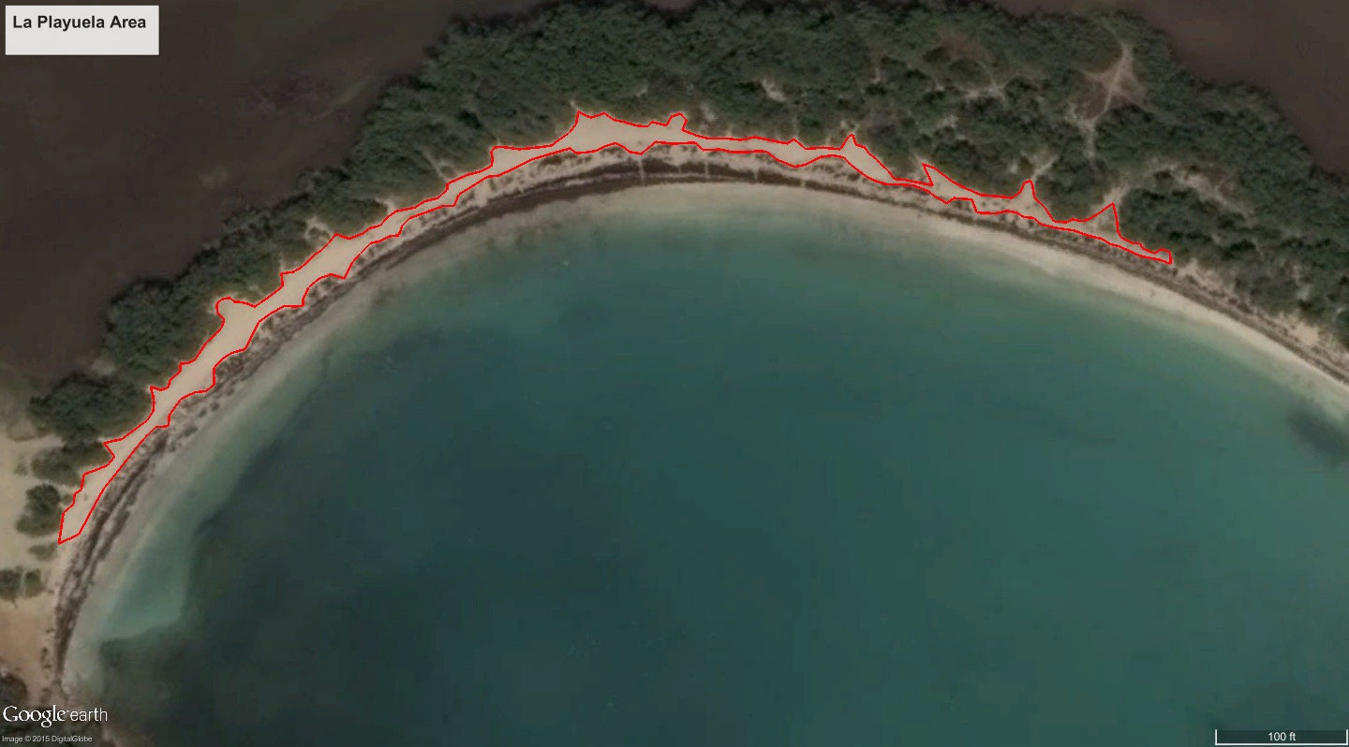
1567 square meters
Notes:
Austin:
- To determine this limit, we measured what usable space there in on the beach.
- PICUTRED ABOVE SOMETHING SOMETHING.
- We then considered, according to our surveys, what is the typical number of people one car will bring to the beach.
- And, assuming they each have their own beach towel, as well as a comfortable amount of space around themselves and between other groups.

Slide 13
Spatial Analysis
136
cars
545
people
Notes:
Austin:
When we take the space on the beach outside of the mangroves, and divide it by the amount of space that a group should occupy, we end up with room for about 136 cars.
This translates to about 545 people .
Now, this number represents the absolute hypothetical maximum. Meaning that even if everyone behaves perfectly, you still couldn’t have more than this, because that would guarantee that people are occupying the mangrove restoration zone. There would be literally no where else to fit.
In reality, people do not behave perfectly, and they’re not going to line up perfectly next to each other. So in practice, we will want less than this.
The important point, is to not let in more people if they’re already overflowing into the mangroves. But this is a good place to start.

Slide 14
Recommendations
Taking action for the future of the land
Notes:
Although we’ve determined an optimal visitor limit, simply restricting access to the beach is not likely to significantly improve beach conditions by itself. Through research, we have determined some additional management actions that, in conjunction with the visitor cap, will yield the maximum benefit. You've already heard about our proposal for creating a restoration zone in the mangrove area, and we formulated a few more promising programs that will positively impact La Playuela. As the ecology changes over time, it will be necessary to modify the management strategies accordingly to align with new challenges posed by varying conditions . Therefore, we looked into potential indicators for future implementation of the Limits of Acceptable Change management framework.

Slide 15
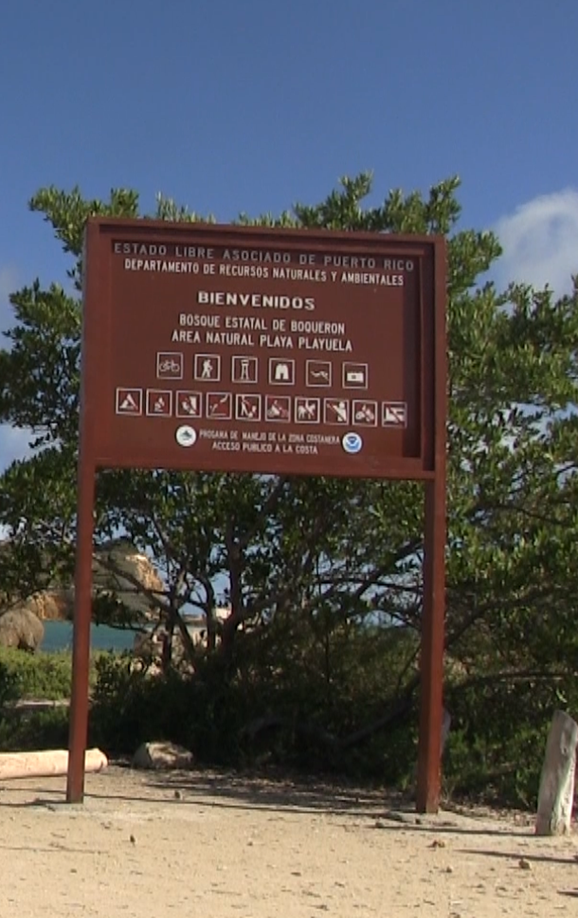
Educational Campaigning
Why is the area protected?
What are the rules?
What impact do invasive species have?
Notes:
Tim
Comments from our
“More orientation to visitors regarding the importance of the beach and wild life. “
“Better signs or at least extra ones about the area”
“No information on the area”
We suggest to add additional signs to the current one, which has some pictograms, but is not really informative.
These signs should encompass three particular areas:
CLICK: Why
habitat of several endangered species
living in a unique ecosystem
gained recognition as a National Natural Landmark.
CLICK: What are the rules?
prohibition of open flames
wildfires and arson
trash policy
and, if implemented, the avoidance of the shady mangrove areas on the beach.
Gives ranger something to point at. No excuses.
40% of returning beachgoers who participated in our survey realized that the plant life at the beach had declined.
It is thereby crucial to display the difference of how the beach used to look before major human influence and its current status.
CLICK: What impact do invasive have?
43% of respondents were willing to not feed the animals on the beach and since the amount of stray cats has increased over the last years, we consider that an issue.
The detrimental impact of stray cats.

Slide 16
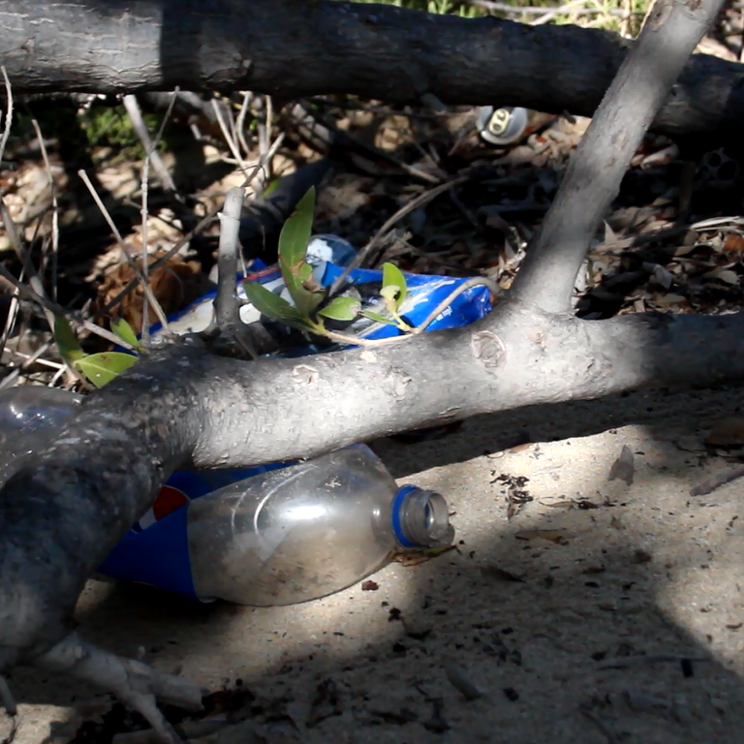

Carry in Carry Out Policy
Notes:
Tyler
As you may remember from the survey results, over 90% of respondents said they are willing to clean up their own trash. You may also recall that the survey showed instances of littering have decreased in recent years. However , litter remains a very noticeable issue at La Playuela. It acts as a food source for stray cats and generally looks unsightly. Adding more trash receptacles in conspicuous areas would detract from the beauty of this protected area and make it look more like a public beach. An alternative would be to make all visitors responsible for collecting and removing their own trash through a Carry In Carry Out policy. As the name implies, whatever the visitors carry into the beach, they should be carrying out with them as they leave. The DNER would remove all trash receptacles in the area and instead provide small bags for trash collection. This policy has been successfully implemented in national parks in at least six states and Washington D.C. It’s benefits include a reduction of litter left on the beach , elimination of the need for employees to empty trash receptacles, and a cleaner beach for all to enjoy.

Slide 17



Reservation Ticketing System
Reserve spots online Print ticket Present ticket at gate
Notes:
Another policy that would benefit both visitors and the DNER would be a ticketing system for visiting the beach. Visitors would reserve spots for their party online and present a printed confirmation to the rangers upon arrival. Rather than arriving at La Playuela only to be turned away if the beach has reached capacity, the online system would show if there are unreserved spots available to be claimed at the gate. The rangers would be able to view the exact number of visitors currently on the beach, allowing them to easily determine if the beach has reached capacity. Data such as average group size and peak times stored by the municipality or the DNER will give a more accurate visitor statistics than a survey, which cannot be administered each day. Such a system can be integrated with educational campaigns, potentially displaying pertinent information such as regulations, before allowing a reservation to be made.

Slide 18





Indicators for Future LAC Implementation
Tree Density
Nesting Data
Visitor Statistics
Litter
Photographs
Notes:
Tyler
Now we’ll briefly talk about the Limits of Acceptable Change framework. Even though it is not currently the optimal management structure for La Playuela, it may be useful to implement it in the future. We selected five environmental indicators that represent the condition of the environment. It will be necessary to monitor these indicators for a few years prior to the implementation of a LAC plan in order to establish the desired levels.
Measuring tree density, either by manually counting trees or by using computer software, not only shows the effectiveness of the restoration zone on mangrove growth but also whether or not the mangroves require additional protection .
Tracking the amount of bird and turtle nests annually as well as the nest locations provides a sense of trends in population size of the species and can also indicate if additional zones should be protected during the nesting season.
Visitor statistics can be collected at the gate, using an information system, or re-administering the survey mentioned previously. They will allow the DNER to gather visitor feedback and track changes in amount of visitors over time. For example, a large number of repeat visitors allows for educational programs to be run less frequently.
Litter is very visible, but counting individual pieces of litter is inefficient and time consuming . Therefore, we suggest organizing one day per month where litter is collected, possibly by volunteers, and weighing the collected refuse. If the amount collected increases, a new policy or educational program may be necessary.
Pictures taken from the same viewpoint each year should be collected in a single location. Satellite photos give the most comprehensive view, but as long as the view is consistent, they are not the only option. Photos should be taken twice per year, once in summer and once in winter It may not be possible to directly measure from the photos, but comparing photos over time will reveal trends in size of certain land features.
ay be I know I’ve given a lot of information in the past few minutes, so Austin will sum everything up for you .

Slide 19
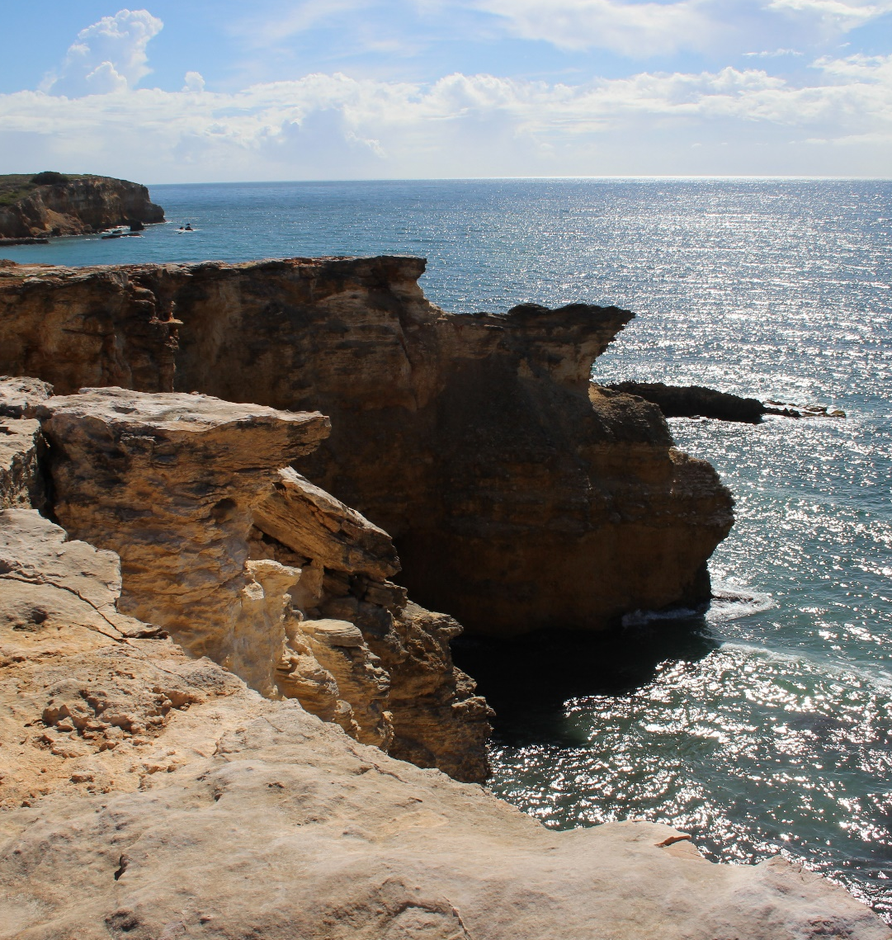
Conclusion
Restoration zone
Visitor capacity
Alternative strategies
Indicators of success
Notes:
Mention out visitor limit, and our recommendations.

Slide 20
Sources
Carry in / carry out. (2013). Retrieved from http://dnr.wi.gov/topic/parks/shelters/carryout.html
Delaware State Parks Rules. (n.d.). Retrieved from http://www.destateparks.com/rules/cico.asp
tripadvisor. (2015). Top 25 Beaches — Caribbean. Retrieved from http://www.tripadvisor.com/TravelersChoice-Beaches-cTop-g147237#16
U.S. Fish and Wildlife Service,. (2007). Antillian manatee /Manatí Antillano. Retrieved from https://www.flickr.com/photos/usfwssoutheast/5840507054
Icons made by freepik from flaticon.com

Slide 21
