Slide 1
Bus Bike Rack Lifter MQP
Cole Flegel & Dylan Baker-Flynn
Advisor: Prof. Eben C. Cobb, ME

Slide 2
Introduction
Problem at Hand: Bike racks on buses are not designed to keep up with the increase in bike-bus commuting.
Objective: Design a new rack system that allows more bikes to be stored on the bus.
Manufactured for use with existing city buses to make it desirable for purchase
Can be installed and removed without modifying the bus

Slide 3
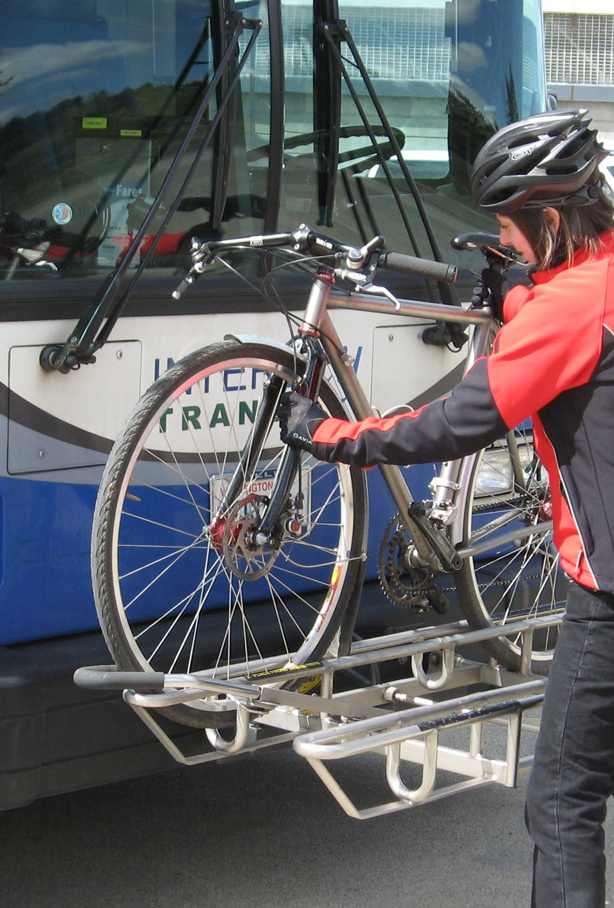
Literature Review
Current Practices
Legal Parameters
Bicycle Parameters
Human Parameters

Slide 4
Functional Specifications
Raises and lowers in less than one minute
Lowers to within two feet of the ground
Weighs less than 50 pounds unloaded
Does not increase the bus length
Does not block view of driver or headlights
Rack remains horizontal
Remains safe to use by cyclists
Intuitive to use by cyclists
Carries four bicycles
Fits in current bus stop space

Slide 5
Design
Ideal application for a four-bar mechanism
Accessible to build and maintain
Low-cost for manufacturing
Notes:
When initially presented with this problem, we realized that it was very similar to the 3 position synthesis problems covered in our classes. This was a perfect place to implement a four-bar mechanism because they’re easy to build and repair. Going with a simple and robust design also helps us keep our manufacturing costs low which helps make it more desirable as a product.

Slide 6
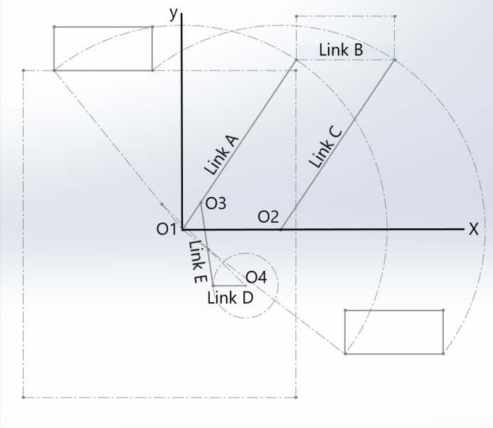
Synthesis and Analysis
Notes:
Using a process similar to the problem on the previous slide, we developed a simple four-bar synthesis and sketch for our initial design. We also included a driver dyad since we wanted to include a motor to raise and lower the bike rack since once it’s loaded with bikes, it would be dangerous to lift by hand.

Slide 7
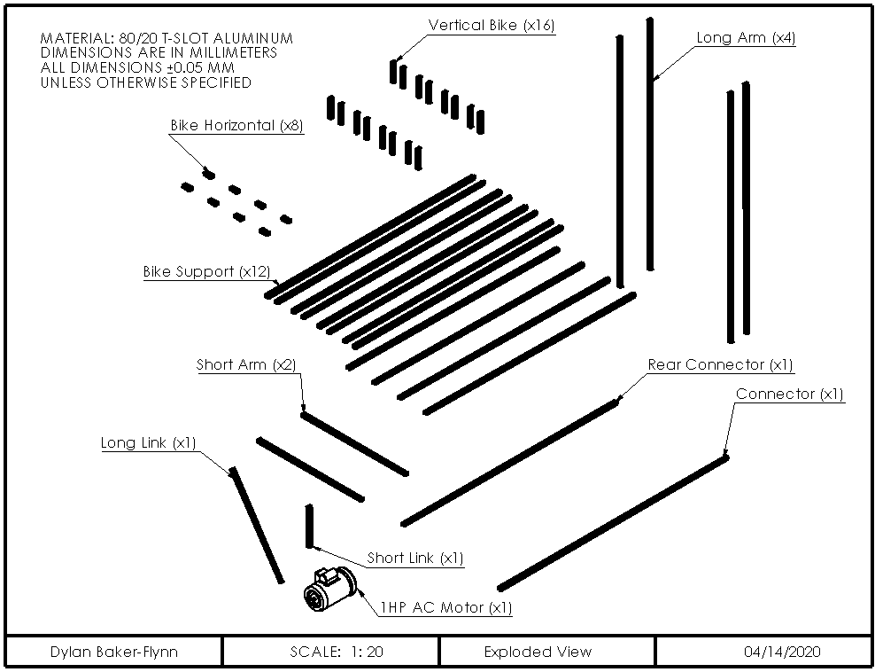
Detailed Design Description
Notes:
Our final design featured two four-bar mechanisms, mirrored on either side of the bus with the bicycle rack itself attached between them. We’ve included an animation of our assembly and an exploded view with a list of parts to help aid in construction.

Slide 8
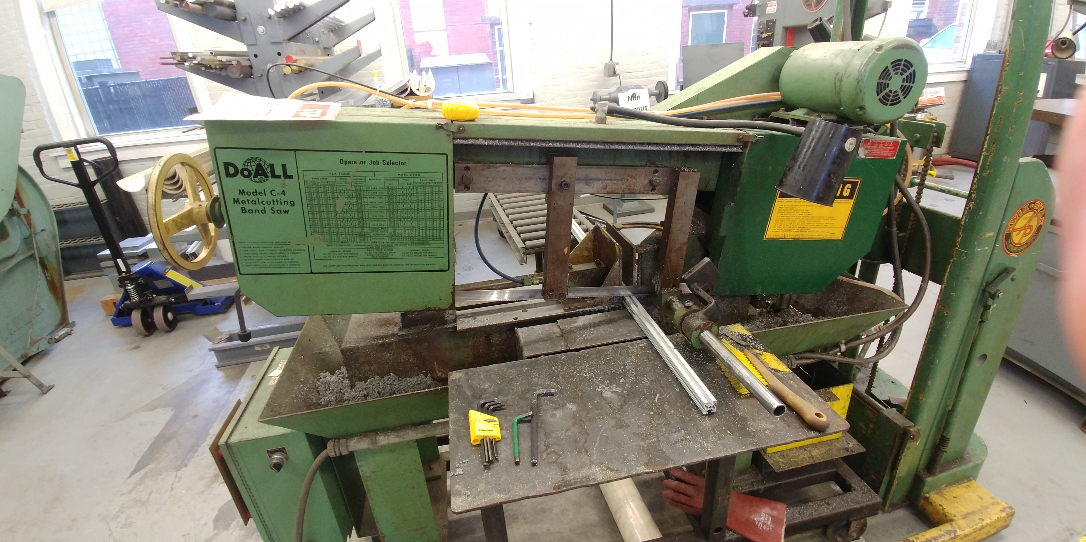
Manufacturing
Notes:
Although our manufacturing period was cut short, we were able to build the majority of our prototype. Due to a restriction on resources and storage space, we opted to build a half-scale model. We primarily used 80/20 for this project due to it being easy to assemble and disassemble. We also built a wooden base in order to mimic the mounting slots on a bus. The majority of our manufacturing was done in the Washburn machine shop as well as the Foisie Makerspace.

Slide 9
Testing
Notes:
Since our testing period was cut short we were unable to complete our testing. However this animation of our design shows how our project would have worked if not due to unprecedented circumstances. The motor and driver-dyad placement was such that one full rotation would lower and raise the bike rack.

Slide 10
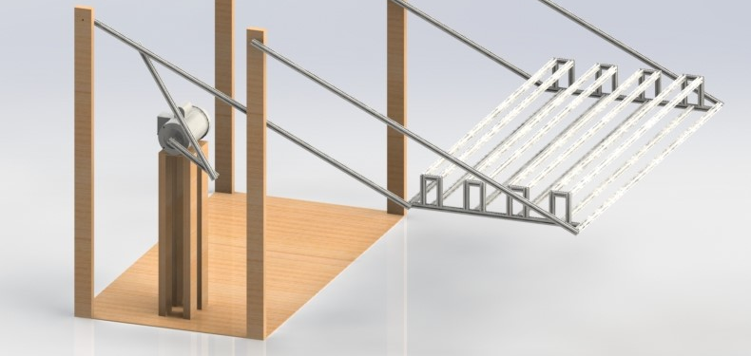
Conclusions and Recommendations
Use of bearings to reduce friction
Use of higher quality materials
Full-scale model

