Slide 1
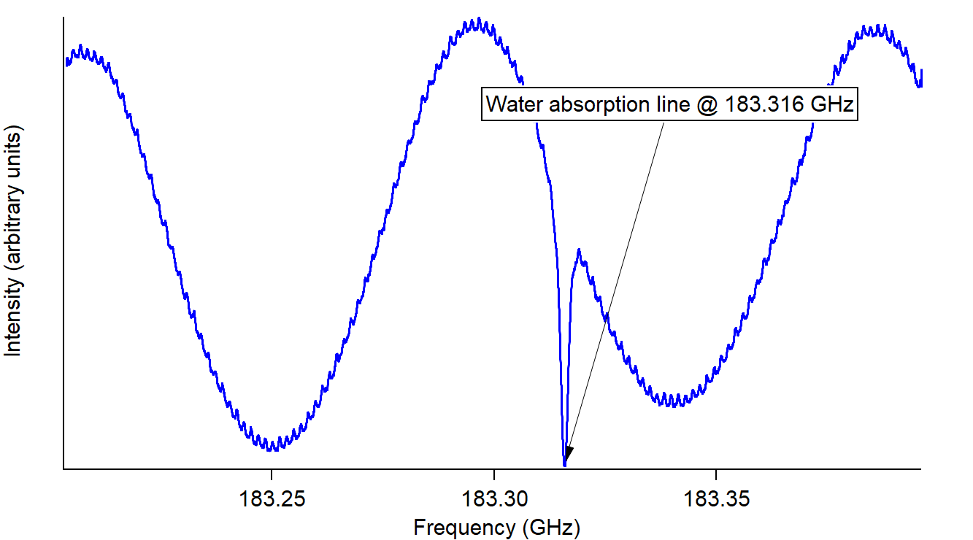
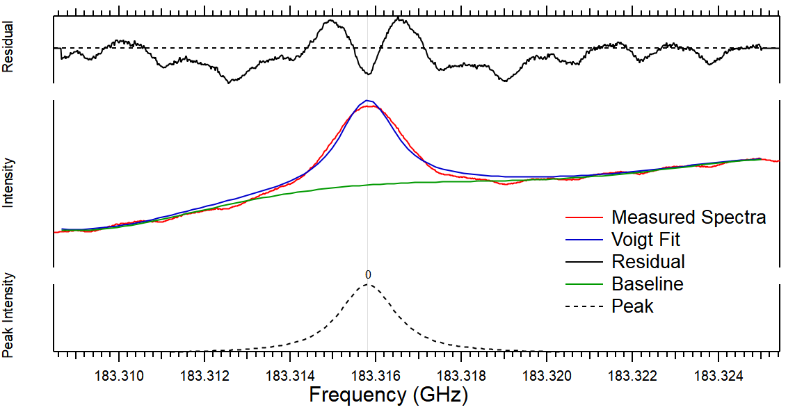
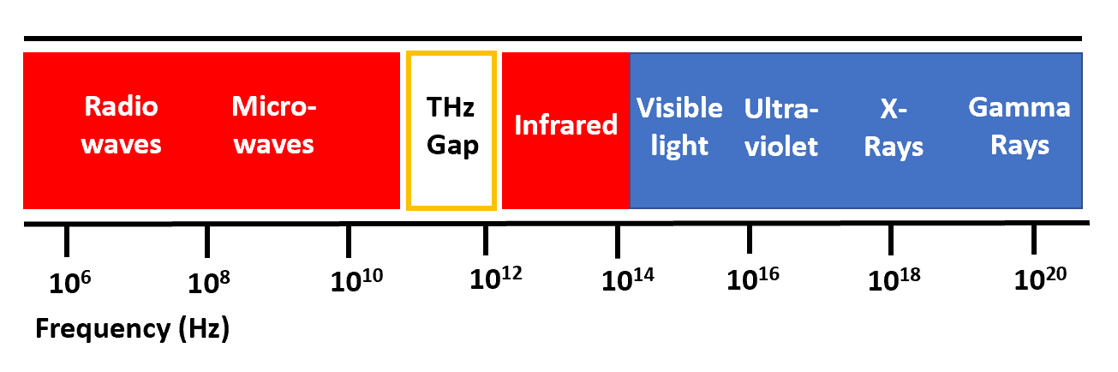
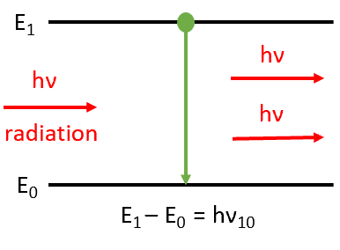
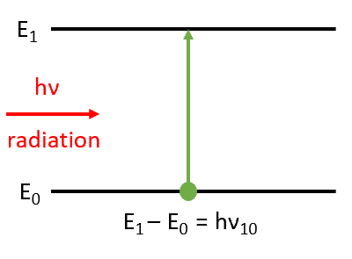
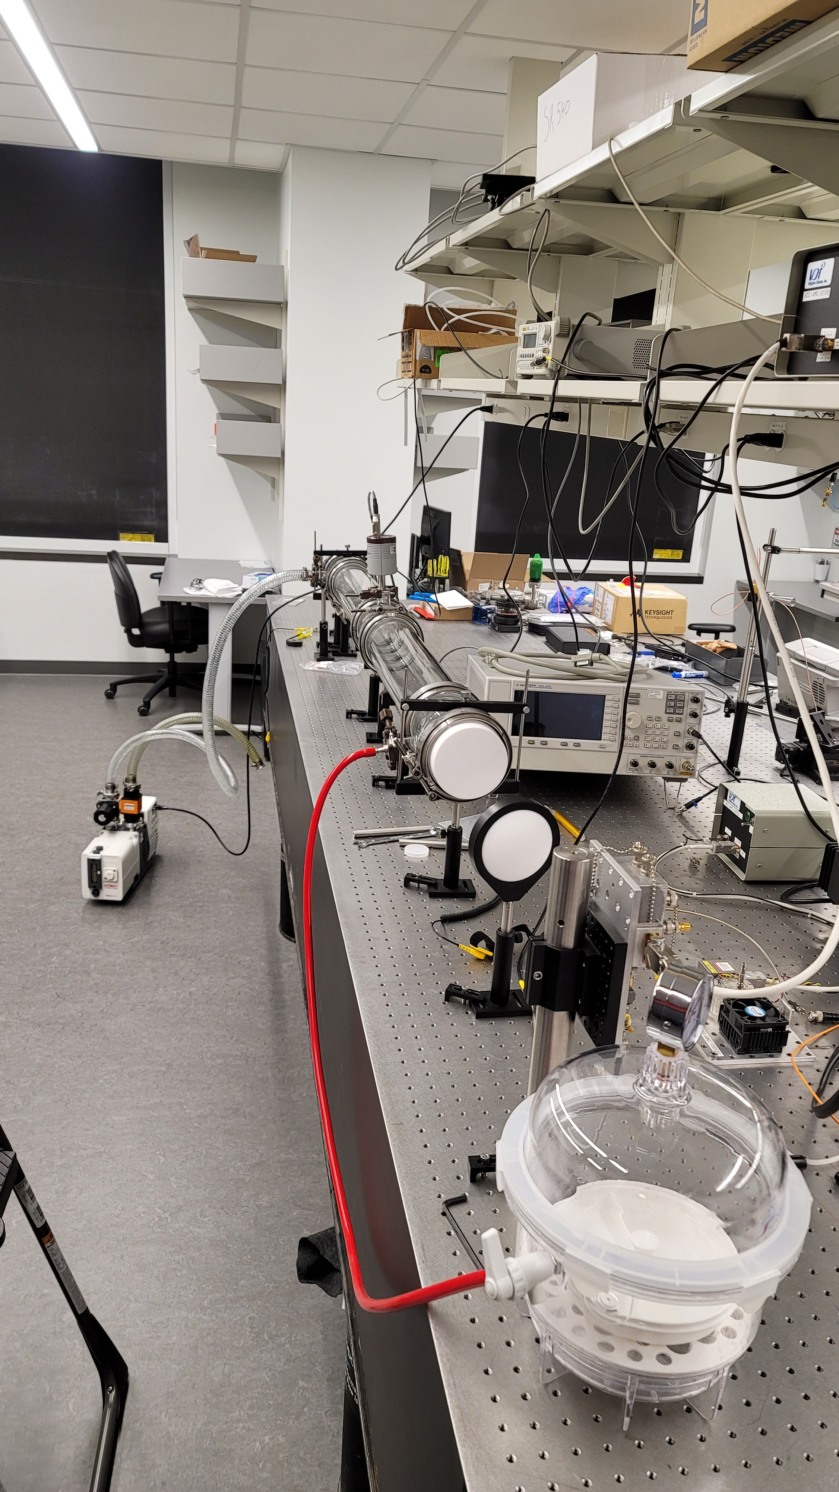
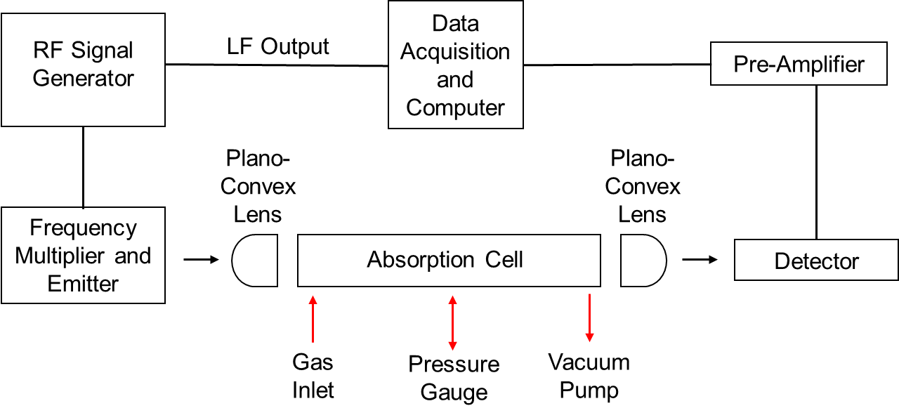
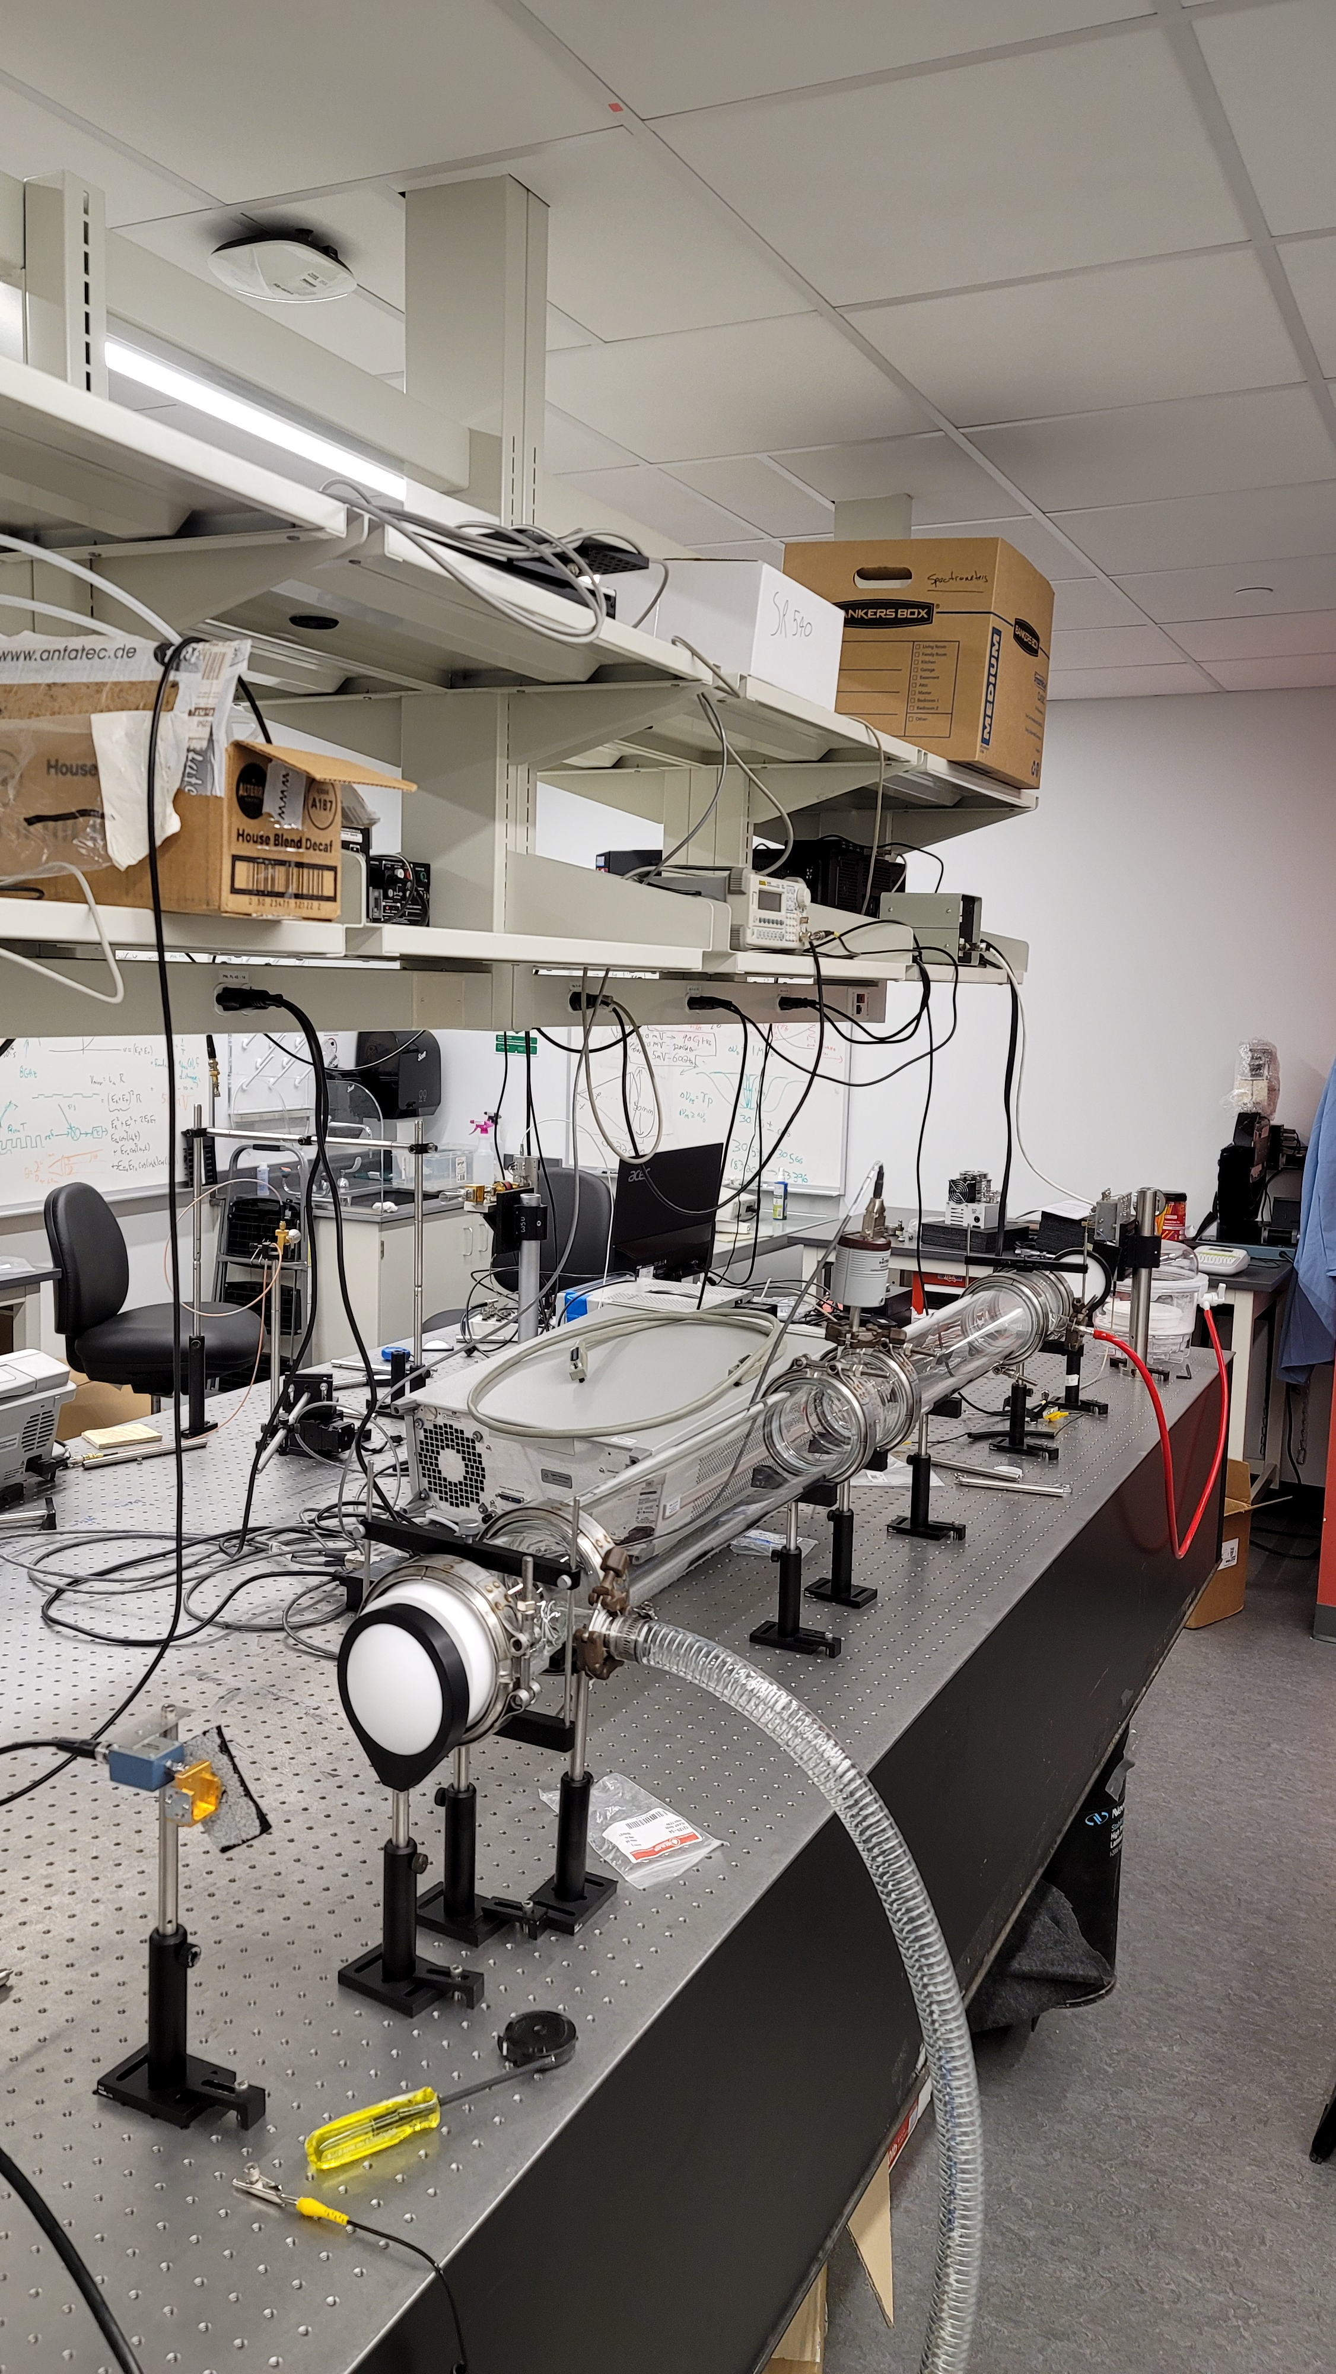





Terahertz Gas-Phase Spectroscopy
for Interstellar Applications
Kaitlin Mason (PH)
Advisor: Professor Douglas Petkie (Physics Department)
Abstract
Interstellar molecules are a significant resource that provide key information to characterize the interior of molecular clouds. Since these molecules are hundreds of lightyears away, samples cannot be taken to identify these molecules. However, molecular spectroscopy can be performed to determine spectral lines of known molecules on Earth to compare with the emission lines captured through radio astronomy. The goal of this project was to design and construct a gas-phase spectrometer utilizing terahertz radiation to measure the spectral line of water and glycolaldehyde, a common complex organic molecule found in the interstellar medium.
Methods
Acknowledgments
I would like to thank the WPI Physics Department’s Lab for Education and Application Prototypes (LEAP) facility for supplying the equipment for both the preliminary and final spectrometer set-up. I would also like to thank Professor Petkie for his guidance and insight throughout the project. Lastly, I would like to thank Jacob Bouchard for the countless hours spent in the lab with me taking measurements and the invaluable feedback provided throughout the project.
1
Build preliminary spectrometer to become familiar with equipment
2
Measure the spectral line of water to confirm system works
3
Design more comprehensive set-up and order equipment
4
Measure spectral line of water and glycolaldehyde with new system
5
Compare lab results with expected results to assess effectiveness of the new system
Results
Background
The terahertz (THz) region of the electromagnetic spectrum refers to high frequencies between 100 GHz and 10 THz or wavelengths between 3 mm and 30 um.
$${∆ν}_{Dopper}=0.531 MHz$$
$${∆ν}_{PB}=1.385 \text{± 0.017} MHz$$
THz radiation is the region of the electromagnetic spectrum where there is a peak in the interaction with the rotational energy levels in molecules with a permanent dipole moment that leads to 1) stimulated emission or 2) absorption.
Spectra taken between 183.204 GHz to 183.396 GHz. The absorption line of water was detected at 183.316 GHz as indicated on the left. The lineshape of the observed absorption line indicated on the right was fitted to a Voigt profile. The Doppler contribution corresponds to a Gaussian profile with a linewidth of 0.531 MHz and the pressure broadening contribution corresponds to a Lorentzian profile with a linewidth of 1.385 ± 0.017 MHz. The absorption line of glycolaldehyde will be measured and analyzed next.
Stimulated Emission
Absorption
$$J_{K_{a}K_{c}}=3_{1 3}$$
Spectrometer Set-Up
$$J_{K_{a}K_{c}}=2_{2 0}$$
Gas-phase spectroscopy is a branch of science that measures the emission or absorption of electromagnetic radiation by gas-phase molecules. THz is a powerful band for spectroscopy since many rotational and vibrational states of molecules exist in this frequency range.
To measure the absorption of THz radiation, the transmitted intensity after interaction is compared to the incident intensity by the Beer-Lambert Law:
$$I\left(ν\right)=I_{0}e^{−α\left(ν\right)L}$$

