Slide 1
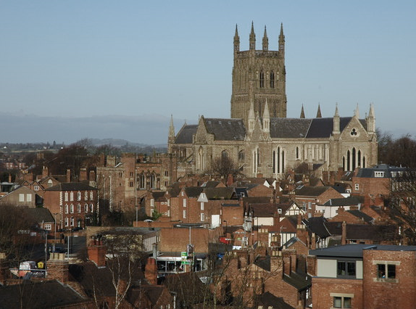
Raising Awareness About Carbon Literacy through Worcestershire Libraries
Team Members: Lauren Balukonis Adam Marsh
Amy Ngan Blake Pedersen
Advisors: Professors Fred and Linda Looft
Sponsors: Professor Katy Boom, University of Worcester
Dr. Stephanie Jones, The Hive
Notes:
Blake
Hello, we are the Carbon Literacy team and our project is *read title*.
Introduce team members, advisors, sponsors.

Slide 2
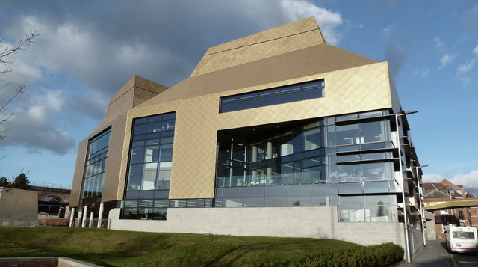
2
‘An awareness of the carbon costs and impacts of
everyday activities and the ability and motivation to
reduce emissions, on an individual, community and
organisational basis.’
Notes:
Amy
The definition of carbon literacy is *read definition*

Slide 3
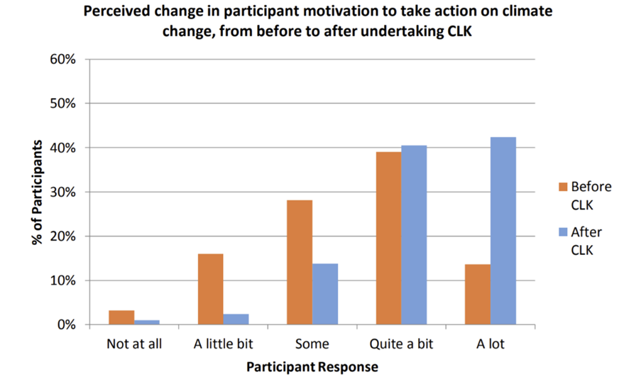
Carbon Literacy Training is Effective
3
Perceived change in participant motivation to take action on climate change, from before to after undertaking Carbon Literacy: Knowledge (CLK)
Notes:
Amy – Say Assertion
This graph presented here shows the perceived change in participant motivation to take action on climate change, before and after taking the carbon literacy knowledge, or CLK. CLK is a framework created to aid trainers in delivering the carbon literacy training. The response choices ranged from “not at all” to “a lot” The orange bars show the levels before the training. The blue bars are the values after the participants undergo the carbon literacy training. As you can see, the not at all section decreased while the percent of participants who want to act on climate change increases drastically. This shows that there is some effectiveness to a carbon literacy training, leading into our project goal statement

Slide 4
4
PROJECT GOAL
Promote carbon literacy in Worcestershire using library resources to help reduce the region’s carbon footprint.
Notes:
Amy
The goal of this project was to *read project goal*.

Slide 5
Documented Worcestershire library networks, demographics, and programs offered to the community
01
Identified library user interest in and knowledge about carbon literacy
OBJECTIVES
02
Researched how carbon literacy training could be delivered based on identified county needs
03
Piloted carbon literacy training and delivery method(s) a. Tailored training topics to the various populations b. Provided relevant feedback and testing information for further training improvement
04
5
Notes:
Lauren
In order to achieve our project goal statement, we have developed four objectives.
*read objectives*
The culmination of these objectives will lead to recommendations that can be given to our sponsors along with recommendations for future IQPs.

Slide 6
6
Methodology
Interviews
Surveys
Observation
Feedback Forms
Notes:
Adam
The following are the methods used to complete our objectives.
We interviewed the five library cluster managers in Worcestershire to gain knowledge on the demographics of the libraries and programs offered.
We travelled to multiple libraries in Worcestershire to observe the demographics and the physical areas of the libraries (i.e., the room space for training delivery)
We sent out surveys to LCAs and library users to gauge knowledge, demographics, and learning preferences.
We utilized feedback forms to gain information on how we can refine the trainings we created.

Slide 7
7
FINDINGS
Notes:
Blake
The completion of our methods resulted in the following findings

Slide 8
8
The Main Demographics in Worcestershire Libraries are Children and Older Aged Adults
Other (“Students”)
Children (1-14)
Retired Adults (60+)
Young Adults (15-22)
Working Age Adults (23-59)
Notes:
Blake
From our Interviews and Surveys, we have found that “assertion statement”.
The graph here is from the Library Customer Advisor survey and as you can see it backs up how children and older aged adults are the primary population of libraries.
The library user survey data, which is not pictured here, also supports this statement, with the majority of our responses favoring older aged adults.

Slide 9
9
The Most Popular times at Libraries are in the Morning and Mid-afternoon
7 AM - 12 PM
2 PM - 4 PM
Notes:
Lauren
Based on information from our manager interviews and data from our LCA survey, we determined the most popular times at the library were the morning (7am to 12pm) and the mid-afternoon (2pm to 4pm)
Specifically, about 47% of the 43 responses from the LCAs said morning and 28% said the mid afternoon was popular. Another time that received responses was from 12pm to 2pm with about 23%.

Slide 10
10
The Best Time to Deliver a Training is on the Weekend or Outside School and Working Hours
40%
27%
13%
Part-Time Workers
Parent
Full Time and Retired
Notes:
Lauren
According to our user survey, most of the users in the libraries are part-time workers, parents or full-time workers.
Part time workers accounted for 40%, 27% were parents, while both full time workers and retired population made up of 13%.
Using that data and combining it with the data from the previous slide we concluded that the best time to deliver a training is on the weekend or outside school and working hours.

Slide 11
11
The Preferred Training Structure is a Shorter Session
 | 30 min | 1 hour | Other | Total
LCAs | 16 | 13 | 2 | 31
Library Users | 9 | 5 | 4 | 18
Total | 25 | 18 | 6 | 32
Notes:
Adam
After interviewing the LCAs and reviewing the library users survey, our group came to the conclusion that the preferred training structure is a shorter session.
Out of the 31 LCA responses, just over 50% agreed a 30-minute session would be best, while 42% believed an hour would be sufficient.
For the library users, 50% agreed with the 30-minute session.
Using this information, our group decided on developing a training that was 45 minutes long, with a 15-minute buffer time for a Q&A and further discussion.

Slide 12
12
Library Users Learn in Different Ways
Audio
Visual
Interactive/Hands-On
Reading/Writing
Notes:
Blake
Library users were presented four options on what their preferred form of learning new information was in our surveys and the results showed that there is no single favorite learning method/method of learning.
Instead, all four options were split, so we incorporated into our deliverables.

Slide 13
13
There is Interest in Learning About Environmental Awareness
Notes:
Adam
Based off LCA survey’s and Manager interviews, we concluded that there was an interest in environmental awareness within the library demographics
However, to go further, we used our User Survey to conclude that there was then also an interest in learning about environmental awareness
Based off the chart, one can see that the majority of the users surveyed agreed to learning about climate change, individual impacts, and actions that help the environment

Slide 14
14
PILOT SESSIONS
Notes:
Lauren
Our findings are what drove to the creation of our pilot sessions
Our deliverables were two separate trainings delivered at the Hive @ 10 kick off event on Earth Day
Here we ran a total of four sessions, 2 adult and 2 family sessions, throughout the day
The sessions were run at:
10 am- Adult
11:15 am- Family
1:30 pm- Family
2:45 pm- Adult
These were decided based on our timeframe findings and conversations with our sponsors

Slide 15
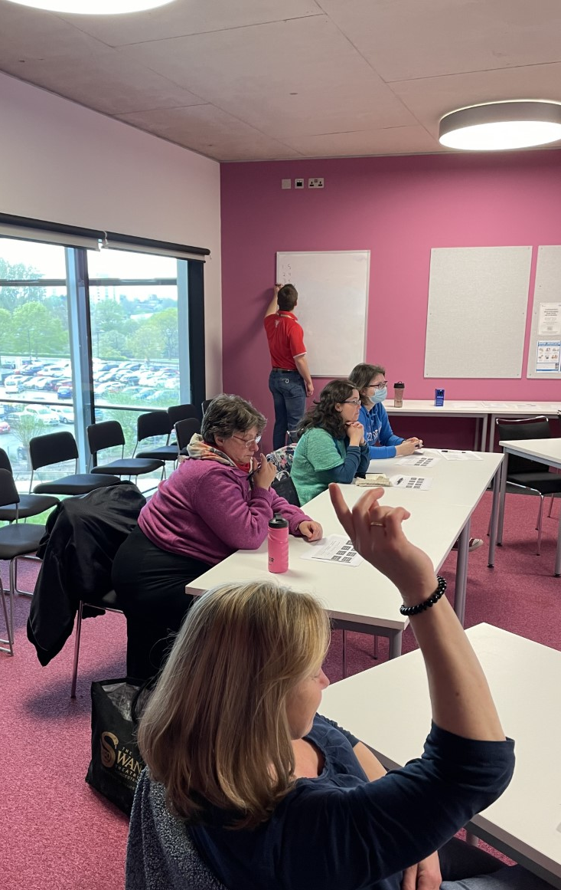
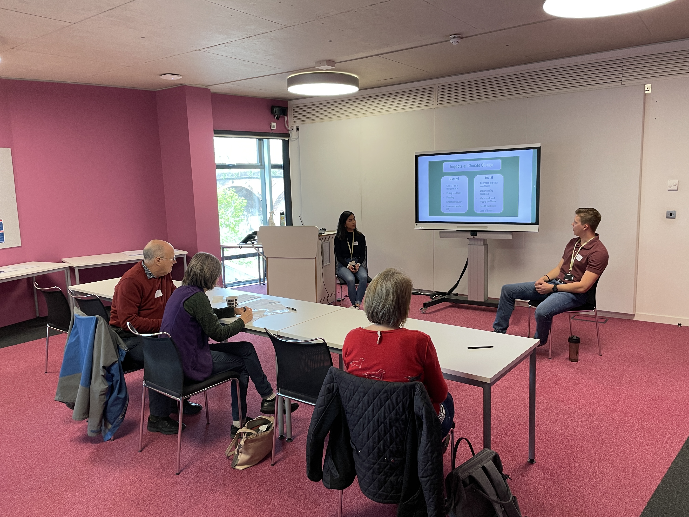
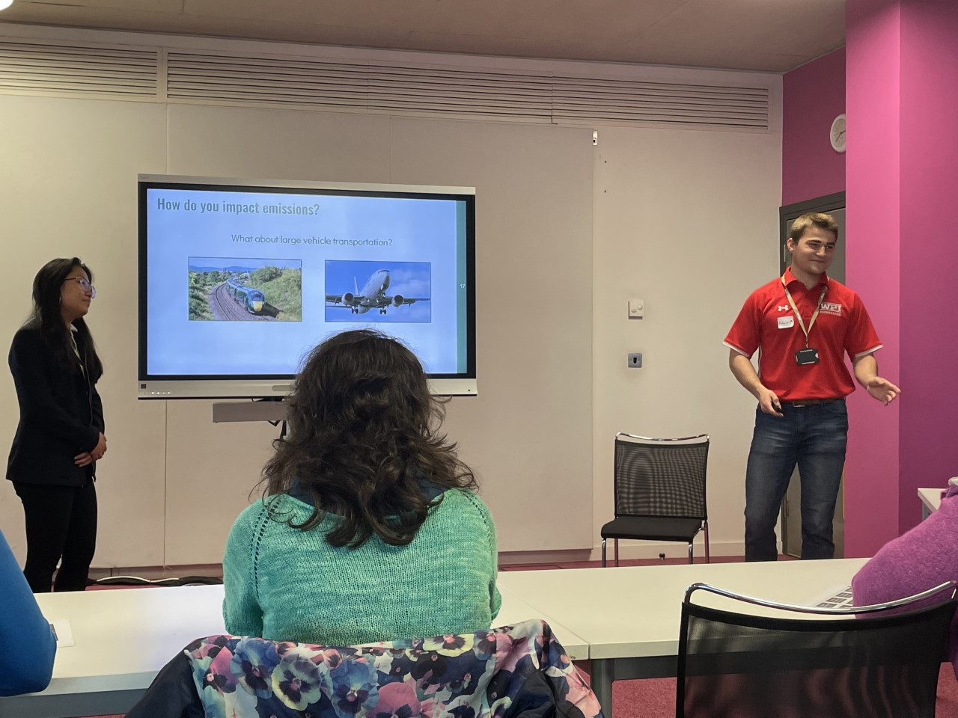
15
ADULT SESSIONS
Notes:
Blake
This session incorporated the four learning methods mentioned earlier where it was mainly a presentation that had videos and figures as well as interactives to engage the audience.
The topics covered in this session included GHG, global warming, the impacts of climate change, and what you can do about climate change.
The interactive activities included ranking actions to ensure a positive future, a carbon emissions food calculator, and a transport carbon emissions guessing activity.

Slide 16
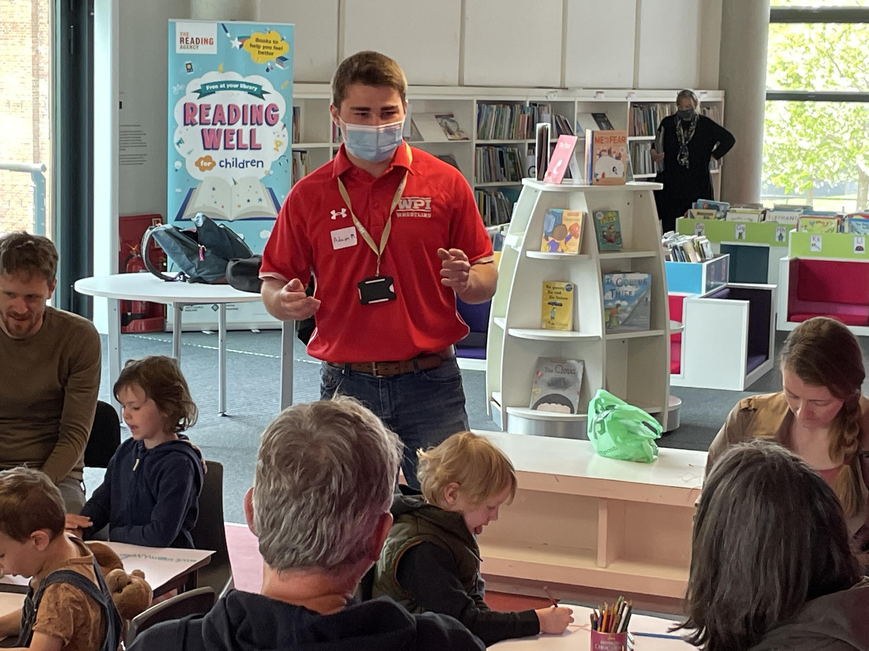
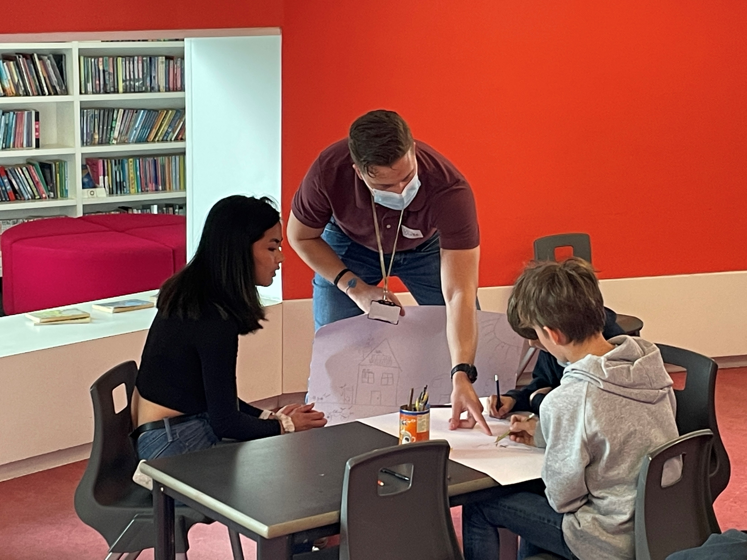
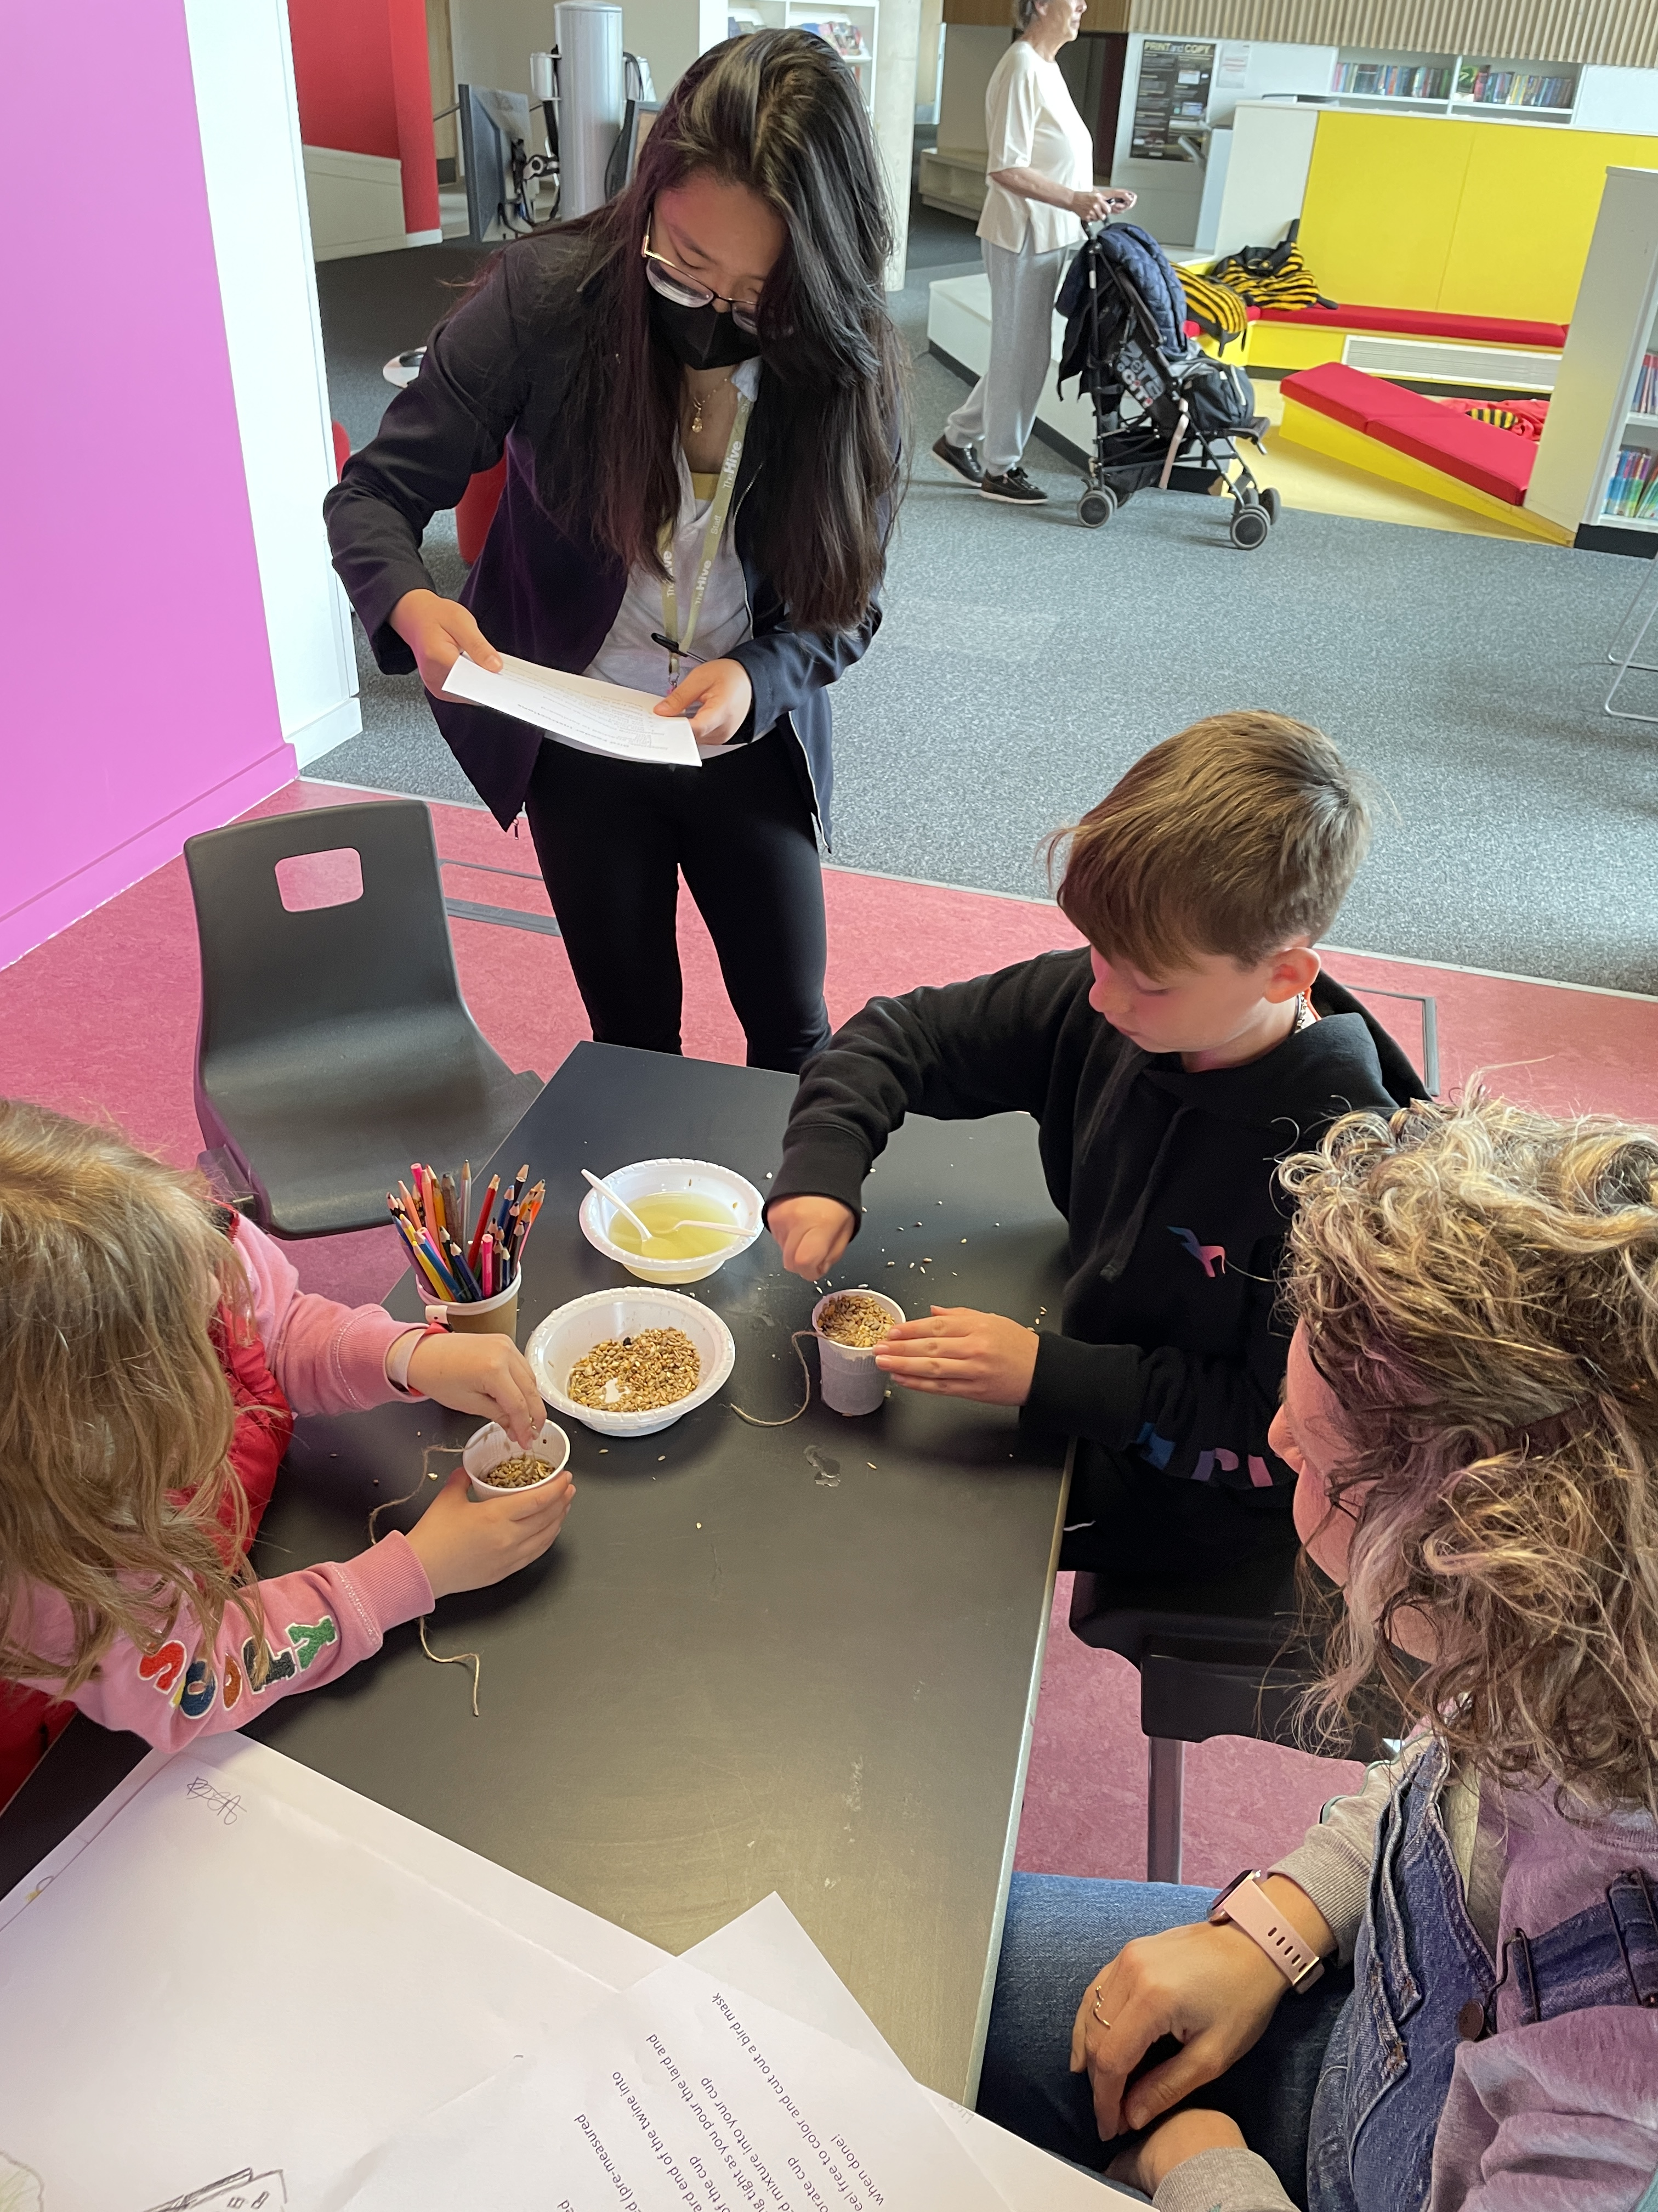
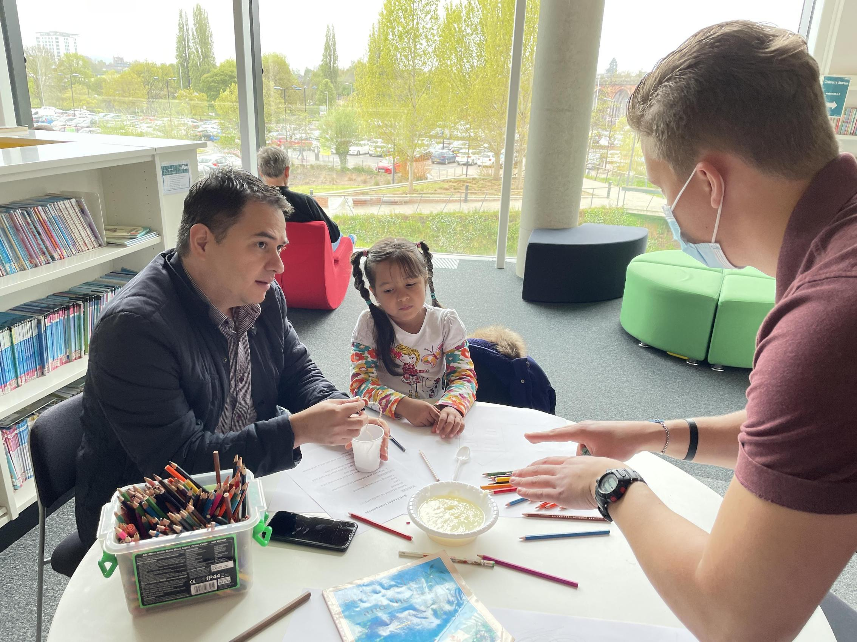
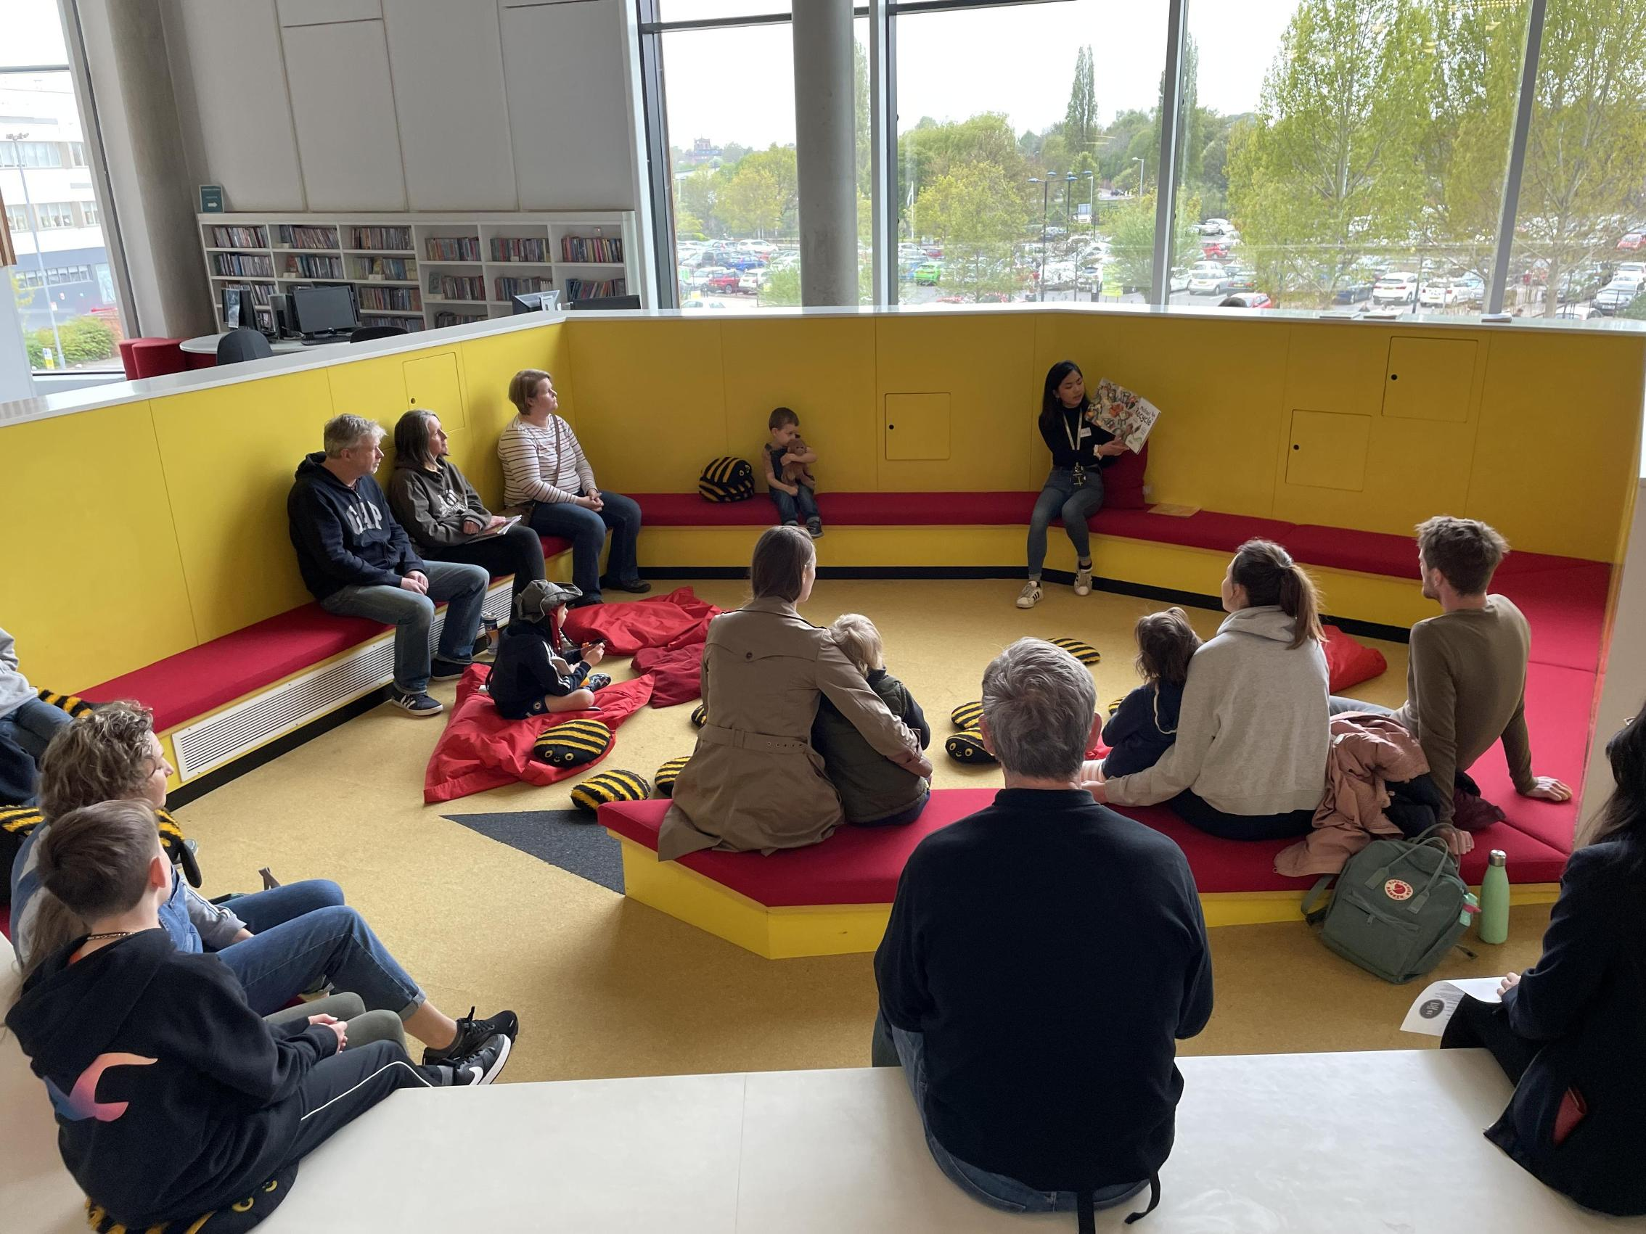
16
FAMILY
SESSIONS
Notes:
Adam
This session is designed to be an interactive conversation-type program.
Main challenge with kids is attention span -> split up into three parts
Breakdown of the session:
Icebreaker/storytime- Involved a story about recycling and icebreaker questions about Earth Day
Drawing activity- We had the kids draw objects that had positive effects on the environment
These objects included:
Electric Cars
Solar panels
Composting
Trees
Recycling bin
Arts and Crafts- We concluded the session with a birdfeeder craft where the kids made bird feeders using recycled cups and cardboard. This was to teach them about the importance of recycling and reusing objects.
Gave out a form to assess how well the kids absorbed knowledge and what the parents thought of the session

Slide 17
Feedback from Pilot Sessions
17
Adult Session:
Family Session:
Well Organized Content
Interesting Activities
More statistics
Include more personal actions
Drawings and crafts were a big hit
More physical activities and varied crafts
Children-friendly video
Notes:
Blake
Adult Session:
Content was well organized, but could go into further depth on the topic
It was mentioned that the participants believed that if we included how much each action affected the positive future in the activity then it would be more impactful. This can be put in a graph or figure, which the participants also wanted more of.
Activities, specifically the food calculator were interesting
Include more personal actions: The positive future activity had large broad actions that need to be taken as a society but it was commented by participants that they would have also liked to see a slide where more personal and immediate actions were listed. In other words, they wanted a slide that mentioned the smaller actions that they can do in their life right now.
Family Sessions:
Overall, a positive response and children/families really enjoyed the event
It was expressed that more physical activities such as dancing or singing were wanted.
Live drawing versus a premade one
Varied crafts such as painting or experiments
Planting seeds, composting, sorting recyclable material
Including a video that explained climate change to the kids

Slide 18
18
Recommendations
Develop partnerships with other organizations
Focus on promoting the training sessions
Offer the accredited training as a further option
Deliver and Pilot Trainings
Notes:
Amy
Develop partnerships with other organizations
For example, partnering with scouts give them the opportunity to take and conduct the trainings themselves. Also, teachers and instructors can take the training created and implement them in their own classroom lectures. This would help with expanding carbon literacy, teaching children at a young age, with the hopes that they can take the knowledge and carry out basic sustainable practices in their everyday lives. Working with nonprofit organizations could also do the same.
Work on Promotion
As a further recommendation, we believe that it is important to focus on promoting the training sessions and try to develop a more efficient way to reach the public. We found it as a disadvantage that in our experience, only being able to use social media as a form of surveying and event promotion. We received a low number of responses and sign-ups due to this. Further promotion could include posting the sign-up links to the training in areas that are easily accessible, ensuring that the links work, and placing flyers and posters up weeks in advance.
Deliver and Pilot Trainings
Since this project concluded with our team only piloting the trainings at the Hive, our recommendation for the future would be to pilot the trainings throughout the county and gather feedback for further training improvement.
Offer the accredited training
Our recommendation would be to figure out a way to implement/offer the accredited Carbon Literacy training from the Carbon Literacy Project within the Worcestershire libraries. Like stated before, one person mentioned that they were already aware of some of the content, so having the accredited training available would have been more helpful to them. As of right now, the only option to further carbon literacy education outside of the University of Worcester is the paid training through the CLP website. We believe that making the accredited training free and easily accessible is essential to promoting carbon literacy in Worcestershire

Slide 19
19
ACKNOWLEDGEMENTS
The Carbon Literacy Team would like to thank the following people for their guidance and resources on our project:
Professor Fred Looft (Worcester Polytechnic Institute)
Professor Linda Looft (Worcester Polytechnic Institute)
Professor Katy Boom (University of Worcester)
Dr. Stephanie Jones (The Hive)
Notes:
Amy
Thank the people.

Slide 20
THANK YOU
20
gr-uk22-cl@wpi.edu
Notes:
Blake
Any questions?

