Slide 1
This work was produced by undergraduate students in the Worcester Polytechnic Institute (WPI) Global Projects Program. For more information:
http://www.wpi.edu/academics/ugradstudies/projectlearning.html
Sample Tabletop Evacuation Scenario
[Target Group]
[Facilitator]

Slide 2
Activity Purpose
Written here. You may also include images with labels of documents and maps given out to the participants.

Slide 3
1. You can have more or less than three
2. You can duplicate these boxes to make more
Primary Goals
3. You can also change the background

Slide 4
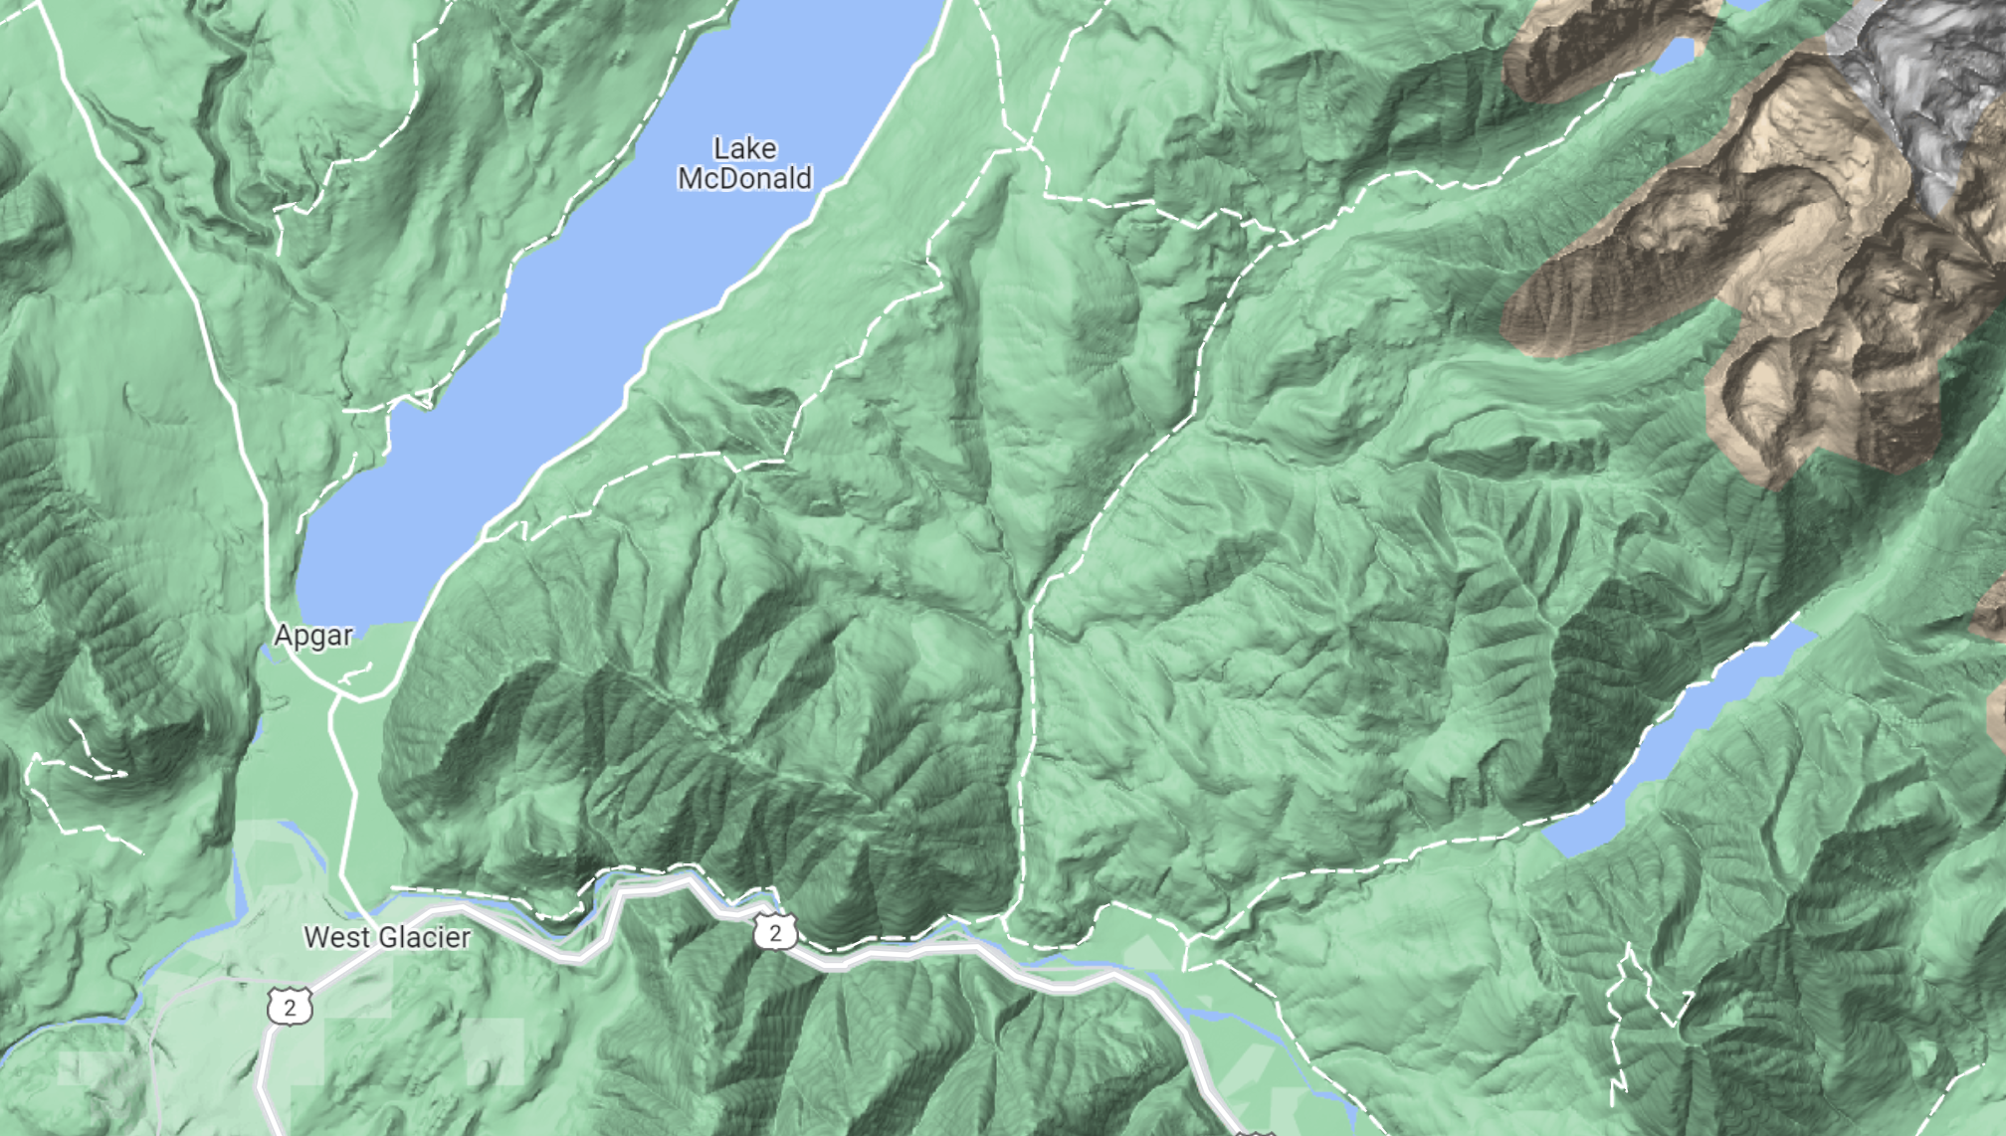
*You can link boxes to slides in the PowerPoint. Click this box to access the Attention Slide
*If you want to draw fire boundaries, navigate to the Draw tab. You can use ‘Ink to Shape’ to move or resize the line

Slide 5
Additional maps and figures can go here!

Slide 6
*This icon is also a link; this will return you to slide 4
ATTENTION

