Slide 1

How to Produce The Floating City
From VE23-STORY: Jared Bailey, Jillian Crandall, Sam David, Nick Leslie, Hayden Padula

Slide 2

Welcome to THE PROJECT
The Floating city is a documentary series made for the Venice Project Center’s 35th anniversary. It will be an arduous, yet satisfying task if you are able to organize yourself.
Godspeed,
V23E-Story Team

Slide 3
Passwords
Equipments
Need to Know Info
Softwares
Subscriptions
Accounts and Passwords Doc
Equipment Guide Sheet
-DaVinci (Editing Software)
-ArcGIS StoryMaps (Story-Boarding Software)
Artlist.io
$60 per month, split this cost amongst the team

Slide 4
PQP/Preparation Phase Objectives
Pick 5 episode topics from this list of topics
Research for those 5 topics
Make 5 Story Maps based on research
Create more interview questions
Schedule interviews (ex: with former sponsors and Alumni)
Create a script for each topic using outline
Categorize projects after 2018 in masterlist
Workshop 35th anniversary celebration

Slide 5
IQP/Execution Phase Objectives
Record and Edit video episodes
Standardize Social Media and Create a Brand Guide for the series
Execute 35th anniversary celebration

Slide 6
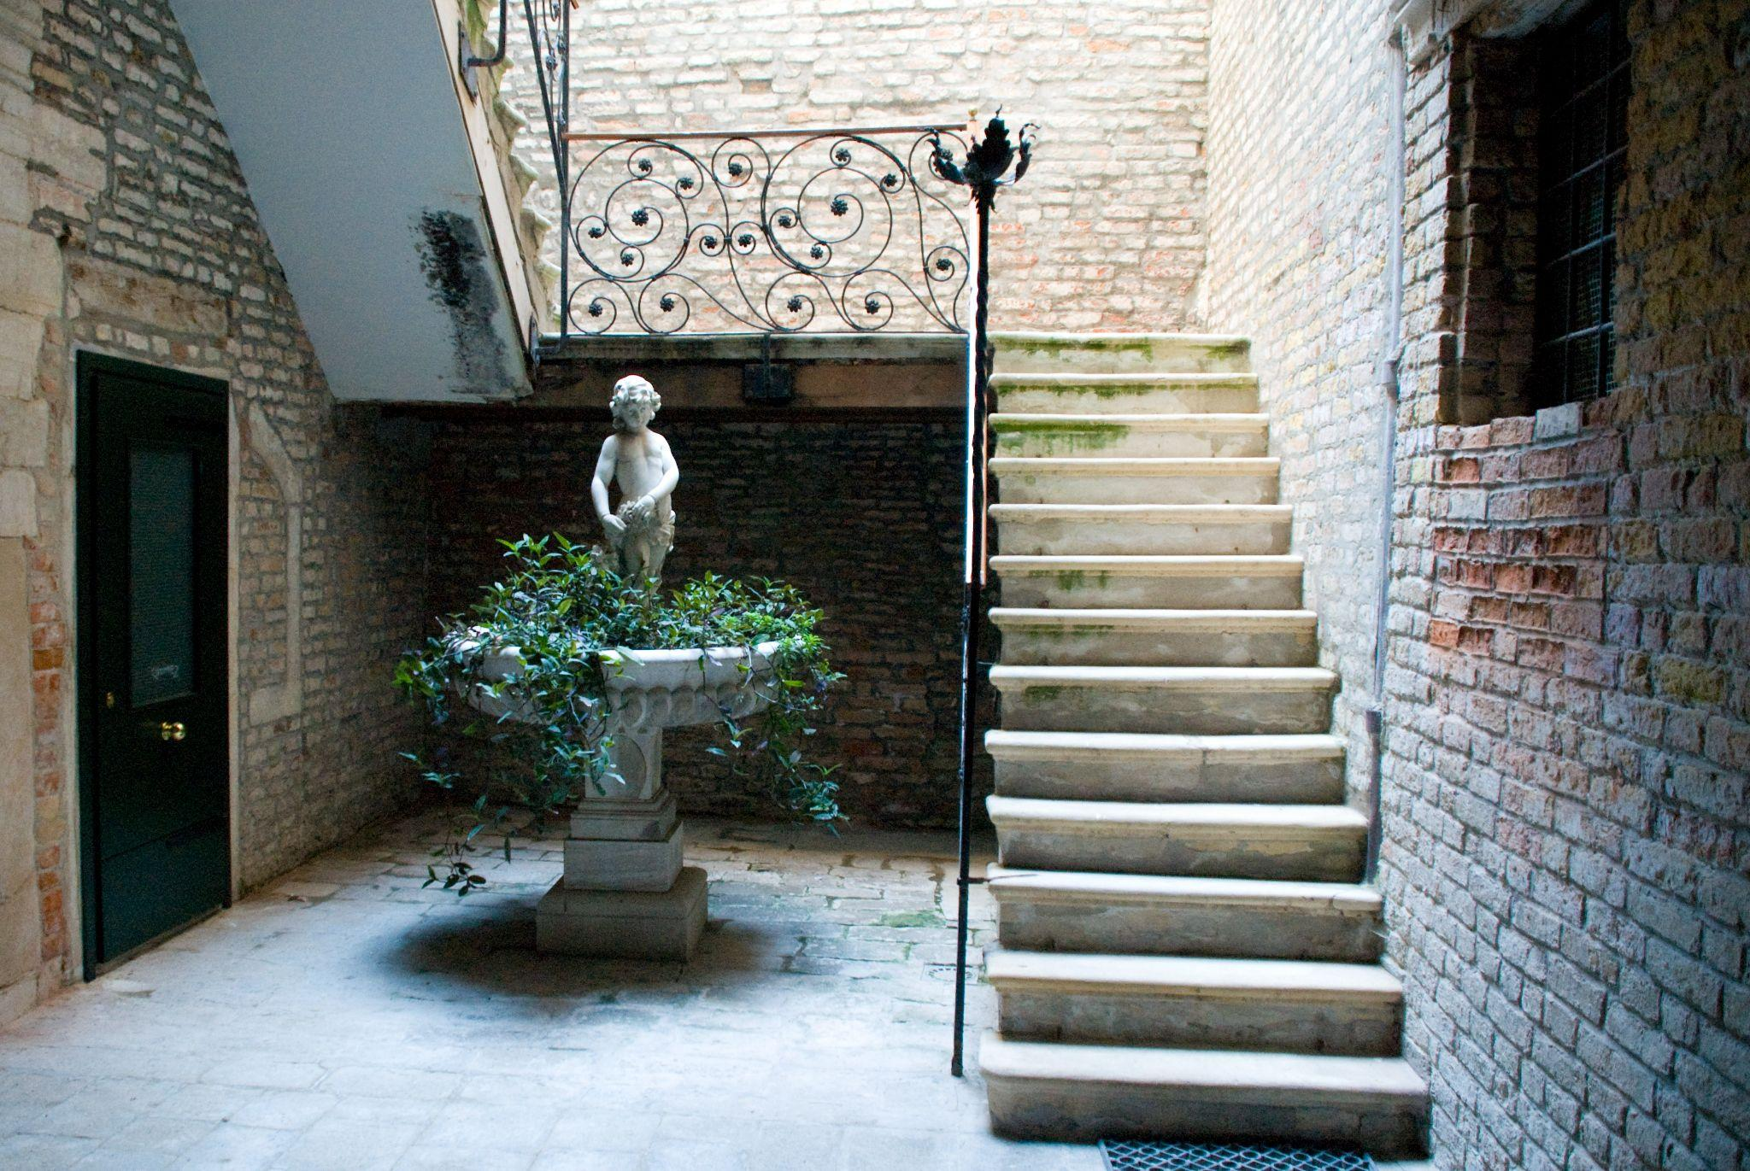
To Be Done by 1st Week of PQP
Schedule a time to meet up for every day
Create your project gmail and alias
Login to the Venice Project Center Gmail (You will need this immediately)
Access V23E Folders
  doc series, how to guides, Material lists, budget tracking, production calendar
Login into ArcGIS (To learn how to use and login click here)
Notes:
ArcGIS: https://docs.google.com/presentation/d/1BAJcY8S26p8Yz7XrVNkYiVzNChiFQtkNDVGrEiVGXR0/edit?usp=sharing

Slide 7
To Be Done In PQP
Contact Global Labs for Equipment Training
  Email: gr-global-lab@wpi.edu
  Get Audio and Camera Training
  Be prepared to schedule 4 meetings over the term
Get used to Story Maps
Contact ATC about borrowing equipment*
*Equipment does not need to be borrowed until the week of the end of PQP but you should know what the process is, what is available to you, and what you need to do to get it
Notes:
Global Labs: https://global-lab.wpi.edu/

Slide 8
About the ATC
We borrowed multiple things from the ATC. The ones that came most in handy were:
-Lapel Mics (Used in addition to the VPC’s DJI mic recorders. The VPC does not have any and it allows for direct audio recording of a interview or narrating subject without the DJI recorder dragging down their clothes)
-Phone Stabilizer (used to create level composition)
Notes:
Global Labs: https://global-lab.wpi.edu/

Slide 9
Groups of 2
Recording
WORK LOADS
Editing
Groups of 1-2
All
Posting
Recording B-Roll and sponsor interviews
Editing is mostly a one person job, but if 2 people are working on one episode each and supporting each other it becomes very productive
Everyone should be part of creating the brand guide and standardizing the approach of posting videos

Slide 10
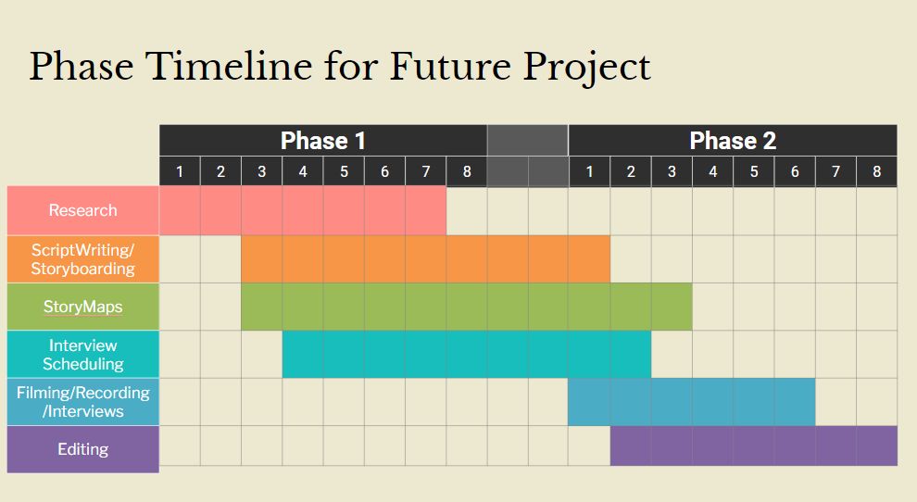

Slide 11
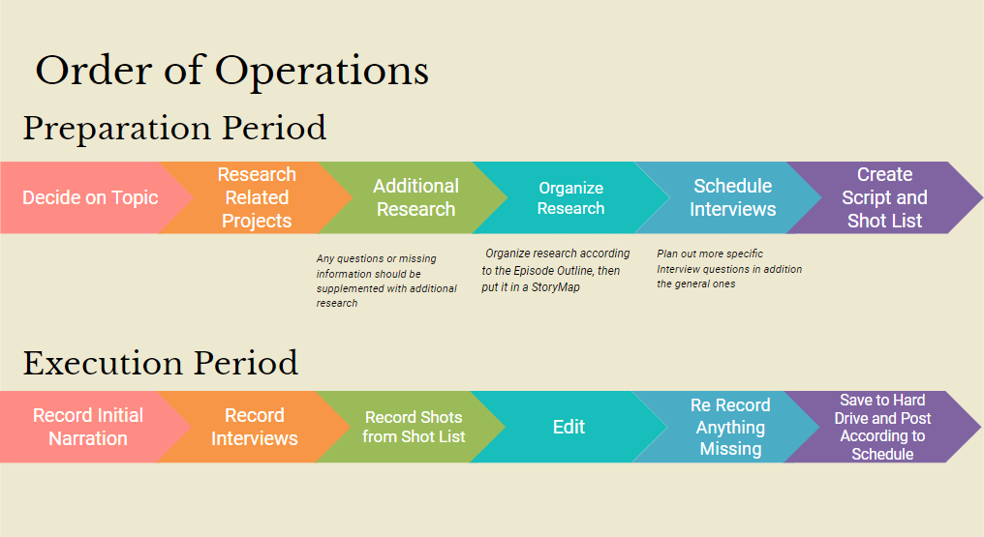

Slide 12
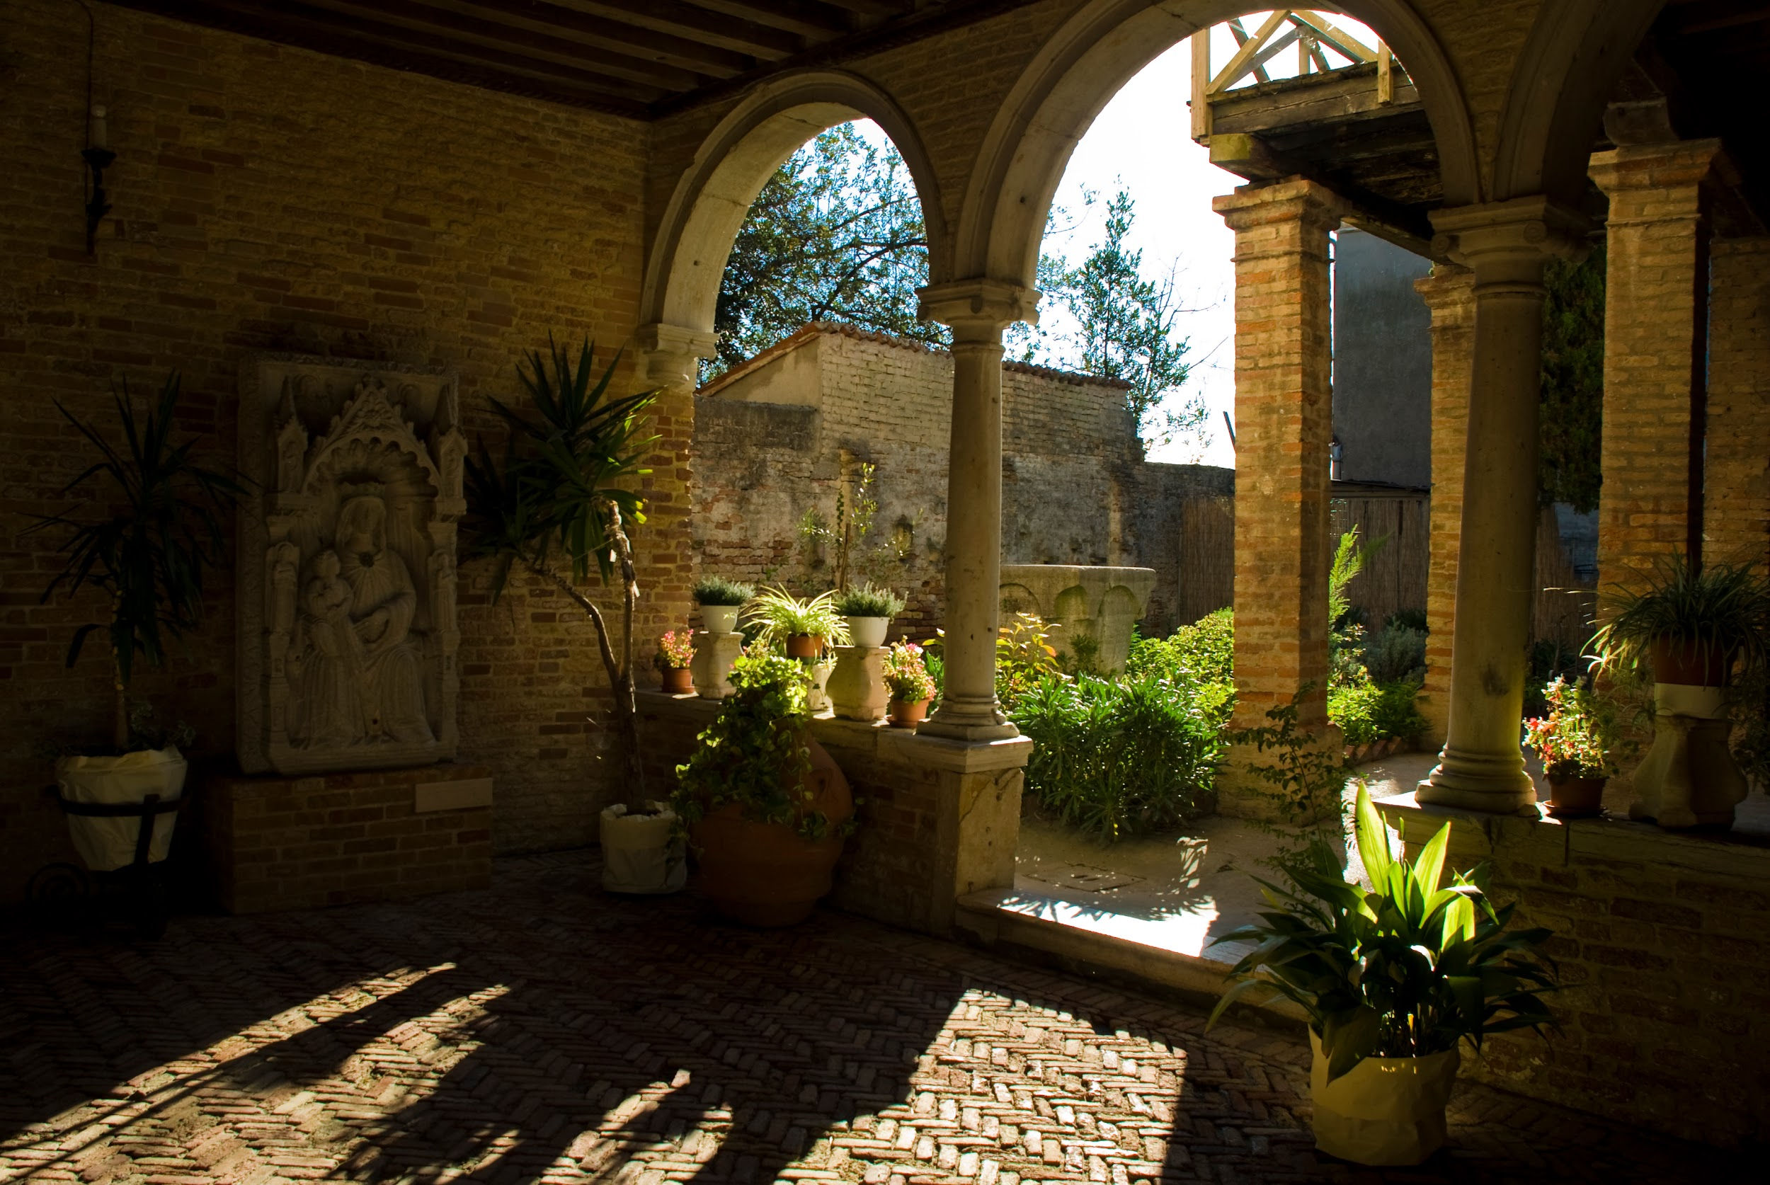
Notes for the Future
Have your own version of equipment that needs to be shared with other groups.
  You will have to share VPC Equipment with others (ATC helps getting this)
Masterlist linked in doc does not have the links to the IQPs through digital WPI. If you use this, some projects have the links but not all. Make sure you add the links to all projects on the new masterlist yourself.
Do not use “WPI jargon” in the scripts of the videos. Use the IQPs as a guide for the content of the episodes, but do not make them the focus. See our traditional boat episode script for an example of this.
An introduction for each episode has already been created and should be accessible through the Google Drive or hard drive.

Slide 13
Work Flow
Pick Topic
Research related IQPs
Research questions and updated data from IQPs
Outline research using Outline
Place all information and details into StoryMap
Contact and schedule interviews with relevant figures
Use interview questions and plan out more specific and pertinent questions related to specifics
Use outline to make script and shot list
Record non dependent lines
Record interview
Record shot list
Edit
Re-record new lines and shots
Redit
Save to hard drive
Create posting schedule

Slide 14
Posting
Video Posting should not happen until there is a good understanding of your work pattern
General updates about the VPC and hints to the videos on FB and IG until you were able to start posting videos
You should have at least two videos done for every one you post so that if something happens there is still consistent posting
Updates on IG and FB can be about old VPC stuff or current projects

