Slide 1
Climate Change Narratives for The Indonesian Village
Nick Odell Chloe Sairs Sam Kelly
Notes:
Nick
Introduction

Slide 2
We Acknowledge
the traditional owners of this land
Notes:
Nick
General

Slide 3
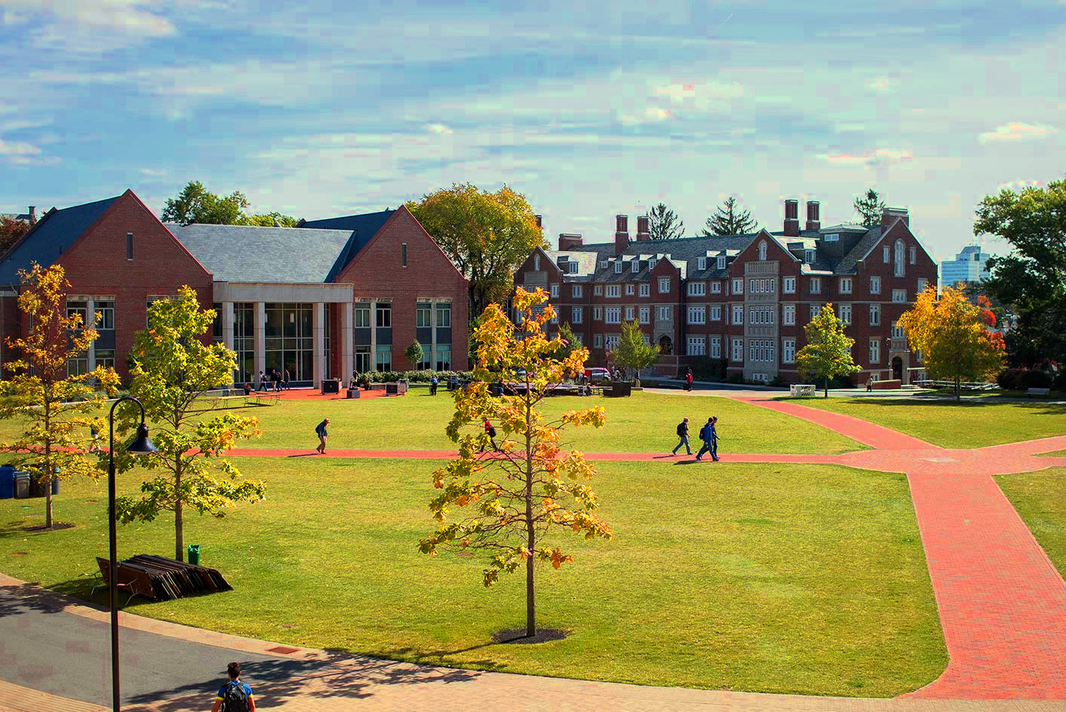
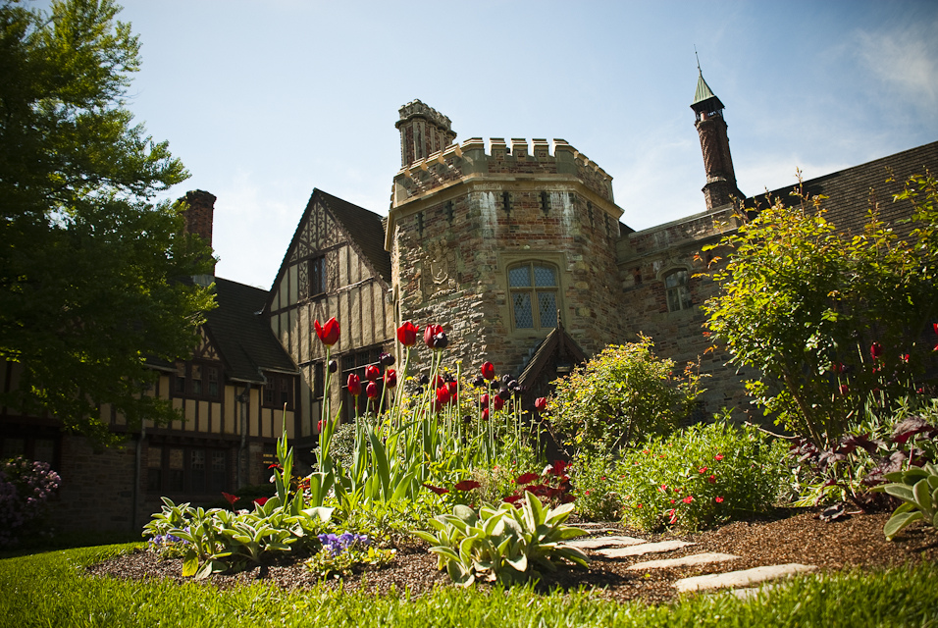
Worcester Polytechnic Institute
Notes:
Nick

Slide 4
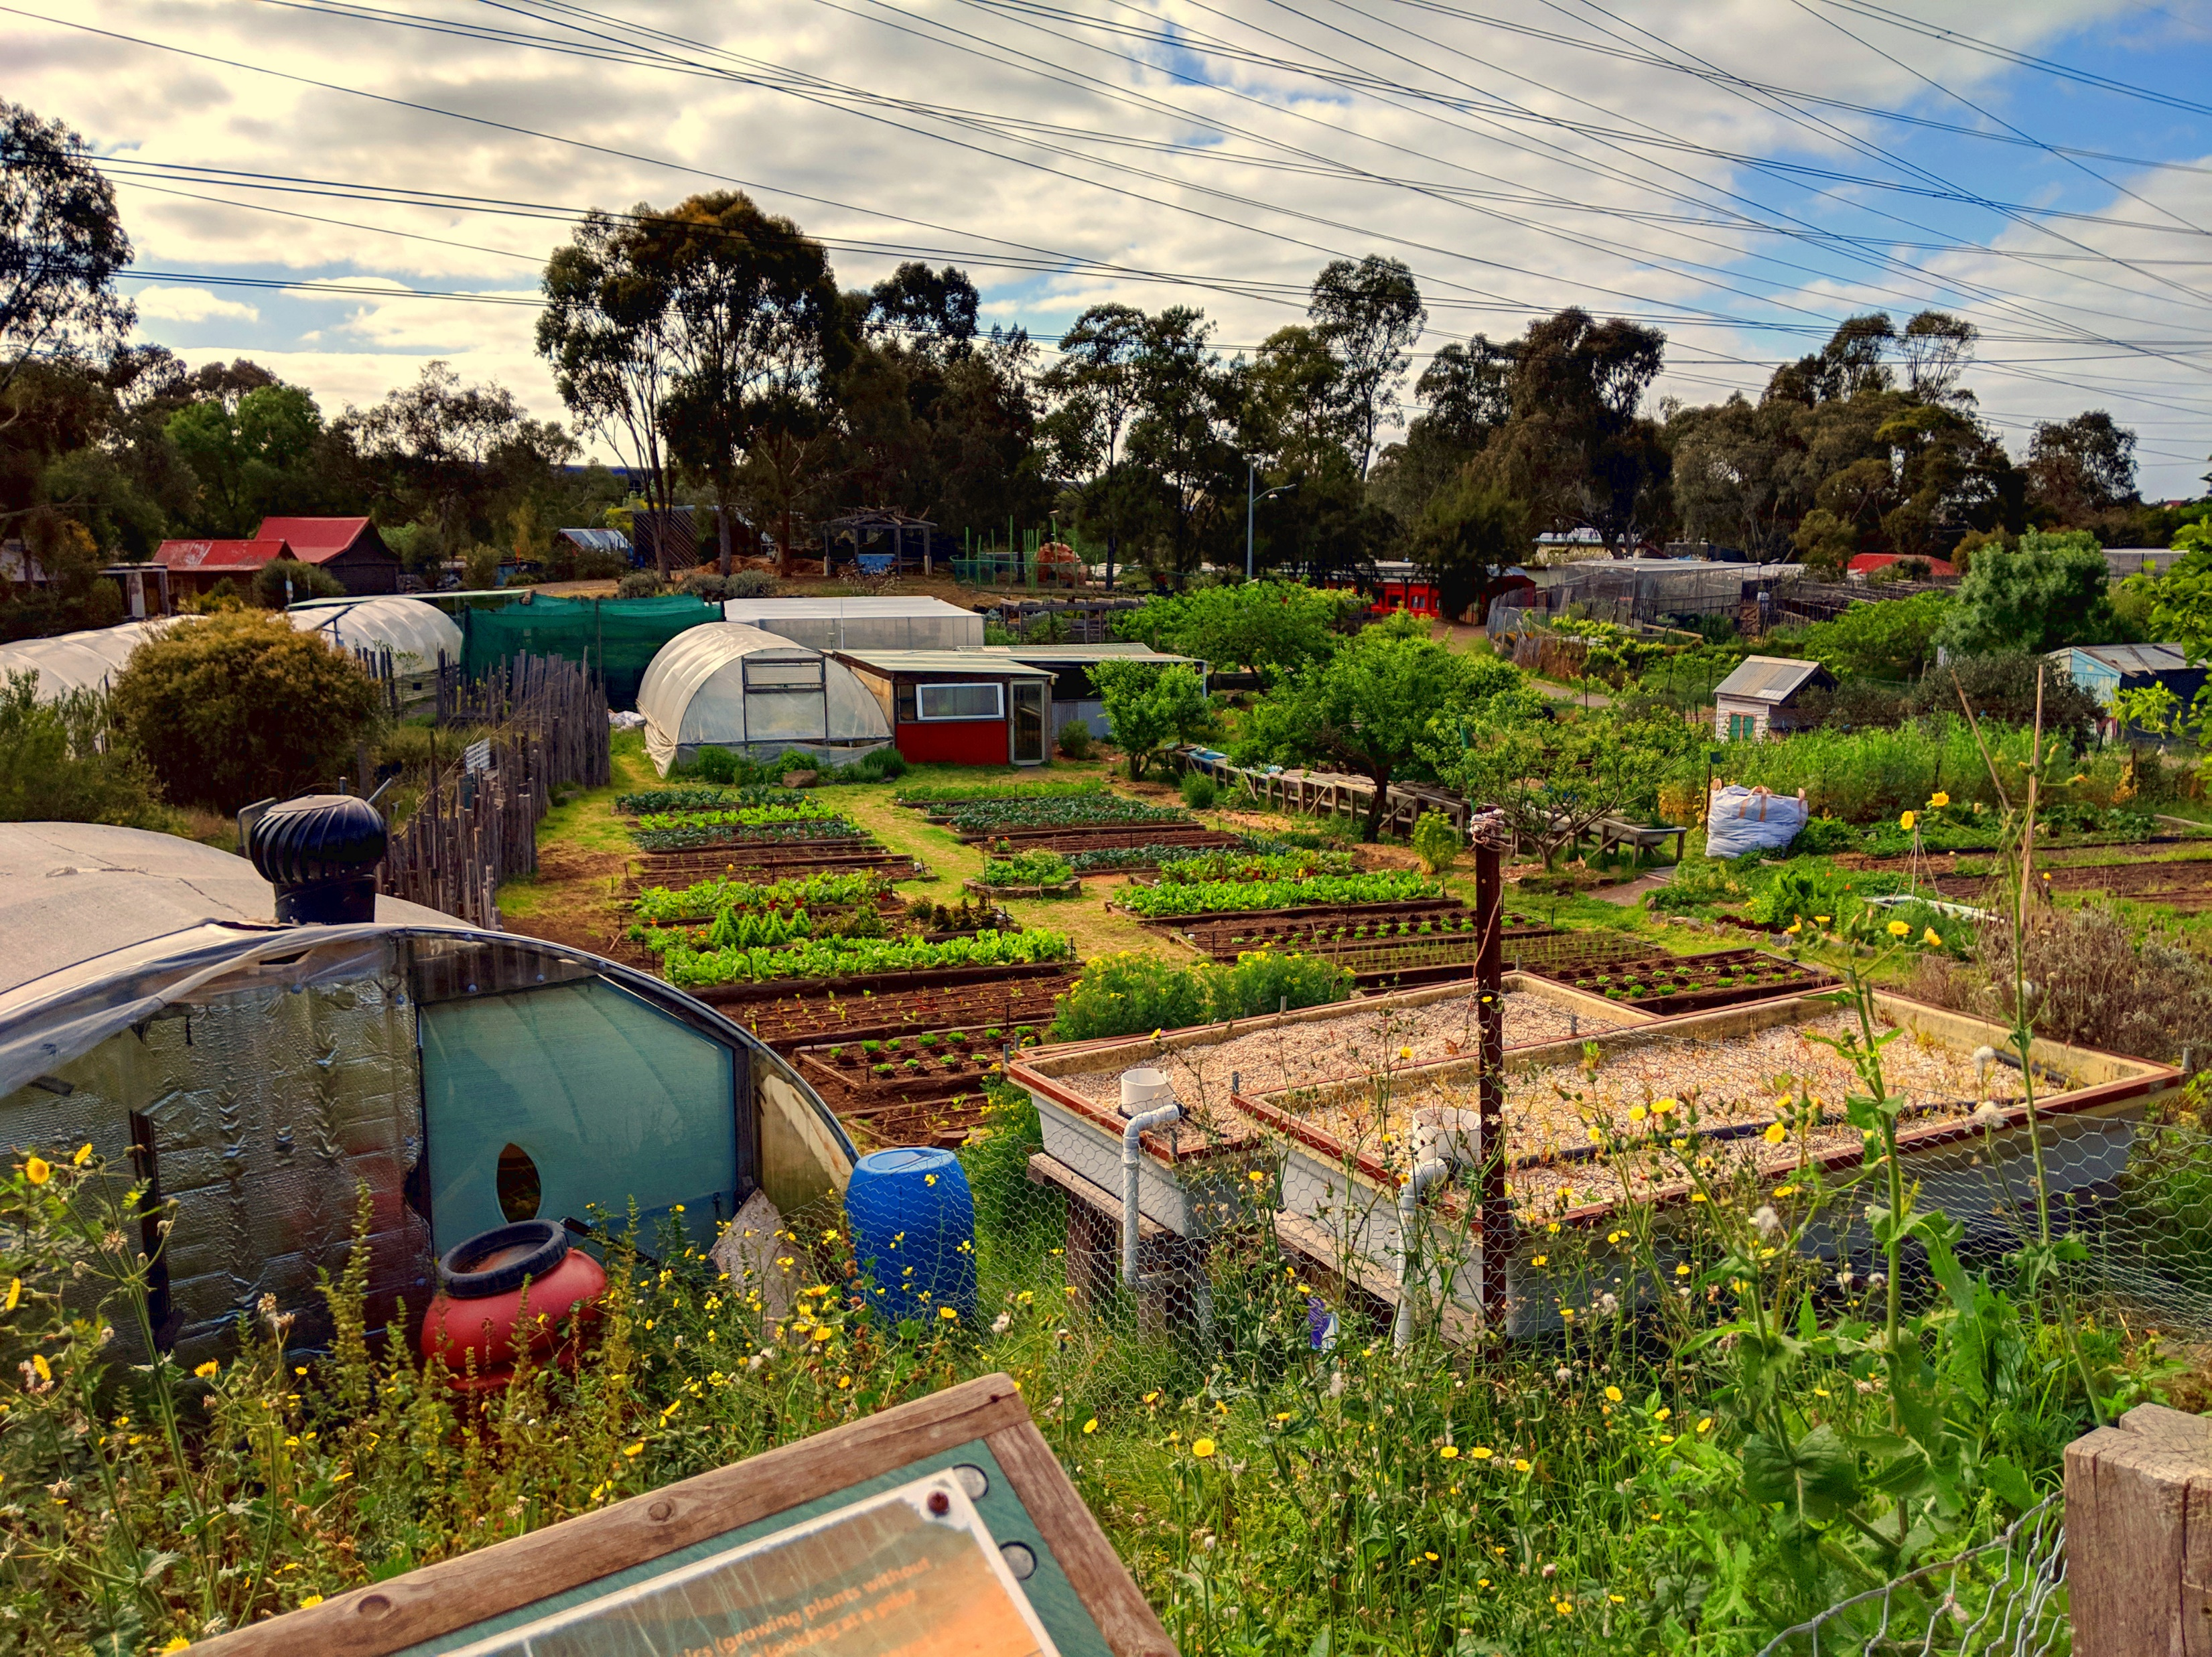
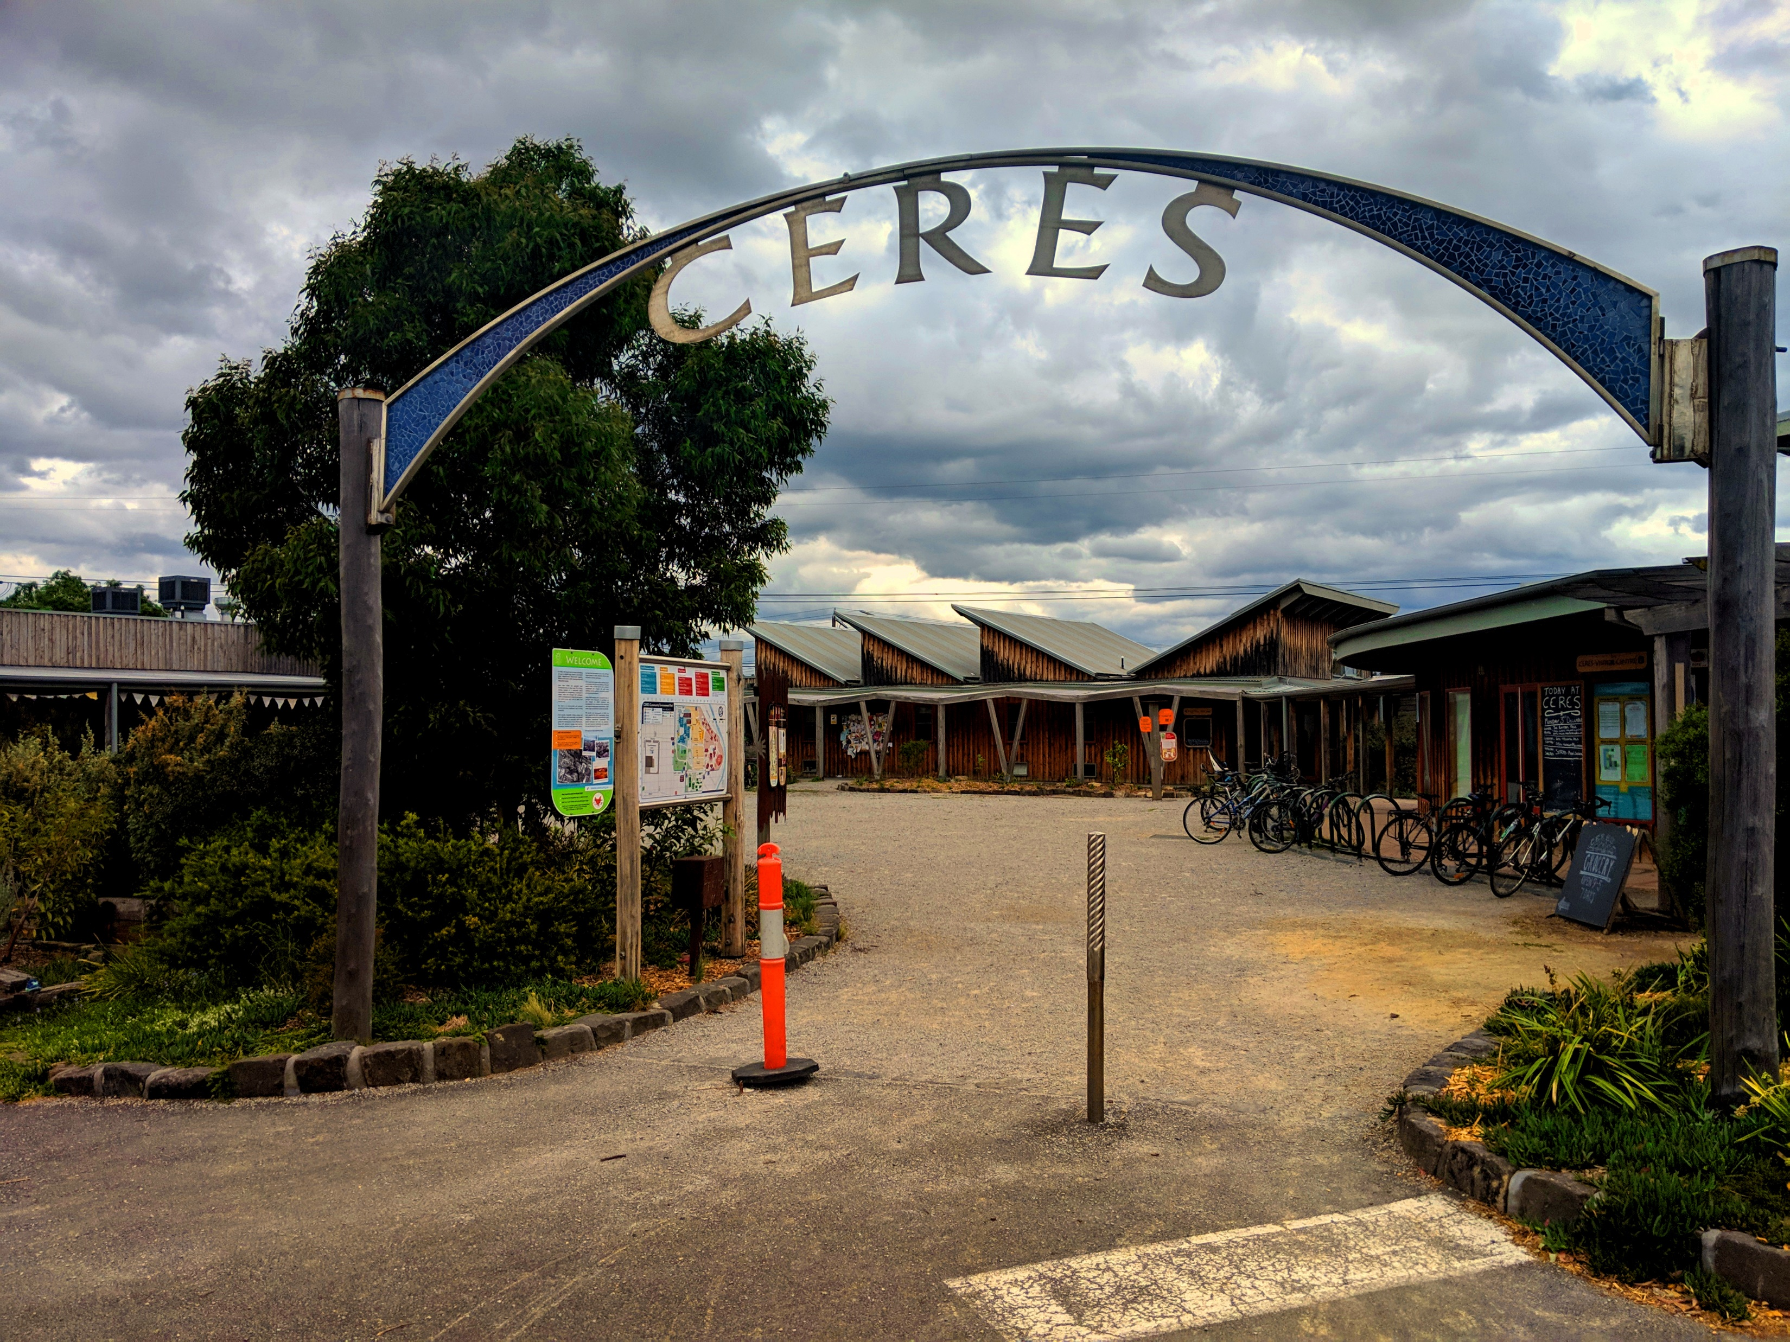
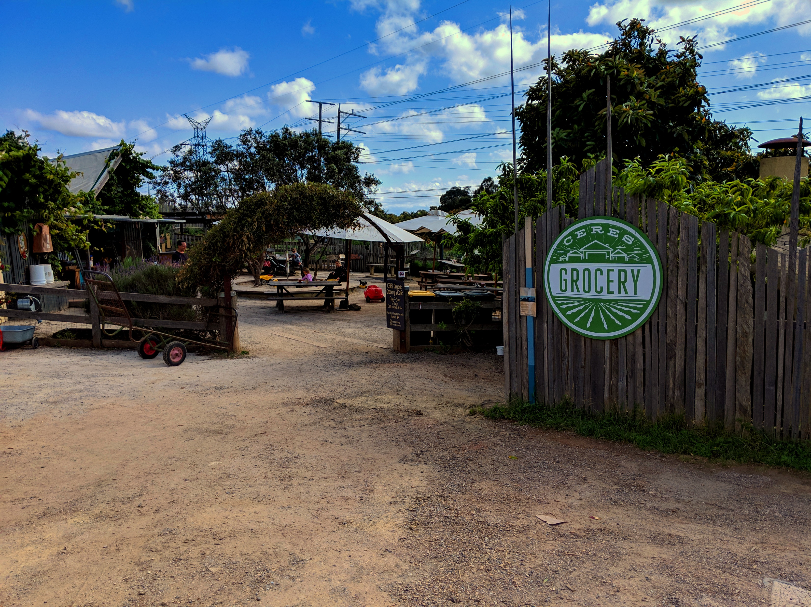
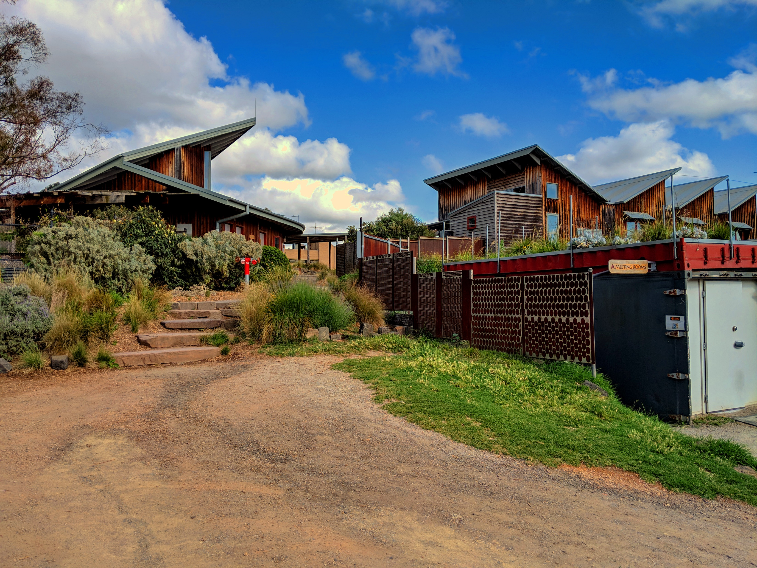
CERES
Centre for
Education and
Research in
Environmental
Strategies
Notes:
Nick

Slide 5
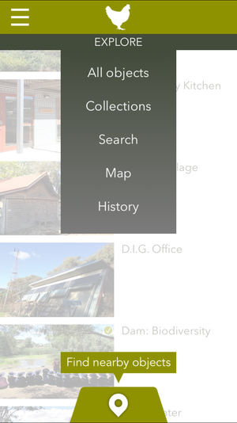
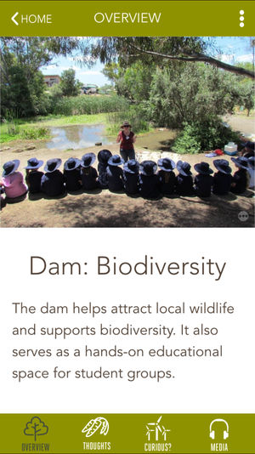
The Chook App
Notes:
Nick

Slide 6
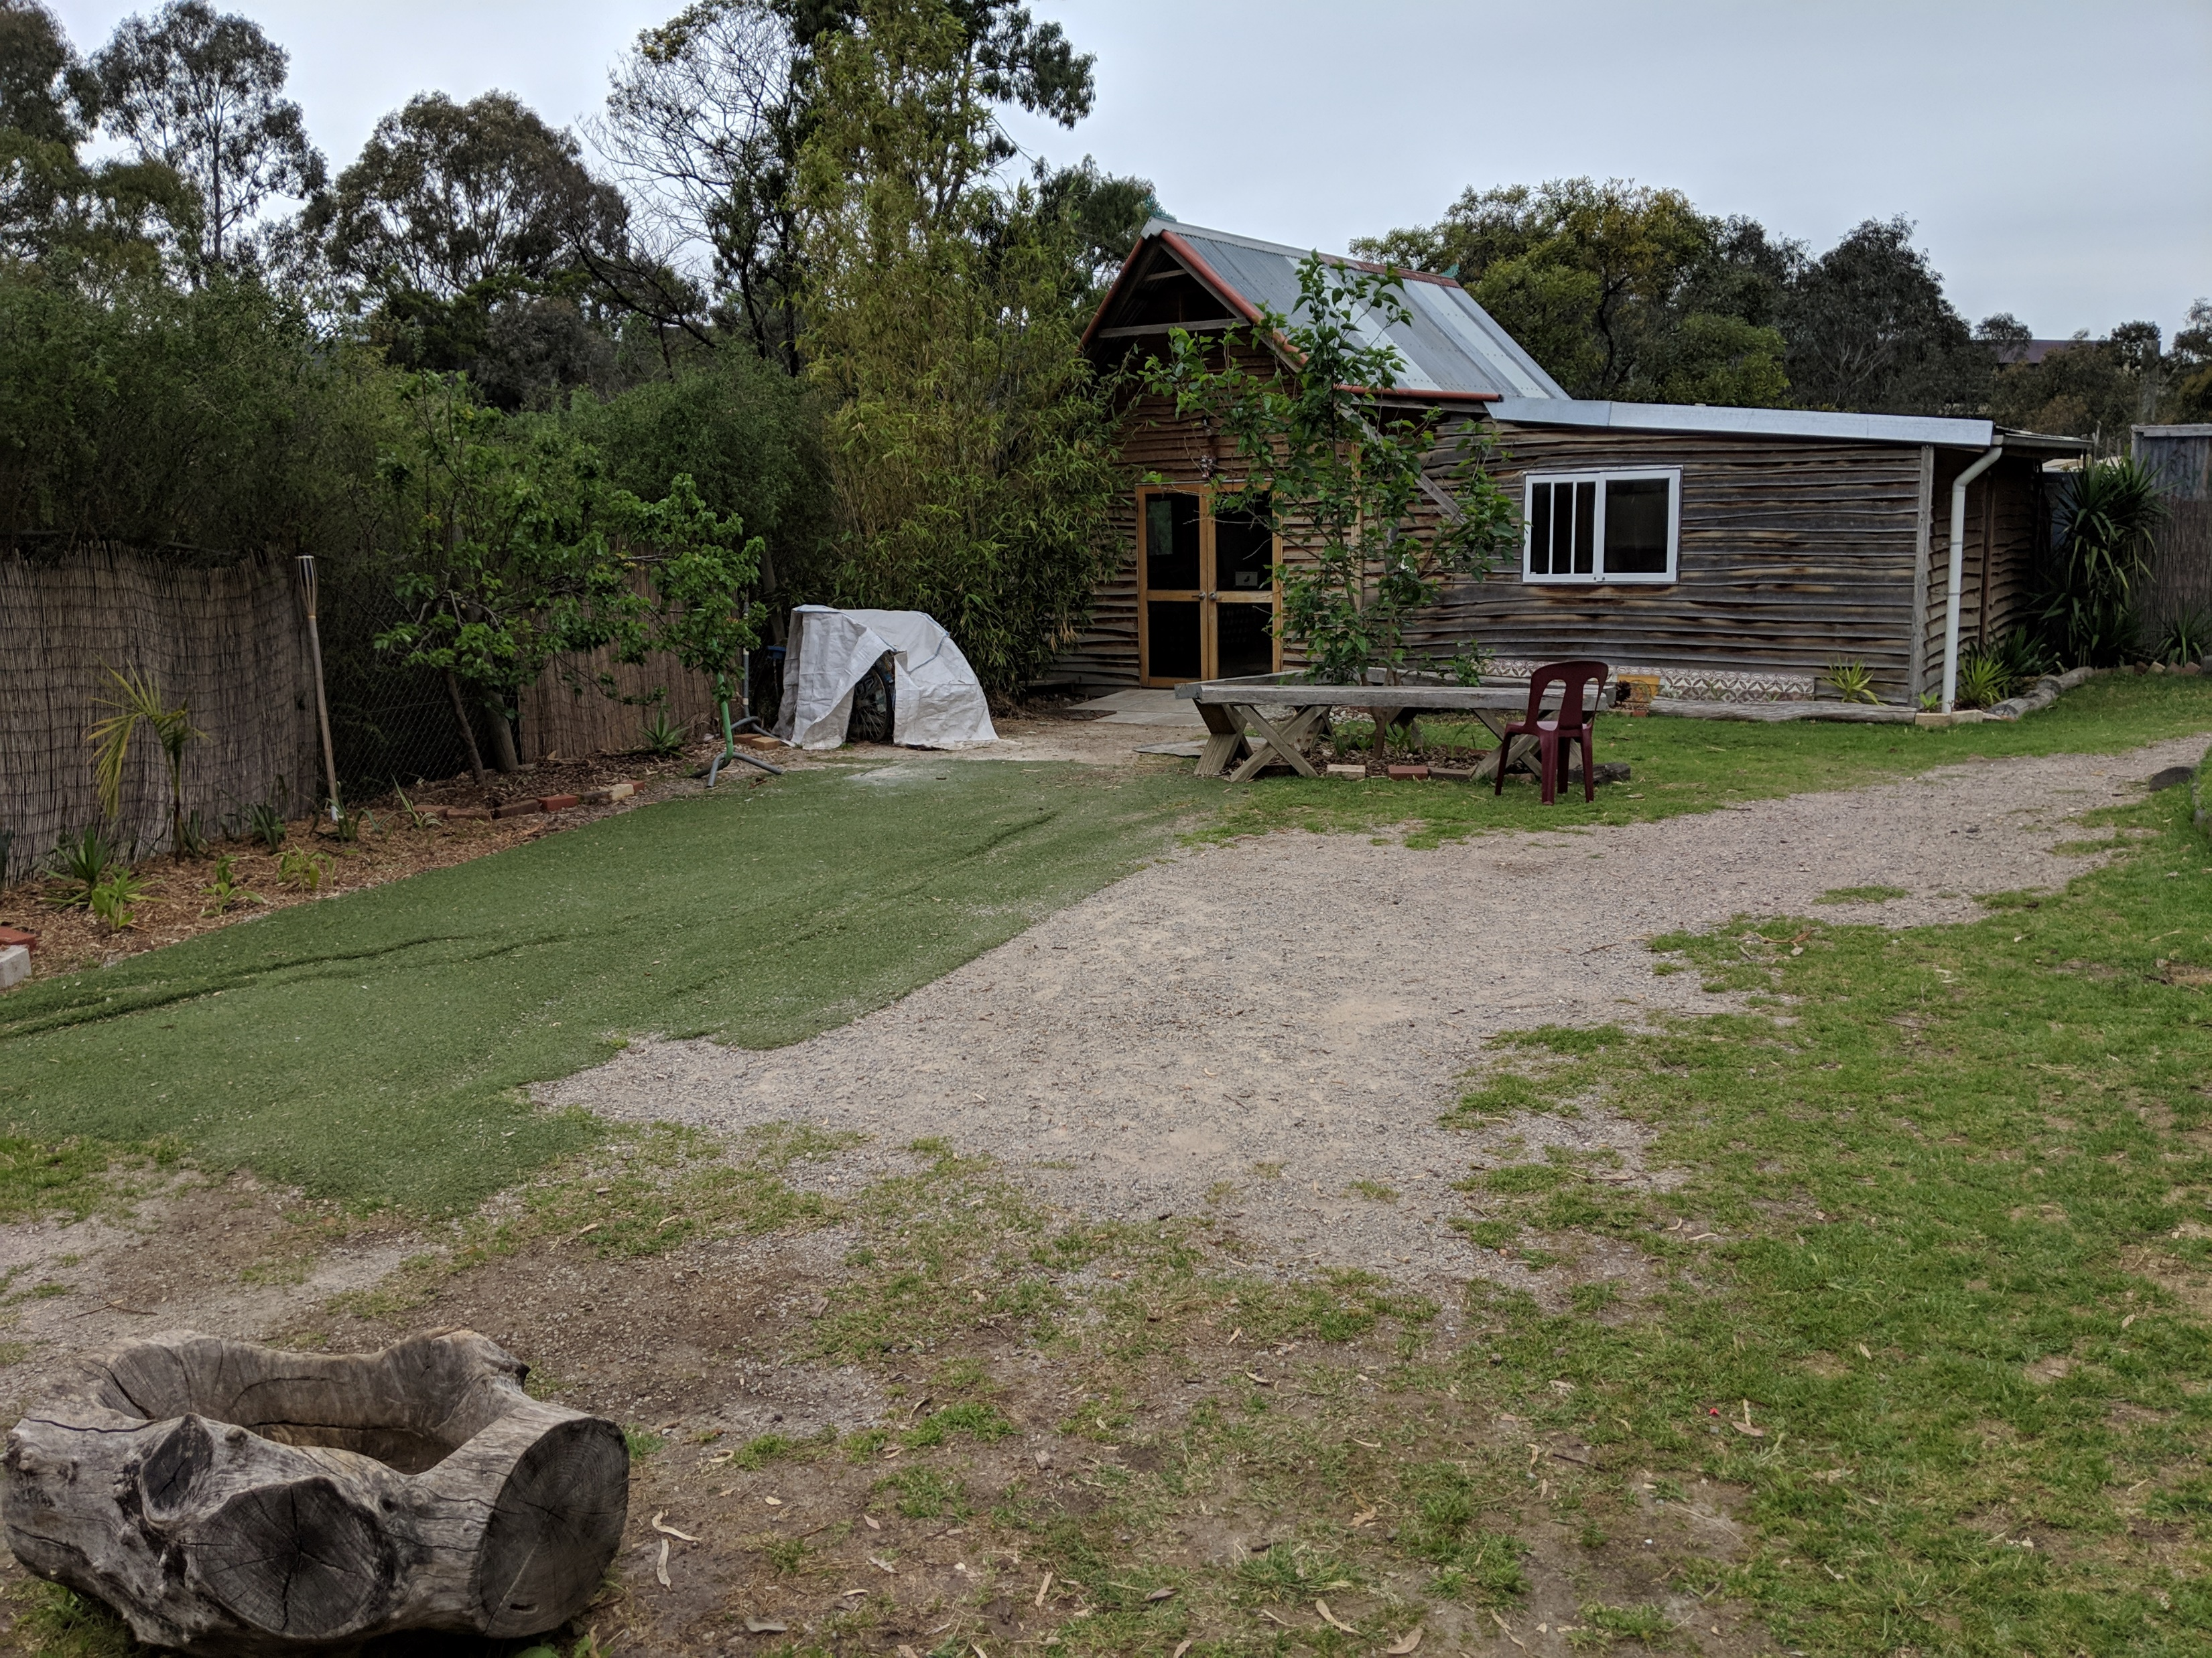
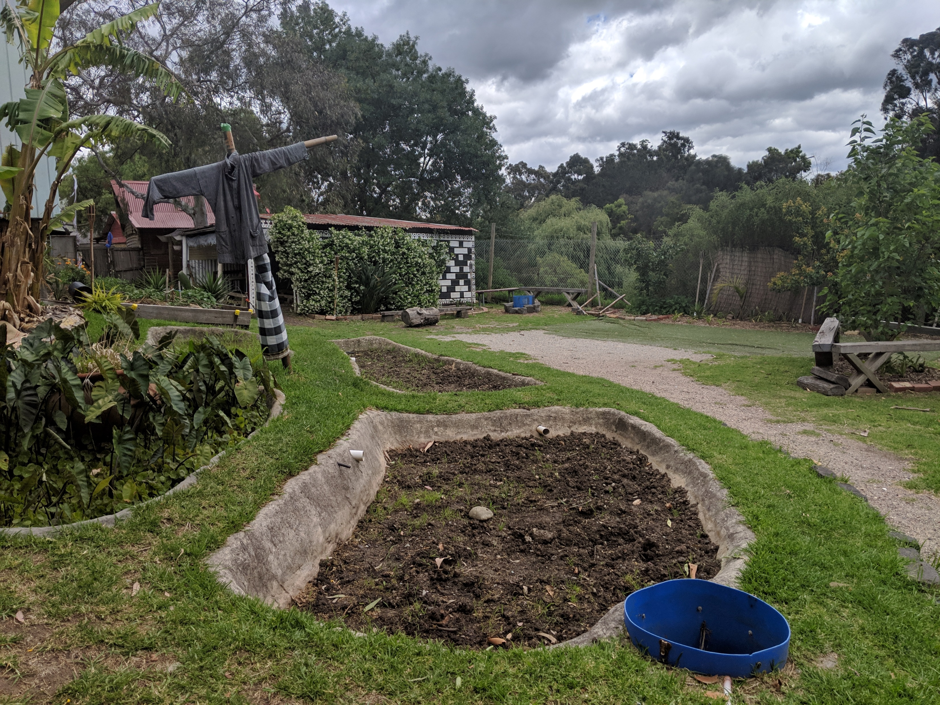
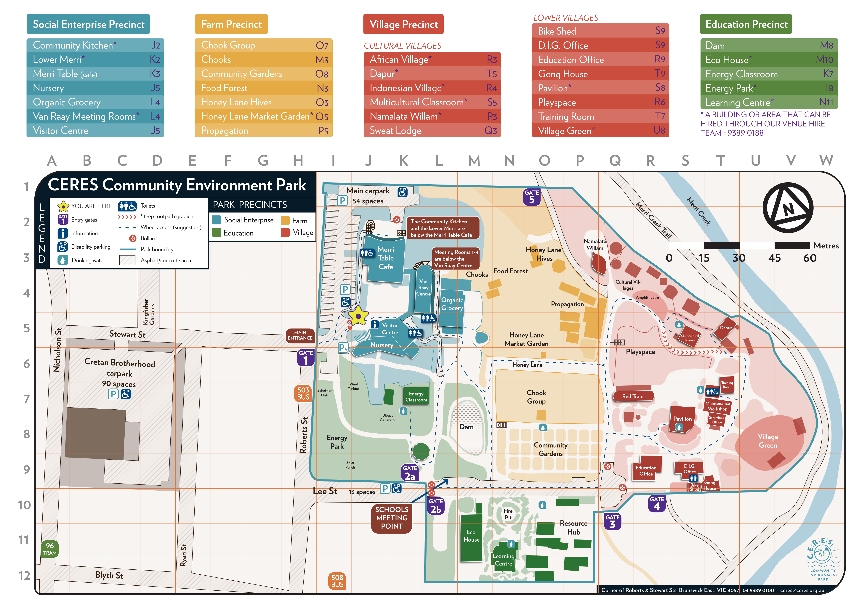
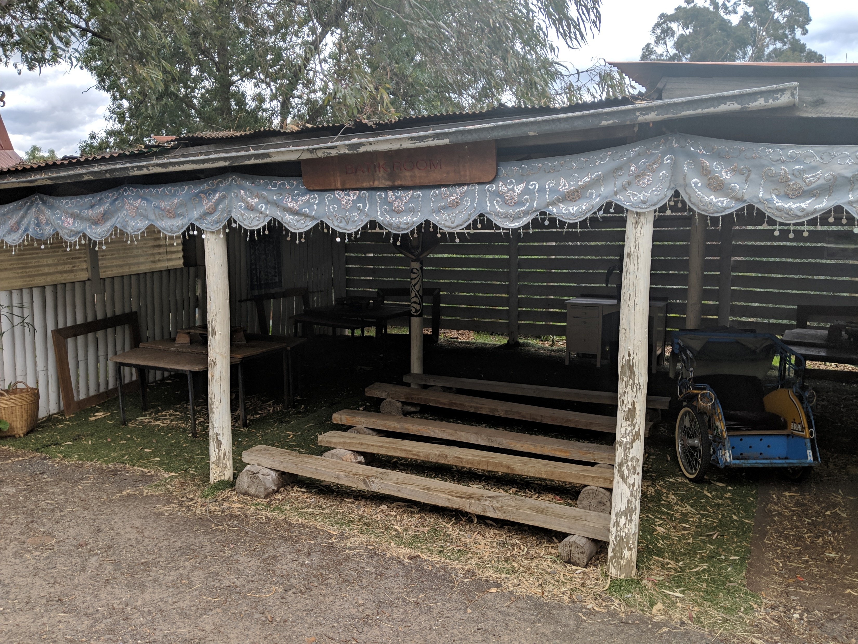
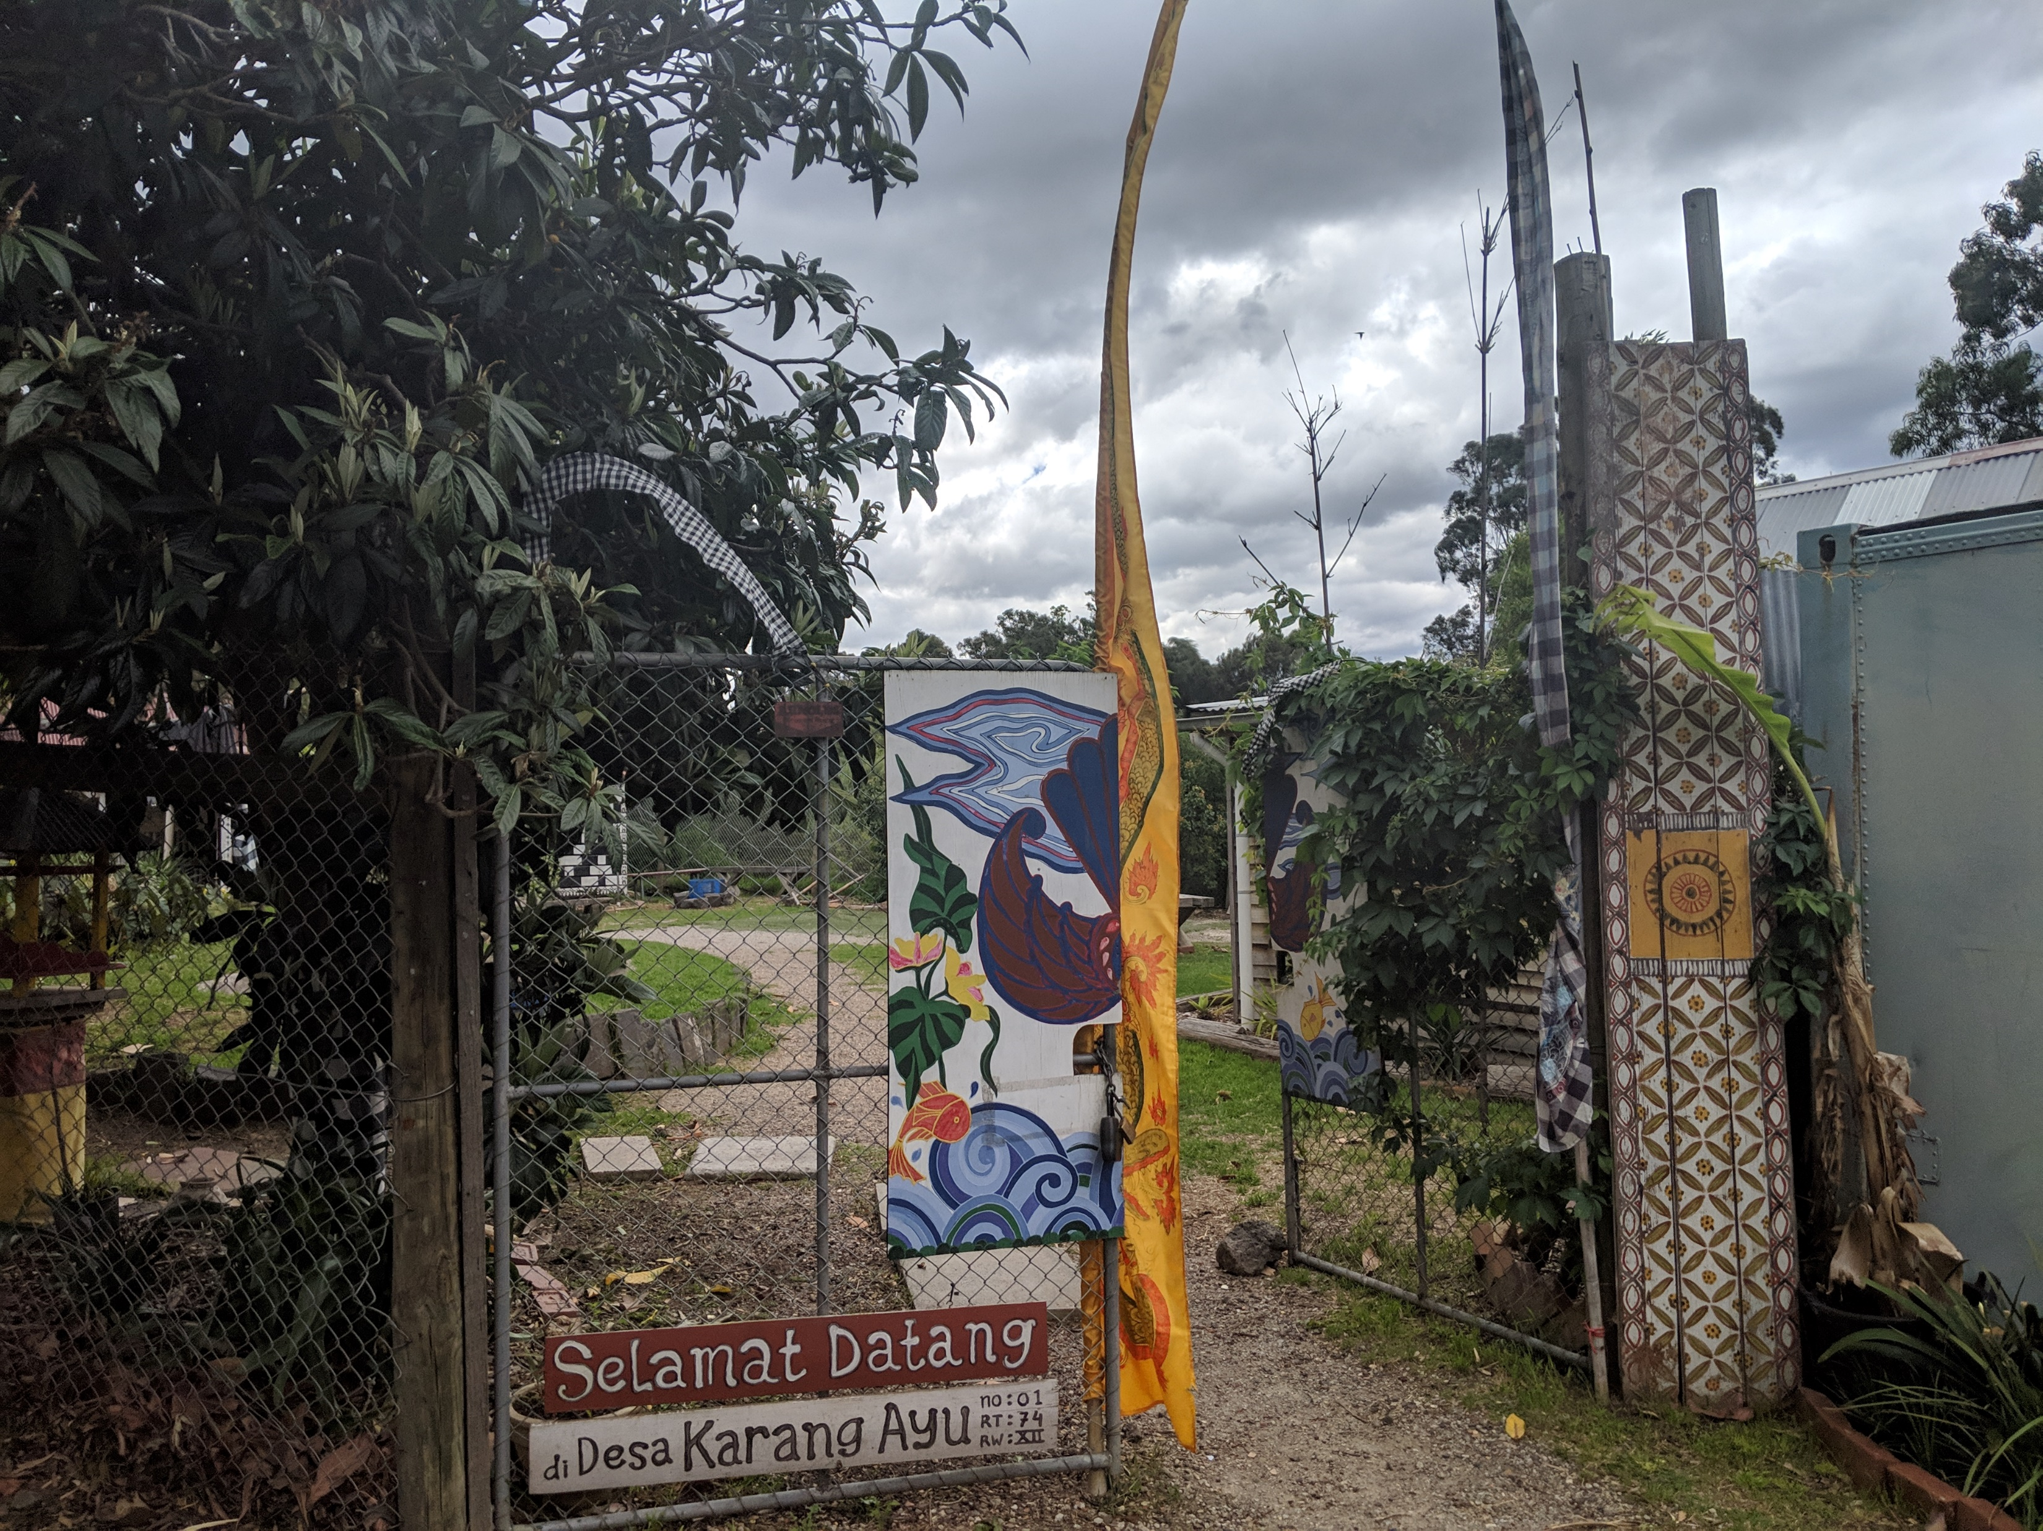
The Indonesian Village
Notes:
Chloe

Slide 7
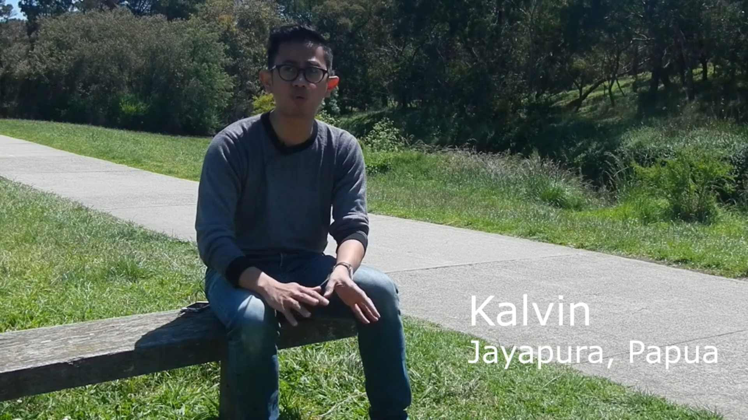
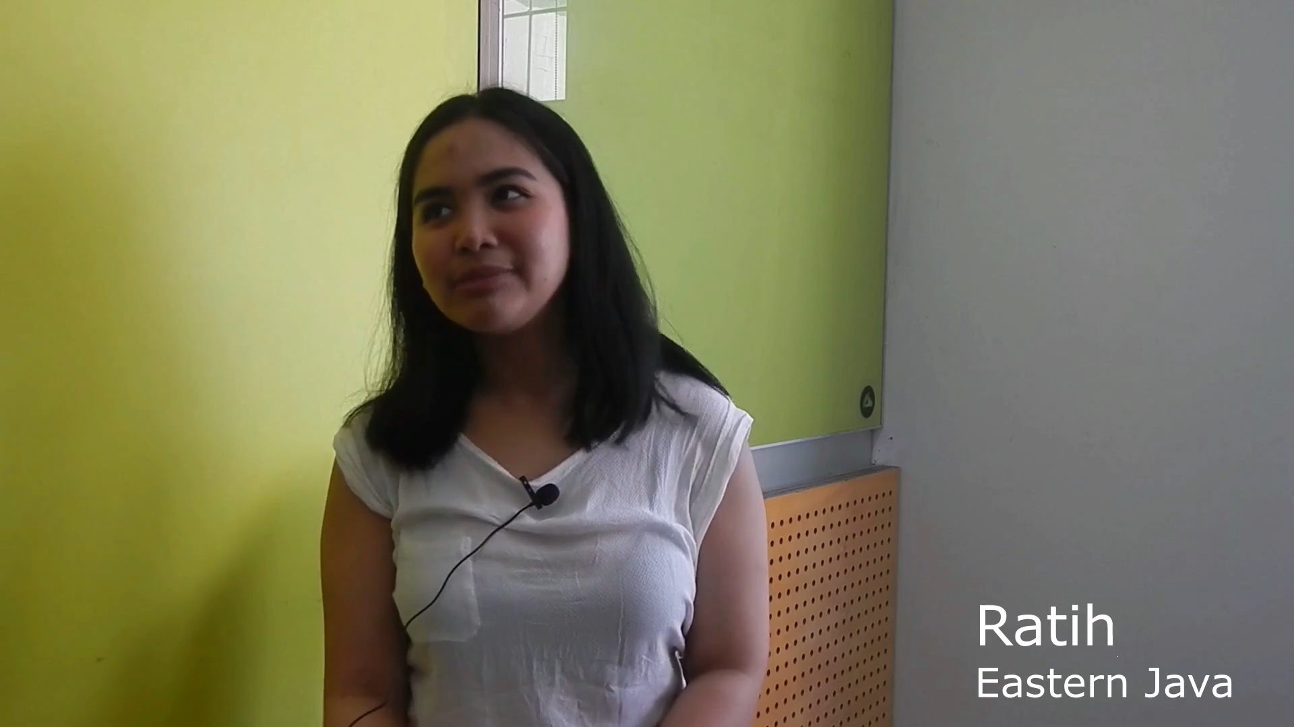
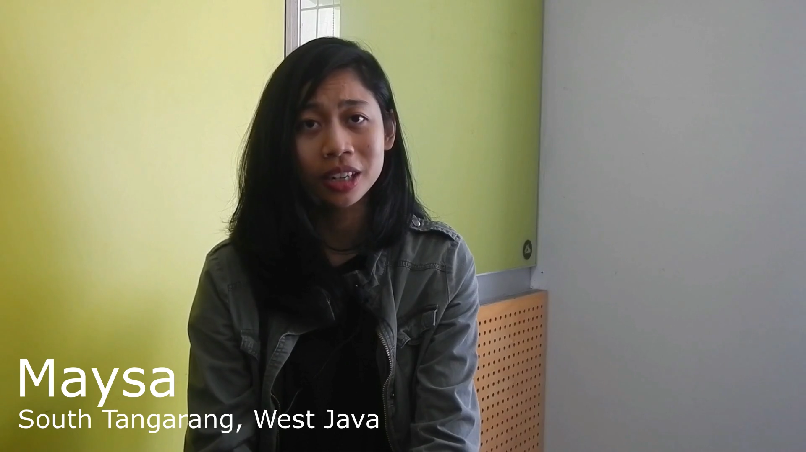
2017 IQP Team
Water Access
Flooding
Industrialization
Notes:
Chloe

Slide 8
Our Goal
Our Objectives
To extend the 2017 IQP’s work by conducting additional interviews with more subjects and to produce videos that can be directly connected to physical exhibits in the Indonesian Village
Capture the Perspectives and Experiences of the Indonesian People in Regards to Climate Change
Edit and Produce Short-Form Videos
Make Recommendations for Improvements for the Indonesian Village
Notes:
Chloe

Slide 9
Environmental Issues in Indonesia
Changes in Seasons and Weather Patterns
Deforestation and Development
Improper Rubbish Disposal
Flooding
Air Pollution
Notes:
Sam

Slide 10
Objective 1
Capture the Perspectives and the Experiences of the Indonesian People in Regards to Climate Change
Notes:
Sam

Slide 11
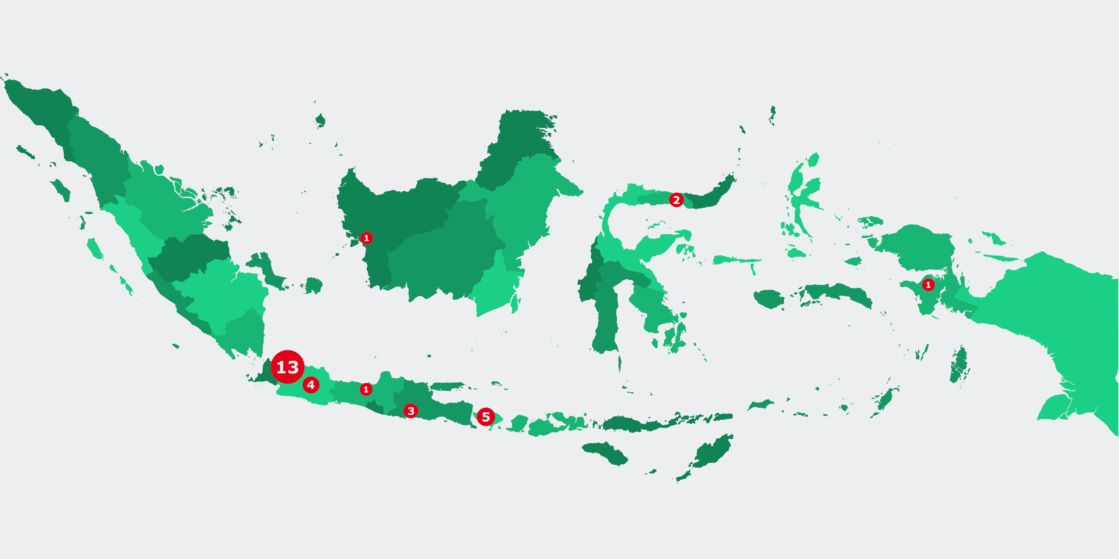
Organizing Interviews
Notes:
Sam

Slide 12
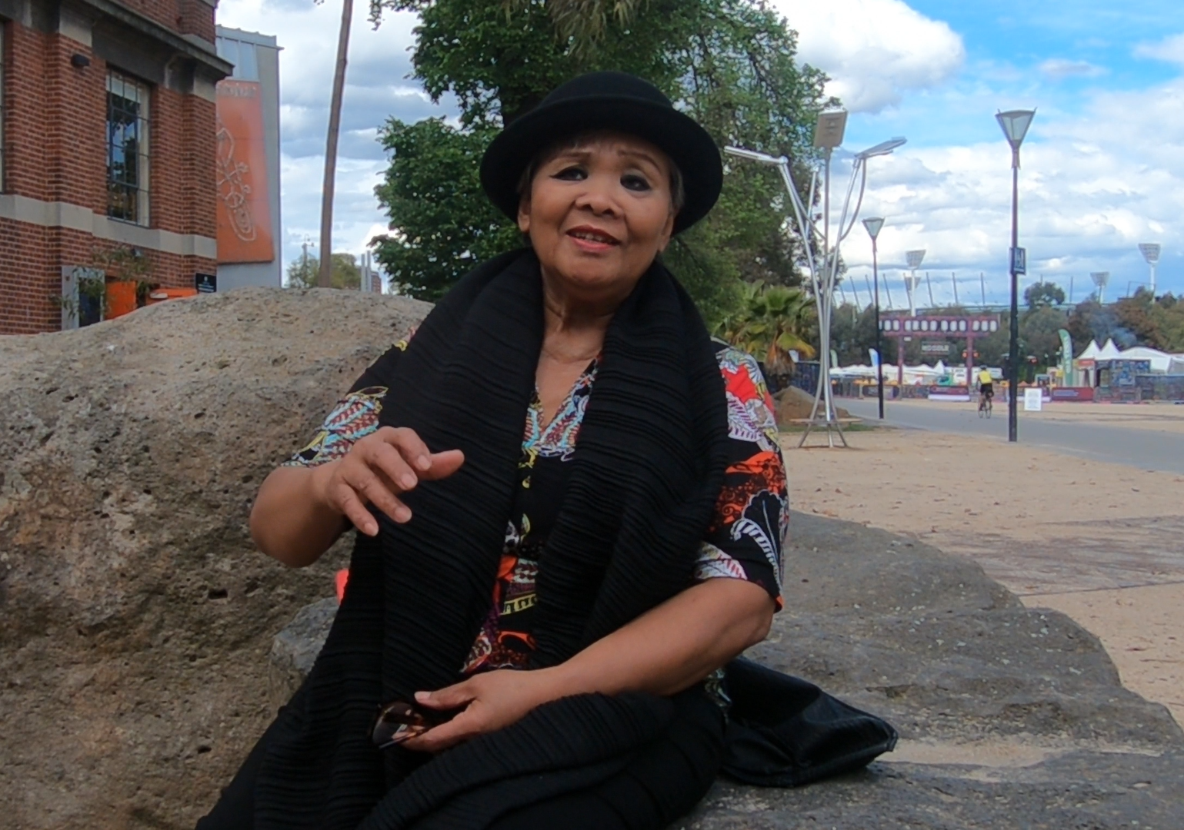
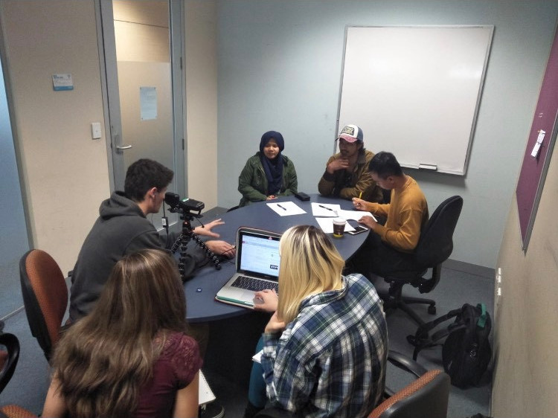
Conducting Interviews
Structured
Unstructured
Semi-Structured
Notes:
Nick
For our interview process we travelled to various locations around Melbourne to interview our 32 subjects
We used a semi-structured interview style, which entailed asking more general questions and encouraging elaboration. A more structured interview would have had more numerous, specific questions, while a less structured style would have required more time than we had.
In the interviews, we had one team member control the camera and microphone as well as ask the questions and interact directly with the interviewee. Another team member took notes on the content of the interview for documentation. Our remaining team member would mark down specific follow-up questions to ask in order to go more in-depth.
Many of these interviews were carried out with groups of two or more subjects at once.
In total we collected almost 10 hours of interview footage throughout the whole process

Slide 13
Interview Questions
Can you describe an average day in Indonesia in your childhood?
Have you noticed changes in the weather or environment since you were younger?
Can you tell us about how you disposed of your waste when you were younger? Has it changed?
Have you had experiences with flooding or other natural disasters?
Is air pollution an issue you have experienced first-hand?
Now that you have received higher education and spent time in Australia, has that changed your perspective on the issues faced back home?
Notes:
Nick
- Introduce the questions, discuss how they were used

Slide 14
Objective 2
Edit and Produce Short-Form Videos
Notes:
Sam

Slide 15
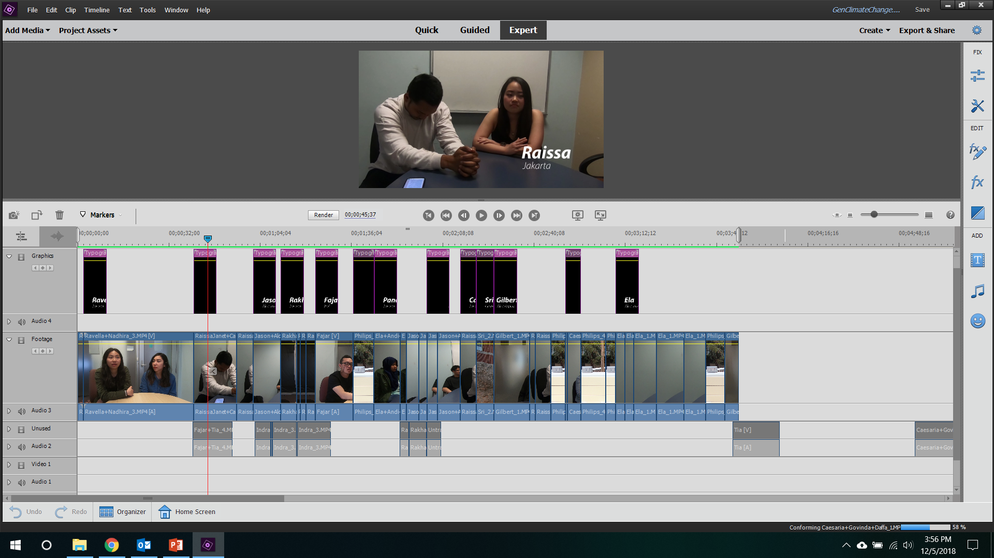
Creating Videos
Notes:
Sam

Slide 16
Objective 3
Make Recommendations for Improvements to the Indonesian Village
Notes:
Chloe

Slide 17
Our Recommendations
- Use the archive we created to produce additional teaching videos
- Make physical signage in the village relating directly to videos
- Enable the village to function as a standalone educational exhibit
- Promote the village to all visitors of the park
- Extend these improvements to the other cultural villages
Notes:
Chloe

Slide 18
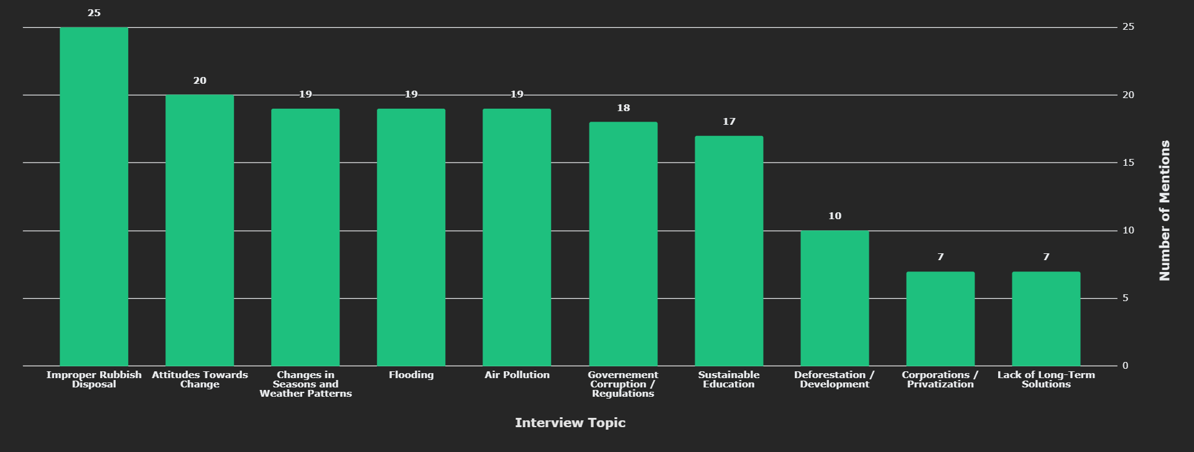
Topics Raised by Interviewees
Notes:
Nick

Slide 19
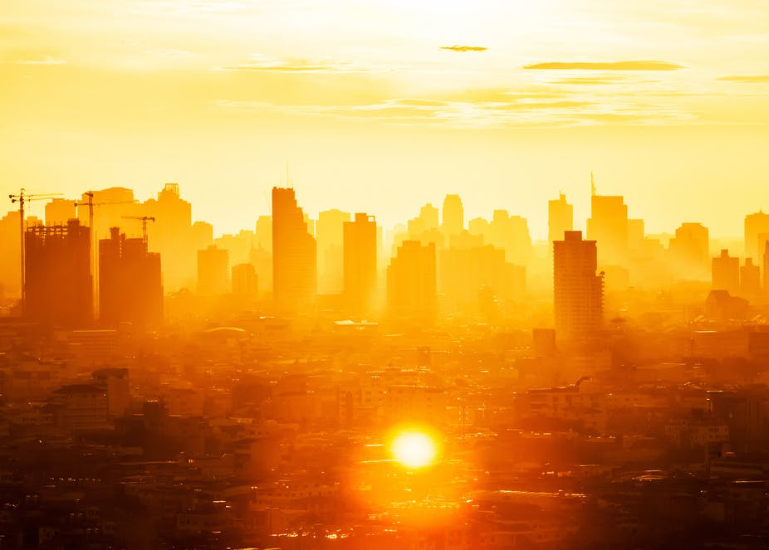
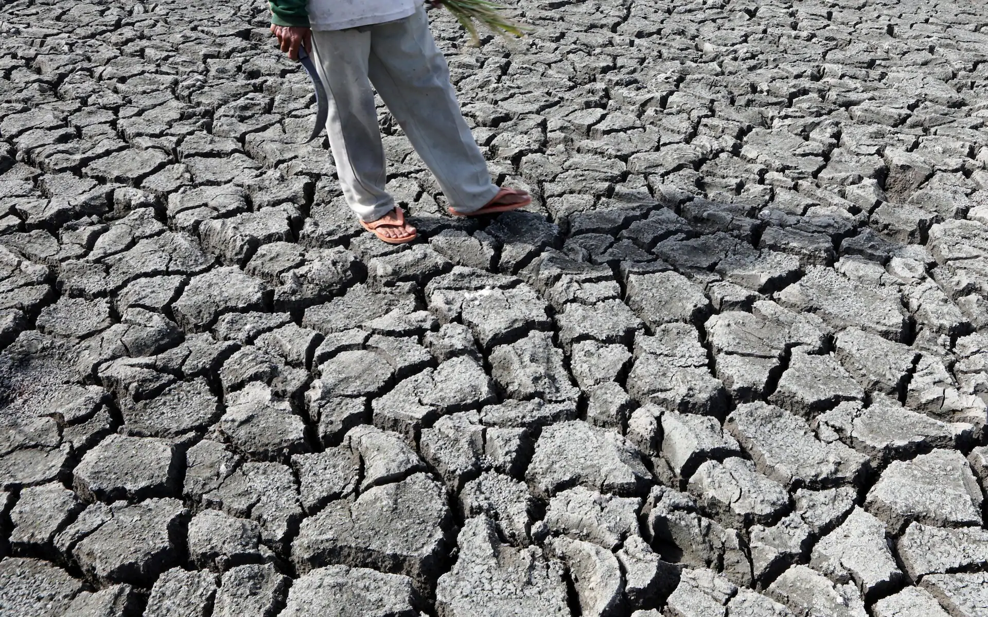
Changes in Seasons and Weather Patterns
Mentioned By
19/32
https://www.shutterstock.com/image-photo/sunrise-over-modern-office-buildings-business-222030145?src=9DRG0Wu5vPHES2gto5RBAQ-1-0
https://www.telegraph.co.uk/content/dam/news/2017/07/21/TELEMMGLPICT000135353574_trans_NvBQzQNjv4BqpVlberWd9EgFPZtcLiMQfyf2A9a6I9YchsjMeADBa08.jpeg?imwidth=1400
Notes:
Sam

Slide 20
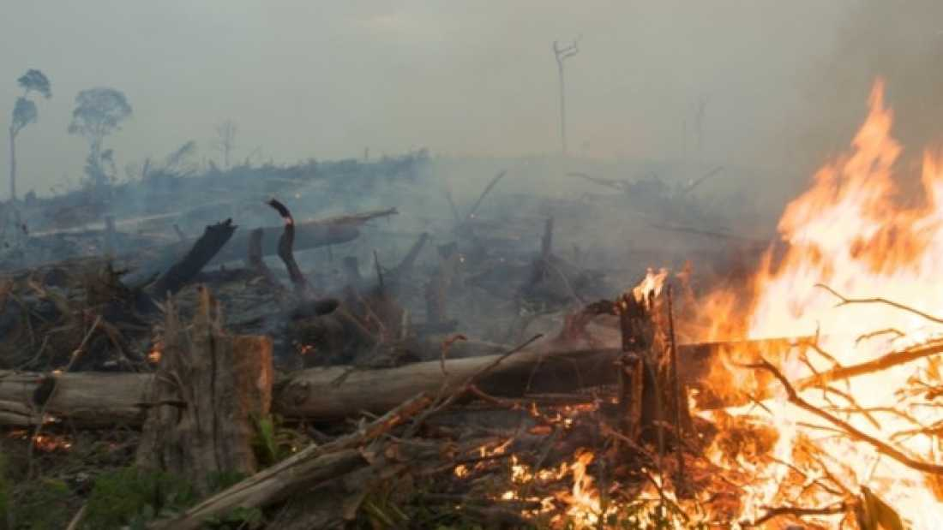
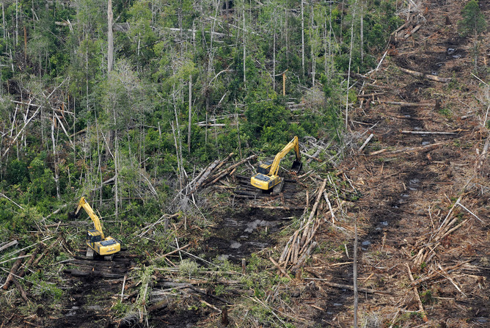
Deforestation and Development
https://www.iflscience.com/environment/feeding-godzilla-indonesia-burns-its-government-moves-increase-forest-destruction/
Mentioned By
10/32
https://titisari04.files.wordpress.com/2016/02/real_estate_development_4.jpg
Notes:
Sam

Slide 21
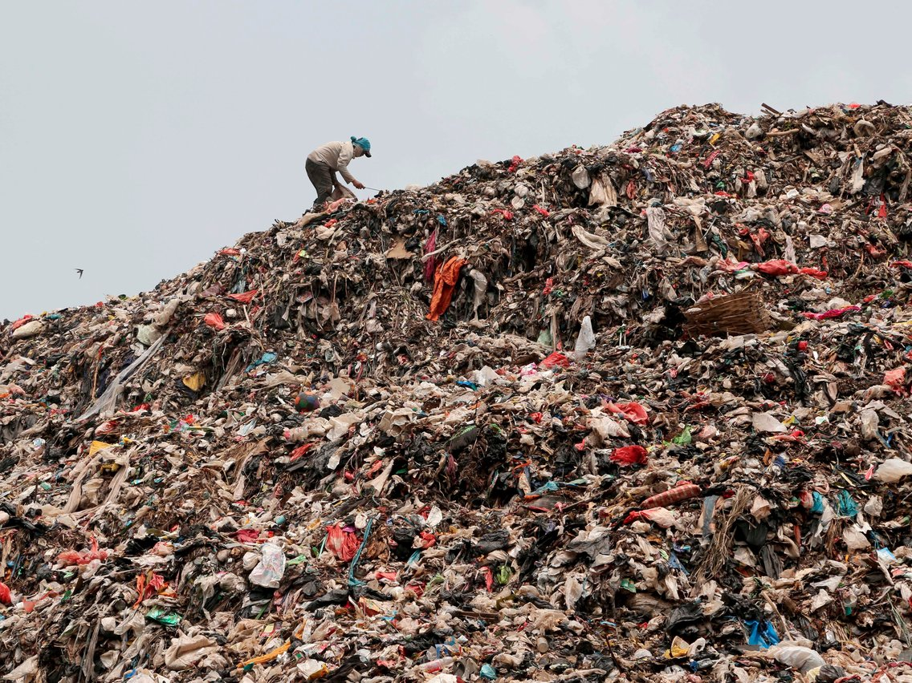
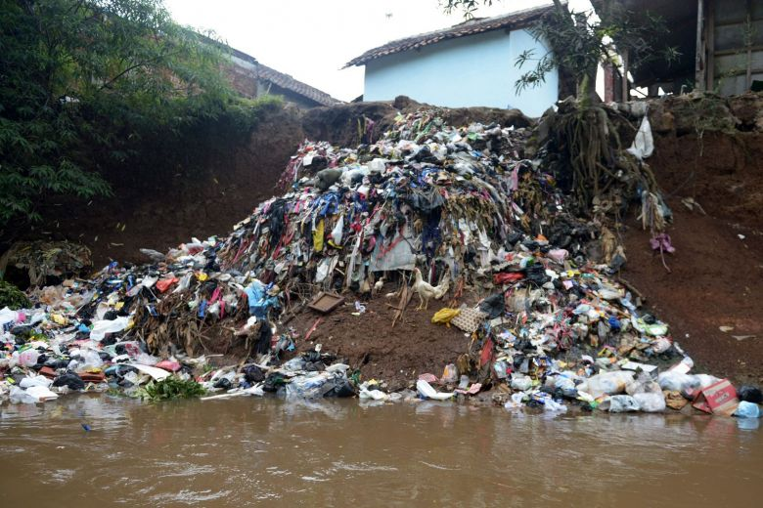
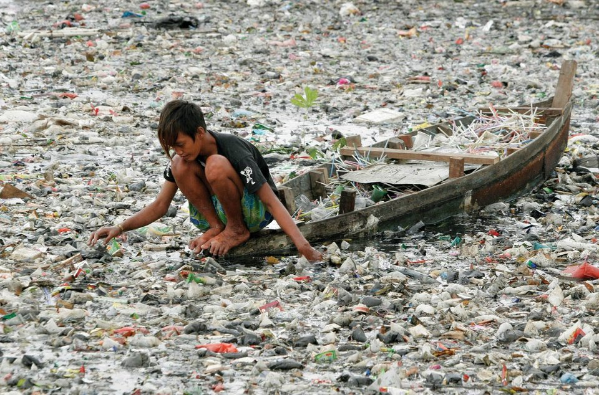
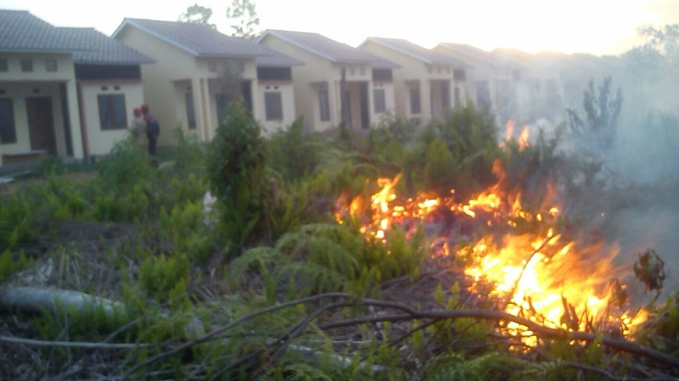
Improper Rubbish Disposal
https://www.straitstimes.com/sites/default/files/styles/article_pictrure_780x520_/public/articles/2018/03/02/wl_dirtriver_030218_0.jpg?itok=1p1WLeQB&timestamp=1519979304
https://img.jakpost.net/c/2016/08/29/2016_08_29_10720_1472445678._large.jpg
Mentioned By
https://external-preview.redd.it/z26-szPDNVs-U5mDNM8fCOhl8PcSTGmg-BXmyljZ3aU.jpg?width=960&crop=smart&auto=webp&s=c0662a3a62bb18db06665ccca5bf9093b6c10512
25/32
https://img.jakpost.net/c/2016/08/29/2016_08_29_10720_1472445678._large.jpg
Notes:
Chloe

Slide 22
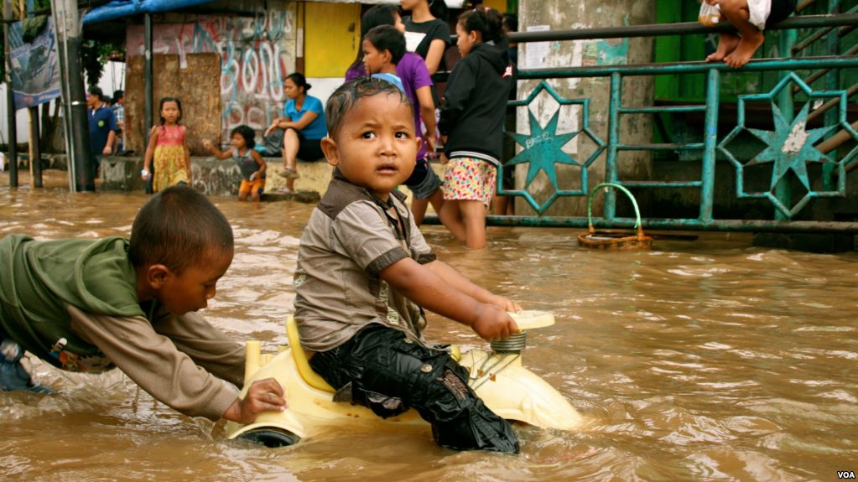
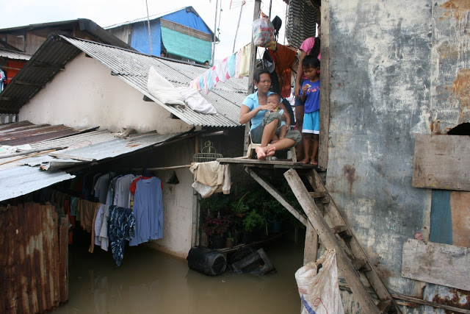
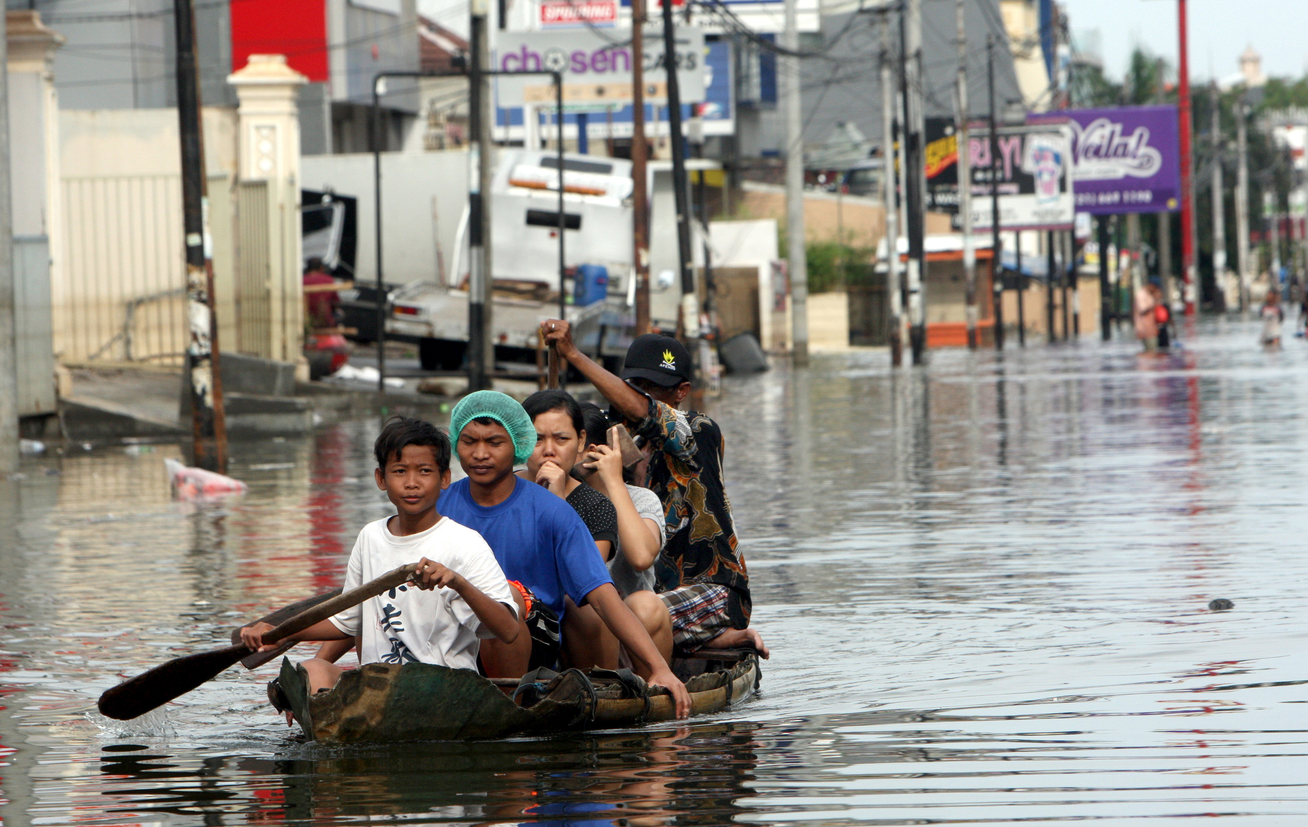
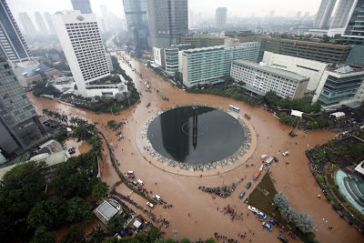
Flooding
https://2.bp.blogspot.com/-nM8N4_pJSLo/VpvFlK5jhjI/AAAAAAAAAZk/CAxIHztFQvw/s640/Flood%2Bbsirait.jpg
https://gdb.voanews.com/5E2B9E64-8733-4A20-BF4D-89EF884CBBD3_cx0_cy6_cw0_w1023_r1_s.jpg
Mentioned By
19/32
https://2.bp.blogspot.com/-E8M3WgI6fe0/UYk72aOEmfI/AAAAAAAAAR4/GHQzS8V1UYA/s400/Flooded+HI+Round+Jan+2013.jpg
https://universe.byu.edu/wp-content/uploads/2013/01/Indonesia-Floods_Bing.jpg
Notes:
Chloe

Slide 23
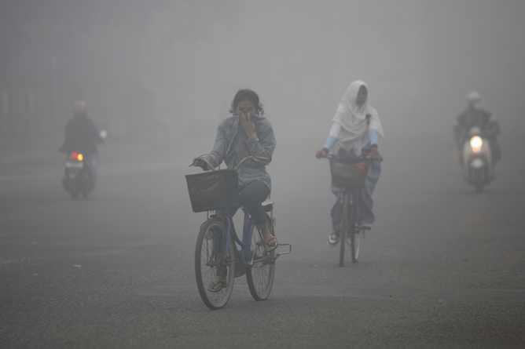
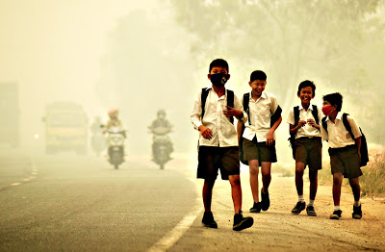
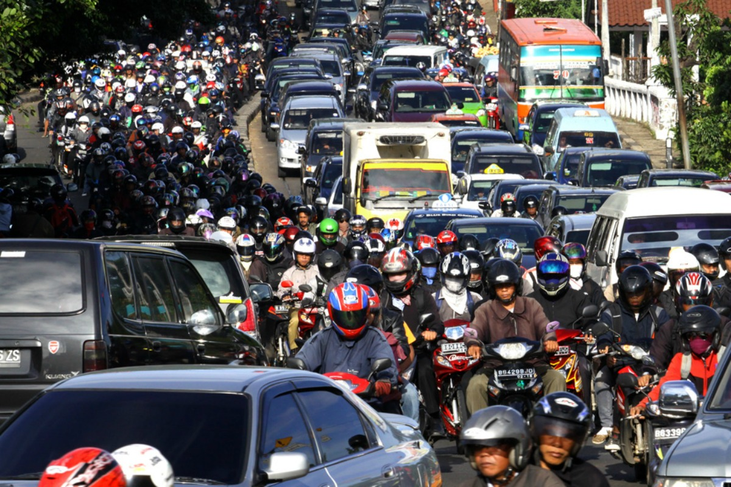
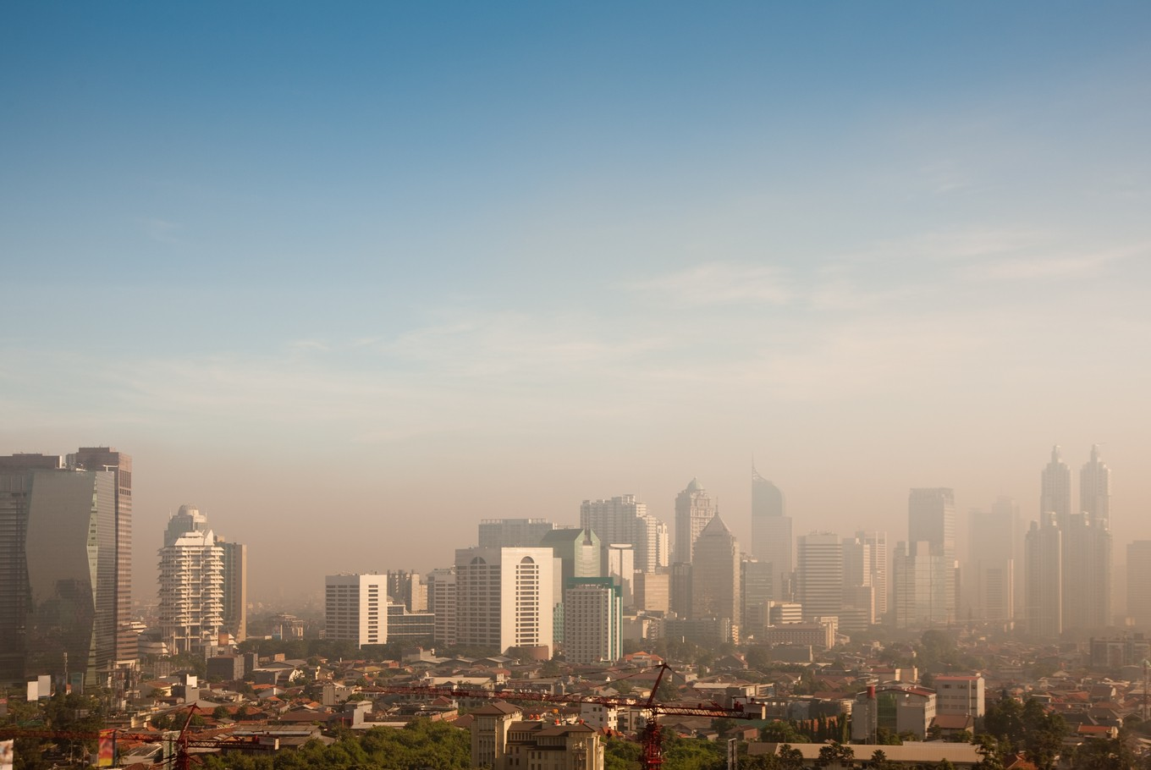
Air Pollution
https://62e528761d0685343e1c-f3d1b99a743ffa4142d9d7f1978d9686.ssl.cf2.rackcdn.com/files/102686/width668/image-20151121-442-13awzn.jpg
http://unicefindonesia.blogspot.com/2017/06/
Mentioned By
19/32
https://d2mpqlmtgl1znu.cloudfront.net/AcuCustom/Sitename/DAM/009/Specialreports-Aug_2017_-_transport_-_congestion_in_Jakata.jpg
https://img.jakpost.net/c/2017/05/02/2017_05_02_26133_1493689431._large.jpg
Notes:
Nick

Slide 24
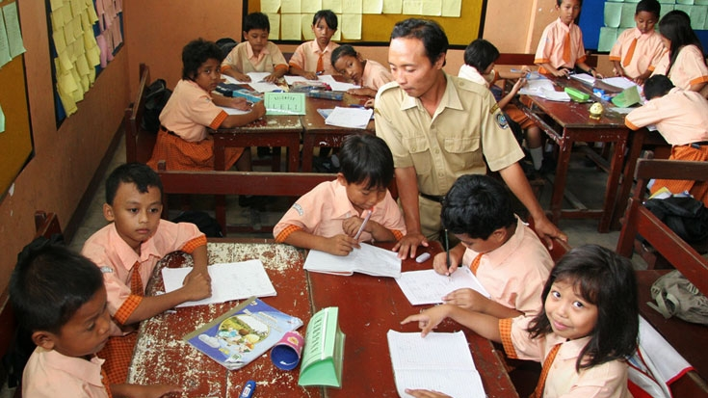
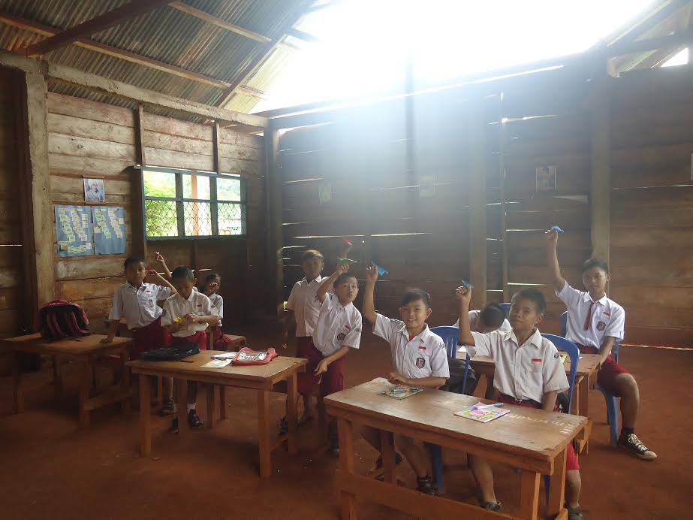
Attitudes Towards Change
Sustainable Education
https://www.mindtools.com/pages/article/bridges-transition-model.htm
http://www.worldbank.org/en/country/indonesia/brief/world-bank-and-education-in-indonesia
Mentioned By
Mentioned By
20/32
17/32
https://www.buildboswell.com/boswell-blog/mitigate-change-orders
http://blessed-to-give.org/teaching-to-create-happiness-in-indonesia/
Notes:
Nick

Slide 25
Impact of Our Project
10 Hours of footage
5 Videos
Thousands of Students
Visit CERES Each Year
Notes:
Nick

Slide 26
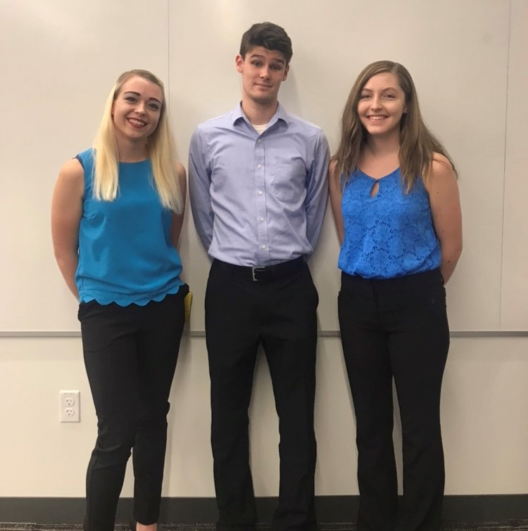
Thank You!
Notes:
Chloe

Slide 27
Questions?

