Slide 1
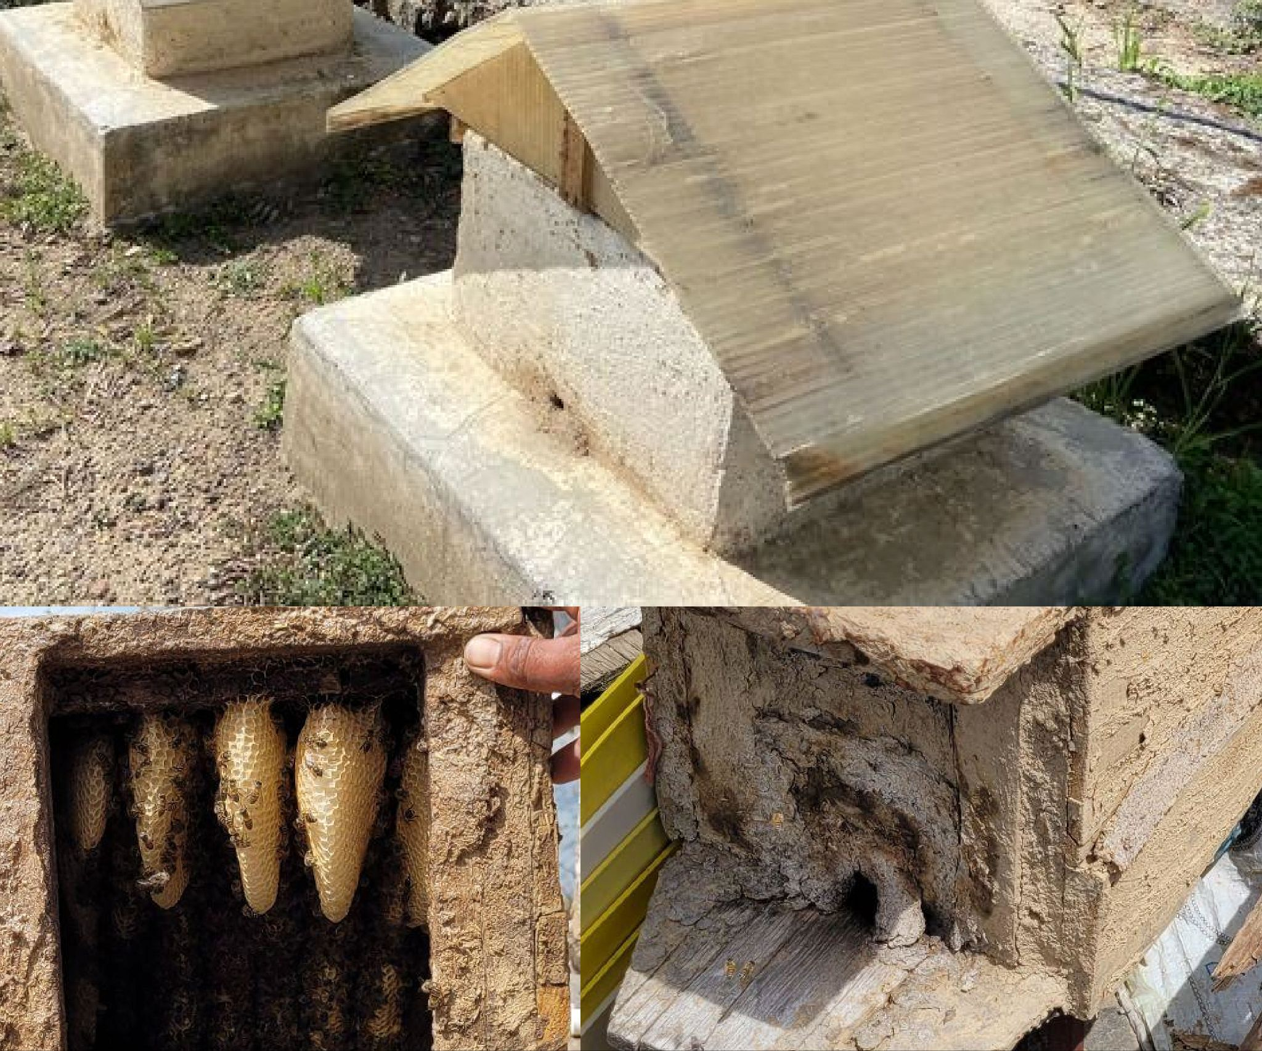
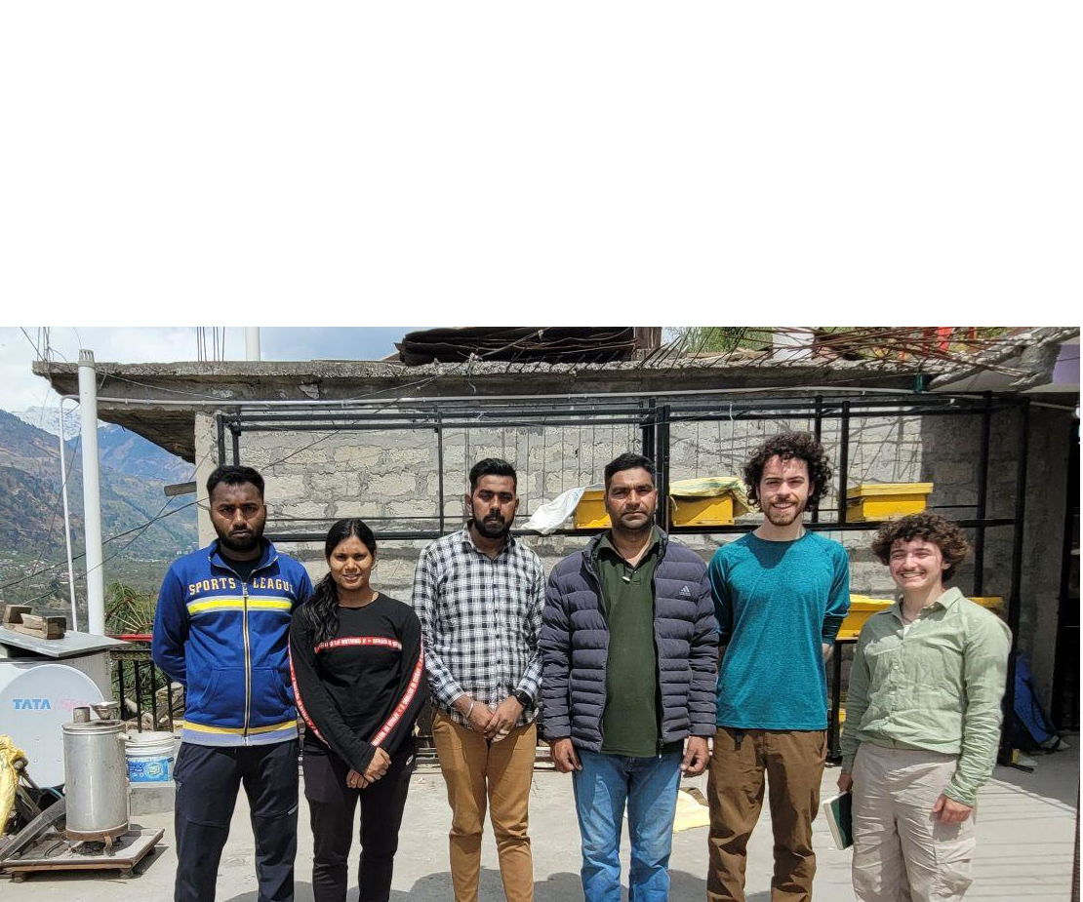
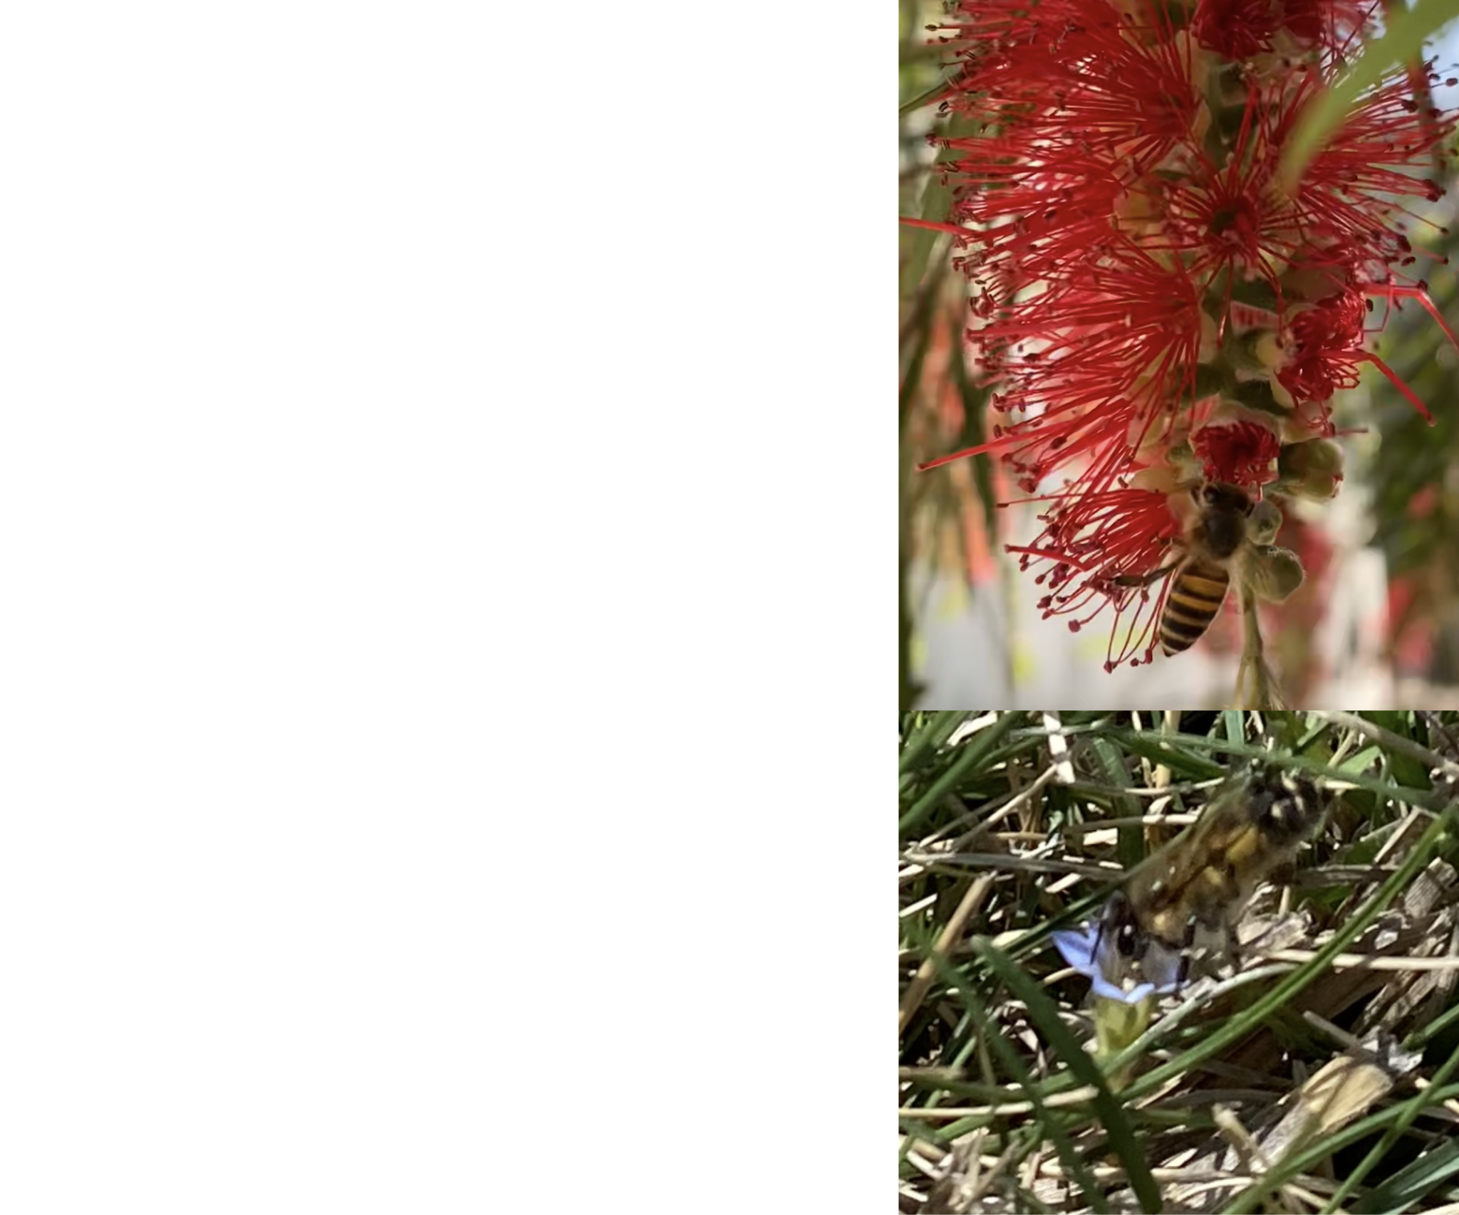
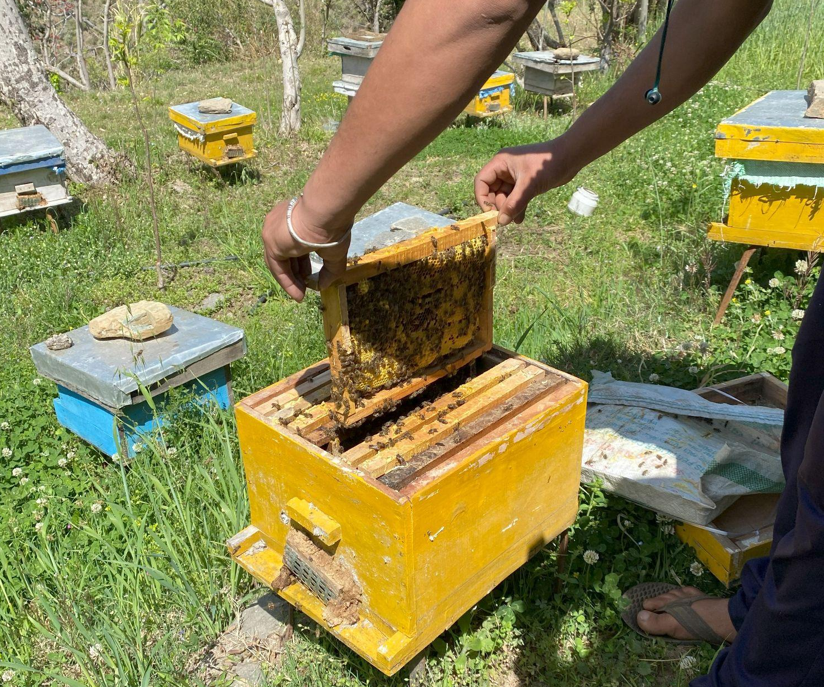
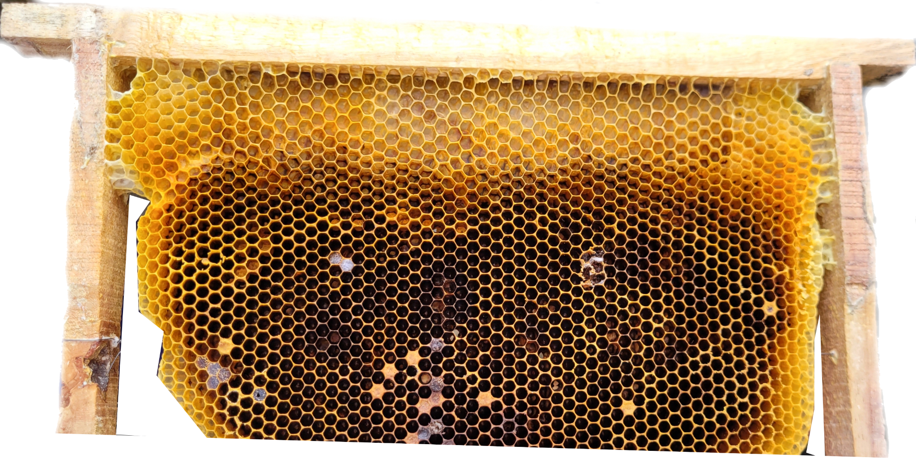
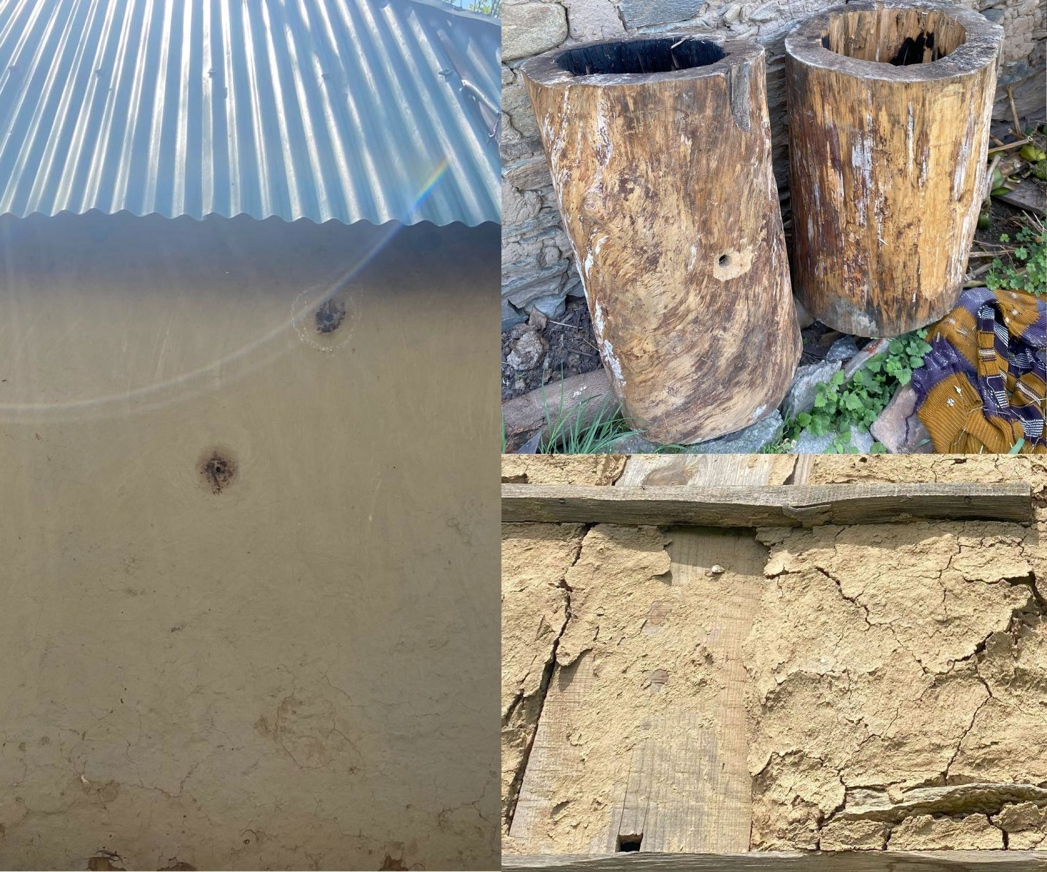
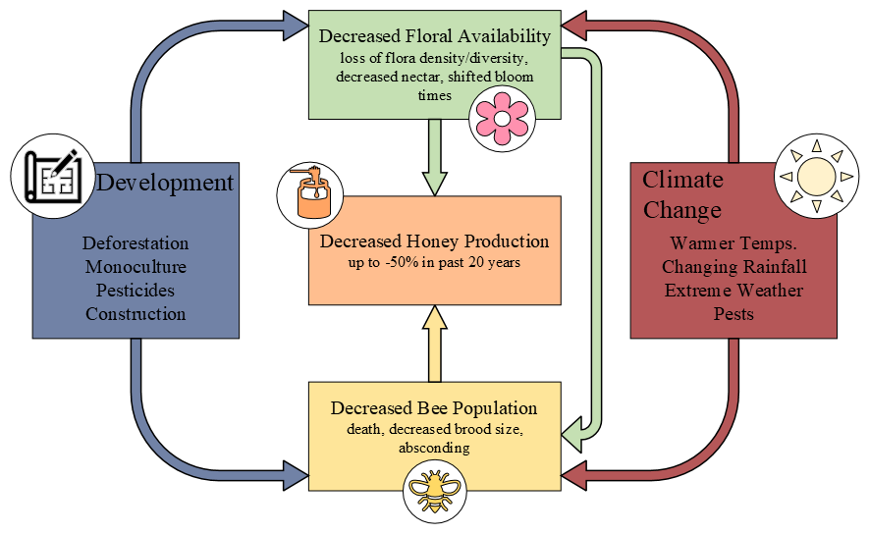
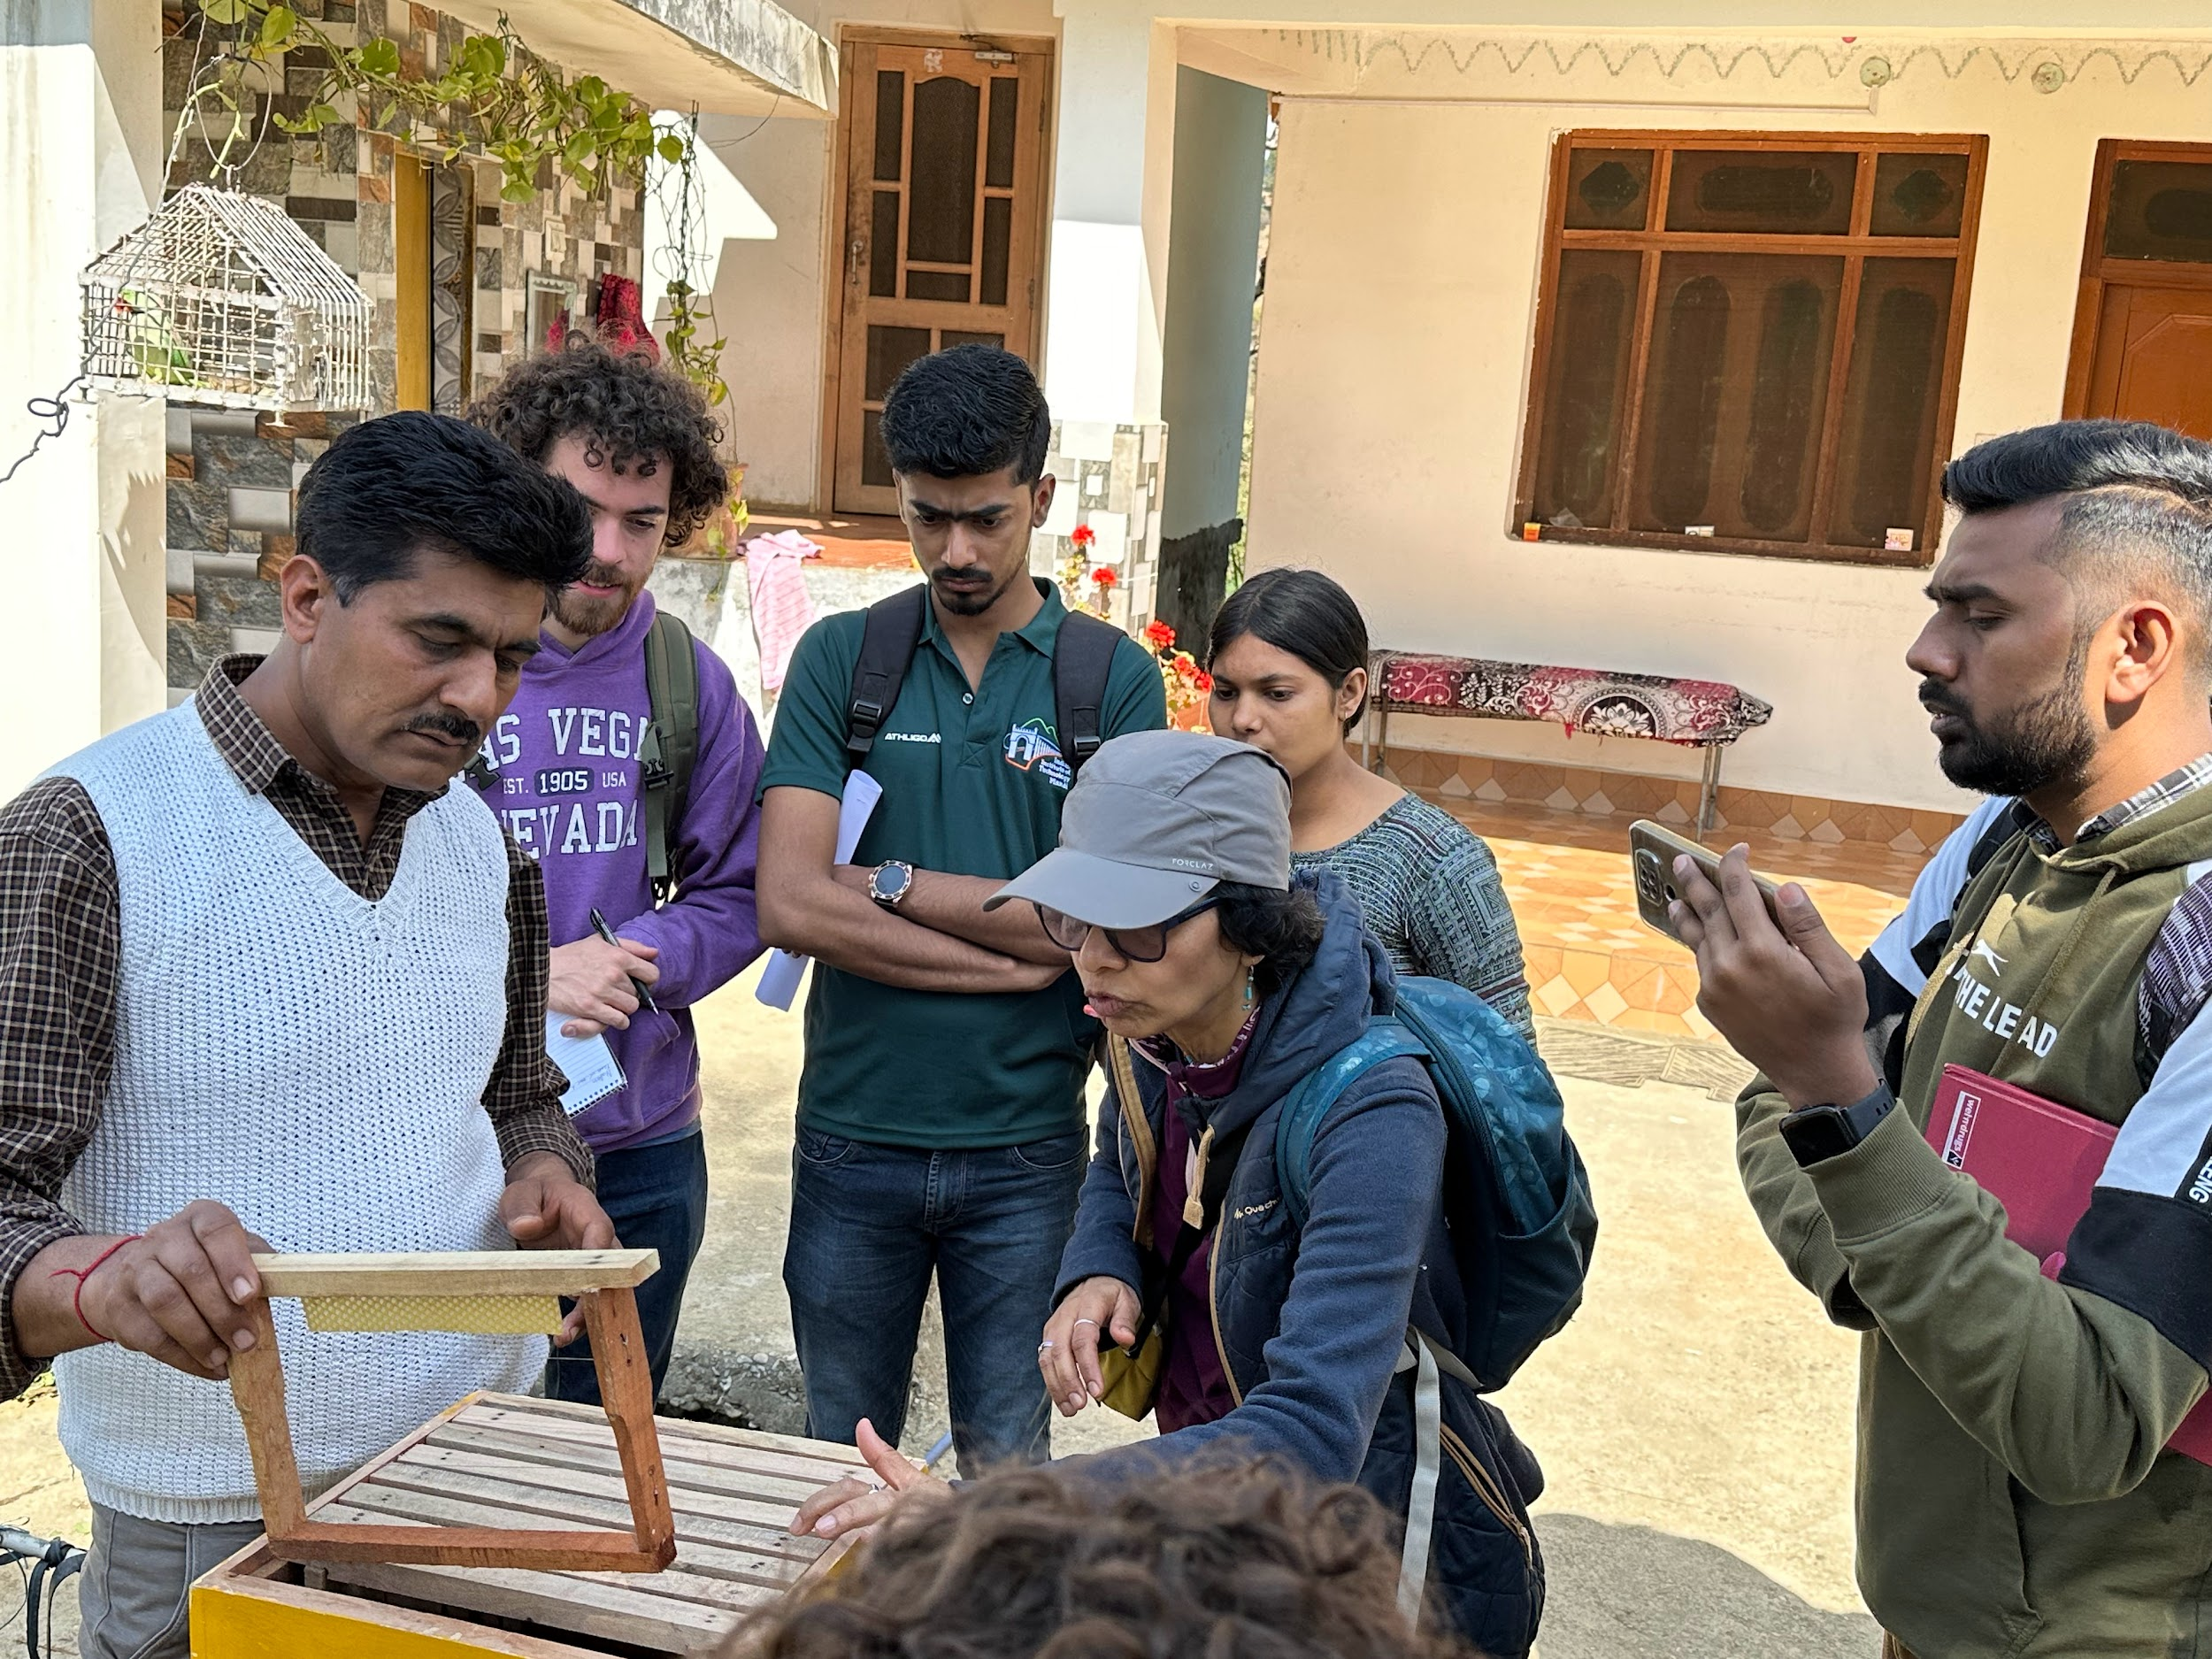
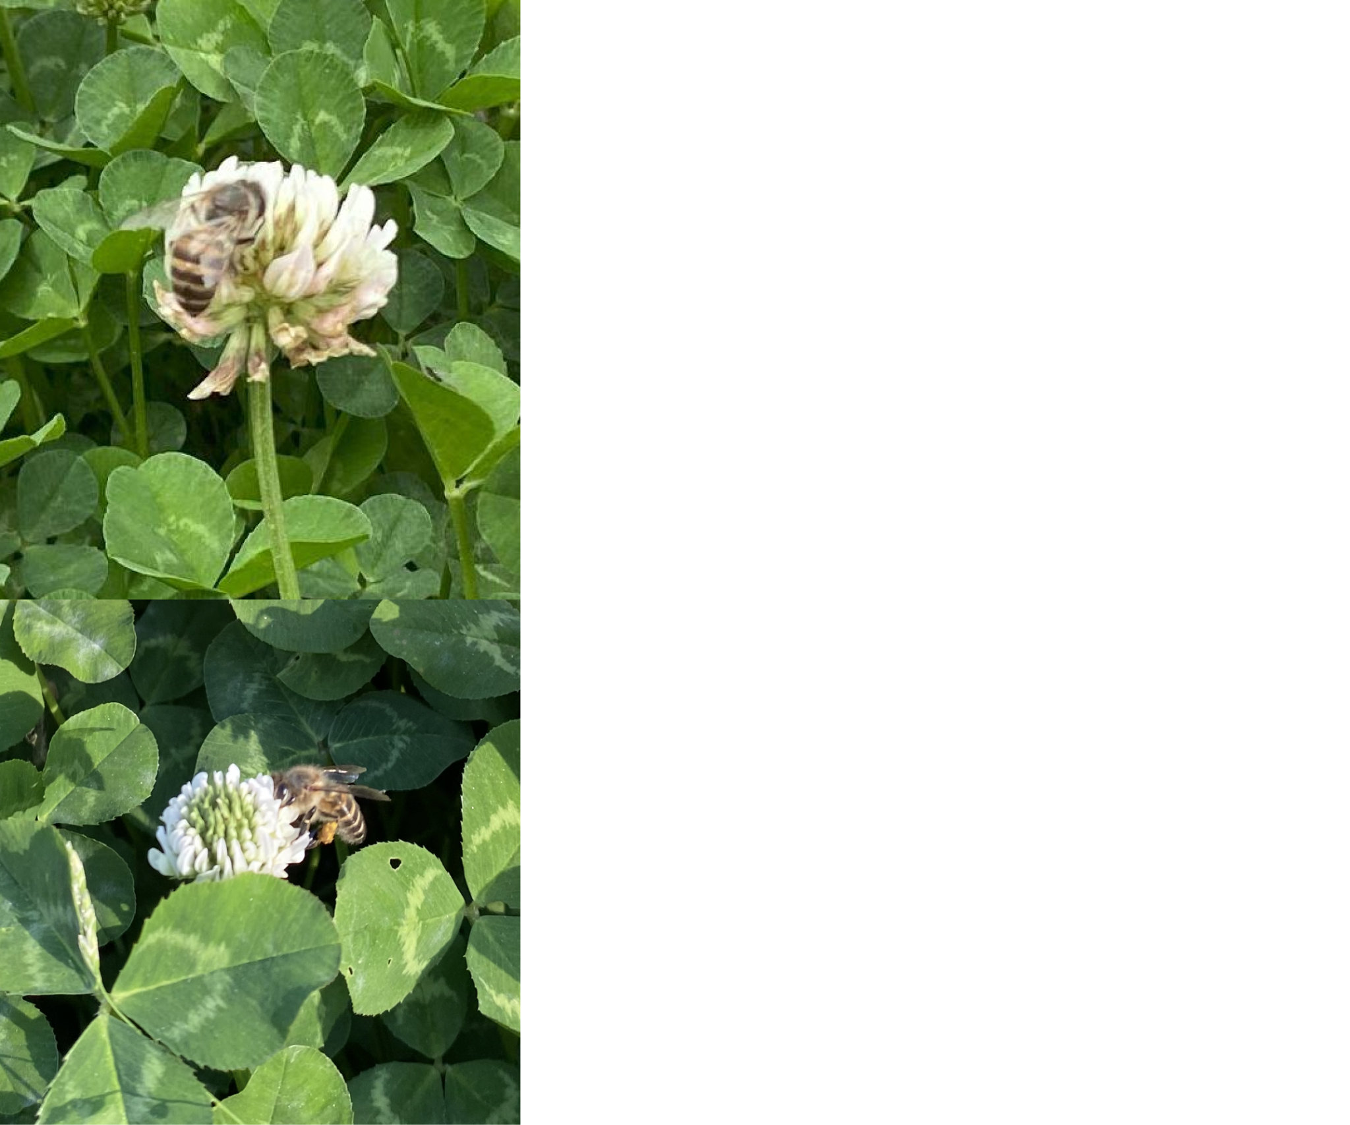
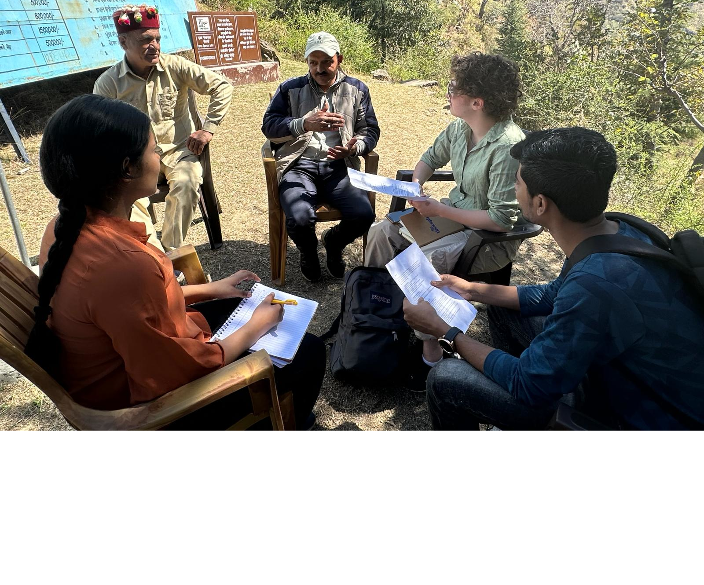
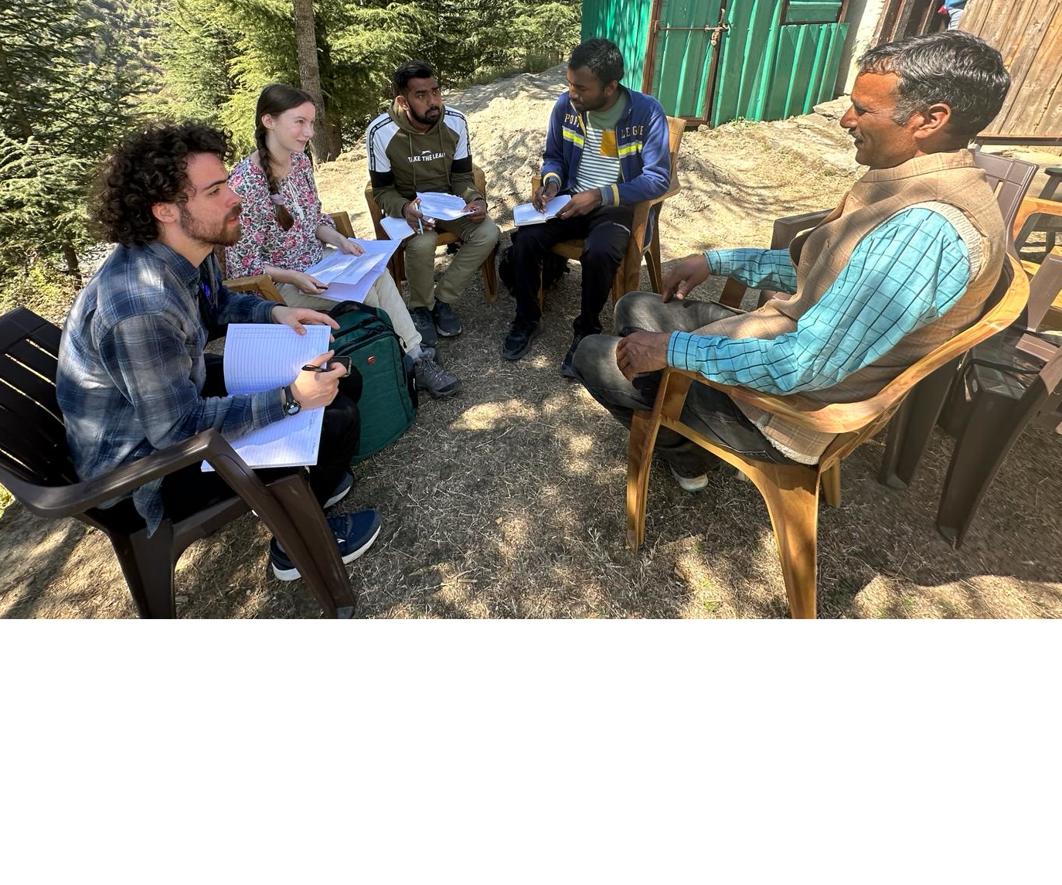
Group 06
ISTP - 2024
Indian Institute of Technology Mandi, India 175005
The Shifting Seasonality of Beekeeping with Climate Change
Mentor(s): Dr. Arti Kashyap (IIT), Dr. Uma Kumar (WPI), Dr. Alex Sphar (WPI)
Val Corrente, Somit Gond, Eric Hughs-Baird, Shubham Kumar, Fiona Morris, Pratibha Mathur, Prem Shankar
Context
Climate change is causing beekeepers globally to experience decreased productivity.
Himachali beekeepers rely on their product for income and are adopting more productive modern methods to advance economically.
Climate change in Himachal Pradesh is resulting in increased average temperatures and erratic rainfall.
The high hills are especially sensitive to climate change, so the slow effects of climate change are especially visible here.
Beekeeping is an agricultural process, and agricultural workers are more aware of changes in seasonality than the average person.
Mud-walled stationary hives
Group photo from field visit to Naggar
Goals
Evaluate the extent to which beekeeping and seasonality in Himachal Pradesh are impacted by climate change and examine how beekeepers perceive and adapt to its impacts.
The knowledge of beekeepers provides a unique, non-scientist perspective on the ways in which climate change is impacting the seasonal rhythms of life.
Wild bees foraging
Methods
We interviewed beekeepers in the Mandi, Shimla, and Kullu districts of Himachal Pradesh.
We consulted apiculture experts to corroborate the concerns expressed to us by beekeepers.
We spoke to government officials to learn about trends in pesticide use and modern beekeeping in Himachal Pradesh.
We observed the hive types used by beekeepers at different altitudes.
Apis Cerana bees in box hive
Group photo from field visit to Gumma
Results & Discussion
Beekeepers reported learning the importance of reducing pesticide exposure and providing supplemental food for their hives as a result of university-run training.
Some beekeepers noticed changes in seasonal timings on the scale of 10-15 days, while others noted no change.
Modern beekeeping methods require more maintenance and attention than traditional methods.
Beekeepers at different altitudes experience climate related changes differently.
Examples of traditional wall and log hives
Conclusions
Intensive monoculture and urbanization have decreased flora and hive populations.
Traditional beekeeping is less sensitive to increased temperature variability than modern methods, requiring less maintenance.
Beekeepers are returning to traditional methods to reduce hive maintenance or switching to modern methods to increase productivity.
Some stationary beekeepers have expressed concerns about the coexistence of traditional and modern methods.
Some apicultural experts consider migratory beekeeping a sustainable option for commercial beekeepers.
Recommendations
Increased access to education about natural farming methods and opportune times to spray pesticides will allow beekeepers in Himachal Pradesh to reduce the exposure of their colonies to harmful chemicals.
Local communities should investigate ways to decrease pesticide use by implementing natural farming or nontoxic pesticide alternatives.
Acknowledgements
We would like to thank our mentors and our peers for their support, the beekeepers and the scientists who graciously gave us their time and expertise, and Dr. Harish Kumar Sharma for his invaluable help.
Beekeeper showing an empty box hive
Interviewing beekeepers in Shegli Village
Interviewing beekeeper in Shegli Village
Wild bees foraging on white clover

