Slide 1


WPI Global Projects Program
Matthew Amodea Emily Gorelik Benjamin Sakac Andrew Sifferlen

Slide 2

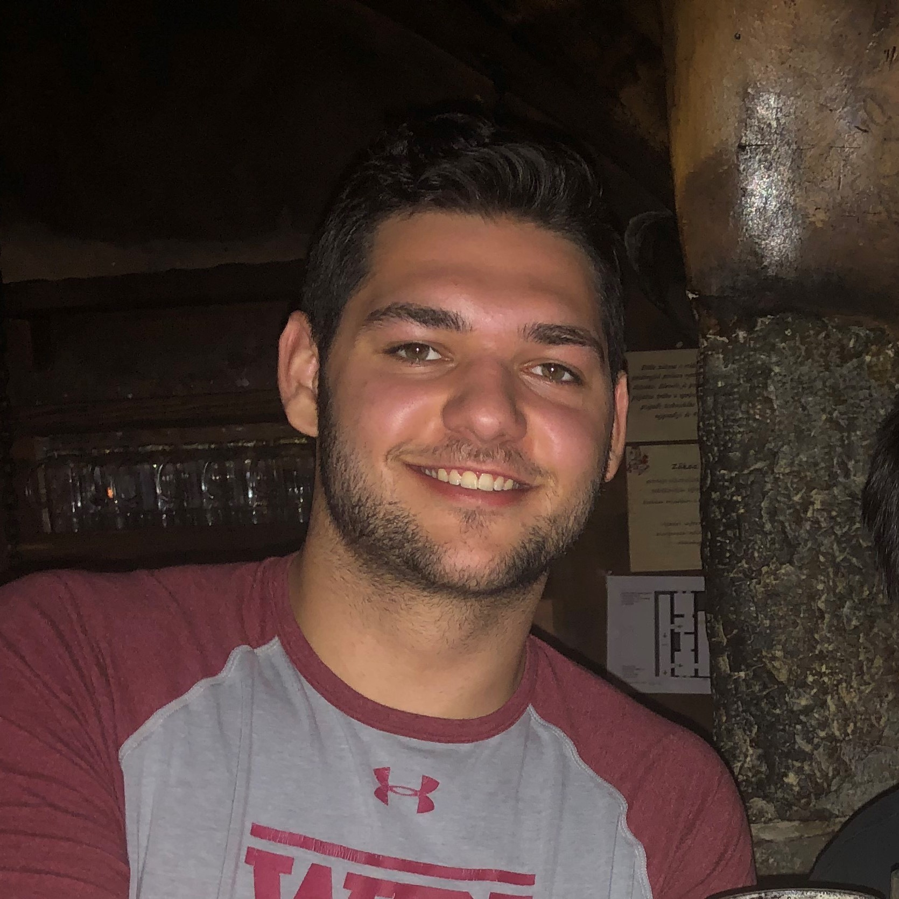
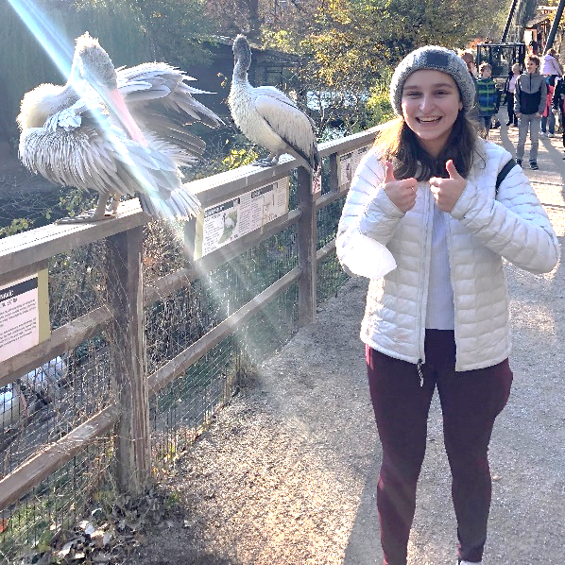

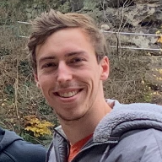
Our Team
Matthew Amodea
Robotics Engineering
Pennsylvania
Emily Gorelik
Computer Science
New Jersey
Benjamin Sakac
Management Information Systems
New Jersey
Andrew Sifferlen
Biomedical Engineering
Massachusetts
2

Slide 3
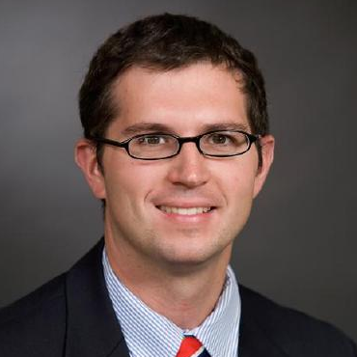
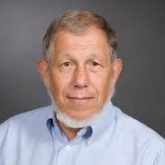
Director and Advisor
Professor Dr. Aaron Deskins
Center Director
Professor Dr. Robert Kinicki
Advisor
3

Slide 4
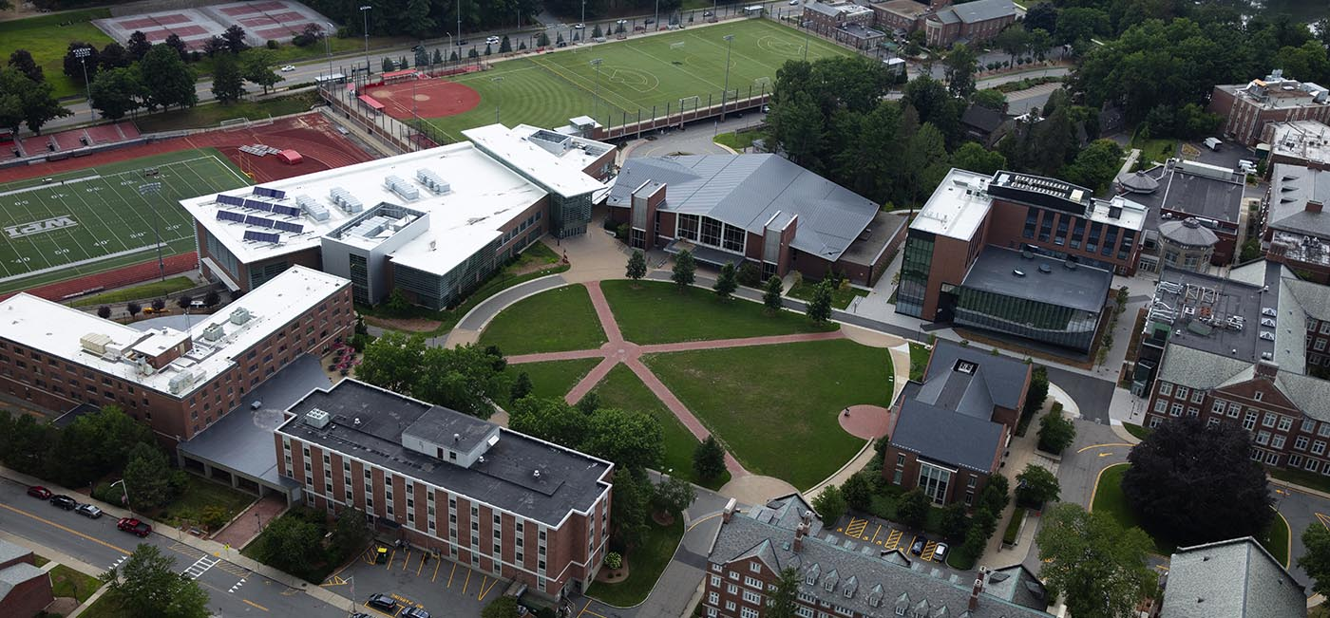

Worcester Polytechnic Institute
Founded 1865 in Worcester, Massachusetts
4661 Undergraduate Students
Project-Based Learning
Interactive Qualifying Project (IQP)
4

Slide 5
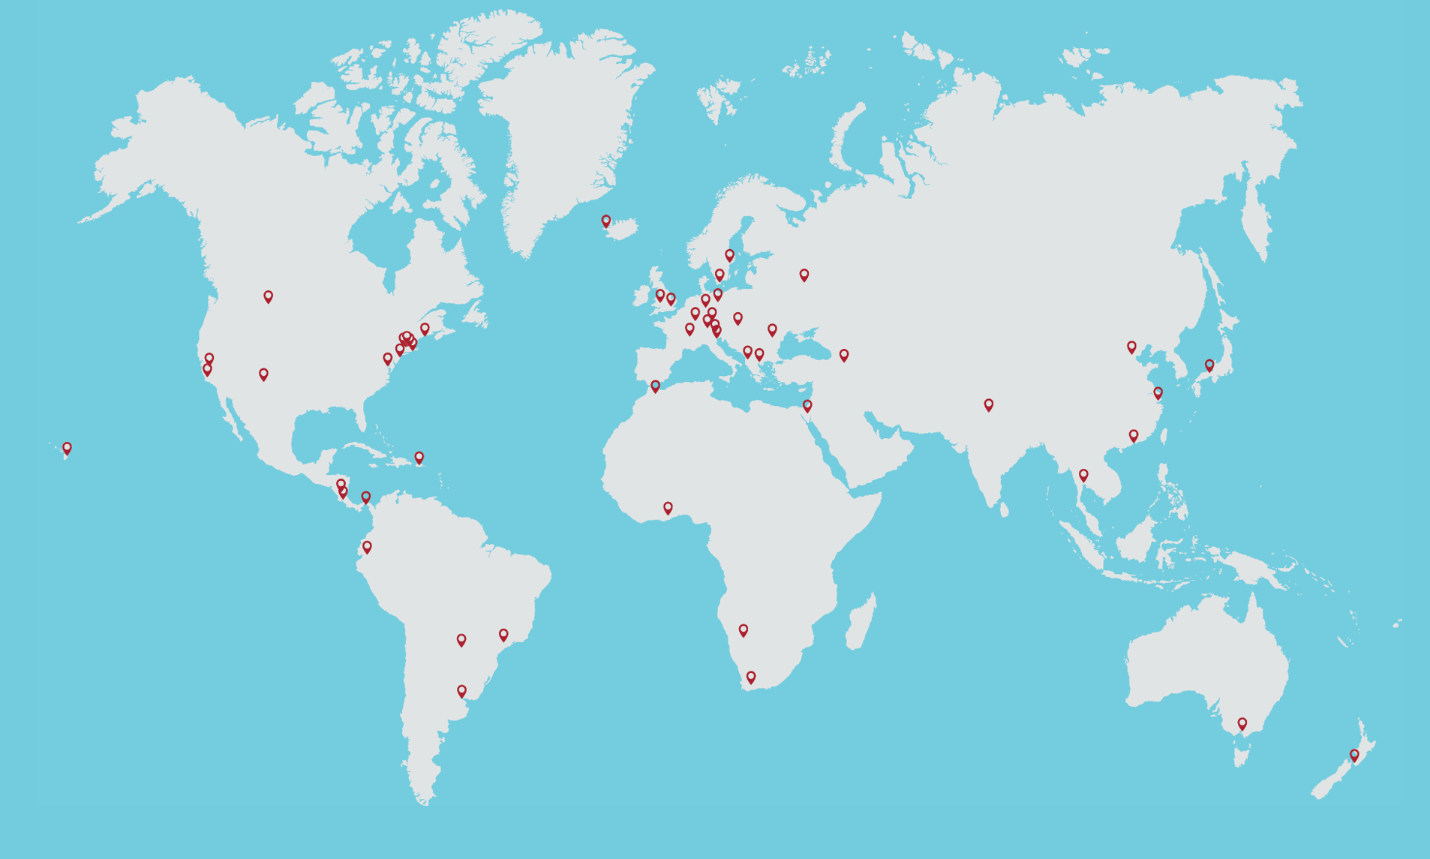

Global system of project centers
5

Slide 6
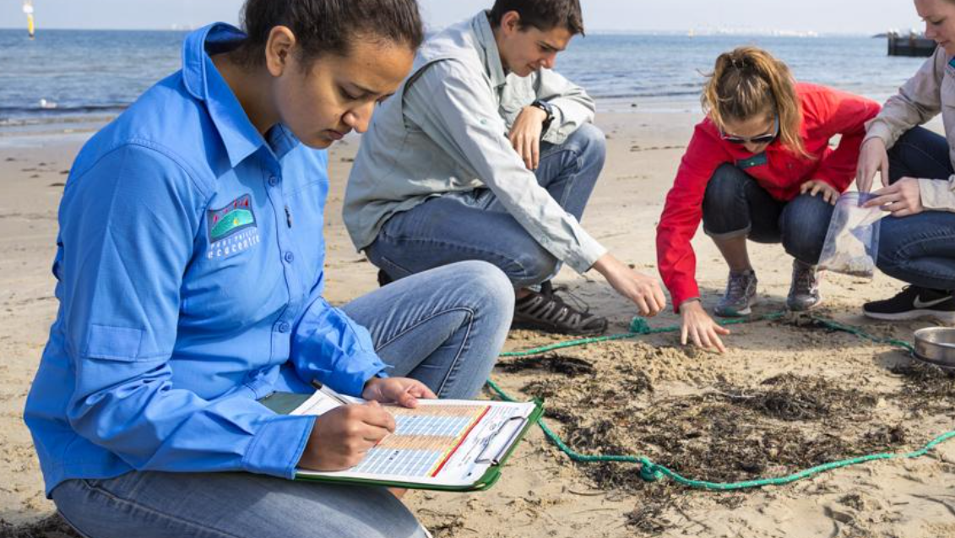
The Interactive Qualifying Project (IQP)
A group of well-prepared college students work with organizations by providing a technology-based solution to a challenge or need
Helps both students and partner organizations
Provides an educational experience for students to learn and grow
Targets projects that organization do not have time to explore
6

Slide 7
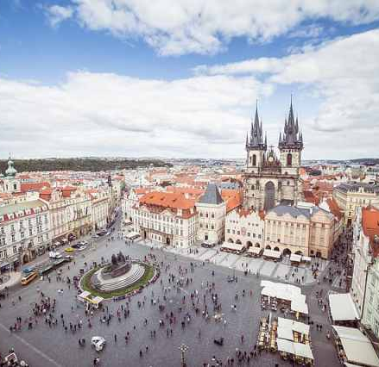
Why are we here?
Grow the Prague Project Center
Establish partnerships with organizations
7

Slide 8
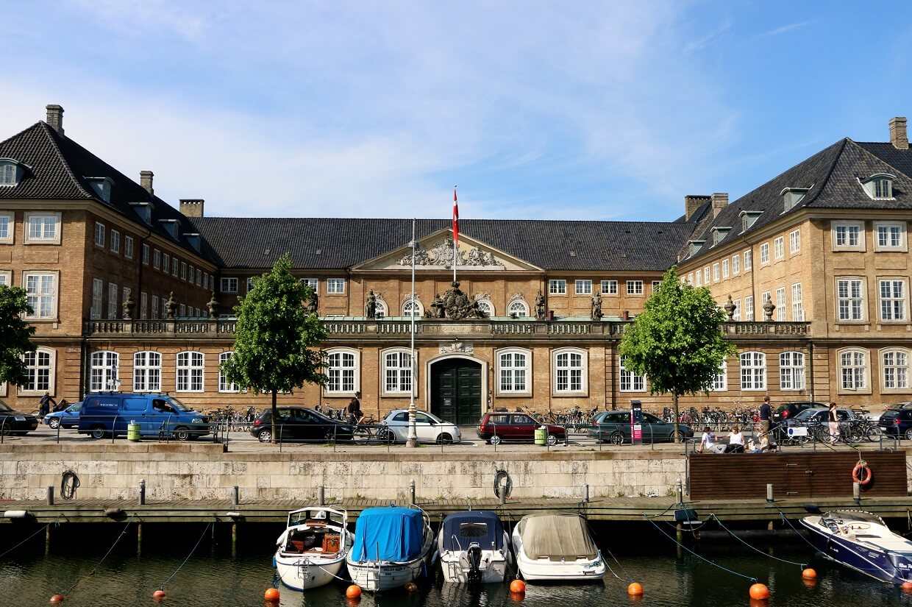

Determination of the most sutiable technology system for virtual touring at the National Museum of Denmark
Goal
Result
Designed virtual touring system, developed prototype, assessed costs
Select the most suitable imaging technology based on specific desires and characteristics
8

Slide 9
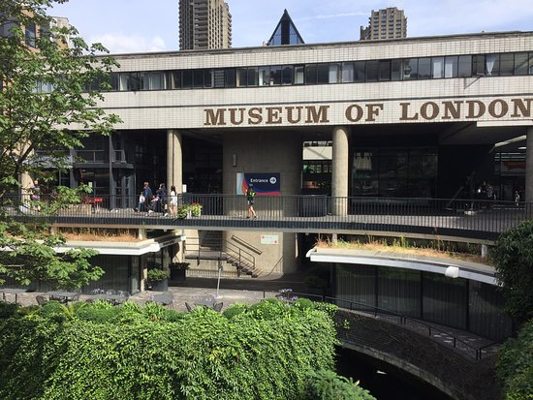
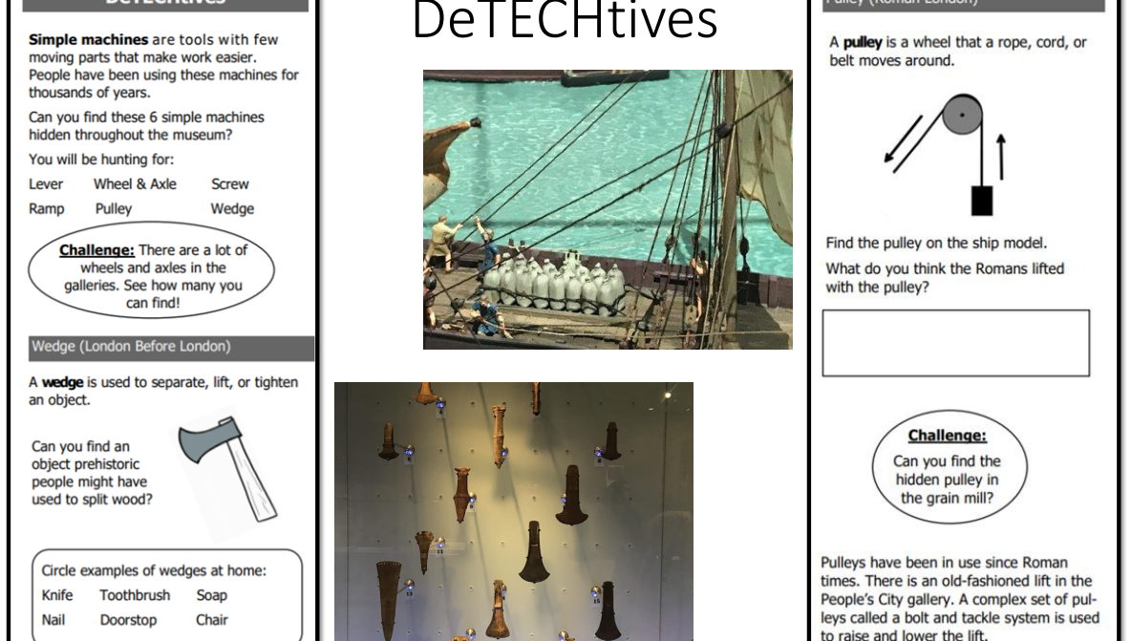

Developing STEM Activities for the Museum of London
Goal
Result
Develop, deliver, and review two STEM-based, family focused activities.
Presented seven new activities and a set of recommendations for design and implementation
9

Slide 10
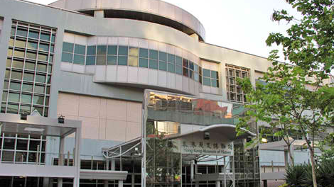
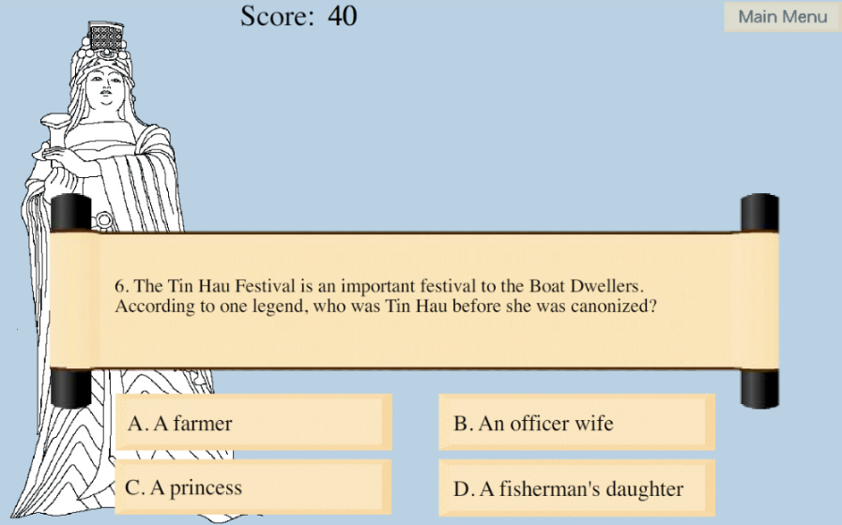

Making History Interactive at the Hong Kong Museum of History
Goal
Assist the Museum in educating visitors about cultural heritage and history
Result
Created interactive hands-on and computer activities that utilized multiple learning styles

Slide 11
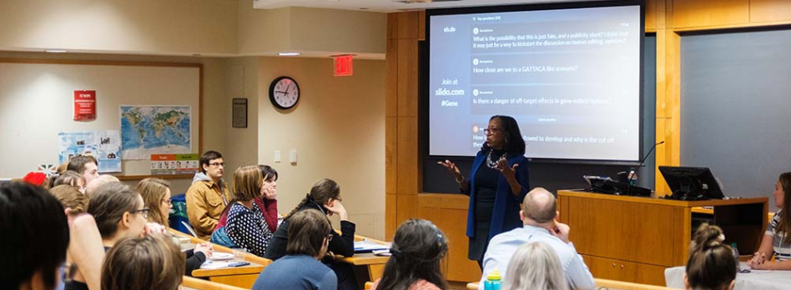
How Students Prepare
Learn research and analysis strategies
Write a project proposal
Remote Interaction with Partner
11

Slide 12
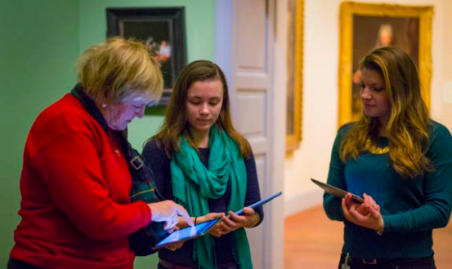
Benefits to Partners
Student dedication and time commitment
Advisors ensure quality work
Final project report and deliverables
12

Slide 13
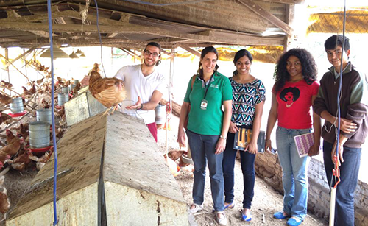
Interns vs. Consultants
Not an internship
Consultancy
Not employees/ no busy work
Partners do not set deadlines
Allows flexibility
Balanced benefits
Multiple Deliverables
  Results and suggestions
  Deliverable for Partner
13

Slide 14
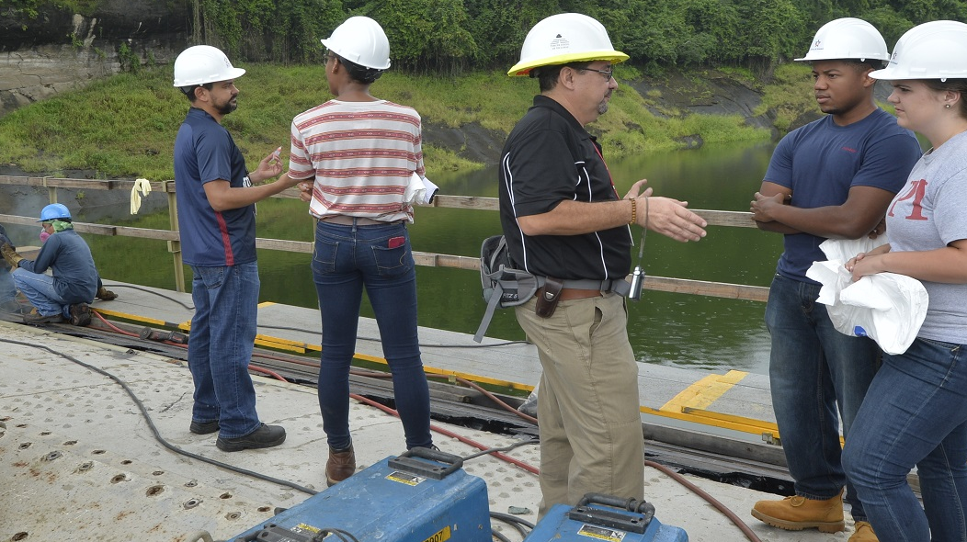
Responsibilities of Partners
Dedicate
2 Hr/week time commitment
Liaison
Maintain
Communication
Provide
Project description
14

Slide 15
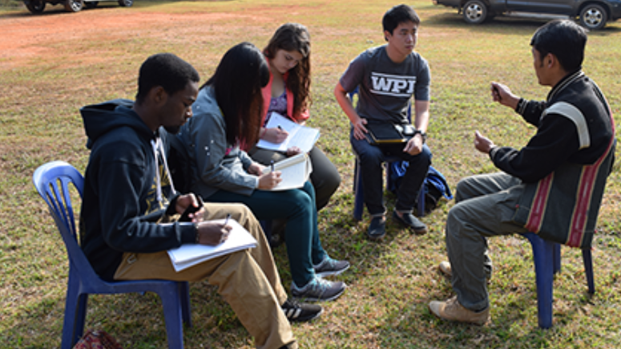





Good Projects Include
Academics
Open-ended solutions
Interactions with local community
Interesting and helpful to the partner organizations
Low Priority
15

Slide 16

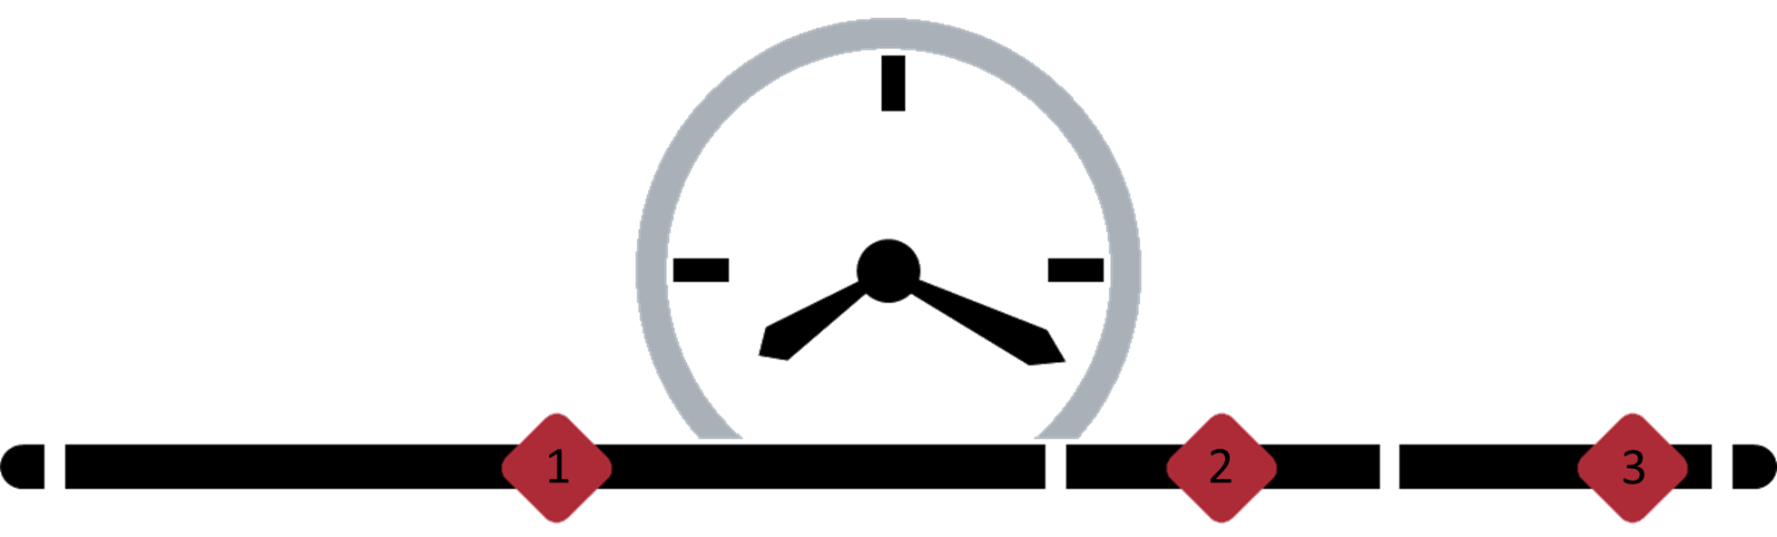
Projected Timeline
1
January – August
Discuss
2
Mid August – Mid-October
Design
3
Mid-October – Mid-December
Implement
16

Slide 17
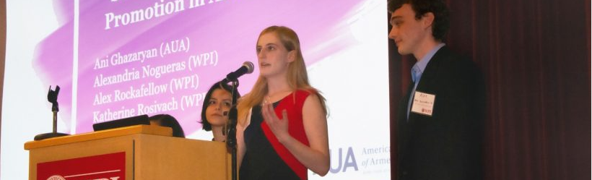



Outcomes
Benefits to students and partners
Project center director communication
No formal commitment
for future projects
17

Slide 18
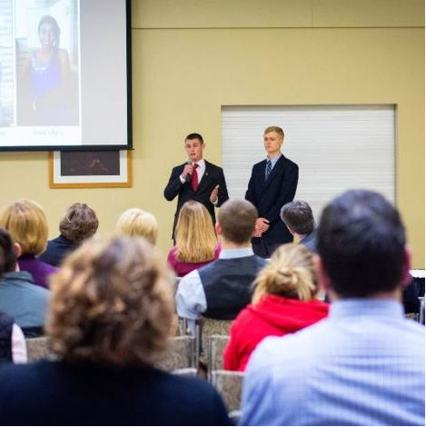
Final Presentations
If you are interested in seeing the final presentations, we can send you the location details once they become available. The presentations can be viewed in person or online.
Date: December 6th
Time: 3-5pm CET
18

Slide 19

Contacts and
Additional Information
Contact the team: gr-futurepragueiqpsponsorship@wpi.edu
Contact our advisor: rek@wpi.edu
Prague Project Center Directors:
Aaron Deskins: nadeskins@wpi.edu
Marie Keller: mkeller@wpi.edu
Prague Project Center Website:
pragueprojectcenter.org
20

Slide 20
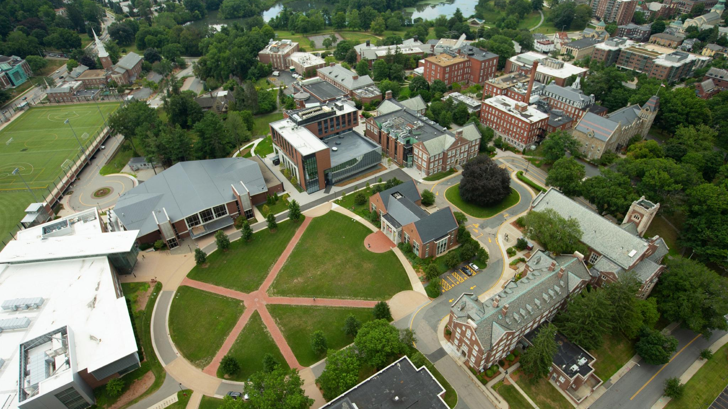
Děkujeme
Questions?

