Slide 1
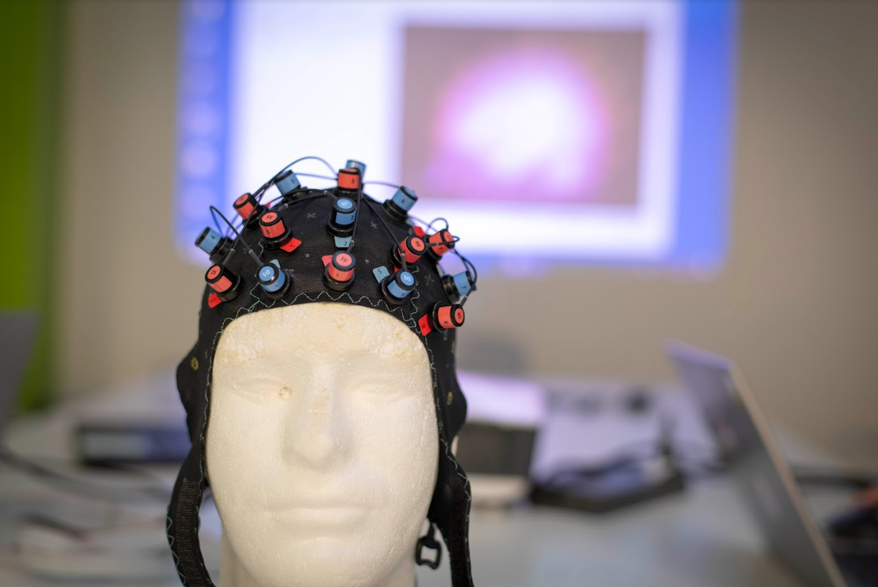
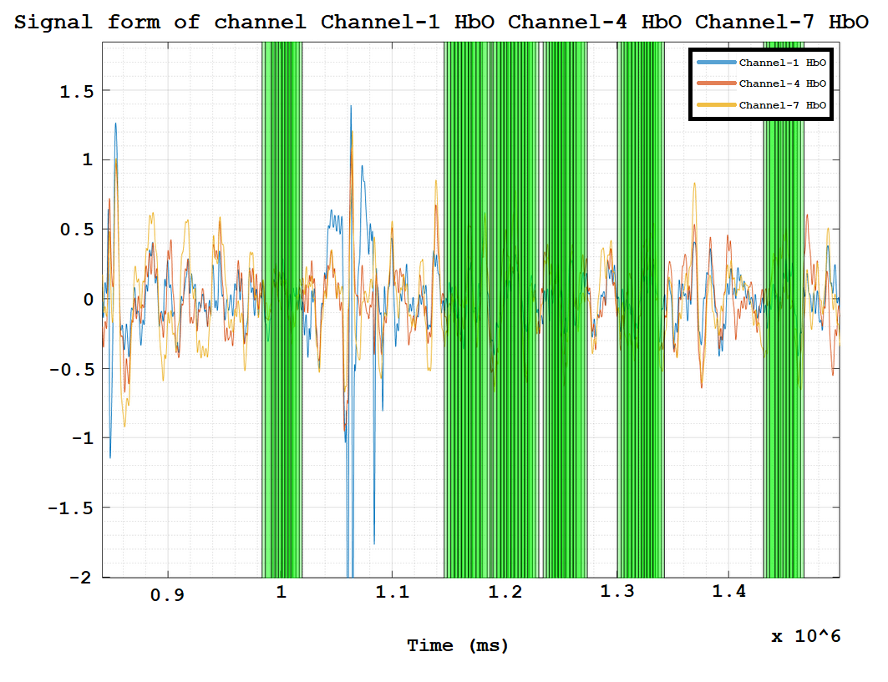
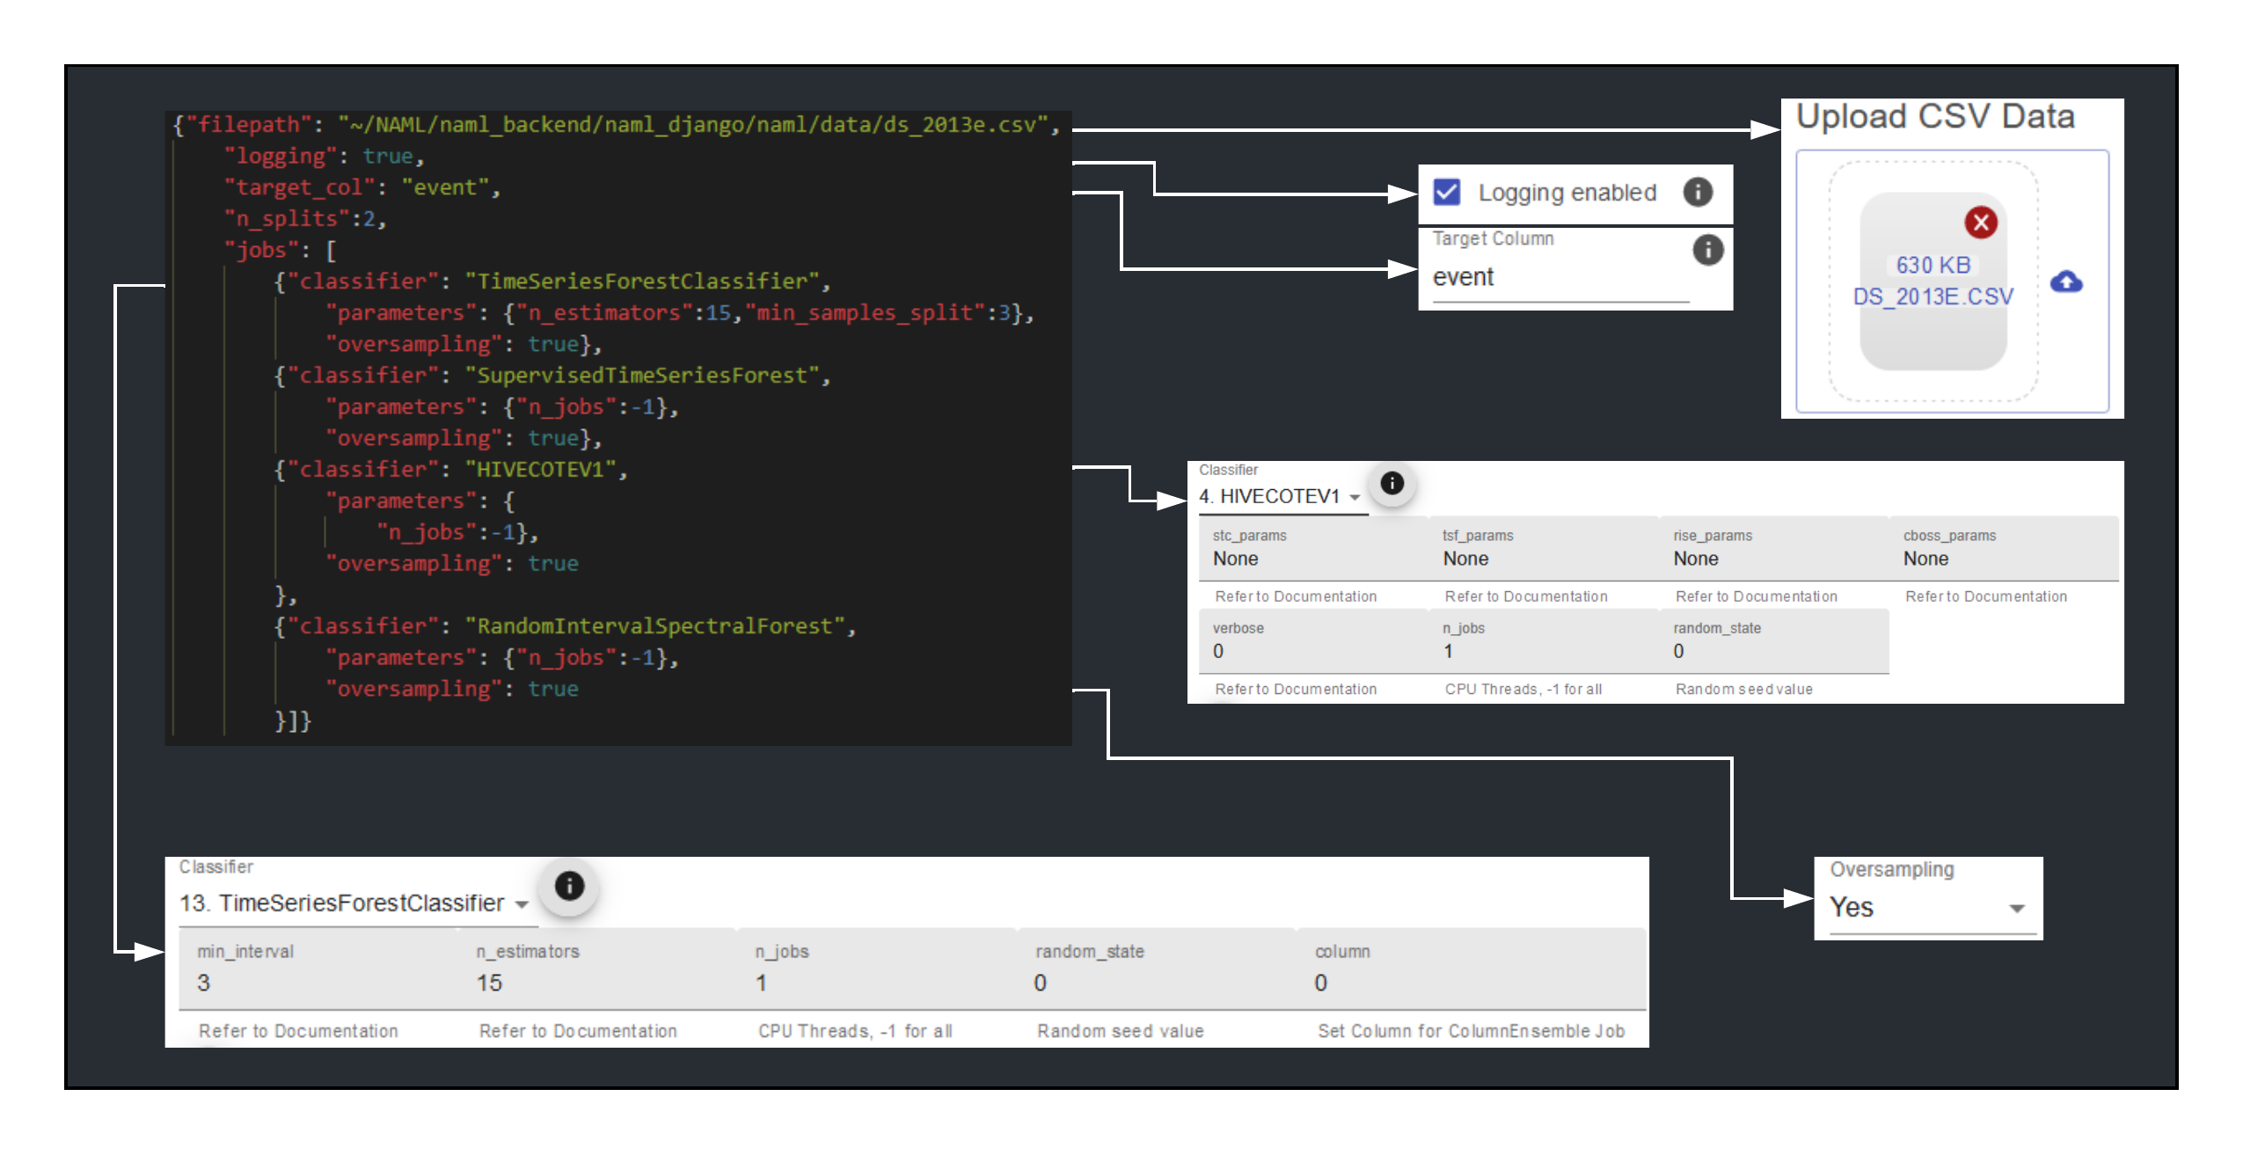
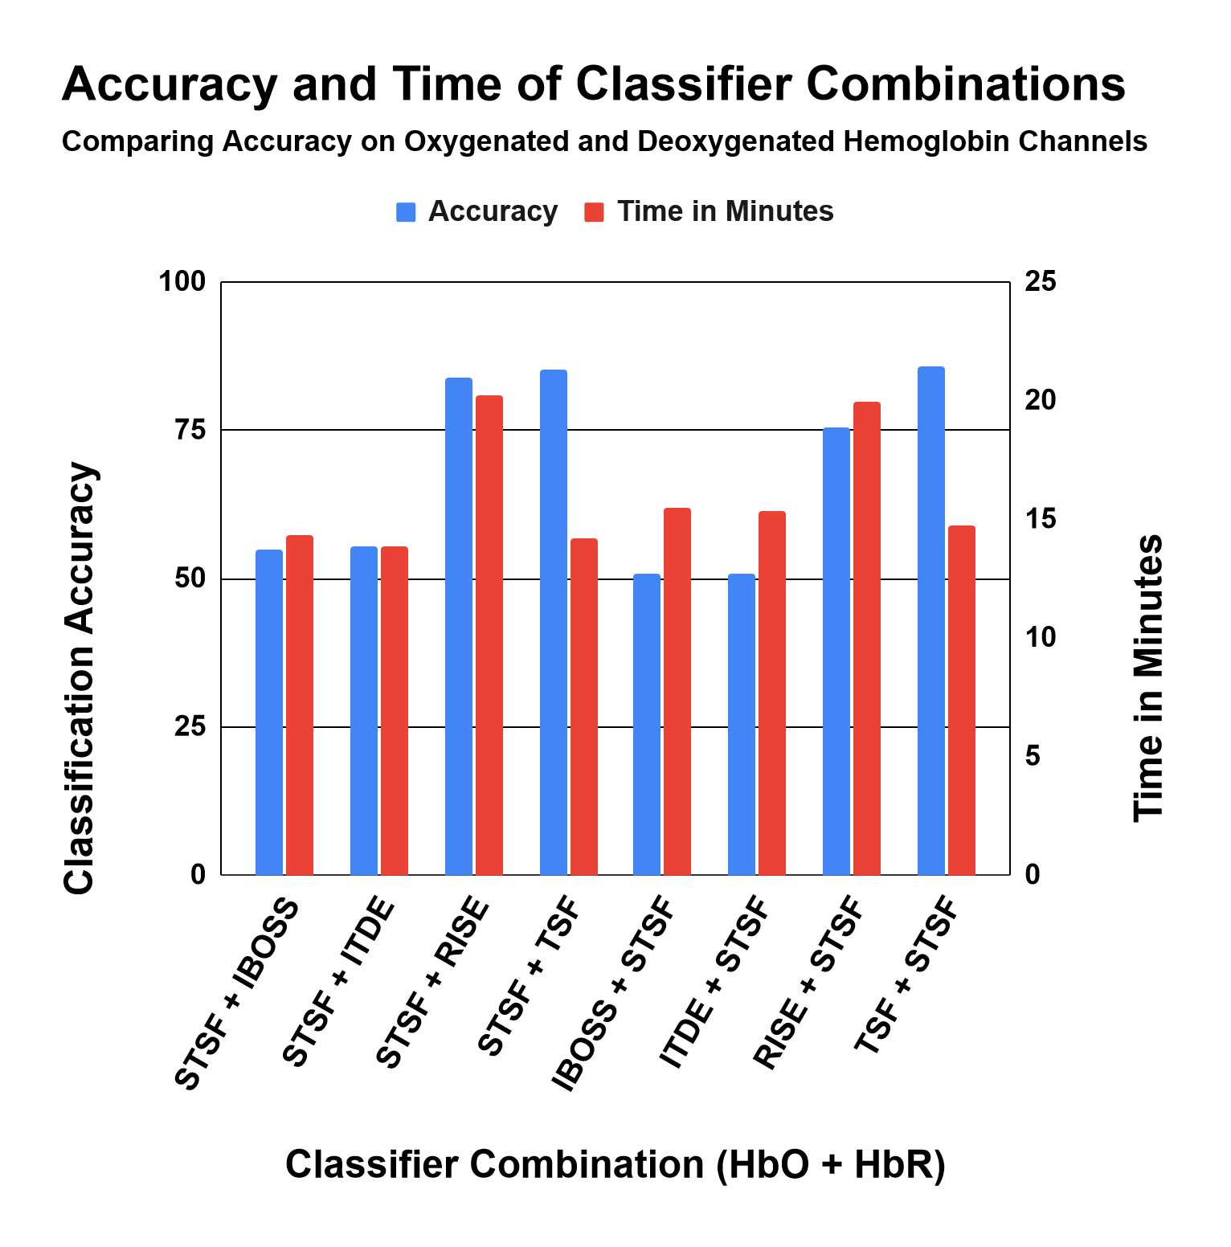
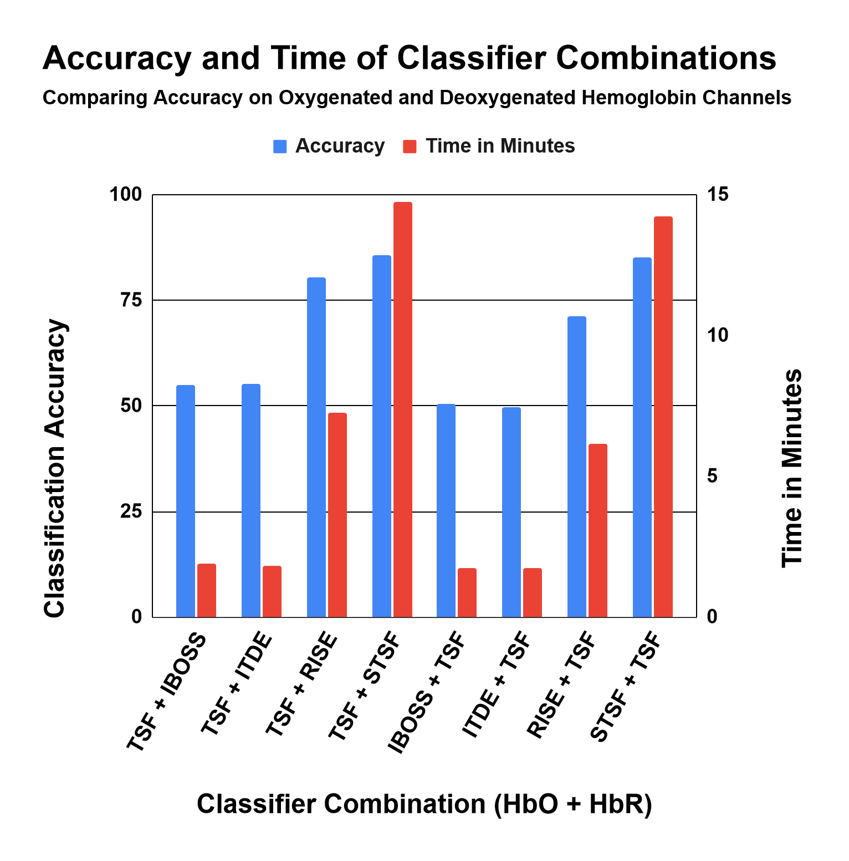
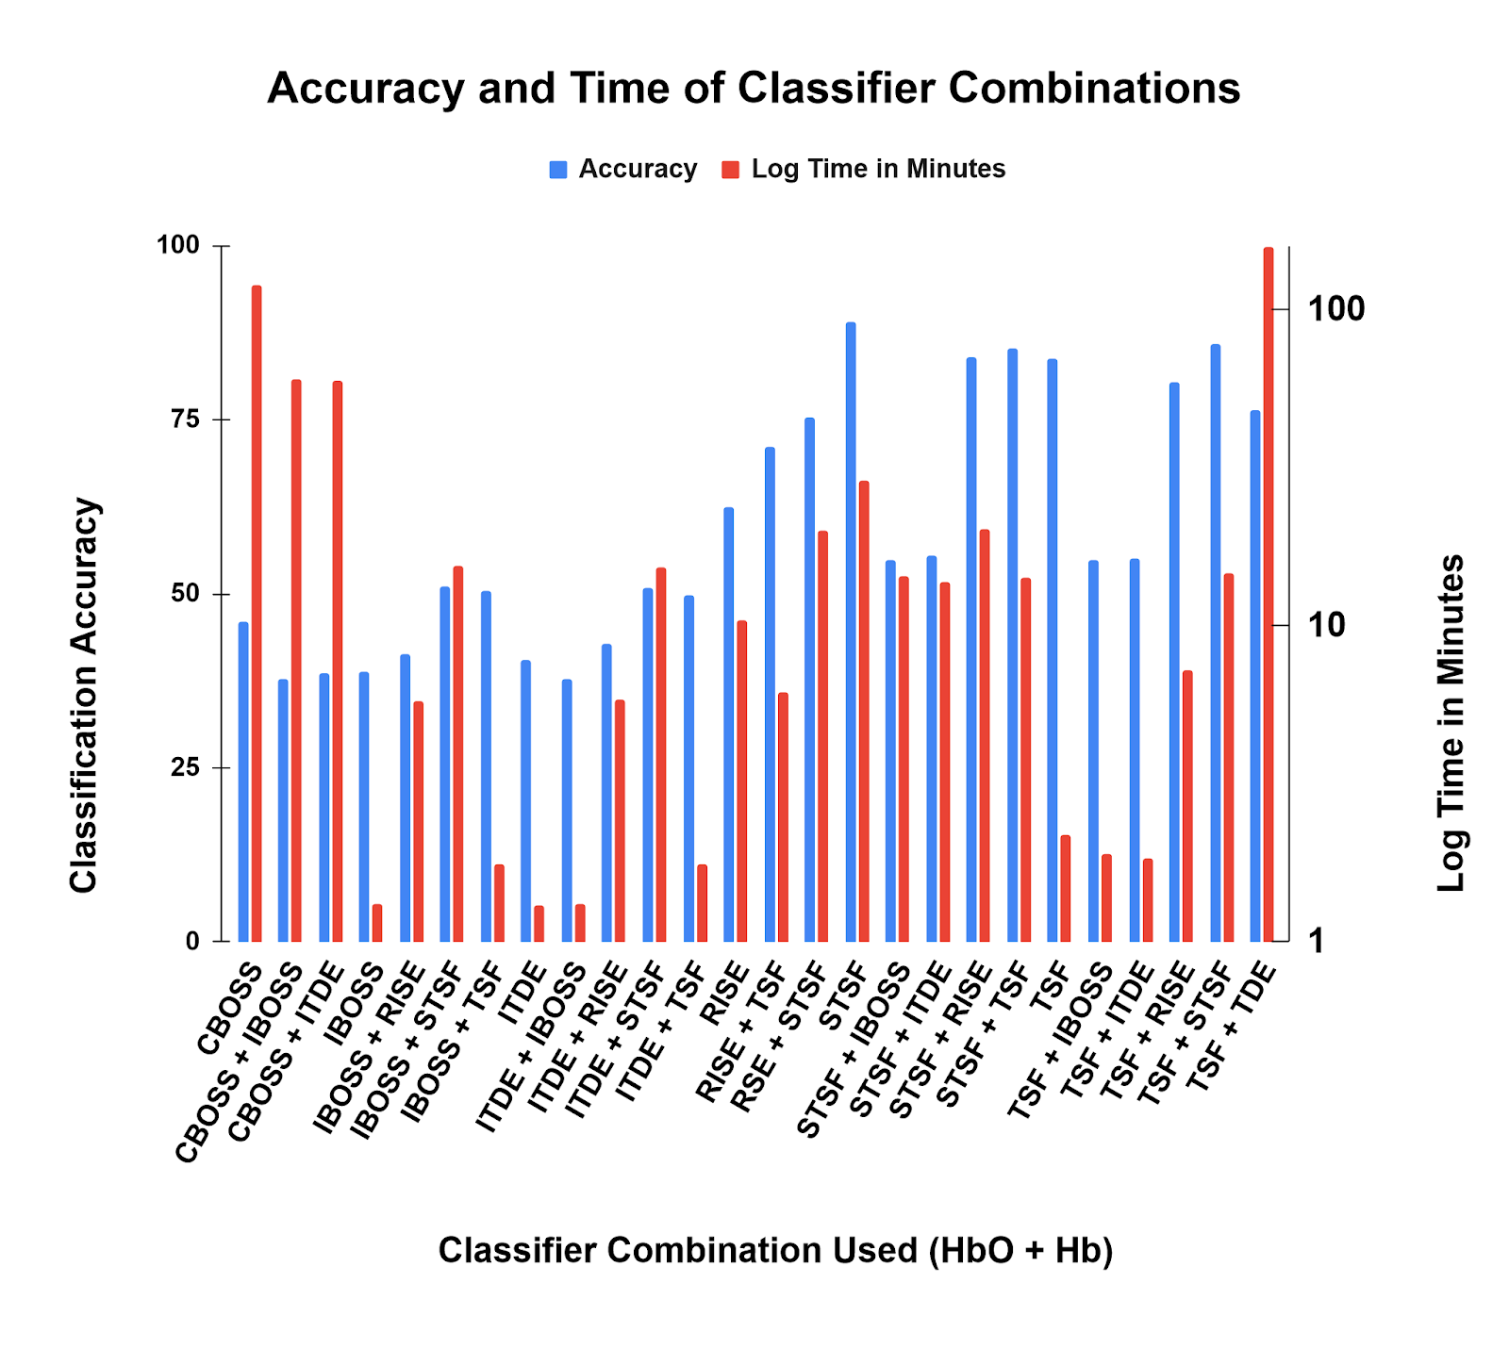
NAML : An Easy-to-Deploy Application
for Time Series Classification
Patrick Houlihan (CS)
Advisors: Professor Rodica Neamtu (CS), Professor Erin Solovey (CS)
What is NirsAutoML?
Continuous Integration with sktime
Create Stable Docker Container
What is fNIRS?
Enables researchers to perform Machine Learning Classification on Multivariate Time Series.
Functional Near-Infrared Spectroscopy is a noninvasive brain sensing technology increasingly used in brain-compute interaction.
Measures difference between emitted light into brain region and what refracted out.
This change can be used as a measurement of brain activity in a specific region (channel).
HbO – Oxygenated Hemoglobin, related to the amount of oxygen sent to the brain.
Hb – Deoxygenated Hemoglobin, related to the amount of oxygen the brain consumed.
Event – A classifiable stimulus that a user experiences during an experiment.
Channel – Time series readings in a particular brain region.
Sequence – The activity recorded by a channel around the time of an event. Shown in green on the left.
Customized for fNIRS data (Collected using the cap to the right)
Built using sktime [2][3].
Realistic Case Study with NAML
Project Goals
Streamline Installation and Deployment
Installation and Deployment
Central Hub for Documentation
Create User Interface
Initial Installation Process
Initial Installation Process
Shortened to a two-step process, install Docker and build the container.
User Interface
Run Command Line NAML Jobs
Can immediately be done by copying datasets and configuration files into the container and running them with python naml.py <configPath>.
Running classifiers in NAML used to require making a config file.
Now, the user interface provides elements to write equivalent config files in less time and with more information provided.
Classifying on HbO vs Hb
When using Supervised Time Series Forest (STSF) and Time Series Forest (TSF) classifiers, accuracy increases by 7-13% with most combinations when run on HbO data as opposed to Hb data.
Launch as a Webapp
For local use of the user interface, a user can enter the container and launch the React frontend and the Gunicorn backend over localhost and submit configurations to NAML.
Access on Remote Server
NAML can be accessed as a command line application via SSH to the WPI HCI lab server or accessed as a webapp at http://brainex.wpi.edu:3030.
Future Maintenance
Case Study
Finding Good Classifiers
Acknowledgements
Can immediately be done by copying datasets and configuration files into the container and running them with python naml.py <configPath>
I would like to thank Dr. Rodica Neamtu and Dr. Erin Solovey for their guidance throughout this project. I would like to thank Alicia Howell-Munson and Christopher Micek for their feedback and dedication. I thank James Plante for his work on BrainEx inspiring improvements to NAML. I thank Chau Do, Ellery Buntel, Fareya Ikram, and all other NAML contributors for providing a strong foundation to build upon.
Refactored code to make adding classifiers easier for future maintainers.
Added Continuous Integration with sktime in the form of dual Conda environments [2][3].
One is stable to ensure consistent results and safe usage for researchers, the other is advanced for getting new sktime additions [2][3].
Given a large dataset with equivalent distribution of many events belonging to four classes [1], what can we find out about this dataset?
Which classifiers are most effective?
Is a specific family of classifiers better than others?
NAML can answer these questions.
A combination indicates the first classifier runs on HbO and the second on Hb data.
The most effective classifiers were TSF and STSF.
Interval-based classifiers outperformed dictionary-based classifiers.
References
1. Huang, Z., Wang, L., Blaney, G., Slaughter, C., McKeon, D., Zhou, Z., ... & Hughes, M. C. (2021). The Tufts fNIRS Mental Workload Dataset & Benchmark for Brain-Computer Interfaces that Generalize.
2. Löning, M., Bagnall, A., Ganesh, S., Kazakov, V., Lines, J., & Király, F. J. (2019). sktime: A unified interface for machine learning with time series. arXiv preprint arXiv:1909.07872.
3. Löning, M., Bagnall, T., Ganesh, S., Oastler, G., Lines, J., Kazakov, V., …, Deshmukh, A. (2020). alan-turing-institute/sktime. Zenodo. http://doi.org/10.5281/zenodo.3749000

