Slide 1
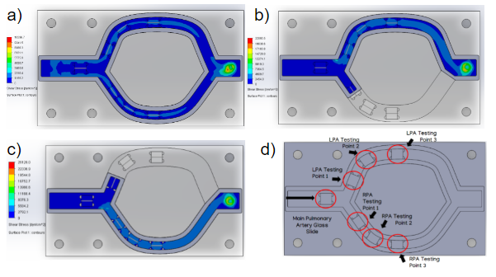
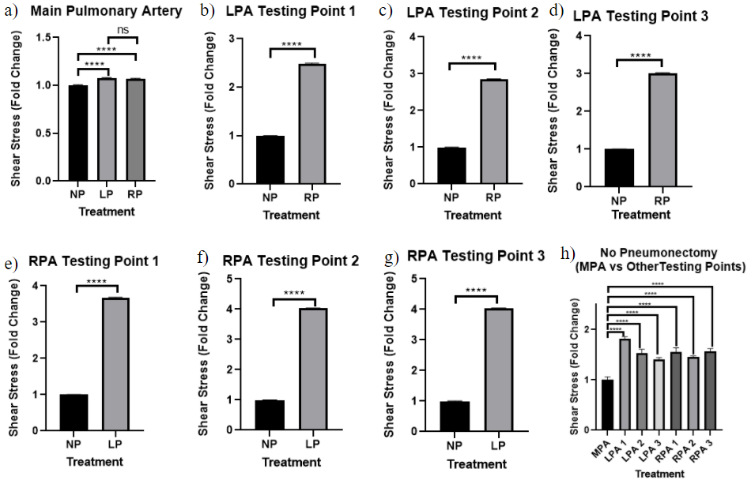
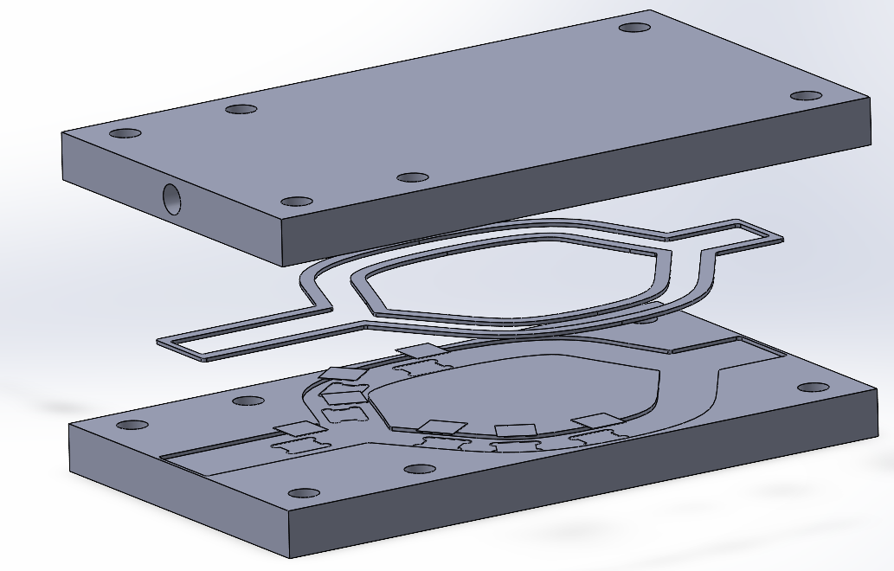
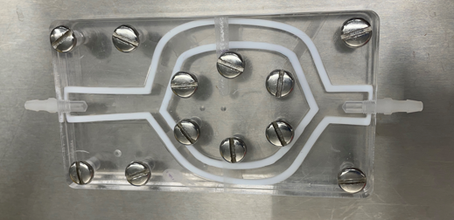
A Parallel Plate Flow Chamber to Investigate Endothelial
Glycocalyx Remodeling After Pneumonectomy
Natasha Cruz-Calderon, Lydia Masse, Gillian Miller, Taylor Paradis,
Samantha Raskind, Aaron Waxman, Solomon Mensah & Kristen Billiar
Worcester Polytechnic Institute Biomedical Engineering Department
Abstract
Methodology
Results
After a pneumonectomy there is an increase in shear stress in the remaining artery, however few studies have examined the effects of this increase on the endothelial glycocalyx. A fluidic model of the pulmonary arteries that could represent a no pneumonectomy or a pneumonectomy. Fluid flow simulations were also performed on a Computer-Aided Design model to study the change in shear stress after a pneumonectomy. The simulations revealed that the shear stress after either a left or right pneumonectomy was significant. The effect of shear stress on endothelial cells could greatly increases post-pneumonectomy and can damage the endothelial glycocalyx. Understanding how shear stress increase affects cells is a critical step in reducing patient mortality after complications post-pneumonectomy.
Flow simulations were completed using Solidworks to confirm the increased shear stress that would be experienced on the cells by introducing an input volume flow of 5 L/min which is the rate that the heart pumps blood through the pulmonary arteries to the lungs.
The following figure shows shear stress overlays of the three experimental models.
The Solidworks flow simulations show that after a left pneumonectomy there is about a four-fold increase in shear stress and after a right pneumonectomy there is about a three-fold increase in shear stress.
To mimic the conditions that endothelial cells and the glycocalyx experience after a pneumonectomy a flow chamber was designed and modeled using Solidworks.
This flow chamber was created to accurately mimic the anatomical features of the main pulmonary artery and the entrances of the left and right pulmonary arteries.
The diameters of the arteries and angles at the branching point were obtained from literature and are reflected in the model.
Introduction
Conclusion
The shear stress overlays do show a significant increase in the shear stress in the remaining artery after a pneumonectomy (seen by the lighter blue color in the pneumonectomy models).
To confirm this, quantitative data was taken at each testing point to measure the fold increase in shear stress after a pneumonectomy.
Based on the Solidworks flow simulations the team has concluded that there is a significant increase in shear stress after a pneumonectomy and that this increase can damage the glycocalyx. The cell images from the experiments are predicted to support this data.
A pneumonectomy is a surgical procedure to remove an entire lung and seal off the connective artery.
The glycocalyx is a cell coating that protects the endothelial cells and helps maintain cellular homeostasis.
The glycocalyx is regulated by the shear stress that blood flow creates and changes to the flow can impair its ability to function.
The disruption of this layer can lead to cardiovascular diseases and can be fatal.
Our study will examine how the glycocalyx might be affected after a pneumonectomy
The bottom plate has the cutout for the flow path as well as spots to sit glass slides.
Seven glass slides were placed at points of interest for studying the shear stress.
The top plate allows for flow to be introduced into the flow path.
Teflon gaskets were created that sits along the edge of the flow path to prevent leaking and give the required height needed for shear stress.
A total of three gaskets were created: one for the no pneumonectomy model, one for the left pneumonectomy model (that blocks the flow to the left artery), and one for the right pneumonectomy model (that blocks the flow to the right artery).
To validate the results from the flow simulations the flow chamber was machined for future in-vitro testing.
We would like to thank our WPI advisors Solomon Mensah & Kristen Billiar for their support and guidance. We would also like to thank Dr. Aaron Waxman of Brigham and Women’s Hospital for his input and help on the project. Lastly, we would like to thank the WPI Biomedical Engineering Department for funding.
Acknowledgements

