Slide 1
CORONAVIRUS STORIES - Capturing the Voices of College Students
Chris Ferrari, Gelila Hailemariam, Lucas Falsarella Guerreiro, Will Schwend
Notes:
Gelila

Slide 2
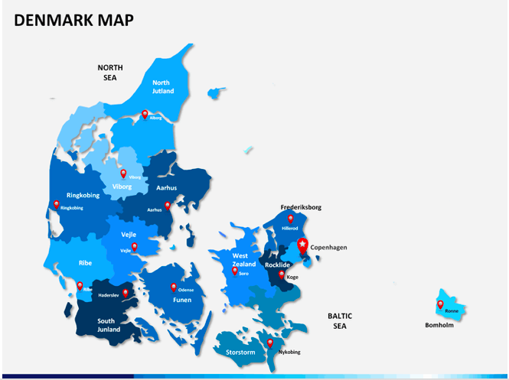
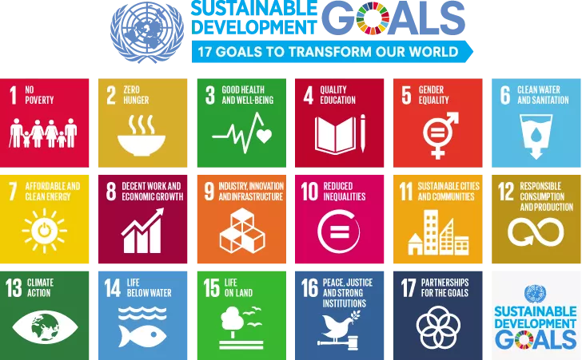
Our Original Project
Notes:
Will:
Our original project was supposed to be in Copenhagen Denmark
The project focused on interviewing local organizations about their climate action plans
One of the main focuses was on how the plans achieved the UN sustainable development goals
Our team was going to then create a video summarizing our findings
With Coronavirus resulting in the cancellation of our original project we wanted to continue as many aspects of that orginal project as possible leading to the project we ended up completing

Slide 3



We chose this project to
Collect video stories of students
Share compiled documentary with universities
Evaluate stories to find commonalities
Notes:
Chris
So, due to the coronavirus we chose to change our project.
We chose this project to:
Collect and make available the video stories of students across the US regarding their experience with COVID-19.
Once these videos were collected we evaluated the stories gathered to find different commonalities amongst colleges’ responses to this
pandemic and the different student perceptions of these responses.
Finally, with all of the responses collected, we worked to create a documentary compiling the best stories from the participants in order
to tell a chronological story.
This video was shared compiled documentary with universities for better decision making in the future

Slide 4
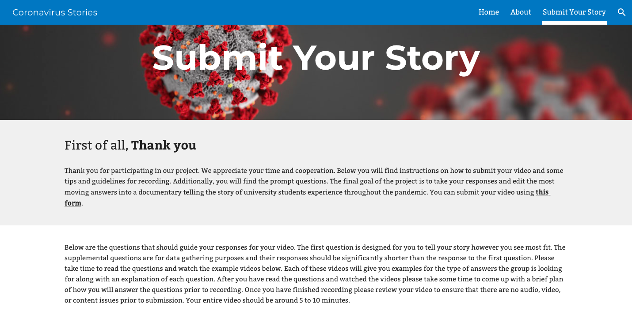
Notes:
Gelila:
To facilitate the collection of videos from students the team created a website with links to informative sites
Some background information about the project, about the team members, and tips on how to record videos,
For students to submit their stories they went to the submit your story page which had
List of interview questions that lay the foundation for the team to gather data and for each student to tell their story

Slide 5
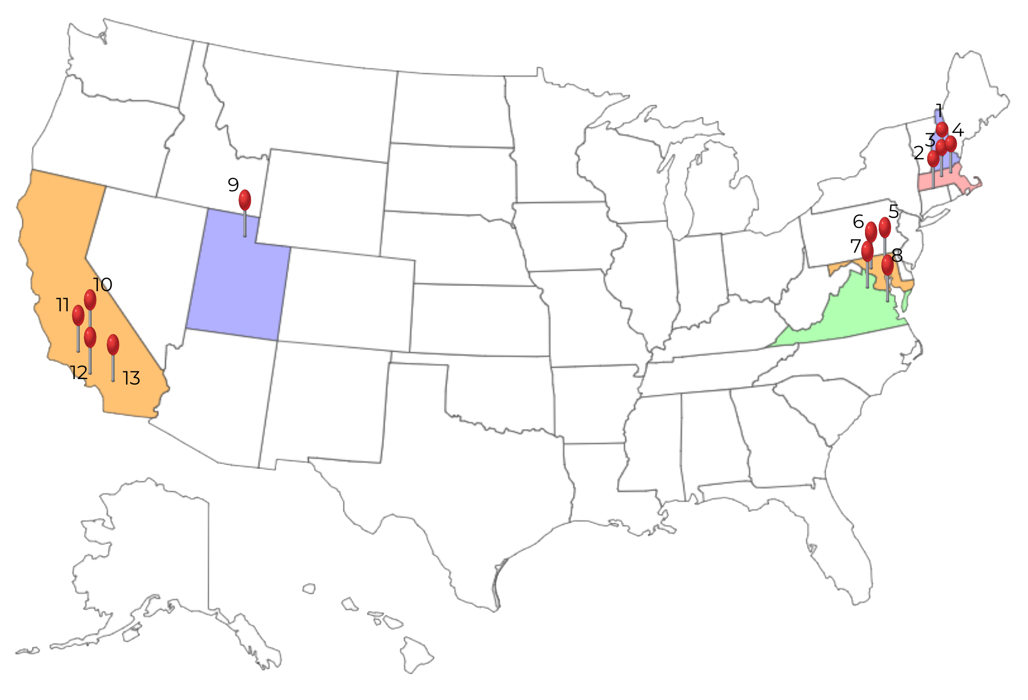
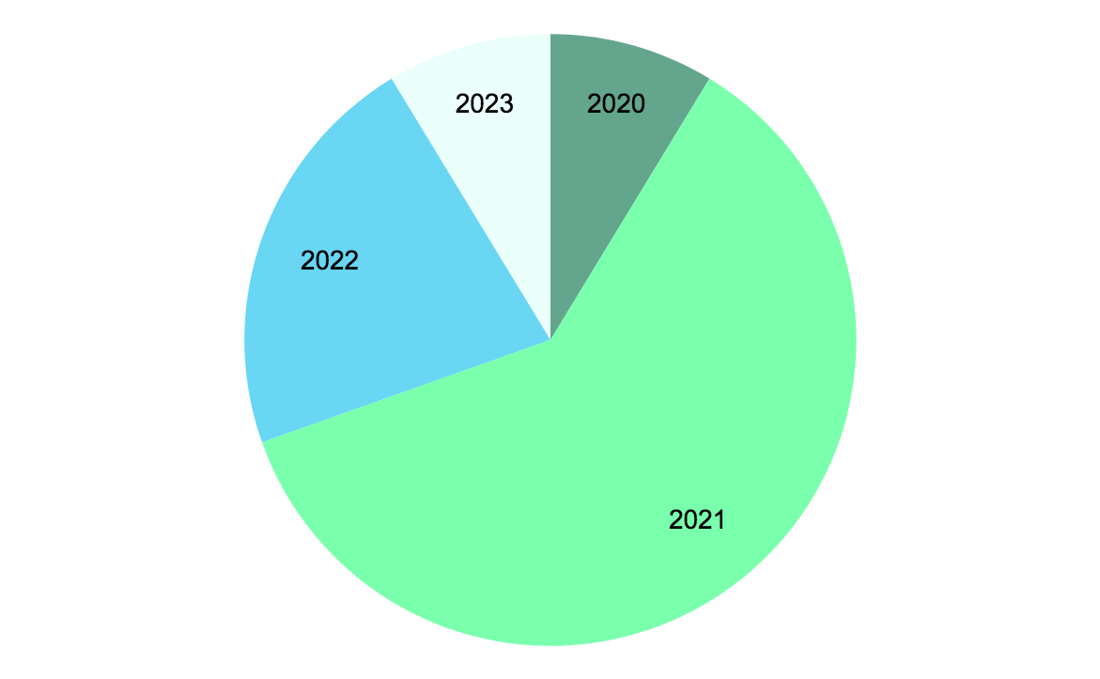
Graduation year
Southern New Hampshire University 9. University of Utah
Nichols College 10. Palomar College
Tufts University 11. University of California Los Angeles
Worcester Polytechnic Institute 12. Mira Costa College
University of Maryland Baltimore County 13. University of California San Diego
University of Maryland College Park
The Catholic University of America
University of Richmond
Notes:
Gelila:
Before each student could submit their video they filled out a form about their demographics
Some of the data collected included the universities they attend. As you can see on the map we received responses from 13 universities across the us and majority of the students being from wpi
One of the other questions we asked was the graduation year of the participants and as you can see majority of them are class of 2021

Slide 6
Analyzing Videos
Team Watches the Video
Responses Entered into Spreadsheet
Responses Coded
into Preset Categories
Team Identifies Commonalities in Responses
Notes:
Lucas
The process for analyzing videos was relatively simple
Participants uploaded their responses through our online form. The team would watch the video taking notes of the key points in each of the videos. We also created a transcript of each response as to have a written record. These key points were entered into a spreadsheet and then coded into preset categories. Using this method the team was able to create a way to visualize and present the data collected. One advantage of this procedure is that it allowed the team to be prepared to receive any number of responses, while still being able to create a data set that was representative of all participants.

Slide 7
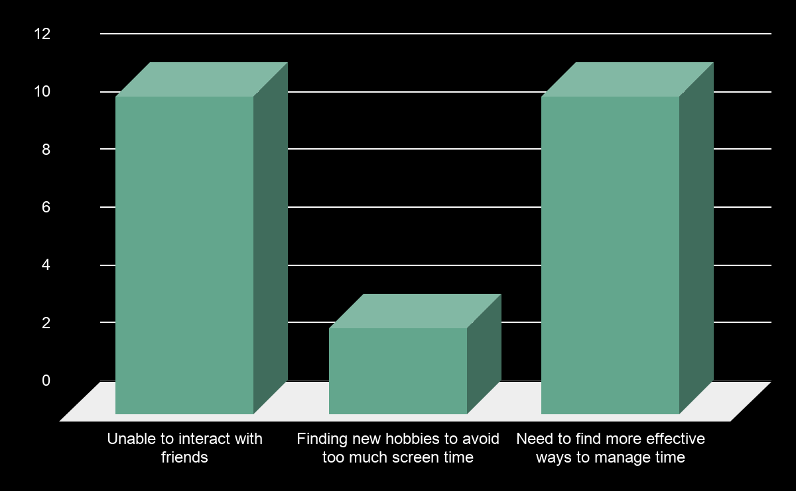
How Students Lives’ Changed
Notes:
Will
The first of the two largest commonalities we identified was how students’ daily lives changed
11 of the respondents said that the biggest change in their lives was unable to interact with friends
Due to college encouraging students to be social through working together in classes and for out of school social life
11 of the respondents said the biggest change was the need to more effectively manage time
Lack of structure typically provided by university
More time lead to worse results
Remaining said that they took up new hobbies
Finally had time to do things they always wanted to do but never had time to

Slide 8
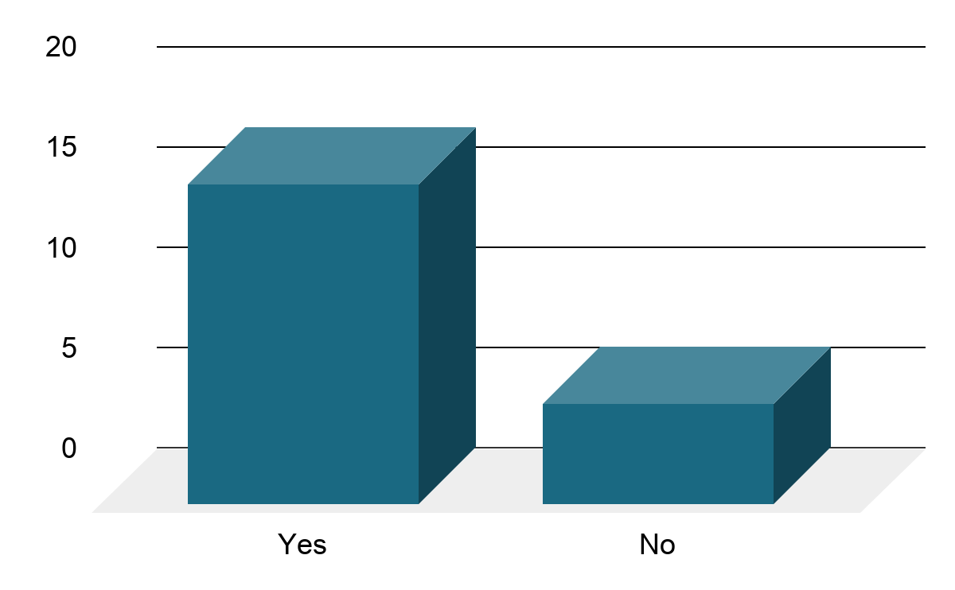
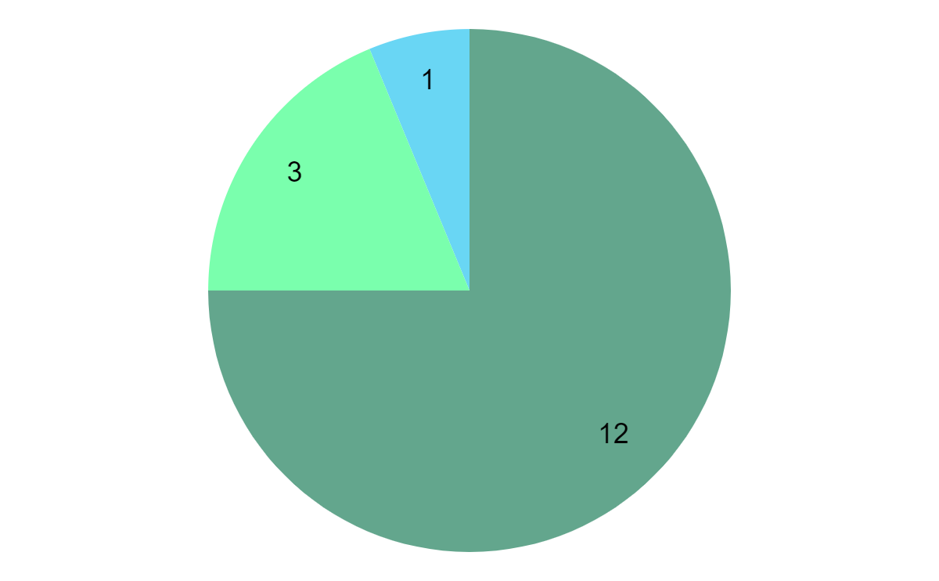
Will the world change as a result of the pandemic?
How?
Increase in social awareness of dangers of
large gatherings
Stricter sanitation guidelines for companies
Reform to healthcare system
Notes:
Will
Second major commonality was in whether students thought the world would change and if so how the students thought the world would change as a result of the pandemic
Over 75% of students said the world would change
Of those most said that it would change as people were more aware of the dangers of large gatherings
This includes concerts, sporting events and other such events
Falls in line with how most individuals said they themselves would change
Other changes included stricter sanitation guidelines and healthcare system reform.

Slide 9
How Universities could Improve Their Response
Timely Communication
Display Empathy Towards Students
Include Students in the Discussion
Notes:
Chris
So, from all our the collected responses we were able to identify three main ways in which universities could improve their response to this
pandemic.
Timely Communication
Most decisions made by different universities were made at a time where it was near last minute and left students scrambling
to figure out what their plans were for the remainder of the school year
Display Empathy towards students
Students felt administration offered little empathy towards their decision to completely change how the rest of the school year
would play out
Include students in the discussion
Many students felt they had no part in the decisions made
This is the main reason for why we decided to do our project: to give college students a voice and allow them the platform
to have that voice heard

Slide 10
Making the Documentary
Introduction:
Establish the History of the Pandemic
Main Body: Students Tell their Stories of the Pandemic
Conclusion:
Students Give Advice to Others
Goal:
Student Voices are Heard
Notes:
Lucas
-break down into three parts
-end with goal

Slide 11


Slide 12
Questions?
YouTube
https://youtu.be/C-rpDtKQ9sI
Website
https://sites.google.com/view/coronavirusstories/home

