Slide 1

Data Aggregation for STC
Hong Kong, C24
Notes:
Lorenzo

Slide 2




Our team
Ansel
Chang
Daniel
Stoiber
Lorenzo
Manfredi Segato
Pedro
Leão
Computer Science, 2025
Computer Science, 2025
Robotics Engineering, Computer Science, 2025
Data Science, 2025
Notes:
Lorenzo

Slide 3
Data: A foundation for marketing
Metrics
Insights
Growth
Notes:
Ansel
Marketing is all about user feedback. If you understand what users want, you can focus your marketing efforts to target those wants. But that’s easy only to say. If I launch a shiny new product, even if a few people think it’s cool, it’s not like people will be jumping at the chance to write long detailed reviews about it. So, what gives?
We live in a digital age. We make google searches, click on different links, scroll social media, and spend variable amounts of time looking at different posts. These actions seem pretty inconsequential, but there’s a catch. Every action we take on the web can be tracked. Companies store metrics like what keywords you searched, how long you spent on a page, and even how many buttons you clicked. And when you get data from millions of users across diverse demographics, you can start to build patterns that tell a story about what users are and aren’t interested in.
For companies, this data is a gold mine, because the insights you gain can reveal a lot about the effectiveness of your marketing campaign. And you can make better marketing decisions to better target users and power company growth.
Marketing = user feedback
People don’t tend to give long comprehensive product reviews
Every action we take on the web can be tracked
Data from millions of users

Slide 4
The Data Aggregation Pipeline
1st
2nd
3rd
4th
Collection
Cleaning
Storage
Visualisation
Notes:
Ansel
But there’s a problem. Millions of users, hundreds of metrics, spanning multiple years, means a LOT of data. You can’t simply expect to open a spreadsheet containing millions of rows of user data and expect to gain any insights from that. And that’s where data aggregation comes in.

Slide 5










Our Sponsor: Hong Kong Standards and Testing Centre
Food Products
Pharmaceuticals
Medical Devices
Clothing
Testing
Inspection
Certification
Home Appliances
Children’s Toys
Notes:
Ansel

Slide 6
Connecting STC to Data Aggregation
Collecting Social Media Metrics
One Solution
Using APIs to automatically fetch relevant metrics
Data Aggregation & Processing
Data structuring allowing for analysis
Marketing Insights
Provide tools to enable data-driven marketing decisions
Notes:
Ansel

Slide 7




A strategic decision
Existing Solutions
STC Goals
Employee Interviews
Data Aggregator Prototype
Tailored Solution
Notes:
Pedro

Slide 8
Pros and Cons
Existing Solutions
Tailored Solution
Off-the-shelf
Prototype
Already deployed: scalable and robust
Time constraints may lead to an unpolished product
Costly
Cost-effective
Has a cost related to it
No subscription fee
Control
Bespoke
Less flexibility and control over the product
Fully customisable with features that match STC’s needs
Notes:
Pedro

Slide 9
Paving the way: Decision Matrix
Criteria | Data Support | Maintenance and Reliability | Cost | Features and Scalability | User-friendliness
Weight | 20% | 15% | 15% | 25% | 25% | Final Score
Tailored | 4 | 2 | 5 | 3 | 5 | 3.85
Coupler.io | 4 | 4 | 2 | 4 | 3 | 3.45
Funnel.io | 4 | 4 | 1 | 4 | 3 | 3.30
Scale 1-5 (ascending)
Notes:
Pedro

Slide 10
Design Philosophy: Iterative
System Architecture
Planning
User Acceptance Testing Feedback
User Guide and Technical Documentation
Research
Notes:
Daniel
While developing this application we followed an iterative design philosophy.
This started with initial planning and research, finding the best technologies and frameworks to speed up development time. It also included interviews with the STC to determine their specific needs. After this we jumped into development and documentation.
During the process of developing we regularly sought feedback from the STC marketing team to further cater the development to their needs. All these changes were implemented and documented leading to another round of feedback.
We will share more details on User Acceptance Testing later in the presentation.

Slide 11
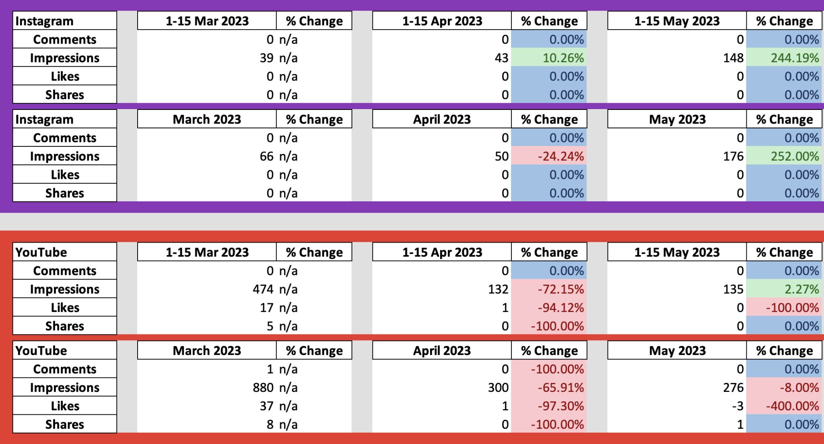
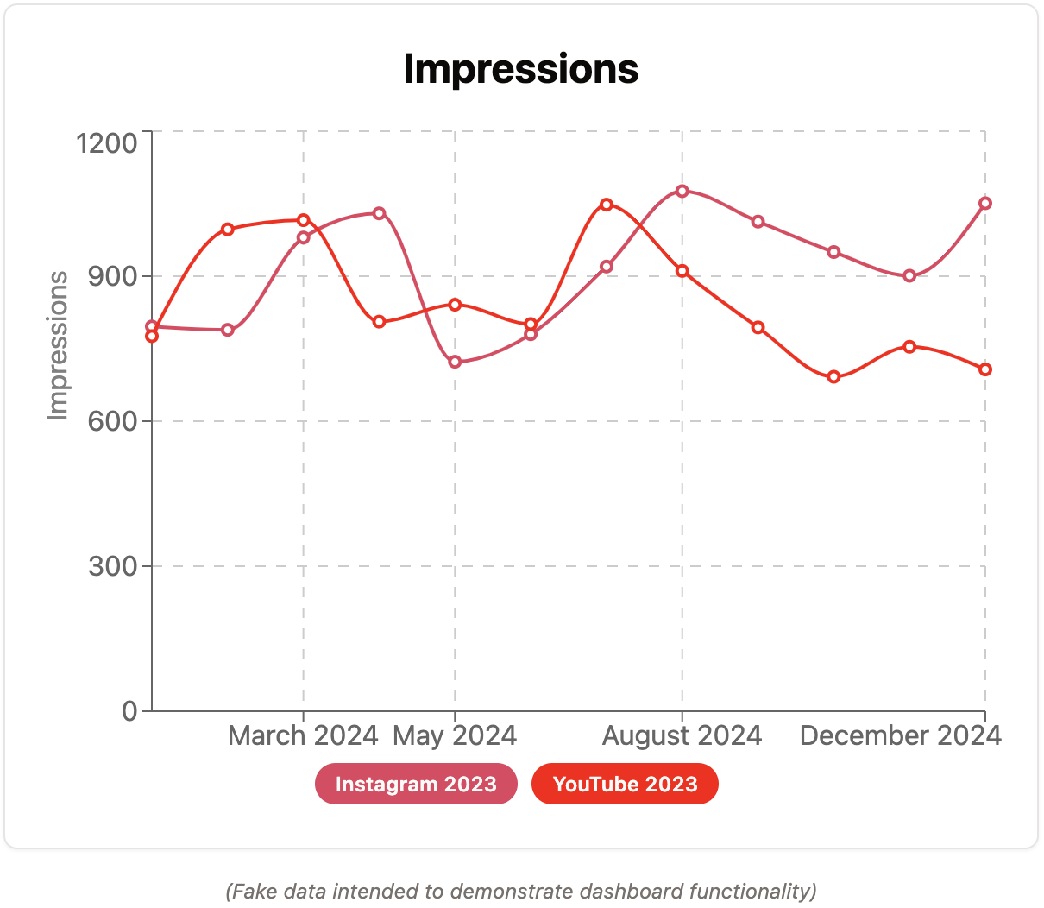
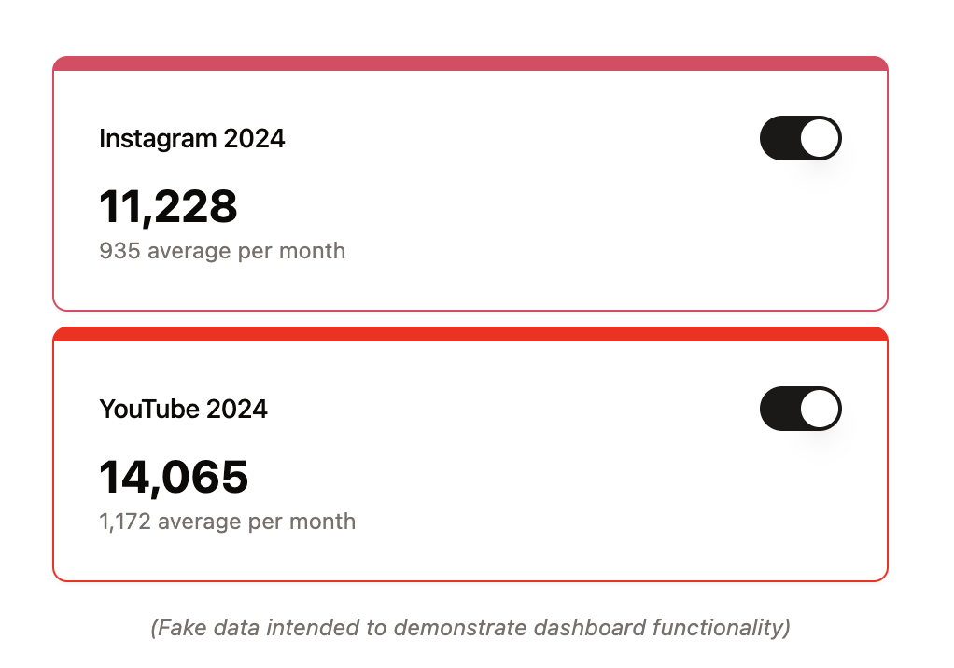
Website Features
Report Generation
Metrics Dashboard
Data Transparency and Manipulation
Notes:
Daniel
Based on the interviews conducted early on with the STC we split the application in two main features.
One feature is the generation of reports to enable the marketing team to document and communicate the results of the STC’s marketing efforts to stakeholders.
The other features is a set of interactive dashboards allowing the team to visualize and analyze STC’s digital presence to make data-driven marketing decisions.
Screenshot of the report.
Explain transparency and manipulation verbally

Slide 12
Challenges & Setbacks
Accessing Data sources
Scope & Time
Authentication
LinkedIn
Google Ads
Limiting features to fit development timeframe.
Programmatically signing into data sources.
Platform
Limitations
Optimisation
Restructuring
Time Range
Rate Limiting
Hosting Provider
Report Generation
Load Times
Adding features as requirements changed.
Notes:
Daniel
Throughout the development process we encountered many challenges and setbacks in all facets of the project.
Accessing Data Sources
A challenge early on was obtaining access to each of the data sources used by the STC. Data sources such as LinkedIn and Google Ads would have required multiple weeks or even month to access which is time we unfortunately didn’t have in our 7 week term.
Scope & Time
Due to this limited timeframe we had to set aside some features requested such as competitor analysis. We worked on prioritizing features which were achievable and had to limit scope to get those done.
Authentication
One major limitation that followed us all the way to the end of the project was authentication. To be able to access data from sources like Instagram and YouTube programmatically you can’t just login with a username and password. You need to go through a multistep process which varies drastically from data source to data source.
Platform Limitations
Each data source has its own set of limitations. For example, Instagram only stores data from the last two years requiring us to store data to be able to derive insights from a longer time range. Another limitation that was one set by our hosting provider limiting report generation to ten seconds.
Optimization
To keep report generation under ten seconds we were required to optimize the process by not requesting data from date ranges we knew would not return data.
Restructuring
As the project matured, requirements changed resulting in us having to restructure how our data is fetched, stored, processed, and visualized. This restructuring was based on feedback from the STC, which Lorenzo will tell you more about.

Slide 13
Regular Progress Debriefs
Features
User Interaction
Schedule
Challenges Faced
Dashboards
Report Generation
Authentication
Accessibility
Internationalisation
Development Timeline
APIs
Authentication
Data sources
Formal Feedback Round
Google Forms
PPTX Feedback
Notes:
Lorenzo
Highlight that the weekly meetings are a systematic iterative process

Slide 14
Demonstration

Slide 15
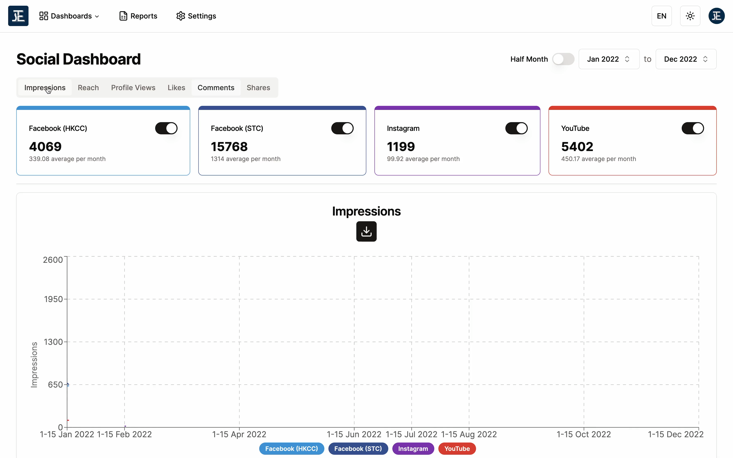

Slide 16
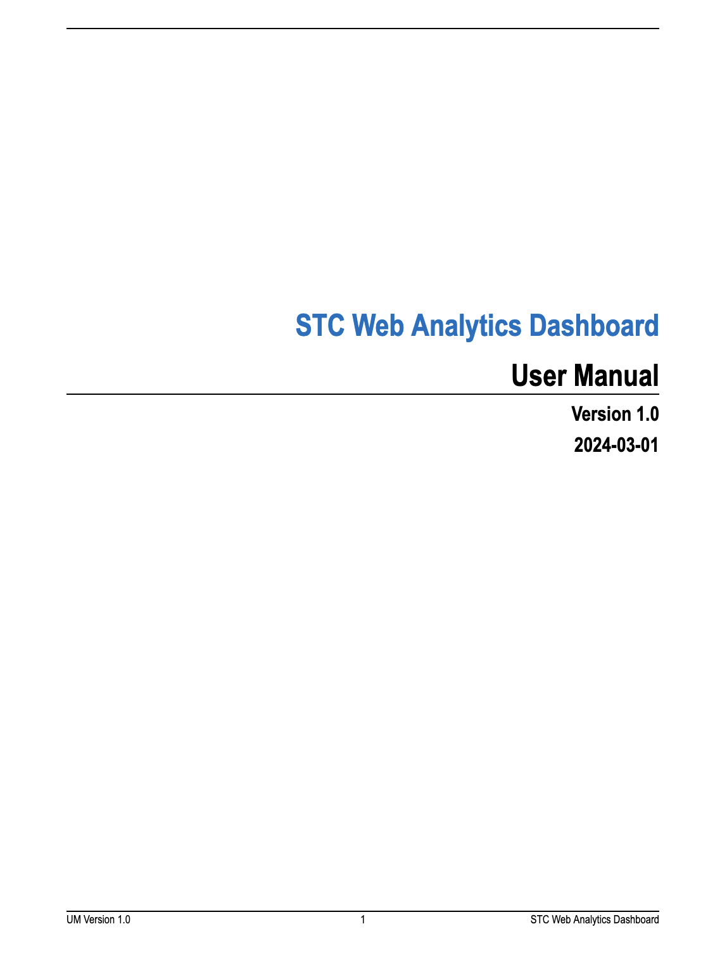
User Guide and Technical Documentation
Providing both a walkthrough of the platform and a deep-dive of the technologies implemented.
Notes:
Lorenzo

Slide 17
If we had more time…
More data sources
Multiple UAT Rounds
Optimisation
LinkedIn, Google Search Console, Google Ads…
A more polished product with additional features
Report Generation and request time
Notes:
Lorenzo

Slide 18

Acknowledgements
Professor Brajendra Mishra
Professor Stephan Sturm
Aster Chiu
Franki Lee
WPI Global Projects Program

Slide 19
Questions?
Thank you for listening!
Notes:
Lorenzo
Add slides for each feature

Slide 20
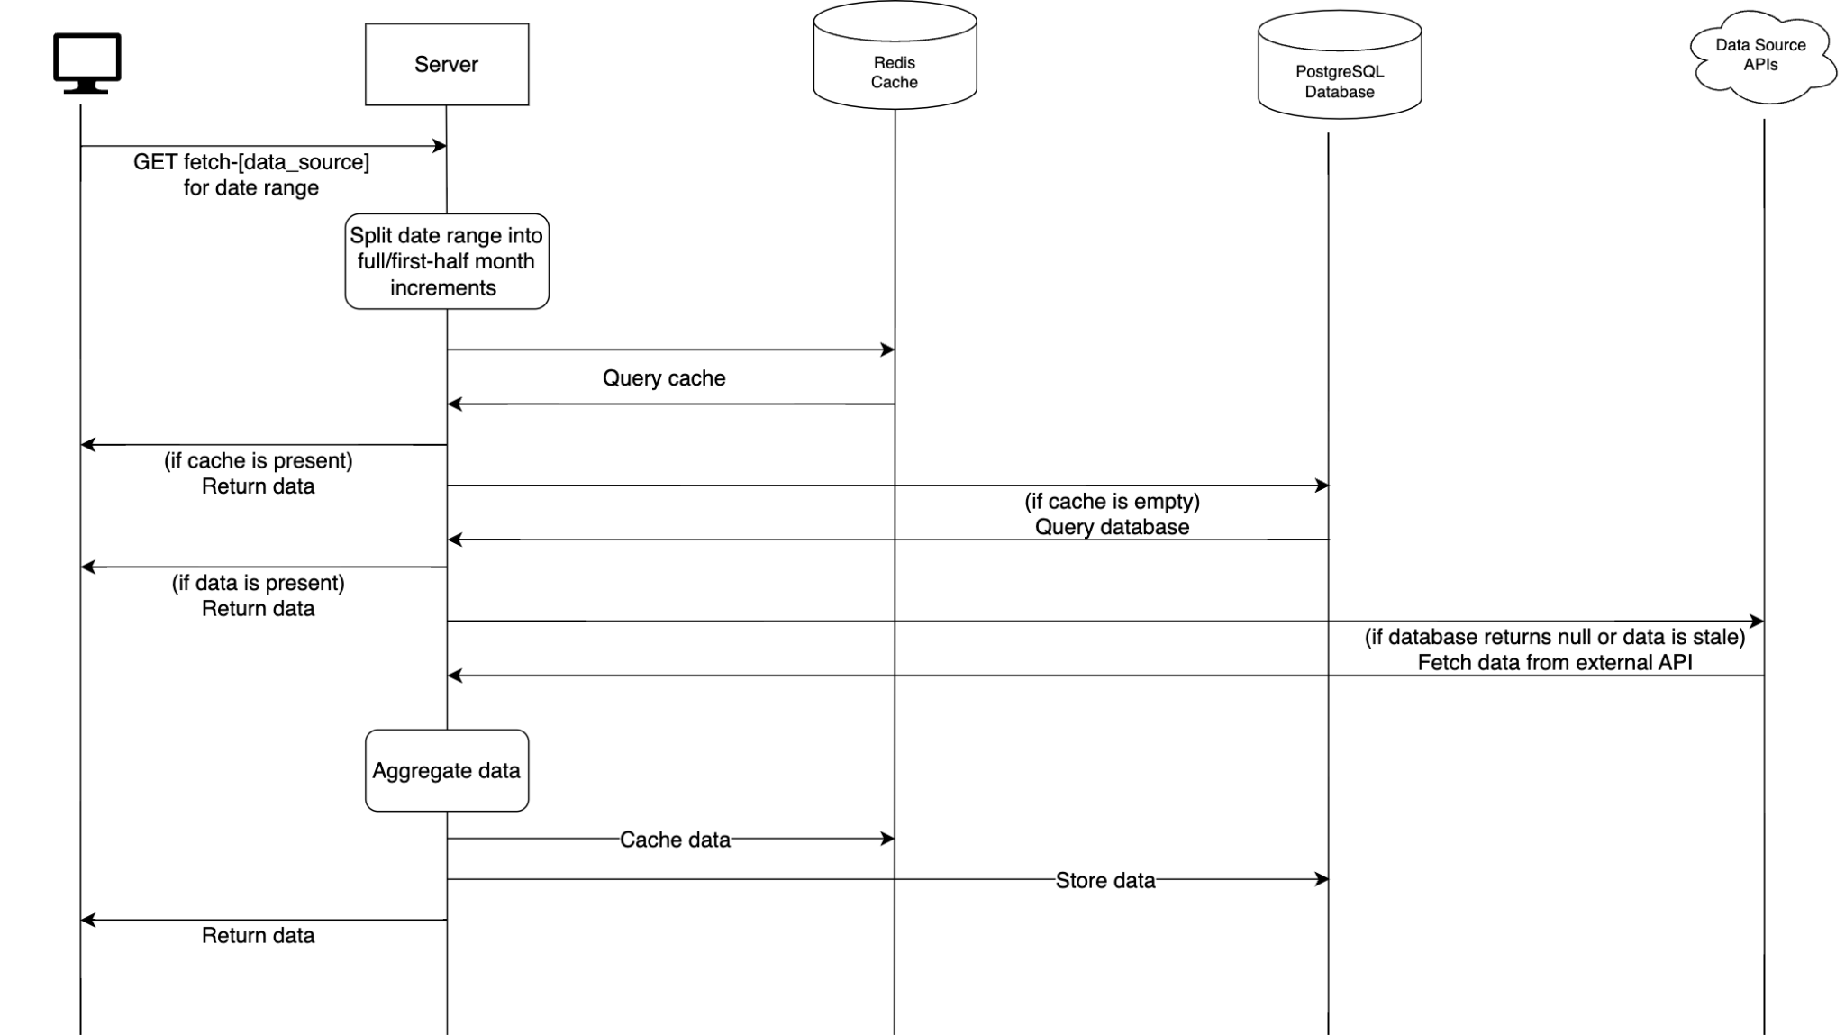
System Architecture

Slide 21
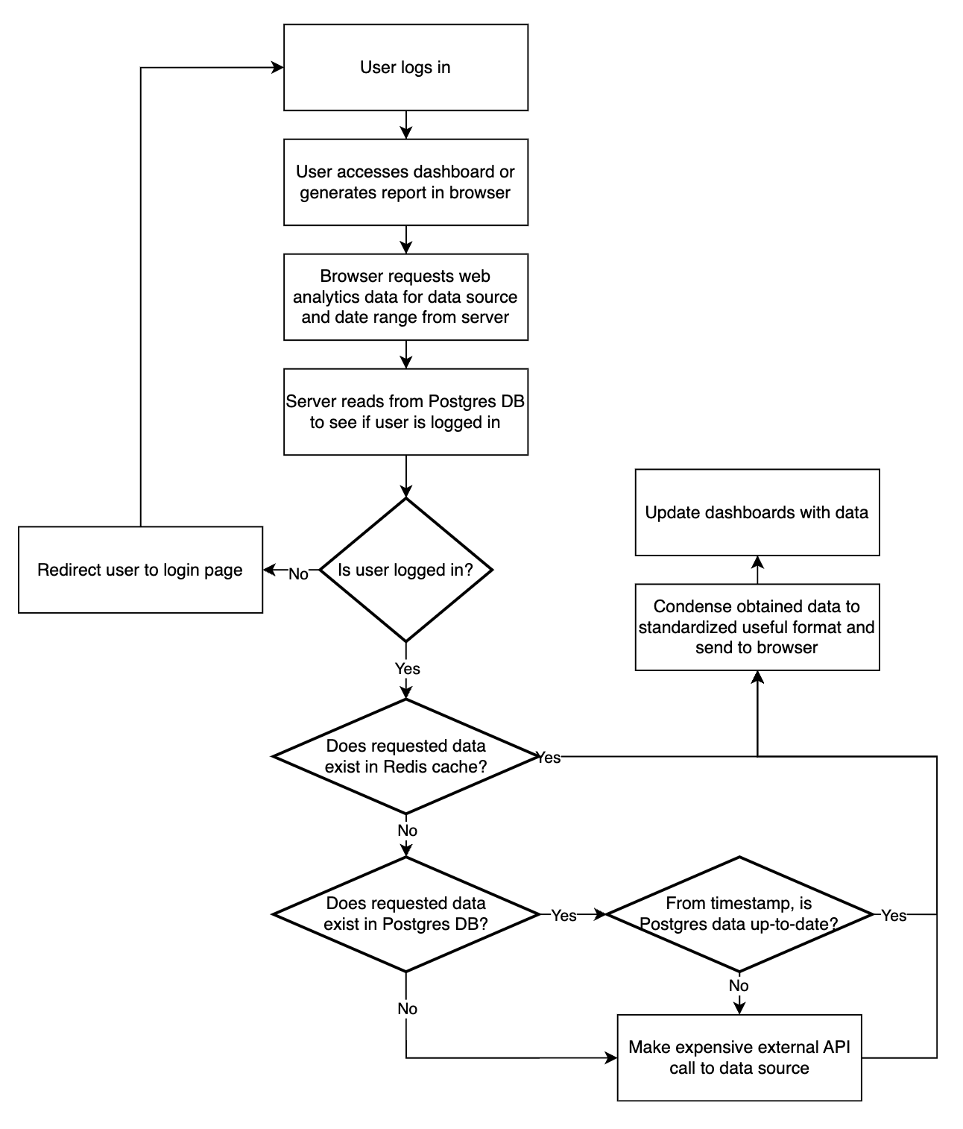
User Experience Flowchart

Slide 22
Bibliography
Chaffey, Dave, and Mark Patron. “From Web Analytics to Digital Marketing Optimization: Increasing the Commercial Value of Digital Analytics.” Journal of Direct, Data and Digital Marketing Practice, vol. 14, no. 1, July 2012, pp. 30–45, https://doi.org/10.1057/dddmp.2012.20.
Fan, Weiguo, and Michael D. Gordon. “The Power of Social Media Analytics.” Communications of the ACM, vol. 57, no. 6, 2014, pp. 74–81, https://doi.org/10.1145/2602574.
Icons
Icon Pack: SEO and SEM Lineal

Slide 23
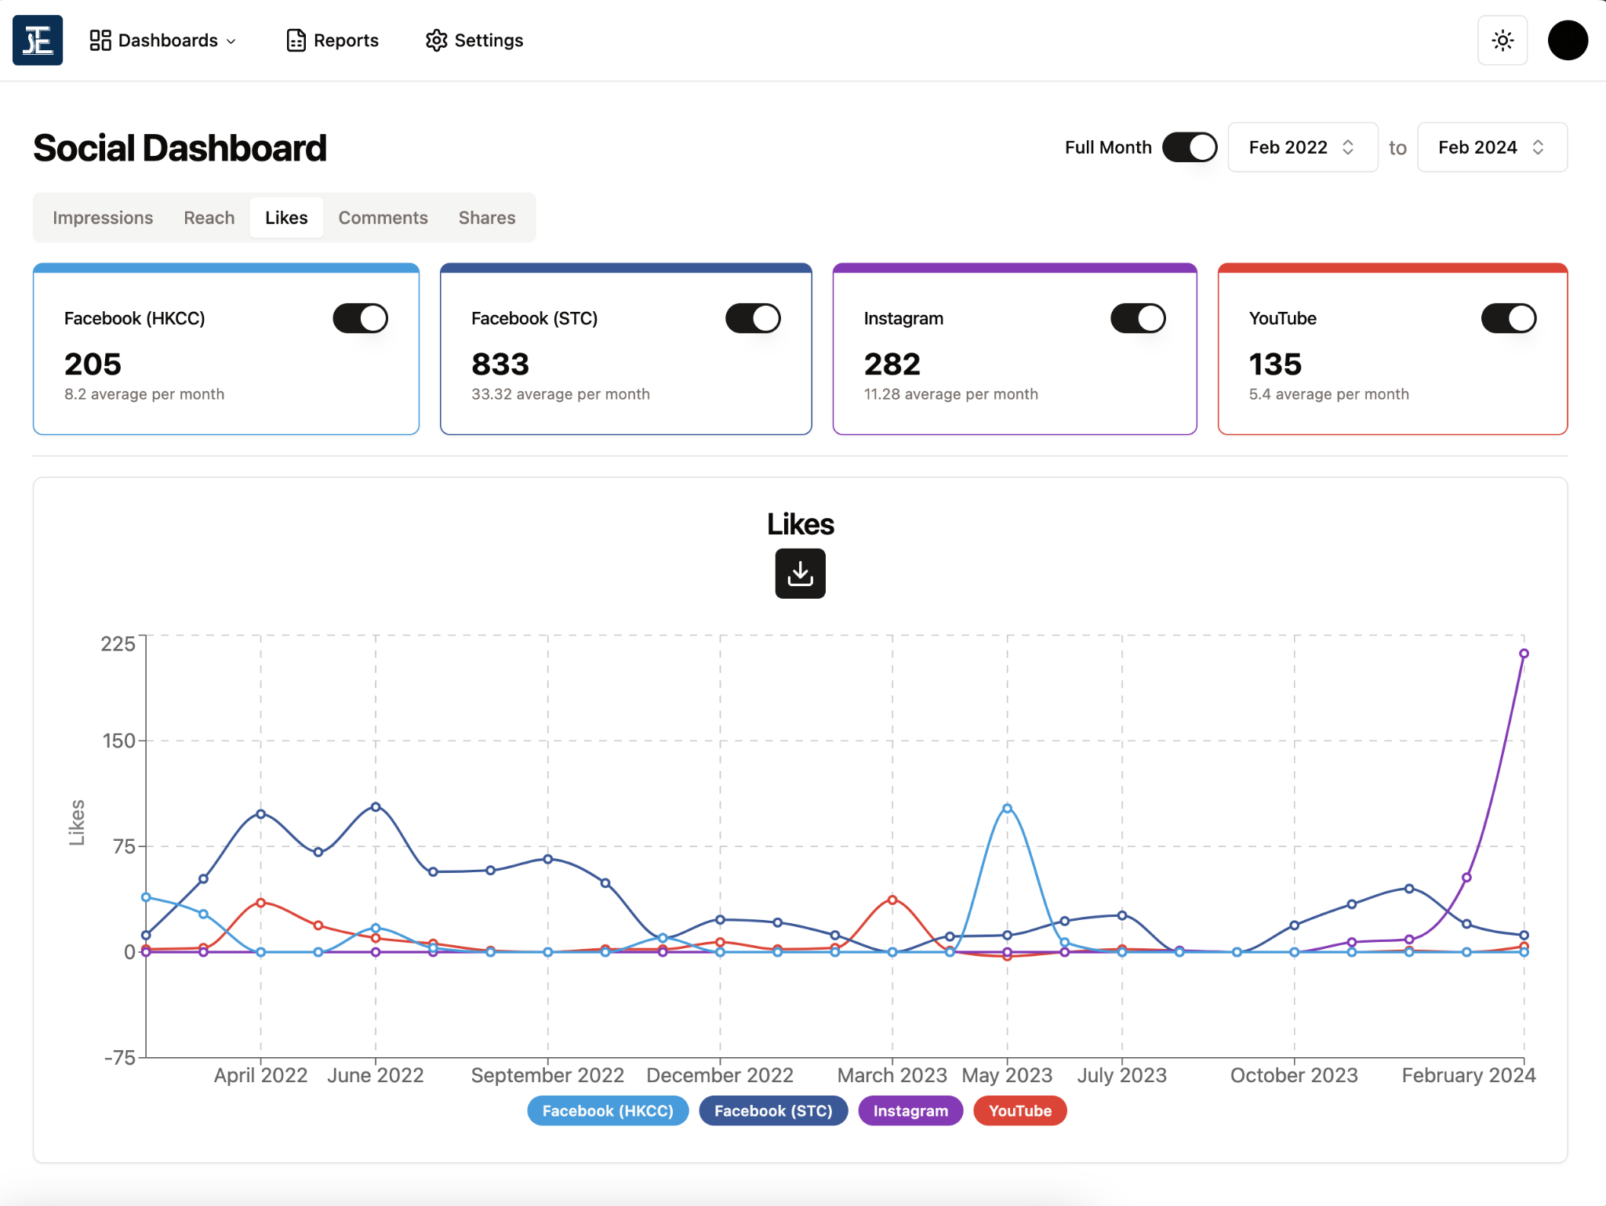
Computer mockup
A preview of our social media
metrics dashboard.

Slide 24
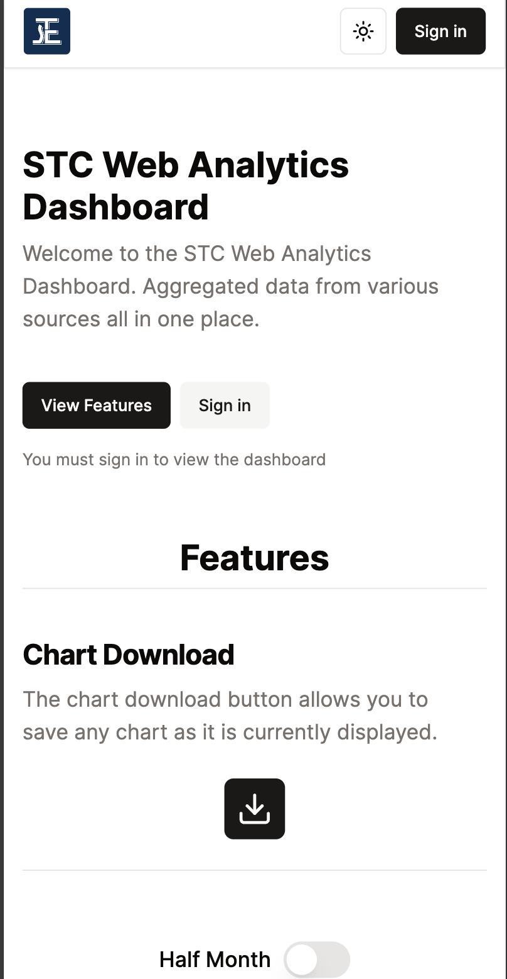
Phone mockup
The sign-in page viewed from a mobile device.

Slide 25
Presentation Overview
01
04
02
05
03
Setting the Scene
Background knowledge and The STC
User Acceptance Testing
Reimplementing Feedback
The First Steps
The process of designing a solution
Conclusions & Final Deliverables
Wrapping things up
Development Process
Development procedure of the webapp
Notes:
remove the subheadings
maybe remove slide entirely

Slide 26


