Slide 1
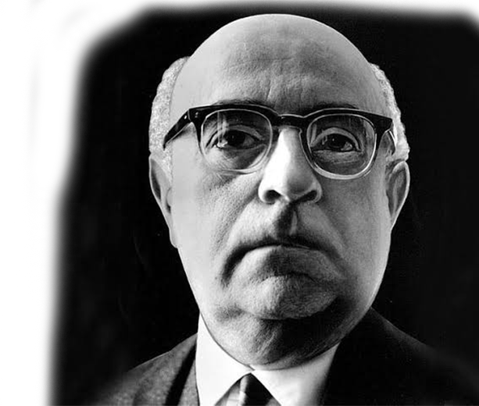

To write poetry after Auschwitz is barbaric”
-Theodor Adorno, 1949
Notes:
"To write poetry after Auschwitz is barbaric."
This was written by well known german philosopher, Theodor Adorno in 1949.
He believed that after the horrors of the the holocaust; creative writing, metaphor, and poetry was no longer suitable. A bit later, after further reading and thinking with his fellow philosophers, Adorno would go back on his initial quote.

Slide 2


To write poetry after Auschwitz is barbaric”
Perennial suffering has as much right to expression as the tortured have to scream”
-Theodor Adorno, 1966
Notes:
"Perennial suffering has as much right to expression as the tortured have to scream." Meaning that despite the horrors, people should have the right to write and express themselves in anyway they would like to. We can think of this more specifically with poetry.
These 2 quotes, and specifically the change of views exemplify Germany's complex history with poetry and expression, and was important background information that we kept in mind throughout our entire project.

Slide 3





Berlin’s Government emphasizes the need for a strong infrastructure supporting literature production and reading
FUNDING
-
Notes:
This appreciation for poetry can be seen today, as berlins government funds multiple literature organizations, with one of them being our sponsor

Slide 4
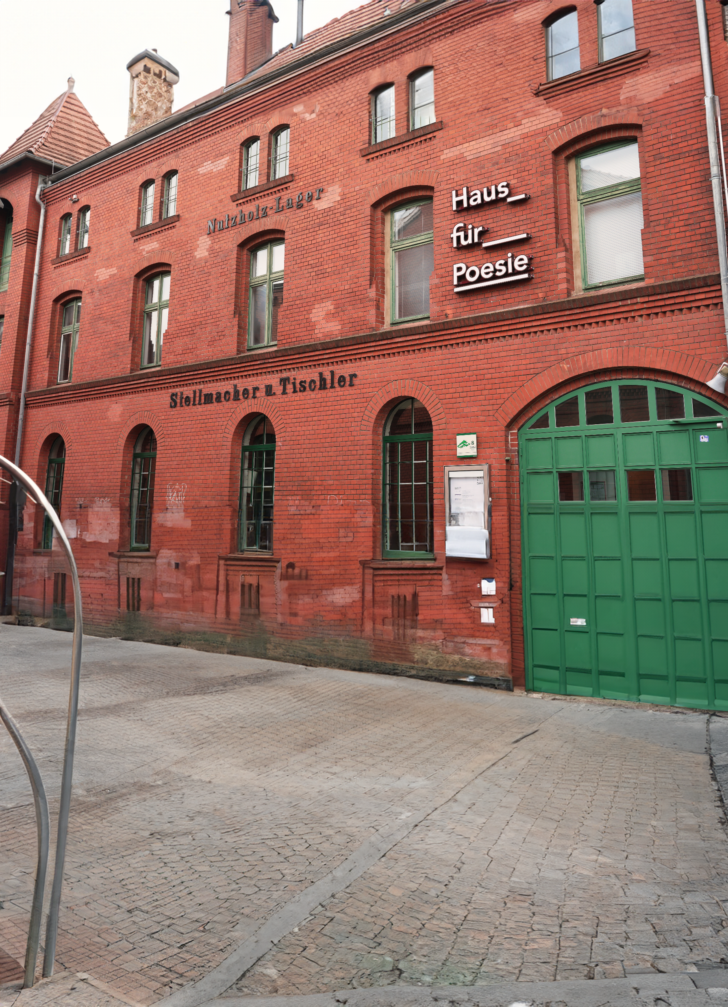
Improving Brand Recognition and Association
for Poetry Organizations
Gabriel Bohorquez
Andrew Mesa
Matthew Neuffer
Connor Wirsing
Notes:
Andrew: Our project is “Improving Brand Recognition and Association for Poetry Organizations”

Slide 5
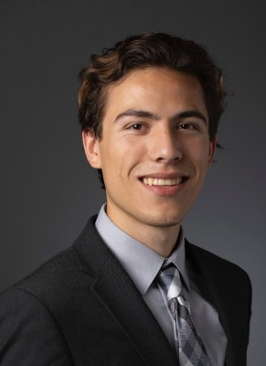
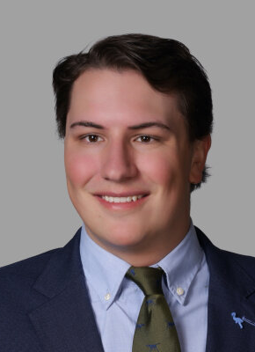
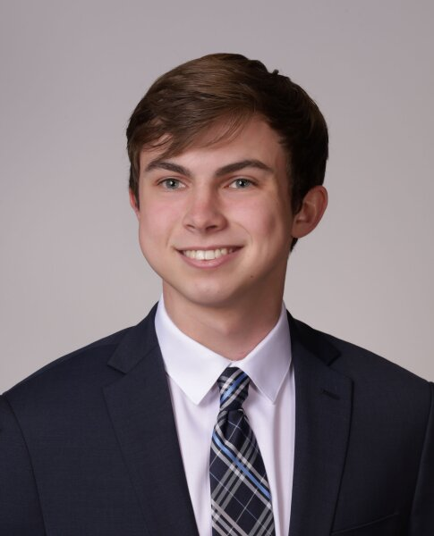
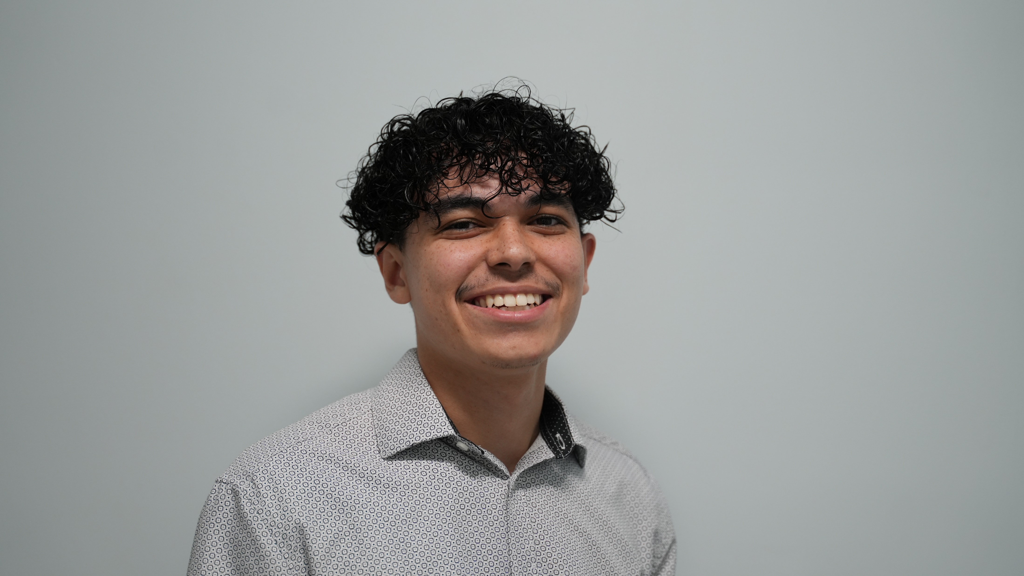
Meet the Team
About Haus für Poesie
Andrew Mesa
Connor Wirsing
Matthew Neuffer
Gabriel
Bohorquez
Project Manager
Lead Researcher
Team Scribe
Head Designer
Communicator Leader
Photographer
Notes:
Andrew starts

Slide 6
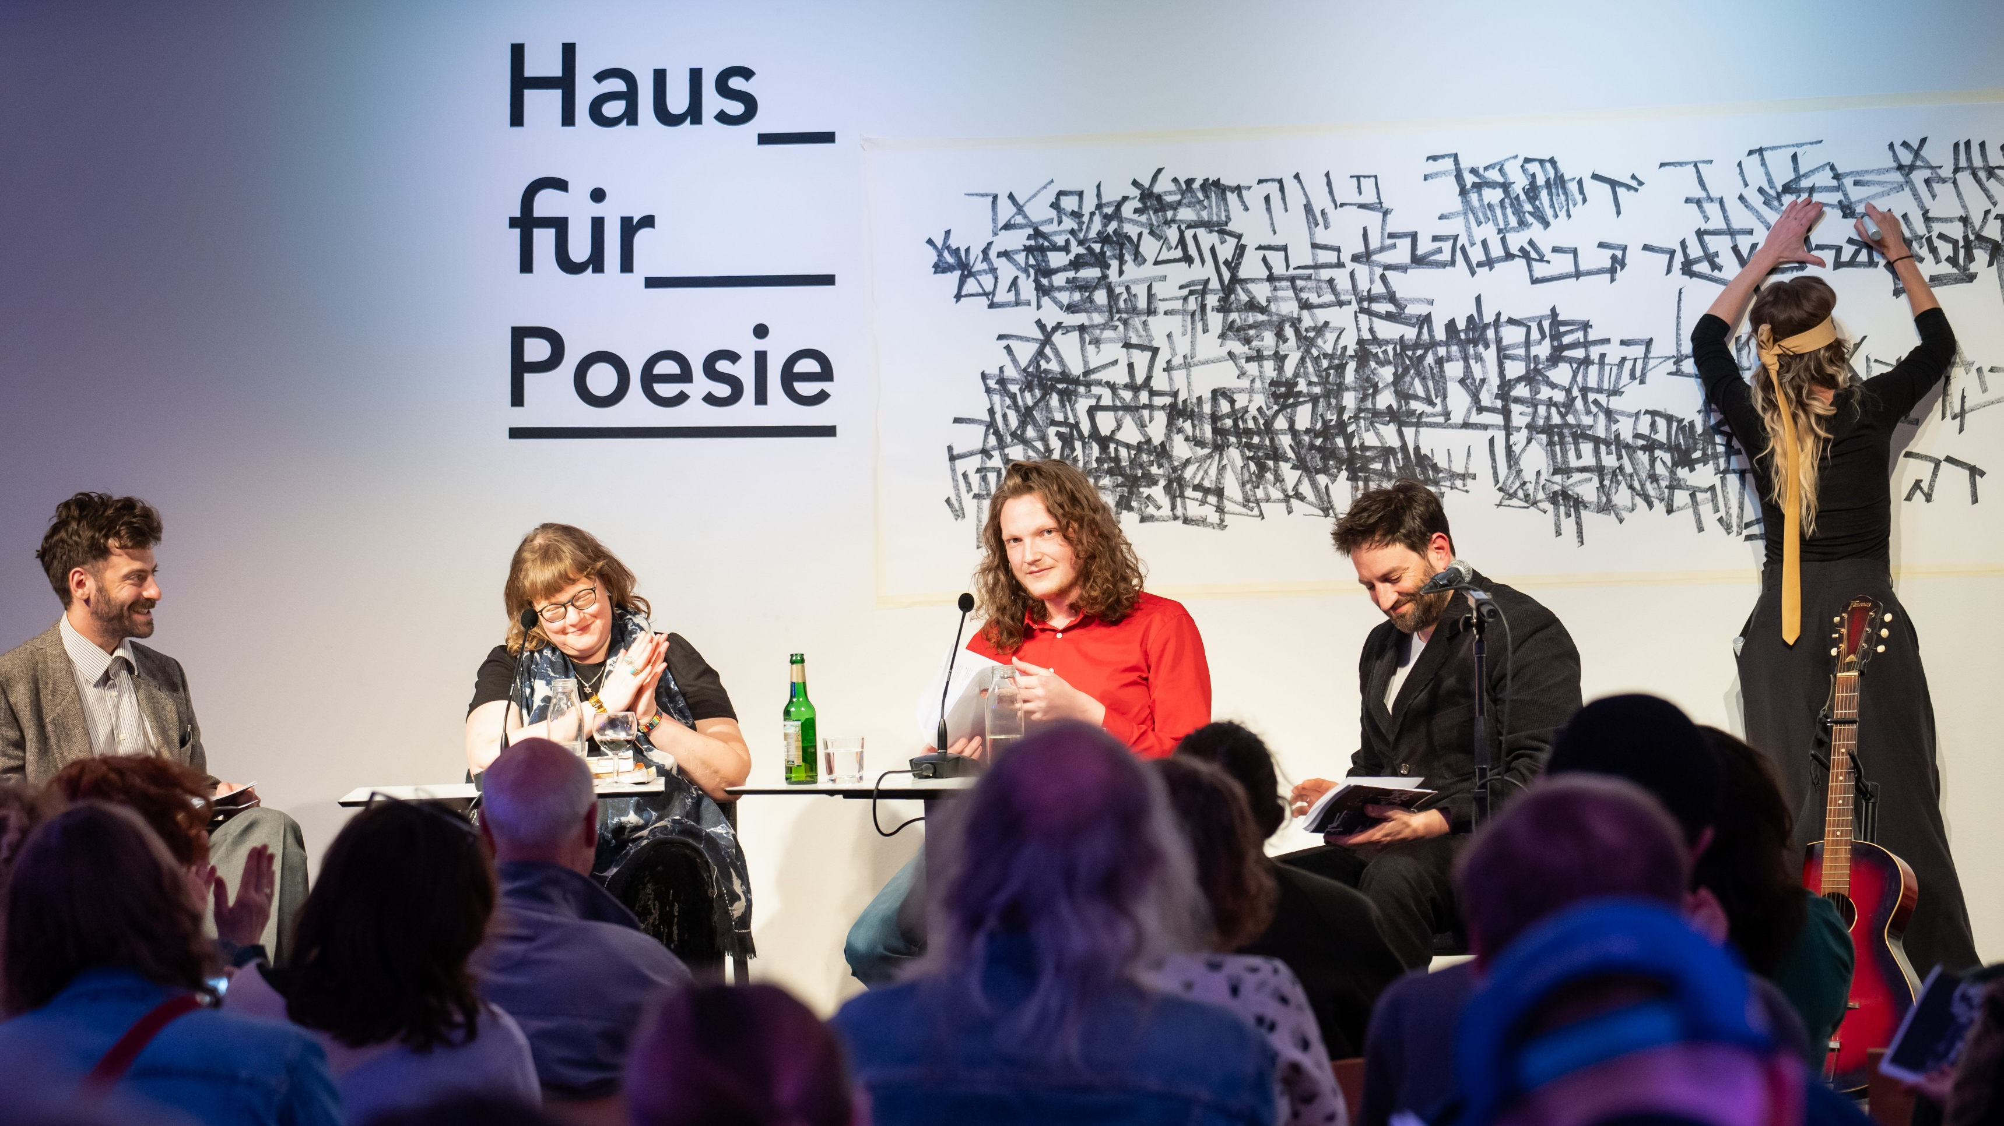
About Haus für Poesie
Haus für Poesie is a cultural institution dedicated to promoting poetry and literary arts.
The institution organizes readings, poetry slams, workshops, lectures, and exhibitions, creating a vibrant platform for poets, writers, and literary enthusiasts.
Notes:
Gabe

Slide 7




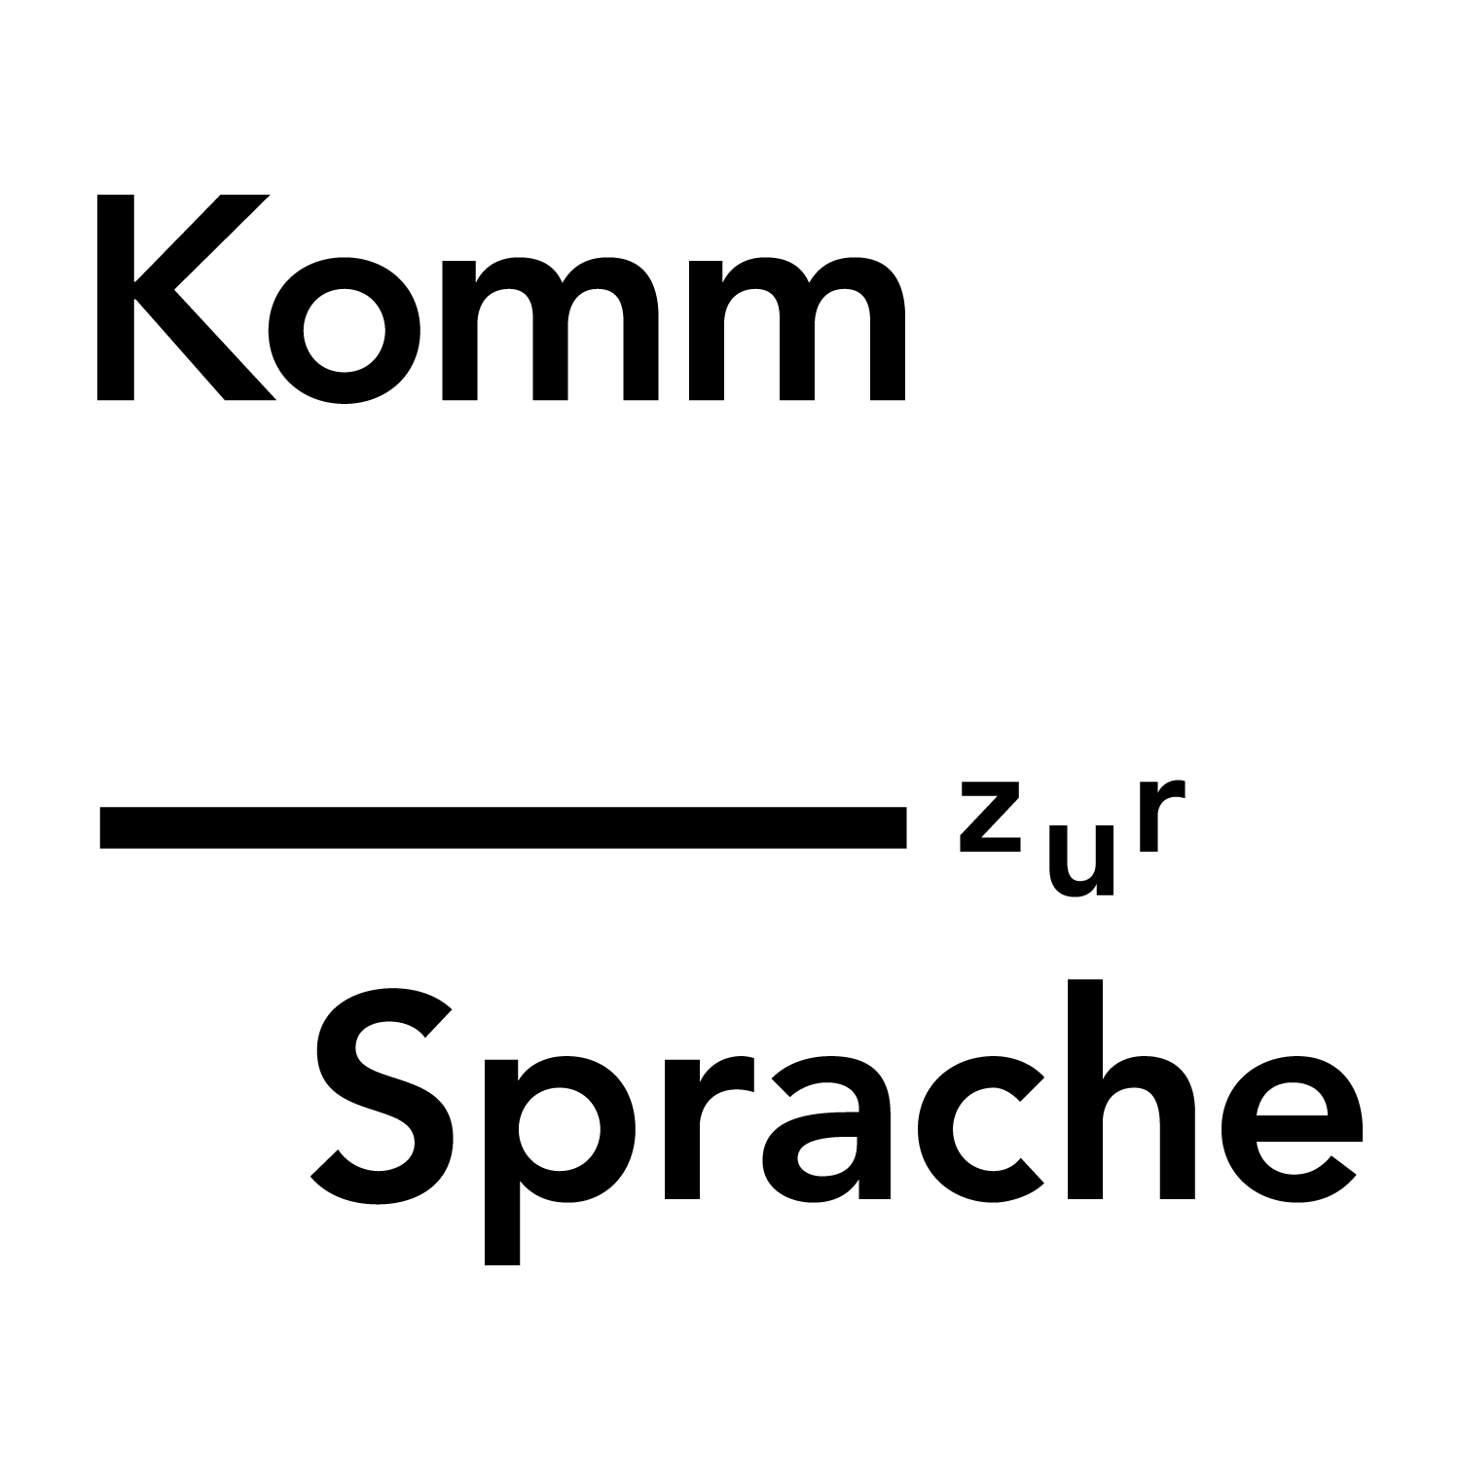


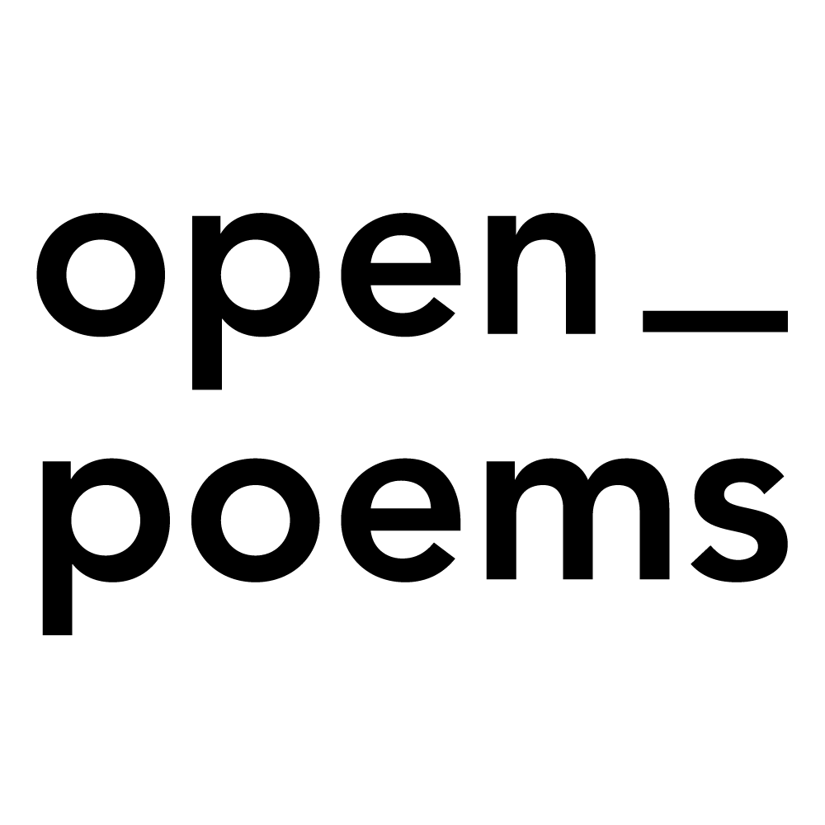
Project Mission
This project aims to improve the brand integration of Haus für Poesie and its subsidiaries, by evaluating current brand architecture and integration strategies, and implementing solutions derived from the assessment on subsidiary websites and social media in order to increase brand awareness and cohesion.
Notes:
Gabe: Our project mission is to improve the brand integration of Haus für Poesie and its subsidiaries, by evaluating current brand architecture and integration strategies, and implementing solutions derived from the assessment on subsidiary websites and social media in order to increase awareness and cohesion for their brands.

Slide 8
1
2
3
4
Determine the best practices for brand integration
Assess the public's associations with the subsidiary brands
Gather users' opinions on the sponsor's website design
Establish which mediums, including social media, are best for community outreach
Notes:
Connor Haus fur Poesie operates many brands related to poetry, including festivals, education tools, competitions, and a massive repository of translated audio-format poems. They also host events at their headquarters in the in Berlin.

Slide 9
Objectives
1
2
3
4
Determine the best practices for brand integration
Assess the public's associations with the subsidiary brands
Gather users' opinions on the sponsor's website design
Establish which mediums, including social media, are best for community outreach
Notes:
Connor: In order to help haus fur poesie increase connection between brands, we completed four primary research objectives. They were:

Slide 10
Methodology
Social Media & Web Analysis
Expert Interviews
Focus Groups
Literature Review
Surveys
Notes:
Matt: To accomplish these objectives, we used a variety of methods including: expert interviews, social media and web analysis, surveys, focus groups, literature review

Slide 11
Roadmap
STEP 2
STEP 4
STEP 6
STEP 1
STEP 3
STEP 5
Notes:
Matt: To accomplish these goals, we used a variety of methods including:

Slide 12
Roadmap
STEP 2
STEP 4
STEP 6
STEP 1
STEP 3
STEP 5
Understand the project and Defining Goals
Notes:
Matt: To accomplish these goals, we used a variety of methods including:

Slide 13
Roadmap
Conduct thorough research to find pertinent information and best practices
STEP 2
STEP 4
STEP 6
STEP 1
STEP 3
STEP 5
Understand the project and Defining Goals
Notes:
Matt: To accomplish these goals, we used a variety of methods including:

Slide 14
Roadmap
Conduct thorough research to find pertinent information and best practices
STEP 2
STEP 4
STEP 6
STEP 1
STEP 3
STEP 5
Understand the project and Defining Goals
Carry out focus groups, expert interviews, surveys, etc.
Notes:
Matt: To accomplish these goals, we used a variety of methods including:

Slide 15
Roadmap
Conduct thorough research to find pertinent information and best practices
Draft the selected solutions to project stakeholders with detailed explanations and rationale
STEP 2
STEP 4
STEP 6
STEP 1
STEP 3
STEP 5
Understand the project and Defining Goals
Carry out focus groups, expert interviews, surveys, etc.
Notes:
Matt: To accomplish these goals, we used a variety of methods including:

Slide 16
Roadmap
Conduct thorough research to find pertinent information and best practices
Draft the selected solutions to project stakeholders with detailed explanations and rationale
STEP 2
STEP 4
STEP 6
STEP 1
STEP 3
STEP 5
Understand the project and Defining Goals
Carry out focus groups, expert interviews, surveys, etc.
Revise with Advisors and Sponsors
Notes:
Matt: To accomplish these goals, we used a variety of methods including:

Slide 17
Roadmap
Conduct thorough research to find pertinent information and best practices
Draft the selected solutions to project stakeholders with detailed explanations and rationale
Propose said solutions to sponsor in the form of a slide deck
Objective 1 Results
STEP 2
STEP 4
STEP 6
STEP 1
STEP 3
STEP 5
Understand the project and Defining Goals
Carry out focus groups, expert interviews, surveys, etc.
Revise with Advisors and Sponsors
Notes:
Matt:
We worked through this project, starting by setting out to understand and define our goals, we then moved forward conducting research to gain valuable information and find best practices, with this background information we then began with our surveys, interviews, and focus groups. Putting everything together, we then worked to develop solutions to propose which came together and concluded our project.

Slide 18
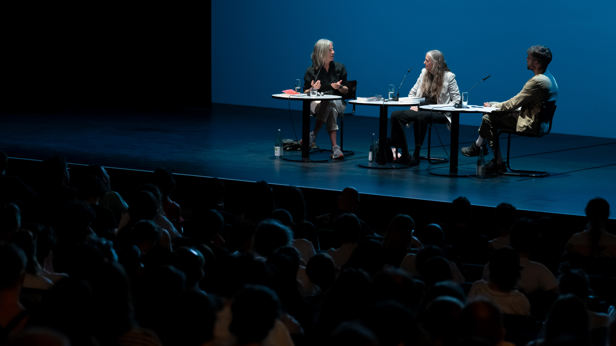
Objective 1 Results
Investigation into the Best Practices for Non-Profit Branding and Marketing
Notes:
Matt: Following this roadmap, we now move into our results and findings, starting with what came from our investigation into the best practices for non-profit branding

Slide 19



Expert Interviews
NON-PROFITS
HIDDEN CHAMPIONS
WEB INTEGRATION
Liz Hawkins
Dr. McIntyre
Branding and online identity should work to establish feeling of engaging with the brand in a virtual space to drive emotional connection
    Pictures and colors help this
    Big text blocks detract from this
Defined as small companies which dominate niche markets without the corresponding notoriety.
  Applicable to lyrikline.org as a poetry translation and audio recording hub
Engagement increases following successful integration of sub websites
Integrating will make it easier for users to access all online services
German advertising should emphasize clarity
Straightforward/matter of fact advertising is preferred
Logo design should convey that all sub brands are part of one organization
Writers use social media to connect with organizations
Twitter was previously the main location for this
  Less used since X rebrand
  Instagram and Facebook good alternatives
Writers care more about services and content than aesthetics
Notes:
Matt: First, with our expert interviews, we began by interviewing Liz Hawkins, a Marketing professional at a german pharmaceutical company. From this discussion, along with a variety of inside german culture and communication practices, we learned that german advertsing is often straightforward and should prioritize clarity. Also she emphasized that logos are one of the most important aspects of branding and should convey that subrands are part of one orgnaization.
Connor: Dr. Kate McIntyre is a professor of creative writing at WPI. Her expertise shed light on the many ways writers connect with organizations, revealing that writers in general are more content driven than advert driven. She also gave us useful information about the types of social media that writers use, citing a recent migration of writers away from the platform formerly known as twitter.

Slide 20
NON-PROFITS
HIDDEN CHAMPIONS
WEB INTEGRATION
Branding and online identity should work to establish feeling of engaging with the brand in a virtual space to drive emotional connection
    Pictures and colors help this
    Big text blocks detract from this
Defined as small companies which dominate niche markets without the corresponding notoriety.
  Applicable to lyrikline.org as a poetry translation and audio recording hub
Engagement increases following successful integration of sub websites
Integrating will make it easier for users to access all online services
Literature Review
Notes:
Connor: To round out objective 1, we also completed a literature review. Some highlighted results of this are important branding strategies for non profits, a way to apply theory surrounding “Hidden champions” to companies which are similar to the sub brands of Haus Fur Poesie, and a study demonstrating many of the techniques and benefits of a successful web integration.

Slide 21
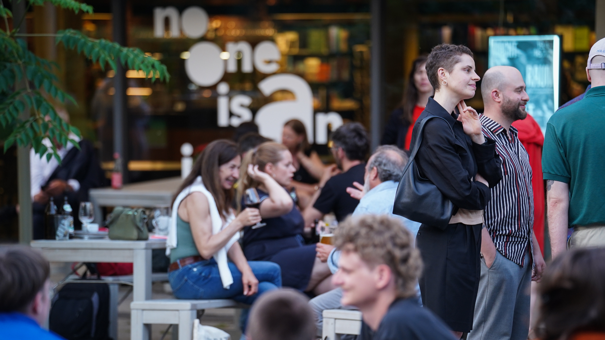
Objective 2 Results
Assessment of User Awareness and Association Between Haus für Poesie, lyrikline, and other Subsidiary Brands
Notes:
Andrew: Our second set of results came from the Assessment of User Awareness and Association Between Haus für Poesie, lyrikline, and other Subsidiary Brands

Slide 22
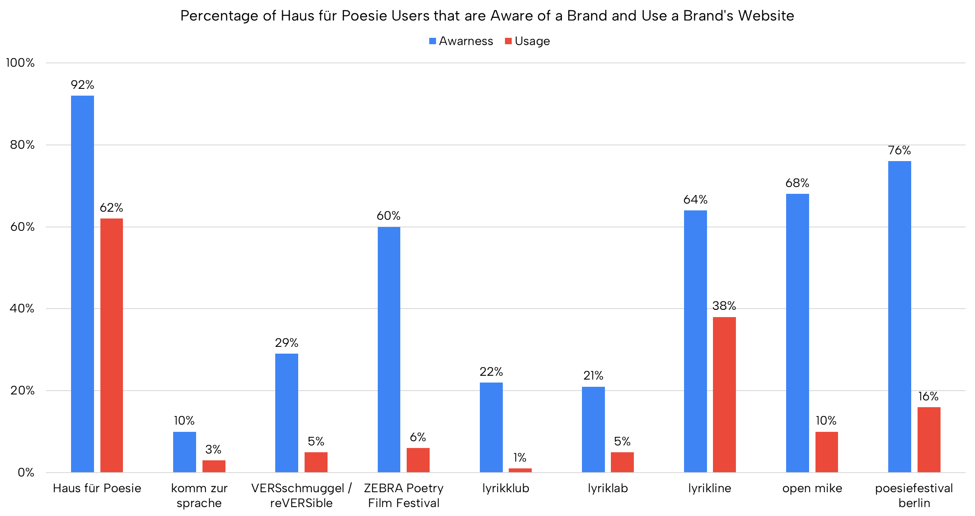
Notes:
Andrew: Survey responses from Haus fur Poesie's website indicated the parent of brand of Haus fur Poesie is much more known then subsidiary brands. The sub-brands of lyrikline, ZEBRA, open mike, and poiesifestival also are well known ...

Slide 23
Notes:
Andrew: but are not used often used most likely due to them being seasonal events. Therefore consolidation of these websites onto their main website is advisable.

Slide 24
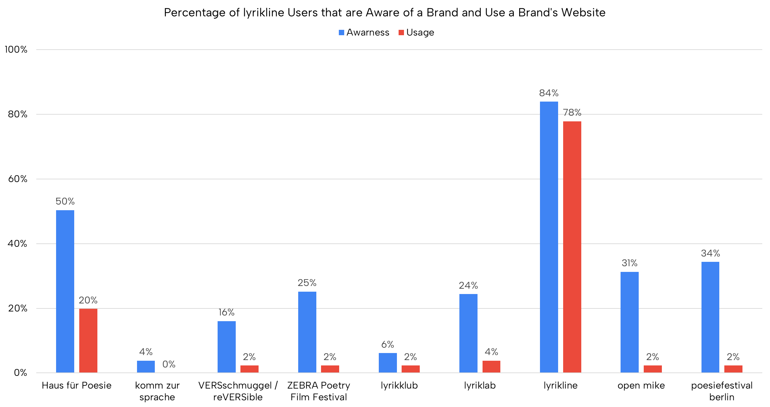
Notes:
Andrew: Survey responses from lyrikline's website show they ...

Slide 25
Objective 3 Results
Notes:
Andrew: are their brand is much more known by lyrikline users then the rest of the sub-brands and main brands. Therefore, focus on improving brand awareness from the subsidiaries website is important.

Slide 26
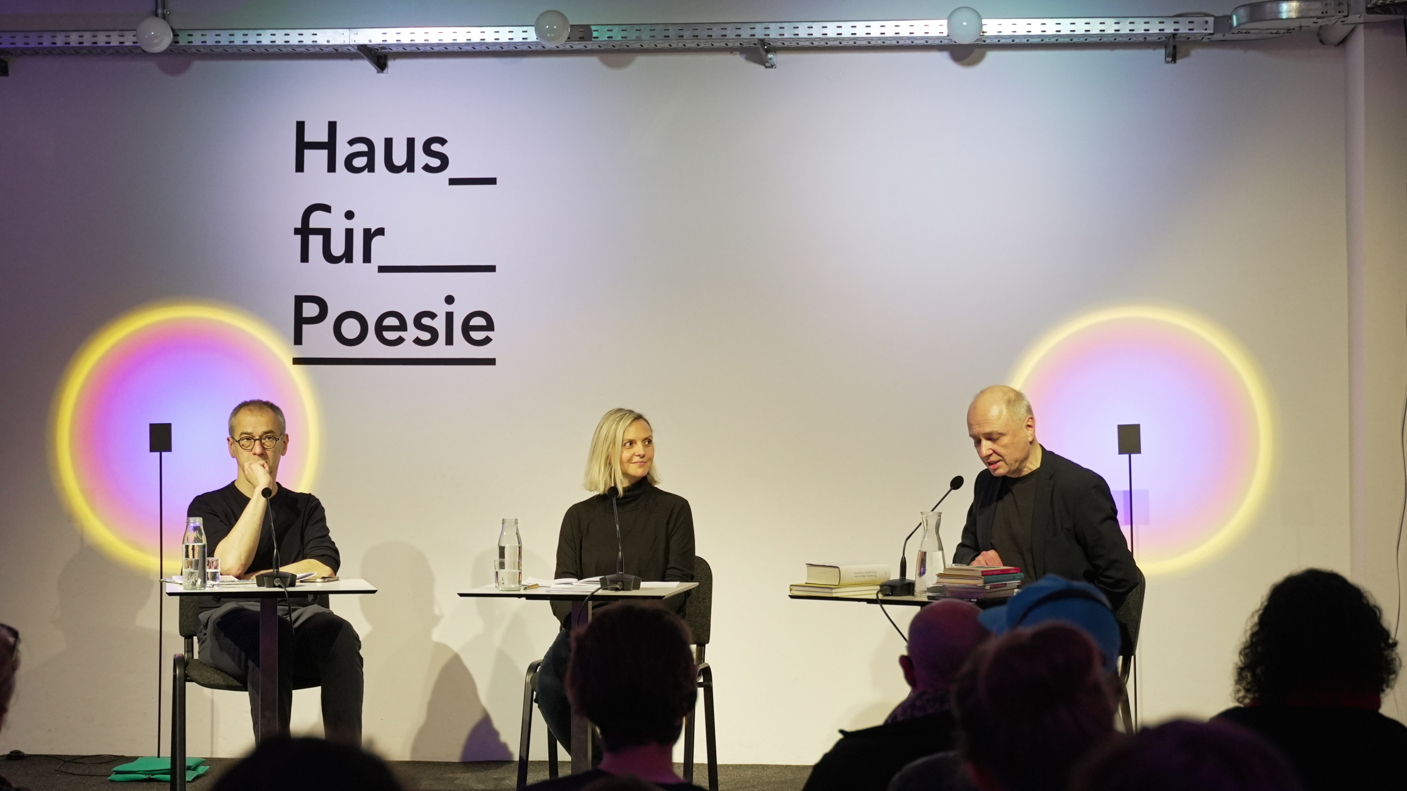
Objective 3 Results
User Feedback on the Website Design of lyrikline.org and haus-fuer-poesie.org
Notes:
Gabe

Slide 27
Usability of Website
Haus für Poesie
17.6%
52.3%
25.5%
4.6%
0%
Very Easy to use
Easy to use
Neutral to use
Difficult to use
Very Difficult to use
Lyrikline
32.8%
46.9%
20.3%
0%
0%
Notes:
Gabe
Although a good number of users rated the usability as neutral.
A larger number of users have a more difficult time using Haus Fur Poesie rather than lyrikline
More effort should be put into working on the Haus Fur Poesie website, instead of lyrikline

Slide 28
Appeal of Website
Objective 4 Results
Haus für Poesie
19.0%
52.9%
22.9%
5.2%
0%
Very Appealing
Appealing
Neutral
Unappealing
Very Unappealing
Lyrikline
20.2%
57.4%
20.2%
2.3%
0%
Notes:
Gabe
A significant number of responses reported the websites to be appealing
Although its appealing, both websites still have room for improvement shown by the neutral and unappealing responses.

Slide 29
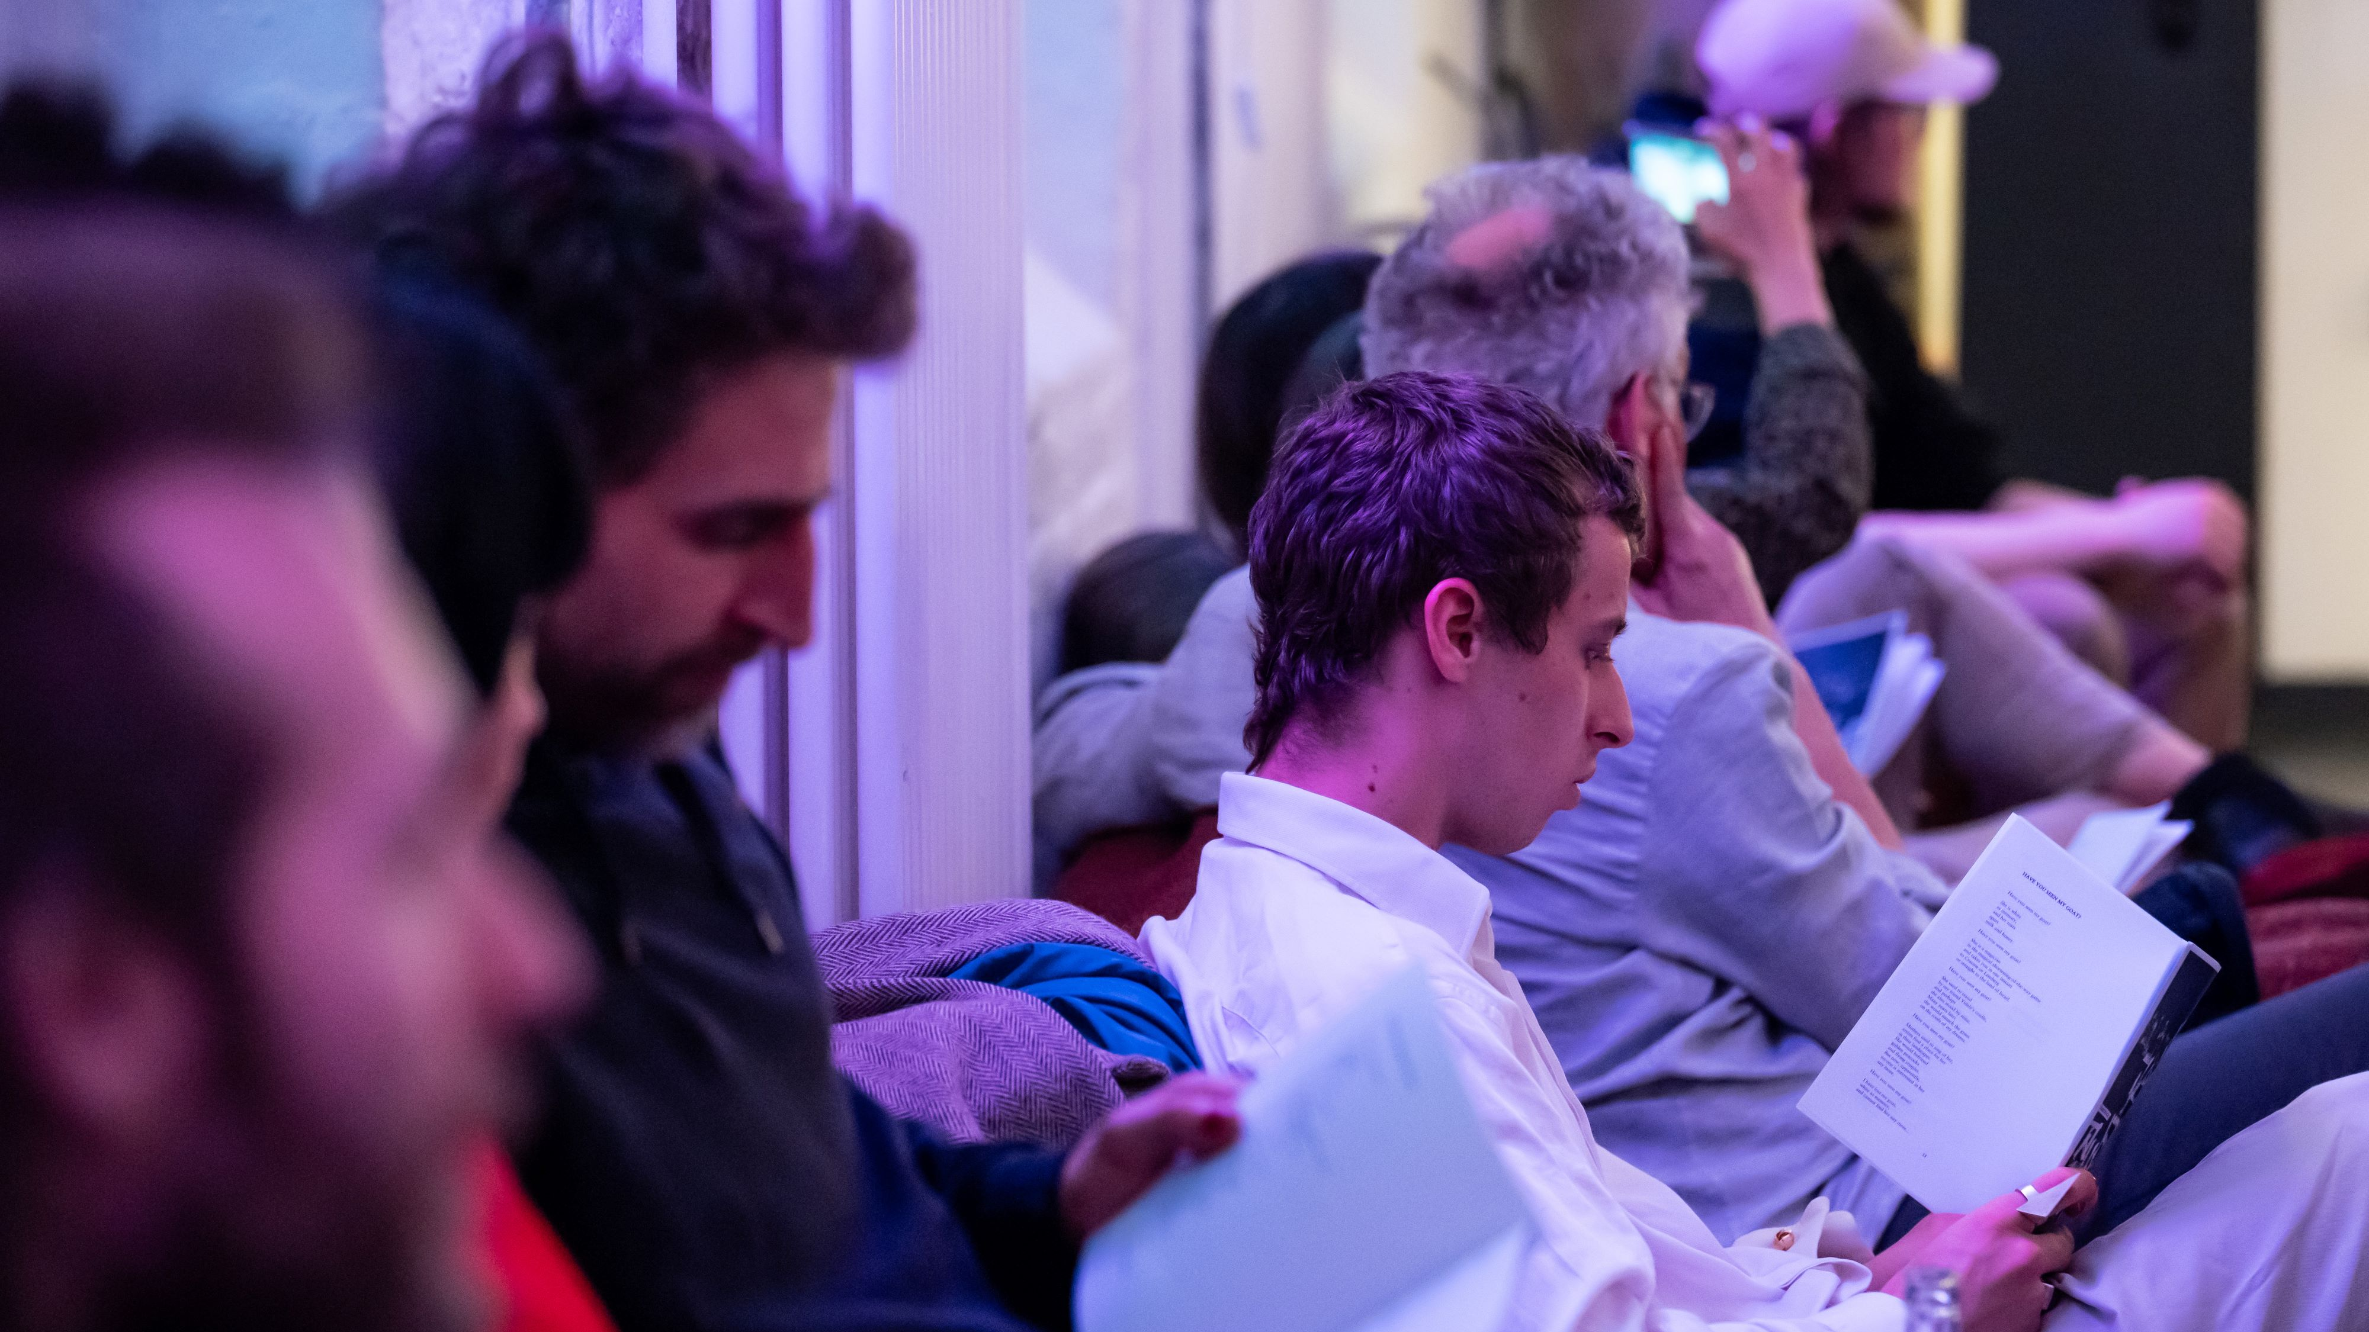
Objective 4 Results
Demographics and Best Practices for Community and Social Media Outreach for Haus für Poesie and Subsidiaries
Notes:
Andrew : Our final set of results included the Demographics and Best Practices for Community and Social Media Outreach for Haus für Poesie and Subsidiaries

Slide 30
Social Media Demographics
For Haus für Poesie & Subsidiary Brands
Male
*Top country across all Platforms and Brands: Germany
Female
31%
38%
40%
41%
TOP AGE 34-44
TOP AGE 25-34
TOP AGE 35-44
TOP AGE 25-34
59%
60%
60%
69%
Lyrikline Facebook
Zebra Poetry Film Festival Instagram
Haus für Poesie Facebook
Haus für Poesie Instagram
Notes:
Andrew: From social media analytics we determined the majority of users for Haus fuer Poesie and their subsidaries were female, and therefore targeting posts towards this demographic would be beneficial for outreach.

Slide 31
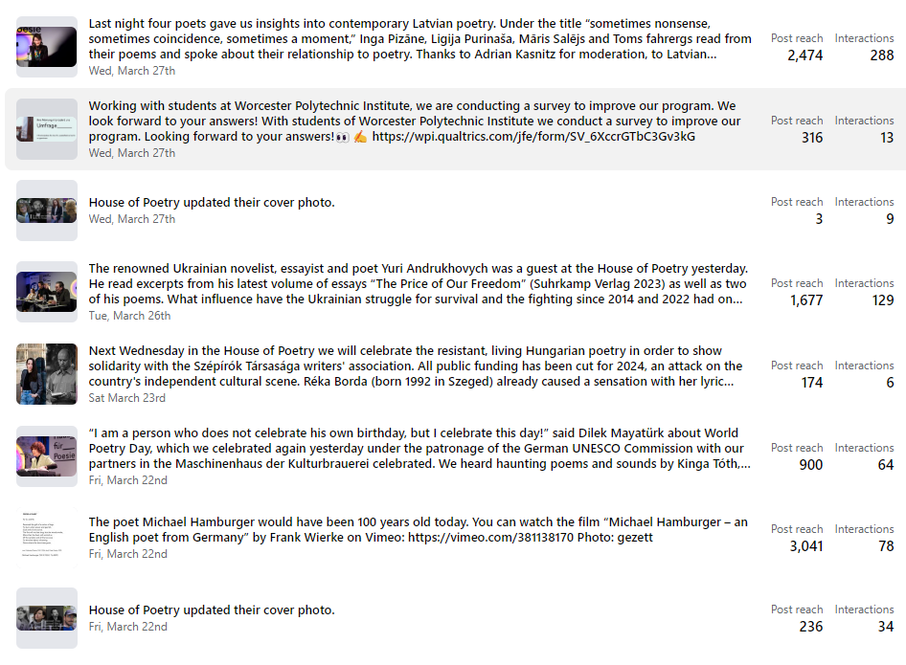
Haus für Poesie’s Previous Facebook Posts
Notes:
Andrew: Taking a closer look at at Haus fuer Poesie's previous facebook posts....

Slide 32
Notes:
Andrew: it can be seen that posts including poets, poems, or event information drives higher engagement.

Slide 33
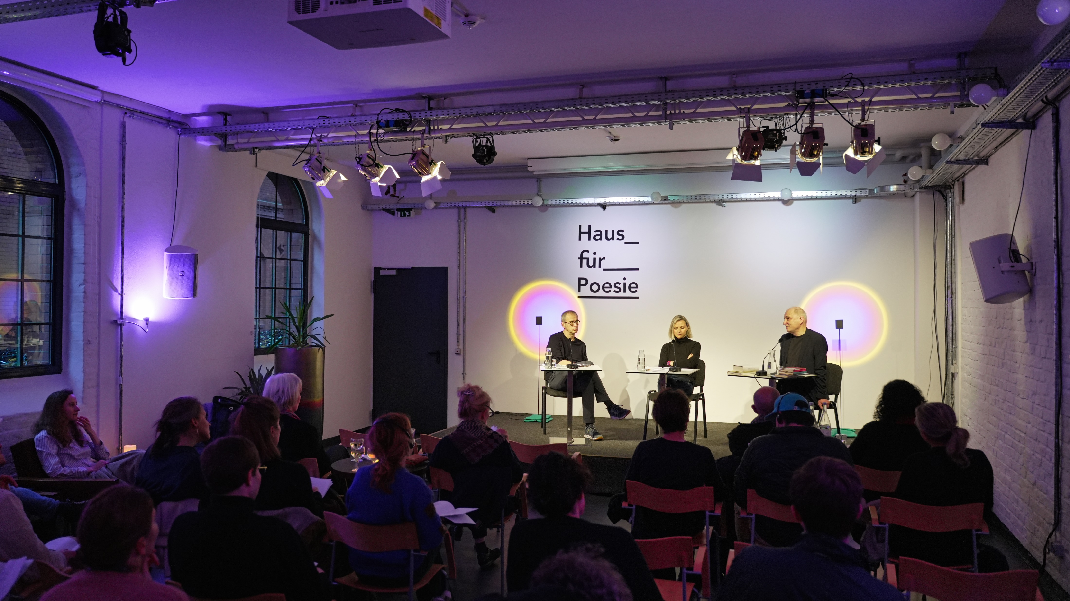
Proposed Solutions
Notes:
Andrew: From these results we formed multiple website and engagement recommendation for Haus fuer Poesie.

Slide 34

Website Recommendations
Notes:
Matt: Starting with our website recommendations

Slide 35
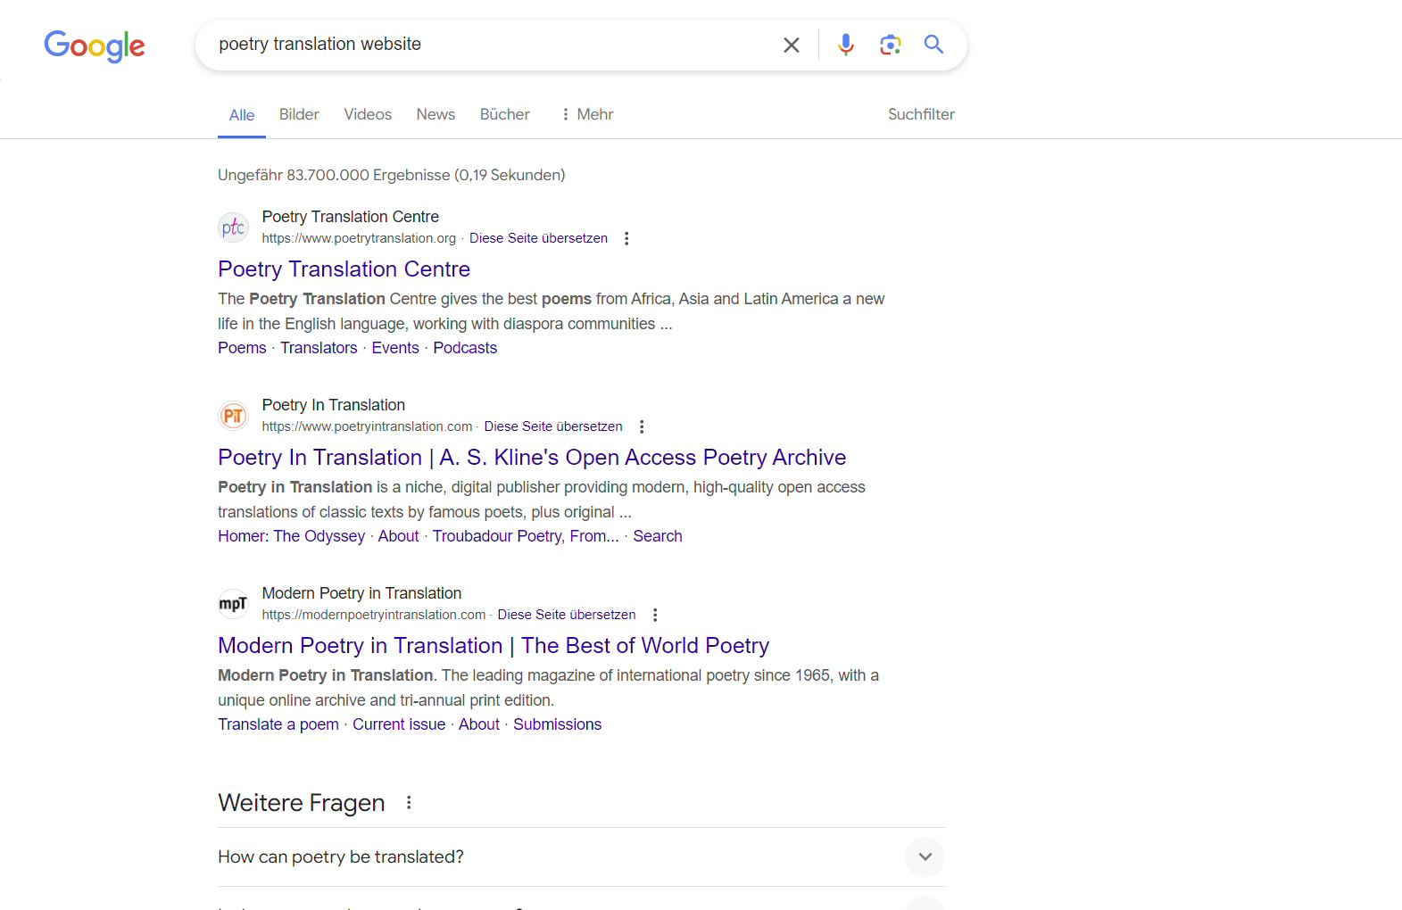
SEO Optimization
  SEO refers to the Search Engine Optimization of a website.
  It is important because helps your website rank higher in search engine results, making it more visible for people searching for relevant topics or keywords.
Notes:
Matt:
SEO or Search engine optimization is very important to help users and potential customers find you online. This is an issue that Haus Fur Poesie faces. The goal is to be at the top of the search results and as shown, in a search for poetry translation website, lyrikline does not appear. Our first recommendation is to better optimize the SEO, primarily by using keywords such as "poetry" "poetry events" "poetry transalation" or "international poetry"
Along with this, it is also recommended to prioritze mobile usability in a future redesign. From our research and data, we found that a large amount of users use the website on their mobile device. Not only will this help with the viewers experience, but mobile optimization also increases a site's SEO ranking.
The goal is to be at the top of the search results.

Slide 36
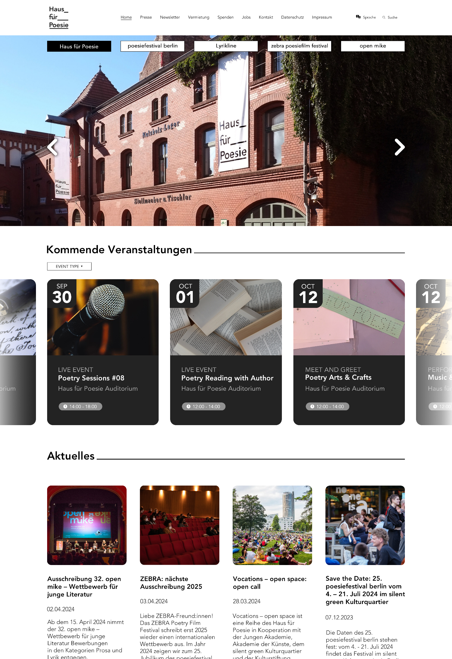
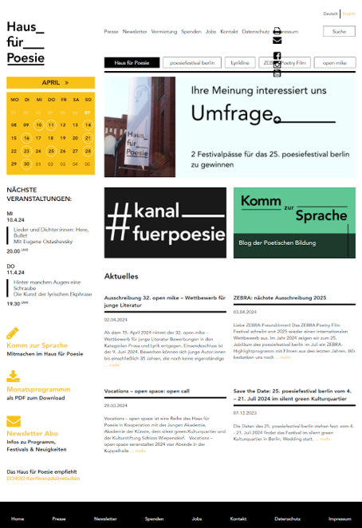
CURRENT HOMEPAGE OF THE HAUS FÜR POESIE WEBSITE
MOCKUP HOMEPAGE FOR THE HAUS FÜR POESIE WEBSITE
Notes:
Gabe
Another recommendation is redesigning their websites for better user experience and a responsive design.
We started off by looking at the main Haus Fur Poesie website. On the left you can see the current website and on the right you can see our proposed mockup.

Slide 37
Notes:
Gabe:
Cleaned up the sub-header by making the buttons wider. This makes it easy to navigate to the other subsidiaries websites while in the HFP main site.

Slide 38
Notes:
Gabe
Made the announcement tab larger to it takes the entire horizonal stretch of the page and it automatically scrolls though recent news about the organization.

Slide 39
Notes:
Gabe
The most significant change is adding a scrollable upcoming events element. Since most visitors of the website come to find out when are their next events, this would make the findability much easier. Each tab shows an image according to the event, the date, type of event, hours, location and short description.
A user can also filter by the type of event based on their preference

Slide 40
Notes:
Gabe
And the last change was to clean up the article section by adding pictures and short excerpts. If a user wants to read more, they can click on the read more button below each article
By having large images and buttons, this make the website more engaging and appealing to the user

Slide 41
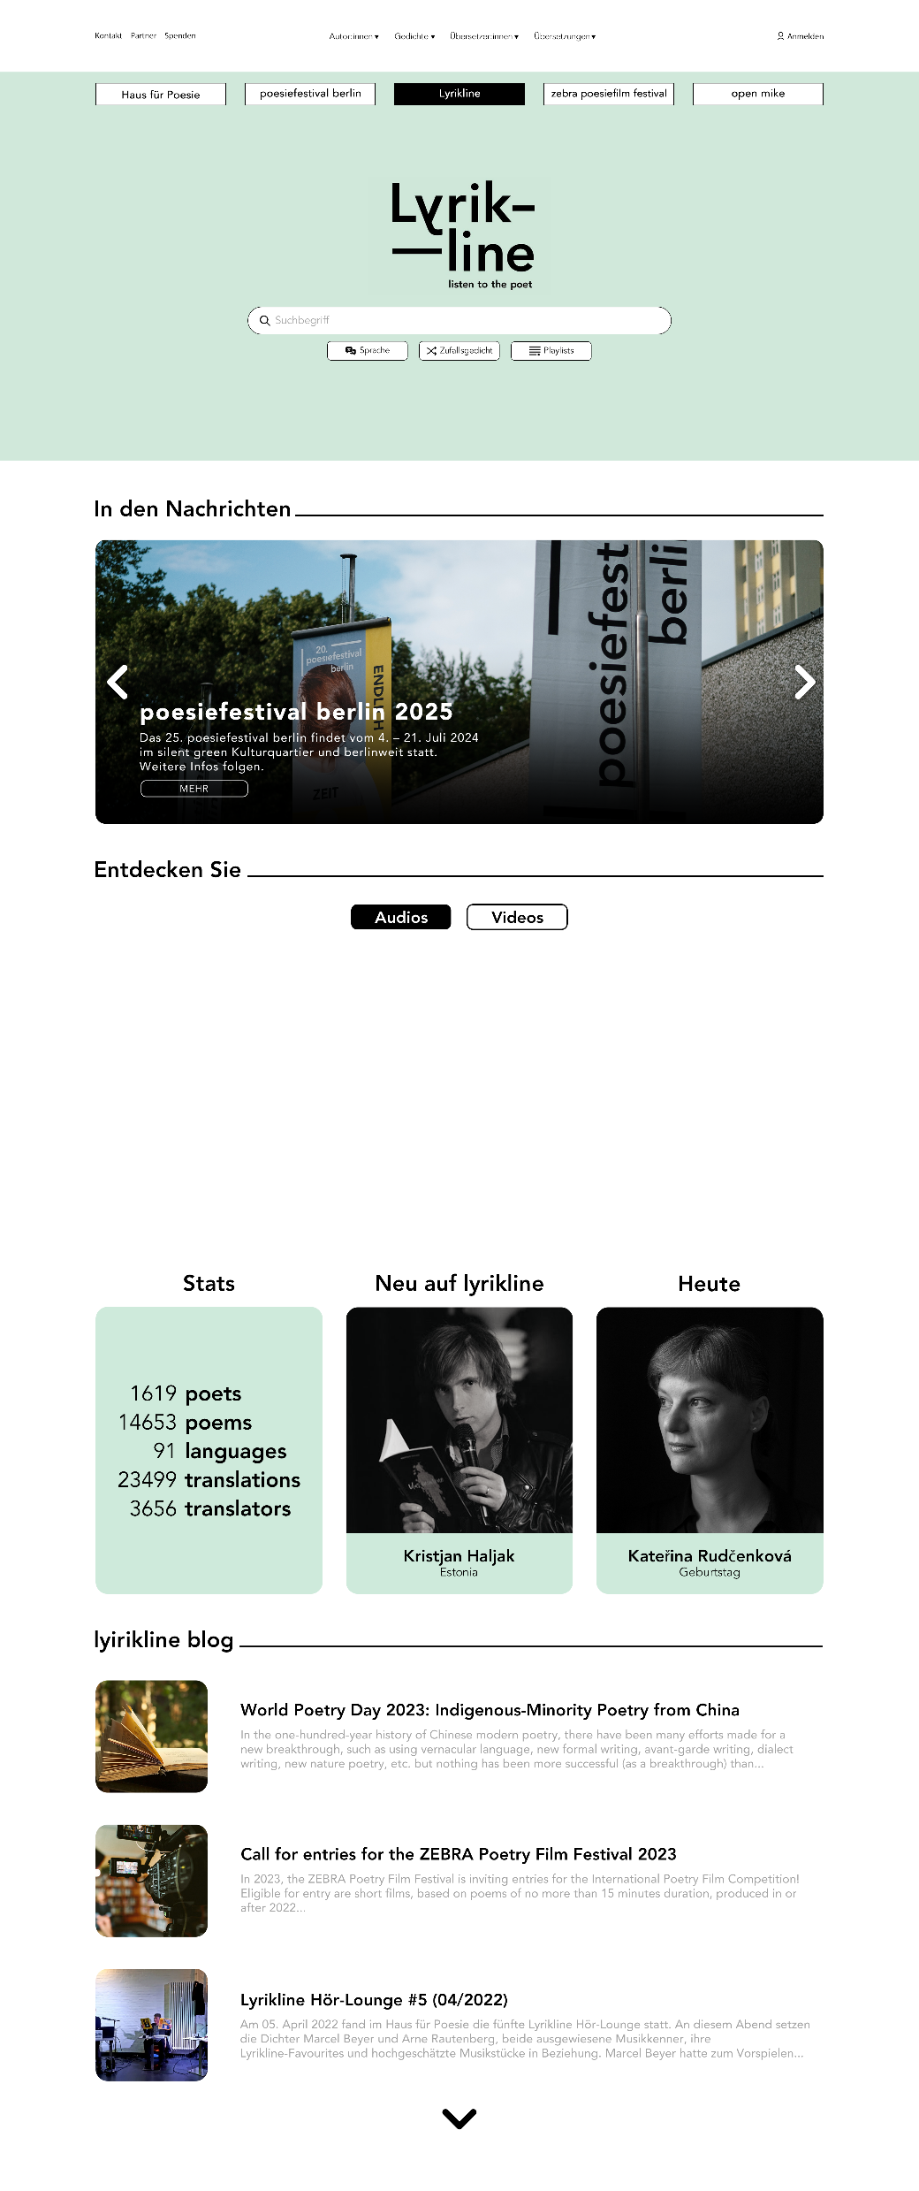
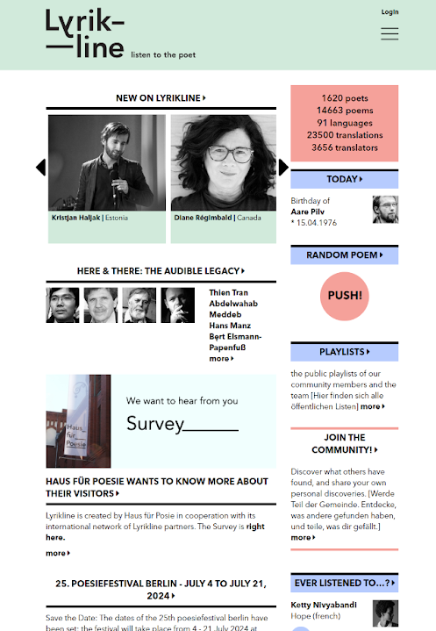
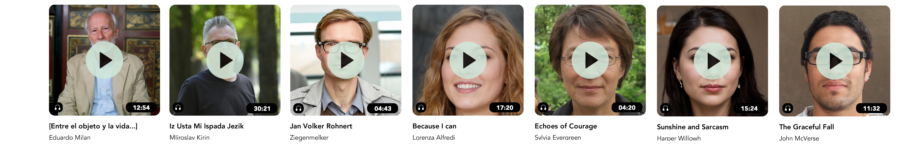
CURRENT HOMEPAGE FOR LYRIKLINE
MOCKUP HOMEPAGE FOR THE LYRIKLINE WEBSITE
Notes:
Gabe
For the lyrikline redesign, we took some of the same ideas from the Haus Fur Poesie website and brought them to hear, making the overall website cleaner and modern
We also removed some elements that essentially have the same functions such as the random poem and ever listened to…
We have the same sub-header present in the other website with all the subsidiary sites listed

Slide 42
Notes:
Gabe
Below that, there is a large announcement tab with news and upcoming events
And the most significant change is the addition of a discoverability feed. This is similar to social media platforms, in where it recommends content that is trending within the community

Slide 43
Notes:
Gabe
Users can scroll through this discoverability function in order to find new poems to listen to

Slide 44
Notes:
Gabe

Slide 45
Notes:
Gabe

Slide 46

Engagement
Recommendations
Notes:
Connor: Finally, we compiled results from surveys, interviews, literature and focus groups to create meaningful feedback to improve and maintain user engagement with the brands.

Slide 47
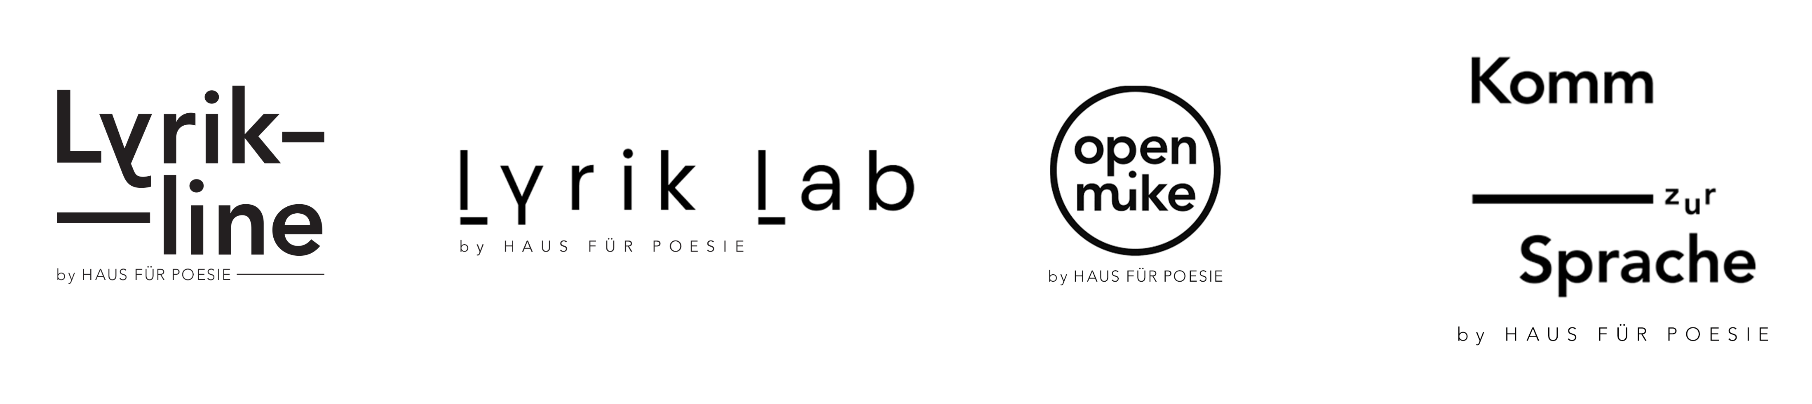
Notes:
Connor: The logo is the face of a brand and conveys important information about a brand’s identity. The addition of a tagline to each logo helps indicate the connection between the subsidiary brand and Haus fur poesie

Slide 48
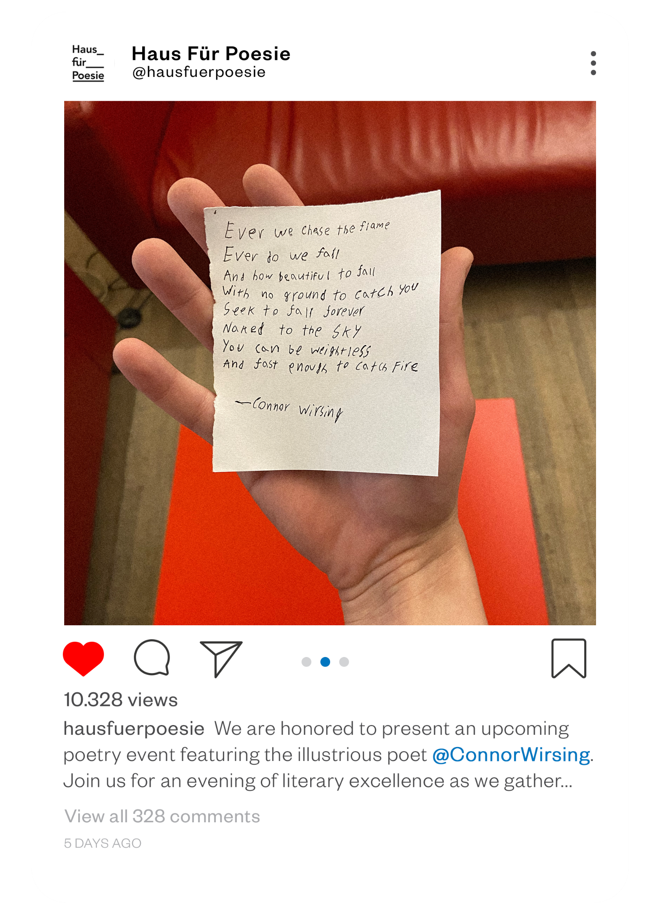

Social Media Approach
  Continue Social Media Approach
    Utilize poet names and poems in posts
    Target posts for female demographic
    Utilize Facebook for 35-44 age group and Instagram for 25-34 age group
Notes:
Connor: Social media allows organizations to connect with their user base on what is perceived as a

Slide 49

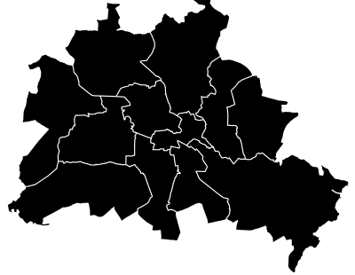


Online Events
  Host online events to reach a non-berlin-based audience, such as:
  Live streams of poetry readings and other events
  Author Q&A Sessions
  Poetry Podcasts or Webinars
Notes:
Connor: Focus group participants living outside the berlin area said they liked the online events during the pandemic, as they were able to engage with haus fur poesie anywhere. Online events will help the

Slide 50

Focus Group Participant
There is one world, different languages but only one world [...], and poetry is a good means to show this one world”
Notes:
Connor: By implementing our recommendations, we hope haus fur poesie is able to bring more people into the world of poetry.

Slide 51
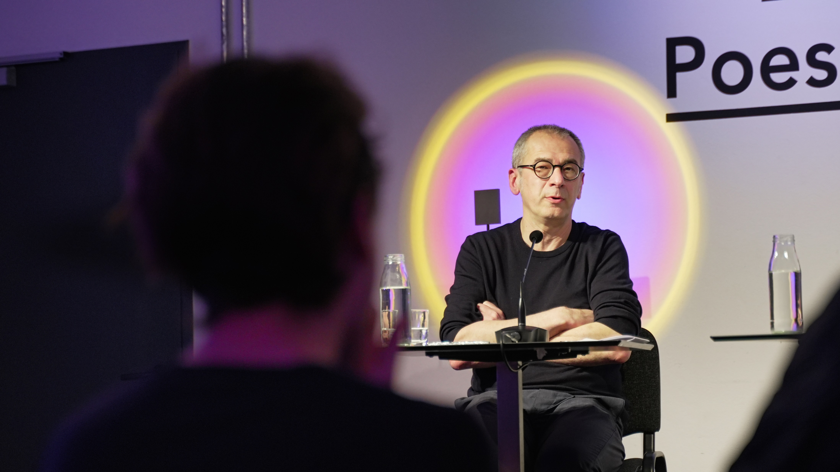
Thank you!
Notes:
Andrew: Thank you for listening.

Slide 52
Sources
Adorno, T. W. (1966). Meditations on metaphysics from Negative Dialektik. Translated by Simon Jarvis.
Adorno, T. (1949). Cultural criticism and society. In Prisms. Retrieved from https://edisciplinas.usp.br/pluginfile.php/5798834/mod_resource/content/1/Theodor%20W.%20Adorno%20Prisms%20%28Studies%20in%20Contemporary%20German%20Social%20Thought%29.pdf
Algharabat, R., Rana, N. P., Dwivedi, Y. K., Alalwan, A. A., & Qasem, Z. (2018). The effect of telepresence, social presence and involvement on consumer brand engagement: An empirical study of non-profit organizations. Journal of Retailing and Consumer Services, 40, 139–149. https://doi.org/10.1016/j.jretconser.2017.09.011
Haus für Poesie. (n.d.). Home. Retrieved from https://www.haus-fuer-poesie.org/en/literaturwerkstatt-berlin/home/
Senate Department for Culture and Europe. (n.d.). Literary houses. Retrieved from https://www.berlin.de/sen/kultur/en/funding/cultural-institutions/literary-houses/
Simon, H. (2009). Hidden champions of the twenty-first century: success strategies of unknown world market leaders. Springer.
Thompson, A. M., Thompson, H. J., Jones, M., & Rosenbloom, M. (2021). One website to rule them all: Lessons learned from a series of reorganizations, integrations, and creation of one university libraries’ website from three. Journal of Electronic Resources in Medical Libraries, 18(4), 177–187. https://doi.org/10.1080/15424065.2021.2010155
picture-alliance / dpa / Bifab. (2019). Der deutsche Philosoph und Soziologe Theodor W. Adorno. deutschlandfunkkultur. Retrieved from www.deutschlandfunkkultur.de.
Notes:
Andrew: Here are our sources for the slideshow and all our data and deliverables can be found on the website accessed through this QR code.

Slide 53
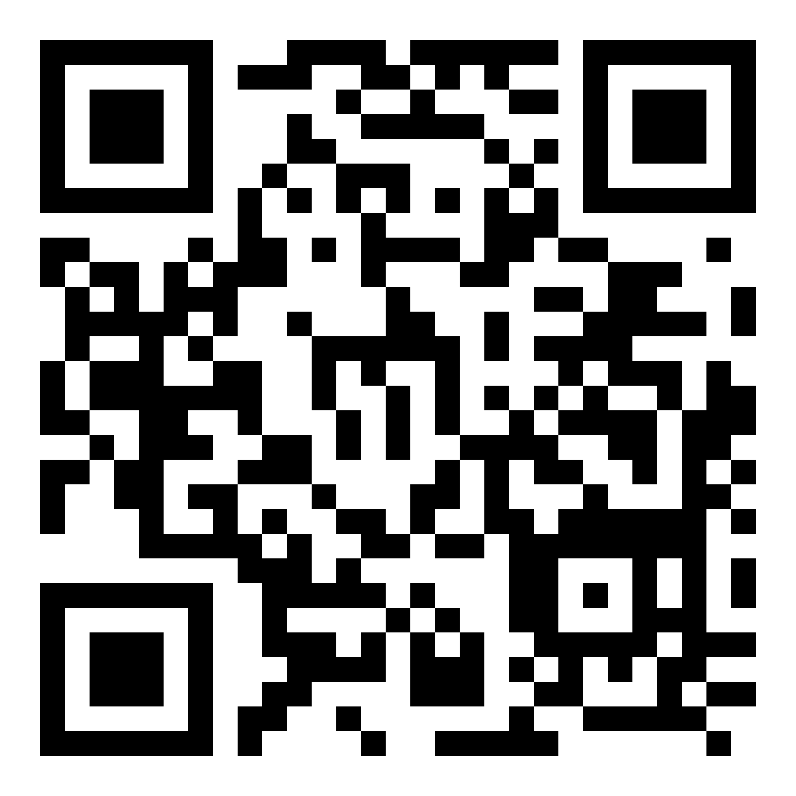
Deliverable and Report Website
Notes:
Andrew

Slide 54
Thank you!
Questions? | Comments? | Concerns?
Notes:
Andrew: Does anyone have any questions for the project team?

