Slide 1
Curve-Fitting Reserves
Zachary Charles Ahearn and Kieran Lee

Slide 2
Reserves
Used to pay off future claims
Estimates
Will be paid out over multiple years
Re-estimated Every Year
Methods
Development Method
Cape Cod Method
$$Reserve=\sum{Ultimate Claims}−\sum{Reported Claims}$$

Slide 3
Development method
Link Ratios
Loss Development Factor
$$Reserve=\sum{Ultimate Claims −\sum{Diagonal}}$$

Slide 4
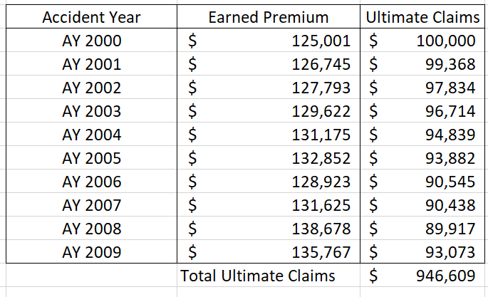
Cape cod Method
$$\sum{Reported Claims}$$ | $$\$827,000$$
$$\sum{Earned Premium⋅\% Reported}$$ | $$\$1,033,750$$
$CCLR=\frac{\sum{Reported Claims}}{\sum{Earned Premium⋅\% Reported}}$
Ultimate Claims = $\frac{1}{LDF}⋅Diagonal+\frac{1}{LDF}⋅CCLR⋅Premium$
= 80%
$$\sum{Ultimate Claims}$$ | $\$$946,609
Total Reserve= $\sum{Ultimate Claims−\sum{Reported Claims}}$
Total Reserve= $274,432

Slide 5
Shortcomings
Interpolation
Discrete Data Points
Lack of Variance
Parameter/Process Variance

Slide 6
Distributions
Weibull
$G\left(x|ω,θ\right)=1−e^{−({x/θ)}^{ω}}$
Loglogistic
$G\left(x|ω,θ\right)=\frac{x^{ω }}{x^{ω }+ θ^{ω}}$

Slide 7
Maximum Likelihood Estimate
$Loglikelihood=∑c_{AY:x,y}⋅\ln\left(μ_{AY:x,y}\right)−μ_{AY:x,y}$
$c_{AY:x,y}$ = Actual Data
$μ_{AY:x,y}$ = Expected Data

Slide 8
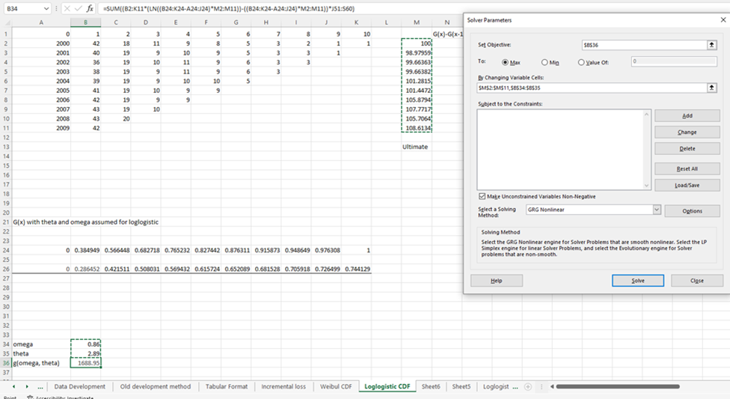
MLE continued

Slide 9
Process Variance
n | 55
ELR | 1
$$θ$$ | 1
$$ω$$ | 1
$$p= (ELR, ω, θ)$$ | 3
n – p | 52
$\frac{Variance}{Mean}=σ^{2}=\frac{1}{n−p}⋅Σ_{AY}^{n}\left(\frac{{\left(c_{AY}−μ_{AY}\right)}^{2}}{μ_{AY}}\right)$
$Process Variance= σ^{2}⋅Reserve$
$Total Reserve=\$255,818$
$σ^{2}= 0.50$
Process Variance $=\$129,035$
Notes:
Make 10 bigger

Slide 10
Parameter
$$Σ= \left[\begin{matrix}VAR\left(ELR\right) & COV\left(ELR,ω\right) & COV\left(ELR, θ\right) \\ COV\left(ω, ELR\right) & Var\left(ω\right) & COV\left(ω, θ\right) \\ COV\left(θ, ELR\right) & COV\left(θ,ω\right) & VAR\left(θ\right)\end{matrix}\right]≥ −σ^{2}⋅I^{−1}$$
Covariance Matrix
Information Matrix
$$I= \left[\begin{matrix}\sum_{y,t}{\frac{∂_{ }^{2}l_{y,t}}{∂ELR^{2}} } & \sum_{y,t}{\frac{∂_{ }^{2}l_{y,t}}{∂ELR∂ω} } & \sum_{y,t}{\frac{∂_{ }^{2}l_{y,t}}{∂ELR∂θ} } \\ \sum_{y,t}{\frac{∂_{ }^{2}l_{y,t}}{∂ω∂ELR} } & \sum_{y,t}{\frac{∂_{ }^{2}l_{y,t}}{∂ω^{2}} } & \sum_{y,t}{\frac{∂_{ }^{2}l_{y,t}}{∂ω∂θ} } \\ \sum_{y,t}{\frac{∂_{ }^{2}l_{y,t}}{∂θ∂ELR} } & \sum_{y,t}{\frac{∂_{ }^{2}l_{y,t}}{∂θ∂ω} } & \sum_{y,t}{\frac{∂_{ }^{2}l_{y,t}}{{∂θ}^{2}} }\end{matrix}\right]$$

Slide 11
Parameter variance continued
$$Σ≥ \left[\begin{matrix}3.70⋅{10}^{−4} & −2.55⋅{10}^{−5} & −7.01⋅{10}^{−4} \\ −1.71⋅{10}^{−5} & 2.94⋅{10}^{−4} & 1.62⋅{10}^{−4} \\ 6.83⋅{10}^{−4} & 8.28⋅{10}^{−5} & 2.02⋅{10}^{−2}\end{matrix}\right]=−σ^{2}⋅I^{−1}$$
$$VAR\left(ELR\right)⋅Premium^{2}=\left(3.70⋅{10}^{−4}\right)⋅\${1,308,182}^{2}=\$633,226,958$$

Slide 12
Total variance
Total variance = process variance + parameter variance
Total Variance$=\$ 129,035+\$ 633,226,958=$
$$\text{\$} \text{633,355,99}\text{3}$$
Standard Deviation = $25,167

