Slide 1

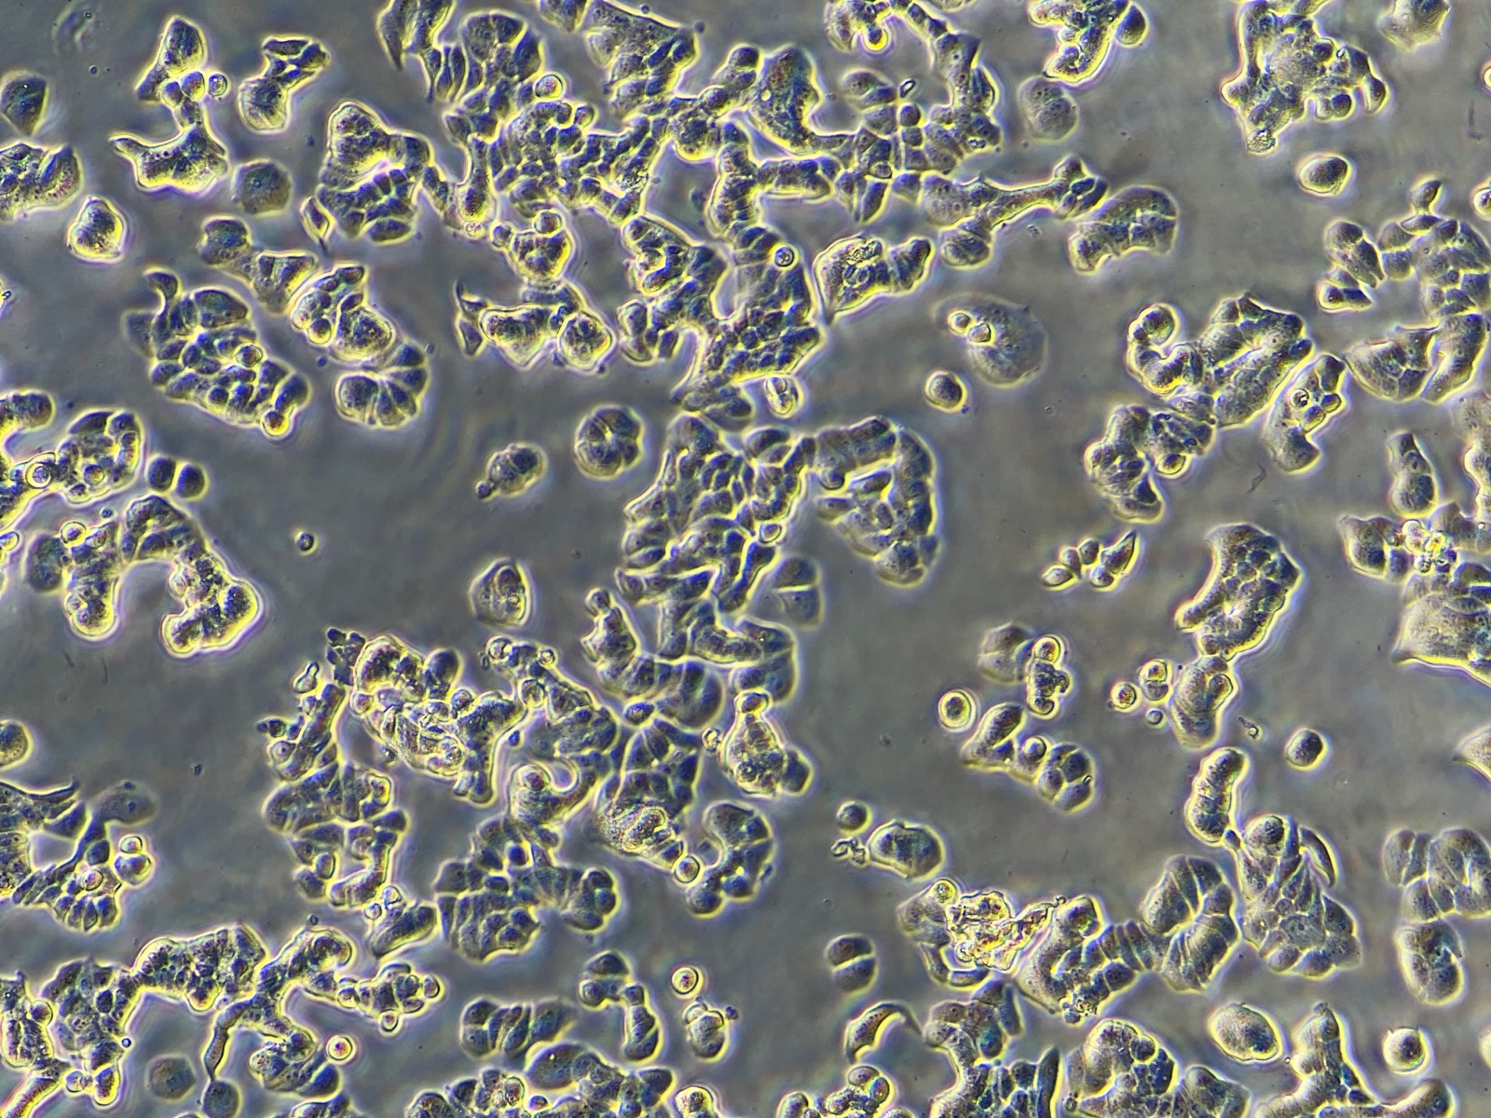
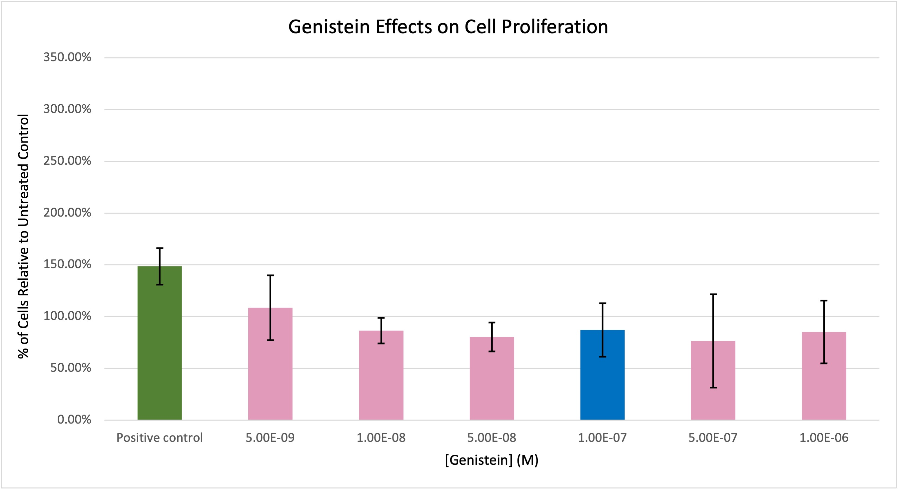
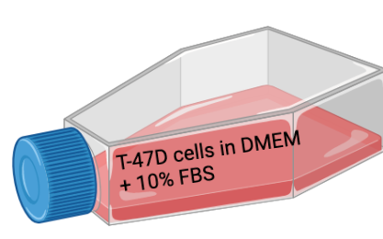
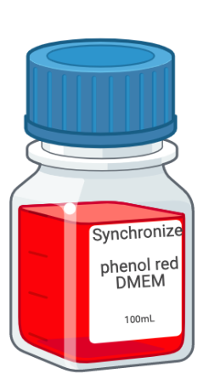
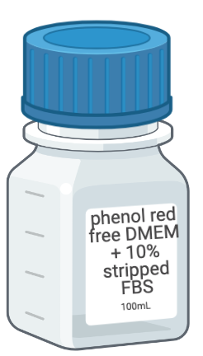
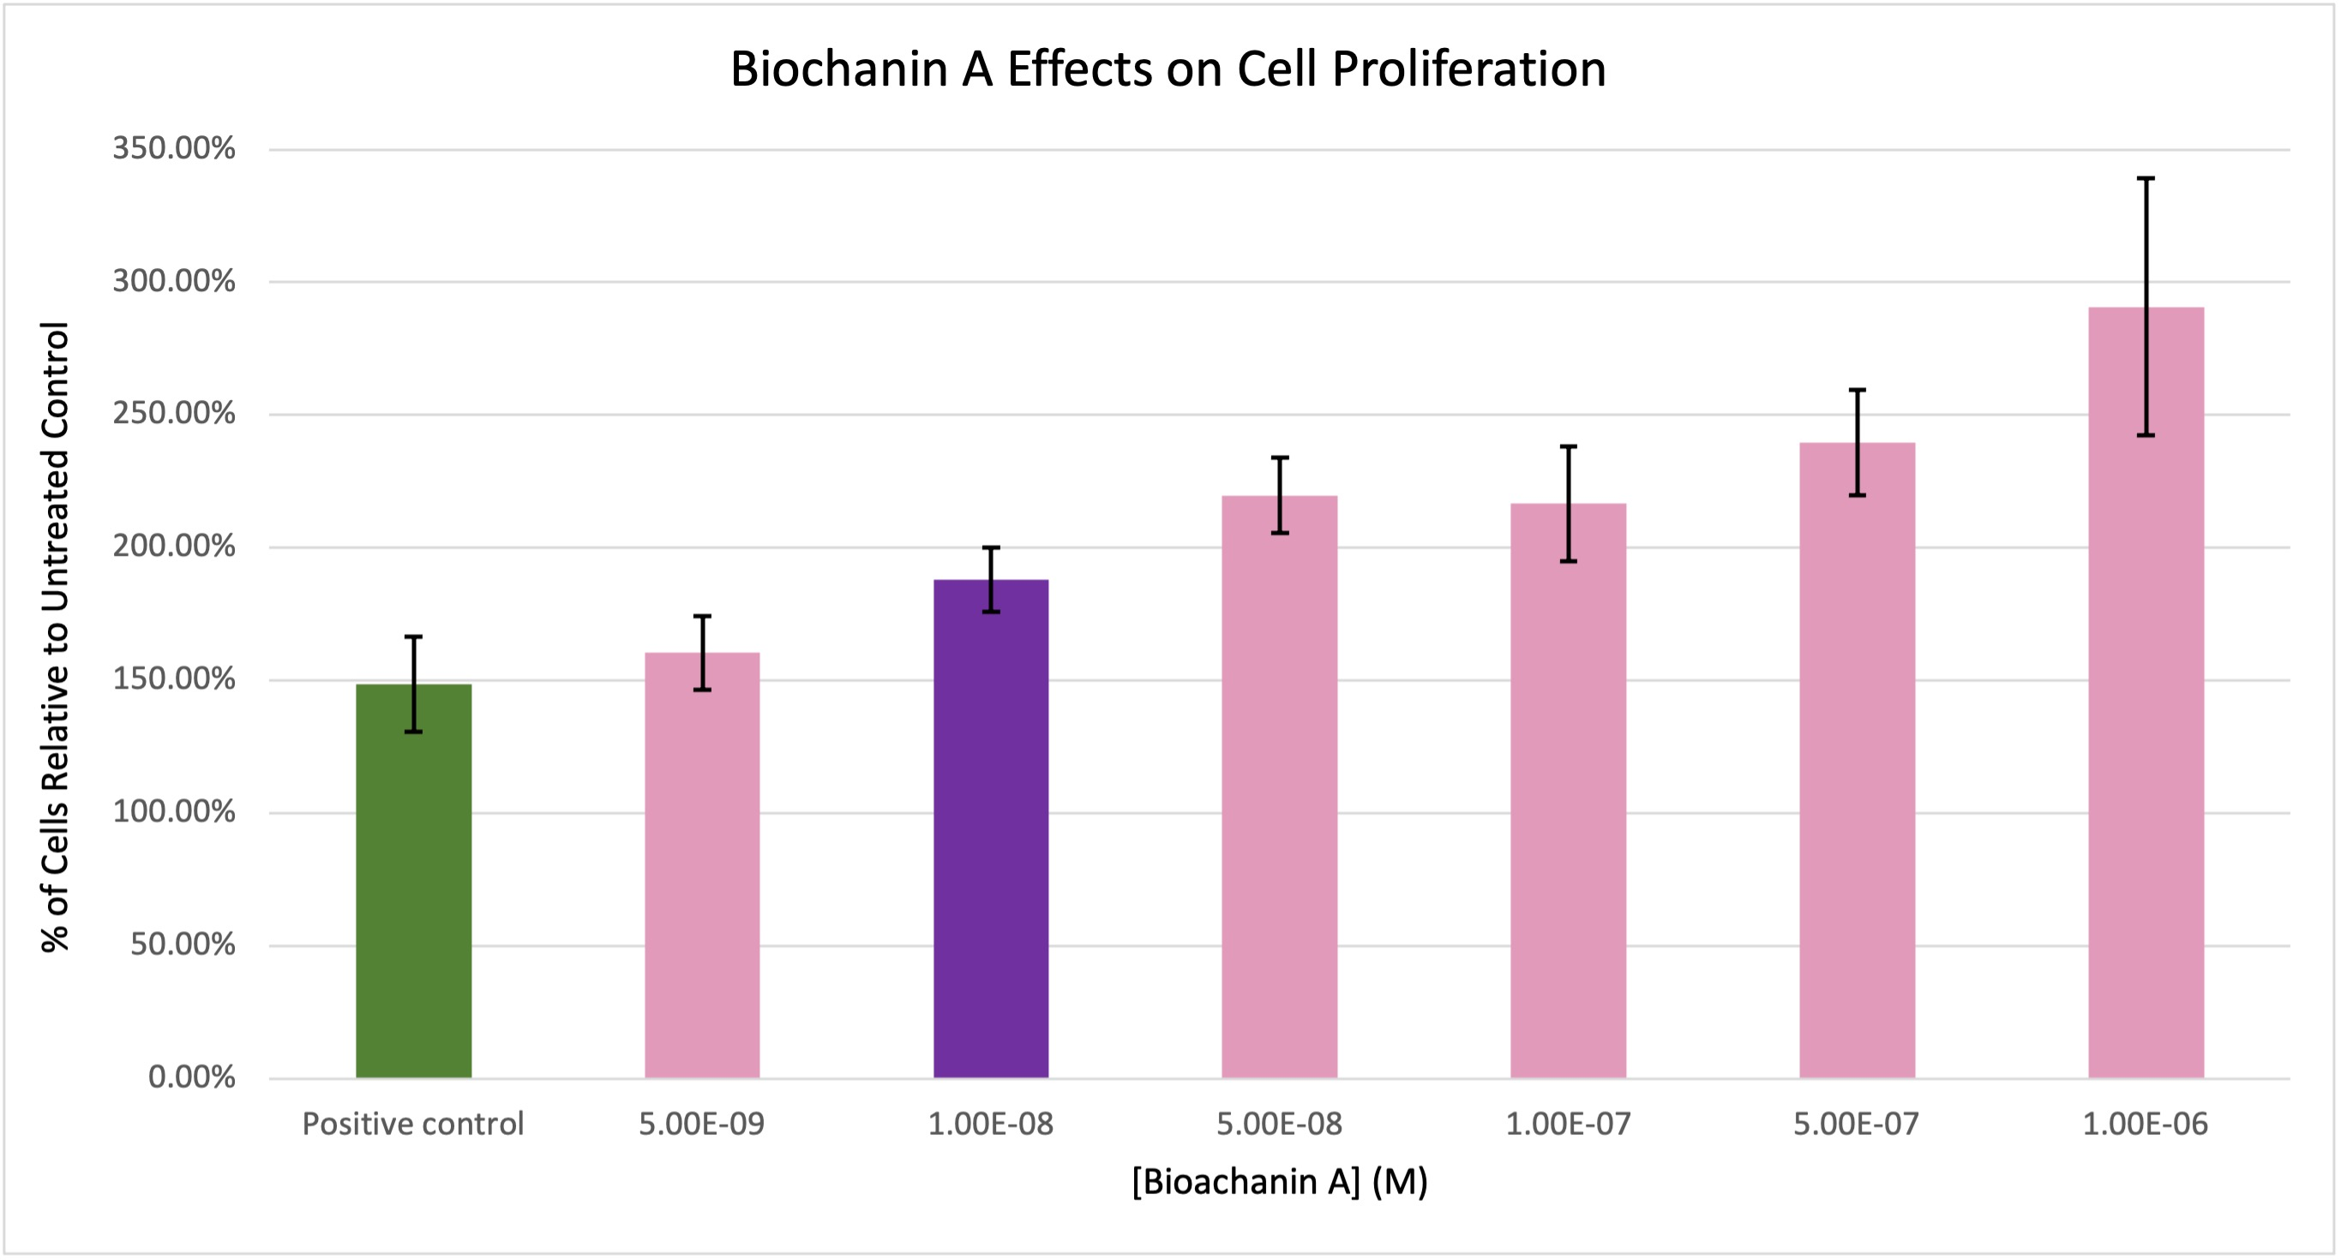
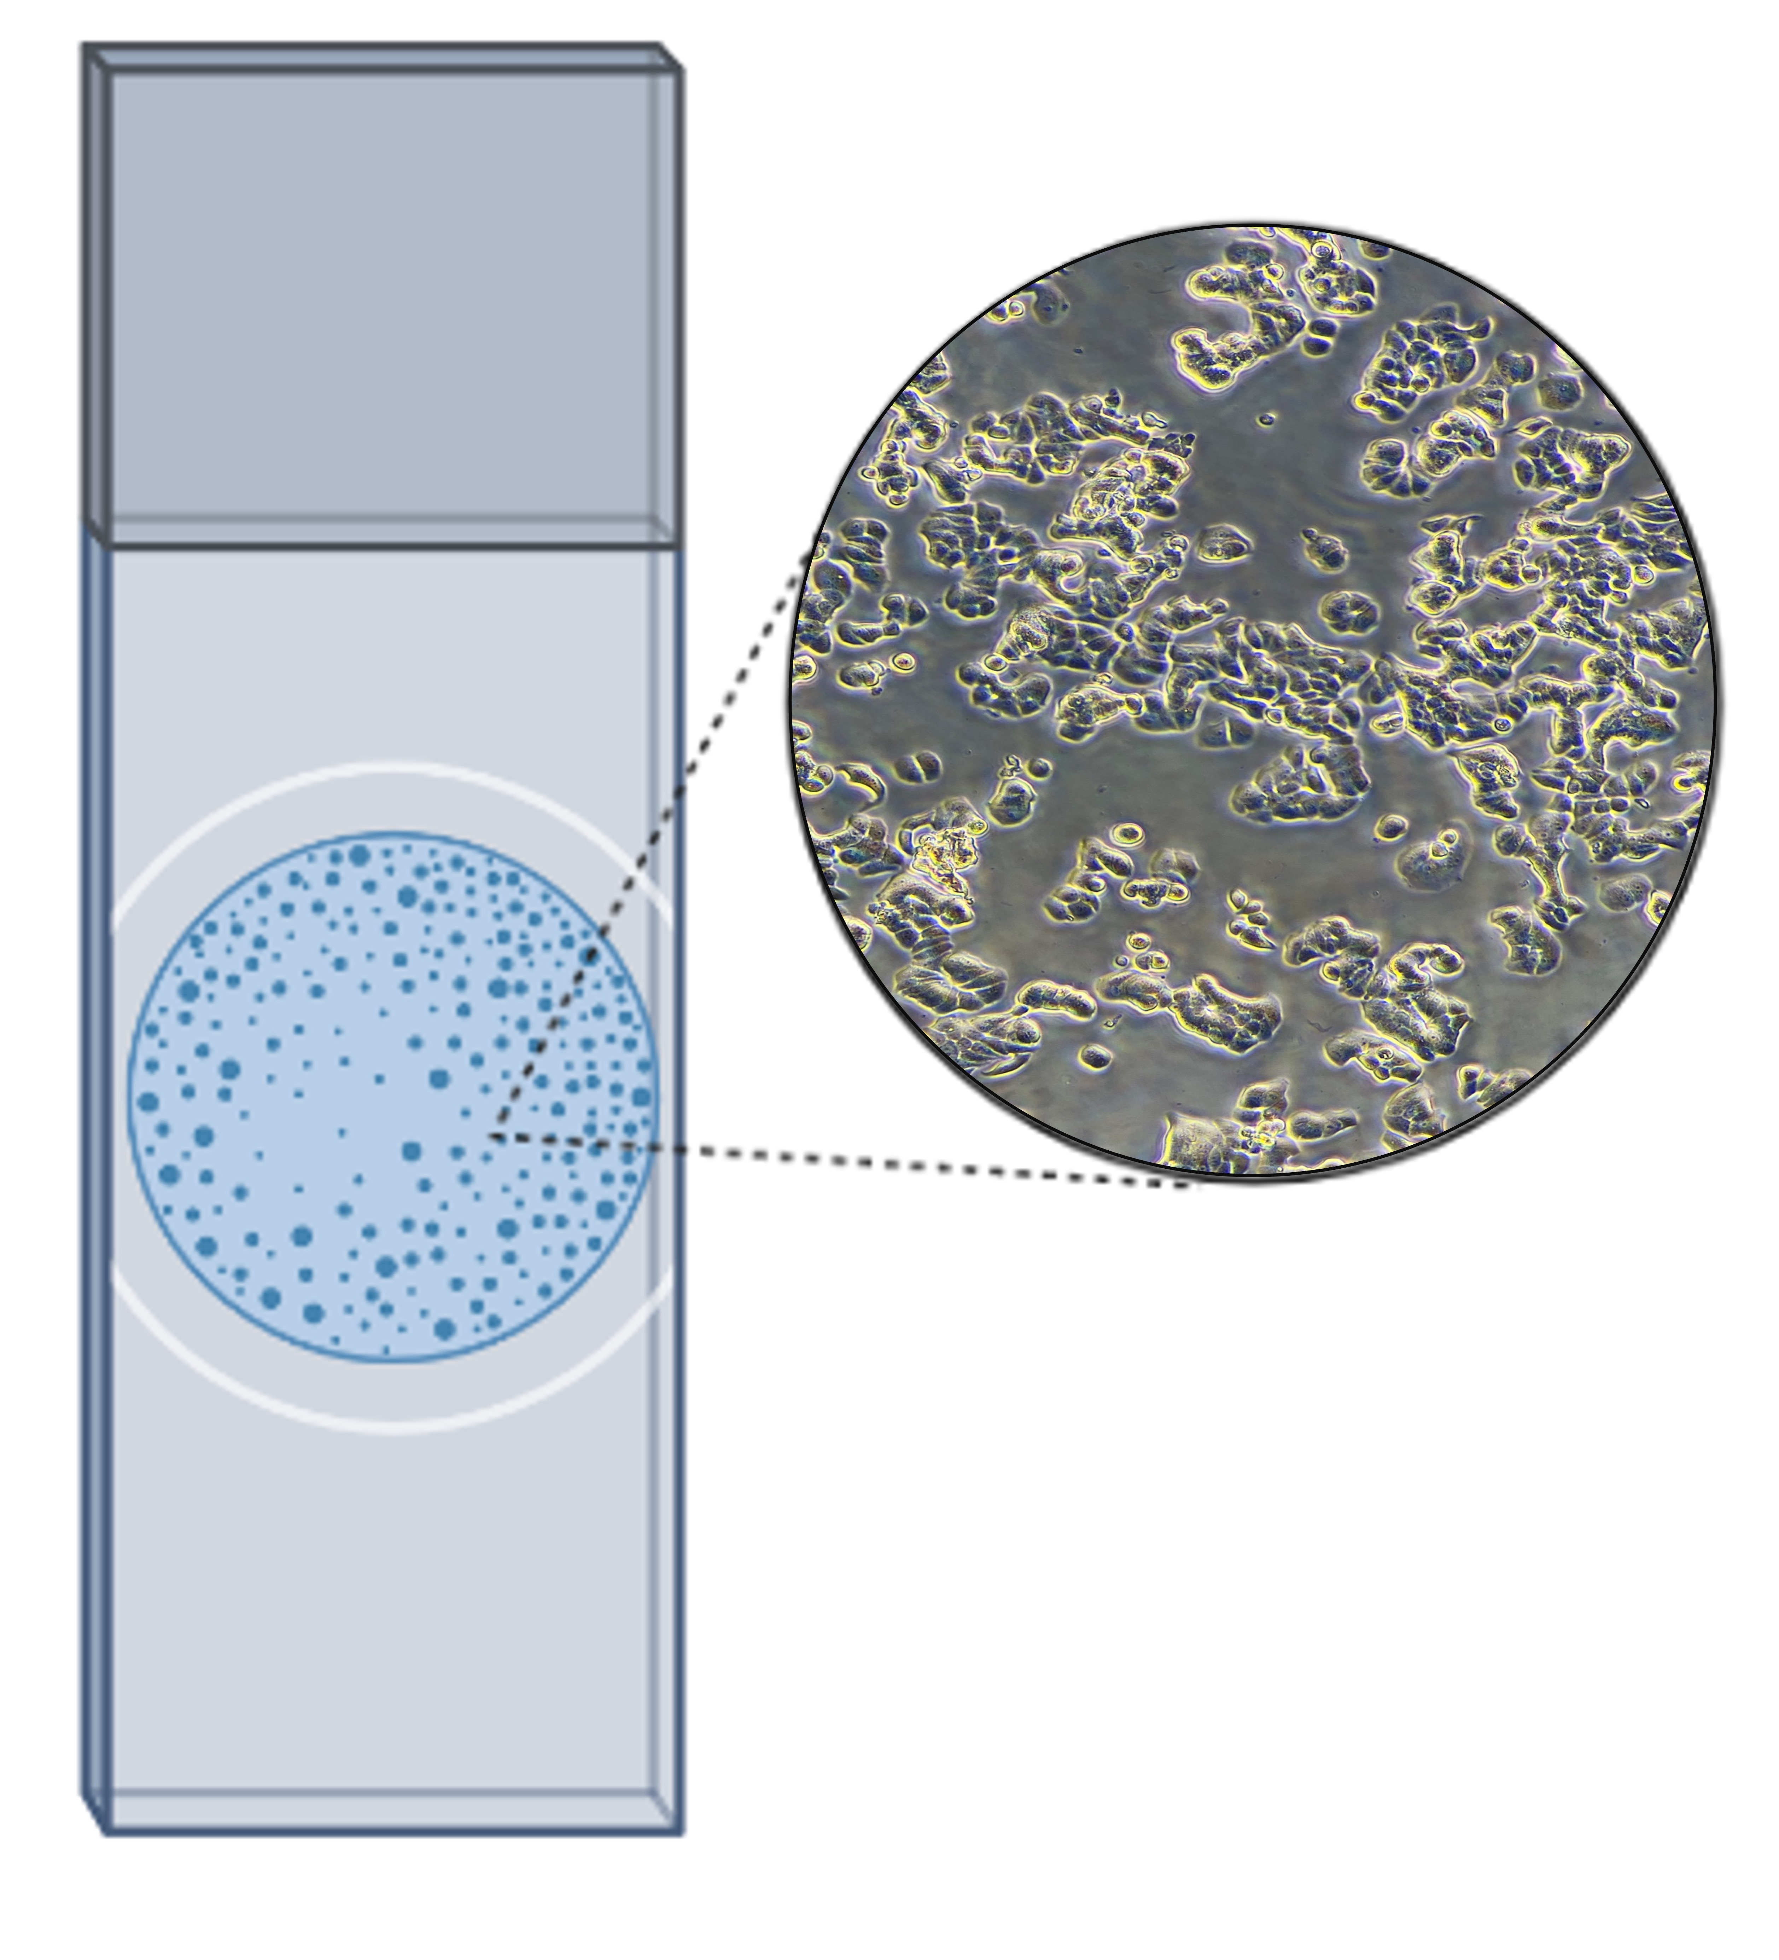
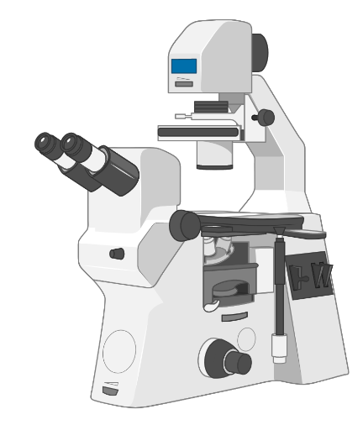
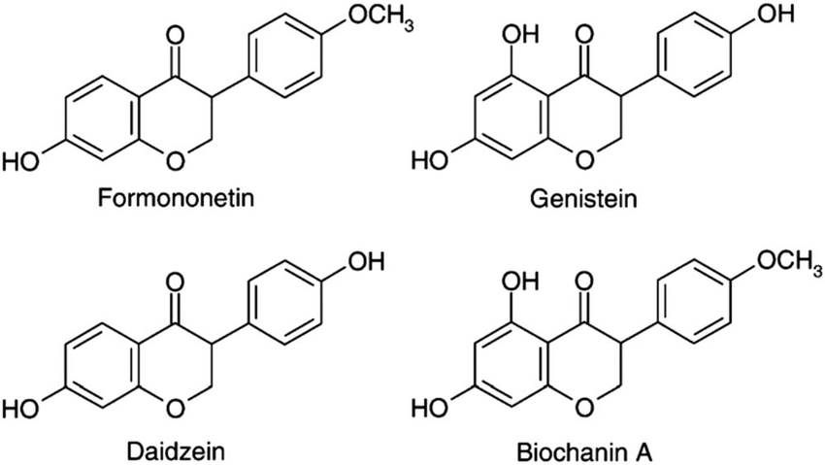
Relationship between Phytoestrogens and Breast Cancer
Adelaide McFarland (BBT), Daniel Mbusa (BBT), Ryan Smith (BBT), Jackson Su (BBT)
Advisor: Professor Mike Buckholt (BBT), Professor Jill Rulfs (BBT)
Abstract
Phytoestrogens (PEs), estrogen-like plant compounds, can be used in place of traditional hormone replacement therapy (HRT) to relieve postmenopausal symptoms. HRT has been shown to increase breast cancer risk. In vitro, one PE product, Promensil, has been shown to decrease the number of T47D breast cancer cells. We found the serum concentrations of four individual PEs contained in Promensil and hypothesize that these PEs are responsible for reduced cell numbers at those concentrations. We investigated two of the phytoestrogens on T47D cells in culture and discovered that at serum concentrations, biochanin A increases cell numbers similarly to estrogen while genistein maintains the same cell numbers as untreated controls.
Methods
Results
Cell growth
Media to synchronize cells into same stage of the cycle
Media with any endogenous steroids removed
Hypothesis
At physiologic concentrations, the phytoestrogens in Promensil decrease cell proliferation.
Synchronization
Background
255,000 women a year are diagnosed with breast cancer, and 42,000 women die¹
Estrogen hormone replacement therapy (HRT) is used to treat menopause symptoms but is a breast cancer risk factor²
HRT has restricted use, so other treatments are being tested
Compounds in red clover called phytoestrogens have been found to help with menopause symptoms³
Supplements like Promensil convert red clover to a pill form
Phytoestrogens have a similar structure to estrogen⁴
Studies show that phytoestrogens can decrease or prevent breast tumor growth⁵
Potential mechanisms of action include using the estrogen receptors to:
  inhibit the cell cycle
  increase apoptosis
To decrease proliferation, phytoestrogens bind the beta estrogen receptor (ERβ) with more affinity than the alpha receptor (ERα)^{5,6}
Phytoestrogen concentrations
In each graph, n=3 , with 3 experimental plates with triplicate wells made for each phytoestrogen. For the controls, n=7, representing 7 plates. Physiologic concentrations of estradiol and each phytoestrogen are highlighted in green, blue, and purple wells (left), while bars (above) of the same colors show the normalized cell counts. Error bars represent SEM.
Conclusions
At physiologic concentrations, genistein does not appear to change cell proliferation
Biochanin A appears to enhance cell proliferation to a level similar to 17β-estradiol
Based on these findings, the phytoestrogens in Promensil are not a recommended replacement for HRT
Cell Counting
Future Recommendations
Western Blot with p21 and Caspase3 antibodies to analyze cell cycle arrest and apoptosis mechanisms
Test phytoestrogen individually at concentrations outside of the physiologic range
Experiment with the other two phytoestrogens, daidzein and formononetin
Perform combination treatments of phytoestrogens to understand synergistic effects
References
CDCBreastCancer. (2022, March 9). Basic Information About Breast Cancer. Centers for Disease Control and Prevention. https://www.cdc.gov/cancer/breast/basic_info/index.htm
Does hormone replacement therapy (HRT) increase cancer risk? (2019, February 27). Cancer Research UK. https://www.cancerresearchuk.org/about-cancer/causes-of-cancer/hormones-and-cancer/does-hormone-replacement-therapy-increase-cancer-risk
van de Weijer, P. H. M., & Barentsen, R. (2002). Isoflavones from red clover (Promensil) significantly reduce menopausal hot flush symptoms compared with placebo. Maturitas, 42(3), 187–193. https://doi.org/10.1016/s0378-5122(02)00080-4
Melchior, E. A., & Myer, P. R. (2018). Fescue toxicosis and its influence on the rumen microbiome: Mitigation of production losses through clover isoflavones. Journal of Applied Animal Research, 46(1), 1280–1288. https://doi.org/10.1080/09712119.2018.1496920
Bilal, I., Chowdhury, A., Davidson, J., & Whitehead, S. (2014). Phytoestrogens and prevention of breast cancer: The contentious debate. World Journal of Clinical Oncology, 5(4), 705–712. https://doi.org/10.5306/wjco.v5.i4.705
Morito, K., Hirose, T., Kinjo, J., Hirakawa, T., Okawa, M., Nohara, T., Ogawa, S., Inoue, S., Muramatsu, M., & Masamune, Y. (2001). Interaction of Phytoestrogens with Estrogen Receptors a and b. 24(4), 6.
17β - estradiol

