Slide 1
Facial Recognition Annotation on Accuracy Sensitive Datasets
Vlad Stelea

Slide 2
Why tracking people in a video is important
Can aggregate information about person
Response to lessons
Understand positive climate
Notes:
Tracking who appears in a video and when is an important pre-processing task for many tasks
For example, within classroom videos, it can be useful to track where and when students and adults appear to see how each student responds to lessons and understand the positive climate
So how can we track people throughout videos?

Slide 3
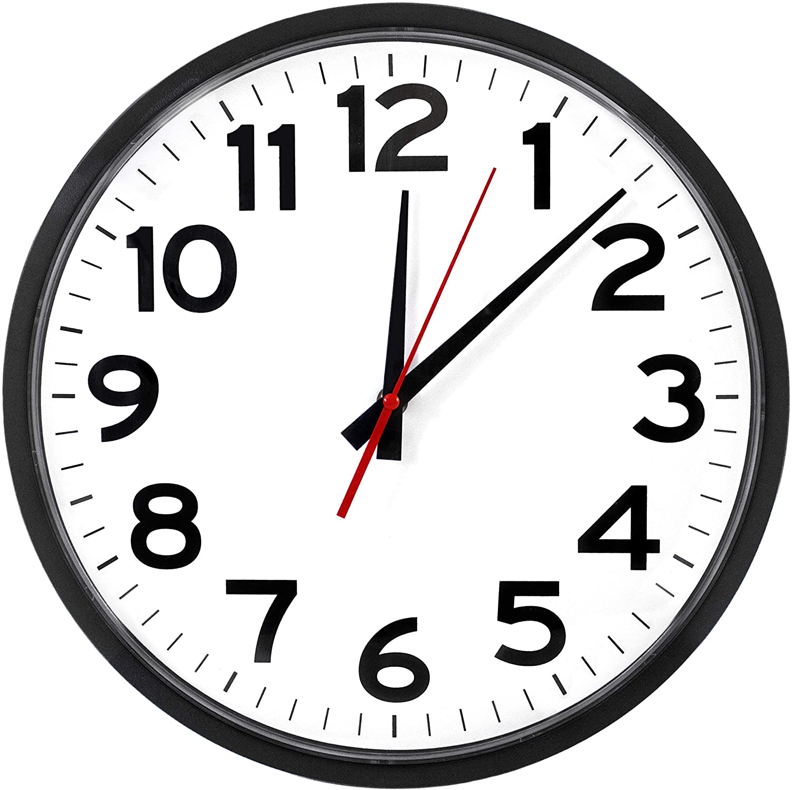
Manual Annotation
Notes:
One method of tracking people is to manually annotate annotate when and where each person appears within a video.
However, this is a very time-consuming process which means that it is also expensive
So what can we do when there is a task that takes a long time to complete?

Slide 4
Facial Recognition
https://blogs.microsoft.com/on-the-issues/2020/03/31/washington-facial-recognition-legislation/
Notes:
We can try to automate it…
Specifically, using facial recognition models we can reduce the time humans spend labeling
We chose facial recognition as our method of identifying people because there are already many existing models to both detect faces and identify who they belong to

Slide 5
Face Recognition Method: Classification
Regular CNN with Softmax at end
Simple to train
Can’t be automatically used with new identities
Notes:
One way to do facial recognition is through the use of regular classification methods
This can be as simple as your favorite CNN with a softmax layer at the end
The major benefit to this time of facial recognition model is that they are much easier to train
However, if you need to detect an identity that does not line up with the trained identities, this type of model is not able to detect that identity

Slide 6
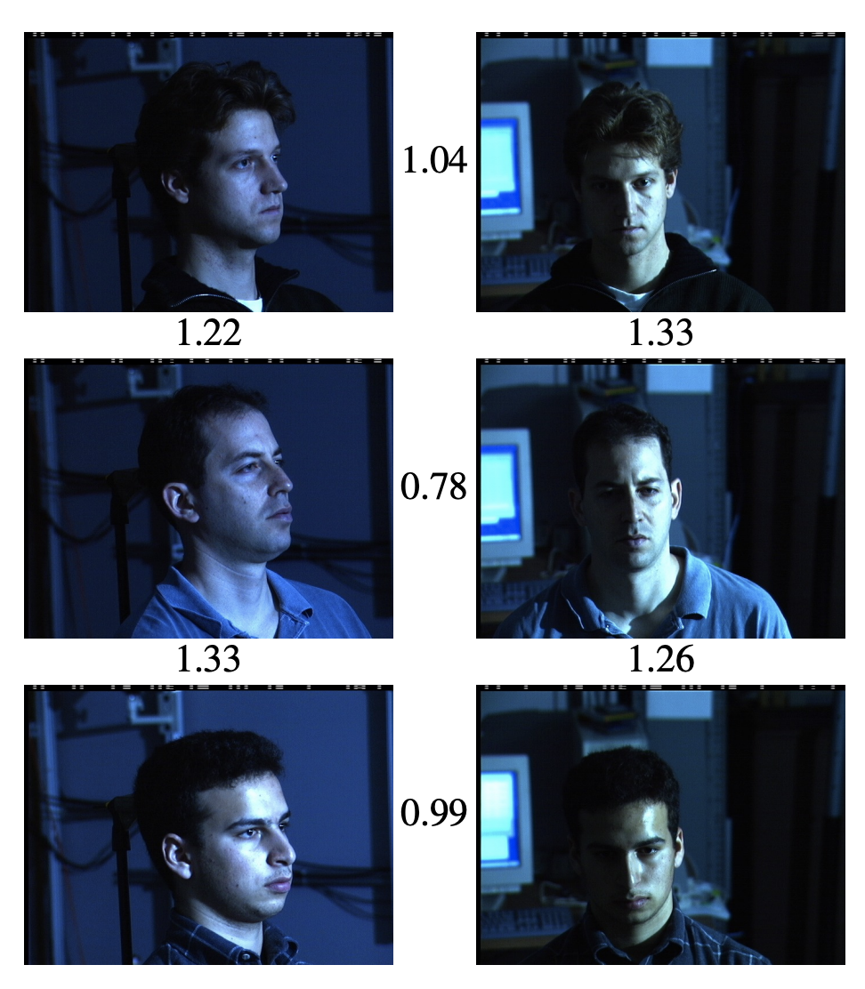
Face Recognition Method: Metric Encoding
Network outputs encoding of each face
Small L2 = Similar Face
Large L2 = Dissimilar Face
Encodings fed into clustering/distance-based classification algos
Schroff et.al
Notes:
Thus, one common method to add new identities post training is through the use of metric encodings
Metric encoding attempts encode images of the same identity close together and images of different identities far apart.
After having an encoding network produce this, we can feed the embeddings into clustering/distance based classification algorithms to get an actual class for the image
Because the encodings are not pre-determined, this means that after training and encoding network we can use it to predict new identities as long as there are multiple examples of that identity in the dataset
TODO: How to Cite images?

Slide 7
Metric Encoding: Triplet Loss
Triplet Loss directly adjusts encodings
3-Components:
Anchor (Class A)
Positive (Class A)
Negative (Class B)
Schroff et.al
Notes:
One way to produce metric encoding models is to use triplet loss paired with a typical gradient descent strategy
This loss function selects an anchor image, positive image of the same class as the anchor and negative image of a different class
It then uses the loss function shown in the slide to move the positive image’s encoding closer to the anchor image’s encoding and the negative image’s encoding farther away

Slide 8
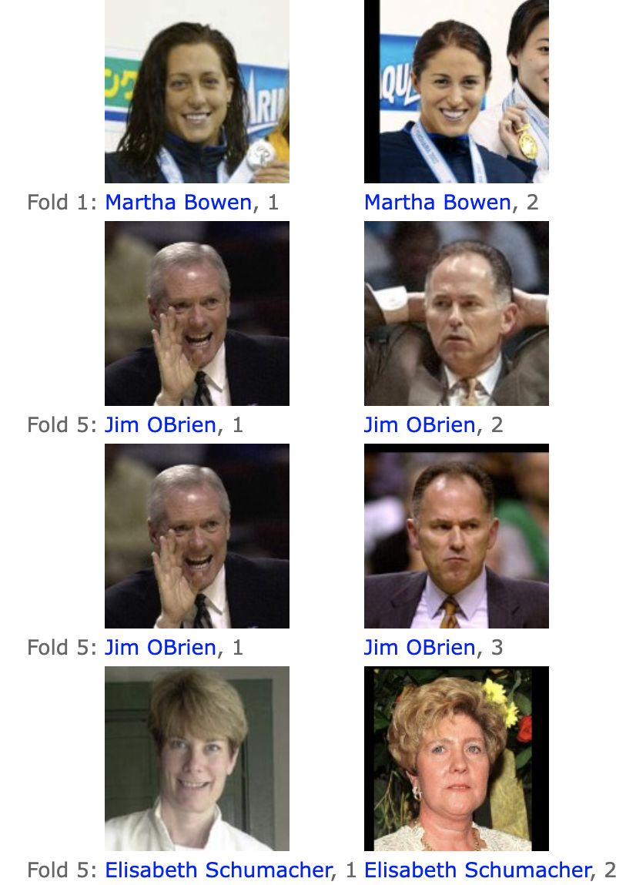
Problem with existing models
Models trained on non-diverse datasets (Bias)
Doesn’t transfer well to classrooms
Huang et.al
Notes:
The major problem with many existing models is that they’re trained on non-diverse datasets which creates a bias in the models
For example, this is a sample of the Labeled Faces in the wild dataset where you can see that there are no children included
This means that models trained on these types of datasets don’t transfer well to classroom environments where understanding where dataset accuracy is mission critical

Slide 9
Our Solution
Combine both by having an annotator correct labels
Doesn’t make the annotator generate all labels
But doesn’t rely on biased model’s predictions
Notes:
So what if we didn’t commit to having a model identify all people or manually annotate an entire video?
We can instead combine these approaches by having an annotator correct machine generated labels which makes sure the annotator does not need to generate all labels but also allows us to check that our dataset is labeled correctly
To take this even farther, what if there are other strategies that allow us to to further reduce the amount of time spent labeling while still producing high quality annotations

Slide 10
FaceSim
Custom simulation engine
Modularity -> Extensible
Notes:
To estimate what type of effect this strategy has on labeling time, we developed a custom simulation engine we call FaceSim that allowed us to understand what type of strategies reduce an annotator’s workload the most
Because FaceSim is built out of many loosely coupled components, it is also extensible which allowed us to easily write new experiments without rewriting a lot of code
For every experiment, I averaged about 1 new class of code and re-used what was already written

Slide 11
Challenge 1: Collecting a Dataset
No Pre-labeled datasets
Expensive Manual Annotation
Notes:
In order to run our simulator, we needed to have a classroom video dataset which has identities labeled.
However, because we couldn’t find a pre-labeled dataset, we had to make our own dataset
But we obviously run into the expensive annotation situation we described earlier if we want to manually annotate this dataset, so we needed to find a better strategy

Slide 12
Solution 1: Fix Model Prediction
Auto-Label
Human Correction
Notes:
So, in order to collect this initial dataset, we take a similar strategy to the proposed one where we have a model predict identities within a video and then we manually correct them
Unlike the proposed solution where our model incrementally labels faces based on the already labeled faces, in this solution, we label all the faces within a video at once and then correct them all using an annotation tool

Slide 13
Auto-Labeling Step
Notes:
This is the process we used to auto-label videos.
First, we ripped 26 videos from a youtube playlist of classrooms. We chose this route to get the raw video because these videos are open domain.
Afterwards, we ran each of the videos through the pipeline shown in the slide
This pipeline splits each video into 60 second segments of 2fps. We split the videos into 60 second sub-video segments because we needed more than 26 total videos for our experiments, and this made labeling easier because we could label in batches. We reduced the frame rate because in practice we found that consecutive frames had the same exact faces appearing multiple times so we did not gain a lot by keeping them all≥
After we get these split videos, we use an MTCNN face detector model to detect all the faces in each sub video and run these faces through our pre-trained facenet model to get encodings for an entire sub-video
After getting encodings for each face, we run them through an agglomerative clustering algorithm which we chose because it allowed us to cluster based on a maximum distance threshold
And then came the fun part: manually correcting the annotations…

Slide 14
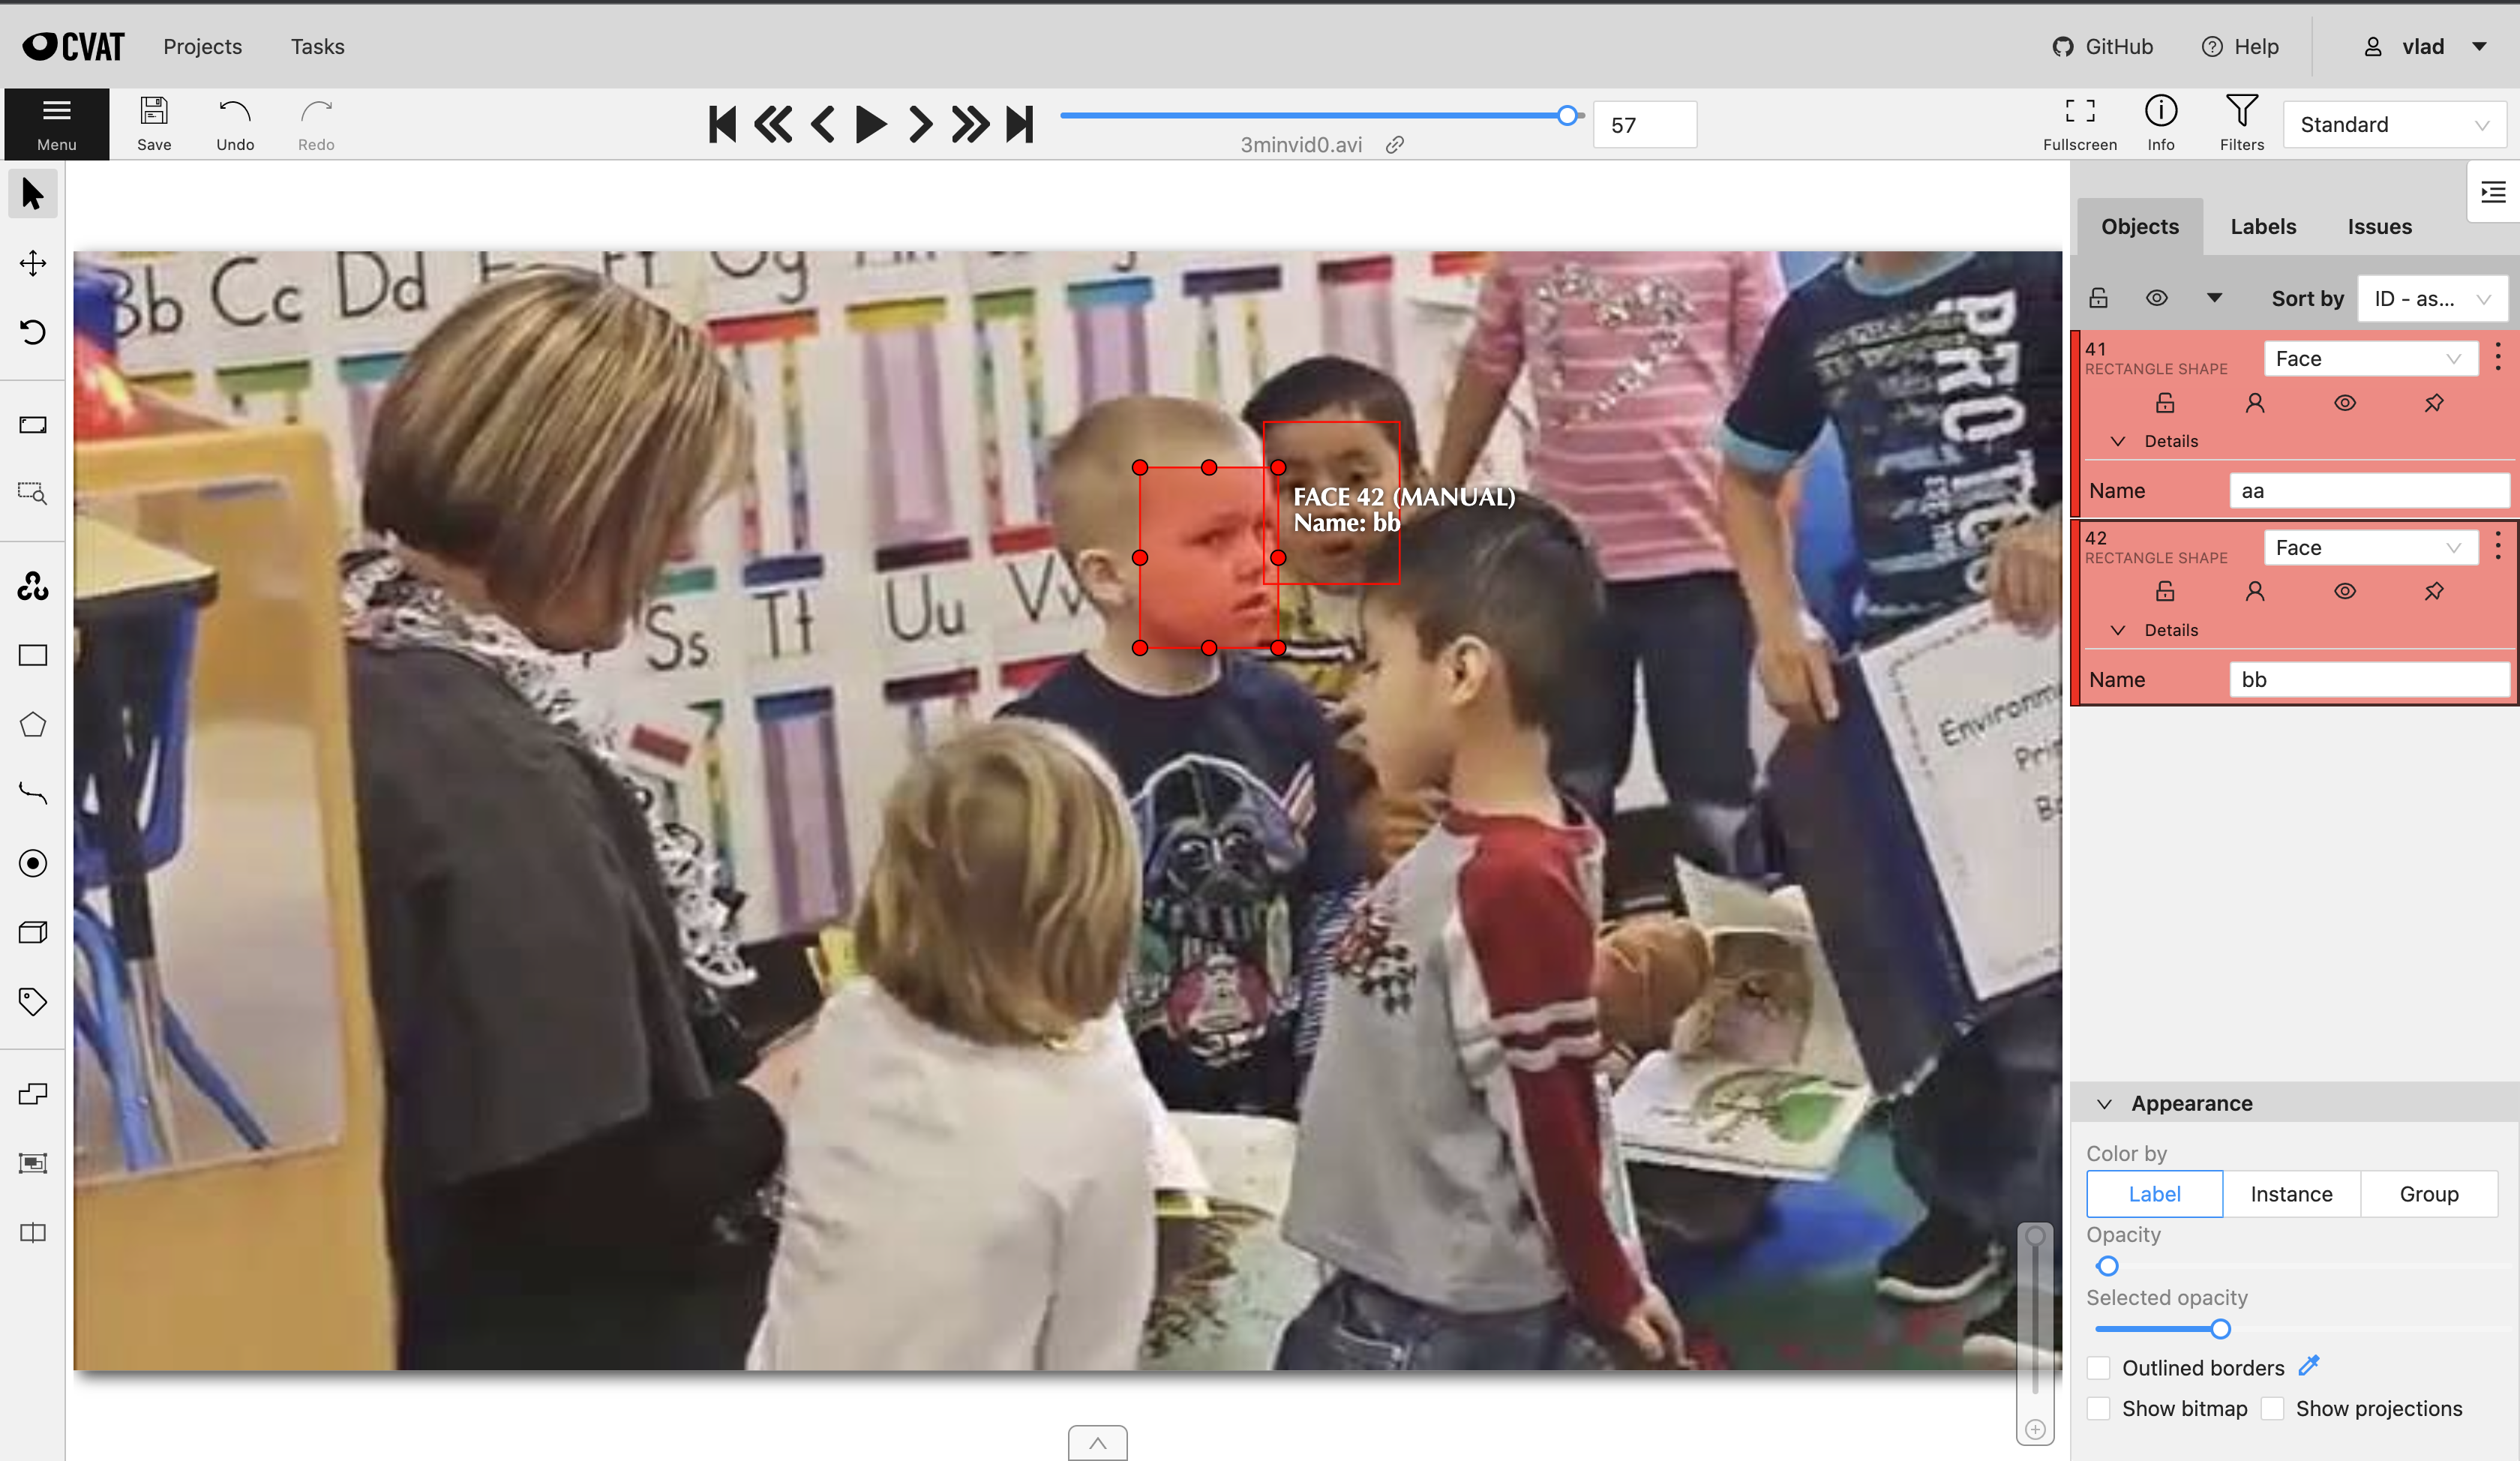
Annotation Tool: CVAT
Notes:
To correct the machine generated labels, we could have used an existing annotation tool like CVAT
However, CVAT made labeling faces difficult because it supports creating labels only at the beginning of the job so to annotate a person’s identity we needed to manually edit a tag field we generated during the auto-labeling process.
This meant we would have to type each person’s name on each frame which made it time consuming to label each video as well as difficult because I would have needed to remember each person’s name

Slide 15
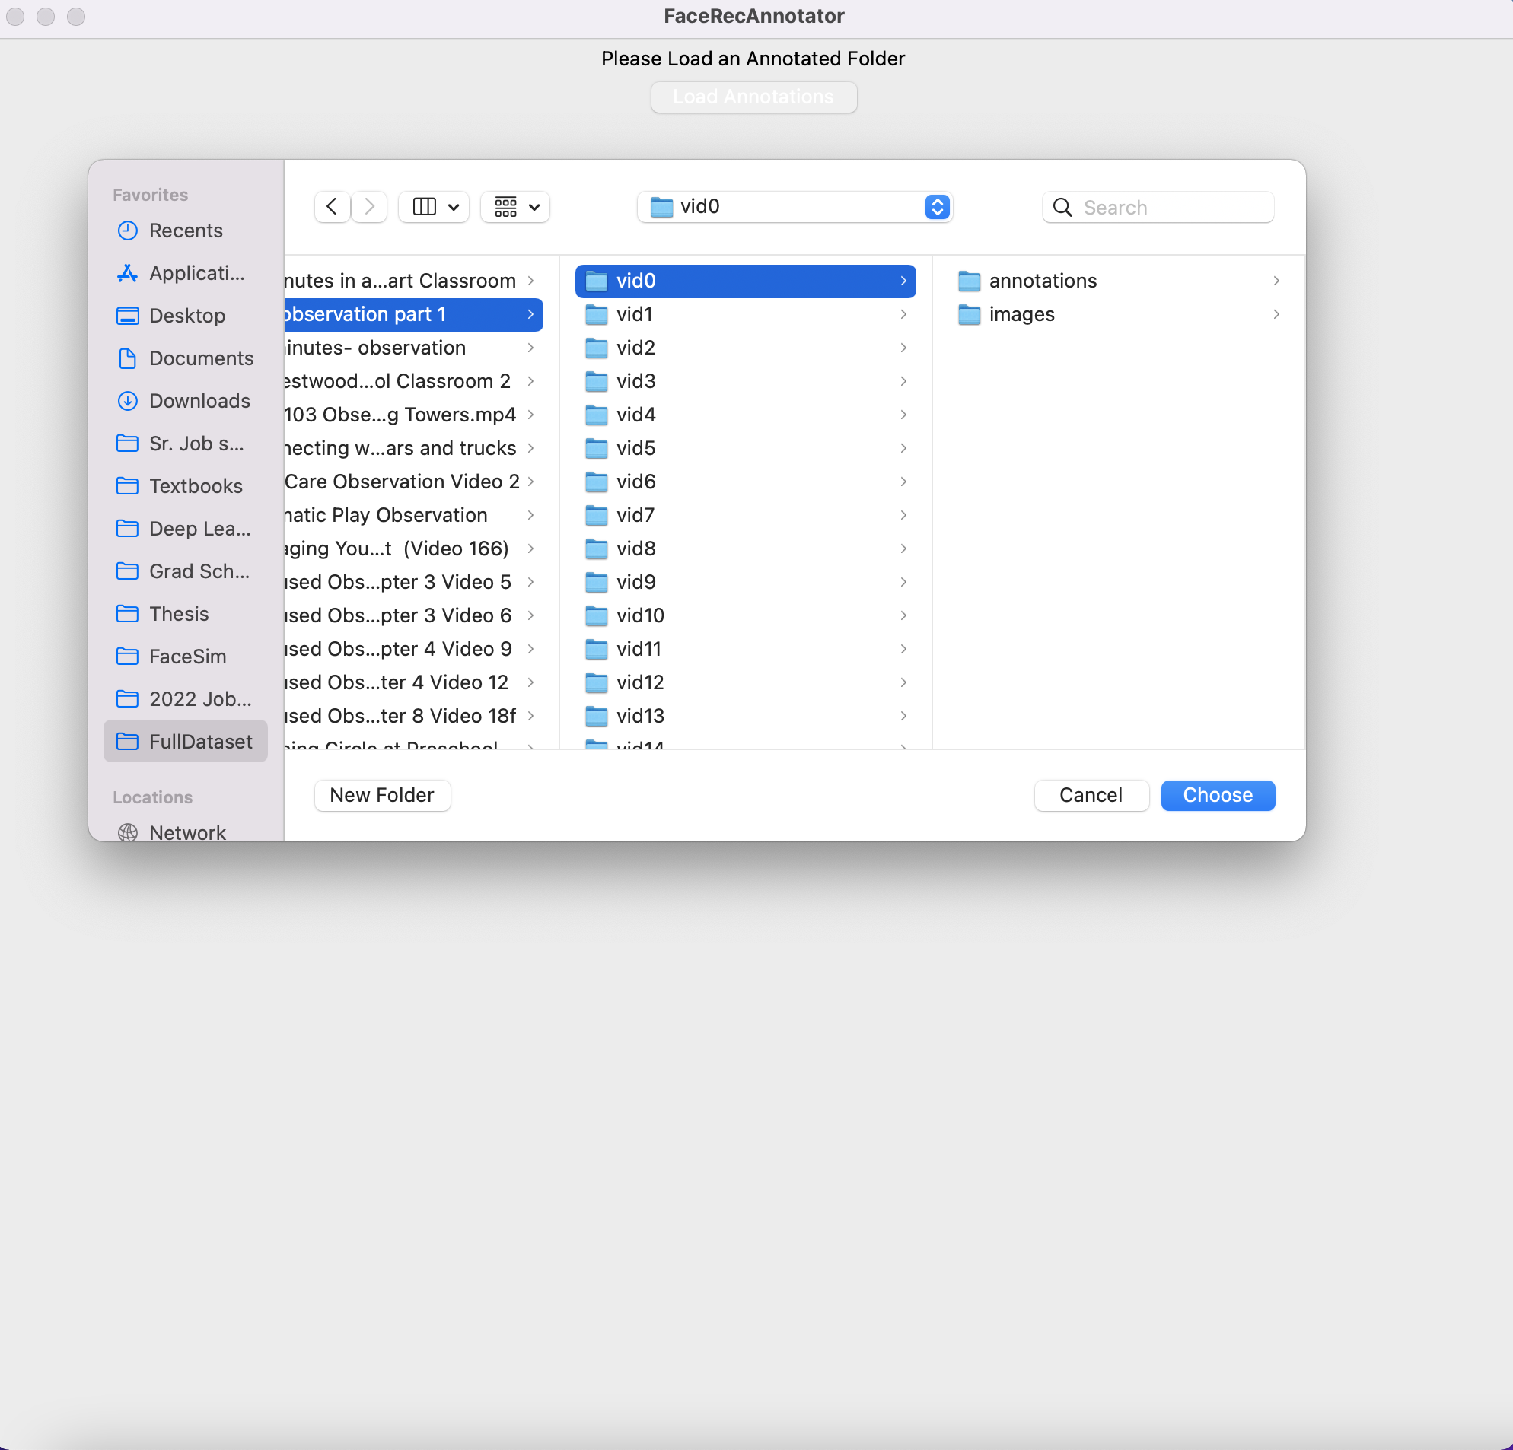
Merge/Split Labeling Tool
Notes:
So to make the labeling process easier on myself, I wrote a custom annotation tool using python and tkinter that used a merge-split strategy to label faces
I chose python and tkinter because it allowed for a quick development time
To start the correction process I would load the auto-labeled sub-video folder using the interface shown in this slide

Slide 16
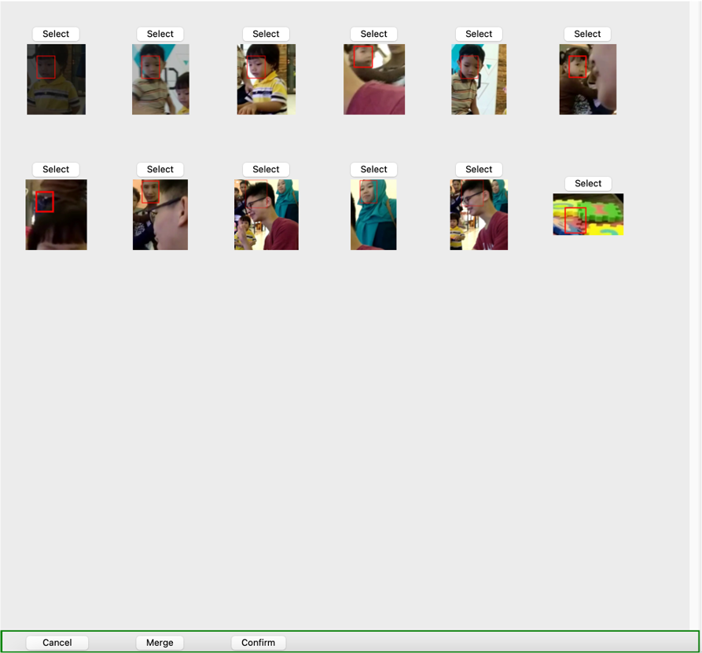
Merge/Split Labeling Tool
Notes:
And follow this process:
When starting the correction process, I was presented with the view on the left which would have exemplar images of what the auto annotator thought each group was.
From this view, if the annotator noticed that two groups were of the same person, they could select them and merge them together.
But what if an auto-labeled group had people of different identities as shown on the right?
The annotator would need to click into that group and and select each person that was in the wrong group then click the split button
This would create a new group that for each person that could then be merged with existing groups from the merge view
Additionally, from the split view, annotators could also label “Faces” with FP and BH which stand for False Positive and Back of Head respectively
We decided to include this information because when using our face detector, we included every face to make sure that we didn’t’ lose any prospective faces
Its also important to notice how student of different identies are grouped together by the model’s predictions. This is why we are looking to solve this problem

Slide 17
Results: Dataset
Notes:
After about two weeks of labeling, we got a dataset with the following properties
As you can see we annotated about 38,000 different faces using the strategy we described earlier
Does anyone have any questions on our dataset/ collection method?
At the end got about 267 total subvideos

Slide 18
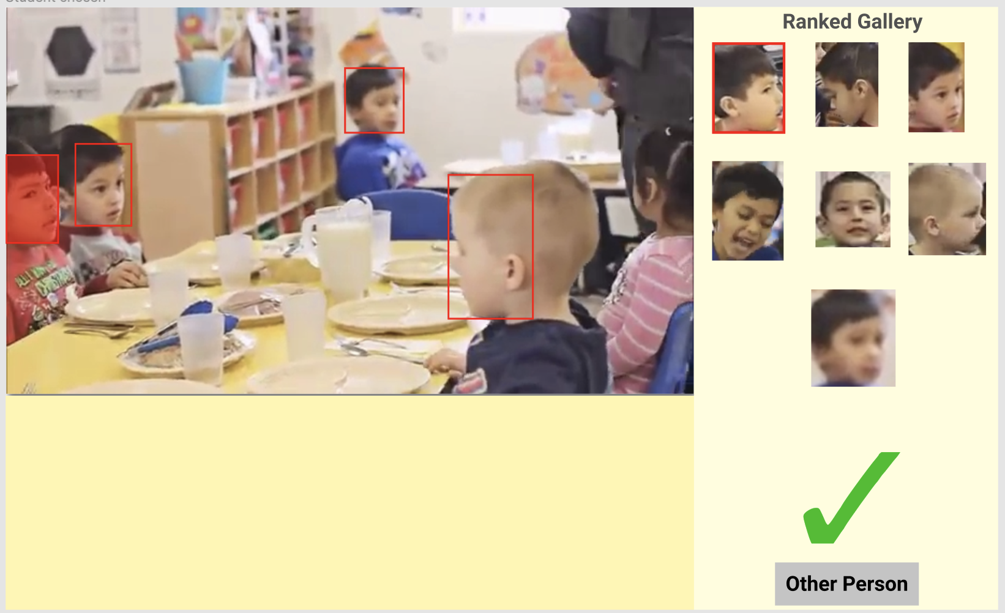
FaceNet Corrections
Notes:
After we had a fully annotated dataset, we were able to start running our simulations
The first strategy we chose to explore was to present annotators with pre-labeled video frames and have them only correct annotations if the label was wrong.
A mock of how this would look outside of simulation can be seen in this image
Here an annotator is presented with a frame and bounding boxes around all the detected faces
They can then select a bounding box and label it with the face of the corresponding student from a previous frame
Because some faces are automatically correct, the annotator would not need to relabel each student which should save them time
We tried two different experiments using this type of strategy: using just an off-the-shelf model and retraining the model after n-videos were labeled

Slide 19
FaceNet corrections: Pipeline
Notes:
We used the same pipeline for classifying faces in all of our facenet corrections experiments
This pipeline can be seen here.
First we loaded a video using the labels file for the dataset as well as each frame. We used the labels file to crop faces, but we ignored false positives and back of heads
After we cropped the faces, we resized the face to a 160x160 pixel dimension because this is the dimensions the facenet encoder expected.
Then we fed the resized face into our encoder model to get a 512 dimensional encoding for each face within the batch which we fed into a KNN classifier
This KNN classifier used a value of K=1 because for this experiment we wanted to see how well the facenet model worked more than the KNN classifier

Slide 20
Facenet corrections: Off-the-shelf
~10X reduction in user actions
Average 88% Accuracy on dataset
Notes:
For our off-the-shelf experiment, we saw promising results that showed about a 10 times reduction in user actions
Over the course of the entire experiment, the facenet model classified about 88% of the faces correctly

Slide 21
Facenet Corrections: Retraining
Grid-search to find optimal hyper params
Performed worse than pretrained model
~84% accuracy
Notes:
After using the off-the shelf model, we wanted to experiment with whether we could further reduce annotation load by retraining the facenet model on newly annotated data.
We thought that by improving the facenet model on classroom datasets, we would be able to further reduce the work annotators needed to take.
However, we found that this ended up reducing our model performance and also increasing the number of actions taken by the annotor
We tried to tackle this issue by doing a grid-search to find optimal hyperparameters but these models ended up still performing worse than off-the-shelf models

Slide 22
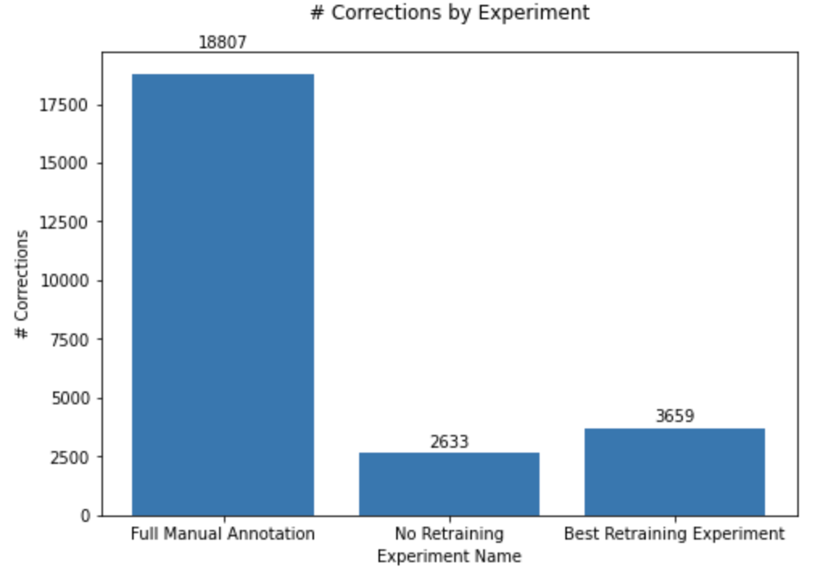
FaceNet Corrections: Results
Notes:
As we can see in the graph here, just taking an off the shelf model significantly reduces the number of actions an annotator needs to take
Surprisingly, retraining made the facenet model perform worse than the off-the-shelf model

Slide 23
Exemplar Experiment
Do we need to check every face?
If not, how many do we need to label?
Notes:
For our next experiments, we wanted to evaluate whether we need to label every face, or we could get satisfactory performance by labeling a subset of faces and letting the encoder KNN pipeline handle the rest
We also wanted to know how many faces we would need to label to get this performance

Slide 24
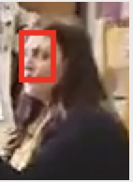
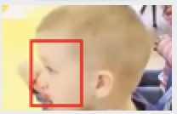
Exemplar Experiment: Methodology
Machine Labeled
Machine Labeled
Human Labeled
Human Labeled
Notes:
A user workflow for this might look like an annotator labeling only the first 70 faces in a video and then allowing the model to predict the rest of the faces
This annotation can be done by selecting the first frames with n total faces in them and then having an annotator label them
Or faces can be chosen at random and the split/merge strategy can be employed to create the identities

Slide 25
Effect of Exemplars: Simulation Methodology
Get Encodings and ground truth of each face
Run KNN on encodings of sub-video, progressively increasing the number of exemplars
Notes:
To figure out whether this was a viable strategy, we got the encodings of each face within a video and ran KNN on the encodings progressively increasing the number of exemplars included for each iteration

Slide 26
Effect of Exemplars: Accuracy
Measures correctness of final dataset
Notes:
For these experiments, accuracy is a measure of how correct our final dataset is
The formula for it can be seen in this slide.
It is important to note that for this definition of accuracy, the accuracy will increase as the number of human annotated labels increases eventually reaching 100% in the case where every face is human annotated

Slide 27
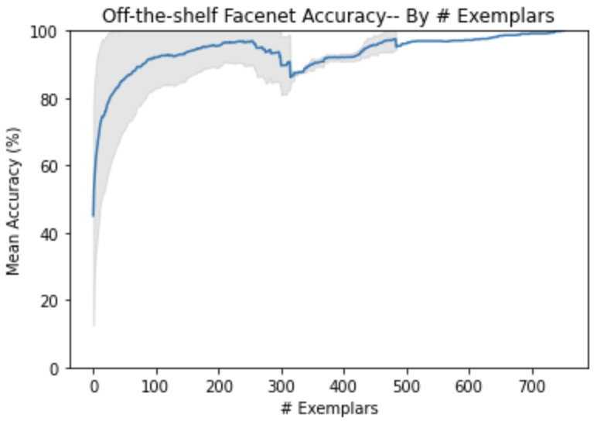
Effect of Exemplars: Results
Notes:
As we can see from the graph in this slide, labeling only a subset of the possible faces results in an accurate final dataset
In this graph, we can see that each exemplar has a large effect on the final accuracy until we reach the 100-exemplar point.
Afterwards, the graph here levels off which indicates that labeling exemplars past this point does not provide as strong of a benefit.
At the 100-exemplar point, the dataset’s accuracy is about 96%

Slide 28
Extra Background: LabOR
Shin et.al
Notes:
Paper that attempted to reduce annotation load for semantic segmentation by labeling only uncertain pixels
Used a Pixel Selector model to find the pixels that were uncertain and then aggregated uncertain pixels together so that the annotator could label regions instead of individual pixels
This pixel selector model was initially trained on a source dataset and was used to label a target dataset
Pixel Selector model took existing feature extractor and added two classifier heads to the feature extractor
Uncertain pixels were pixels where two classifier heads disagreed on because if two classifiers were trained on the same dataset generated different predictions on a region, this means that there is a high variance in that region
The heads are initially trained on a source dataset, and then a discrepancy maximization step is run on the target dataset to increase the discrepancy between the two heads

Slide 29
Uncertainty Labeling: Goal
Does labeling only the most uncertain examples increase final labeling accuracy?
Notes:
This experiment can be seen as an extension of the exemplars experiment where the n images labeled by the annotator are the ones where the encoding model is the most uncertain about its predictions.
This still leads to one question though how do you quantify uncertainty within an encoding?

Slide 30
Uncertainty Labeling: Pipeline
Head A
Head B
Notes:
Took a similar approach to LabOR but instead of giving class labels, the heads gave encodings of the same dimensionality as the facenet model.
At this point, we still need to quantify the uncertainty into a scalar value

Slide 31
Uncertainty Labeling: Quantifying Uncertainty
Notes:
This should be pretty easy right? We can just get the L2 distance of the two head’s outputs and use that value as our metric

Slide 32
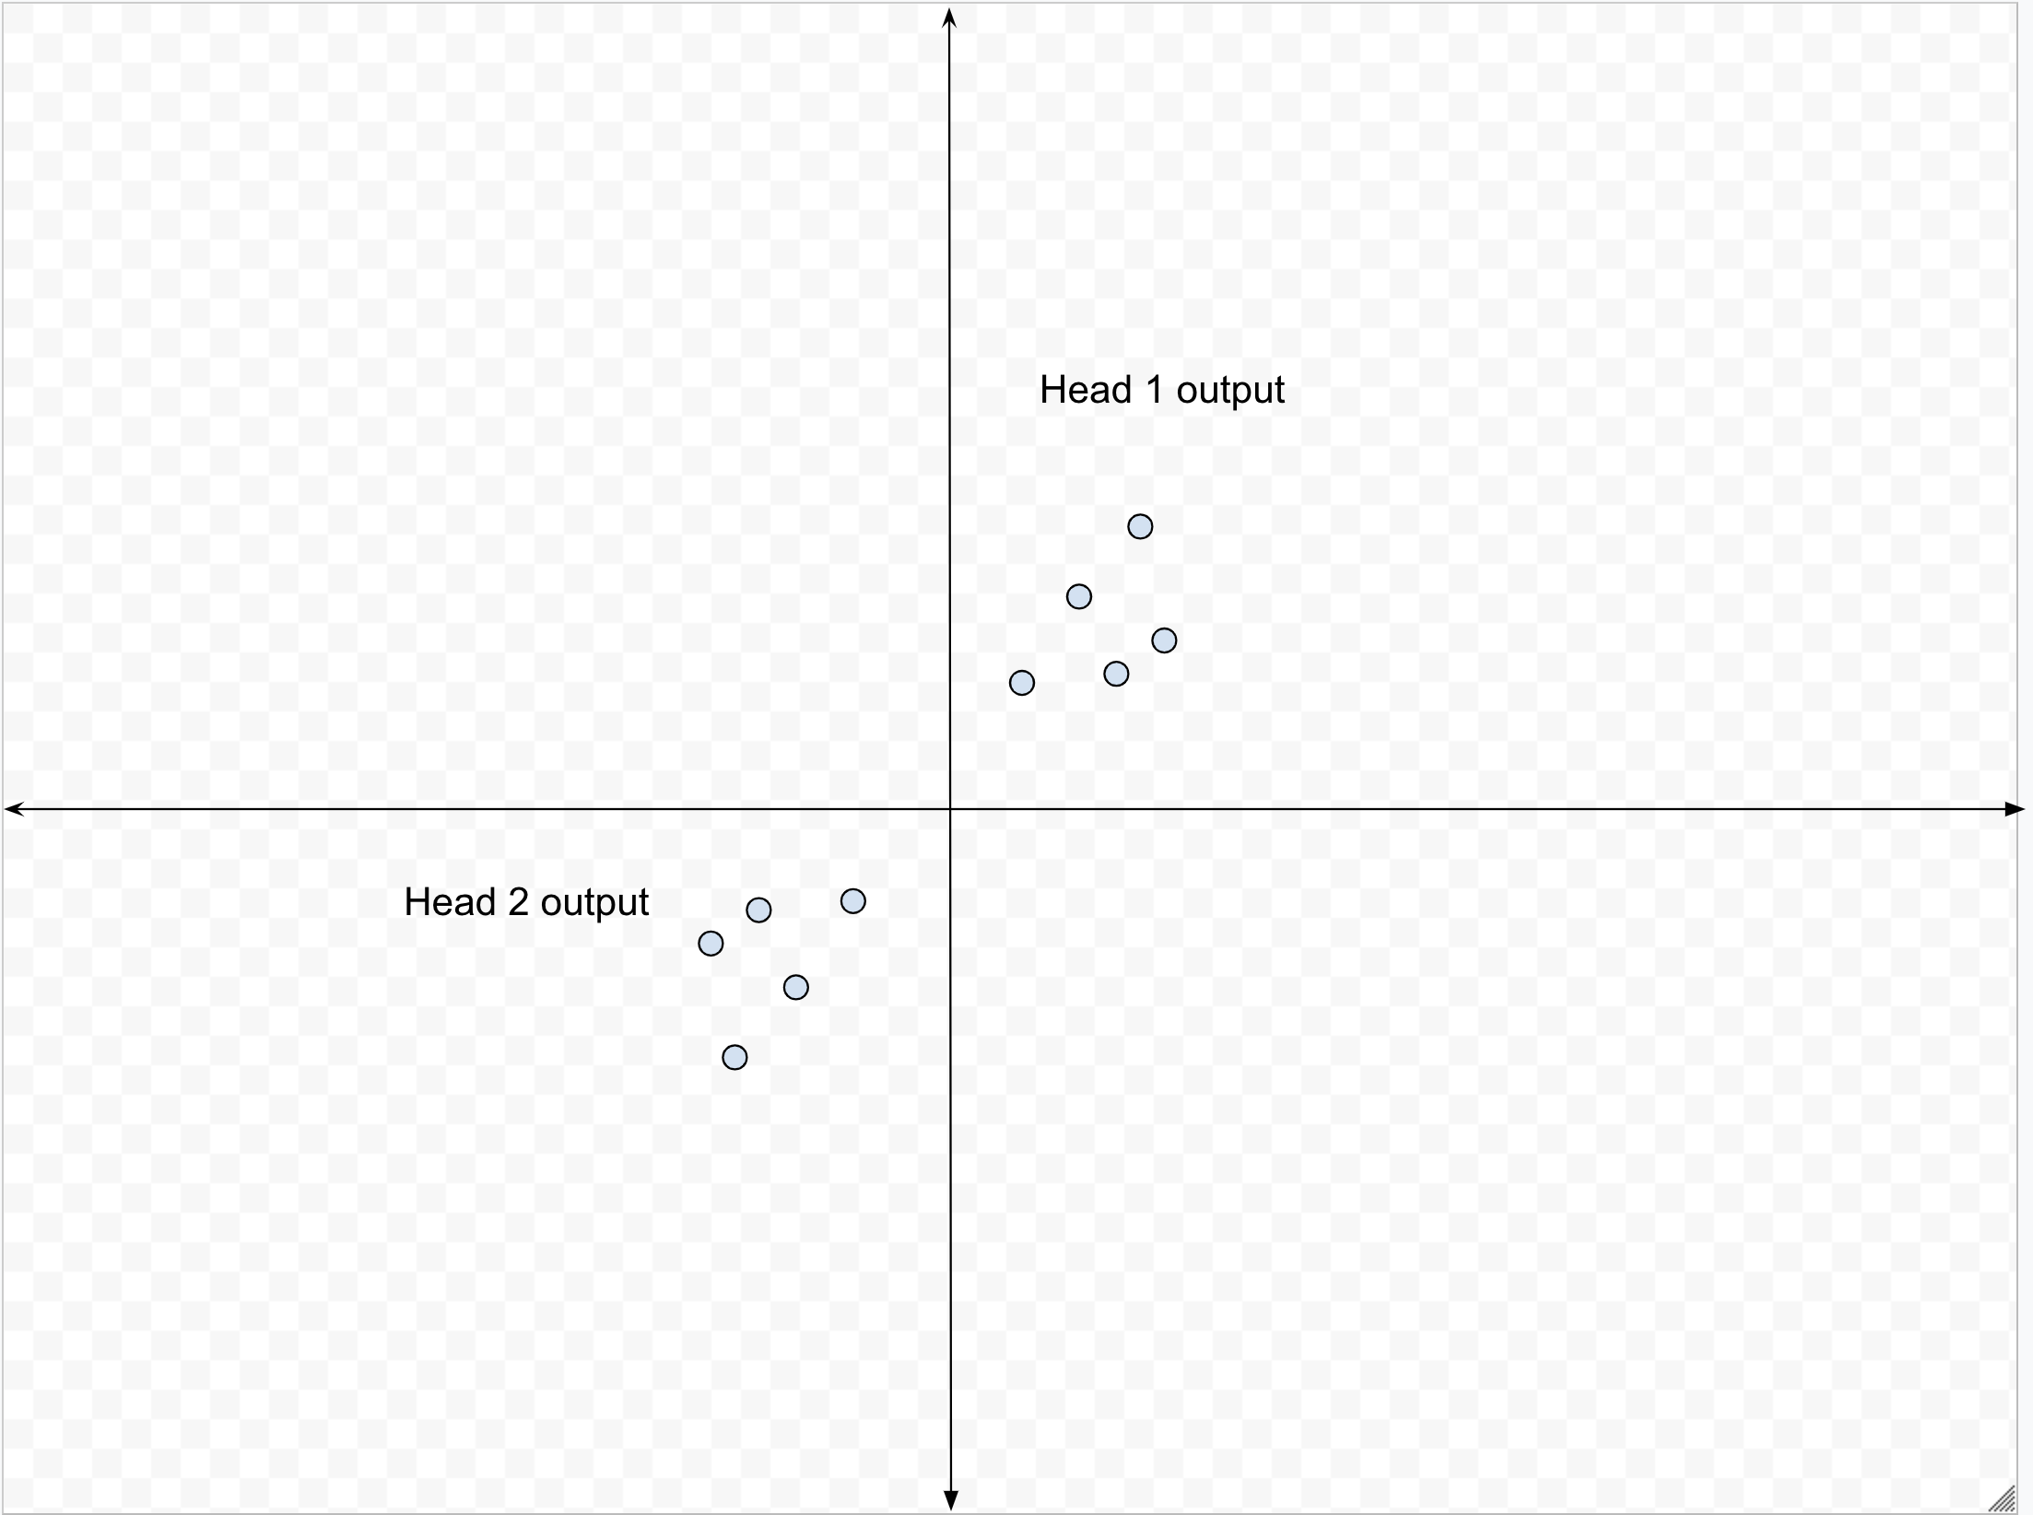
Uncertainty Labeling: Quantifying Uncertainty
Notes:
But this leads to the issue where different indices of the encodings can be swapped leading to head 1 being an approximate rotation of head 2 and the L2 distance being large when the two heads agree with each other.

Slide 33
Uncertainty Labeling: Quantifying Uncertainty
Notes:
To solve this, we quantify uncertainty a little differently
First we find the vector of L2 distances between the encoding from head j of face f and compare that encoding to those of all the other known faces
We then take the vector produced by yj and pass it into the softmax function which gives us a normalized vector that takes the distance of each identity from the encoded image into account
We then use the cross-entropy function between the two softmax outputs in order to measure the agreement between the two encoding functions
If the cross-entropy is high, then that means that the two heads disagree with each other while a low cross entropy means the two heads agree

Slide 34
Training Regimes
Triplet Loss Tuning
Triplet/Discrepancy Loss Combination
Maximizing Discrepancy
Notes:
One failure case of our uncertainty model is that the two heads learn to produce just different values for any value.
It is important that our regimes don’t produce heads that produce random encodings because this does not give us any signal on the uncertainty
So, we tried 3 training regimes to produce a useful model
Additionally, because we want to quantify the uncertainty of the pre-trained model, we freeze the encoder model

Slide 35
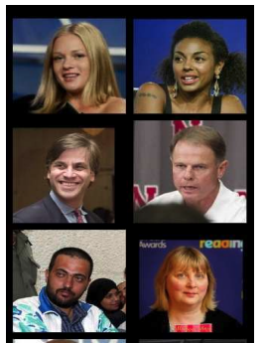
Source Dataset
Huang et.al
Notes:
For our source dataset within our training regimes, we use the Labeled Faces in the wild dataset

Slide 36
Training Regime: Triplet Loss Tuning
Initialize both heads randomly
Train both heads using triplet loss
Notes:
The first training regime we use to tune the uncertainty heads is one where we just use batch hard triplet loss to reduce their loss
We start off this process by initializing both heads randomly and training both at the same time.
Because of the random initialization, we hope that both heads reach different local minima’s

Slide 37
Training Regime: Triplet/Discrepancy Loss
Initialize both heads randomly
Combine both triplet loss and discrepancy loss to train
Notes:
Same as before, we initialize both heads randomly
This time however our loss function combines both triplet loss and discrepancy loss to train the two heads
Alpha is a hyper parameter that weighs how much the discrepancy loss affects the overall loss
If alpha is too large, its possible that our two heads just output bad encodings

Slide 38
Training Regime: Maximizing Discrepancy
Took best three models from previous training regimes and maximized the discrepancy loss
What are the best models?
Notes:
Took best three models from previous training regimes and maximized the discrepancy loss
But how do we know which are the best models?

Slide 39
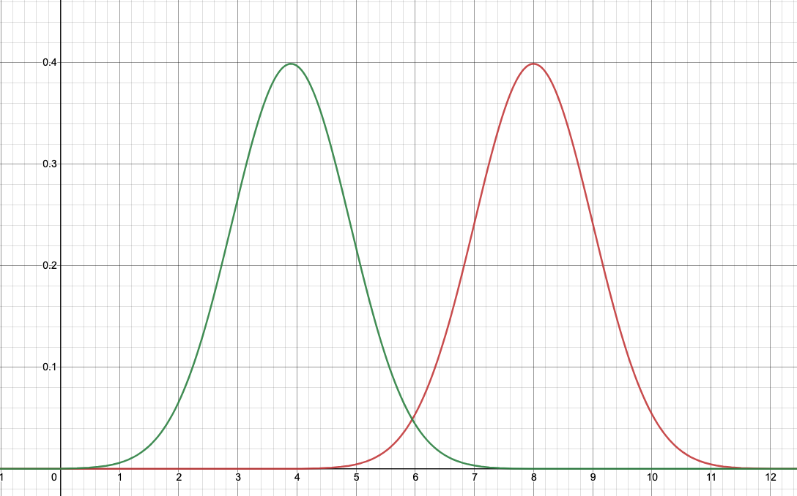
Uncertainty Labeling: Selecting Model
Can use t-score to compare uncertainty of two heads between correctly labeled examples and incorrectly labeled examples
Notes:
Can use t-score to compare uncertainty of two heads between correctly labeled examples and incorrectly labeled examples
Because the t-score describes how different two groups distributions are, we want a large value for our t-test
For example, the graphs shown in the diagram would yield a high t-score which is what we want(as long as the green is the correct uncertainty and red is the incorrect uncertainty)

Slide 40
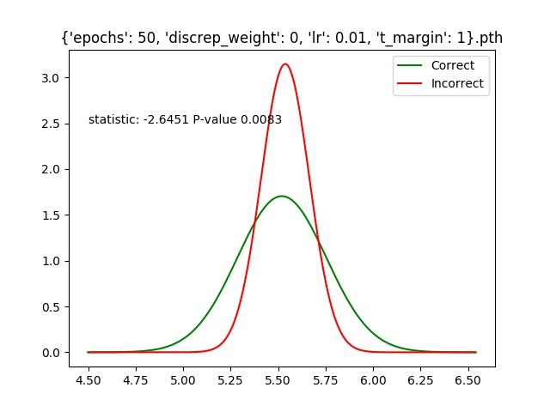
Our plotted distribution
Notes:
While the previous graphs are ideal, in practice it is much more difficult to train these types of models leading to distributions like this

Slide 41
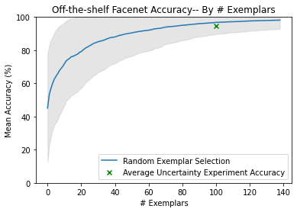
Uncertainty Results: Dataset Accuracy
Notes:
In order to understand whether labeling the most uncertain examples provides a benefit compared to randomly selecting which faces to label, we compared this experiment’s results to the exemplar experiment
Based on the graph, we see that labeling the most uncertain examples ended up reducing performance

Slide 42
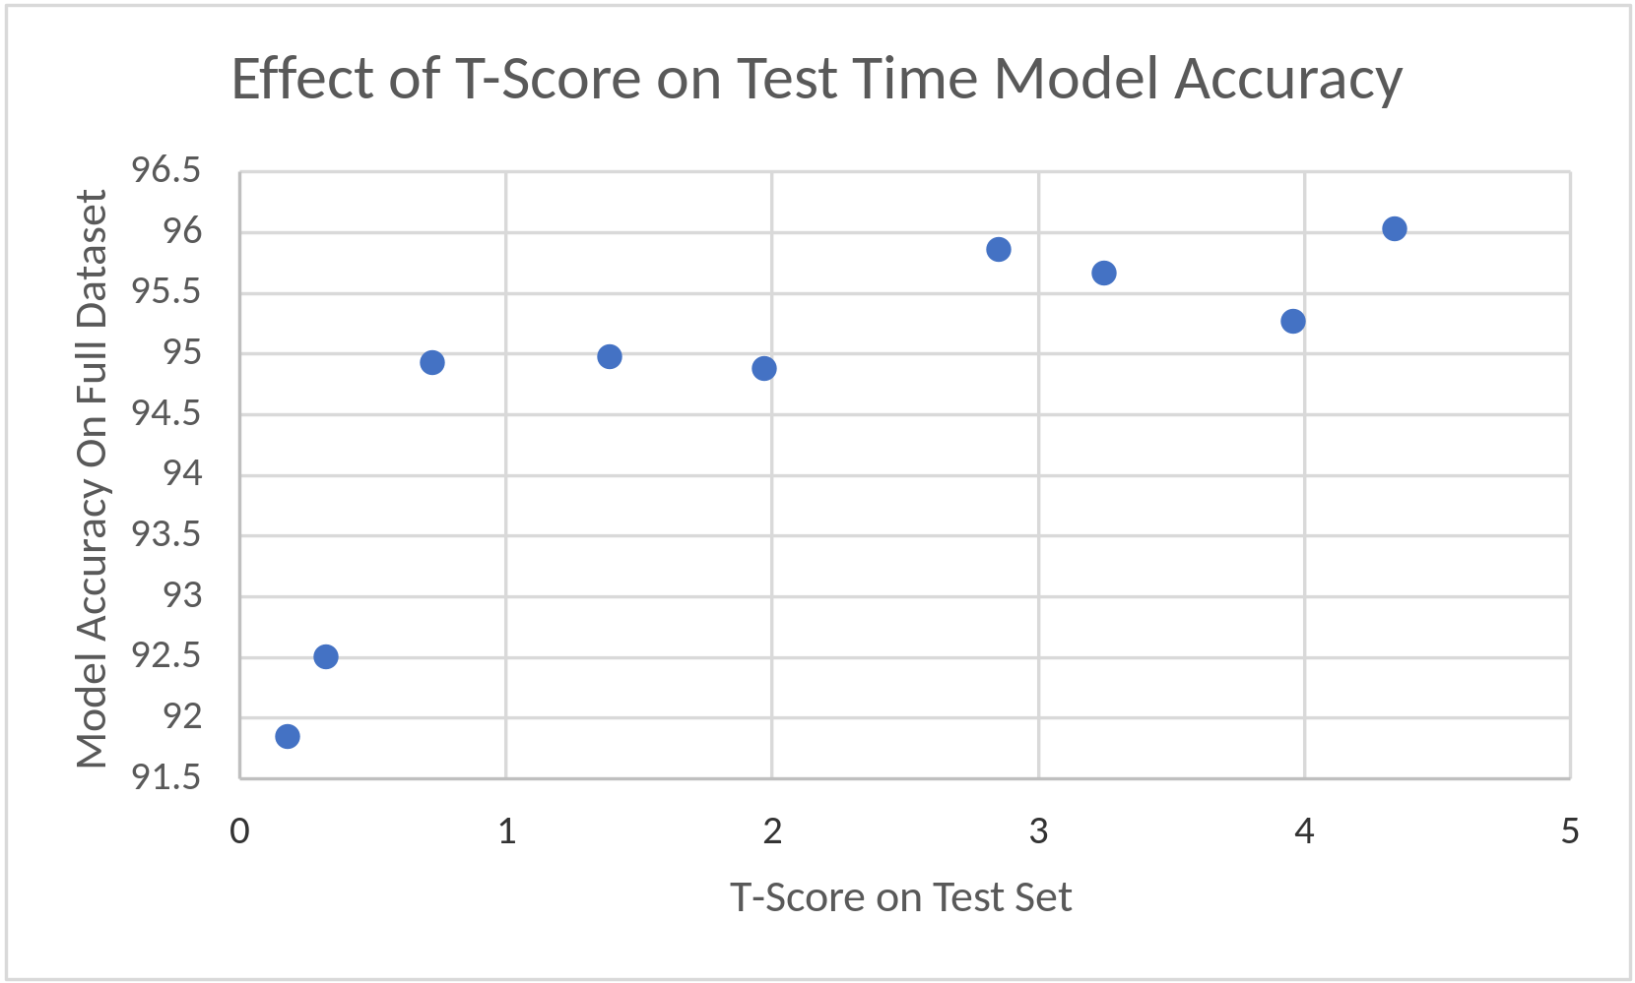
Uncertainty Results: Selection Metric
Notes:
Even though the results of the uncertainty experiment did not show an improvement compared to randomly selecting which faces to label, using our selection metric to select the best models did produce the best results.
As you can see in the chart here, the models with the higher t-score ended up performing more strongly than models that did not.
This is exciting because potentially with better training regimes, we could create an uncertainty model that is able to outperform random selection

Slide 43
Uncertainty Results: Training Regimes
Notes:
Overall, our first two training regimes performed the best.
Surprisingly, the discrepancy tuning regime ended up strongly reducing the benefit that our uncertainty produced.

Slide 44
Future Work
Use our simulation findings for a real annotation tool
Better training regimes for uncertainty model

Slide 45
Questions?
Notes:
Decrease cognitive load by showing picture
Take credit for first part of thesis for labeling and building custom tool

