Slide 1
Design of an Assistive Partial Knee Support Device
Amelia Ring (ME), Emily Bodurtha (ME), and Justin Rodriguez (ME)
Advisor: Professor SelÇuk GuÇeri
Notes:
Emily
~introduction~
This is our presentation of our MQP: a design of an assistive partial knee support device. This is a continuation of a similar project that was started last year.
Phase 1 utilized electromyography or emg to provide an intuitive control operations of a planetary gear system that represents the motion of the knee as a simple circular hinge joint.
Our phase 2 direction was to reassess the design problem and produce another device with the goal of providing partial torque to a user’s knee and maximizing useability.

Slide 2
Project Objective
Design an active partial knee support device, based on a pulley system analogous to the knee joint, capable of supplementing approximately 10% of the maximum knee torque to the average user, while remaining both low profile and affordable.
Notes:
Emily
The objective of our project was to design an active partial knee support device based on a pulley system which is analogous to the knee joint. We aimed to have our device provide 10% supplemental knee torque to the average user while being low-profile and affordable.

Slide 3
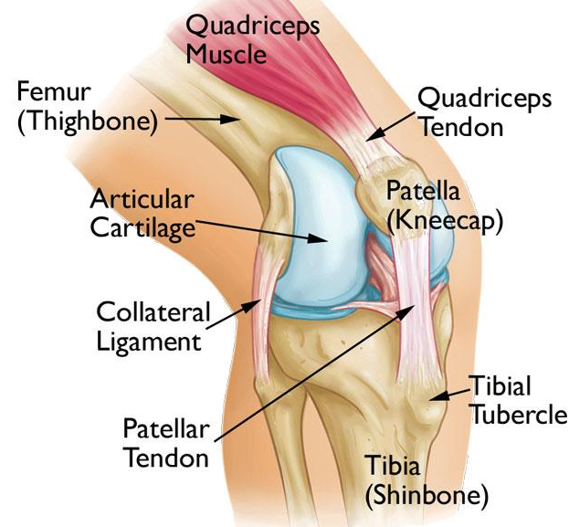
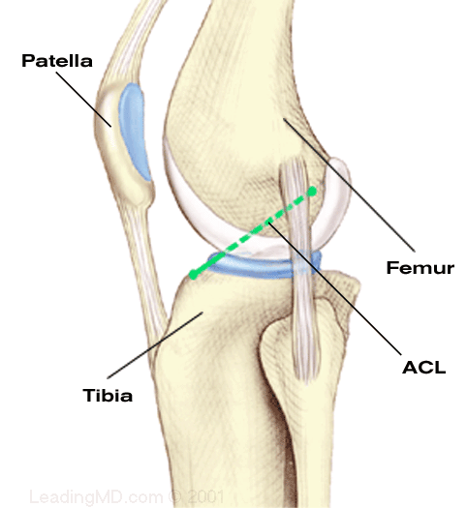
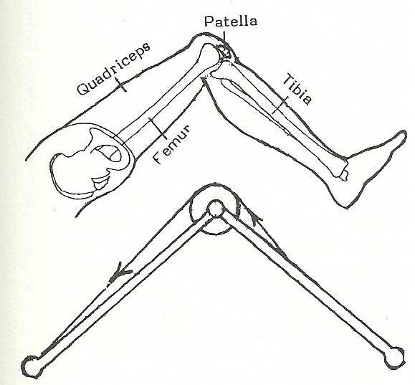
Biomechanics of Lower Limb Motion
The Patellofemoral Joint
The patella is a triangle shaped bone resting in the trochlear groove of the femur. It is bound to the quad muscle by the quad tendon and to the tibia by the patellar tendon (technically a ligament).
It transfers and magnifies the force of the quadriceps muscle to the tibia, causing lower leg extension or flexion.
The joint is an anatomical pulley. It not only redirects the upper leg quadriceps force, but also increases its mechanical advantage, magnifying the force.
When the leg bends, the surface area of the patella in contact with the cartilage changes, there by changing the lever arm and manipulating the mechanical advantage.
Trochlear
Groove
GIF
Notes:
Amelia ---------------------
To design an assistive knee device, we must first understand the function and forces of the knee. The kneecap or patella is a sesamoid bone, a bone embedded in tendons. Sesamoid bones function as anatomical pulleys inside the human body which not only redirect but also magnify the forces being transferred. To engage the knee, the quadriceps muscle is contracted, which pulls on the quad tendon. The patella is embedded in the quad tendon, and so it moves with it, gliding up the trochlear groove of the femur. As the patella changes surface area in contact with the femur, it adjusts the moment arm of the system and so changes the mechanical advantage. The patella is also embedded in the patellar tendon which is bound to the tibia. Therefor as the quadriceps muscle pulleys the patella, it also lifts the tibia, engaging the lower leg.

Slide 4
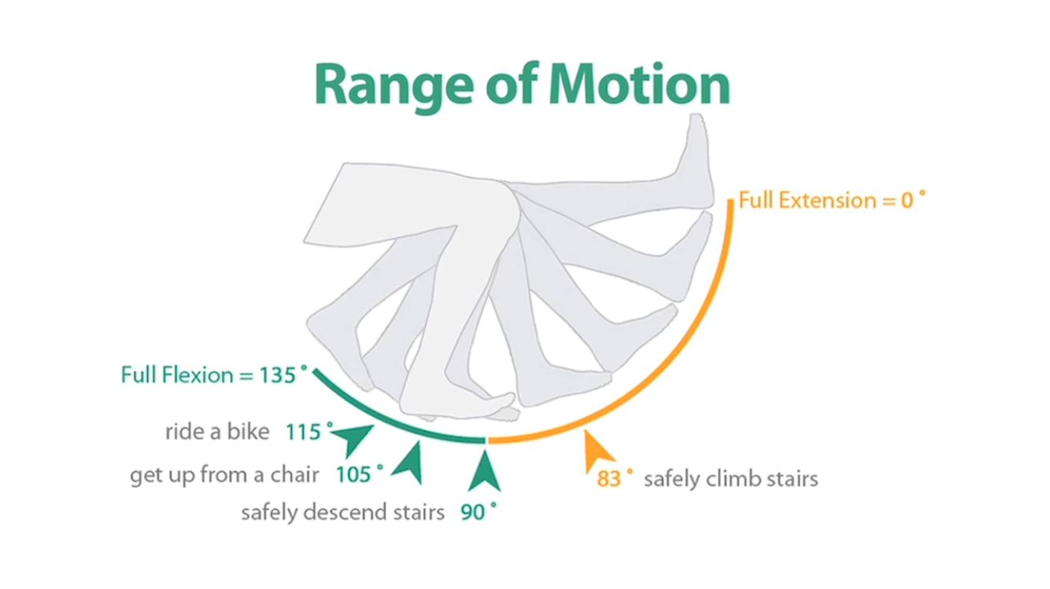
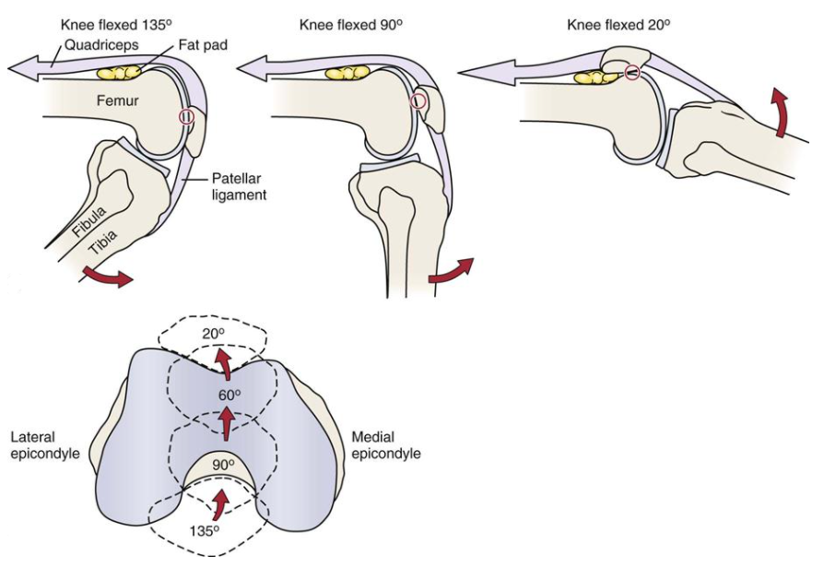
Biomechanics of Lower Limb Motion
Knee Extension and Flexion
We require a certain range of motion to complete daily tasks, roughly 0 to 135 degrees of motion. As different angles of extension/flexion are achieved, the patella makes different amounts of contact as it slides along the femur and stretches the patellar tendon/ligament.
This provides help magnifying and distributing the forces to achieve the desired motion.
The trochlear groove is lined with articular cartilage which pads the surface that the patella articulates with. This cartilage reduces friction, pads the bones below, and helps to disperse reaction forces evenly and reduce joint stress.
This area of the body sees some of the greatest cartilage deterioration, which causes pain and often results in the inability to access the full range of motion.
Notes:
Amelia -------------------
In order perform daily tasks, we require a certain range of motion, approximately 135-140 degrees of motion. As our leg occupies these positions, the patella shifts the amount and position of contact it has with the femur, moving up and down as necessary. As such, the trochlear groove is lined with articular cartilage which helps to reduce friction, pad the joint, and disperse the reaction forces. This area of the body see lots of wear and deterioration of this cartilage, just one of the reasons accessing the full range of knee motion with ease is difficult for many individuals.

Slide 5
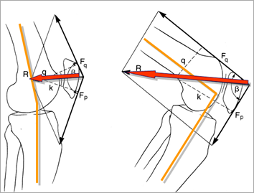
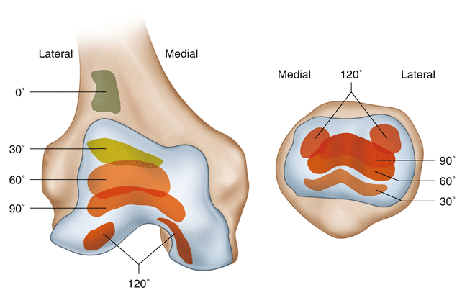
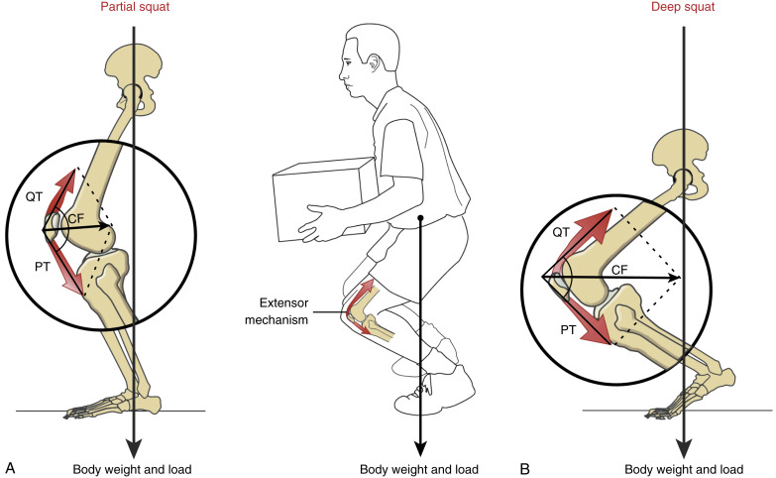
Biomechanics of Lower Limb Motion
Reaction Forces
In performing its purpose as an anatomical pulley, the patella become subject to great reaction forces, as previously mentioned.
The quadriceps force from above and the patellar force from below, along with the flex angle, creates
a reaction force that pushes the patella into the femur.
This reaction force will magnify greatly as the angle and magnitude of the forces adjust during motion.
The greater amount of articulating surface area the patella and cartilage have the better, as then it can more fully and evenly distribute the force.
Maximum contact seems to occur between 60 and 90 degrees of leg flex, lining up with more intensive activities, like squatting.
Notes:
Amelia --------------------
Because the patella is acting as a pulley, and magnifying and directing these forces, it is subject to reaction forces, as seen here. The force from the quadriceps and the patellar tendons pulling the patella in two directions results in a compressive reaction force the pushes the patella up against the articular cartilage. This reaction force can magnify or reduce depending on the angle and forces experienced during the given motion. The portion of the patella that articulates with the femur and cartilage changes as the knee shifts positions. The more contact, the better the reaction forces are distributed. This appears to happen around 60 - 90 degrees of flexion which might occur during an knee intensive activity like squatting.

Slide 6
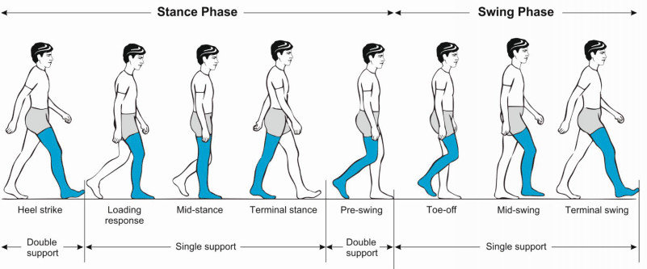
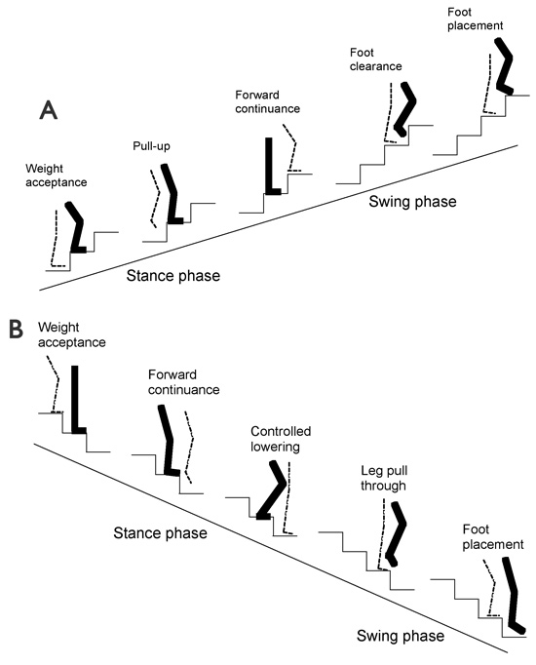
Biomechanics of Lower Limb Motion
The Human Gait
The human gait cycle is broken into two phases, the stance and swing phases. The stance phase encompases the period of time where the foot makes contact with the ground (only one leg examined at a time) and makes up roughly 60% of the cycle. Conversely, the swing is the time where the foot leaves the ground and swings from the previous position to the next.
There is a similar gait cycle for ascending/descending stairs which also includes a stance and swing phase although it requires slightly different motions and angles of extension/flexion.
Both of these gait cycles repeat continuously to bring the person towards their desired destination
Notes:
Justin - We wanted our device to assist with walking and stairs, so understanding the human gait cycle was also key. The walking gait cycle consists of the stance and swing phases. The stance phase occurs when the foot being examined is in contact with the ground, while the swing phase is when the foot leaves the ground and swings to move the body forward. Both of these phases can be broken up into various sub-phases that define specific moments during the cycle. While ascending or descending stairs, there is a similar gait cycle with analogous phases, but during this cycle the motions are more strenuous and involve more knee flexion and extension. We examined these cycles, doing force analysis at each instance to better understand what kind of forces and torque the user experiences during each type of motion.

Slide 7
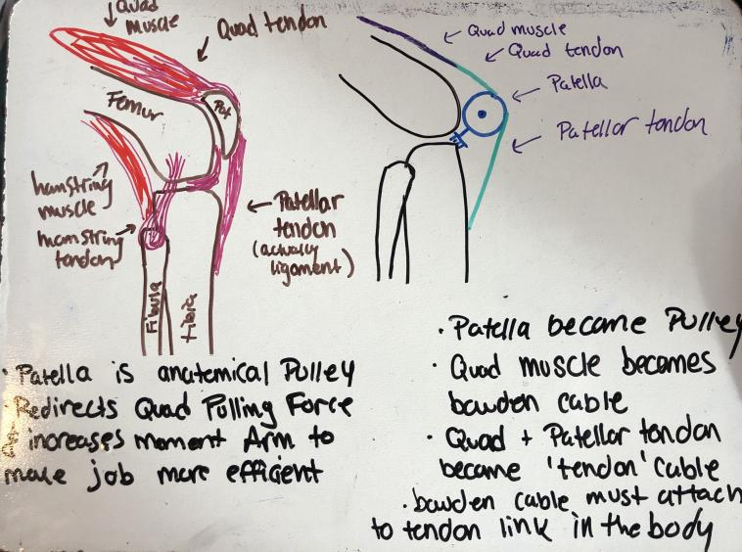
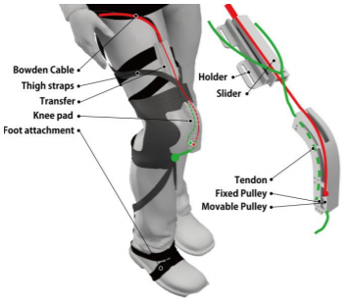
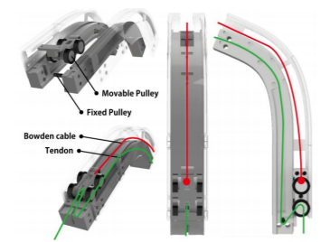
Mechanical Design
Determining Actuation
The first step in the design was to determine the actuation method. The method by which the desired amount of torque is supplemented will determine the direction of the design.
The team wished to mimic the natural anatomical pulley design of the patellofemoral joint, drawing one-to-one
analogous comparisons between biological
and mechanical components.
The specific mechanical
components were inspired by
the H. Park et. al article.
Reference Project
A 2019 Robotics project from Tsinghua University and Southern University of Science and Technology (China) entitled Design of a Soft Wearable Device for Hip and Knee Extension Assistance (H. Park et al) provided a clear framework for a viable pulley based knee support mechanism.
The design was conveniently analogous to patellofemoral joint, but with room for improvement and optimization for a practical audience.
H. Park et al
Notes:
Justin - The first goal of our project was to determine how our design would apply torque to the knee. We had seen previous designs that incorporated a motor directly at the knee joint which provided torque through a hinge mechanism. We noted that this design did not consider the biomechanics of knee movement, which are much more complex than a simple hinge. We wanted our design to mimic the anatomical pulley of the patellofemoral joint and have mechanical components that were analogous to the biological components involved in knee movement. We also believed this would allow us to design a softer and slimmer device for everyday use.
While in our research phase, we discovered a project we felt provided a great foundation for a design that mimicked the patellofemoral joint to provide additional torque to the knee. ‘Design of a Soft Wearable Device for Hip and Knee Extension’ (cited: H Park et al) gave us a clear framework for a pulley-based knee support device. However, we noticed some aspects of the design that could be improved or optimized to make the device more practical for its intended audience.

Slide 8
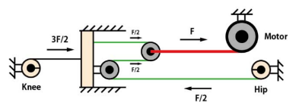
Mechanical Design
Components of H. park et al
Bowden Cable - Control cable analogous to the quad muscle
Transfer - Guides the Bowden cable to the knee pad system
Tendon Cable - Flexible cable analogous to the patellar tendon/ligament
Knee Pad System - Includes the knee pad (articulating cartilage) as well as the pulley track, housing a fixed and moveable pulley system (the patella)
Thigh Straps - Helps hold the mechanism in place and distribute forces throughout the leg
Waist Belt System - Housing the actuating motor and power source at the waist
H. Park et al
Notes:
Justin - The H Park design consists of multiple components that work together in a way that mimics the biology of the patellofemoral joint. A Bowden cable (a type of control cable) acts as the quad muscle and controls the application of the initial force. During actuation the Bowden cable pulls on the moveable pulley (acting as the patella). The moveable pulley is also bound to the tendon cable (a fine cable) which is strung through a fixed pulley. The whole pulley system is nestled in a protective knee pad, acting as the articulating cartilage, supporting the knee and ensuring torque is applied in the intended way. Thigh straps extending from the knee pad system to the waist hold the entire mechanism in place and distribute forces throughout the leg. A waist belt houses the actuating motor and its power supply at the waist. A part called ‘the transfer’ is located on the mid-thigh; it guides the Bowden cable to the knee pad system from a waist belt.

Slide 9
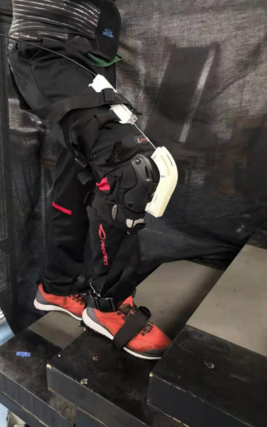
Mechanical Design
Modifications to the Reference Design...
Major Areas
Profile
While thinner than many devices, both the knee pad and main track have unnecessary bulk and are constructed of rigid materials that do not morph with the geometry change of the leg.
Additionally the ‘transfer’ part is unnecessary and adds bulk. The same goal could be achieved with small guides.
Usability
This is supposed to be made for those with mobility issues who may struggle to situate the device with the excess of overlapping straps and separate pieces to the mechanism.
Unnecessary
Unnecessary
Bulky
Bulky
Confusing
Notes:
Justin - The major areas of the design that we felt could be improved were related to its profile and usability.
Although it is thinner than many other devices in a similar vein, the device still has an unnecessarily bulky profile. The knee pad and pulley track are both constructed of rigid, bulky materials. These components may not only be uncomfortable to users, but also do not morph to the change of the leg while walking or completing other tasks. Ideally, these components would be flexible and move with the motion of the knee. Additionally, the transfer component is unnecessary and adds to the bulk of the device. It’s function could be achieved with small guides that hold the Bowden cable in place along the thigh. These changes would help slim the device down more and make it more comfortable and convenient to wear beneath everyday clothing.
The device also has issues with usability. This device is meant to be used by people with mobility issues. We wanted our design to be accessible to such people by being easy to put on and use. These people may struggle with using this device. The excessive overlapping straps may be difficult to properly put on and secure, and the separate pieces of the mechanism may be difficult for users to configure for proper usage. We wished to minimize that confusion and make the device more user friendly.

Slide 10
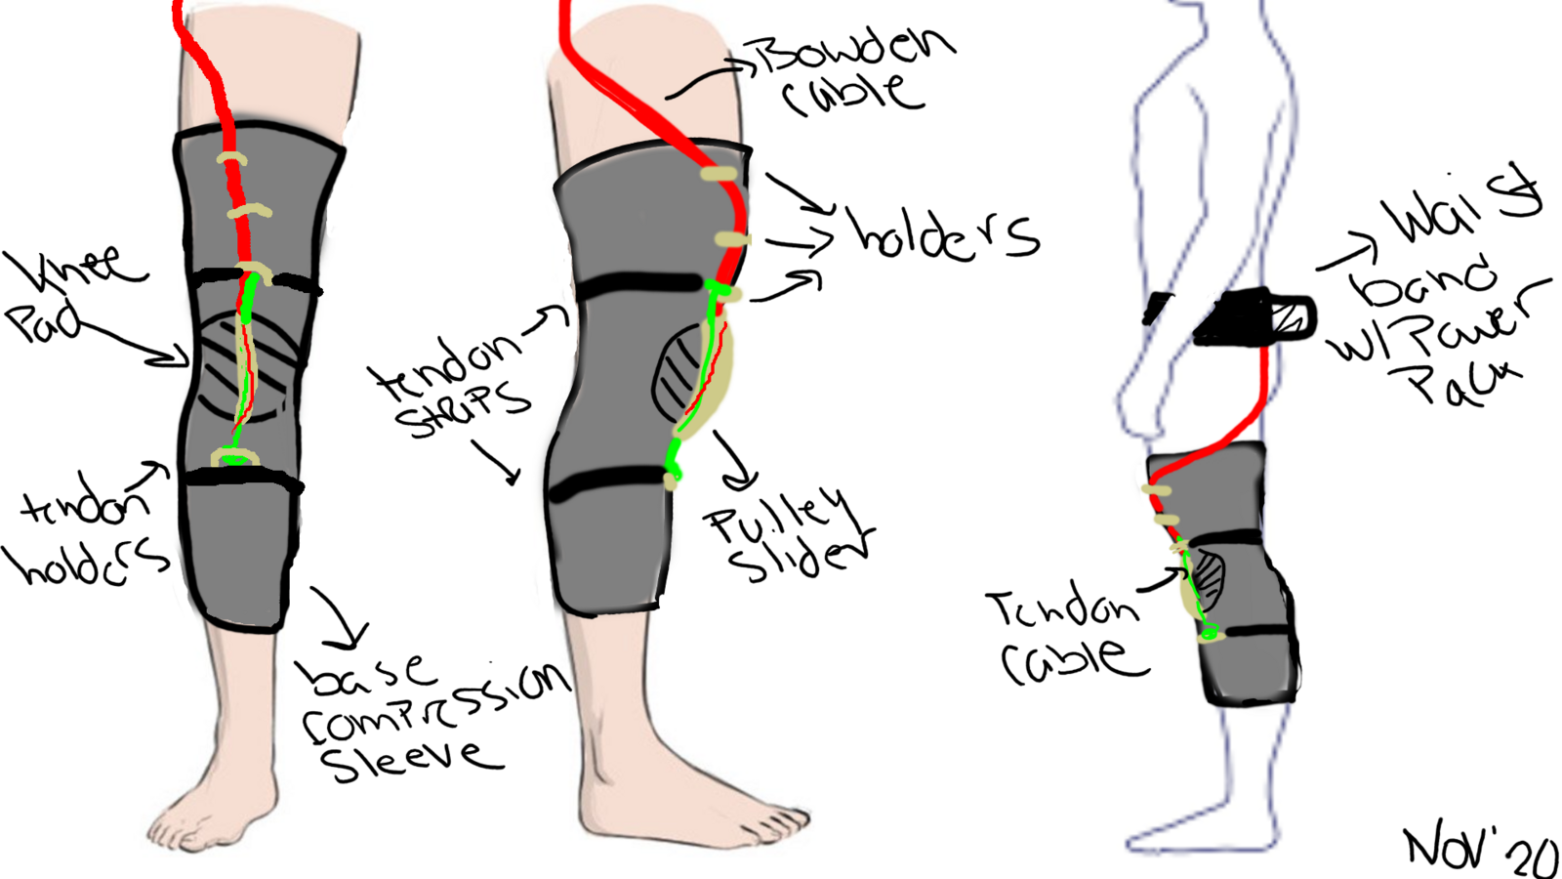
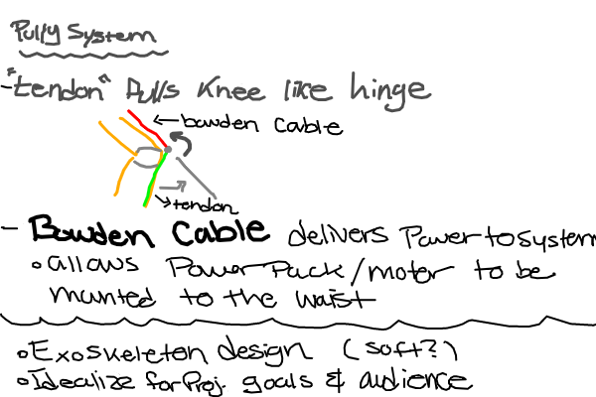
Mechanical Design
Design Considerations
Profile
Complete redesign of knee pad system:
A slim knee padding material and a malleable pulley track equipped to bend/morph with the leg as is flexes.
Minimized pulleys using the smallest bearings available.
Eliminated the tracer part in favor of a few small guides to keep the Bowden cable on track and a few mounting pieces to keep the tendon cable in place.
Usability
The numerous mounting and force distributing thigh straps have been completely replaced with a almost full leg compression sleeve and minimal (2) Velcro straps for the tendon cable guides.
Compression sleeves are a type of passive knee support device.
An optional piece of additional material can be affixed to the side of the sleeve to cover the mechanism and avoid interference under clothes.
Notes:
Amelia
- Based on H Park et al and the determined areas for modification, we began our design.
We sought to consider the profile of the design by redesigning key elements and removing redundant ones. The knee pad system was completely redesigned using slimmer materials and malleable pulley track and pad that can bend and compress with the leg during motion. The pulleys were minimized using smaller bearings to reduce the size of the pulley system. The transfer was removed and replaced with a few small guides to hold the Bowden cable in place as well as a few mounting pieces, on straps, that keep the tendon cable connected to the limbs.
We also improved the usability of the design by removing many of the thigh straps and replacing them with a full leg compression sleeve and minimal velcro straps that hold the pulley track and tendon cables in place. The compression sleeve also functions as a passive knee support device that supports the knee and reduces inflammation and pain. Also, the design can be modified with an additional piece of fabric on the side of the sleeve that can cover the mechanism and avoiding any disturbance to the pulley mechanism under clothing.

Slide 11
Mechanical Design
Final Design
Full cables not shown
Track for Wheels
Moveable Pulley in 90* formation
Crimp
Custom Pulley (Fixed) & Mount
Custom Wheels
Unsheathed Bowden Cable
Mounting Wings
Bottom of Track
Cap w/ Holes for Cables
Custom Pulley & Mount
Moveable Pulley Assembly
Top of Track
Notes:
Amelia
Here is an up close look at the model for the moveable pulley, fixed pulley, and track system. The movable pulley is mounted to a small block fitted with small wheels. The other side of the block is bound to the unsheathed end of the bowden cable and crimped in place. When the bowden cable actuates, the system will roll up the track. The tendon cable, which interfaces with both the fixed and movable pulleys and is bound to the upper and lower legs will respond and pull the leg as desired. A few additional features were added, like the mounting wings (to mount to the compression sleeve) and the cover at the top of the track (which leaves room for the cables to exit but not for the pulley to be pulled through).

Slide 12
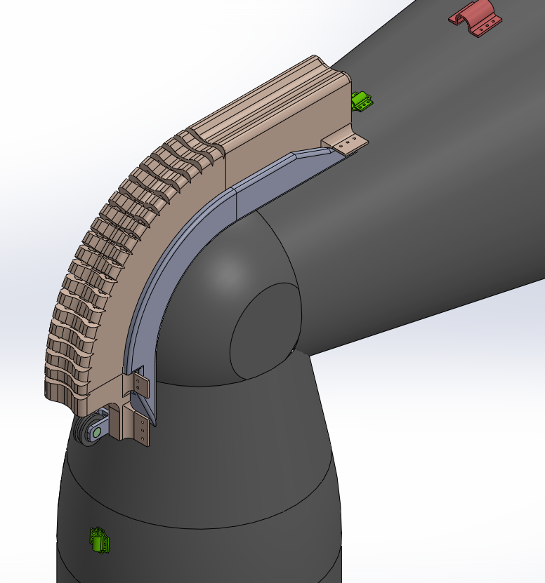
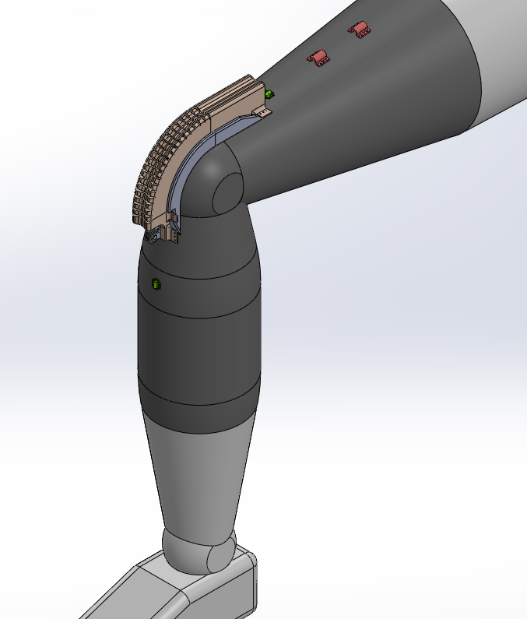
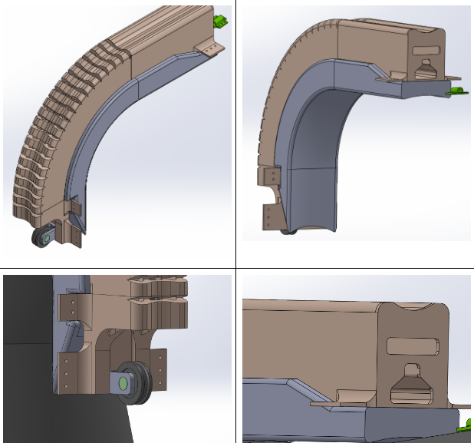
Mechanical Design
Full cables not shown
Bowden Cable Guides
Flexible Track
Knee Padding
Knee Padding
Base Compression Sleeve
Mounting Wings
Tendon Mount
Top Cover
Fixed Pulley
Final Design
Notes:
Amelia
Now the final model design (cables not shown) has the track nestled in the knee pad and mounted on the leg to the compression sleeve. The default position is 90* flexion, but the track and pad are made from a malleable material, so they easily bend and compress or extend as necessary to access the full range of motion. The track has additional cutouts in the top to prevent warping and deformation to the track that would disrupts motion as it flexes. The bowden cable guides are also mounted to the compression sleeve and simply keep the sheathed portion of the cable on track along the leg. The tendon cable mounts are on a separate velcro strap (not shown here) because they cannot be mounted to the stretchy material of the sleeve, they must be securely mounted to the leg themselves, via straps.

Slide 13
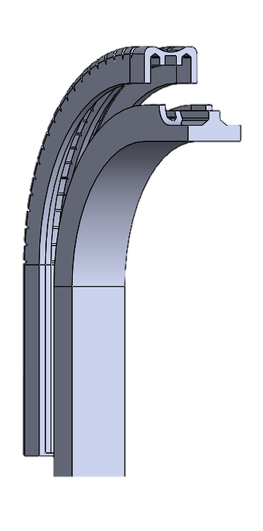
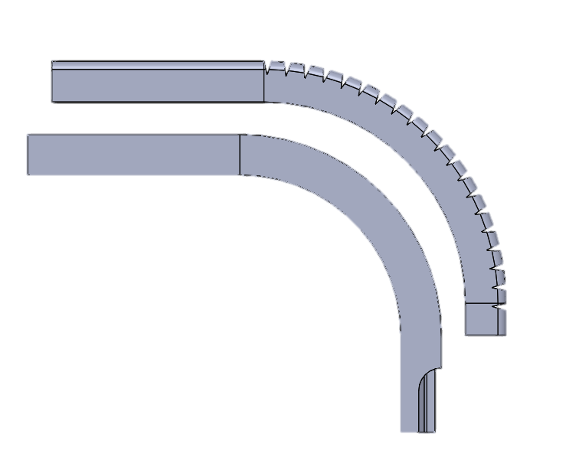
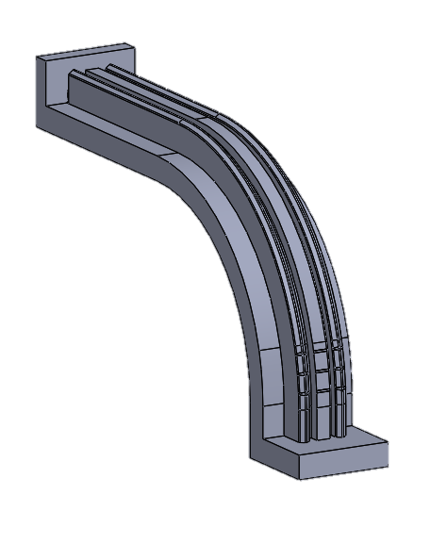
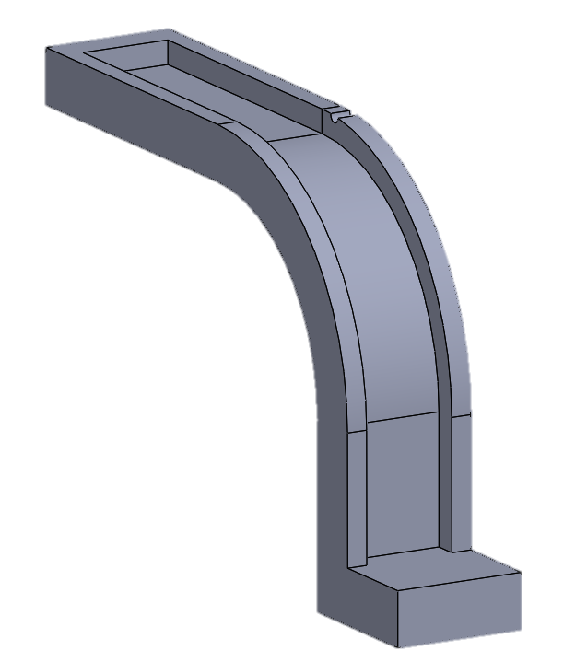
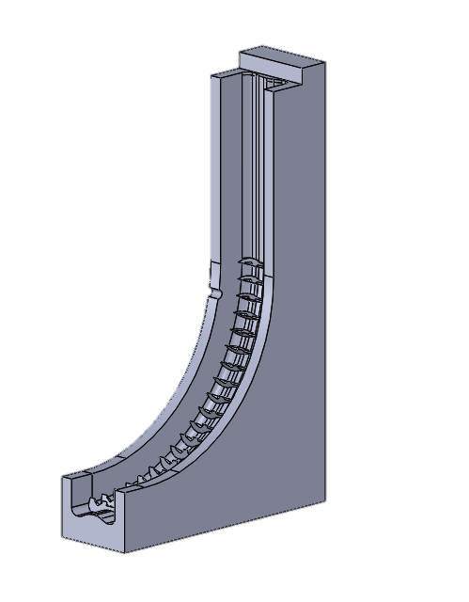
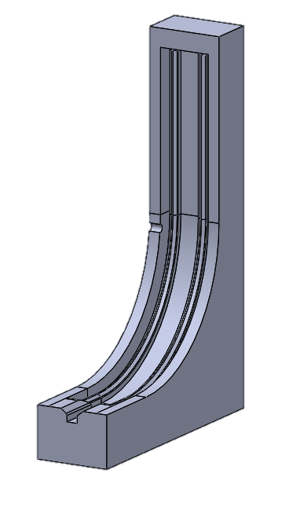
Fabrication
Fabrication Design
Ideally, the pulley track would be able to flex with the knee to provide maximum comfort and ease of motion with the system. One way to achieve this is to use low pressure injection molded parts. The result would be a fairly rubbery flexible track. The team had access to some off campus resources which allowed for some initial prototyping of the track.
In order to fabricate this part through injection molding, the final design model needed to be split into two pieces to create separated molded parts which will be adhered to each other. This method allows the molding to properly capture the complicated inner geometry of the track.
Each half of the track needs two molds to create. 3D printed ABS suffices.
Notes:
Emily
Ideally, the pulley track would be able to flex with the knee to provide maximum comfort and add less strain to the system like Amelia and Justin have emphasized. One way to achieve this is to use low pressure injection molded parts.
In my experience with the right material you can achieve a rubbery flexible quality which is ideal for the pulley track design. I have access to a few molding systems and an ABS printer at my job which allowed for us to test out the basic design and material choice. To be able to mold this, I had to split the design in half which you can see in the pictures toward the left of the slide in order to capture the inner geometry of the track.
Each half of the track required two mold halves and I printed them using the ABS 3D printer i have access to.
The result would be a fairly rubbery flexible track. The team had access to some off campus resources which allowed for some initial prototyping of the track. In order to fabricate this part through injection molding, it needed to be split in half and made in two pieces for prototyping purposes. Each half of the track would need two mold halves. These were printed in ABS.

Slide 14
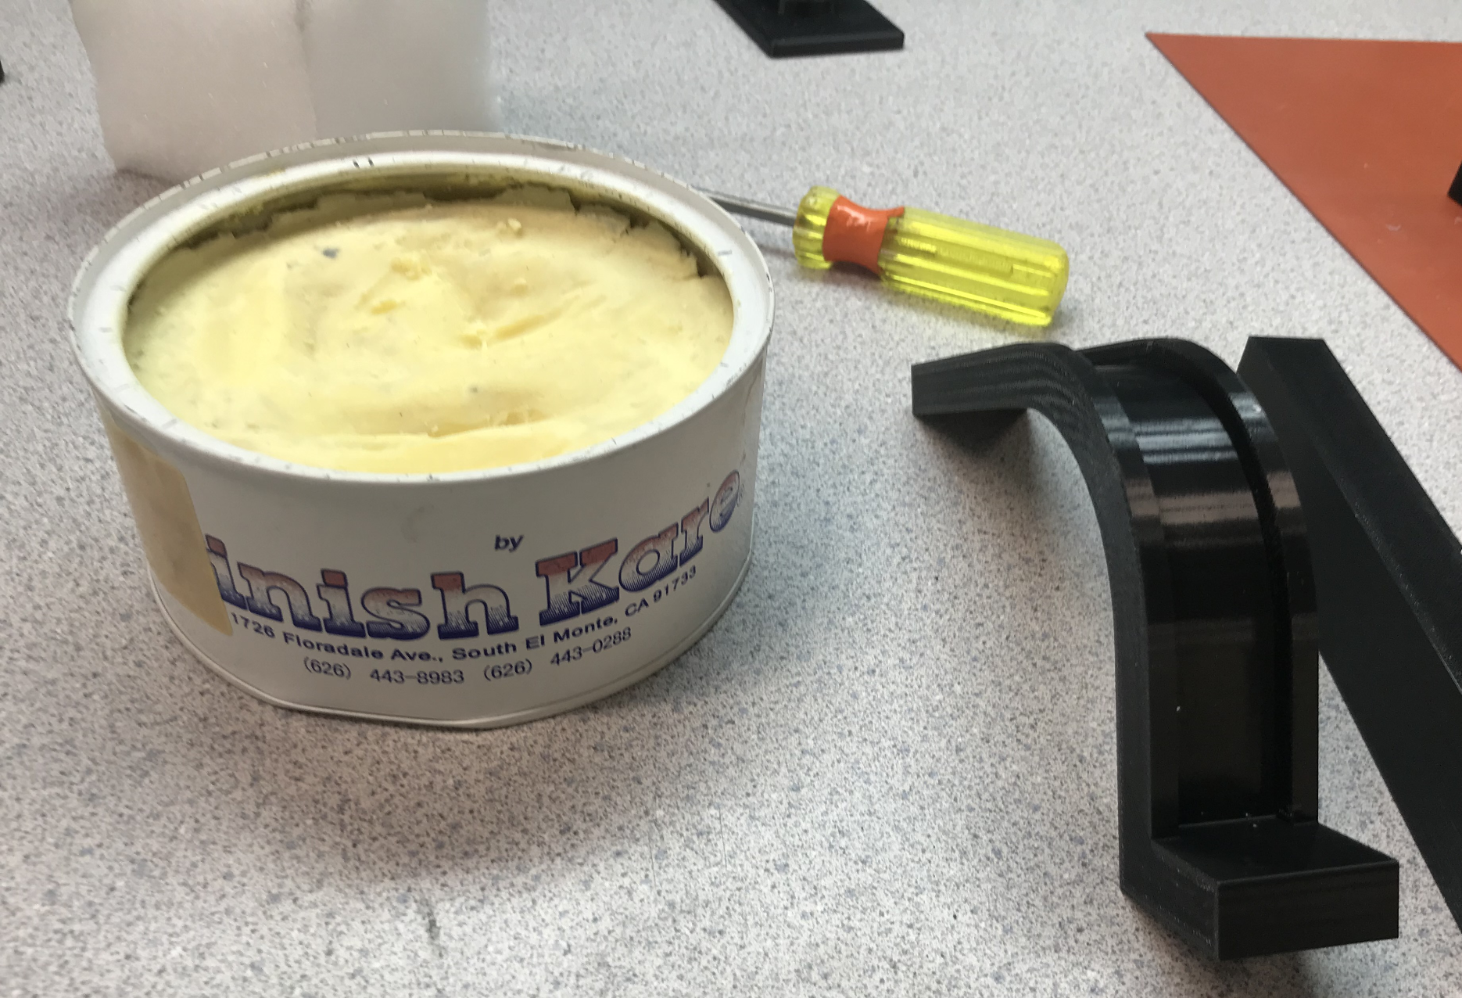
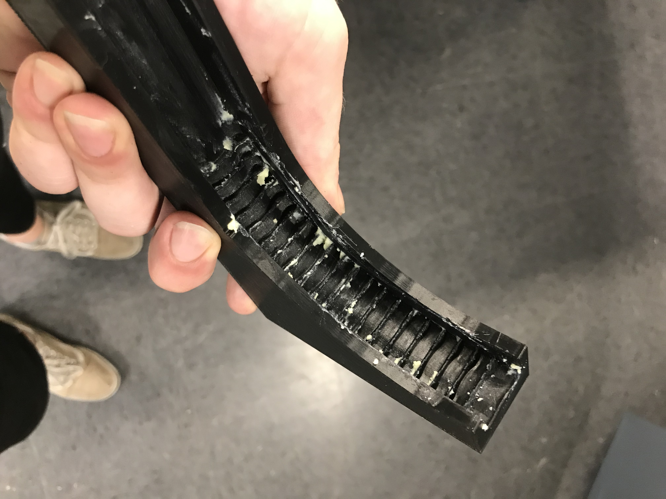
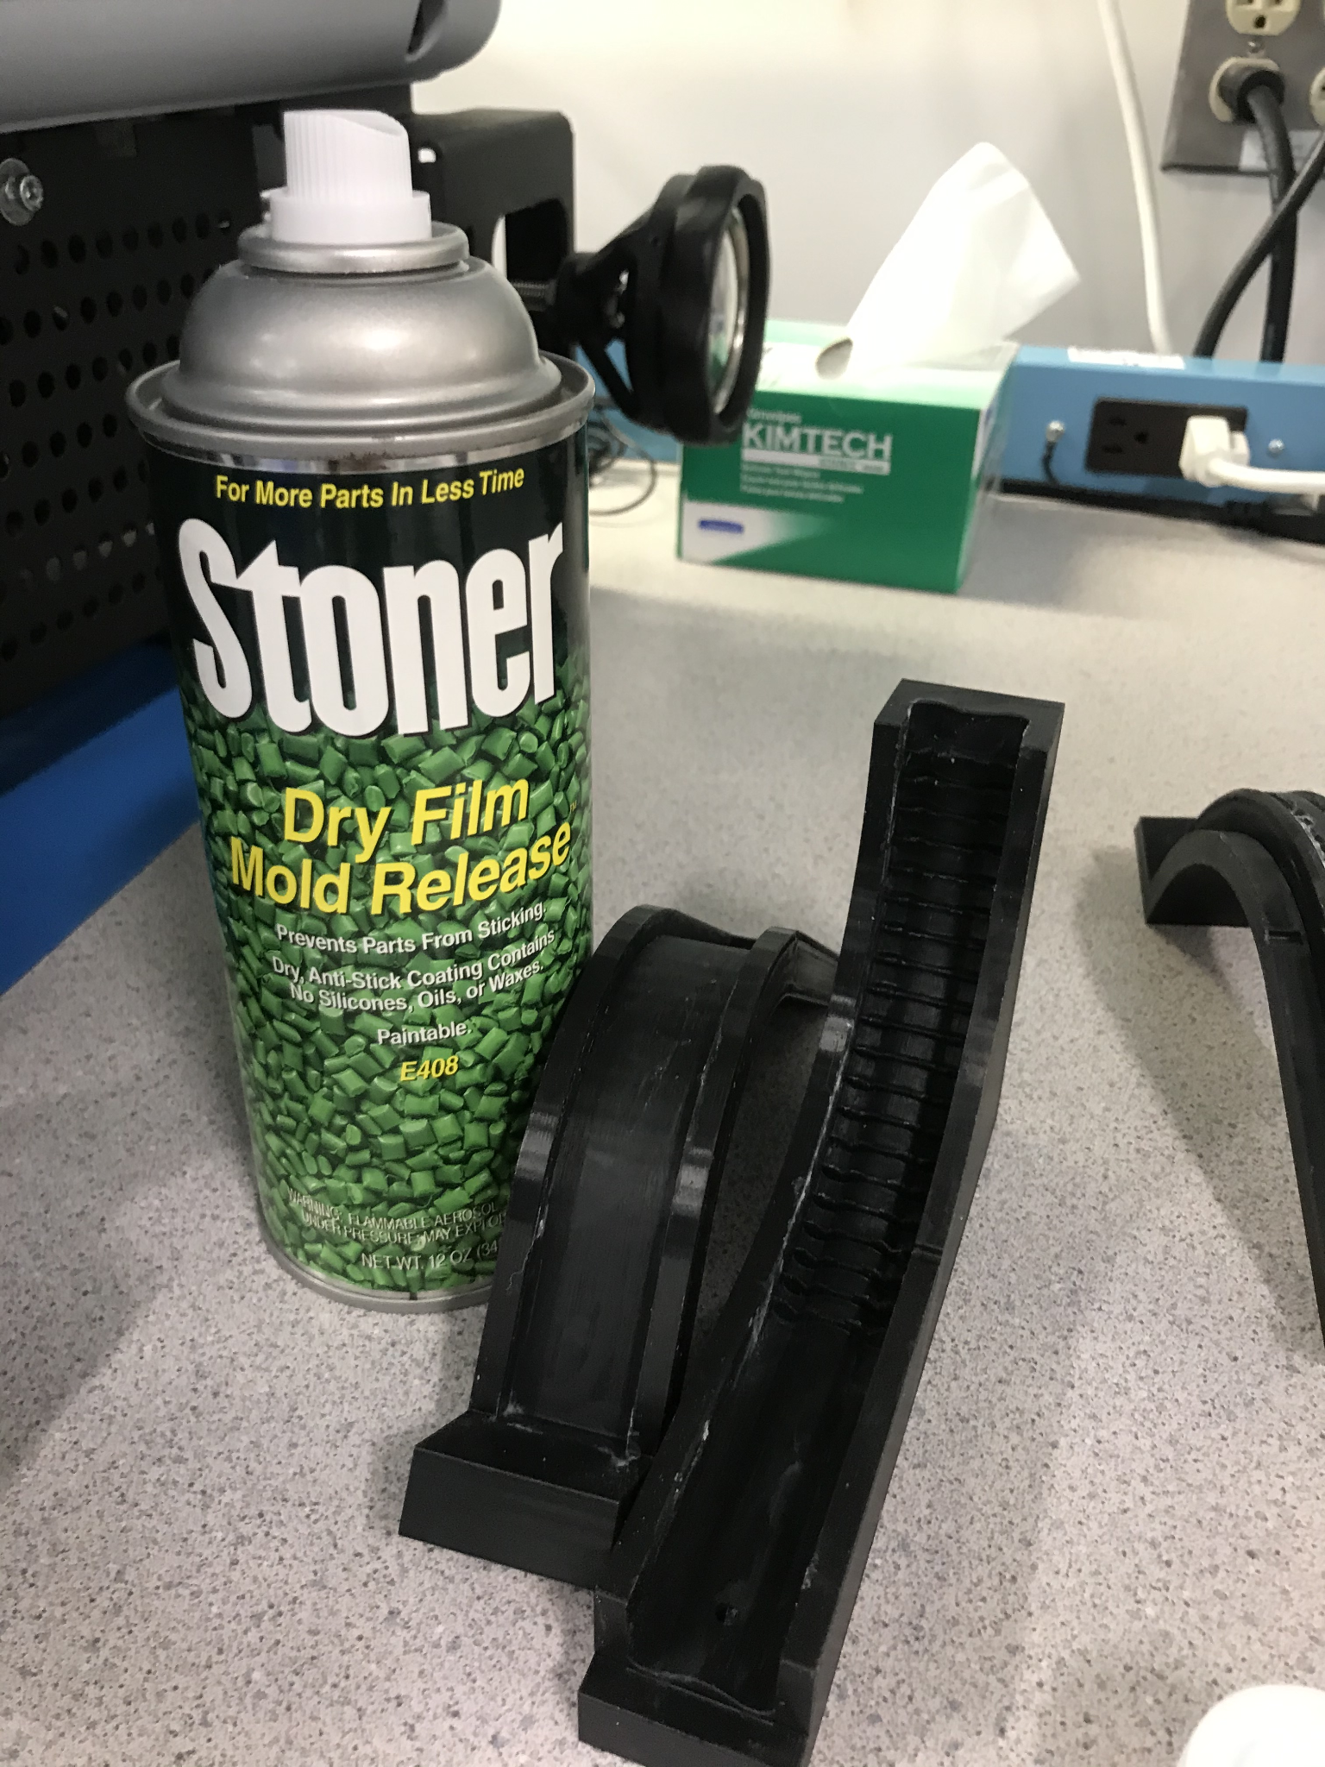
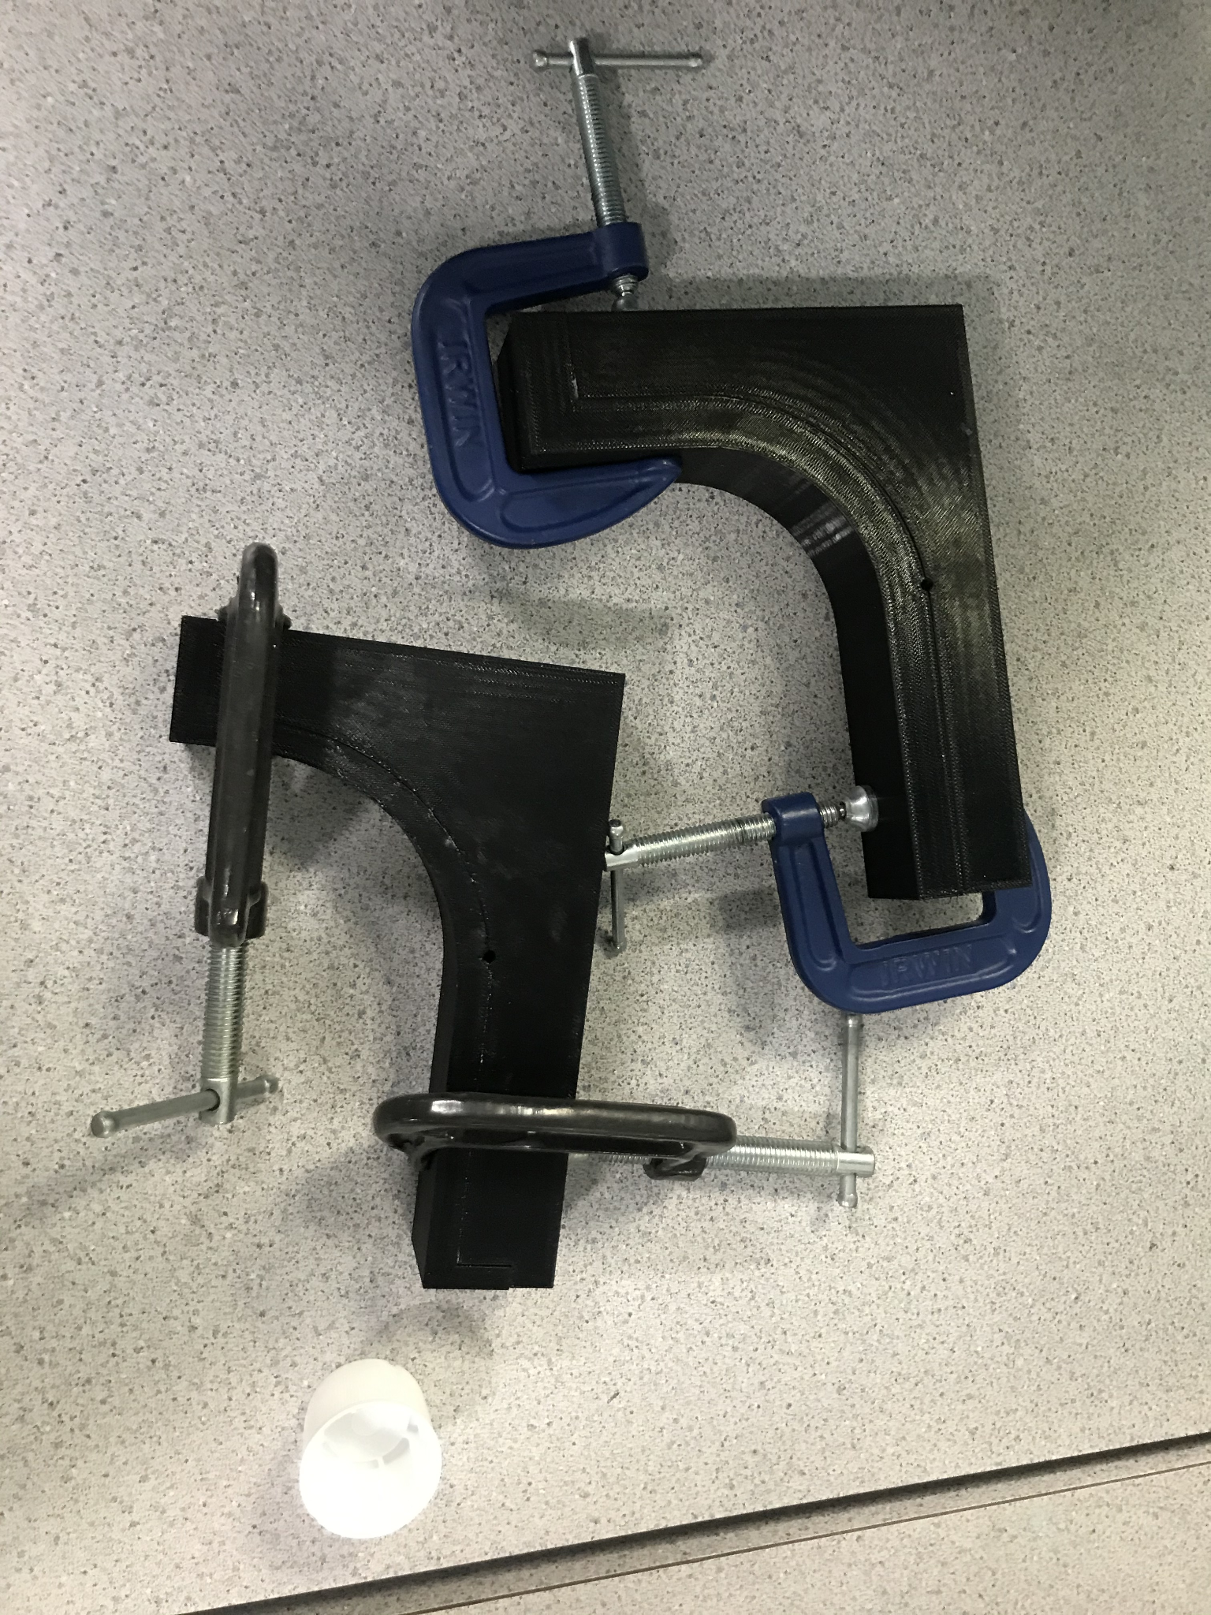
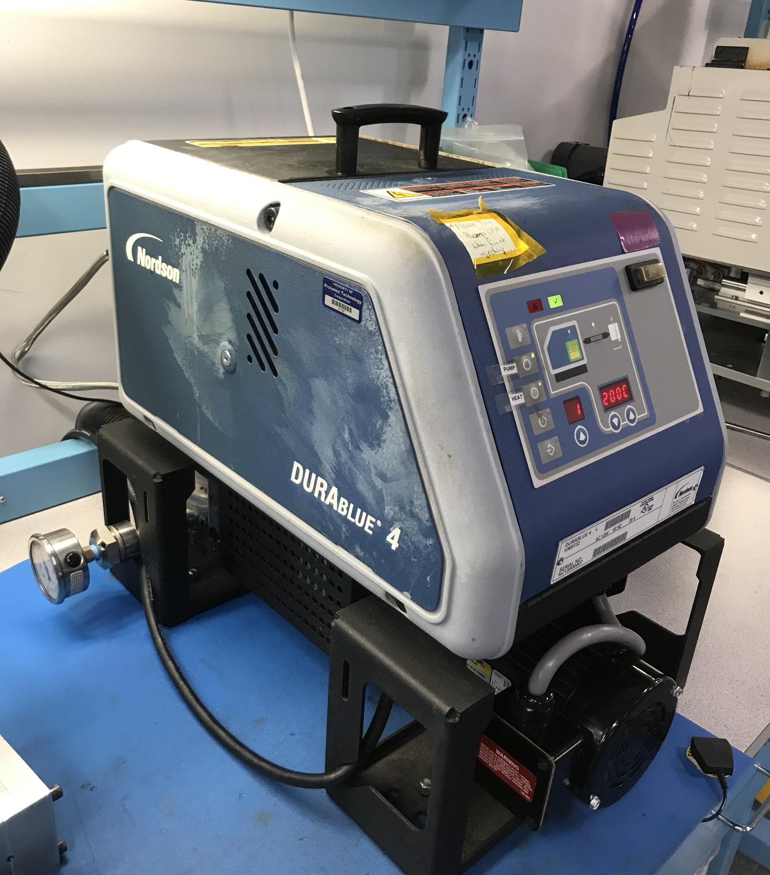
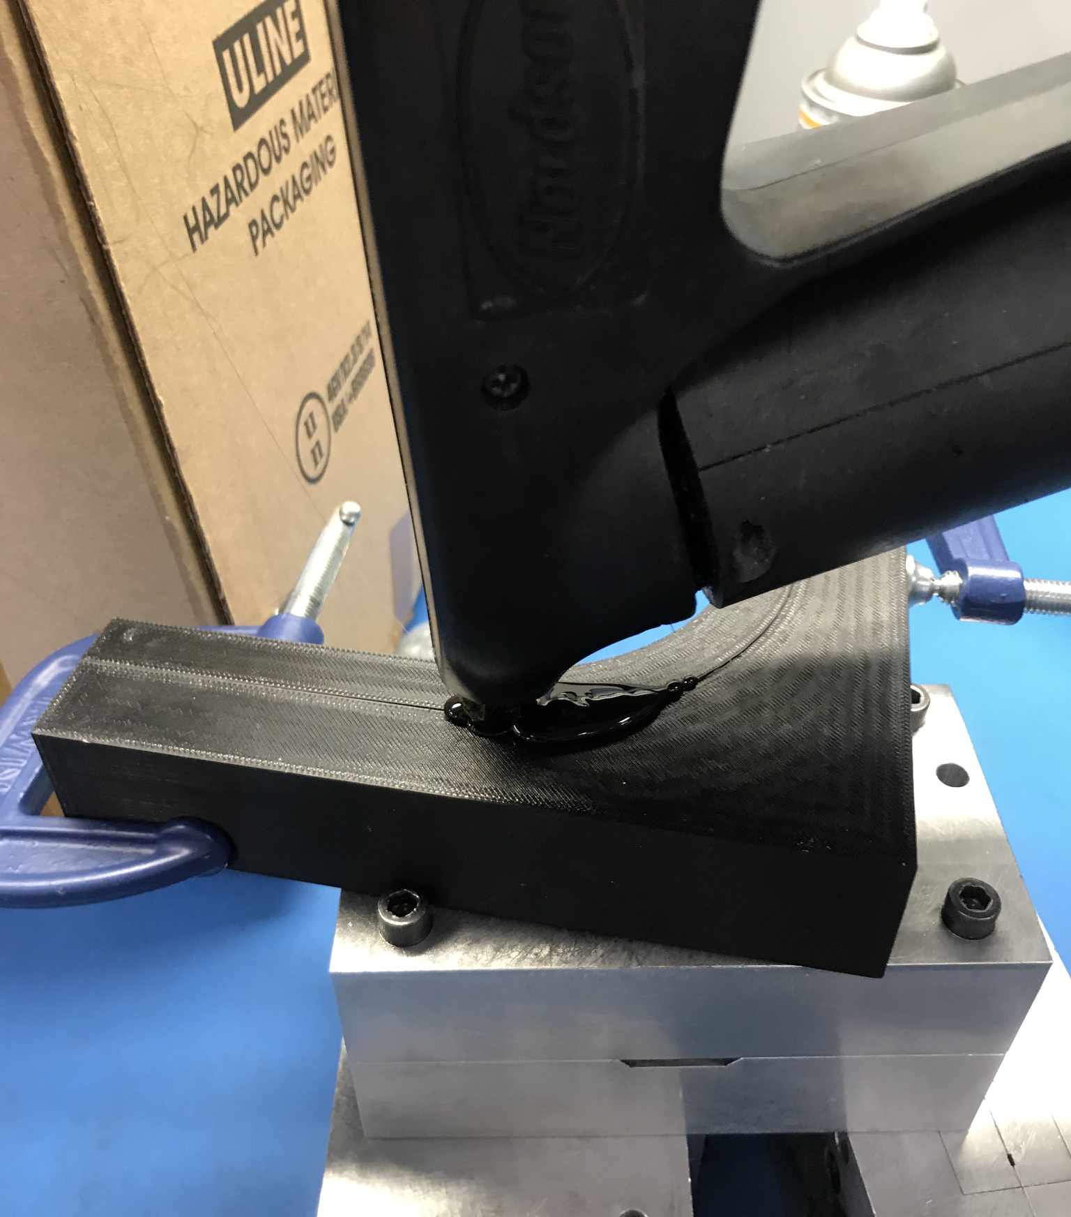
Fabrication
2
After both mold releases were applied, the mold halves were clamped together. A Gluco handheld injection molding machine was used to form the parts. The material used was Technomelt. The parts are then placed in a freezer to cool down before removing the molded part.
This is, of course, not what typical molds look like, but for the sake of prototyping and to create this initial design this was the best route to take.
1
Wax and spray mold release were both used on the mold before injection.
This combination often helps to ensure the injection molding material doesn’t fuse to the mold.
The wax is also helpful to fill the layer gaps that come with 3D printing the molds. The molds were sprayed with an air nozzle after the wax was applied to get rid of excess.
Notes:
Emily
ABS obviously cannot achieve the best surface finish or have the best thermal properties for injection molding, but for prototyping purposes it gets the job done. The major issue is getting the part out of the mold halves at the end of the process. To try and combat fusion of the ABS and the molding material which is this case is Technomelt, I used two different mold releases. The first one is a wax consistency and helps to also fill some of the layer gaps that come with 3D printing. The second was a mold release spray.
After applying those, the mold halves were clamped together and I used a Gluco handheld injection molding machine to form the parts.

Slide 15
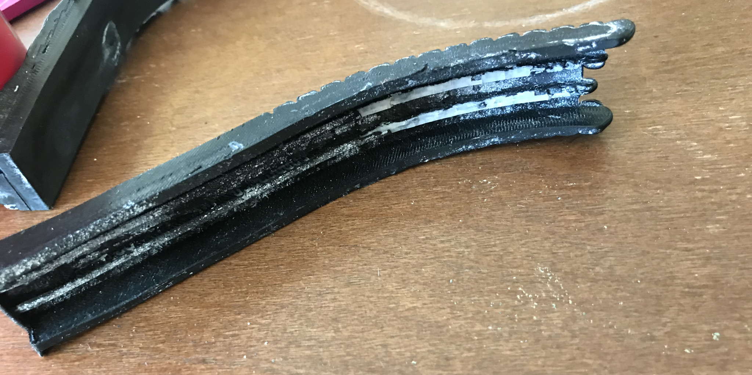
Fabrication Considerations
These are some pictures of the molded parts. They came out a little rough due to the nature of the makeshift 3D printed molds, but we got the general shape desired and the flex of the parts was ideal for moving with the motion of the knee.
In terms of actually producing this product, a aluminum or steel mold would be milled and an automated molding system would produce the parts.
Some re-design is definitely necessary to make a production worthy product. Most low pressure molding material would achieve the flex effect for the part.
If it needed to be made in two parts, they could be attached together nearly seamlessly with an ultrasonic welder.
Notes:
Emily
This slide shows what the final prototype came to look like. We found that the general shape pretty much worked, the complex geometry was captured fairly well, and the flex of the material is exactly what we were hoping for. In terms of producing this product, an aluminum or steel mold would need to be milled and an automated molding system would be used to produce the parts. Some re-design is necessary to make this a production worthy product and there is a large array of low pressure molding materials that could be used to achieve the desired flex.
To create a final product the two halves would need to be adhered together post molding or produced in one piece. An ultrasonic welder could be used to seamlessly attach the two halves together if needed.

Slide 16
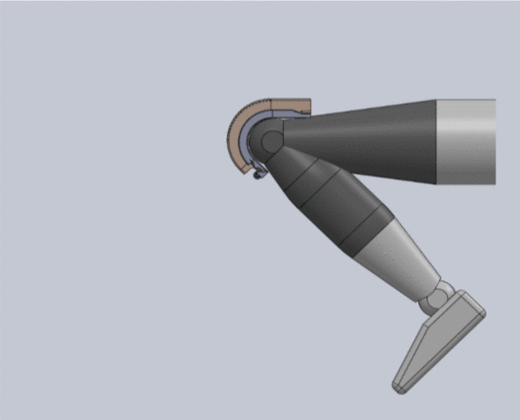
Mechanism Motion
Sample Motion:
Rising from a Deep Squat
GIF
The Range of Motion
Notes:
Emily
This is an animation of the mechanisms motion as the knee moves. It shows a kind of shrinking effect of the pulley track, but in reality the desired effect would look more like a stretching and compression effect of the track flexing and straightening out as the user goes from a squat to standing. The animation also shows the full range of motion of the mechanism. The cables are not shown as the system was too complex to assemble the model in this way and the animation would not be as clear.

Slide 17
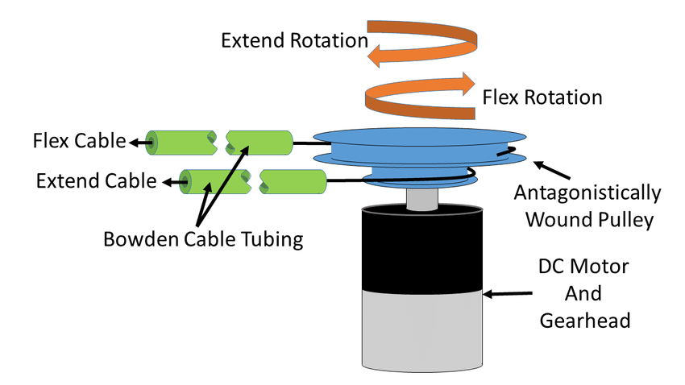
Power and Actuation
Waist Belt
Bowden Cable Actuation
Bowden Cable Actuation
Motor & Gearing
Bowden Pulley
Power Supply
Electronics
Notes:
Amelia ------------
We were unfortunately unable to fully investigate and design the power and actuation aspect of our project due to extenuating circumstances with a former team member. We were however, able to do a preliminary plan for the function of these elements.
As previously mentioned, there is a waist belt portion of the design. This will house the Bowden cable actuation system, power supply and associated electronics (PCB). The waist is the location point because It helps to keep this additional weight from hindering the user’s center of gravity, causing other mobility issues. Ideally, the system won’t use that much power, and gearing can be used to increase the torque of the motor in order to keep those elements as small as possible.
The bowden cable is actuated using a geared motor and an attached drum. When the motor is actuated in either direction, the bowden cable will respond, setting the system into motion! A possible motor and battery choice are shown above.

Slide 18
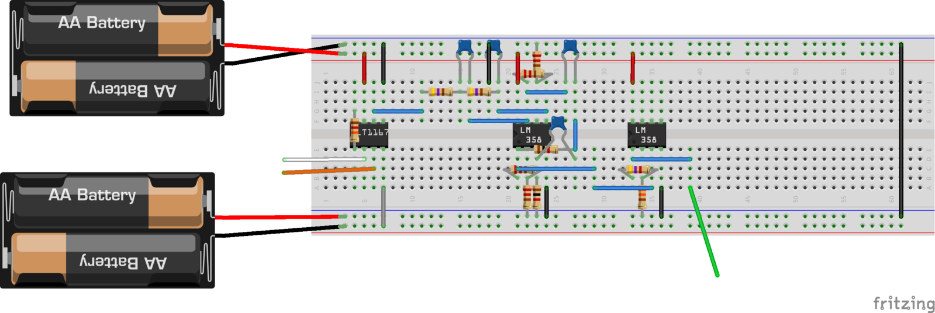
Power and Actuation
Operation Flow Chart
Electrical Signal
Tendon Cable
Pulley System
Initial EMG Circuit
Bowden Cable
EMG Sensor
Leg
Arduino
Motor
Bowden Pulley
Notes:
Justin - We initially planned to incorporate and EMG sensor on the inner surface of the leg sleeve. These non invasive sensors would detect electrical signals sent to the thigh during motion. This sensor would be read by an Arduino microcontroller which would activate the motor on the waist belt accordingly. The attached drum pulley adjusts the Bowden cable. Then engages the tendon pulley system and pulls the tendon cable which would in turn pull the bottom part of the leg forward. This would provide supplemental torque to the knee that is similar to how the knee provides torque naturally and in sync with the desired motion.

Slide 19
Conclusions & Next Steps
EMG measurements
Test rig set up to record EMG measurements in order to determine necessary muscle movements and the linear motion of the knee
Testing
Full assembly & testing at Practice Point
Re-design & Prototyping
Improve manufacturability
Reduce bulk further
Notes:
Emily
The original plan for this project included creating a test rig using a potentiometer and a circuit board to record the position and EMG measurements of a users knee to help us to determine the necessary muscle movements and the linear velocity which would help us determine the torque needed for a user to walk, stand, go up stairs, etc experimentally. We hope this project can be completed in a Phase 3 continuation, hopefully in a full on campus environment and with someone with ECE experience, where all these things can be accomplished. Full assembly of the whole system and testing at the WPI practicepoint healthcare development facility would also be a next step for the project. Practicepoint would provide the team with equipment to actually measure the torque used for various knee motions. Phase 1 had the chance to do some initial testing there, so further utilization of this facility would be useful.
A major goal of ours was to reduce the bulk of the system and add less strain to the users leg from phase 1. Our design achieved this, but we believe that the system could be further reduced in bulk and requires far more testing and proof of concept work. Right now our design is also a hassle to fabricate, so improvements in the manufacturability of each component would also be needed.

Slide 20
Acknowledgments
Professor SelÇuk GuÇeri
The Mechanical Engineering Department
Notes:
Justin - Lastly, we would like to thank Professor Selcuk Guceri for his support and enthusiasm during our time working on this project. His guidance helped our team overcome the obstacles and limitations we encountered and his encouragement kept us motivated. Also, his personal experience being someone with knee issues allowed us to gain valuable, user-centered input which helped formed the goals of our project. We would also like to acknowledge the mechanical engineering department for giving us the opportunity and funding to work on this project.

Slide 21
Image Sources
Labeled Knee
Anatomical Pulley
Patellofemoral Joint GIF
Range of Motion
Patella Articulation 1&2
Reaction Forces Diagram
Patella Articulation 3
Squatting Reaction Forces
Walking Gait
Stairs Gait
H. Park et al Diagrams
Bowden Cable Actuation

