Slide 1
Designing A Circular Economy Board Game to Engage the Banksia Community with Climate Resilience Efforts
By: Sean O’Connor, Jonathan Metcalf, Evan Vadeboncoeur, & Elitumaini Swai
28/4/2022
Notes:
Sean and then everyone
Anecdote about why Eli isn’t here

Slide 2
Acknowledgement
WPI and Banksia Gardens Community Services acknowledge the Wurundjeri Woi Wurrung people as the traditional owners of the land on which BGCS is located. We pay respects to their Elders past and present, and extend that respect to the First Nations and Elder members of our multicultural community.
Notes:
Sean

Slide 3
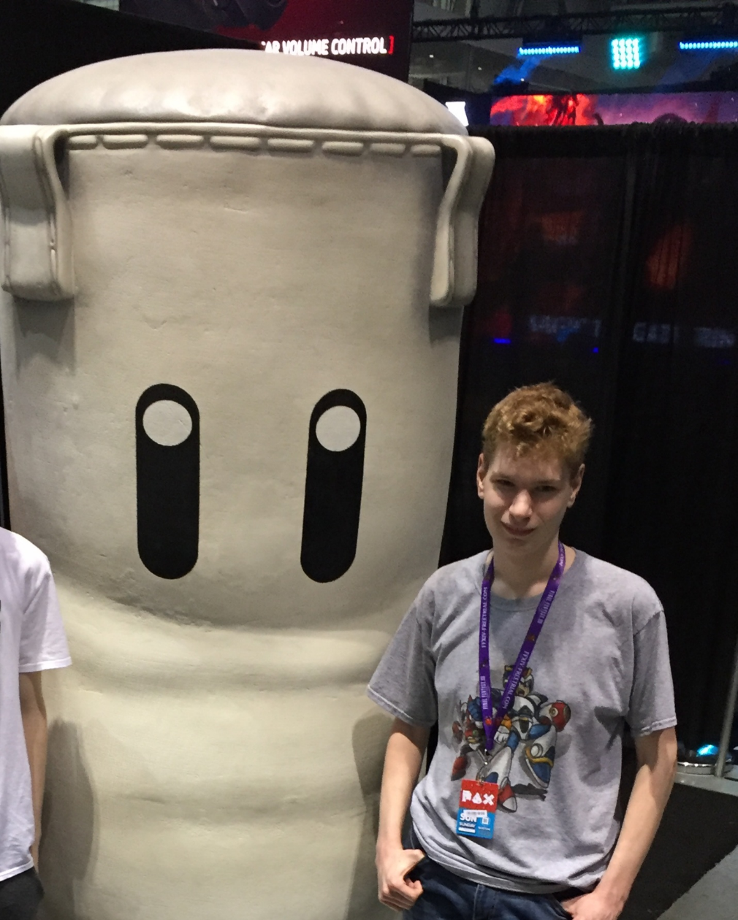
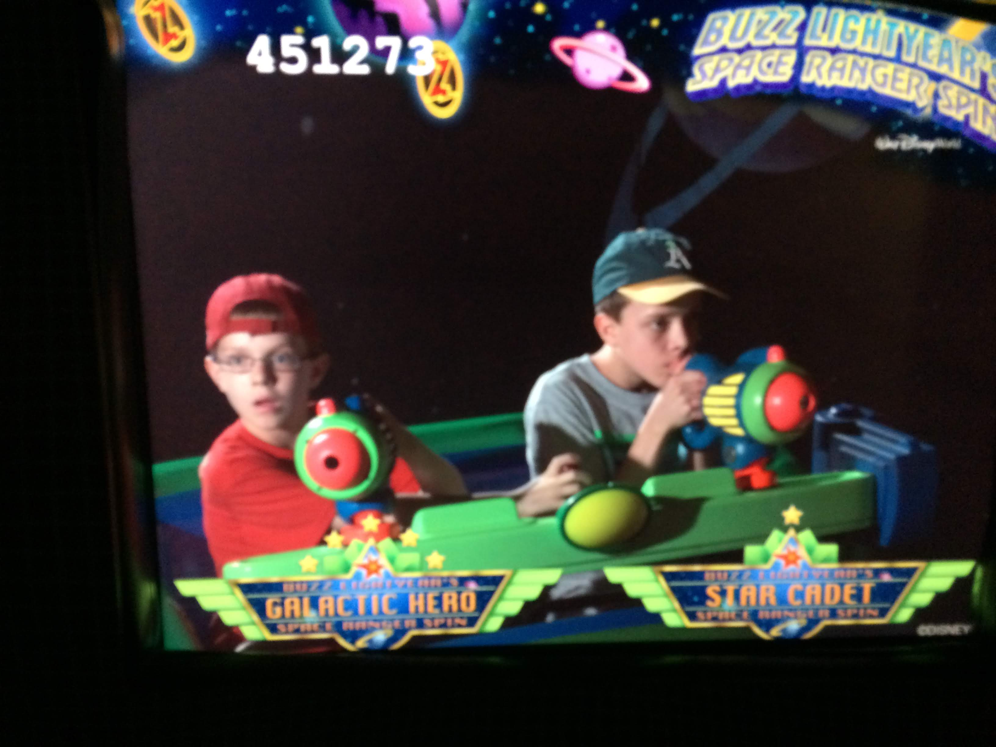
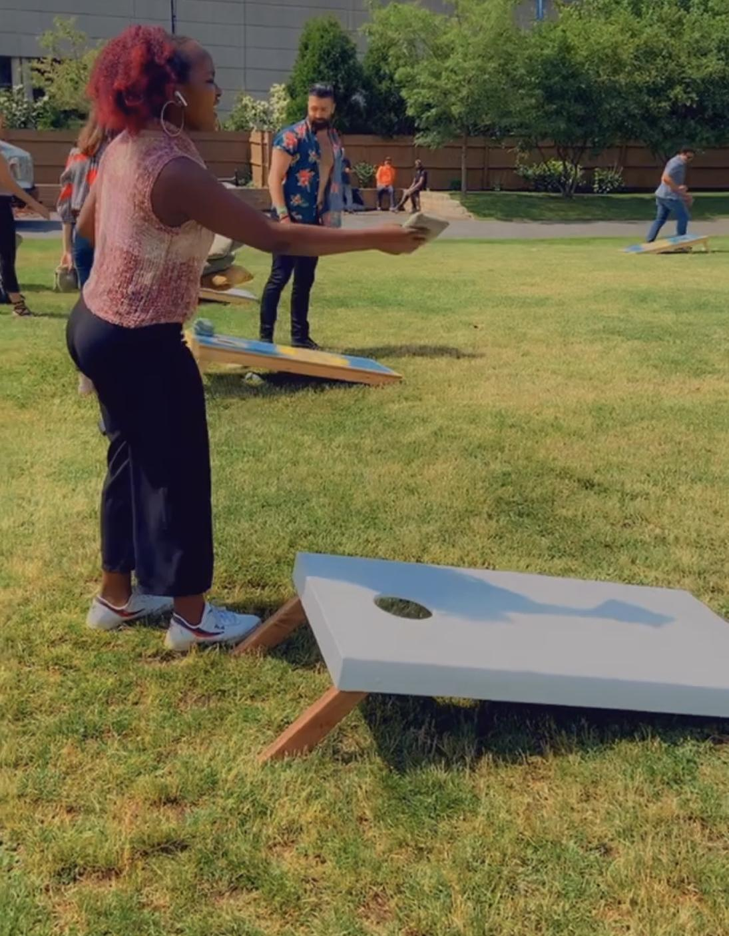
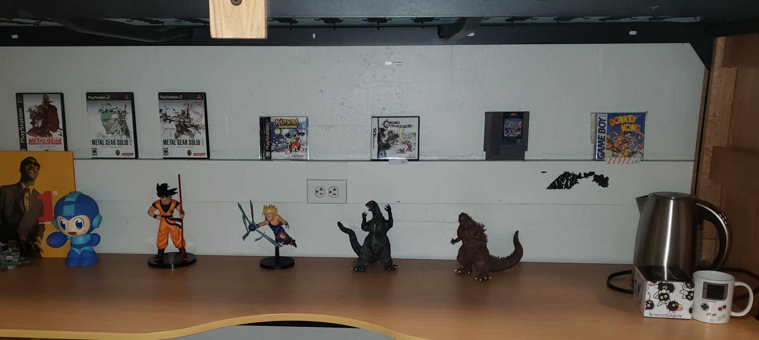
Who We Are
Notes:
Game anecdote
Anecdote about why Eli isn’t here
I personally tend to get very competitive when playing games and that’s how I express my love for gaming.
Unfortunately I was unable to be there in person because I couldn’t obtain my visa on time. This was as a result of long processing times experienced by the Australia Immigration Services due to COVID. …
Who knows the Social Injustice that is magnified by bad events like this pandemic. However as Human beings we are learning to adapt to that, and our team is a living proof for this , we have worked together to use our love for games to create a game for positive impact
Anecdote/joke about your job interview

Slide 4
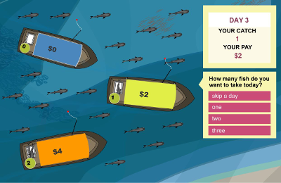
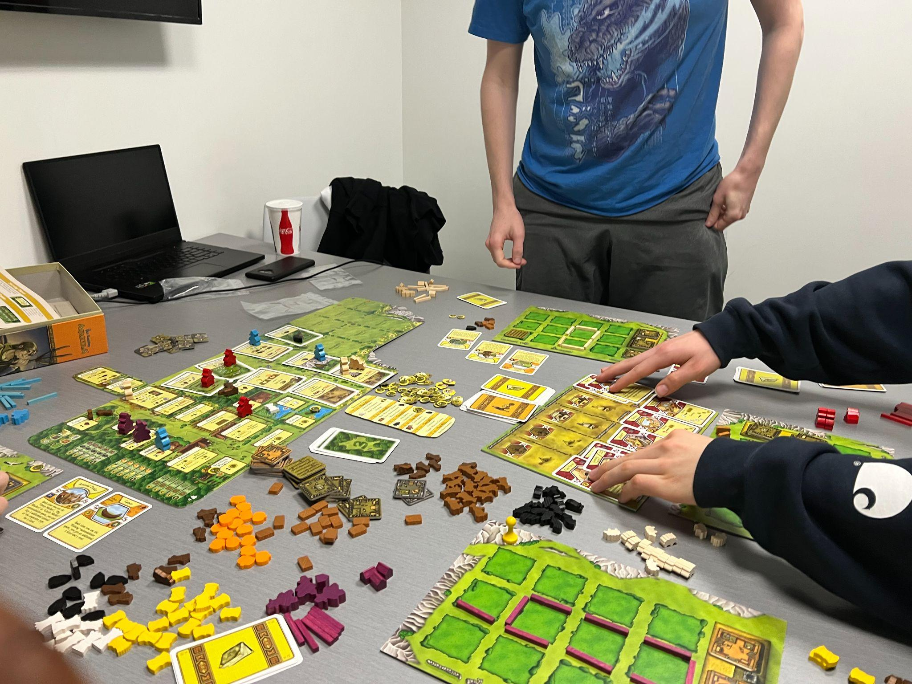
We’d Like to Create a Serious Game
The Fish Game, an example of a serious game
Agricola, an example of a board game concerning resource management and farming
Notes:
Sean
Outside of Banksia Garden’s current community initiatives, there have been other ways organizations and companies have tried to teach current issues, which includes the use of interactive games.
Serious games are designed with characteristics from entertainment games but with a focus on learning and training rather than pure entertainment. This is done through theoretical instructions that teach players new concepts for real world environments.
An example of a serious game is The Fish Game. Players choose the number of fish they want to take from the lake while other fishermen try to catch as many fish as possible. The lake can only contain a specific number of fish at a time, and reproduction occurs at a rate of 25%. The game targets environmental sustainability and the effects of taking too much, as the “aim of the game is to show how individuals’ decisions affect resources and may cause its depletion”.
As a medium, games have the potential to teach various concepts. An example is the board game Agricola, a turn based board game where players take on the role of a farmer and work on their farms, collecting materials and raising their family. To succeed in the game, players must grow their families and wealth through proper resource management and farming.
https://iopscience.iop.org/article/10.1088/1748-9326/aac1c6/pdf

Slide 5
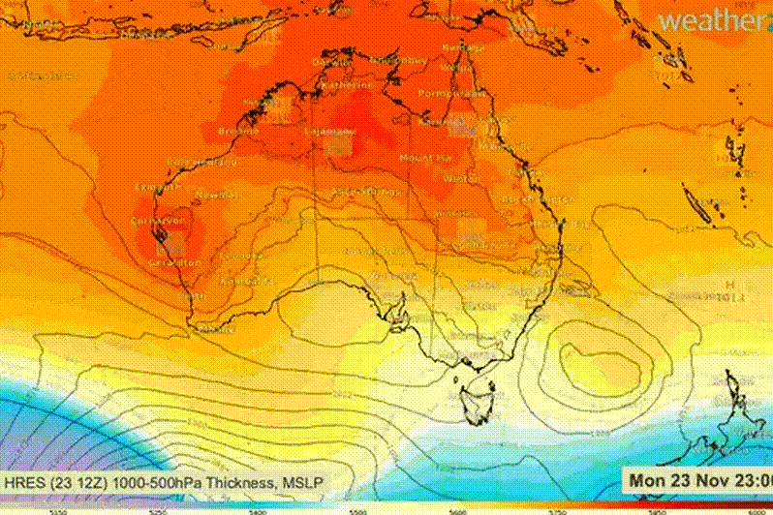
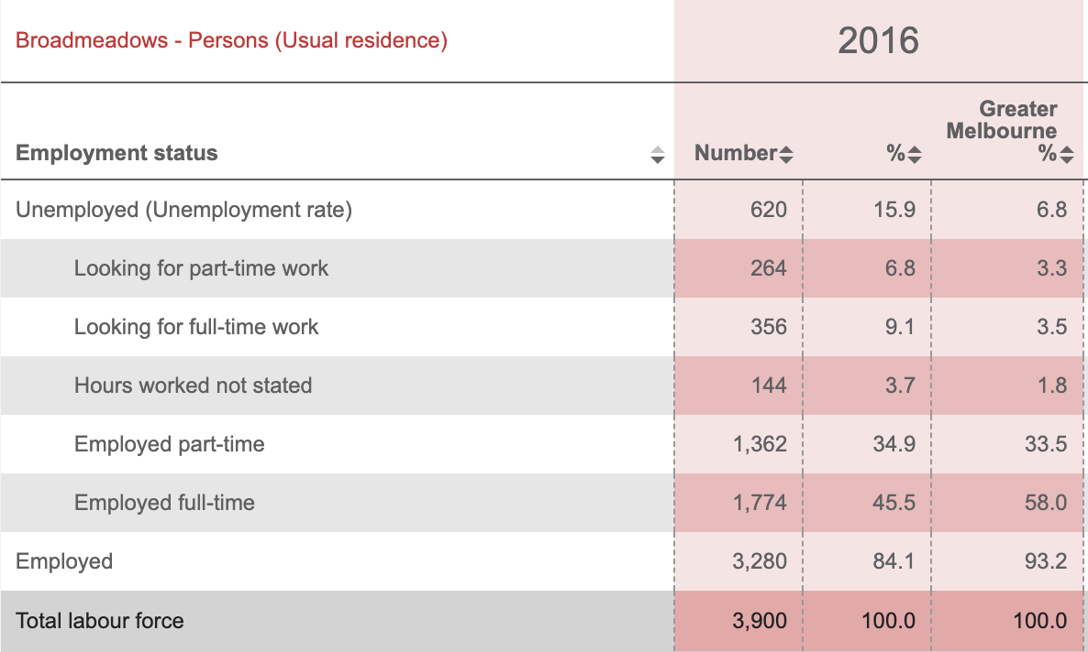
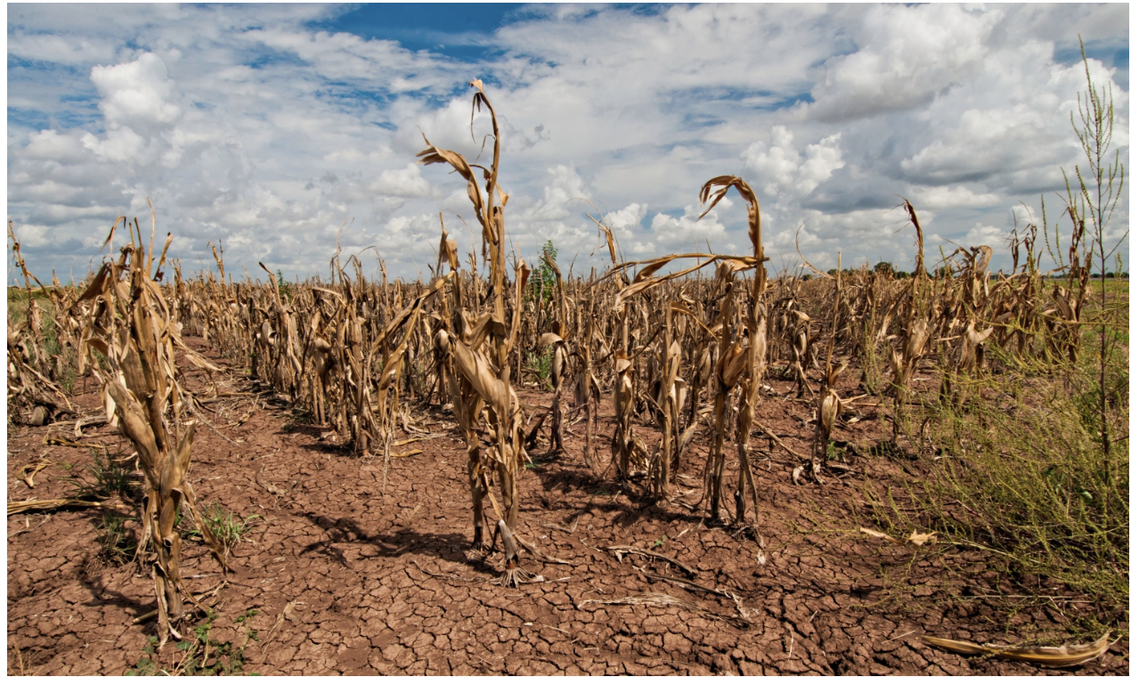
Climate Change Affects Disadvantaged Communities More
Recent heatwave in Australia & Droughts effects on Crops
Unemployment Profile for the Broadmeadows Community
Notes:
Eli
Pose question: Did you know : Disadvantaged communities, bear the most of climate change effects compared to other developed areas around the world? This is exactly why our team was inspired to create a serious game to engage the Broadmeadows community with ways to mitigate around the climate change impacts .
Climate change has been a significant problem in the world , but more so Australia has been affected significantly. This has been noticed through intense heat waves , droughts leading to food insecurities. As seen on the left side images on our slide here.
. Broadmeadows community is one of the most disadvantaged areas in the city of Hume located in Melbourne; There are many issues prevalent in the area, including unemployment rate of about 15.9% as of 2016, and high crime levels. These are only part of the issues that make them the main victims of climate change effects.
Our game aims to engage the Broadmeadows community with ways in which they can mitigate around the climate change impacts.
End
https://www.smh.com.au/environment/climate-change/trend-towards-worsening-heatwaves-is-accelerating-new-research-finds-20200703-p558s8.html - 1st Image
https://www.theguardian.com/australia-news/2018/aug/04/australias-drought-crisis-and-farmers-stories-of-anxiety-fear-and-resilience -
https://ideas.ted.com/famine-extinction-natural-disasters-takeaways-from-the-new-2022-ipcc-report/ 2nd image
https://www.climatecouncil.org.au/resources/hard-to-swallow-how-climate-change-is-affecting-australian-food/ - info on crops threats and food insecurities
https://profile.id.com.au/hume/employment-status?WebID=120 - Broadmeadows as a disadvantaged community

Slide 6
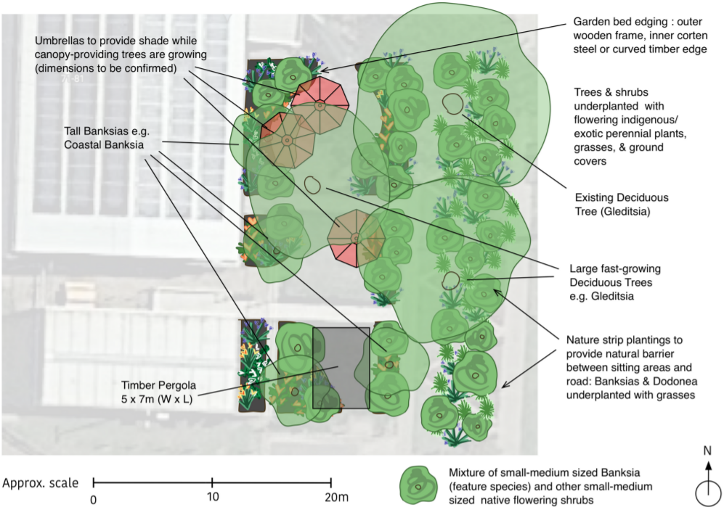
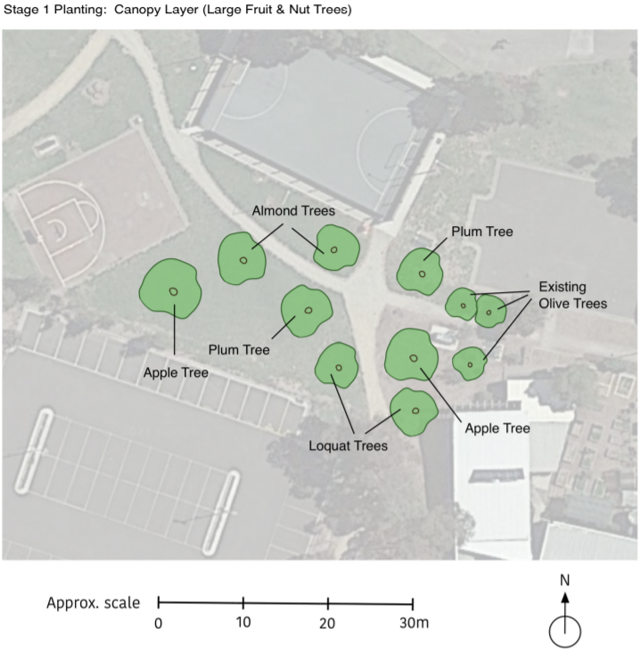
BGCS’ Planned Climate Initiatives
Concept Design for the Heat Haven
Concept Design for the Food Forest
Image Sources: Caballero, E. (2022). Banksia Gardens—Concept design Community Square. Wild Urban Green. https://www.wildurbangreen.com.au/
Notes:
Jonathan
Some of BGCS’s planned climate initiatives are the Heat Haven and the Food Forest.
They are similar topics, but are both climate initiatives that will be very helpful for the community
Heat Haven:
Heat Haven provides residents with shelter from the heat waves that come as a result of climate change as we discussed earlier.
The current design includes some large fast-growing trees with overlapping canopies as well as a pergola and three umbrellas to help provide shade.
The goal is to provide a central shaded area for residents and staff to relax and enjoy in the summertime
Food Forest:
The Food Forest initiative supports BGCS’ food program and will provide people with a place to cool down in the adjacent area to the property with extra shade, as well as develop the surrounding land.
The current design is just for the initial stage, and includes many types of trees such as apple, plum, and olive trees.

Slide 7
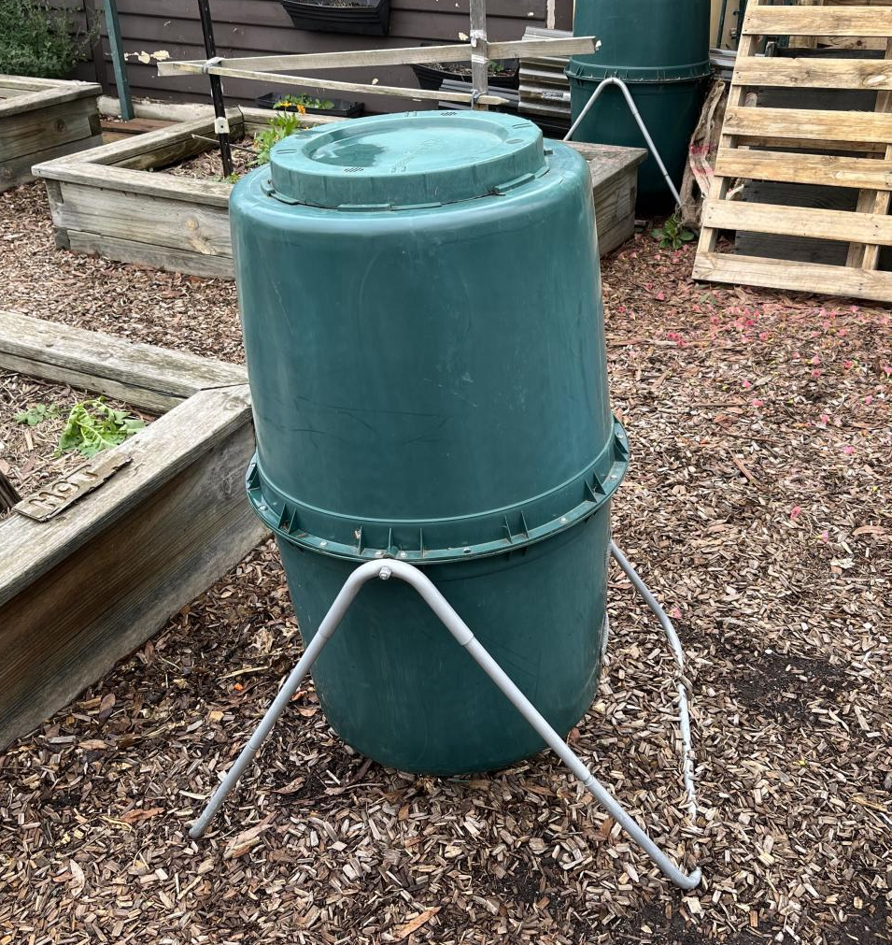
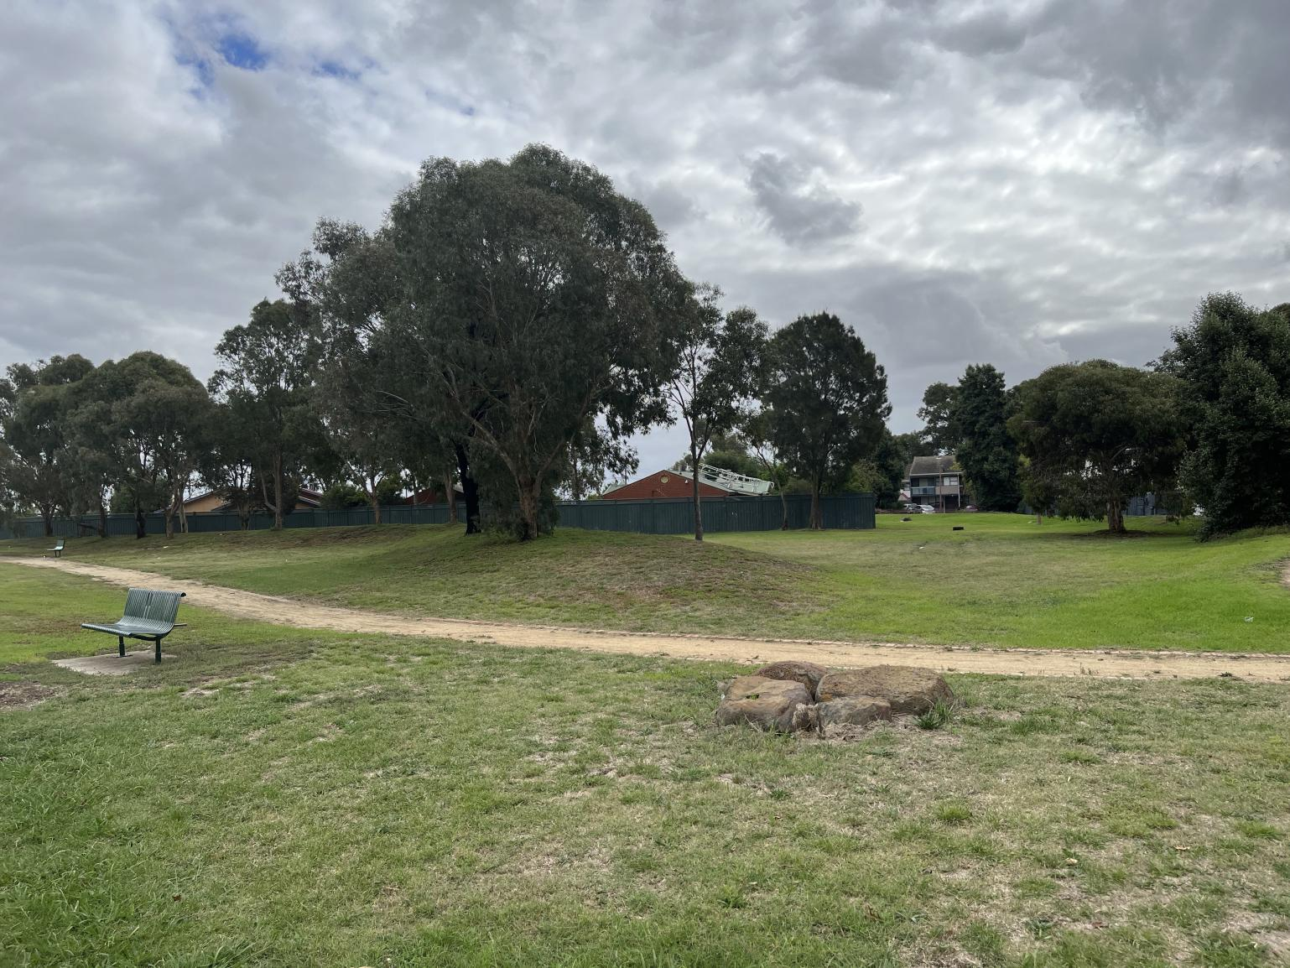
BGCS’ Use of Circular Economies
Composter at BGCS
Proposed Food Forest Location
Notes:
Evan
The group next had to research circular economies before we could create a game.
All familiar with…
Good example we stumbled on to help us understand: space waste
Discarded rocket boosters and satellite debris orbit the Earth as a result of NASA’s non-reusable rockets and satellites
SpaceX has created the Falcon 9, a reusable rocket that eliminates the needless space waste
To summarize: This is a prime example of a circular economy, one that “closes the loop” where the resources put into the economy stay in the economy (as little waste as possible)
Next we spoke with our sponsor to determine prominent circular economies at banksia we can base our game on
BGCS’ climate initiatives will help establish a circular economy for the community
BGCS processes a lot of organic matter from its various food programs to avoid creating waste
Organic matter gets processed w/ vermicompost, bokashi anaerobic pre-composting and aerobic composting
Composted organic matter goes into
Garden beds
Food Forest to regenerate soil outside Banksia
Plant more trees to create the food forest
Food forest will allow BGCS to grow fruits and vegetables, which will contribute to their food programs and create more OM, restarting the cycle
Additionally, this will help combat climate change because bokashi keeps CO2 and methane in the soil

Slide 8
Our project is to design a board game that highlights the principles of circular economies to engage the community around BGCS in climate resilience planning.
Notes:
Sean

Slide 9
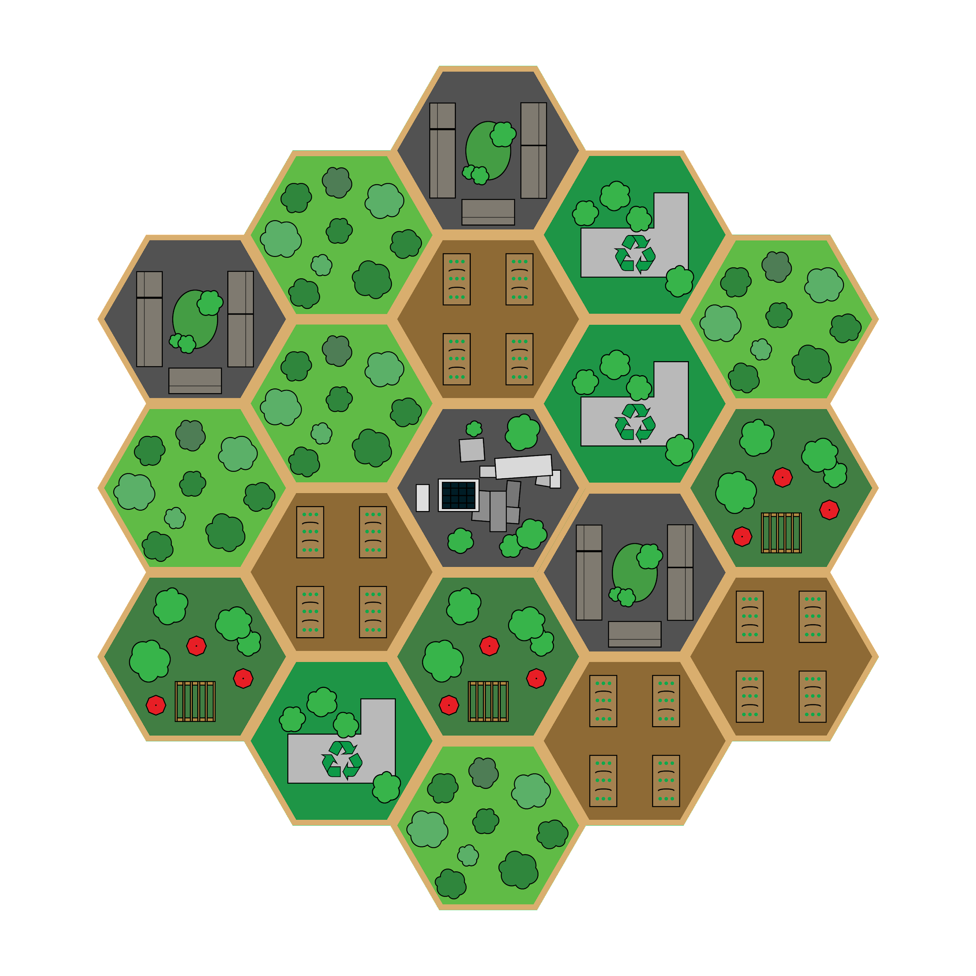
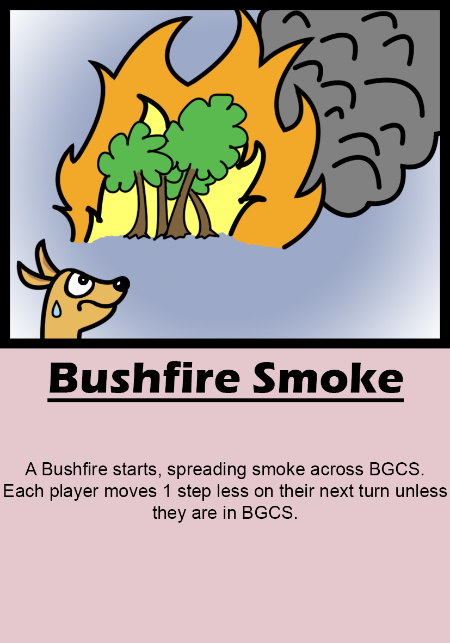
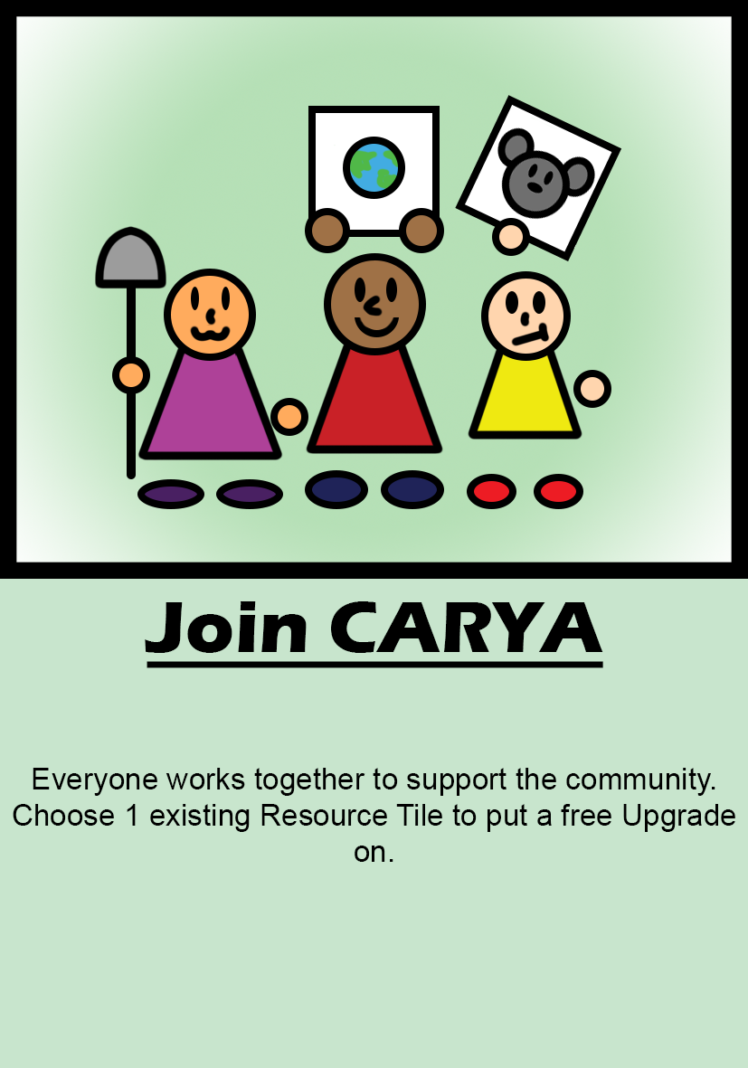
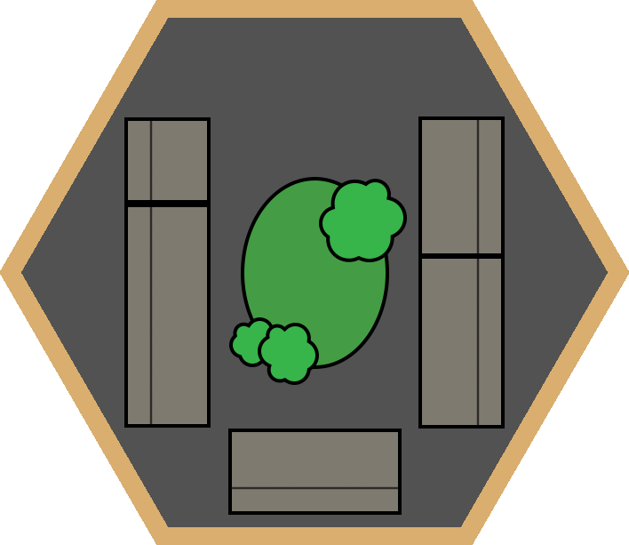
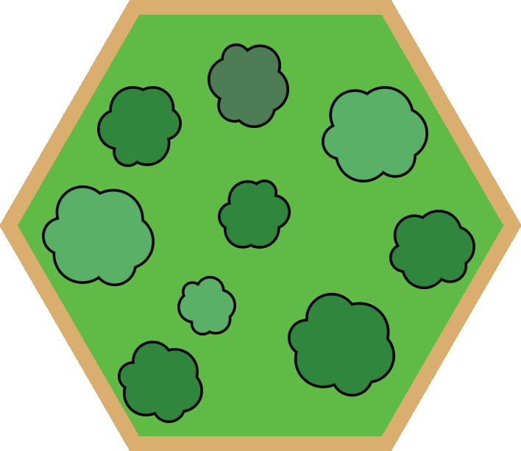
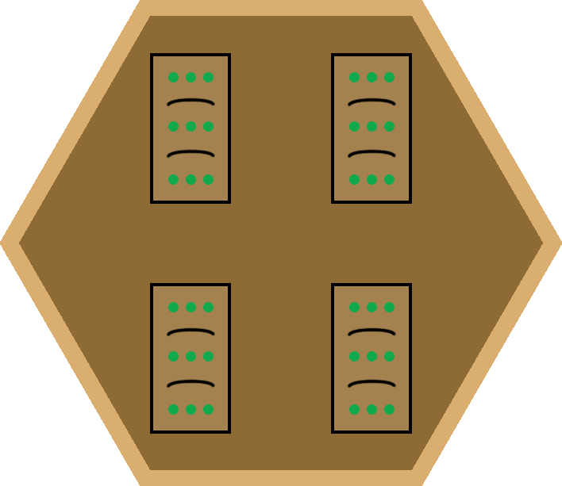
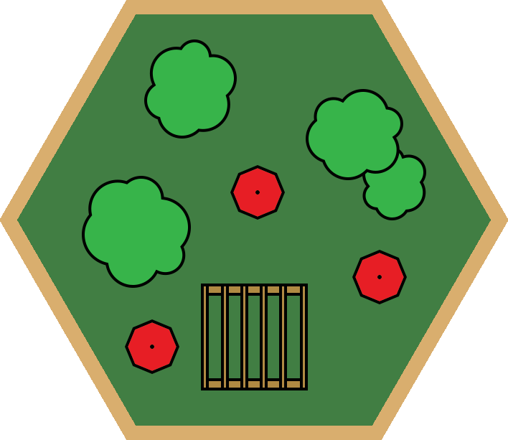
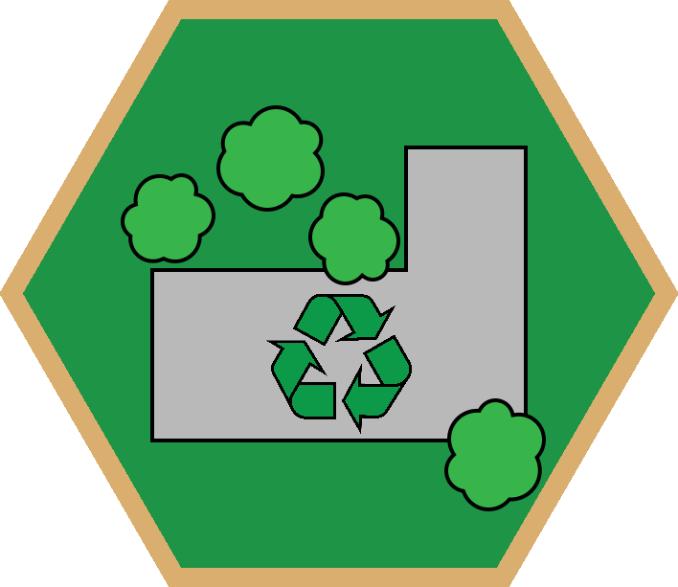
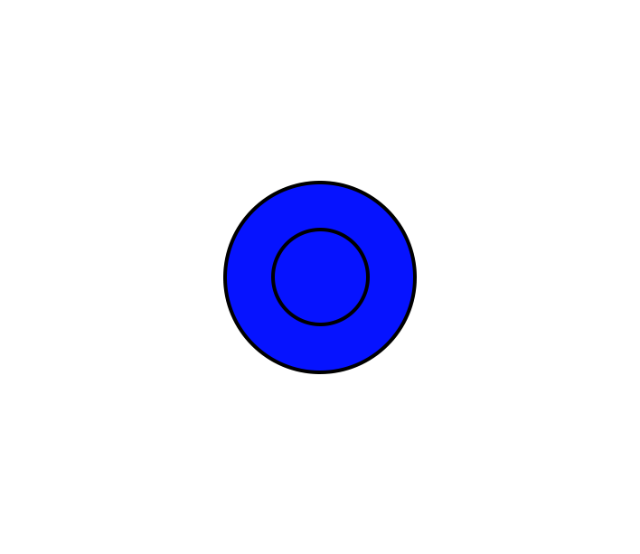
Game Overview
Notes:
Evan
Here is final concept art for the game.
The object of the game is for players to cooperate to sustainably expand Banksia Gardens outwards by gathering resources, trading, crafting, and keeping an eye on waste.
Players traverse the board with a spinner.
Go over game pieces/tiles/cards

Slide 10
Connection to Circular Economies
Notes:
Evan
The general idea of the circular economy in the game is to close the waste loop which is done by players recycling all resources wasted by the social housings (as opposed to letting them go to waste). This teaches sustainable growth because players understand additional houses produce more waste and require consideration to maintain.
Social housings produce 2 waste at the start of each round. Players may recycle this waste back into the economy when they choose by operating the recycler (costs resource to build and resources to operate).
Social housing require 1 food and water each to sustain at the start of each round. If players do not have a composter, these resources are not sustainably used and are wasted (aren’t recycled back into the circular economy)
Additionally, players need to be aware of the amount of resources they are holding – if they have too many at the end of their turn, they must discard them, which teaches sustainable growth.

Slide 11
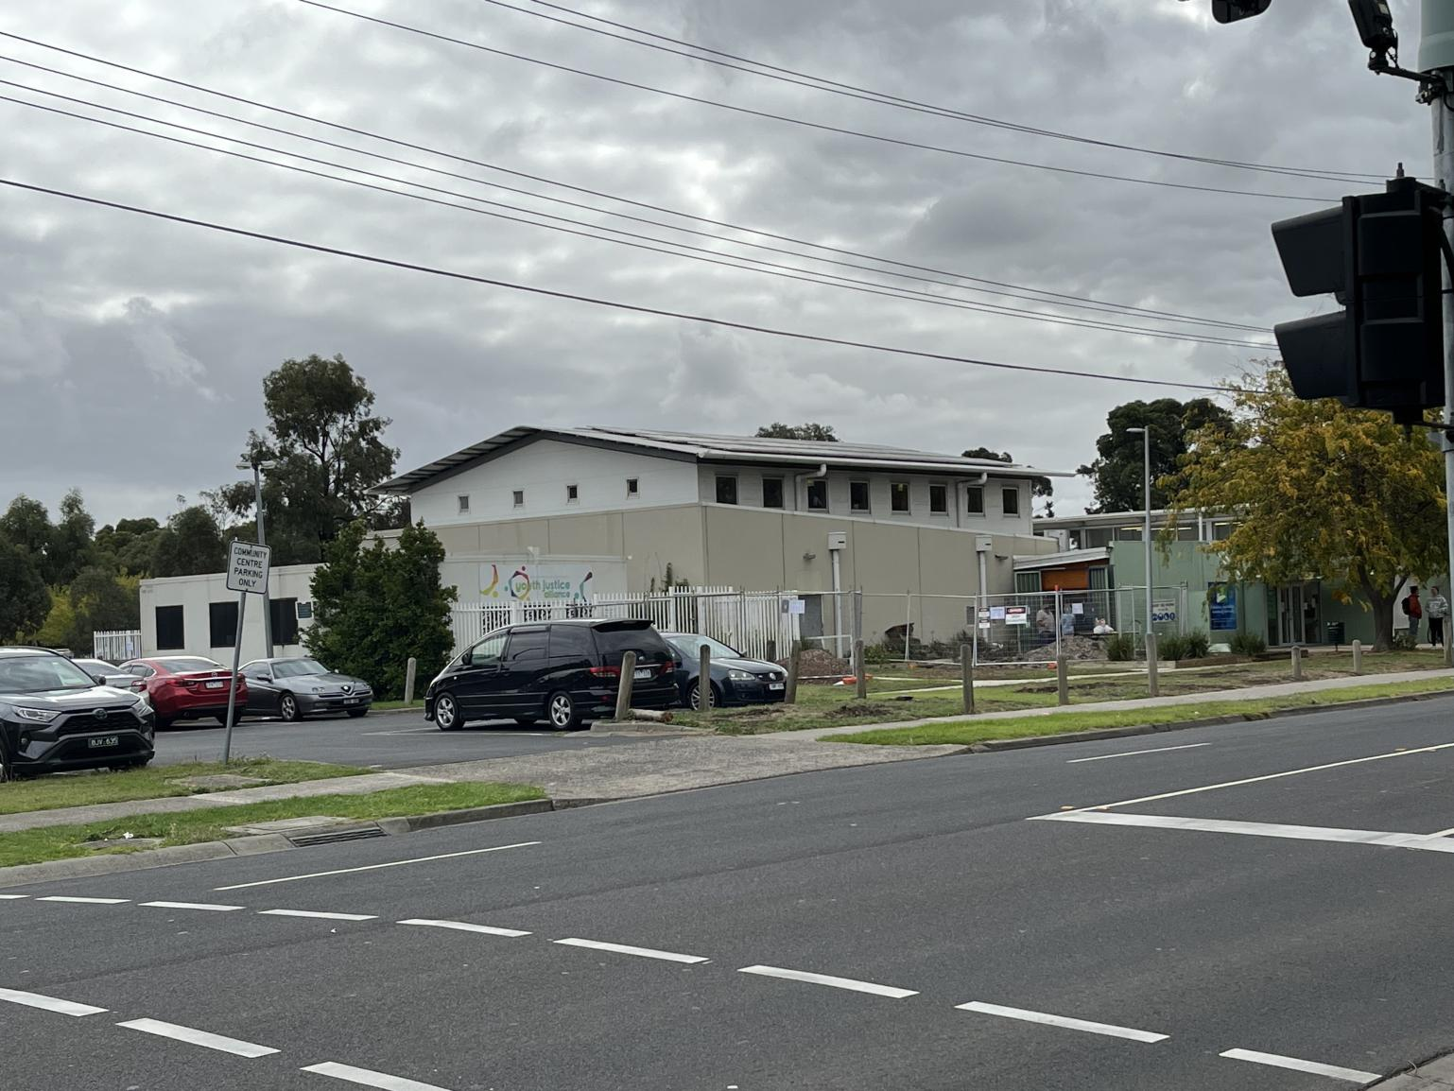
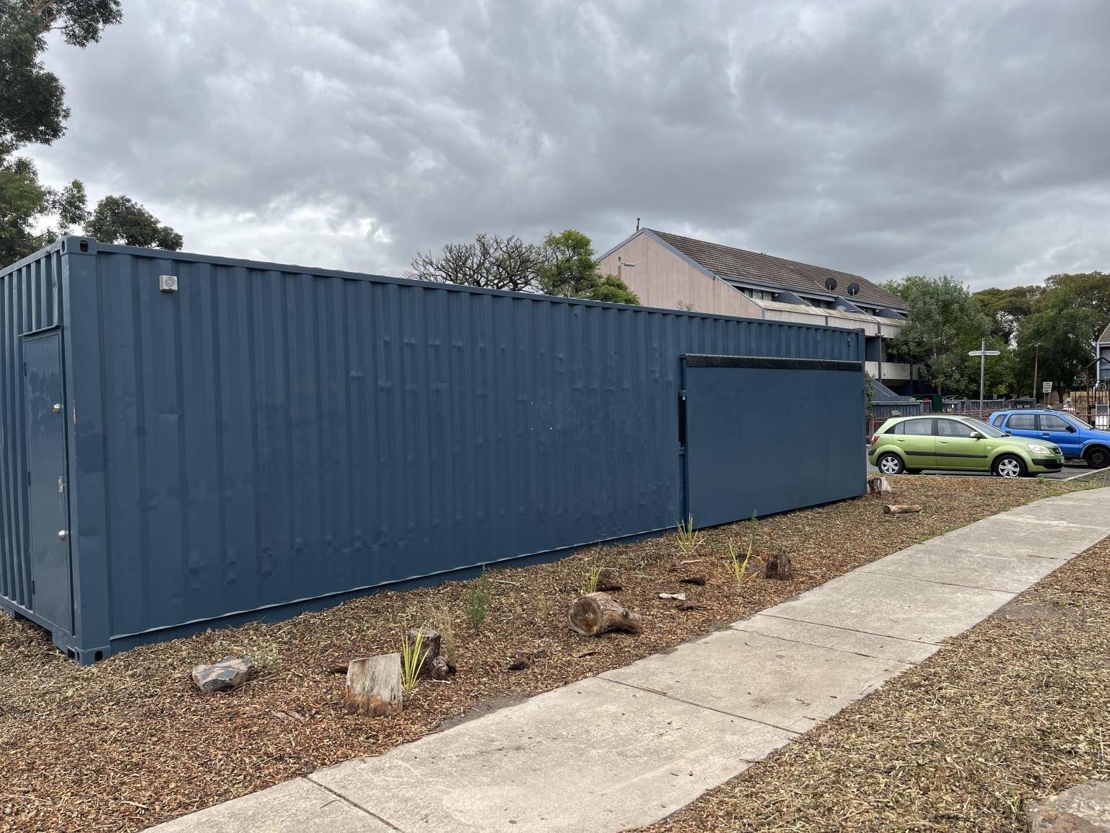
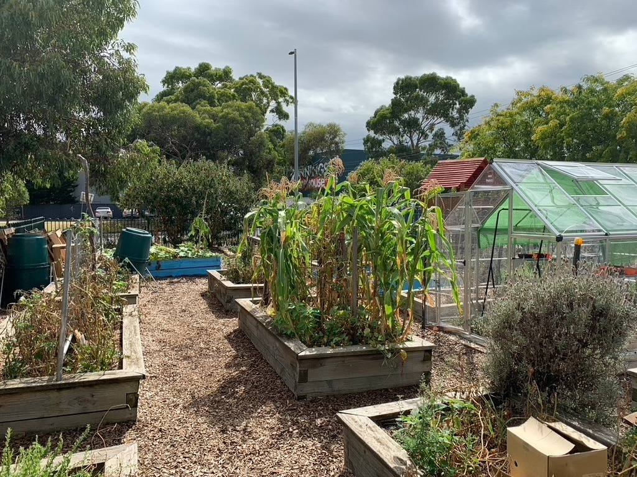
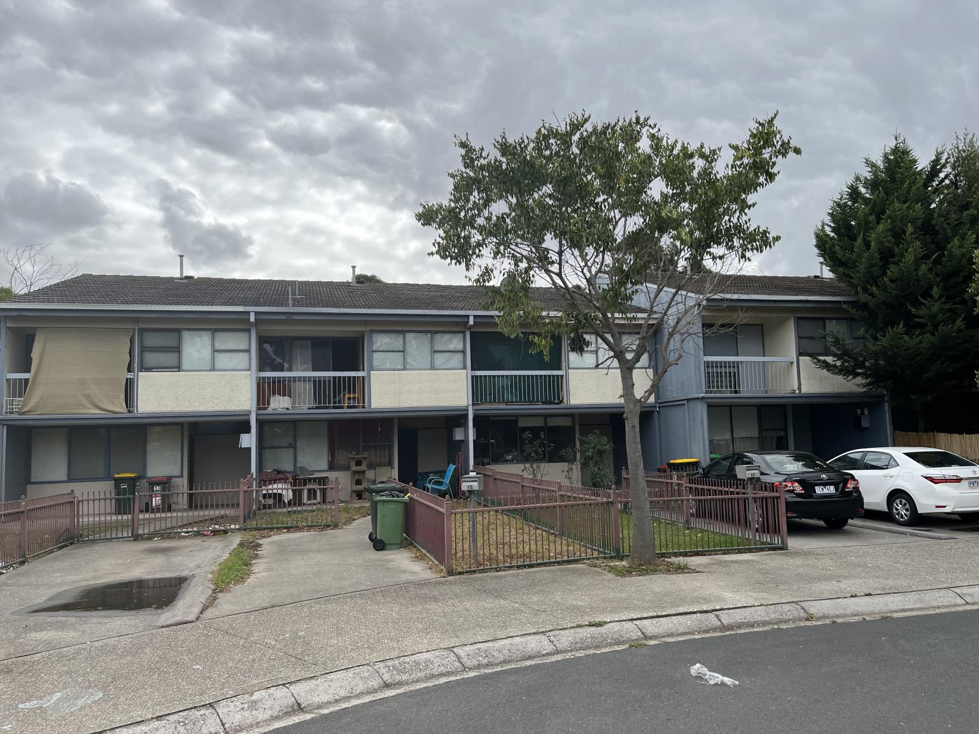
Important BGCS Features for Game Board
Key Features of BGCS
Community Garden
Food Forest
Heat Haven
Social Housing
Additional Features
Bus Stop
Composter
Irrigation System
Shelter
Shipping Containers
Notes:
Sean
Based on discussions and information gathered during the preparation term, it was decided that the board game would present multiple upcoming community initiatives as specific locations. These include:
Community Garden
Heat Haven
Food Forest
These locations were chosen as they not only showcased a variety of Banksia Gardens’ community initiatives related to sustainability but brought alongside them potential in creating engaging gameplay. The Food Forest and Heat Haven in particular are planned to grow in size. Such growth could be represented through the game through player expansion.
In addition, the social housing was chosen to be represented in-game as a way to show the role the community members play in both Banksia Gardens and the circular economy as a whole.
Discussions with our Sponsor helped to finalize the locations and to figure out specific details to be represented in each, such as the presence of shipping containers within the social housing. These details were discussed to help accurately represent the locations and community initiatives showcased and influenced the additional features represented within the game including the:
Bus Stop
Composter
Irrigation System
Shelter
Shipping Containers
Many of these were chosen due to their presence at Banksia, such as the composter and shipping containers, while others, such as the irrigation system and shelter, were created based on the intended purposes of the community initiatives.

Slide 12
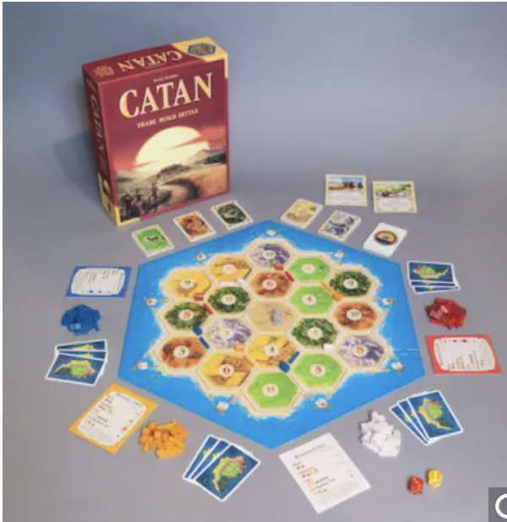
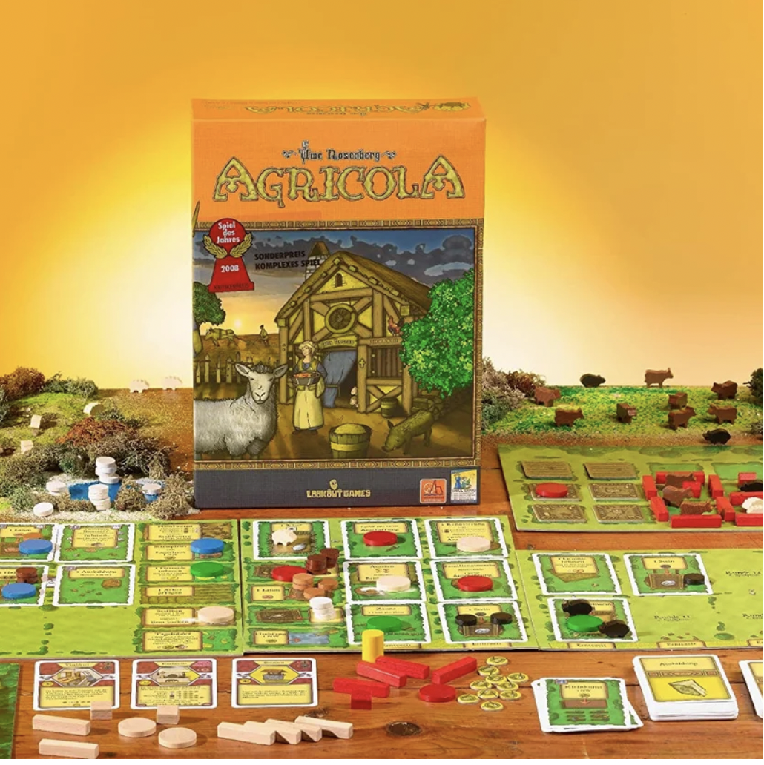
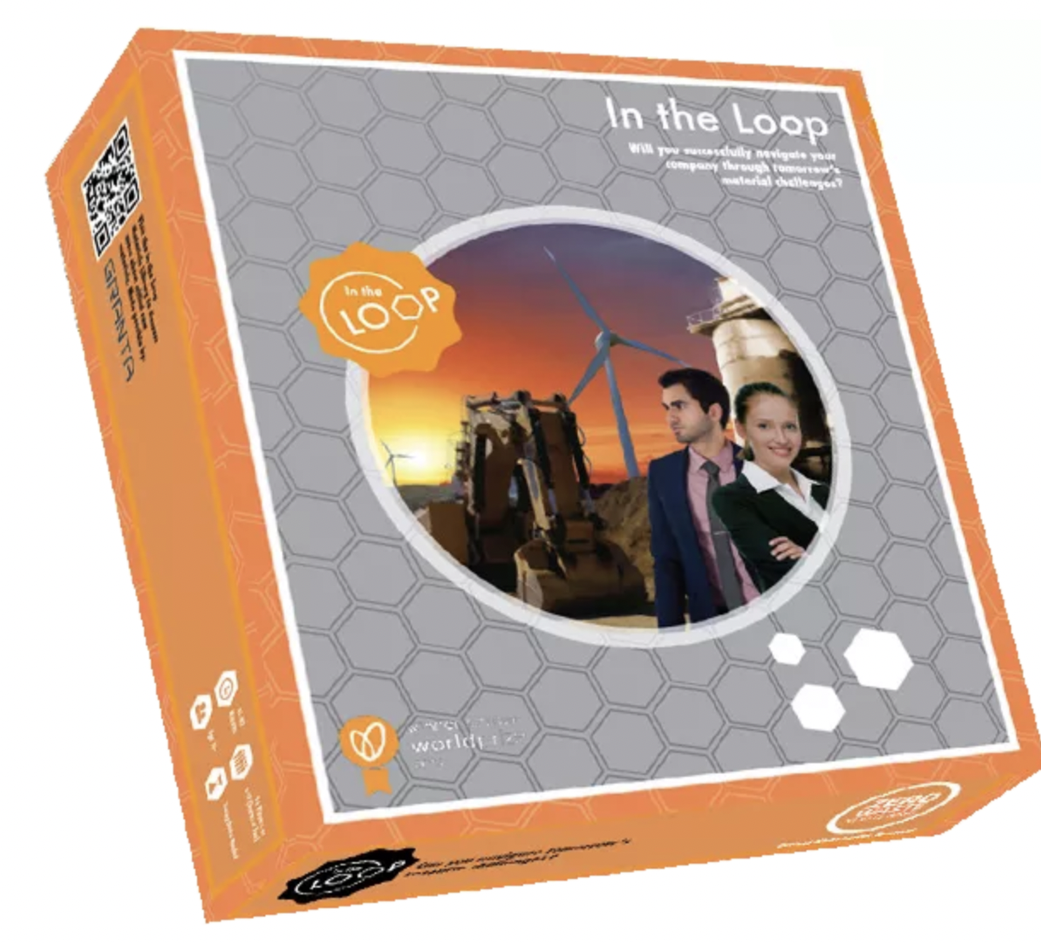
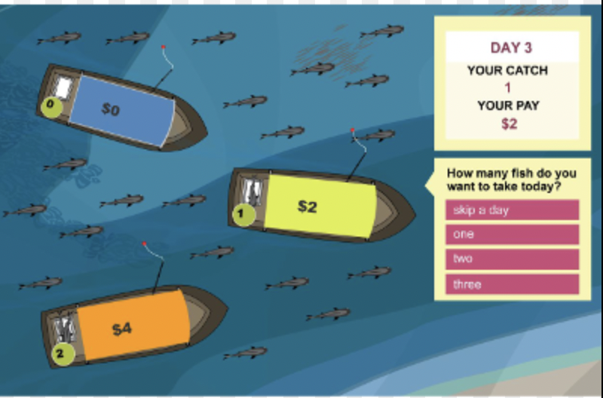
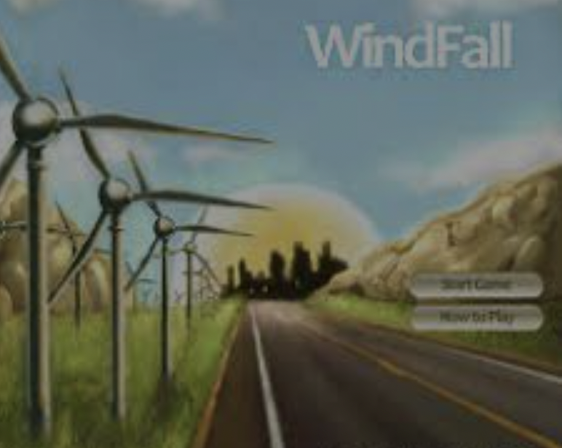
We Played Games to Help Make Our Own Game
Constraints:
Simple (not for kids)
Engaging
Educational
Collaborative
Fast-paced
Features of BGCS
We used a rubric to evaluate different games, focusing on Fun, Difficulty, Aesthetics, and Level of Cooperation
Notes:
Eli
The team picked board games like : And we also explored games for sustainability like
Settlers of Catan
Agricola
In the Loop
The Fish Game
Windfall
When playing the team the team used rubrics to evaluate various aspects of the game like the Fun, Difficulty, Artwork, level of Cooperation, but mainly we kept emphasis on game mechanics and Relevancy to BGCS

Slide 13
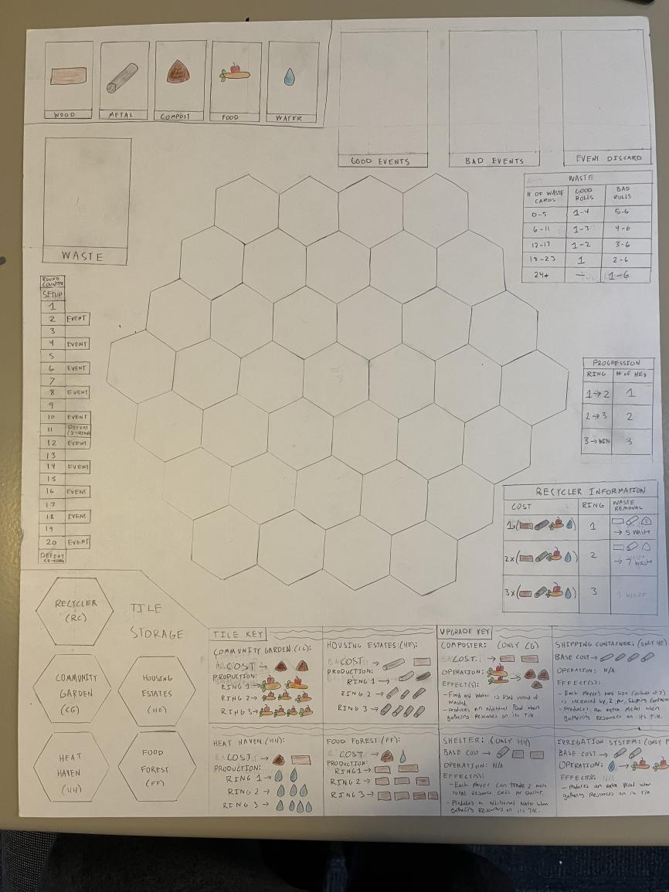
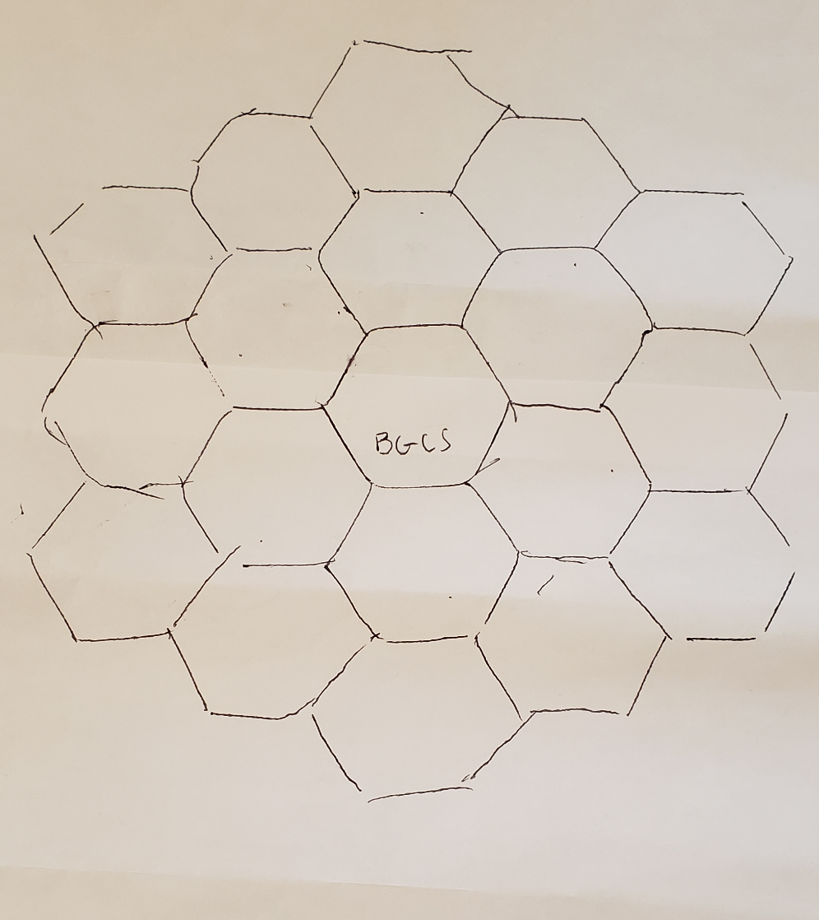
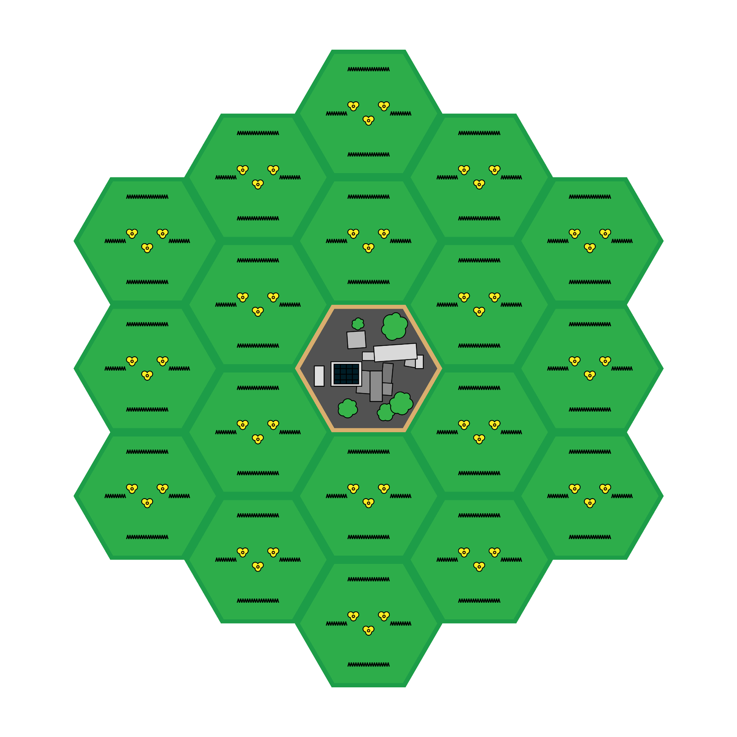
We Began Prototyping
Prototype 0 was a rough draft of the board layout
Catan-like hexagon tiles
Gave us ideas for mechanics
Prototype 1
Complete board using poster board and colored pencils
Most of the pieces present as paper scraps
Several iterations of gaining more info on board, changing costs, etc.
Final product has been created digitally
Zeroth
Prototype
First Prototype
Final Product Concept
Notes:
Jonathan
We created several different prototypes, each with more complexity and effort, as the game mechanics got more and more settled
Prototype 0
Prototype 0 was a very rough draft that was merely the board layout.
It started with the idea to make BGCS a central hub with rings around it
It gave us the ideas for further mechanics such as crafting, movement, etc.
We never played on it, but it was an important piece of the project.
Allowed us to visualize the game at the beginning
Prototype 1
Made it in week 2 of the project
Remade the board layout with Jonathan’s “Unit Hexagon” (which was misshapen)
Used a poster board, pencils, colored pencils
This allowed us to change a lot about the board, such as costs of various craftable things
Adding new things to the board, such as tables of information
Doesn’t have all of the final pieces (spinner, die, tiles, event cards w/ art)
Used an online spinner, die, slips of paper to represent tiles, further RNG for event selection
Prototype 1 went through several iterations of playtesting and subsequently gaining more information on the board
Crafting costs + tile production
Resource reservoirs for resources
Round counter w/ token to not lose position in the game
Progression conditions
Tweaked the maximum amount of each tile/upgrade that players can build (added more resource tiles and recyclers, still need to add more upgrades)
Final Product
Sean has been working on artwork throughout the project by using photoshop
End goal of being printed on chipboard
Separate information and necessary game features into different parts of the board — “Reference Sheets”
Split the board up into different pieces so it’s not just one big poster
Cardboard tiles to place on board when crafted
Actual pieces (would like to 3D print but don’t have resources to)
Real die
Online spinner (link to spinner in rule book)
Print event cards w/ finished art, laminate

Slide 14
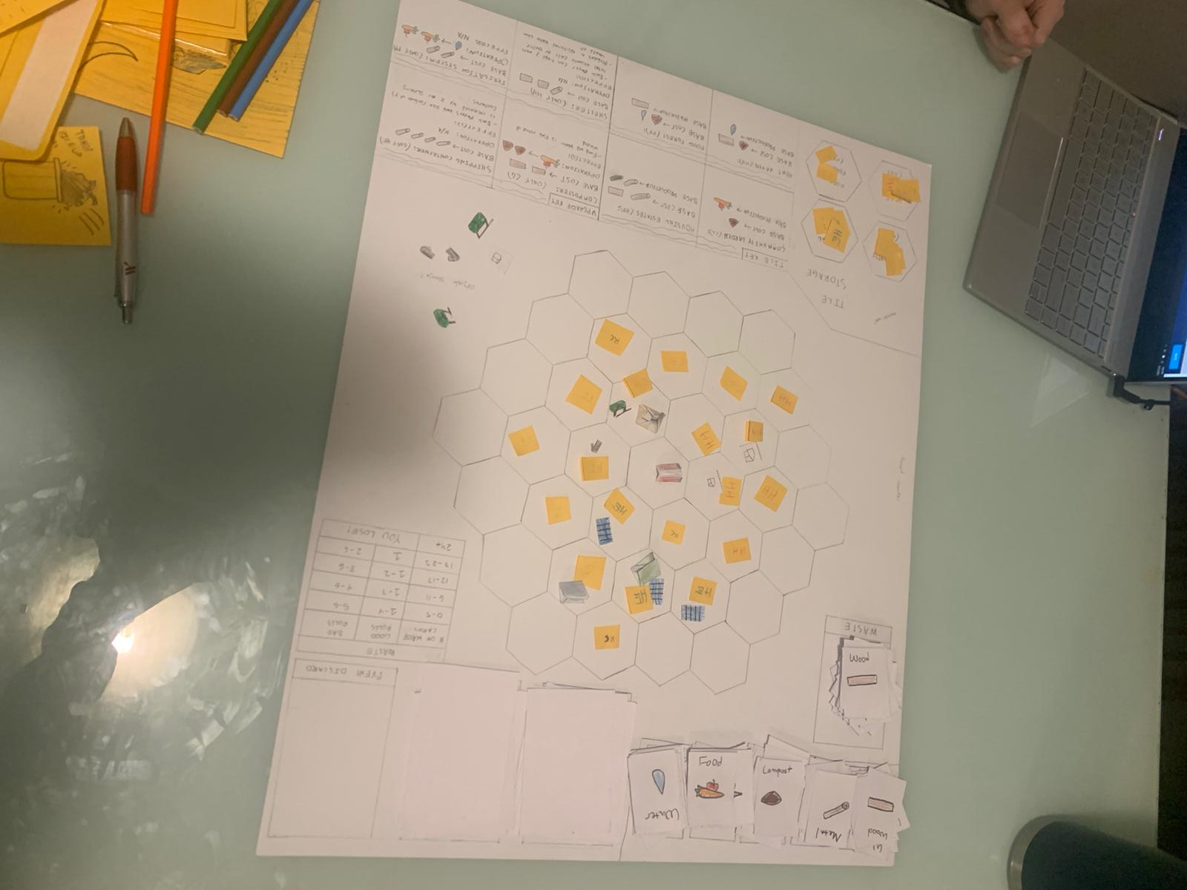
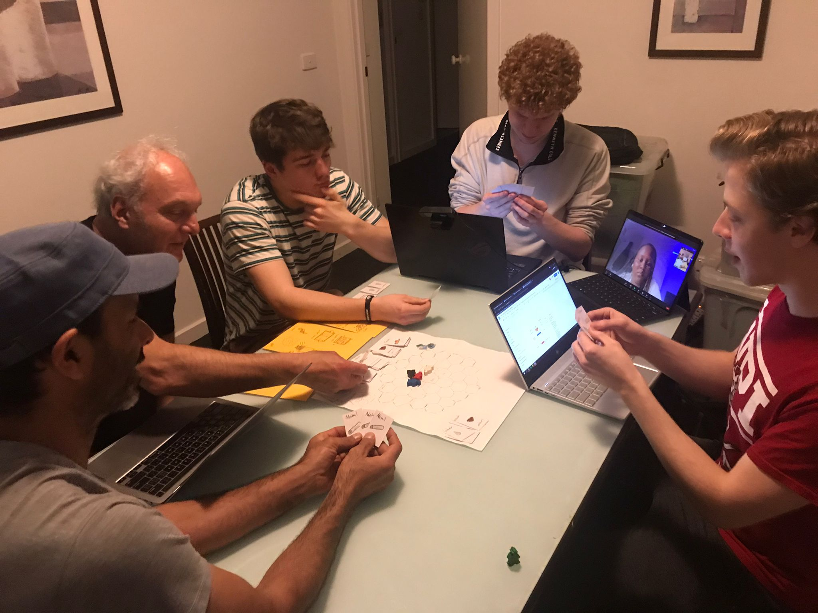
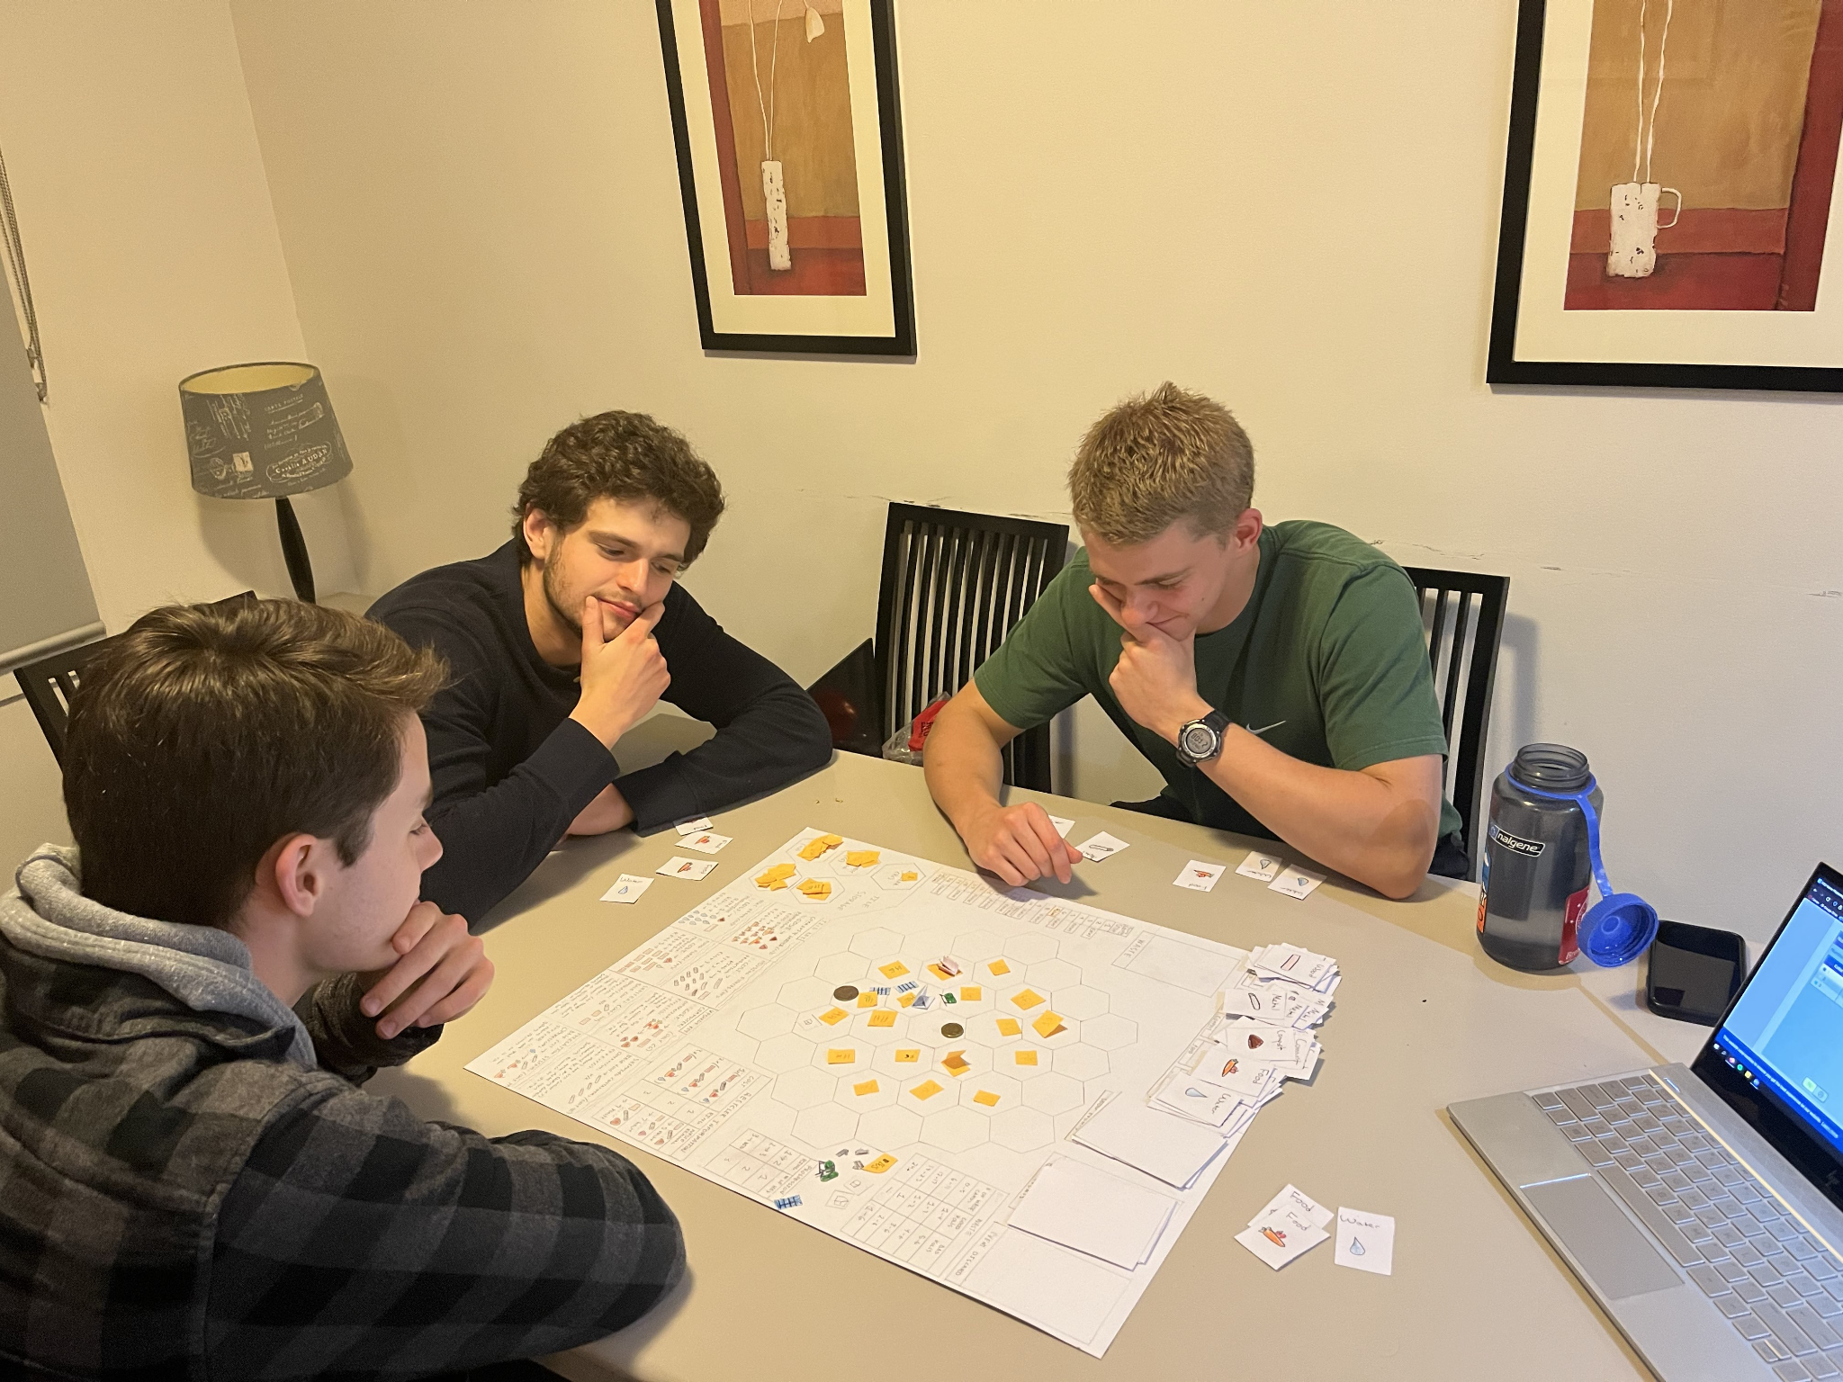
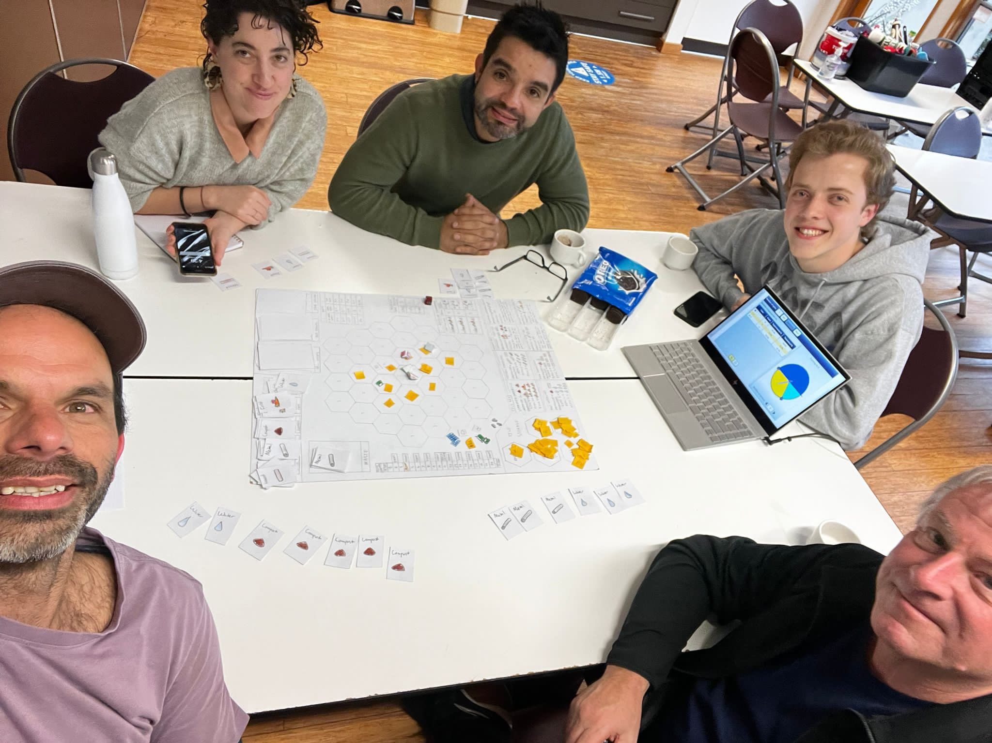
We Tested our Prototypes
Testing among group (kinda)
Initial testing done to make game actually playable & winnable
Overhauled and simplified many features such as turn structure and trading
Testing among cohort and advisors
Confirm intuitiveness of the game
Testing with external people
Confirm educational ability
Individual Testing
Testing with Advisors
Testing with Cohort
Testing with Others
Notes:
Jonathan
Testing among group members:
We started out by doing initial testing within our group to make sure the game was actually playable, winnable, and actually enjoyable.
We overhauled and simplified many large features such as the structure of turns and trading.
Turns were originally moving, gathering resources, taking an action (which was not the same as gathering resources), then trading.
Found that this was too restrictive and slow paced, so we settled on our action → move → action structure and allowed trading at any point during a turn.
We also made many changes to things like costs, power level of certain mechanics, and waste production/removal
Testing among cohort and with advisors:
Once the game was in a balanced enough state that playing it was actually enjoyable, we moved onto testing with other members of our group
This time, since we weren’t playing “perfectly”, it was a good way to make sure the game was still balanced for the average player
The big thing we were testing this time was how intuitive it was, since new players were experiencing our game
We found that the game had a bit of a learning curve (mostly due to the instruction rulebook needing to be structured better), but after playing a couple rounds, players quickly caught on and played well
Several tweaks were made to be more clear, especially regarding to information on the board
Testing with External People
Tested with Caitlin from Circular Economy Victoria, Ian from the Business Network from Hume City Council, and Francisco the bio-medical lecturer from RMIT.
The final stage of testing was to make sure the game was educational and informative enough
General tweaks that don’t necessarily need to be presented on:
Made non-shipping container upgrades more relevant
Switched events to all even rounds
Decreased amount of waste HE produce to flat rate
Changed progression conditions to contain HE (necessitate building of HE to establish circular economies)
Added late-game upgrades that contain large risks if used inappropriately

Slide 15
Recommendations
Creation of the final game board itself
Printing designs on chipboard/cardboards
3D printing of game pieces
Potential further testing and refining with other groups
Digitization
Upcoming project teams could take over this project
Expanding the game beyond Broadmeadows
Accessibility features for colorblindness, etc.
Notes:
Eli

Slide 16
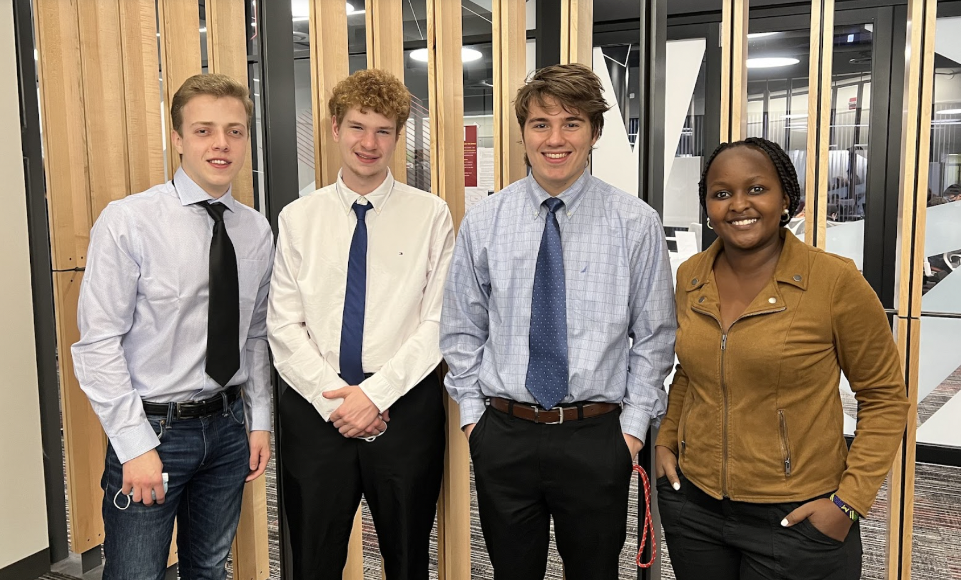
Contact Information
Team: Sean O’Connor, Jonathan Metcalf, Elitumaini Swai, & Evan Vadeboncoeur
Email: gr-m22-game@wpi.edu
Team Website
Advisors: Stephen McCauley and Fabio Carrera
Sponsor: Banksia Gardens Community Services
Sponsor Website
Notes:
Sean

Slide 17
A Question for You…
What should the name of our game be?
Notes:
Sean

Slide 18
Questions?
Notes:
Sean

Slide 19
Bibliography
2016 Census QuickStats: Broadmeadows. (n.d.). Retrieved February 14, 2022, from
https://quickstats.censusdata.abs.gov.au/census_services/getproduct/census/2016/quickstat/210051242
About Us—Banksia Gardens Community Services. (2022). https://banksiagardens.org.au/about-us/
Abram, N. J., Henley, B. J., Sen Gupta, A., Lippmann, T. J. R., Clarke, H., Dowdy, A. J., Sharples, J. J., Nolan, R. H., Zhang, T., Wooster, M. J., Wurtzel, J. B., Meissner, K. J., Pitman, A. J., Ukkola, A. M., Murphy, B. P., Tapper, N. J., & Boer, M. M. (2021). Connections of climate change and variability to large and extreme forest fires in southeast Australia. Communications Earth & Environment, 2(1), 1–17. https://doi.org/10.1038/s43247-020-00065-8
Caballero, E. (2022). Banksia Gardens—Concept design Community Square. Wild Urban Green. https://www.wildurbangreen.com.au/
Circular-economy-related opportunities. (2022). Circular-economy-related opportunities. https://themasites.pbl.nl/o/circular-economy
Employment status | Hume City | Community profile. (2022). https://profile.id.com.au/hume/employment-status?WebID=120
Halog, A., Balanay, R., Anieke, S., & Yu, T. Y. (2021). Circular Economy across Australia: Taking Stock of Progress and Lessons. Circular Economy and Sustainability, 1(1), 283–301. https://doi.org/10.1007/s43615-021-00020-5
Hume Regional Climate Change Adaptation Strategy. (2021, December 17). Engage Victoria. https://engage.vic.gov.au/hume-regional-climate-change-adaptation-strategy
Mohapatra, M., Doan, M.-C. D., & Dominguez, S. A. (2020, March 5). Climate Adaptation Requires Youth Action: Creating the C.A.R.Y.A. Program Framework. Worcester Polytechnic Institute.
Museum, A. (2022). Impacts of Climate Change. The Australian Museum. https://australian.museum/learn/climate-change/climate-change-impacts/australian.museum/learn/climate-change/climate-change-impacts/
News item—2020 Large-scale Renewable Energy Target capacity achieved. (n.d.). Retrieved February 14, 2022, from http://www.cleanenergyregulator.gov.au/About/Pages/News%20and%20updates/NewsItem.aspx?ItemId=683&ListId=19b4efbb-6f5d-4637-94c4-121c1f96fcfe
News item—Australia reaches the 3 million solar milestone. (2022). http://www.cleanenergyregulator.gov.au/ERF/Pages/News%20and%20updates/News-item.aspx?ListId=19b4efbb-6f5d-4637-94c4-121c1f96fcfe&ItemId=1016
Pollard, G., Ward, J., & Roetman, P. (2018). Water Use Efficiency in Urban Food Gardens: Insights from a Systematic Review and Case Study. Horticulturae, 4(3), 27. https://doi.org/10.3390/horticulturae4030027
Notes:
Sean

Slide 20
Bibliography (Cont.)
Prototyping Webdesign. (2022). https://pixabay.com/photos/ux-prototyping-design-webdesign-788002/
Shu, J., Qu, J. J., Motha, R., Xu, J. C., & Dong, D. F. (2018). Impacts of climate change on hydropower development and sustainability: A review. IOP Conference Series: Earth and Environmental Science, 163, 012126. https://doi.org/10.1088/1755-1315/163/1/012126
Stahel, W. R. (2016). The circular economy. Nature, 531(7595), 435–438. https://doi.org/10.1038/531435a
Stanitsas, M., Kirytopoulos, K., & Vareilles, E. (2019). Facilitating sustainability transition through serious games: A systematic literature review. Journal of Cleaner Production, 208, 924–936. https://doi.org/10.1016/j.jclepro.2018.10.157
The Fish Game. (2022). Games4Sustainability. Retrieved February 14, 2022, from https://games4sustainability.org/gamepedia/the-fish-game/
Types, Methods and Importance of Irrigation (Watering Crops)—Conserve Energy Future. (2020, July 17). https://www.conserve-energy-future.com/types-methods-importance-irrigation.php
https://unsplash.com/photos/NrS53eUKgiE
Unsplash. (2021, January 4). Photo by Noémie Cauchon on Unsplash. Beautiful Free Images & Pictures | Unsplash. https://unsplash.com/photos/Y_bpePELbP
Unsplash. (2019, March 5). Photo by Amy Hirschi on Unsplash. Beautiful Free Images & Pictures | Unsplash. https://unsplash.com/photos/JaoVGh5aJ3E
Unsplash. (2020, January 1). Photo by national cancer institute on Unsplash. Beautiful Free Images & Pictures | Unsplash. https://unsplash.com/photos/xDSD3Vmzh70
WHO | Climate change. (2022). WHO; World Health Organization. https://www.who.int/heli/risks/climate/climatechange/en/
WPI in Melbourne. (n.d.). Banksia Gardens Community Services. Retrieved February 14, 2022, from https://banksiagardens.org.au/wpi-in-melbourne/
Notes:
Sean

Slide 21
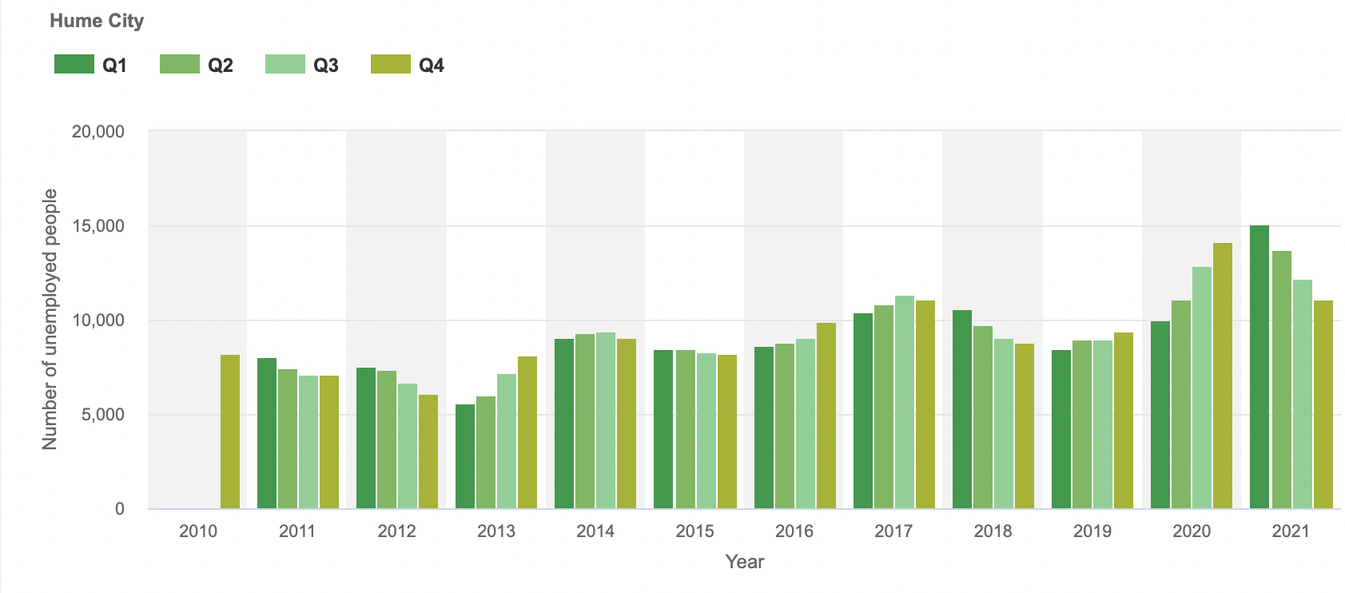
Climate Change Affects Disadvantaged Communities More
Unemployment Profile for the Hume City
Notes:
Eli
Pose question: Did you know : Disadvantaged communities, bear the most of the effects of climate change compared to other developed areas around the world?
Climate change has been a significant problem in the world , but more so Australia has been affected significantly. This has been noticed through various events like the increased temperatures from intense heat waves , droughts leading to food insecurities. Researchers have even reported that Melbourne had 3000 extra deaths in 2019 as a result of intense heat waves.
Broadmeadows community being one of the disadvantaged areas in Melbourne , have been main victims . Broadmeadows is a suburb of about 12,000 people located in the northern region of Melbourne in the city of Hume; There are many issues prevalent in the area, including high rates of unemployment of about 15.9% as of 2016, and high crime levels.
Our game aims to engage the Broadmeadows community with ways in which they can mitigate around the climate change impacts.
End
https://www.smh.com.au/environment/climate-change/trend-towards-worsening-heatwaves-is-accelerating-new-research-finds-20200703-p558s8.html - 1st Image
https://www.theguardian.com/australia-news/2018/aug/04/australias-drought-crisis-and-farmers-stories-of-anxiety-fear-and-resilience -
https://ideas.ted.com/famine-extinction-natural-disasters-takeaways-from-the-new-2022-ipcc-report/ 2nd image
https://www.climatecouncil.org.au/resources/hard-to-swallow-how-climate-change-is-affecting-australian-food/ - info on crops threats and food insecurities
https://profile.id.com.au/hume/employment-status?WebID=120 - Broadmeadows as a disadvantaged community
https://economy.id.com.au/hume/unemployment

Slide 22
Banksia Gardens Community Services (BGCS)
Banksia Gardens
Social Housing
Notes:
Jonathan
BGCS:
On the left is a photo of part of Banksia Gardens Community Services, or BGCS
BGCS is a community service organization in the Broadmeadows area
BGCS has collaborated with WPI since 2010
They have many initiatives to combat climate change through educational programs focused on sustainability and preservation.
The overall goal of these programs is to create awareness for climate change and engage the community.
Social Housing:
On the right is a photo of part of the social housing around BGCS
I would like to first point out that there are lots of cats, even though it’s hard to see any in this photo
The social housing is a place for the families around the area to have a place to live
BGCS runs some events such as the community planting day in an area in the middle of the social housing, which strengthens the community

Slide 23
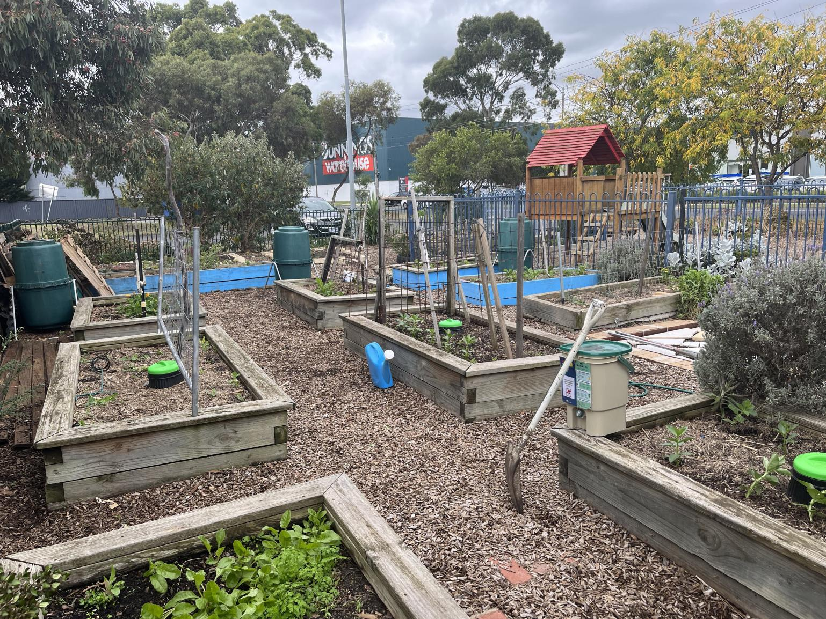
Some BGCS Features
Community Garden
Shipping Containers
Notes:
Jonathan
Community Garden:
The purpose of BGCS’s Community Garden is to educate community members with gardening knowledge and life skills
It promotes sustainable food sources and is volunteer-run, which helps provide a sense of ownership to the community members using it.
It produces food for their food relief program, which assists the most vulnerable members of the community with getting food.
Shipping Containers:
BGCS recently added some shipping containers to an area in the social housing where they are also doing further plantings.
The shipping containers are used for storage and also a place to sit in some shade
They were used during the community planting day we went to for kids to do activities inside while people planted

Slide 24
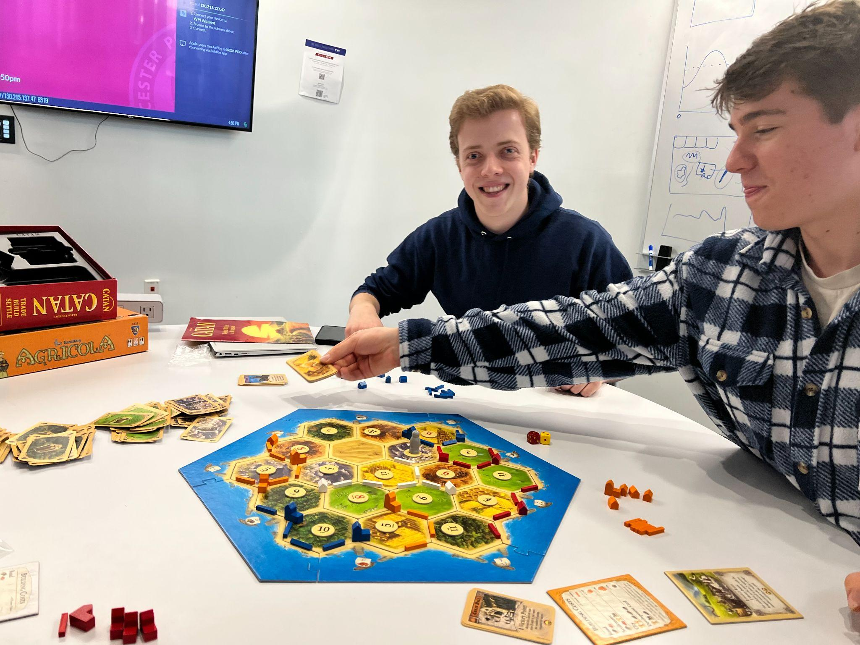
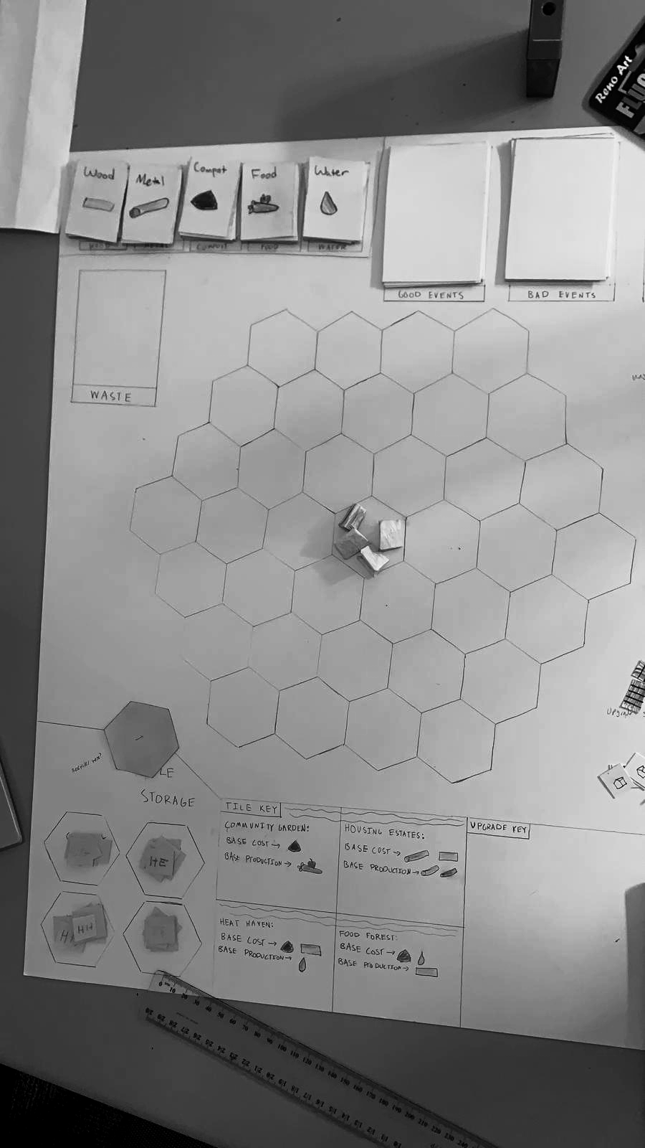
We Determined Design Constraints For Our Game
Simple
Engaging
Educational
Collaborative
Fast-paced
Features of BGCS
‹#›
Notes:
Sean
When beginning the process of designing the game, several design constraints were placed onto it, both self-imposed and inherent.
Based on the gaming research, constraints created by the team were that the game had to be simple in concept, engaging to play, provide educational value pertaining to circular economies, emphasize collaboration between players, and stay fast paced. These design constraints were inspired by games played such as Catan and Agricola. Catan inspired the desire to create a simple game, one that was easy to pick up and learn but remained engaging and collaborative.
Agricola was used as an influence in what to try and avoid, specifically the difficult learning curve and slow pacing, but was also seen as a great example of how to teach players about a subject matter through the gameplay.
Features of Banksia Gardens were an inherent design constraint placed onto the game, as the game not only had to represent the concepts of circular economy but also Banksia Gardens itself. The community initiatives were chosen to be represented within the game due to this constraint.

Slide 25
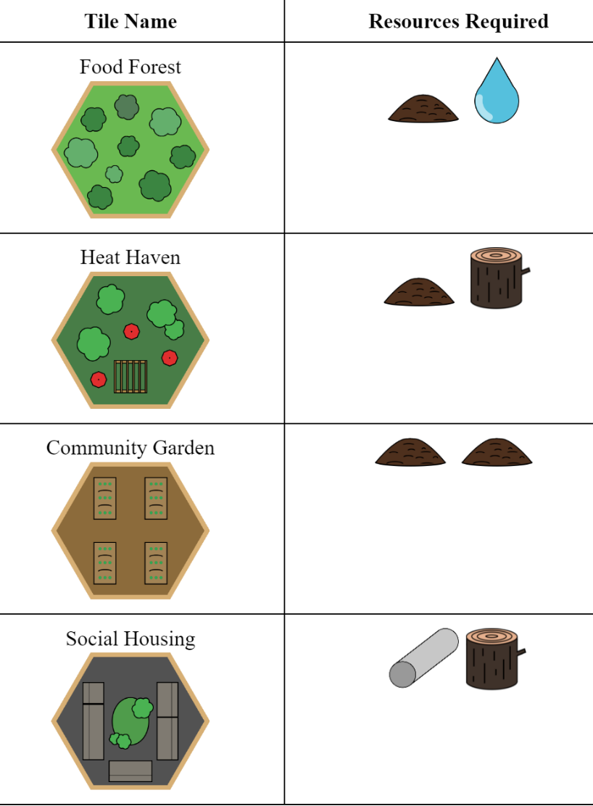
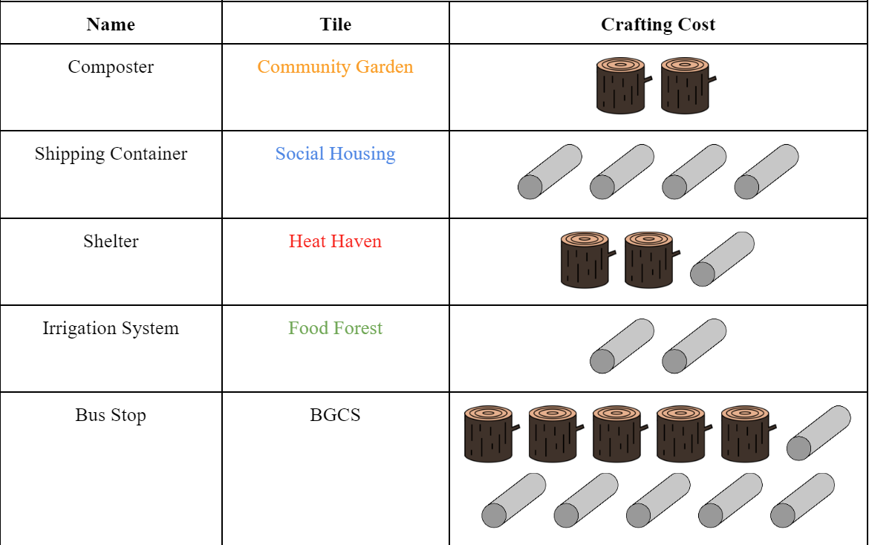
Game Mechanics – Trading and Crafting
Upgrade Crafting Costs
Tile Crafting Costs
Notes:
Evan
Brief overview of some of the game’s mechanics - the manual as it stands is 17 pages and counting.
Crafting allows players to create tiles or upgrades that are the different Banksia initiatives or aspects of those areas, familiarizing players with all of the sustainable programs BGCS offers
Players “Use” resources when they craft, meaning they aren’t wasted, and go back into the resource bank, as these items are now in the circular economy
Players may craft HH, FF, CG, SH, REC tiles
Upgrade them with Shelter, Irrigation System, Composter, Shipping Container
Wasting refers to discarding Resource cards into the Waste pile, which is communal for all players, since in the real world, each of our individual actions affects the environment
Waste level determines the probability players may get good or bad events
If waste level too high (> 24 cards), players lose the game
Food and water are wasted until composter is built as they aren’t used sustainably to make compost
SH produce 2 waste at the start of each round as an upkeep
Shows the cost to sustain people
Players Need to be able to handle the consequences of what they build
Recycling refers to returning Resource cards back from the Waste pile into the Resource Bank. this is communal for all players, since they all get access to these Resources again, representing how people can affect the environment positively as well.
Several different ways to recycle Waste, primarily through use of the Recycler, which is a Tile that recycles Waste if certain Resources are “Used”
Also certain events such as Trash Pickup Day recycle some waste
Players are also allowed to trade with each other with some restrictions, such as being connected through a chain of players and only up to a certain limit of resources. These restrictions are strict enough to ensure the mechanic isn’t overpowered, yet lenient enough that trading is still a powerful mechanic that players should take advantage of. The goal of this mechanic is to emphasize the cooperative nature of the game.
Events are global events that affect all players that occur on certain rounds, and require the players to work together.
Bad events such as heat waves or droughts that can require players to Use their resources to negate bad effects
Good events in which all players can reap the benefits
Probability of good and bad events are based on the amount of Waste
Highlights the “runaway” effect of climate change – you have to be careful to not waste too much or you will get more bad effects and dig yourself deeper

Slide 26
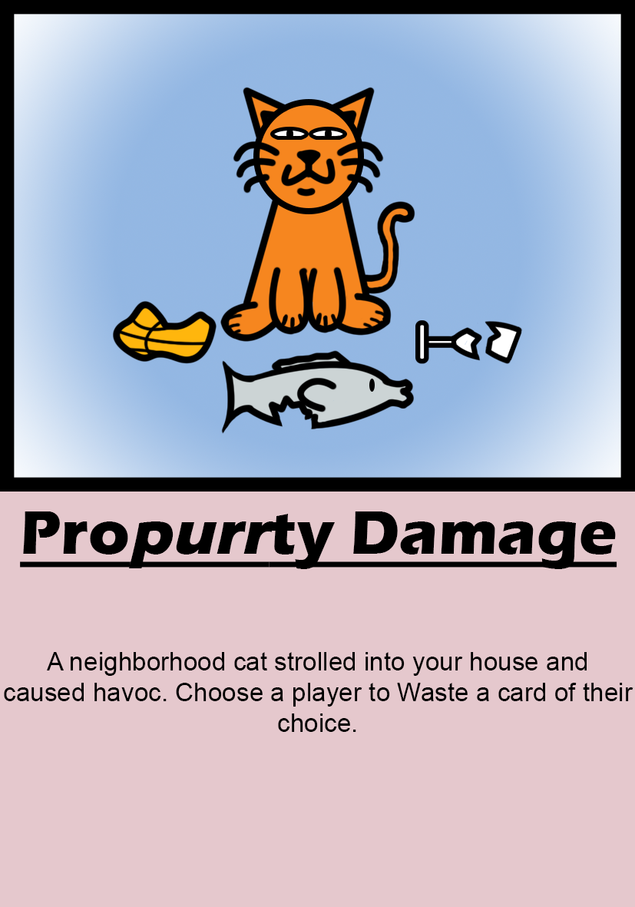
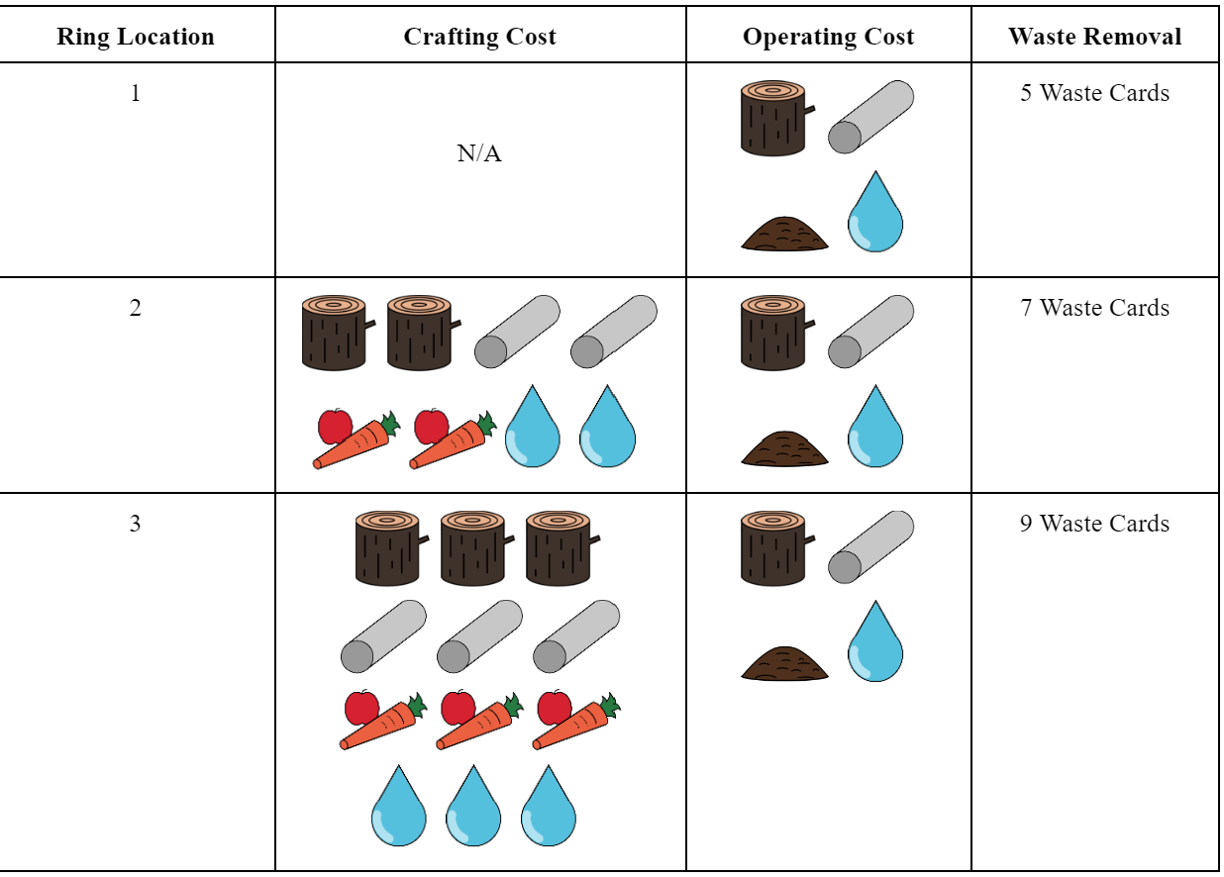
Game Mechanics – Wasting, Events & Recycling
Event Example
Recycling
Notes:
Evan
Brief overview of some of the game’s mechanics - the manual as it stands is 17 pages and counting.
Crafting allows players to create tiles or upgrades that are the different Banksia initiatives or aspects of those areas, familiarizing players with all of the sustainable programs BGCS offers
Players “Use” resources when they craft, meaning they aren’t wasted, and go back into the resource bank, as these items are now in the circular economy
Players may craft HH, FF, CG, SH, REC tiles
Upgrade them with Shelter, Irrigation System, Composter, Shipping Container
Wasting refers to discarding Resource cards into the Waste pile, which is communal for all players, since in the real world, each of our individual actions affects the environment
Waste level determines the probability players may get good or bad events
If waste level too high (> 24 cards), players lose the game
Food and water are wasted until composter is built as they aren’t used sustainably to make compost
SH produce 2 waste at the start of each round as an upkeep
Shows the cost to sustain people
Players Need to be able to handle the consequences of what they build
Recycling refers to returning Resource cards back from the Waste pile into the Resource Bank. this is communal for all players, since they all get access to these Resources again, representing how people can affect the environment positively as well.
Several different ways to recycle Waste, primarily through use of the Recycler, which is a Tile that recycles Waste if certain Resources are “Used”
Also certain events such as Trash Pickup Day recycle some waste
Players are also allowed to trade with each other with some restrictions, such as being connected through a chain of players and only up to a certain limit of resources. These restrictions are strict enough to ensure the mechanic isn’t overpowered, yet lenient enough that trading is still a powerful mechanic that players should take advantage of. The goal of this mechanic is to emphasize the cooperative nature of the game.
Events are global events that affect all players that occur on certain rounds, and require the players to work together.
Bad events such as heat waves or droughts that can require players to Use their resources to negate bad effects
Good events in which all players can reap the benefits
Probability of good and bad events are based on the amount of Waste
Highlights the “runaway” effect of climate change – you have to be careful to not waste too much or you will get more bad effects and dig yourself deeper

