Slide 1
Impacts of Covid-19 on water usage
David Datta, Pranjal Mann, Patrick Spillane

Slide 2
OVerview
The COVID-19 pandemic disrupted everyday life across the globe. Understanding the impact is critical, especially in areas essential to life like water usage.
Notes:
DD

Slide 3
Focus Points
Initial Approach:
How was water usage in Massachusetts impacted by the COVID-19 pandemic and its corresponding policies?
Reaching further:
What was the state of water infrastructure BEFORE the COVID-19 pandemic (problems, complications, etc.) and how did the pandemic and its corresponding policies affect this infrastructure?
Notes:
DD

Slide 4
Why does it matter?
Our research helps identify compliance with regulations and standards and provides insight into how water use behaviors might change in the long term.
Notes:
PS

Slide 5
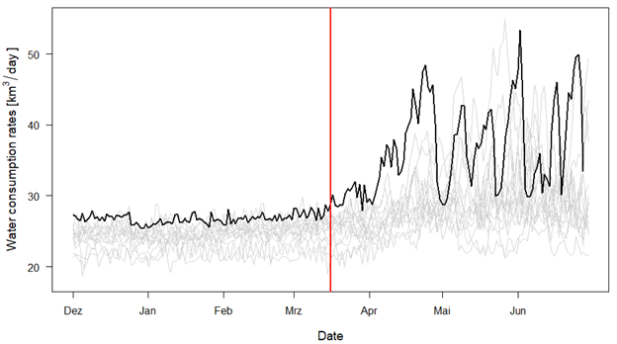
COVID-19 effects on water USE
Outside Massachusetts, household water consumption rates increased immediately following pandemic policies
Notes:
PS

Slide 6
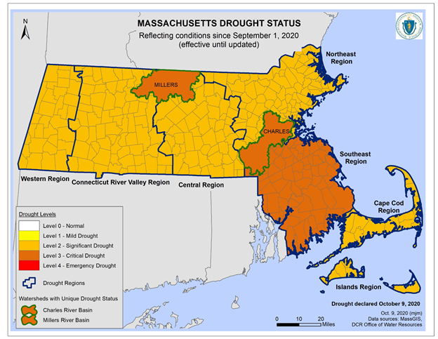
Drought’s impact on water
2020 Drought
Droughts lead to increased water demand for irrigation and drinking water supply
Notes:
PS

Slide 7
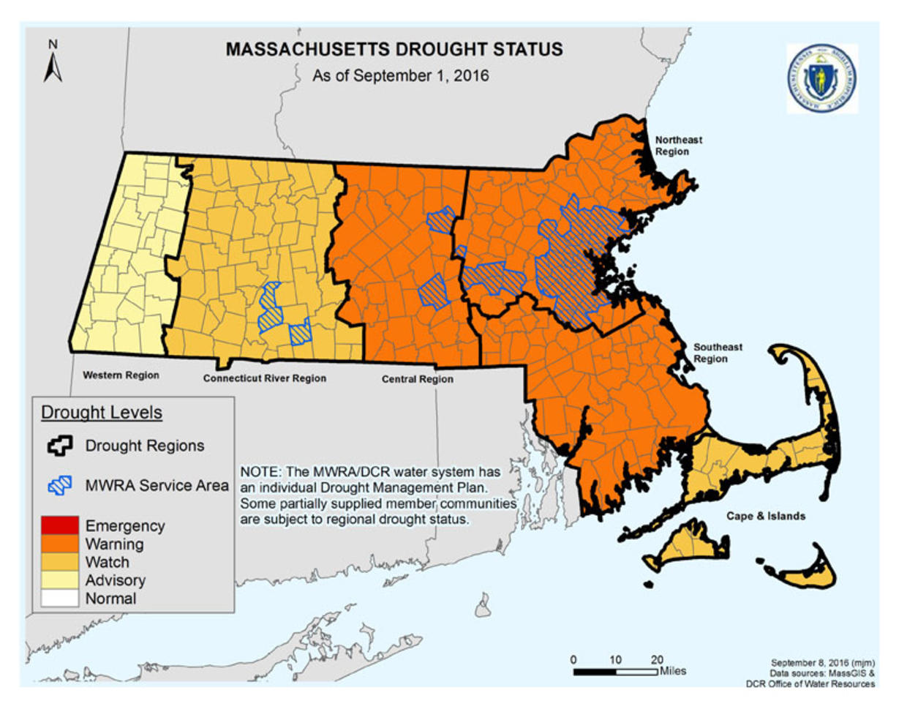
Drought’s impact on water
2016 Drought
Both the pandemic and a drought occurred in 2020, and therefore we use the 2016 drought as a control to identify pandemic influences on water.
Notes:
PS

Slide 8
Methods
Identify Pandemic’s Effect on Water Usage in MA
How did water use change?
Why did water use change?
Organize Data
Analyze/Identify Patterns and Trends
Mapping water use against socioeconomic factors

Slide 9
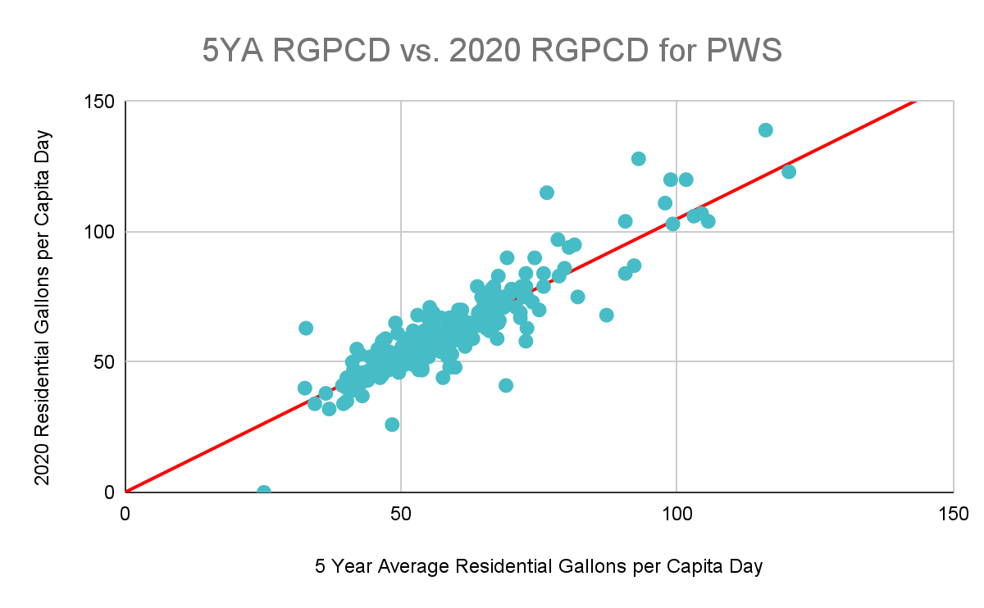
Analyzing Patterns/trends
Residential gallons per capita day public water suppliers

Slide 10
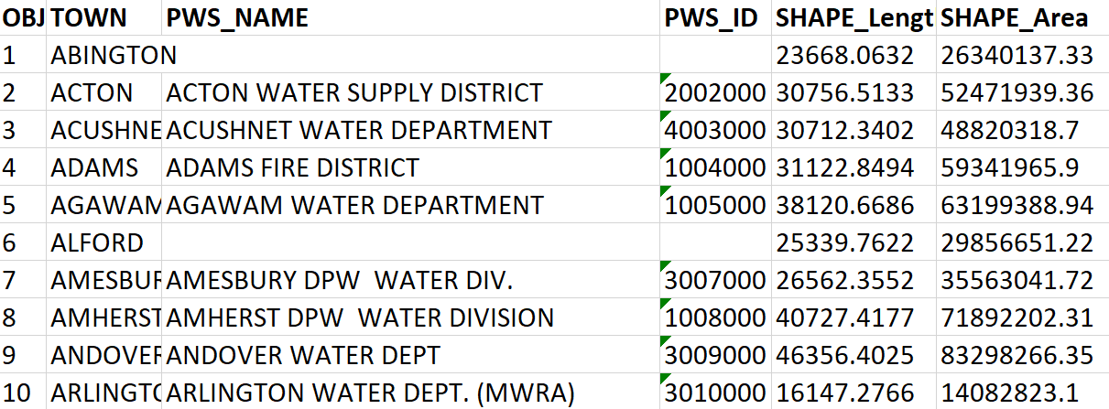
Mapping against income

Slide 11
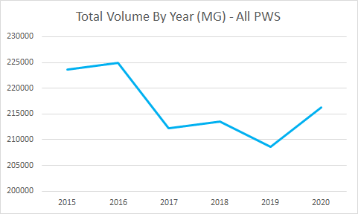
Results
Total volume of water across all of MA did not change significantly.

Slide 12
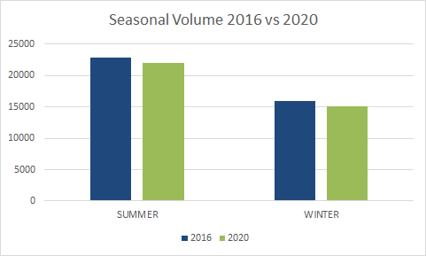
Results
The seasonal changes in water volume between drought years were consistent with other years, allowing us to ignore drought impacts on water.

Slide 13
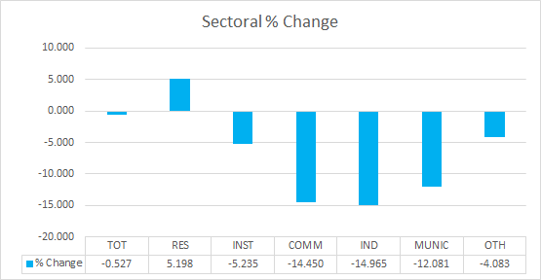
Results
Water usage shifted from the non-residential sectors towards the residential sector.
Note: The agricultural sector is not shown due to scale, agriculture makes up an insignificant amount of water in MA but increased by ~33.4% in 2020.

Slide 14
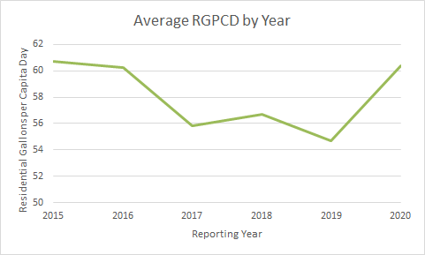
Results
Residential water use per capita per day increased by ~5% in 2020 compared to previous years.
65
77
214
202
Residential gallons per capita day (RGPCD) is the number of gallons of water used, on average, each day by a resident for purposes such as washing clothes, flushing toilets, showering and lawn watering
Notes:
PS

Slide 15
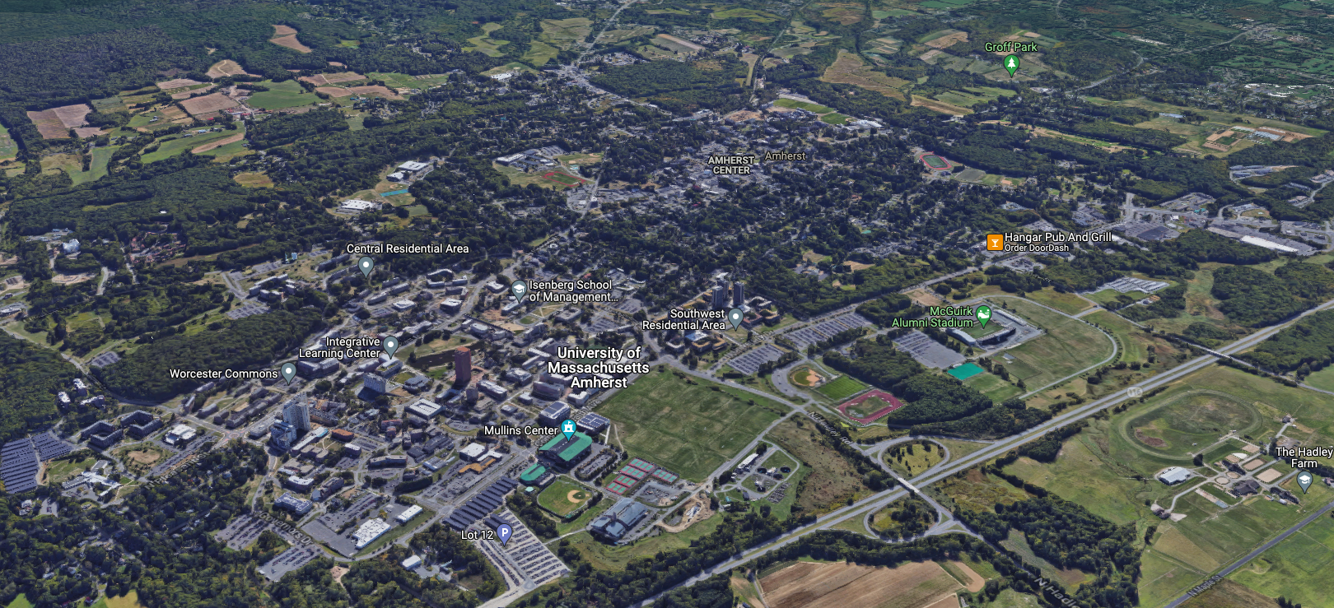
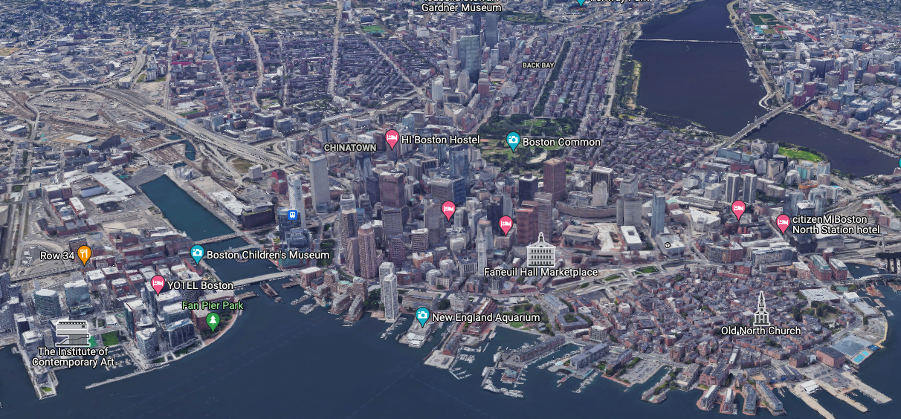
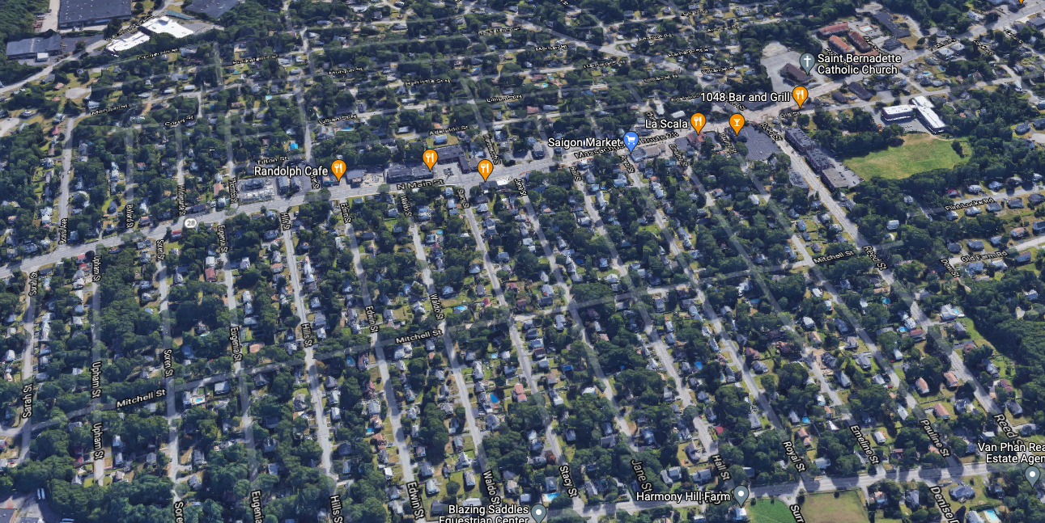
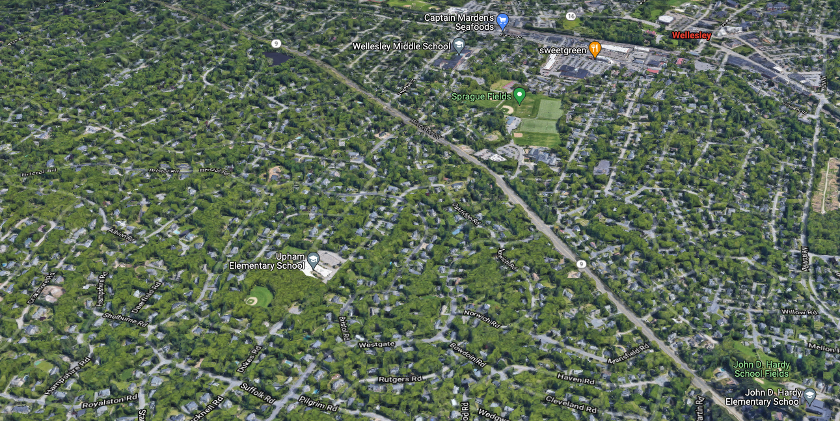
Amherst
Boston
FurtHer Look into Amherst, Boston, Randolph, and Wellesley
Randolph
Wellesley

Slide 16
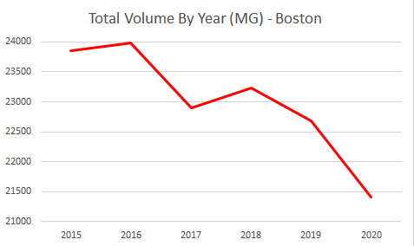
Results
Boston’s total volume consumption in 2020 was comparatively less than the average of 2015-2019.

Slide 17
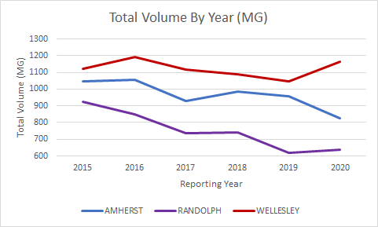
Results
Amherst and Randolph saw a slight decrease in total water use, while Wellesley had a insignificant increase in total volume consumption.

Slide 18
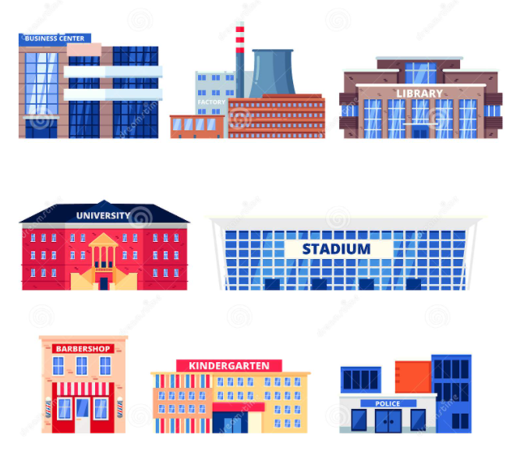
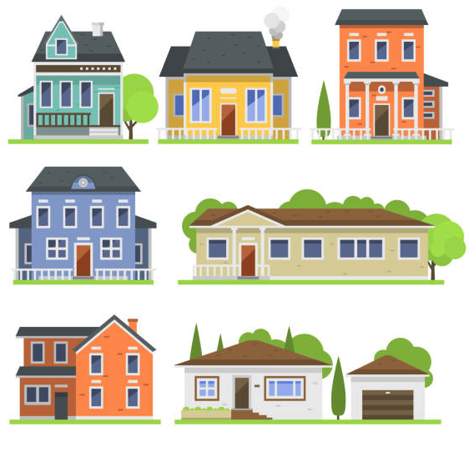
Sectoral Changes
Non-residential
Residential

Slide 19
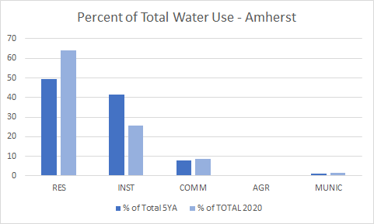
Results
Amherst saw a substantial decrease in institutional use.
Notes:
PM

Slide 20
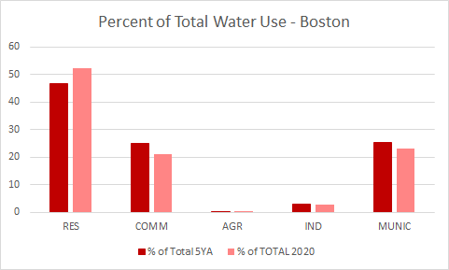
Results
Boston saw a large decrease in the commercial sector likely due to a large number of office buildings, restaurants, and hotels.
Notes:
PM

Slide 21
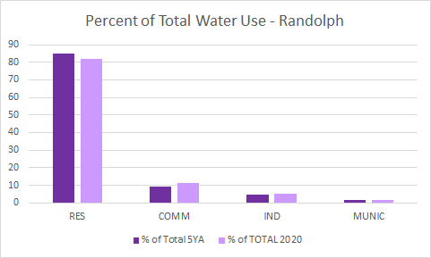
Results
In 2020, the public water distribution system suffered water contamination leading to murky water. This possibly lead to the residential decrease.
Notes:
PM

Slide 22
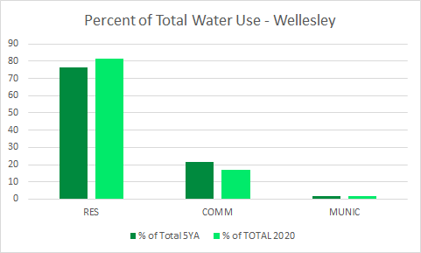
Results
Wellesley saw a higher residential water use in 2020 compared to the other municipalities possibly due to its high average median income.
Notes:
PM

Slide 23
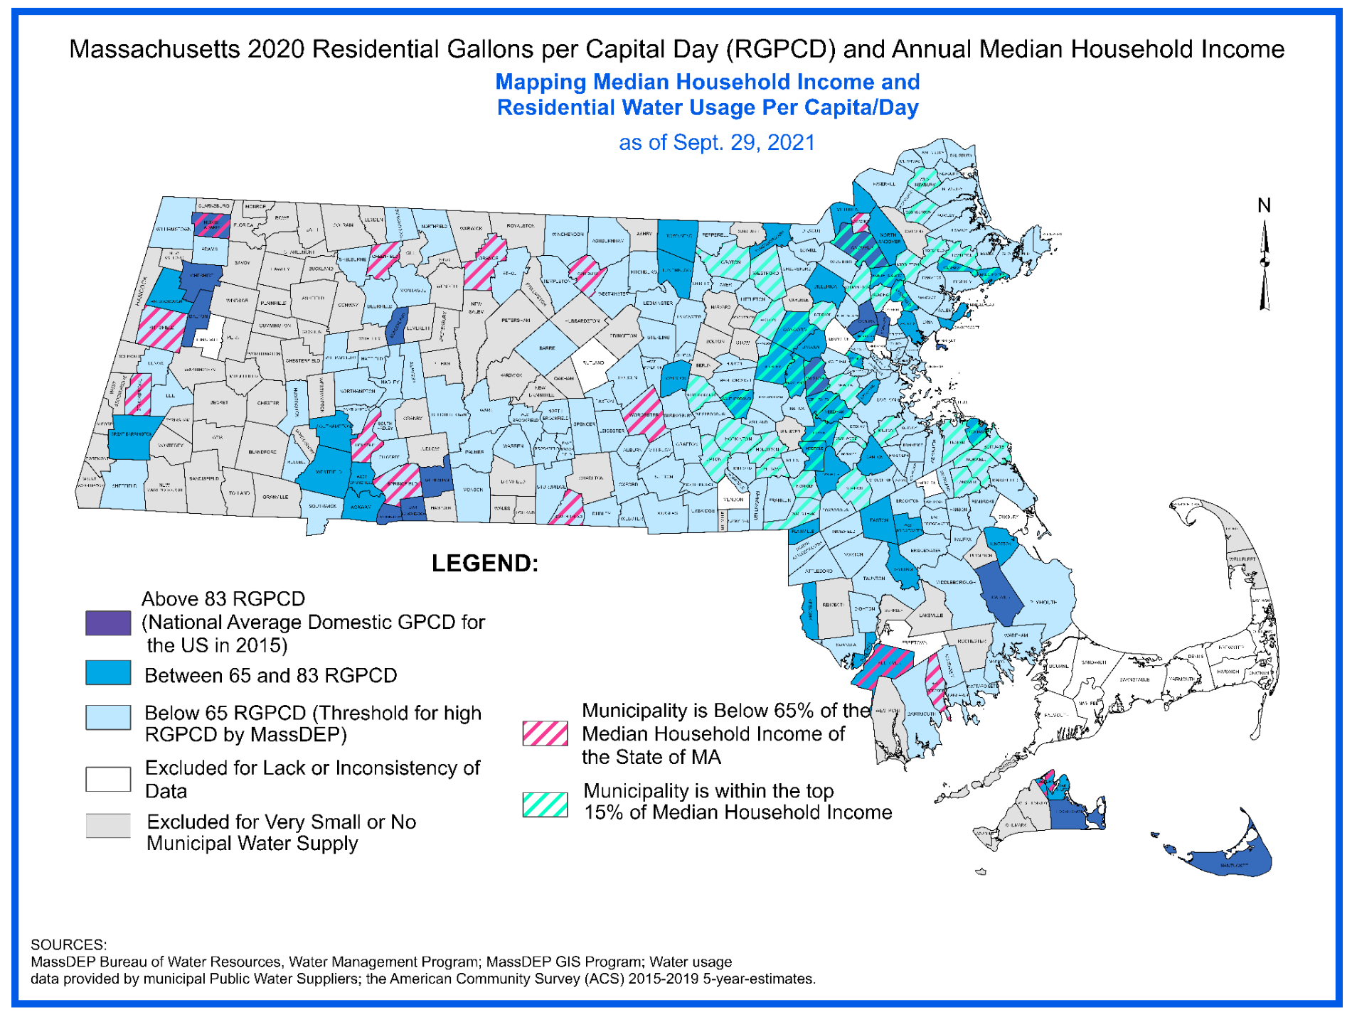
Mapping

Slide 24
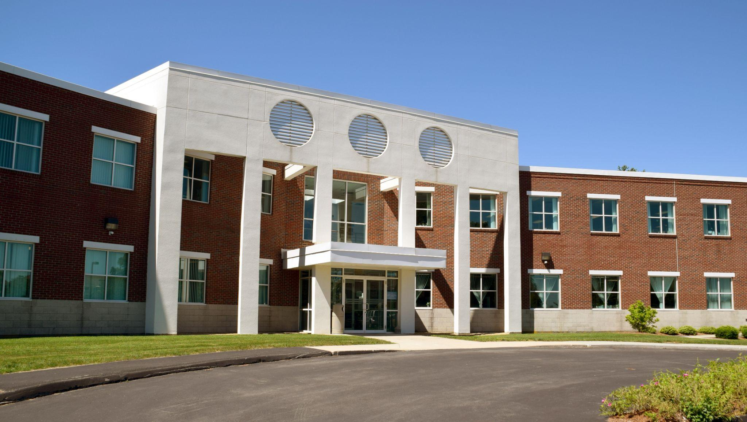
Conclusions
Conclusion:
Total water volume did not change significantly
In general, water shifted to the residential sector from the non-residential sectors
Recommendations:
Further study into how median household income affects water usage
Further study on the impact of higher education moving online during 2020 (Amherst)
Further study on the impacts of a shift to a virtual workforce (Boston, Wellesley)
MassDEP Southeast Regional Office
Notes:
PM

