Slide 1
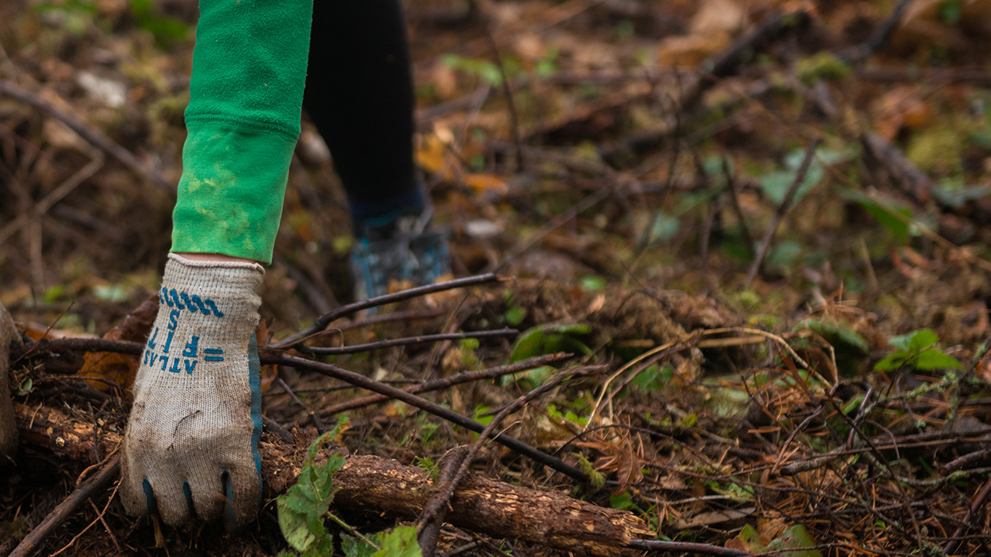
Day 1: Introduction to Restoration Ecology
What is restoration ecology, and why is it important?
Oregon State University 2022, available at https://www.forestry.oregonstate.edu/undergraduate-programs/natural-resources/ecological-restoration

Slide 2
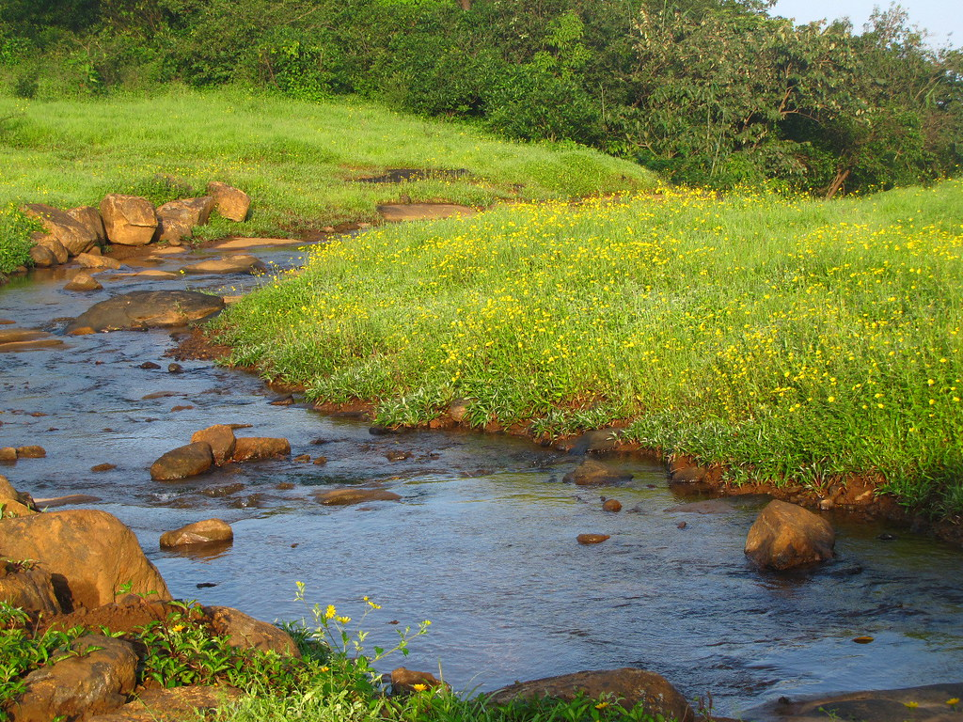
Warmup: Think, Pair, Share!
Introduce yourself to your neighbor(s) and answer the following questions:
What is an ecosystem?
List some examples & describe them
Why are ecosystems important?
Give examples of different ecosystem services*
What is restoration ecology? (Make an inference if you are unsure)
What do you think it entails?
"Ecosystem/Nature" by biodiversity western ghats(before it is gone) is licensed under CC 2.0
*Ecosystem services: benefits that ecosystems provide humans

Slide 3
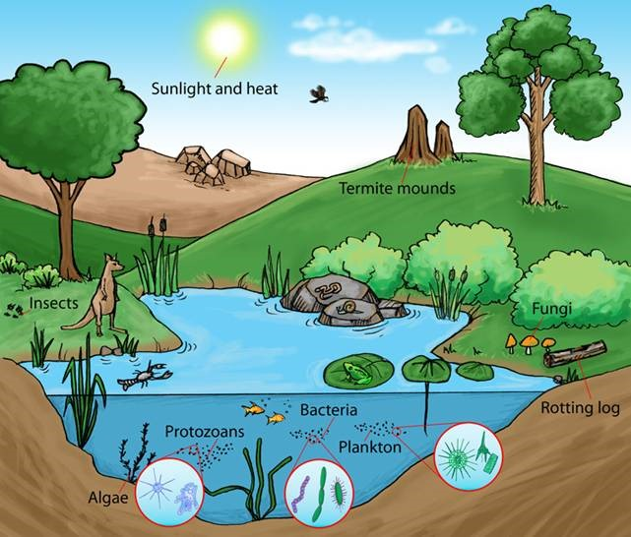
Recap: What are Ecosystems?
An ecosystem is an area where living organisms interact with both each other as well as the non-living parts of the environment.
Ecosystems consist of both:
Biotic factors
Animals, plants, bacteria
Abiotic factors
Soil, rocks, air, sunlight…
https://www.aiscollaborations.com/process-this-blog/2018/8/10/understanding-your-workplace-ecosystem

Slide 4
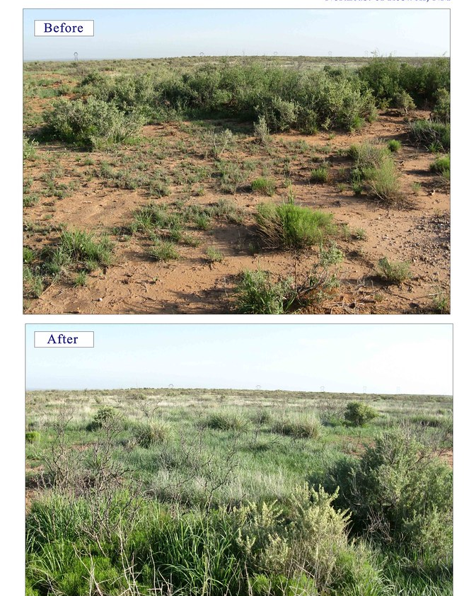
What is Ecological Restoration?
Ecological restoration is the process, via human intervention, of assisting and renewing an ecosystem that has been disturbed: this can be anywhere from mildly degraded to completely destroyed.
Oftentimes intense disturbances, whether natural or human-induced, can alter entire ecosystems.
"BLM Embraces Partnerships to Restore New Mexico" by mypubliclands is marked with CC BY 2.0.
Disturbance: environmental change that affects ecosystem structure & function

Slide 5
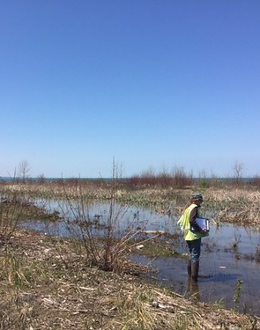
Disturbance Levels & Example Causes
Damaged: acute, distinct negative impact
Road construction, invasive species, poaching, selective logging
Degraded: intense human impacts that lead to more severe disruptions in ecosystem function/structure/composition & biodiversity loss
Persistent invasive species presence, long term overgrazing & fishing/hunting
Destroyed: degradation so severe it completely wrecks physical environment and eliminates all macroscopic life (most chronic level of disturbance)
Mining, urbanization, coastal erosion, land clearing
"Buffalo District continues GLRI ecological restoration at Walnut Beach" by USACE Buffalo is marked with CC BY-ND 2.0.

Slide 6
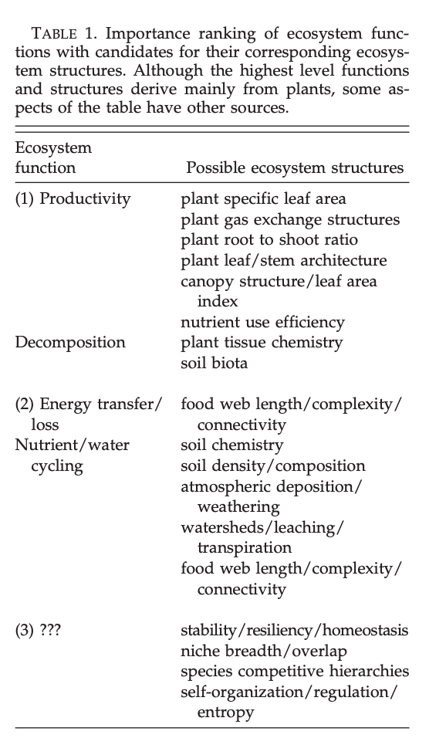
Disturbances Affect Both Ecosystem Function & Structure
Ecosystem Function: the “capacity of natural processes and components to provide goods and services that satisfy human needs, either directly or indirectly” (de Groot et al. 2002)
Ecosystem Structure: derived from ecosystem function, structure is all the physical living & non-living components of an ecosystem and how they’re arranged (Myster 2001)
Myster R, 2001. Available at https://www.fs.fed.us/global/iitf/pubs/ja_iitf_2001_myster001.pdf

Slide 7
Why Should we Care?
Ecosystems provide us with countless goods and services, and they serve many functions. There are 4 main categories of ecosystem function:
Regulation: regulation of necessary ecological processes and life support systems via bio-geochemical cycles and varying biospheric processes
Services provided: clean air, water and soil
Habitat: provides shelter and resources to wildlife
Conserves evolutionary processes and biological & genetic diversity
Production: processes like photosynthesis & nutrient flow through food chain
Services: food, raw materials, energy resources, and genetic material
Information: has rich history with human evolution and maintains our health
Services: reflection & spiritual enhancement, cognitive development, recreation and aesthetics

Slide 8
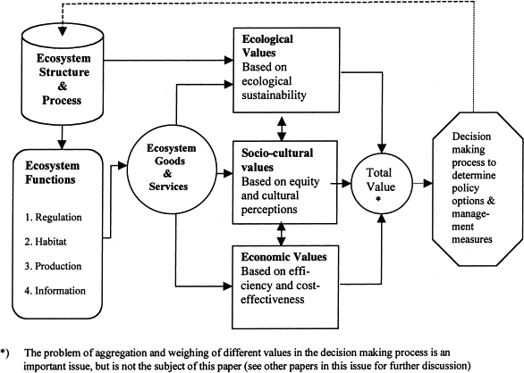
Fig. 1. Framework for integrated assessment and valuation of ecosystem functions, goods and services. (de Groot et al. 2002)

Slide 9
Key Principles of Restoration Ecology

Slide 10
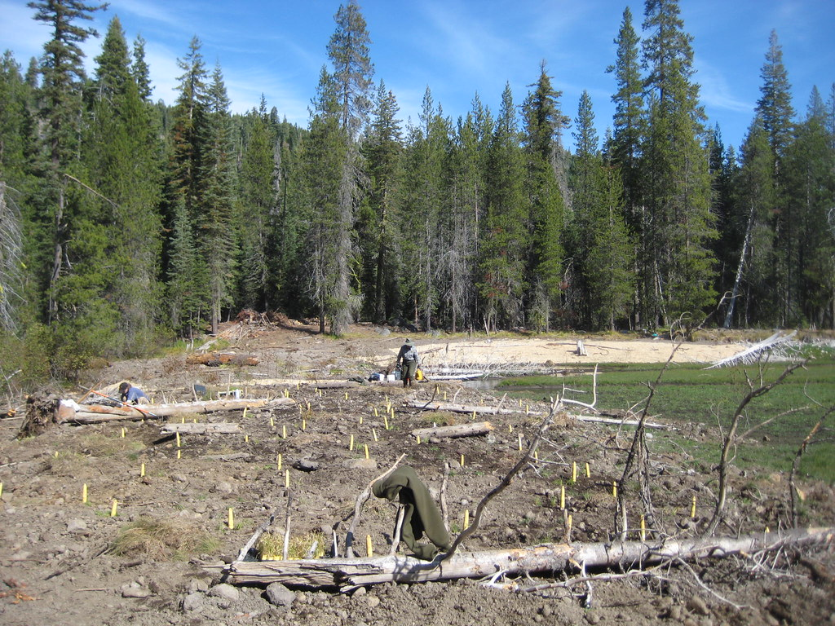
Types & Methods of Restoration
Different restoration projects have different end goals, and therefore different methods for achieving each.
Revegetation: replenishing or establishing new vegetation and erosion control
Soil replacement & direct/hydroseeding
Habitat enhancement: manipulating the natural landscape to change function
Ecological landscaping & habitat creation
Remediation: improving a destroyed ecosystem or replacing it with a new one
Excavation & soil vapor extraction
Mitigation: legally authorized remediation of lost protected ecosystem/species
Planning & zoning
"Dam area revegetation" by LassenNPS is marked with CC BY 2.0.(Lassen National Park)
Notes:
- https://www.nature.com/scitable/knowledge/library/restoration-ecology-13339059/
- https://vtechworks.lib.vt.edu/bitstream/handle/10919/84267/CSES-210.pdf?sequence=1

Slide 11
Class Activity/Homework
For the remainder of class, we will split into groups based off case studies. Introduce yourselves, then begin to read your assigned article. Take notes on key concepts, though you may have to do a bit of outside research for clarity/required information.
View the assignment “Restoration Successes” for the requirements and rubric. Your slideshows should be about 5-10 minutes long and will be presented next class.

