Slide 1
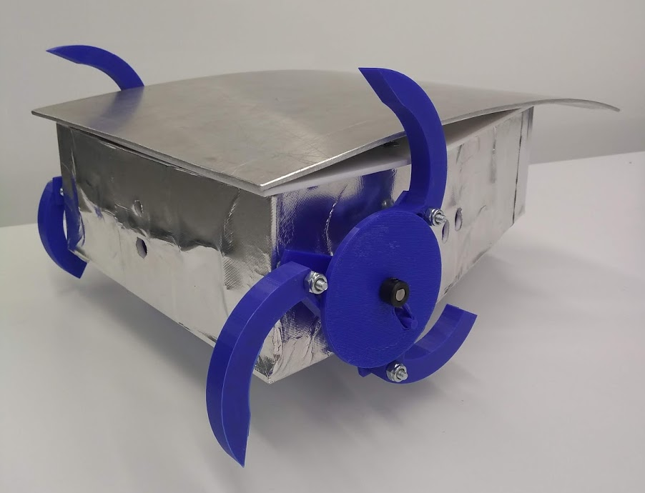
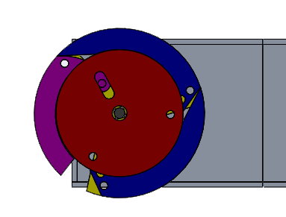
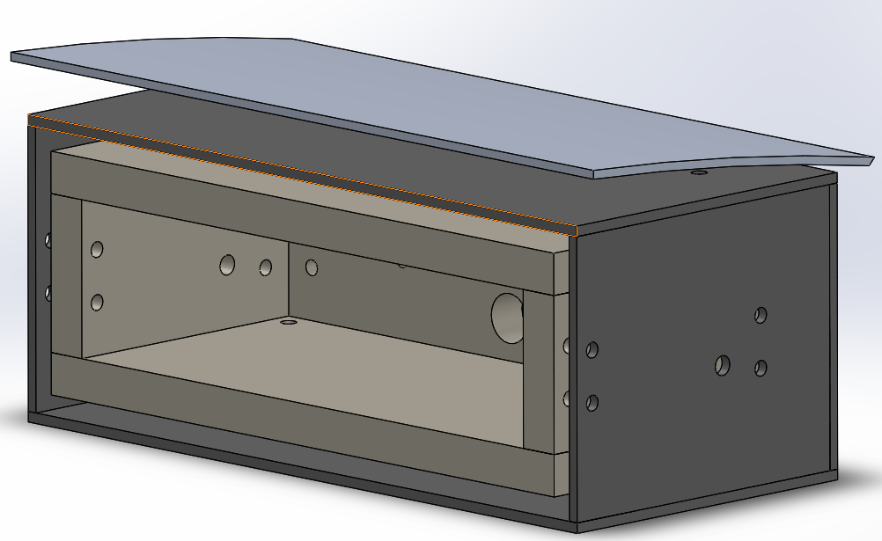
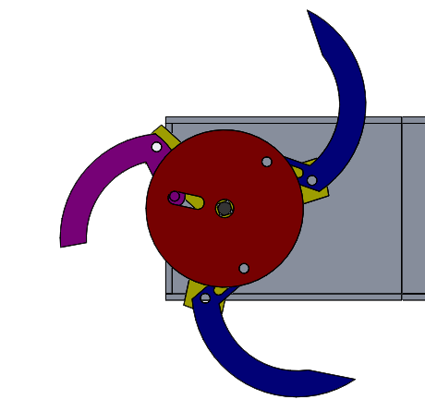
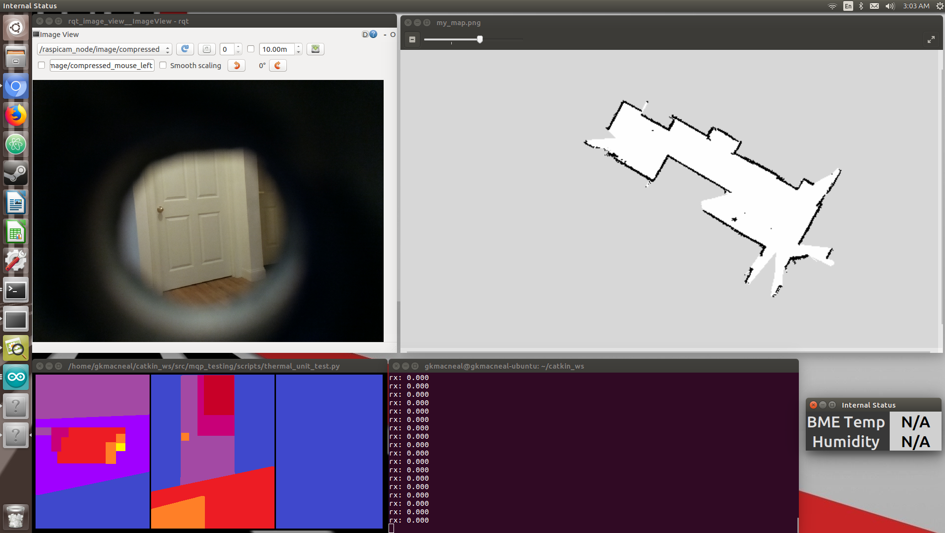
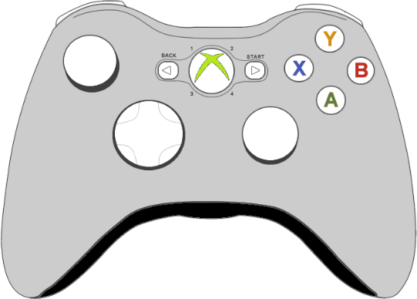
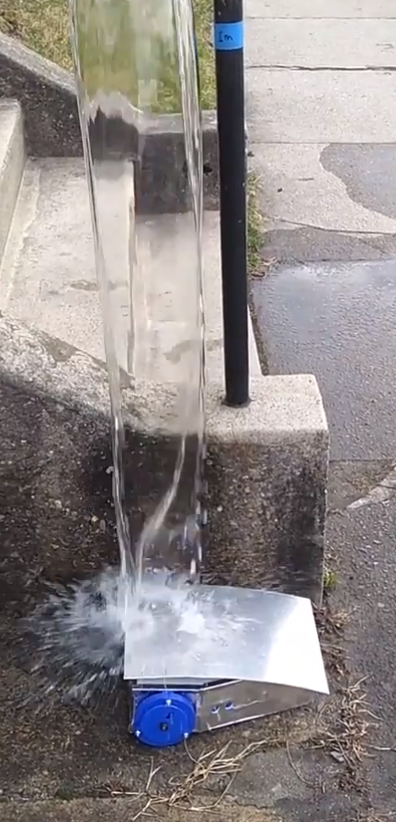
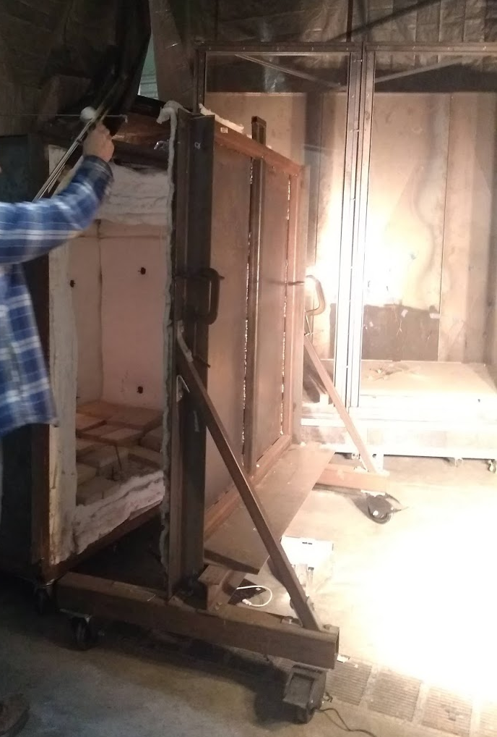
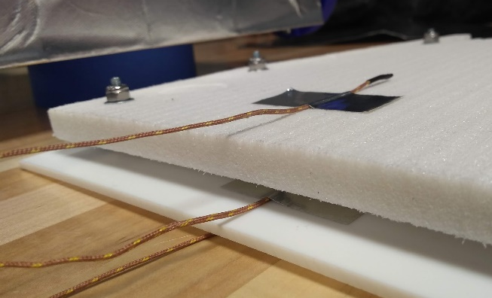
FRED: Firefighting Remote Exploration Device
Eva Barinelli (RBE), Jacob Berman-Jolton (RBE), Gavin MacNeal (RBE/CS), Karina Naras (RBE), Yil Verdeja (ECE/RBE)
Advisors: Carlo Pinciroli, Sarah Wodin-Schwartz, William Michalson
Graduate Advisors: Dominic Cupo, Joshua Bloom
Abstract
Whegs
Layers
Fire environments are dangerous and constantly changing. The goal of this project is to design and build a robot to provide firefighters with additional information about a fire environment to help them make more informed decisions when fighting a fire. We have built a prototype robot that is compact and quick to deploy, with a heat, water, and impact-resistant chassis designed to function in an unpredictable fireground. The remote-controlled robot returns a real-time video feed and a heat map of a designated area in a building.
Trigger Leg
Rigid Thermal Foam
Air Layer
Aluminum Shield
Teflon covered in Reflect-A-Cool
Project Goals
User Interface
Robot Requirement | Measurement Metric
Heat-Resistant | Survive 15min at 300°F, maintain internal temperature <140°F
Water-Resistant | Survive 5 gallon water pour
Impact Resistant* | Withstand impact of items up to 2kg dropped from 1m
Collect environmental data | Detect environmental temperature and heat flux
Communicate wirelessly | Maintain video feed and teleoperation through a single wall
Communication
Electronics
Operation Device
Motor Commands
IR Arrays
Ambient Temp and Humidity sensors
Camera
Distance sensors
IMU
14.4V NMC battery
2x 12V DC motor
Sensor Data:
Thermal Arrays
Internal Conditions
TOF Distance
Testing & Results
Camera Data
Encoders
Forwarded Sensor Data
Raspberry Pi
Water Testing:
5gal poured from ~1m
Interior of foam remained dry
ESP-32
Wi-Fi
Serial
Lessons Learned
Thermal Testing:
11m 36s until internal temperature reached 140°F
Future Work
Most of the lessons learned in this project stem from the fact that heat-proofing a robot is very difficult. Designing a heat-resistant robot requires a strong background in materials science and thermodynamics. Many thermally insulating materials are expensive, so keeping the robot low-cost was difficult. Lastly, we learned to be more careful researching sensor compatibility, because the I2C used by the thermal sensors does not integrate well with the Raspberry Pi.
Autogenerate map
Integrate autonomous capabilities
Improve user interface
Refine thermal data collection
Seek alternative adhesive to seal edges of Teflon layer
Implement phase change or active cooling
Add another material layer
Improve impact resistance
Screening E119 Furnace at WPI FPE Lab
Thermocouples between chassis layers
*Impact testing not yet conducted at time of poster printing

