Slide 1
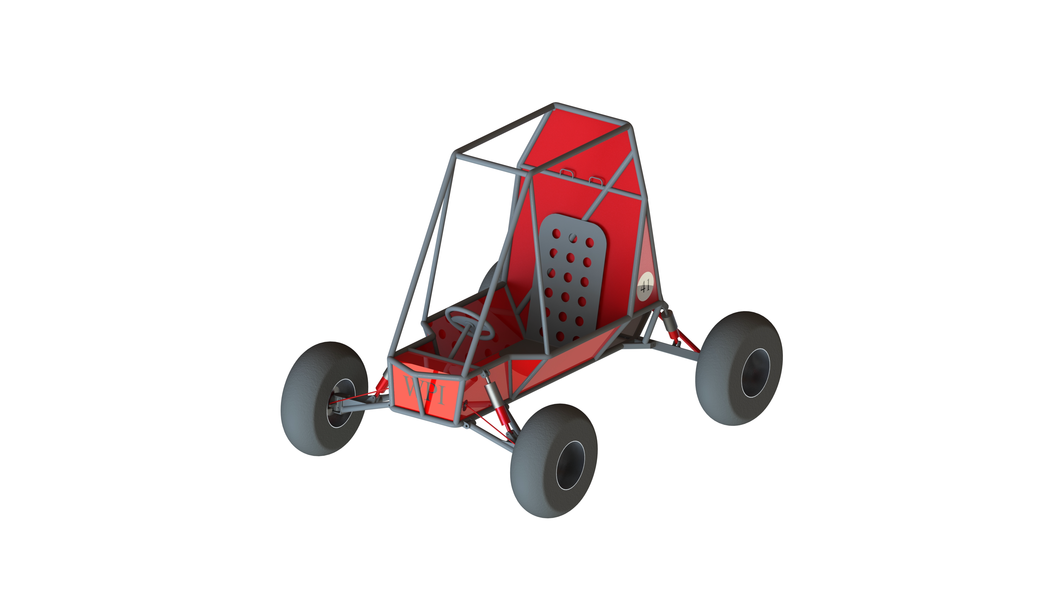
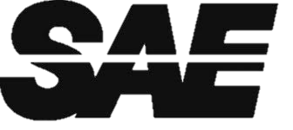
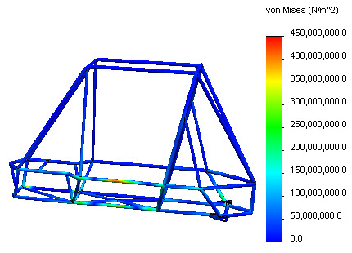
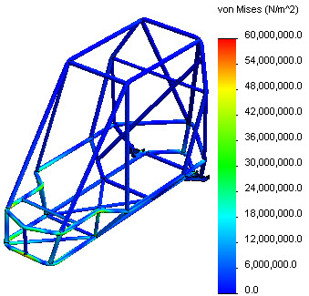
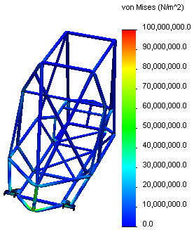
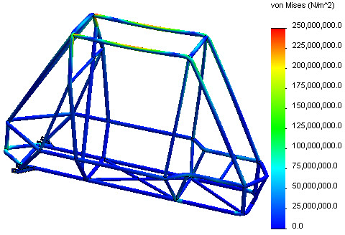
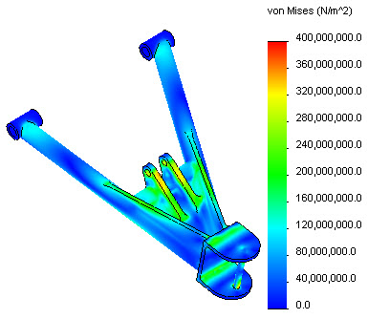
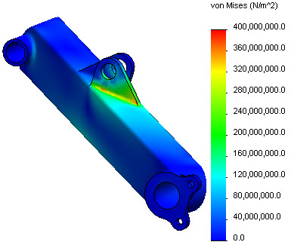
Design of a Baja SAE Vehicle
Members: Bertan Atamer (ME), Julian Enjamio (ME), Stephen Oliveira (ME), Jeffery Wong (ME), Travis VanDale (ME)
Advisor: David Planchard
Abstract
Material | Young's Modulus [GPa] | Strength [MPa] |  | Density [g/cc]
 |  | Yield | Tensile
6061 T6 | 70 | 275 | 310 | 2.70
7075 T6 | 75 | 505 | 570 | 2.80
AISI 1018 | 205 | 370 | 440 | 7.87
AISI 1020 | 200 | 295 | 395 | 7.87
AISI 3140 | 210 | 425 | 690 | 7.87
AISI 4130 | 210 | 460 | 560 | 7.85
The Baja SAE competition is an off-road/rally type event where universities from around the world compete. All teams have the same engine so a lightweight vehicle is crucial to be successful. Due to changes in the Baja SAE competition’s rules, the WPI racecar became ineligible to compete. This project tested the old racecar, identified weaknesses, then developed and fabricated a completely updated and legal Baja SAE racecar. Additionally, the team undertook an outreach initiative by collaborating with Assabet Valley Regional Technical High School.
Table 2: Possible Materials for Frame and Suspension
Results
According to the simulations, the frame is well designed for frontal, side, and rear impacts. It also protects the occupant when another Baja vehicle lands on it from 20ft. The deformation does not exceed 44mm (~1.75in). The frame is 10% lighter than last year’s frame and that should improve performance.
The new suspension is capable of supporting 5Gs and offers an extra 2in of ground clearance to get over challenging obstacles. The steering provides a turning radius of 12ft at most. The camber angle adjusts from 0º to -8º for optimum handling.
Objectives
Objective | Outcome
Test existing Baja SAE vehicle | ✔ Completed
Design and simulate new frame | ✔ Completed
Design and simulate new suspension | ✔ Completed
Design new steering system | ✔ Completed
Design and fabricate new body | ✔ Completed
Seek and acquire collaboration partners | ✔ Completed
Comply with stricter competition rules | ✔ Met
Reduce weight of vehicle to under 400lb | ✔ 375-400lb*
Reduce turning radius to under 20ft | ✔ 9-12ft*
Switch from positive to negative camber | ✔ -8º at max*
Increase ground clearance to over 12in | ✔ 12-14in*
Figure 1: Render of Vehicle
Conclusions
The new frame is an improvement over last year’s frame. It is lighter, stronger, and safer. This frame is eligible for competition and should perform better than the previous one based on the results that were obtained.
The new suspension eliminates camber issues in previous Baja vehicles and provides for greater handling characteristics in off-road conditions. The steering was also improved and combined with the new suspension, they make the vehicle more maneuverable and stable.
* Predicted values
Table 1: Objectives and Outcomes of Project
Figure 2: Side Impact Stresses
Figure 3: Frontal Impact Stresses
Methodology
Material properties were compared and AISI 4130 was chosen. Table 2 shows the materials that were considered. FEA simulations were conducted to optimize designed parts. The frame had to withstand perfectly inelastic collisions at 60kph (~37mph). Fully loaded, the frame weighs 270kg (~600lb) and comes to a complete stop in 0.1s. Impact forces were calculated using:
The frame also has to protect the occupant if another identical vehicle lands on it from a height difference of 6m (~20ft). This force causes the suspension to travel 0.25m (~10in). This impact force was calculated by:
The new front and rear suspension had to withstand forces of 5G. This impact force was calculated with:
Future Work
Possible areas future teams could focus on as a continuation of this project:
Finish assembling vehicle
Take vehicle to competition
Develop double A-arm front suspension
Implement Ackerman steering
Install gearbox with high, low, and reverse gear
Incorporate brake bias
Figure 4: Rear Impact Stresses
Figure 5: Vehicle Landing on Vehicle Impact Stresses
Acknowledgements
We would like to thank the following people and organizations for their contributions to this project:
Worcester Polytechnic Institute
Dean of Mechanical Engineering: Prof. Jamal Yagoobi
Worcester Manufacturing, Inc.
Assabet Valley Regional Technical High School
Bryant Laflamme
Figure 6: A-Arm Impact Stresses
Figure 7: Trailing Arm Impact Stresses

