Slide 1
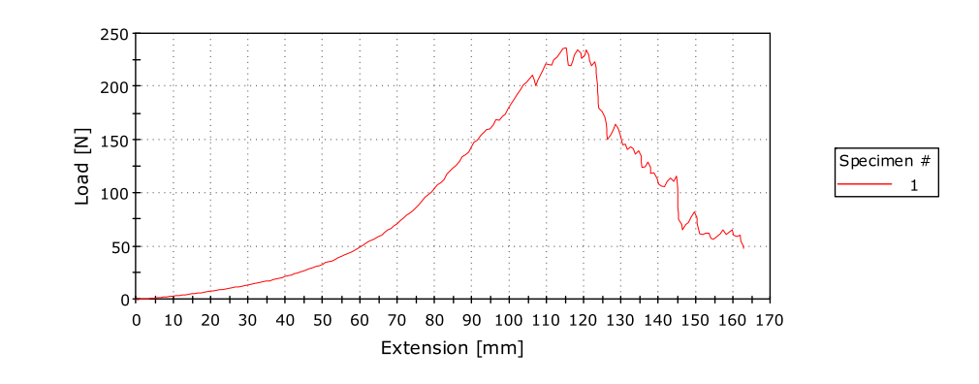
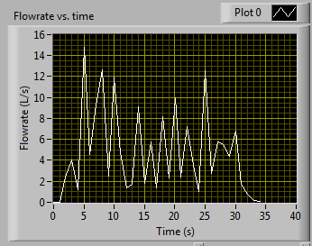
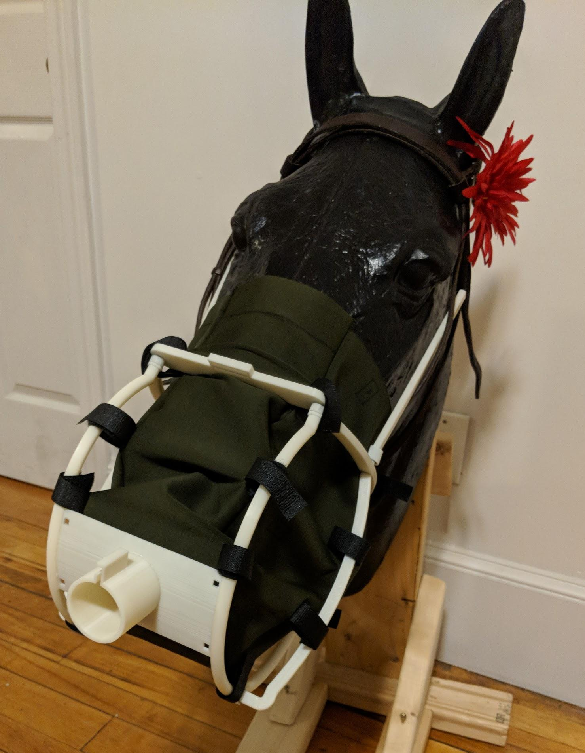
Equine Lung Function Testing
David Frederick², Brandon Hoghaug^{1,2}, Justin Shanahan^{1,2}, and Aaron Weeks¹
Department of Mechanical Engineering¹ and Biomedical Engineering²
Introduction
Up to 80% of stabled horses experience respiratory disorders (i.e. Asthma, COPD, etc.)[1]
Horses are obligatory nose breathers, causing increased sensitivity, particle accumulation, and nasal obstruction [2]
Current respiratory measurement techniques are invasive, large, or expensive (~$8000.00/device)[3]
Current design also presents hazards being heavy and cumbersome being hazardous an ineffective
Frame composed of 3D printed acrylonitrile butadiene styrene (ABS)
High compressive strength and lightweight
Cost competitive and easily manufacturable
Mesh composed of neoprene fabric
Water resistant, high in tensile stress, and breathable
LabVIEW code simplified for digital output and Excel data acquisition. Simplified user input and display for operation
Final Design
Statement of Purpose
Develop an affordable, accurate, and durable respiratory monitor and mask to measure and display the breathing function of horses for clinical and civilian applications.
Fig 3 and 4: Tensile Testing and Flow Test
Include Respiratory Inductance Plethysmography bands to system
Design attachment for DAQ box on the saddle/bridle for testing
Design portable alternative using an Arduino or similar device for wireless data collection
Test the sensor and mask on horses to gauge response to the system in action
Methods
Future Work
Test and approve sensor from previous MQP group
Create preliminary mask designs based on decision matrix provided by sponsor DVM. Mazan
Reduce size and extension from horse’s nostrils, reduce weight with appropriate material selection, reduce cost in sensor and mask design, ensure mask is breathable and cleanable
Select final materials through visualization, mechanical testing, and comparison
Test mask for breathability and flow distribution with human sized mask
Optimize LabView code for data recording and presentation
Create proposed methods for future iterations and wireless testing
Fig 1: Solidworks Model
Fig 2: Final Mask
ABS tested in 3pt bending in Instron 5543 for force to failure, stress, and energy to fracture
Neoprene fabric tensile tested in Instron 5543 for force to failure, stress, and energy to fracture (See Fig, 3)
Neoprene fabric is tested for water resistance with contact angle test
Mask comfort and breathability is tested with a miniature version of final design demonstrated in fig. 1 for human trial
Data is collected on human breathing volume and compared to measure accuracy of the system (See Fig. 4)
Testing
References
[1] Mazan, D.VM., Cummings Veterinary Medical Center, 2016.
[2] Robinson, N. E. (2003). Inflammatory airway disease: defining the syndrome. Conclusions of the Havemeyer Workshop. Equine Veterinary Education, 15(2), 61-63.
[3] Mazan, D.VM., Personal Communication, 2017.

