Slide 1
GREEN SKILLS AND CAREERS:
A WORKSHOP PROMOTING A SUSTAINABLE FUTURE
Athina Koutougka, Max Maria,
Matthew Urrea, Alexander Zhang
1
Notes:
hello we are the green skills and careers team. our project was to develop a workshop promoting a sustainable future
im matthew urrea……

Slide 2
Terminology
GREEN SKILLS: Knowledge, abilities, & attitudes that help reduce the negative human impact on the environment
GREEN CAREERS: Jobs that contribute to preserving or restoring the environment and our planet
2
Notes:
firstly, I will tell you about terminology we have been using.
green skills refer to the knowledge, abilities, and attitudes that help us use environmentally friendly technologies & processes to support a society in reducing the negative human impact on the environment
green careers refer to the jobs that contribute to preserving and restoring the environment and our planet

Slide 3
BACKGROUND INFORMATION
The 25-Year Plan (2018)
Net Zero Strategy (2021)
Sustainability and Climate Change Strategy (2023)
3
Notes:
Now I will discuss why we are here.
In 2018, the govt of the UK passed the 25-Year Plan which sets out to restore the environment and its biodiversity.
This led to the declaration of a climate emergency in the UK.
in 2021, the govt then passed The Net-Zero strategy which laid down foundational reform for a green economy while trying to keep track of reaching net zero carbon emissions by 2050.
this leads us to last year, in 2023 the department for education (DfE) set out the sustainability and climate change strategy recognizing the importance of educating the youth about green skills to take into green careers, which would help flourish the green economy in a push for Net-Zero.
However, a huge load is put on the educational front to handle this strategy. Schools are left to deal with this burden of implementing it into the current curriculum with a lack of resources and funding from the DfE. As well, The government of the united kingdom plans to convert 500 schools to meet Net-Zero, which is only 2% of the national school estate.
These issues and concerns in the education system leads us to

Slide 4
GOAL
To improve knowledge and interest in green skills and careers, by developing and piloting a workshop for young adults.
4
Notes:
Our goal which was....To improve knowledge and interest in green skills and careers, by developing and piloting a workshop for young adults.

Slide 5
MAIN OBJECTIVES
Develop and Deliver a workshop
Establish a teacher's guide for future workshop sessions
Prepare article for UW source magazine
5
Notes:
Athina Slide:
To achieve our goal we developed three main objectives:
our first objective was to develop and deliver a workshop to the chase and nunnery schools. we had 4 workshops in total, with two eco and two economics classes
our second objective was to create a teacher's guide so teachers can replicate our workshop and depending on what course they are teaching there is an integration guide.
lastly, we prepared an article for the UW source magazine summarising our project.

Slide 6
METHODS
WORKSHOP DEVELOPMENT
TEACHER’S GUIDE
UW ARTICLE
TABLE SITTINGS
BRAINSTORMING
SPONSOR FEEDBACK SESSIONS
PRE AND POST SURVEYS
TEACHER FOCUS GROUPS
CONTENT REVIEW
6
Notes:
Athina Slide:
To accomplish our objectives we used the following methods:
For workshop promotion we conducted table sittings, for workshop development we conducted brainstorming and sponsor feedback sessions and for workshop evaluation we conducted pre and post workshop surveys, for our teacher guide we conducted student teacher focus groups and for our article we conducted a content review.

Slide 7
TABLE SITTING
7
Notes:
As discussed in the methods, we began with a table-sitting where students rated themselves on a scale from 1 to 10 with green skills familiarity. As you can see in the graph, most students rated themselves at approximately 7/10. While that's not super high, it implies that students are at least decently familiar with green skills.
Or at least students believe they are well-versed with green skills? Are they really though?

Slide 8
TABLE SITTING
8
Notes:
At this same table-sitting, students also answered if they could name any green jobs. Unfortunately, the results did not show that the students actually understood what green jobs were.
The majority of the students responded with the same answer of "farmer." While a farmer is a green job, a knowledgeable student-base would have answered with more diverse answers, such as some of the rarer answers given: "environmental scientist", "marine biologist", and the like.
As a result of this table-sitting, we realized that our workshop should be focused on the fundamentals of green skills and careers.

Slide 9
GREEN SKILL FAMILIARITY
9
Notes:
So, a critical question we asked our workshops participants was there familiarity with green skills and careers. We presented the workshop to five groups, and the average self-rating on a 5-point scale are shown above. The dark-green represent the pre-workshop score and light green post.
From this graph, we can see that all of the scores increased. Not including the first workshop, the scores all increased by about 1.1 points. From this we can gather that the students' perceived familiarity increased quite a bit from the workshop. But did it really increase?

Slide 10
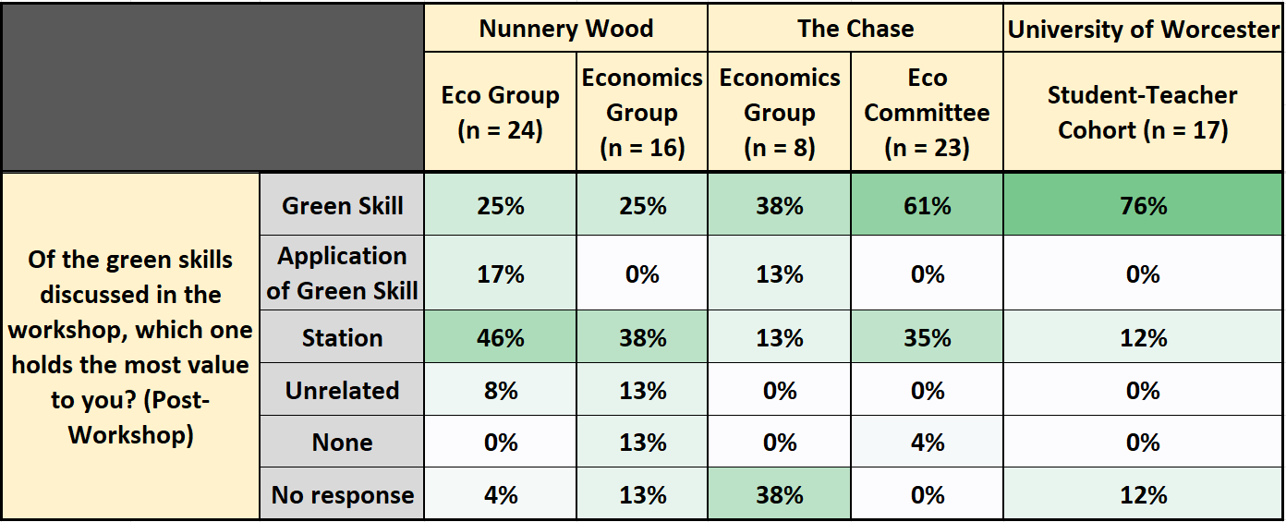
GREEN SKILL RETENTION
10
Notes:
To determine if students' understanding of green skills and careers actually increased, we asked students a question which prompted a green skill response. This way we could tell if students understood what green skill was by what they answered.
*Show red box*
As the workshop developed, the actual understanding of green skills improved. On the first 2 workshops, only 25% of students showed understanding. But in the following workshops, 38%, 61% and even 76% of students were getting the critical material.
This showed us that the workshop, once developed with the right details and lesson plan, was quite effective at actually teaching material.
However, good at teaching is one thing. Was it also engaging?

Slide 11
WORKSHOP ENDORSEMENT
11
Notes:
From our results, we would say yes. Students were asked if they would recommend the workshop to their peers, and the vast majority of them set yes. Almost all of the students that didn't explicitly recommend the workshop, just didn't respond.
We only had 2 students who actively wouldn't recommend the workshop out of the 88 students who participated.
As a result, we think that the workshop was both informative and engaging. With these results and analysis, I will be passing it off to Max, who will talk about our future recommendations.

Slide 12
SHORT TERM RECOMMENDATIONS
Teacher’s Guide
Student Teacher Workshops
Opt-in Workshops for Students
Sponsor Elena Lengthorn:
12
Notes:
The first short term recommendation involves how to run our workshop, this is summarized in a teacher's guide we have created.
It is grouped with workshop materials in a google drive accessible to teachers.
As previously discussed, the workshop has shown to be effective and students would recommend it to others, which is why we recommend the spread of the teachers guide
The second short term recommendation is an emphasis on presenting the workshop to a group of student-teachers.
This is because it may inspire those teachers to use it, expanding the reach of the workshop.
In our experience, this also resulted in valuable feedback.
The last short term recommendation we have is to offer opt-in workshops for students.
This is something our project did not cover, however we think it would be valuable for those students who want to learn more about green skills and careers.
Teachers could possibly work with the worcester cathedral eco group or the hive library for promotion of the workshop as well as spaces to present it

Slide 13
LONG TERM RECOMMENDATIONS
Worker Led Workshops
Green Career Networking
Policy Advocacy Initiatives
Updating Materials
Workshop Wind Turbine Technician Activity:
13
Notes:
Our first Long term recommendation suggests teachers finding an employee currently or previously in a green career
This would be more engaging to the students, facilitating a greater chance those students become involved in a green career
The worker would also be knowledgeable on the topic of green skills, bringing value to the content of the workshop
This leads into our next recommendation where we encourage forming a relationship with a green company or someone in a green career so that job tours or shadowing opportunities can be offered to students
This could become a direct resource for students interested in a green career
As Matt mentioned before, there is a lack of resources and funding given to the teachers to achieve the goals set out by the DfE. We recommend teachers to undertake policy advocacy initiatives to change this
Our fourth long term recommendation is to update materials
As time goes on, the global warming facts and data used in the workshop may become out of date

Slide 14
FUTURE OF THE PROJECT
Expansion Strategy
Workshop Led by a Single Facilitator
Other Workshop Designs
Presentation of Workshop:
14
Notes:
Our last list of recommendations are for those who continue to work on this project.
The first recommendation is to focus on expanding the workshop to more schools with more workshops
This will lead to more students receiving the workshop and more teachers possibly being inspired to give the workshop themselves
Also the data they collect will have a larger sample population, leading to increased validity of the evaluation of the workshop
The next recommendation is to test out the teachers guide by observing a session led by a single facilitator
This could lead to important changes or additions to the teachers guide, as we have not tested it ourselves
The final recommendation we have for the next group is to test other workshop designs
We created one workshop and developed it, however we think it would be valuable for another group to create 2-3 workshops and see how each one performs in a classroom.

Slide 15
ACKNOWLEDGEMENTS
Advisors:
Professor Linda Looft – Worcester Polytechnic Institute
Professor Fred Looft - Worcester Polytechnic Institute
Sponsors:
Elena Lengthorn – Senior Lecturer, University of Worcester
Georgina Beard – Teacher, Nunnery Wood
Sarah Dukes – Sustainability Coordinator, The Chase
Special Thanks to:
Rosemary Taylor – Instructor, WPI
Claire Finch – Business Support Officer, The Chase
Matthew Haywood – Teacher, Nunnery Wood
Glesni Speake – Assistant Headteacher, The Chase
Mike Fieldhouse – Headteacher, The Chase
Steve Powell – Headteacher, Nunnery Wood
15

Slide 16
Thank you
Questions?
16

