Slide 1
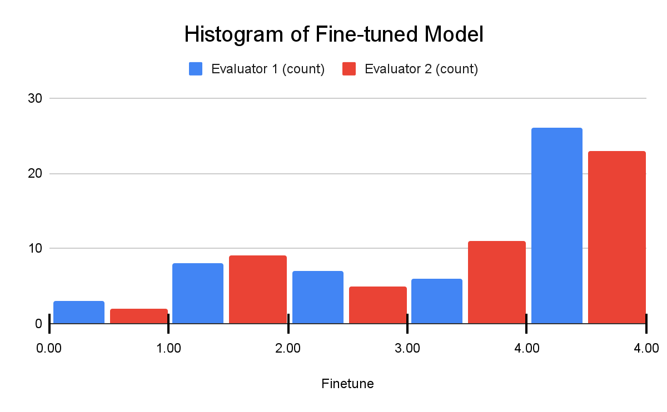
Fine-Tuning Large Language Models for Math Education
Eamon L. Worden and Neil T. Heffernan
Fine-Tuning Open-Source Large Language Models for Generating Math Explanations
Neena Xiang, Paul Godinez, Eli Hoffberg
Worcester Polytechnic Institute
Worcester Polytechnic Institute, Worcester, MA
Fine Tuning-Prompt Engineering Framework
Fine-Tuning
Background
Low rank adaptation (LoRA) allows for fine-tuning at a fraction of the cost and time [5]
Fine-tuning allowed us to tailor the output of the response to follow a consistent format which improved explanation readability
Models were fine-tuned with 981 ASSISTments questions with explanations that were generated by GPT4
The final model was tuned on this Prompt:
Below is a math question and the correct answer. Write a step by step explanation to the question.
### Instruction: <Question>: [Question] <Answer>: [Answer].
Large language models (LLMs) are highly advanced AI systems that understand and generate human-like text.[13]
ChatGPT has been the most powerful LLM and brought LLMs into the public realm [14]
Open source LLMs have been developed by Stanford, Meta, Mistral AI (French start up) [16, 12, 7]
Fine-tuned open-source LLMs are becoming ever closer to the most powerful privately developed models such as GPT4
Using a combination of fine-tuning and prompt engineering allows for the most optimized performance of the models
Fine-tuning on specific data (such as math problems) allows models to write more accurate and coherent responses
Prompt engineering the models allows us to find what the best set of instructions is to get the most accurate results
To evaluate the models, all responses for each prompt were double-blinded to ensure an unbiased score
The double-blinding and evaluation part of the framework was used during the final comparison of 3 models: base WizardMath, fine-tuned WizardMath, and GPT-3.5
ASSISTments
Results
Prompt Engineering
ASSISTments is an online learning platform used by middle school math teachers to give homework
Teacher’s assign their own problems or problems from within the Illustrative curriculum, can assign redo problems if students get questions wrong, and easily view student performance
ASSISTments has already started integrating AI into their program, but have yet to develop a good LLM for generating problem explanations
Open-source LLMs offer a more cost effective option compared to GPT-3.5 and a more time efficient option compared to generating explanations by hand [4]
Models were tested on 50 questions and evaluated using the prompt engineering and evaluational part of our framework
As part of our evaluation framework, prompts were double-blinded and their corresponding responses were evaluated to ensure grading is unbiased
Responses were scored based on the table below
Score | Meaning
0 | Gibberish
1 | Mentions math terms, unclear and wrong
2 | Comprehensible but wrong and/or very incomplete
3 | Almost right path/answer
4 | Nearly perfect, right answer, right explanation
Prompts were iteratively improved upon in testing-grading cycles
Starting with a control of not providing any prompt, the model’s performance improved up to 80% though iteratively improving prompts
LLMs of Interest
The final fine-tuned model was able to answer perfectly about 50% of the time as seen in the score distribution in the figure above
Scoring Llemma LLM | Control | Cycle 1 | Cycle 2
Evaluator 1:
Average Score: | 0.154 | 0.462 | 0.846
Improvement (%): | N/A | 66.7% | 45.5%
Because we wanted to write accurate math explanations, we found models that already had strong mathematical and logical reasoning.
Mistral: This model as been shown to generate good explanations and is a small model [7]
Llemma: This model has been used to solve math problems, and as a smaller model, easier to work with because it was faster to test [12]
WizardMath: As the largest model of the three with 13B parameters compared to the 7B of the other two, we could evaluate how much of a difference in performance the difference in size made [11]
 | Base WizardMath | Fine Tuned | GPT-3.5
Evaluator 1:
Average Score: | 2.72 | 2.88 | 3.96
Standard Deviation: | 1.499 | 1.365 | 0.283
Evaluator 2:
Average Score: | 2.74 | 2.88 | 3.92
Standard Deviation: | 1.291 | 1.288 | 0.444
Future Work
Increase the size of the training set to include a more even distribution of problem types
Create a 50 question test sets for each question category to evaluate model performance on each type of problem
Change the base LLM and evaluate the performance impact of that change
If more RAM was available, we would fine-tune and test a 70B parameter model and compare how the model performance changes
The fine-tuned model improved the base model by about 5% while GPT-3.5 outperformed the base model by roughly 45%.
While there was no statistical difference between the fine-tuned model and the base model, the fine-tuned model did have a higher average
References
Sponsors & Funding
We would like to thank the NSF (e.g., 2118725, 2118904, 1950683, 1917808, 1931523, 1940236, 1917713, 1903304, 1822830, 1759229, 1724889, 1636782, & 1535428), IES (e.g., R305N210049, R305D210031, R305A170137, R305A170243, R305A180401, R305A120125, & R305R220012), GAANN (e.g., P200A180088 & P200A150306), EIR (U411B190024 & S411B210024), ONR (N00014-18-1-2768), and Schmidt Futures. None of the opinions expressed here are that of the funders. We are funded under an NHI grant (R44GM146483) with Teachly as a SBIR.

