Slide 1
SolSmart Zoning Review
1
Grace Phillips, Alana Reid, Daniel Brower, Brendan Fainer
In partnership with: lauren sinatra, energy coordinator
December 11, 2023
Notes:
[Grace]
Introduce ourselves
Thank audience for your time in your busy agenda to hear our presentation
State title
State that this presentation is part of Nantucket’s path to SolSmart status
~~CLICK~~

Slide 2
SolSmart is a national program that recognizes municipalities that have demonstrated solar leadership.
2
BRONZE
SILVER
GOLD
PLATINUM
Image by SolSmart from Home | SolSmart under a CC0 (public domain) license
Notes:
[Grace]
National designation program
Over 500 local governments nationwide have achieved SolSmart designation.
Helps communities “become solar energy leaders”
~~CLICK~~
Designations are tiered as Bronze, Silver, Gold, and Platinum, however no one has platinum and the remaining three designations are distributed roughly equally
~~CLICK~~
It is Nantucket’s goal to achieve SolSmart Silver status, and is endorsed by the Town Manager
~~CLICK~~

Slide 3
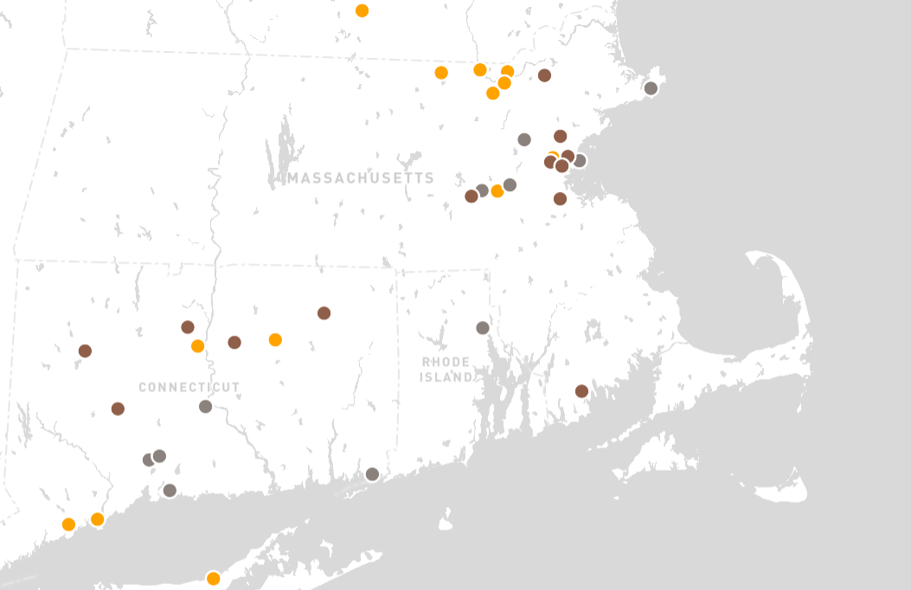
Image Credit: https://solsmart.org/our-communities
Notes:
[Daniel]
Here is a map of the SolSmart communities in Massachusetts and surrounding states, colored by designation status.
~~Click~~
As you can see here, Nantucket would be the first community on the Cape and Islands to achieve SolSmart Status.
~~Click~~
(Take that, Martha’s Vineyard)

Slide 4
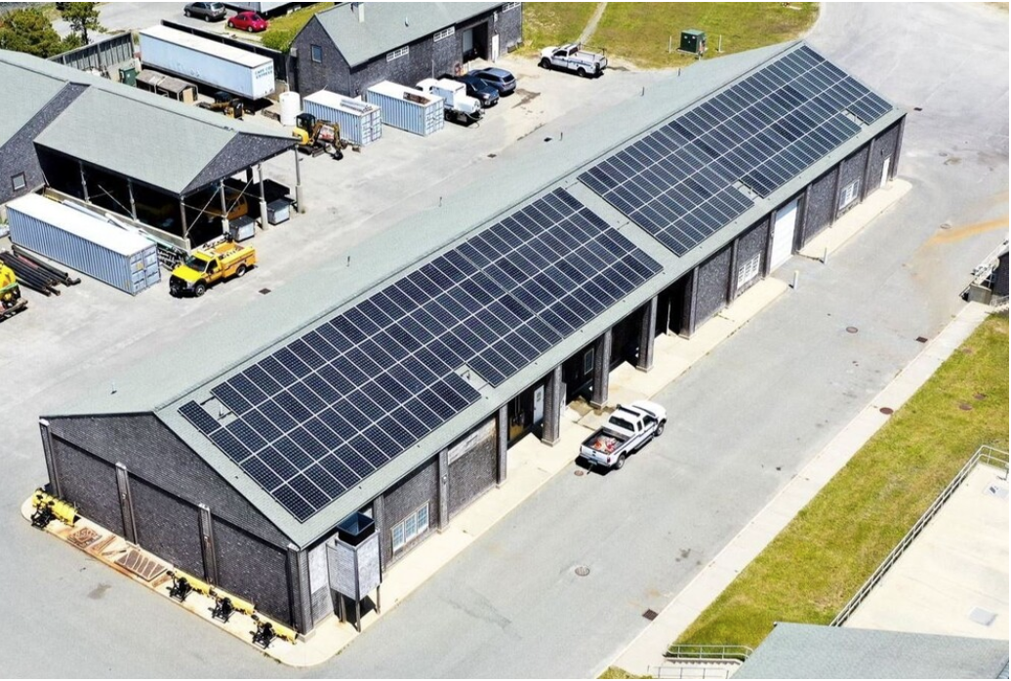
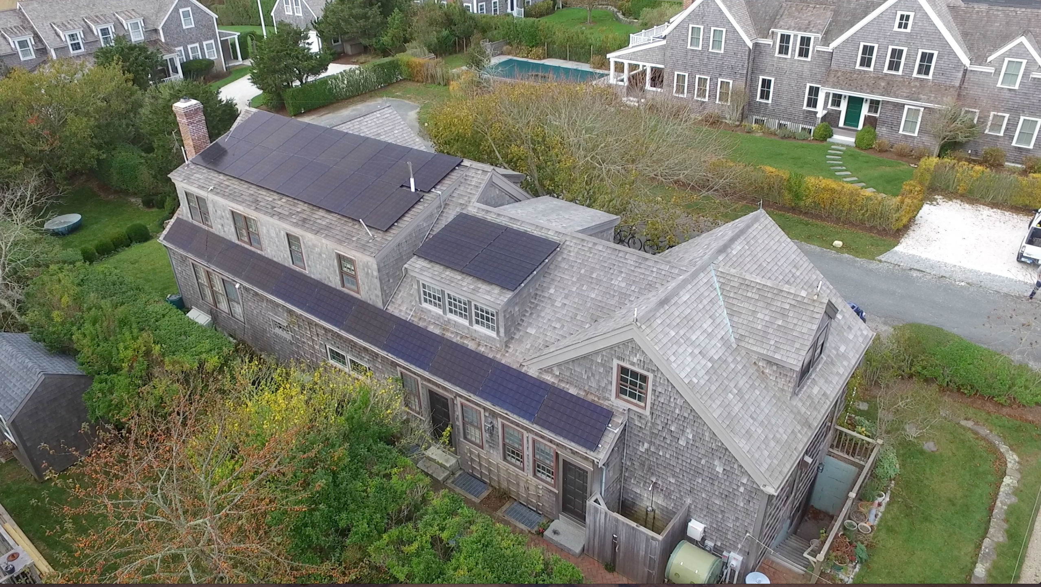
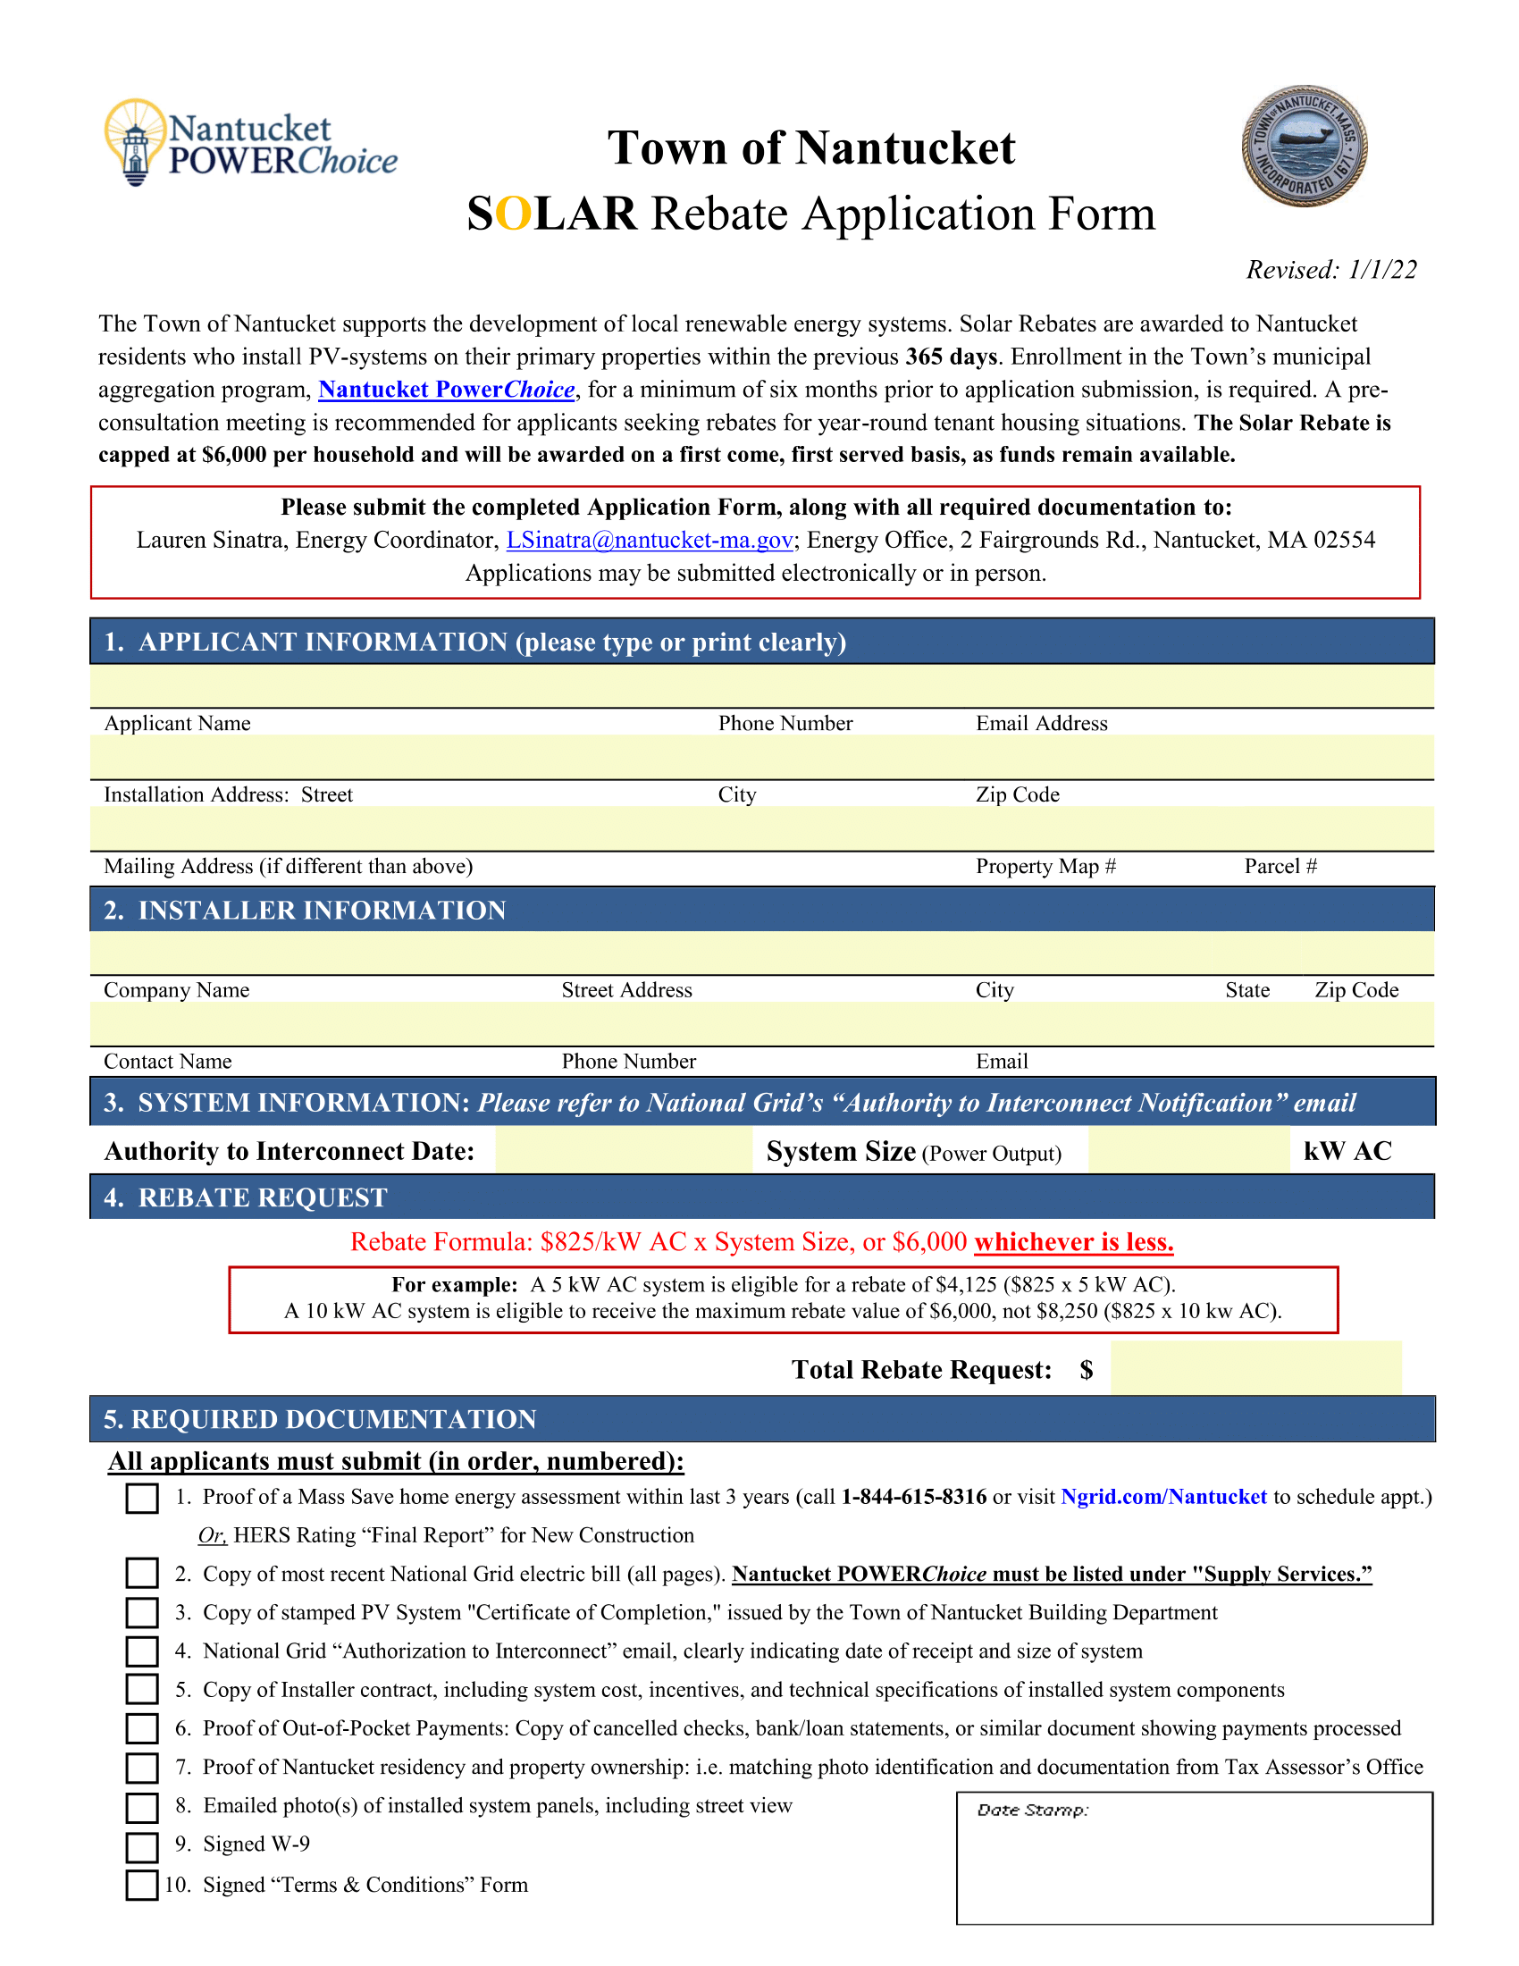
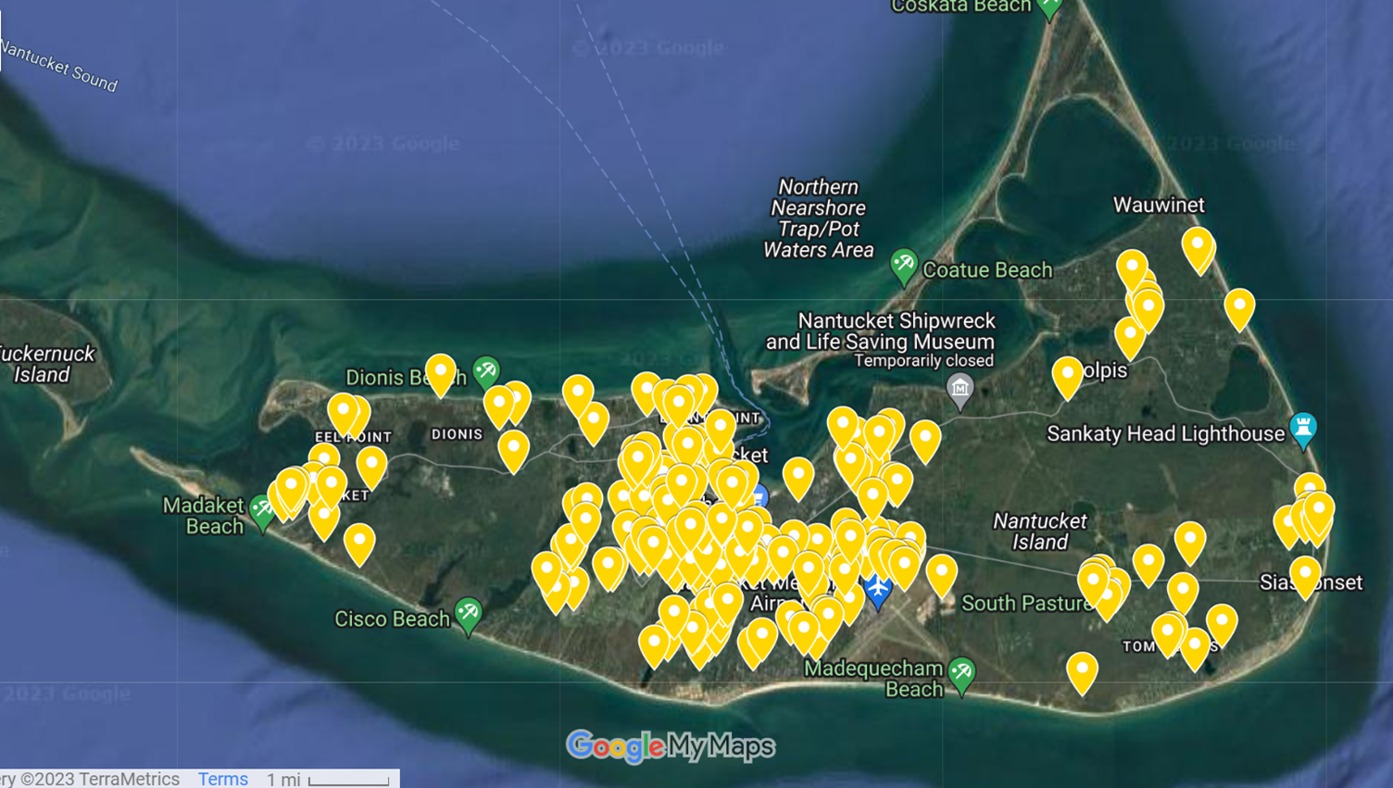
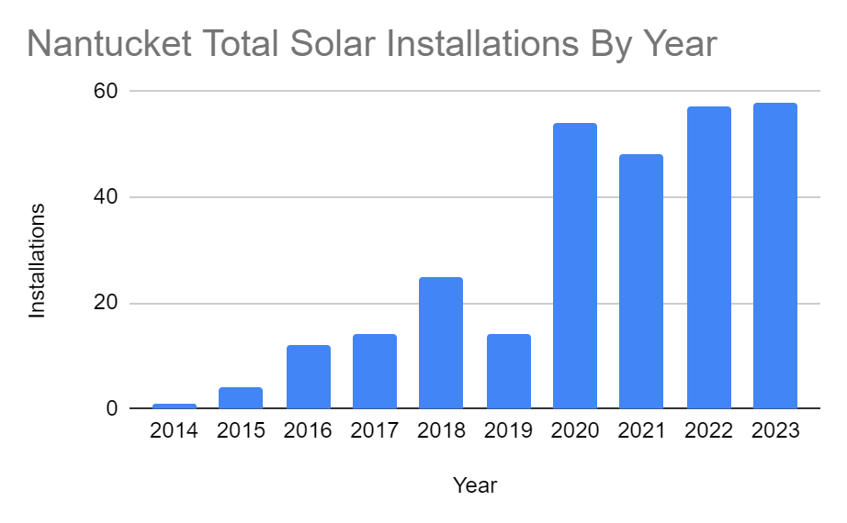
Nantucket is a Solar Leader
4
Notes:
[Alana]
Nantucket is a solar leader. Even though it may seem like Nantucket’s status as a historic district and its protections around what can be constructed would prevent it from having a clear process to install solar panels, Nantucket has already implemented programs to facilitate solar development and completed numerous residential and commercial solar installations.
~click~
Depicted here are a few of the over 200 residential solar installations on the island.
~click~
The Historic District Commission, which oversees every publicly-visible construction on the island, wrote these Solar Guidelines in 2009 to clarify how to install solar panels without disrupting the historic character of the island.
~click~
And visible here are markers of every solar installation on Nantucket as of 2017 - people can and do install solar on island.
~click~
When a year-round resident of Nantucket installs solar on their residence, they can receive up to $6,000 in the form of a Local SOLAR Rebate (funded by an energy aggregation program called Nantucket PowerChoice). Since 2017, the Local Solar Rebate has given over $500,000 back to the community, with qualifying installations producing over a megawatt of power.
~click~
Nantucket has also completed a large commercial solar installation at the Surfside Wastewater Treatment Plant in the summer of 2023. The installation consists of 232 solar panels, producing over 100 kilowatts of power, and it is expected to offset over 100 metric tons of greenhouse gas emissions per year.
~click~
Visible here is a graph of new solar installations by year.
~click~
As we can see, there is a clear upward trend over time.
All this admirable work that the Town of Nantucket has done put it in a prime position to obtain SolSmart Silver designation, so long as it could complete the prerequisite criteria for Bronze and Silver.

Slide 5
Roadmap to Silver Designation
5
Remaining Criteria & Prerequisites
SILVER
☑ Solar Info Webpage
☑ Permitting Checklist
☑ Staff Training
☑ Zoning Clarification
☐ Bylaw Review with
Town Planners
☑ Solar
Statement
Submitted
☑ Zoning
Review
Received
10/25/23
11/9/23
January 2024
Notes:
[Alana]
Desiring recognition these efforts and more, Nantucket published a Solar Statement (In your packet!) announcing its further commitment to facilitating solar installations
Then, SolSmart performed a review to determine where Nantucket’s code and bylaws did and did not adhere to solar best practices
Nantucket has completed most of the requirements to achieve Silver designation. As part of the process to achieving Silver, our goal today is to complete a review of SolSmart’s BYLAW REVIEW WITH TOWN PLANNERS and thereby earn additional recognition with SolSmart ~click~
With all Nantucket has done, Silver is attainable in early 2024

Slide 6
SolSmart’s Zoning Code Analysis
6
Nantucket’s code was assessed for best practices, possible barriers and gaps related to solar installation.
Eight recommendations were provided to:
Improve transparency of processes
Clarify development standards
Enhance the locally-compliant solar market
Notes:
[Grace]

Slide 7
Zoning Bylaw Recommendations
7
Purpose or Intent (p. 1-2)
Definitions (p. 2-3)
Roof-Mounted Accessory Use Solar (p. 3)
Roof-Mounted Solar Height (p. 3-4)
Define Nantucket's intent for solar energy in alignment with town goals.
Distinguish between solar energy system types. (i.e. roof vs ground-mounted)
Explicitly permit by right in all major zoning districts
Exempt roof-mounted panels from height restrictions.
Notes:
[Daniel]
These are some of the recommendations given by SolSmart, as seen in the Zoning Review memo in your attachments packet (Name starts with “PZ-1”)
Purpose or Intent - The code does NOT contain a purpose or intent for including solar energy regulations in the code. (Such as ‘to encourage clean energy production on the island’)
Definitions – In the code, small solar energy systems are not defined. Should distinguish between solar energy system type (roof-mounted vs ground-mounted) and use (accessory vs primary) to provide clarity
Roof-Mounted Accessory Use Solar - The code does NOT explicitly permit accessory use roof-mounted solar PV as a by-right or allowed use. Paul Murphy, Zoning Officer, signed a zoning clarification letter.
Getting this codified additionally would additionally put Nantucket one step closer to a SolSmart Gold designation.
Roof-Mounted Solar Height - The code does NOT exempt roof-mounted solar PV from height restrictions.

Slide 8
Zoning Bylaw Recommendations
8
Ground-Mounted Accessory Use Solar (p. 4-5)
Ground-Mounted Solar Lot Coverage/Impervious Surface (p. 6)
Ground-Mounted Solar Setbacks (p. 5)
Ground-Mounted Solar Placement (p. 5)
Explicitly permit by right in at least 1 zoning district
Codify setback standards for solar.
Clarify where ground-mounted solar energy systems are appropriate on a property.
Exempt ground arrays from lot coverage requirements.
Notes:
[Daniel]
Ground-Mounted Accessory Use Solar - The code does NOT explicitly permit accessory use ground-mounted solar PV systems as a by-right or allowed use in at least 1 zoning district.
(The Solar Energy Overlay District does allow "Solar Energy Facilities" by right, seemingly only for primary use, not accessory use.)
Ground-Mounted Solar Setbacks - The code does NOT contain setback standards for accessory use ground-mounted solar PV.
Ground-Mounted Solar Placement - The code does NOT contain placement standards for accessory use ground-mounted solar PV.
Suggested language “Ground-mounted solar energy systems shall be located in the side or rear yard of the property.”
Ground-mounted Solar Lot Coverage/Impervious Surface - The code does NOT exempt accessory use ground-mounted solar PV from lot coverage and/or impervious surface standards.
Ground-mounted PV systems are not analogous to paved driveways or accessory structures like sheds, and therefore do not need to be included in lot coverage or impervious surface calculations.
Suggested Language: "Ground-mounted solar energy systems are exempt from lot coverage and impervious surface requirements if the area under the system contains vegetative ground cover."

Slide 9
Nantucket’s Codified Best Practices
9
(§ 139-12) - Solar Energy Overlay District (SEOD) (p. 6-7)
Adopted at 2019 ATM as prerequisite for Nantucket’s Green Communities designation, which was achieved in Feb 2020.
Allows primary-use solar by right (p. 6-7)
§ 139-17 – Solar energy facilities in the SEOD permitted to exceed 32’ height limitation
No barriers to solar development in the code (p. 8-10)
Notes:
[Daniel]

Slide 10
Next Steps
10
SILVER
☐ Review Bylaw Recommendations with Town Planners
January 2024
GOLD
☐ Codify “by right” accessory use at ATM
☐ 3-day permit turnaround time
2025 - TBD
Notes:
[Brendan]
Looking at our next steps in the SolSmart designation process, we now have completed the review of the bylaw recommendations.
~Click~
There are a few remaining tasks to complete before Nantucket earns its designation likely in January 2024.
To further benefit the town’s solar installation process, the town can seek to earn SolSmart gold status. To earn this the town would need to complete these two tasks, codifying by right accessory use into the town’s zoning code at an annual town meeting, and guarantee that the required permits for solar can be turned around in 3 days.

Slide 11
Conclusion
11
Nantucket is a solar leader
Nantucket is poised to achieve SolSmart Silver Status by January
The SolSmart Zoning Review identified Recommendations for improving solar-related bylaws
Notes:
[Brendan]
We want to end by recapping some of the key points of the presentation.
1. We want to express that Nantucket is a solar energy leader. The island has over 200 residential solar installations and that number continues to grow. The energy office is constantly identifying ways to improve the solar permitting and installation process. Earning a SolSmart designation helps to promote and recognize the work the town has accomplished.
2. That leads into the next point, the town is in a great position to earn Silver designation by January of the new year.
3. Lastly SolSmart completed a zoning review of the town’s zoning code and identified recommendations of how the town can improve solar related bylaws. The recommended best practices provide clear and transparent standards for the development and use of solar energy on Nantucket.

Slide 12
Thank You! Questions?
12
Notes:
[Brendan]
With that we would like to again thank you for taking the time during your busy schedule for listening to our presentation. Any questions?

