Slide 1
Design of a Semi-Quantitative Stimuli Delivery System for MR Imaging in Awake Animal Models
Josephine Leingang
Shivam Mehta
Joseph Miceli
Jonathan Perry

Slide 2
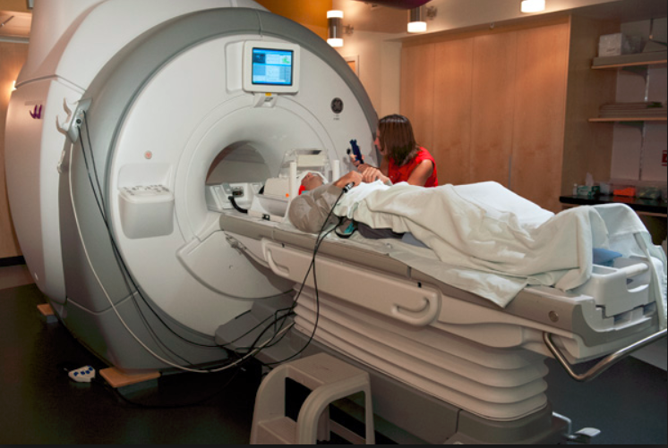
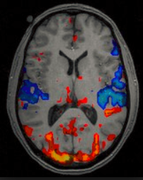
Clinical Need
Brain Disorders
Odor Research
Neuroscience
Over 18% of US adults suffer annually from a mental disorder
This number has been increasing since 2013
Rodents are the most commonly used mammalian subjects and are often exposed to stimuli for testing
fMRI used to characterize these disorders
Olfactory neuroanatomy is intertwined with parts of the brain responsible for emotion and behavior
[1]
[2]
[1] McClure, Max. “Stanford Psychologists Uncover Brain-Imaging Inaccuracies.” Stanford University, 7 Mar. 2013, news.stanford.edu/news/2013/march/brain-imaging-inaccuracies-030713.html.
[2] Devlin, Hannah. “What Is Functional Magnetic Resonance Imaging (FMRI)?” Psych Central, 17 July 2016, psychcentral.com/lib/what-is-functional-magnetic-resonance-imaging-fmri/.

Slide 3
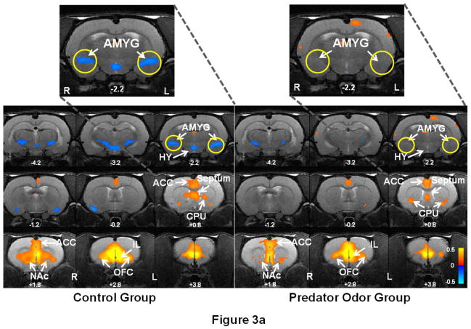
Clinical Need - Continued
[3]
[3] Liang, Z., King, J. and Zhang, N. (2014). Neuroplasticity to a single-episode traumatic stress revealed by resting-state fMRI in awake rats. NeuroImage, 103, pp.485-491.

Slide 4
Client Statement
“Design, characterize, and create an odor delivery system for an MRI subject holder that is capable of enabling the precise delivery of more than 3 odors with adjustable odor strengths during MR imaging regimes with a maximum input delivery delay of 30 seconds, with a reliable evacuation system to reduce confounding factors and safely remove stimuli.”
Notes:
Jon
Currently, to introduce odors to subjects within the MRI, a technician would have to rely on soaking a piece of gauze in a liquid odorant and introducing it manually while running the MRI. This technique introduces human error and does not guarantee that the amount of scent delivered to the subject is consistent between trials. Additionally, it limits the number of odors that can be delivered in quick succession, and does not allow for any amount of odor strength quantification. For this reason, our problem statement was to design, develop, and characterize an odor delivery system for an MRI subject holder that enables precise delivery of one or more odors during MR imaging regimes.

Slide 5
Design Strategy
Design
Objectives
Functions and Specifications
Final Design
Research and Development
Notes:
Pairwise charts to prioritize important aspects of the design.
Next, the team outlined a list of the Needs and wants of the clients.
FUnctions and specifications
Analyzing major parts of system and needs/wants allowed us to draft 3 potential designs and 1 final design

Slide 6
Design Objectives
Objectives
1. Delivery
2. Quantification
3. Evacuation
•HEPA
•Charcoal
4. Ease of Use
5. Cost Effectiveness
•Efficient
•User Manual
•Budget
•Time
•Precise
•Reproducible
•Reliable
Design Objectives
Functions and Specifications
Research and Development
Final Design
Notes:
Joey
-Used Pairwise analysis
-Delivery is most important
- Quantification
- Evacuation
-Additional objectives associated with any project is cost effectiveness and ease of use

Slide 7
Functions and Specifications
Function | Specifications
Component Connections | -Non-stick -Resistance to kinks and knots -Easily cleaned -Durable
Stimulus Quantification System | -Precision more important than accuracy -Relative measurements are acceptable for the design -Include addition for more accurate system in the future
Stimulus Evacuation System | -At least 90% stimulus evacuation between delivery periods -Safely deposit the waste gases outside the testing environment
Test Subject Interface | -Fits within the subject restraint system and MRI machine -Compatible with the MRI
Design Objectives
Functions and Specifications
Research and Development
Final Design

Slide 8
Functions and Specifications
Function | Specifications
Stimulus Storage | -Prevent cross contamination -At least 3 stimuli -Efficient stimuli switching
Flow/Carrier Gas Source | -Stimulus flow rate of 1.5 L/min -Short, intense bursts of odor -Prevent backflow
Control Method | -Start time delay of less than 30 seconds -Near instantaneous response time for control method
Design Objectives
Functions and Specifications
Research and Development
Final Design

Slide 9
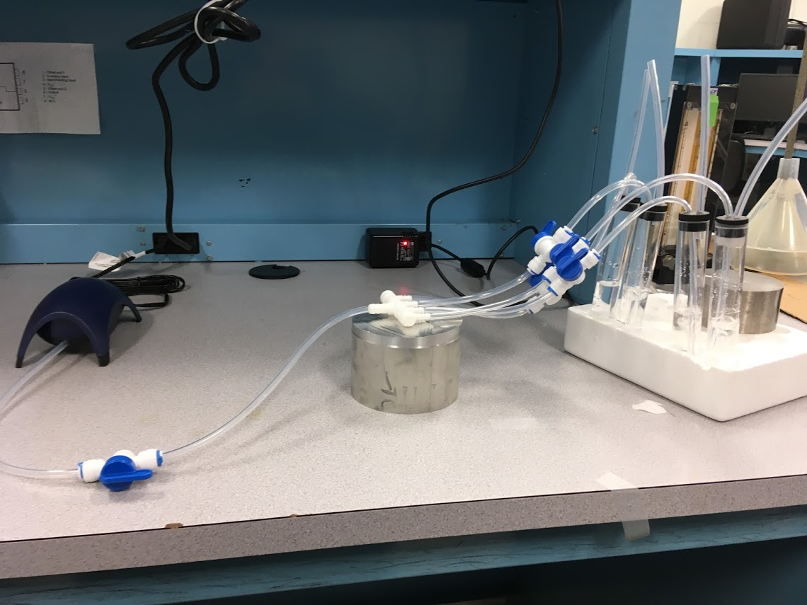
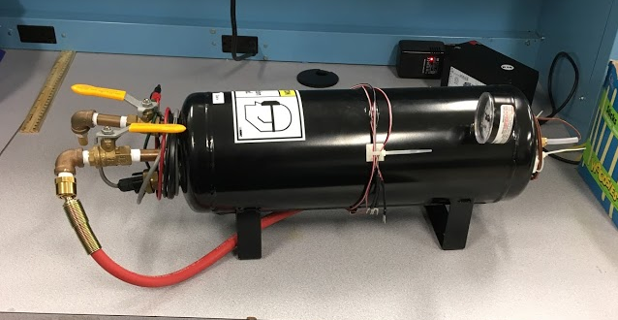
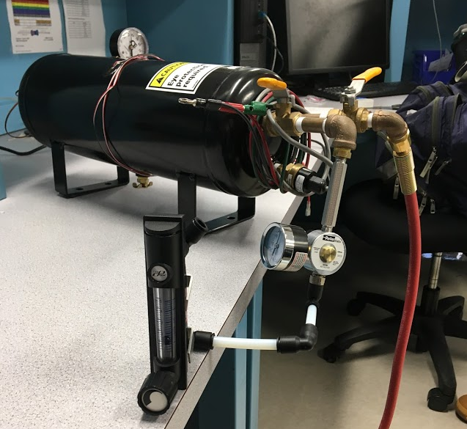
Research and Development
Elements and Means
Stimuli Container Testing
Compressor/Air Tank Validation
Air flow Regulation Testing
Design Objectives
Functions and Specifications
Research and Development
Final Design
Notes:
Joey
Quantitative means analysis

Slide 10
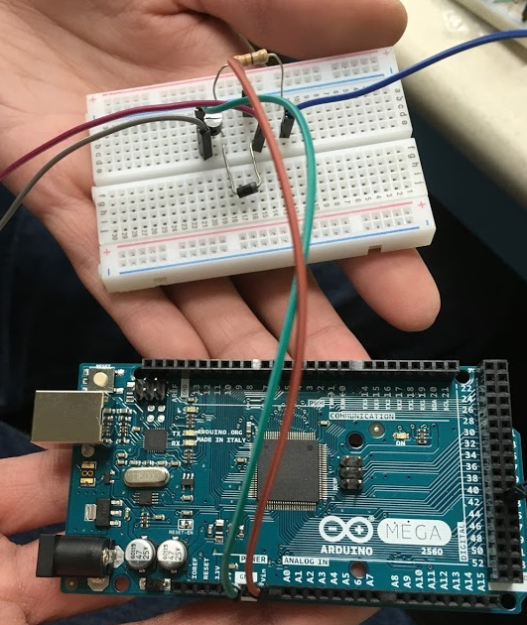
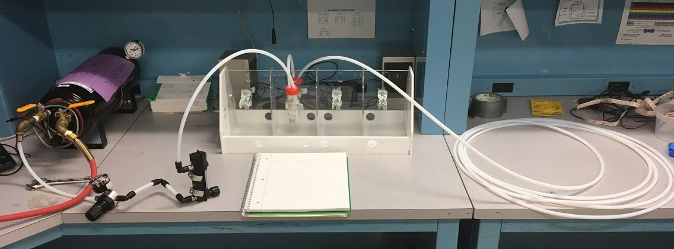
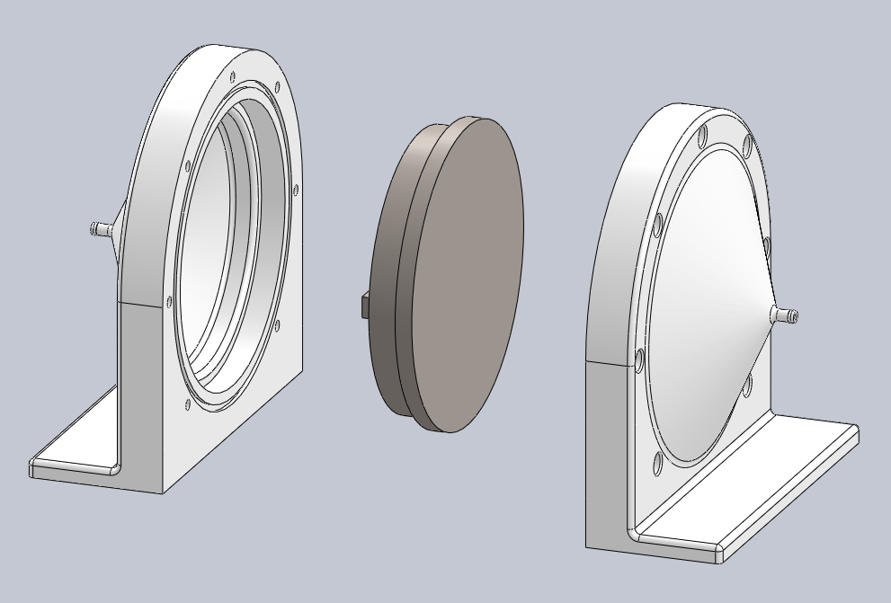
Research and Development
Quantification Trials
Control Box/Programming
Evacuation Testing
Final System Validation
Design Objectives
Functions and Specifications
Research and Development
Final Design
Notes:
joey

Slide 11
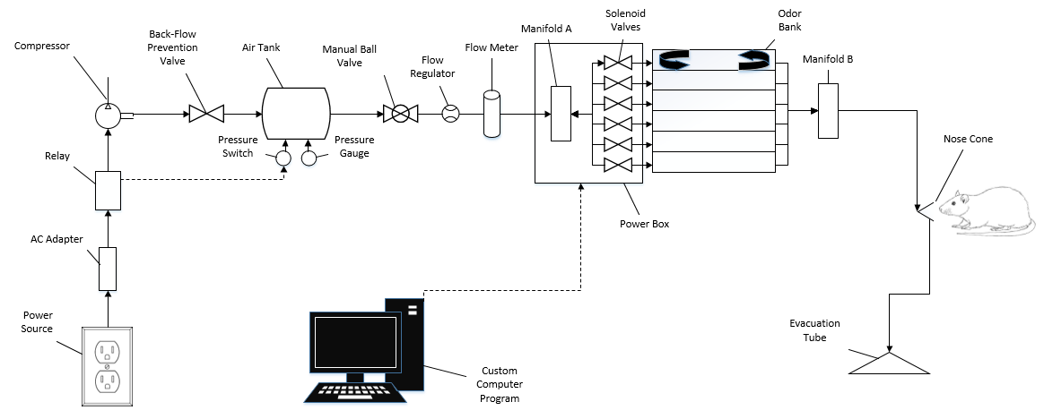
Final Diagram
Design Objectives
Functions and Specifications
Research and Development
Final Design
Notes:
After outlining the design objectives, a Block diagram was created
Block diagram = high level view of the design.
Computer interface and power source power and run the device.
Carrier air source = delivery, odor bank/airflow control = quantification, then subject and evacuation

Slide 12
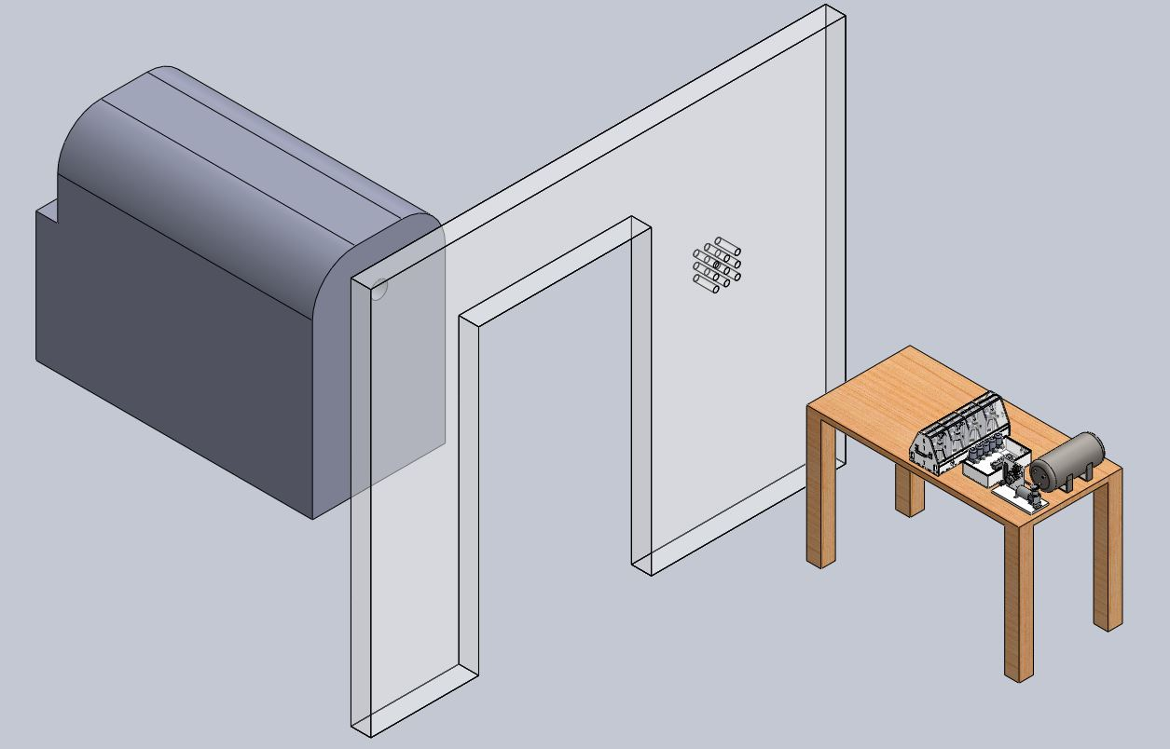
Room Layout
Testing Room
MRI Machine
MRI Room
Final Device
Notes:
josie

Slide 13
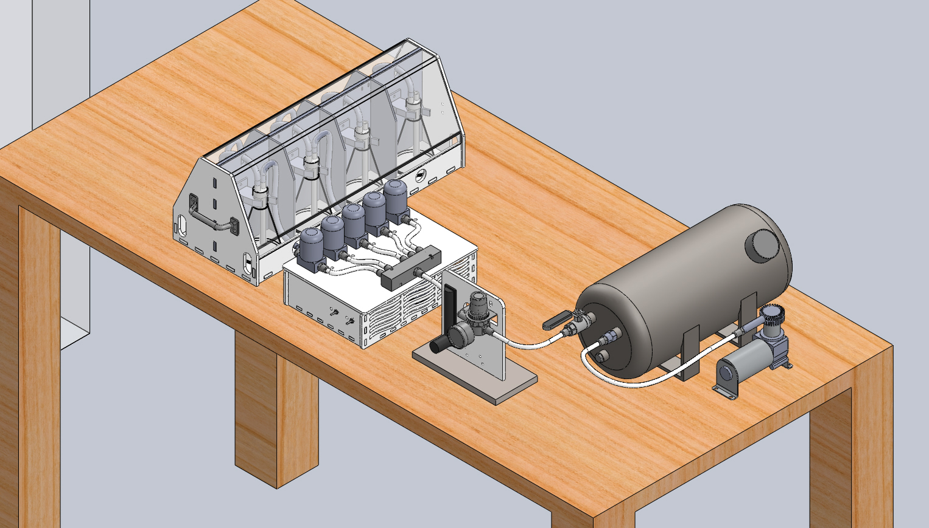
Final Device
Notes:
josie

Slide 14
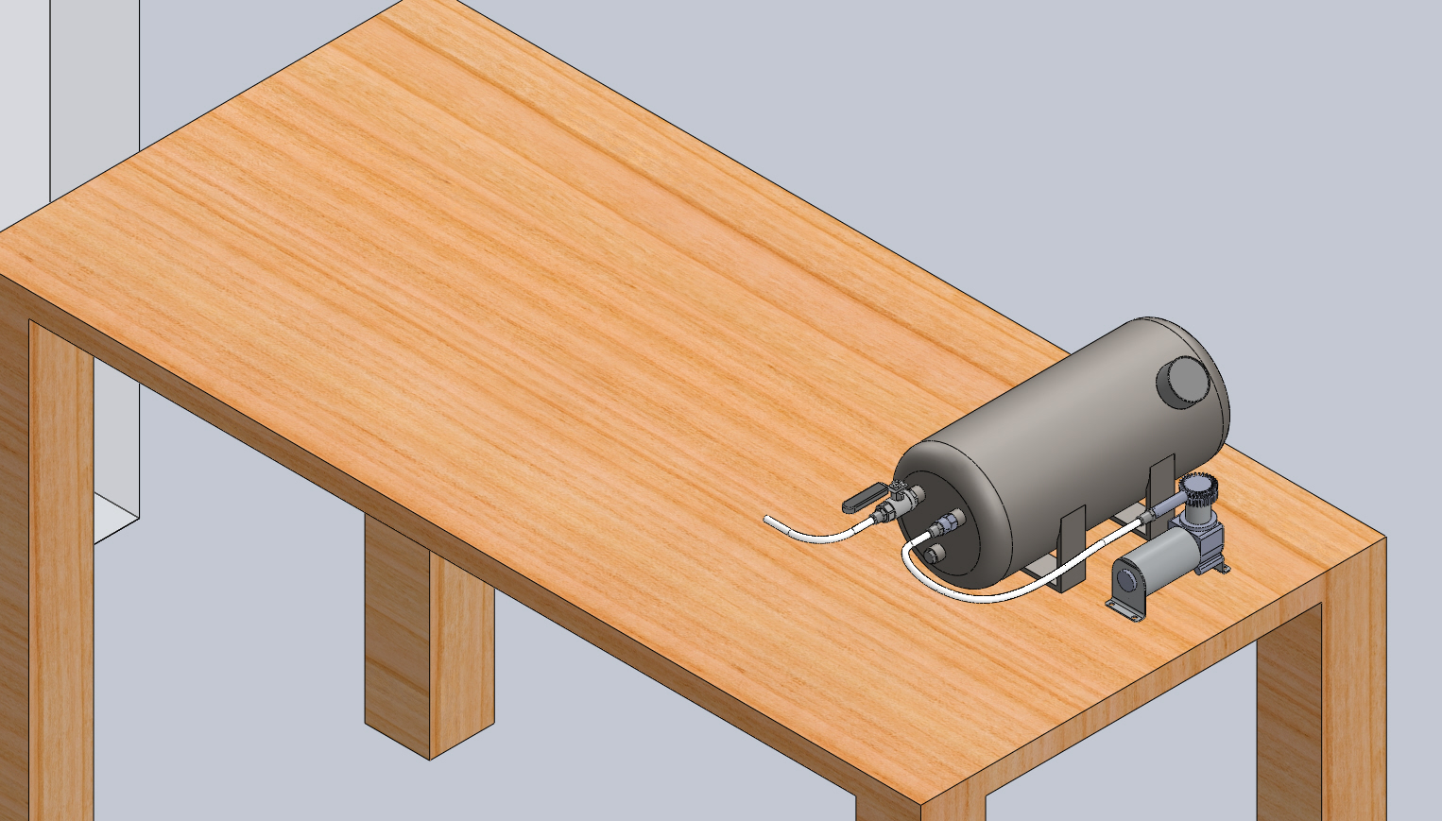
Carrier Air Source
Notes:
josie

Slide 15
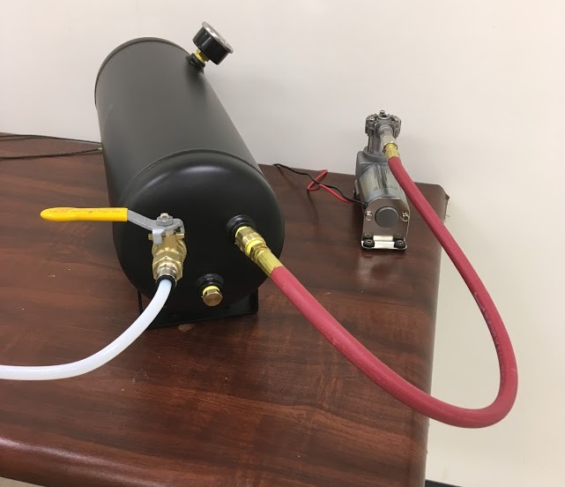
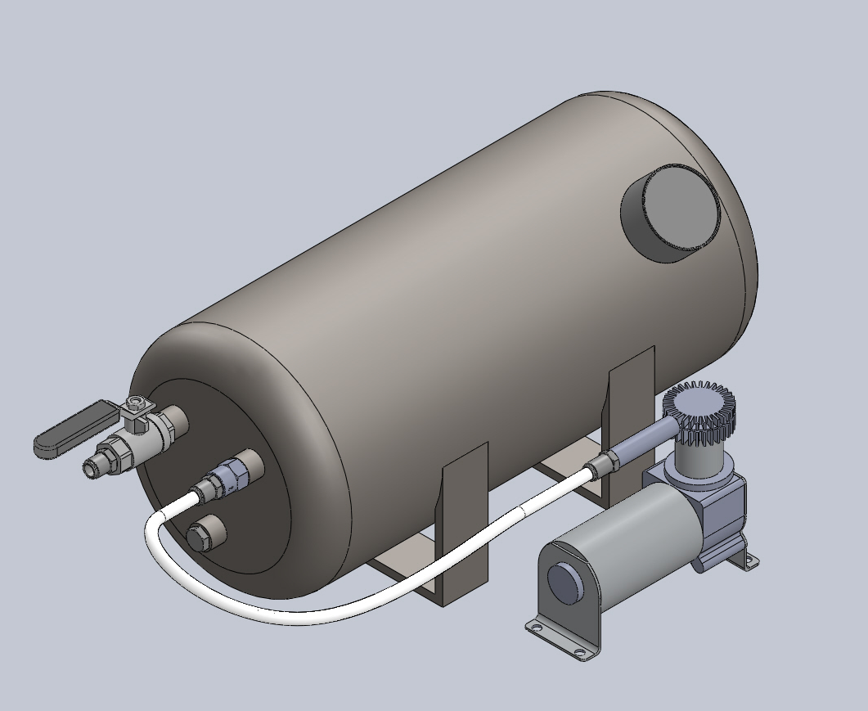
Carrier Air Source
Air Tank
Compressor

Slide 16
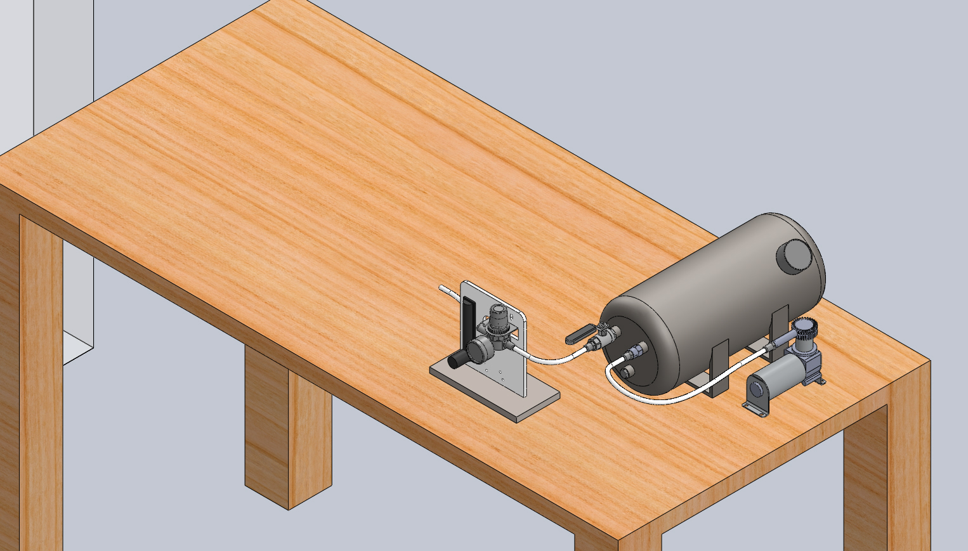
Air Flow Control
Carrier Air Source
Notes:
josie

Slide 17
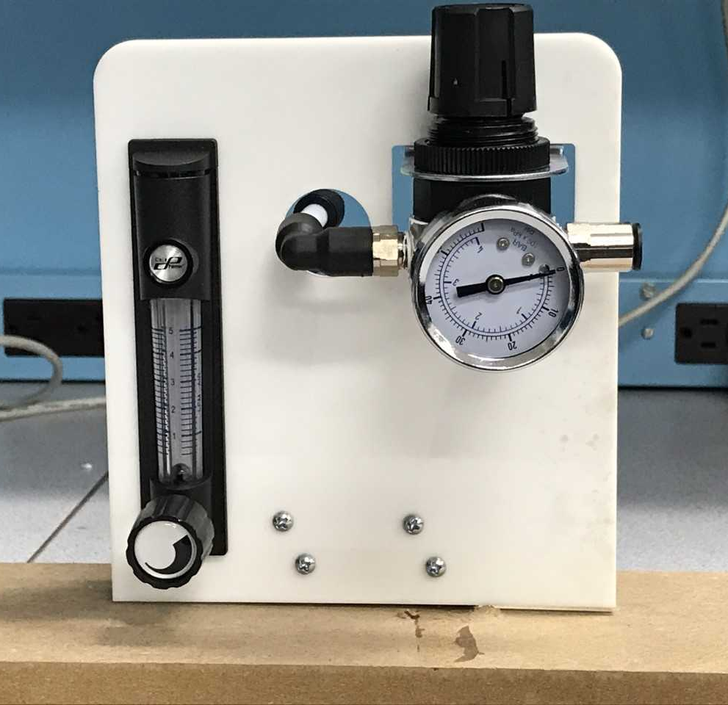
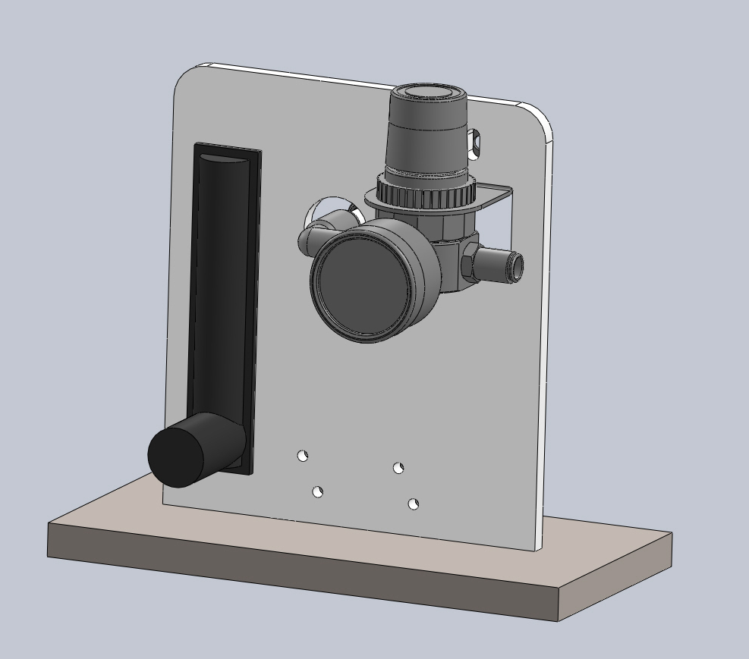
Air Flow Control
Flowmeter
Pressure
Regulator

Slide 18
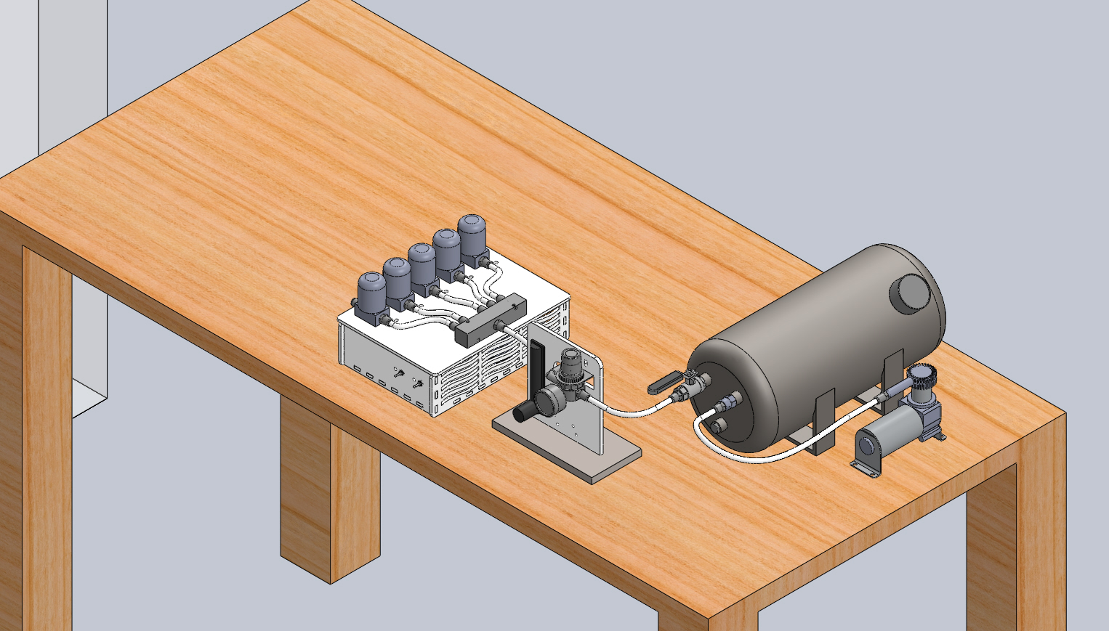
Control Box
Flow Control
Carrier Air Source
Notes:
josie

Slide 19
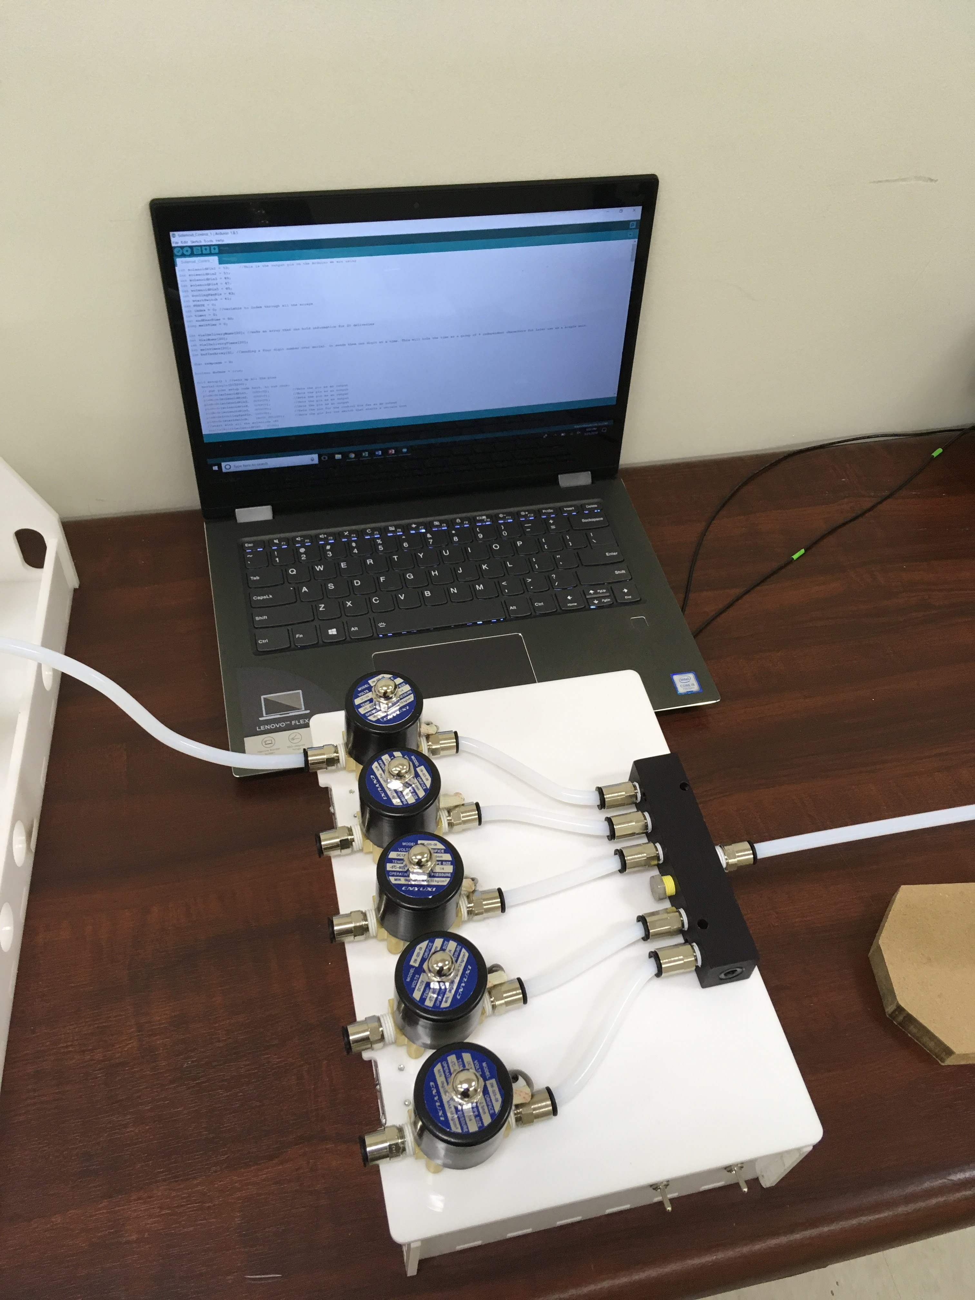
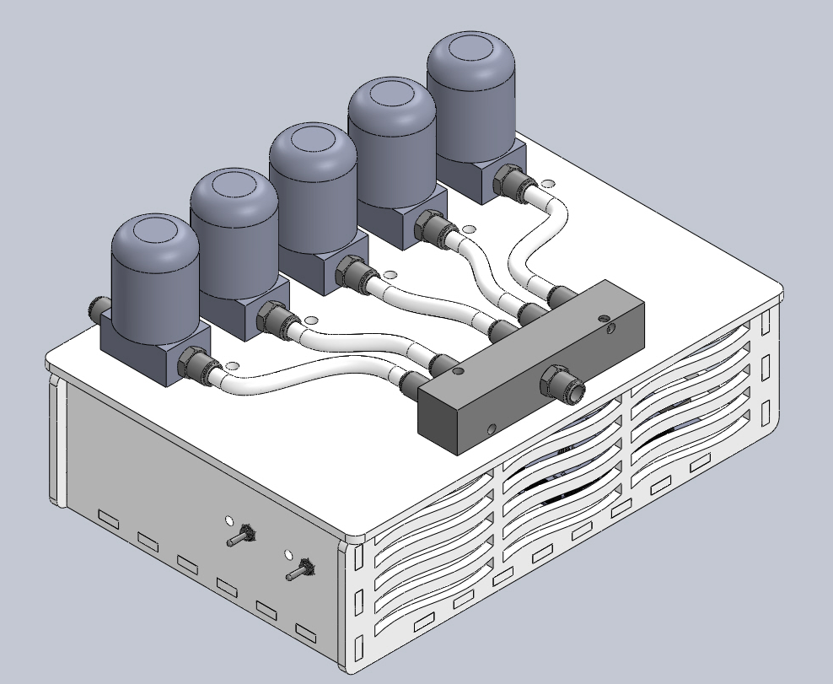
Control Box
Solenoids
Manifold

Slide 20
Odor Bank
Control Box
Flow Control
Carrier Air Source
Notes:
josie

Slide 21
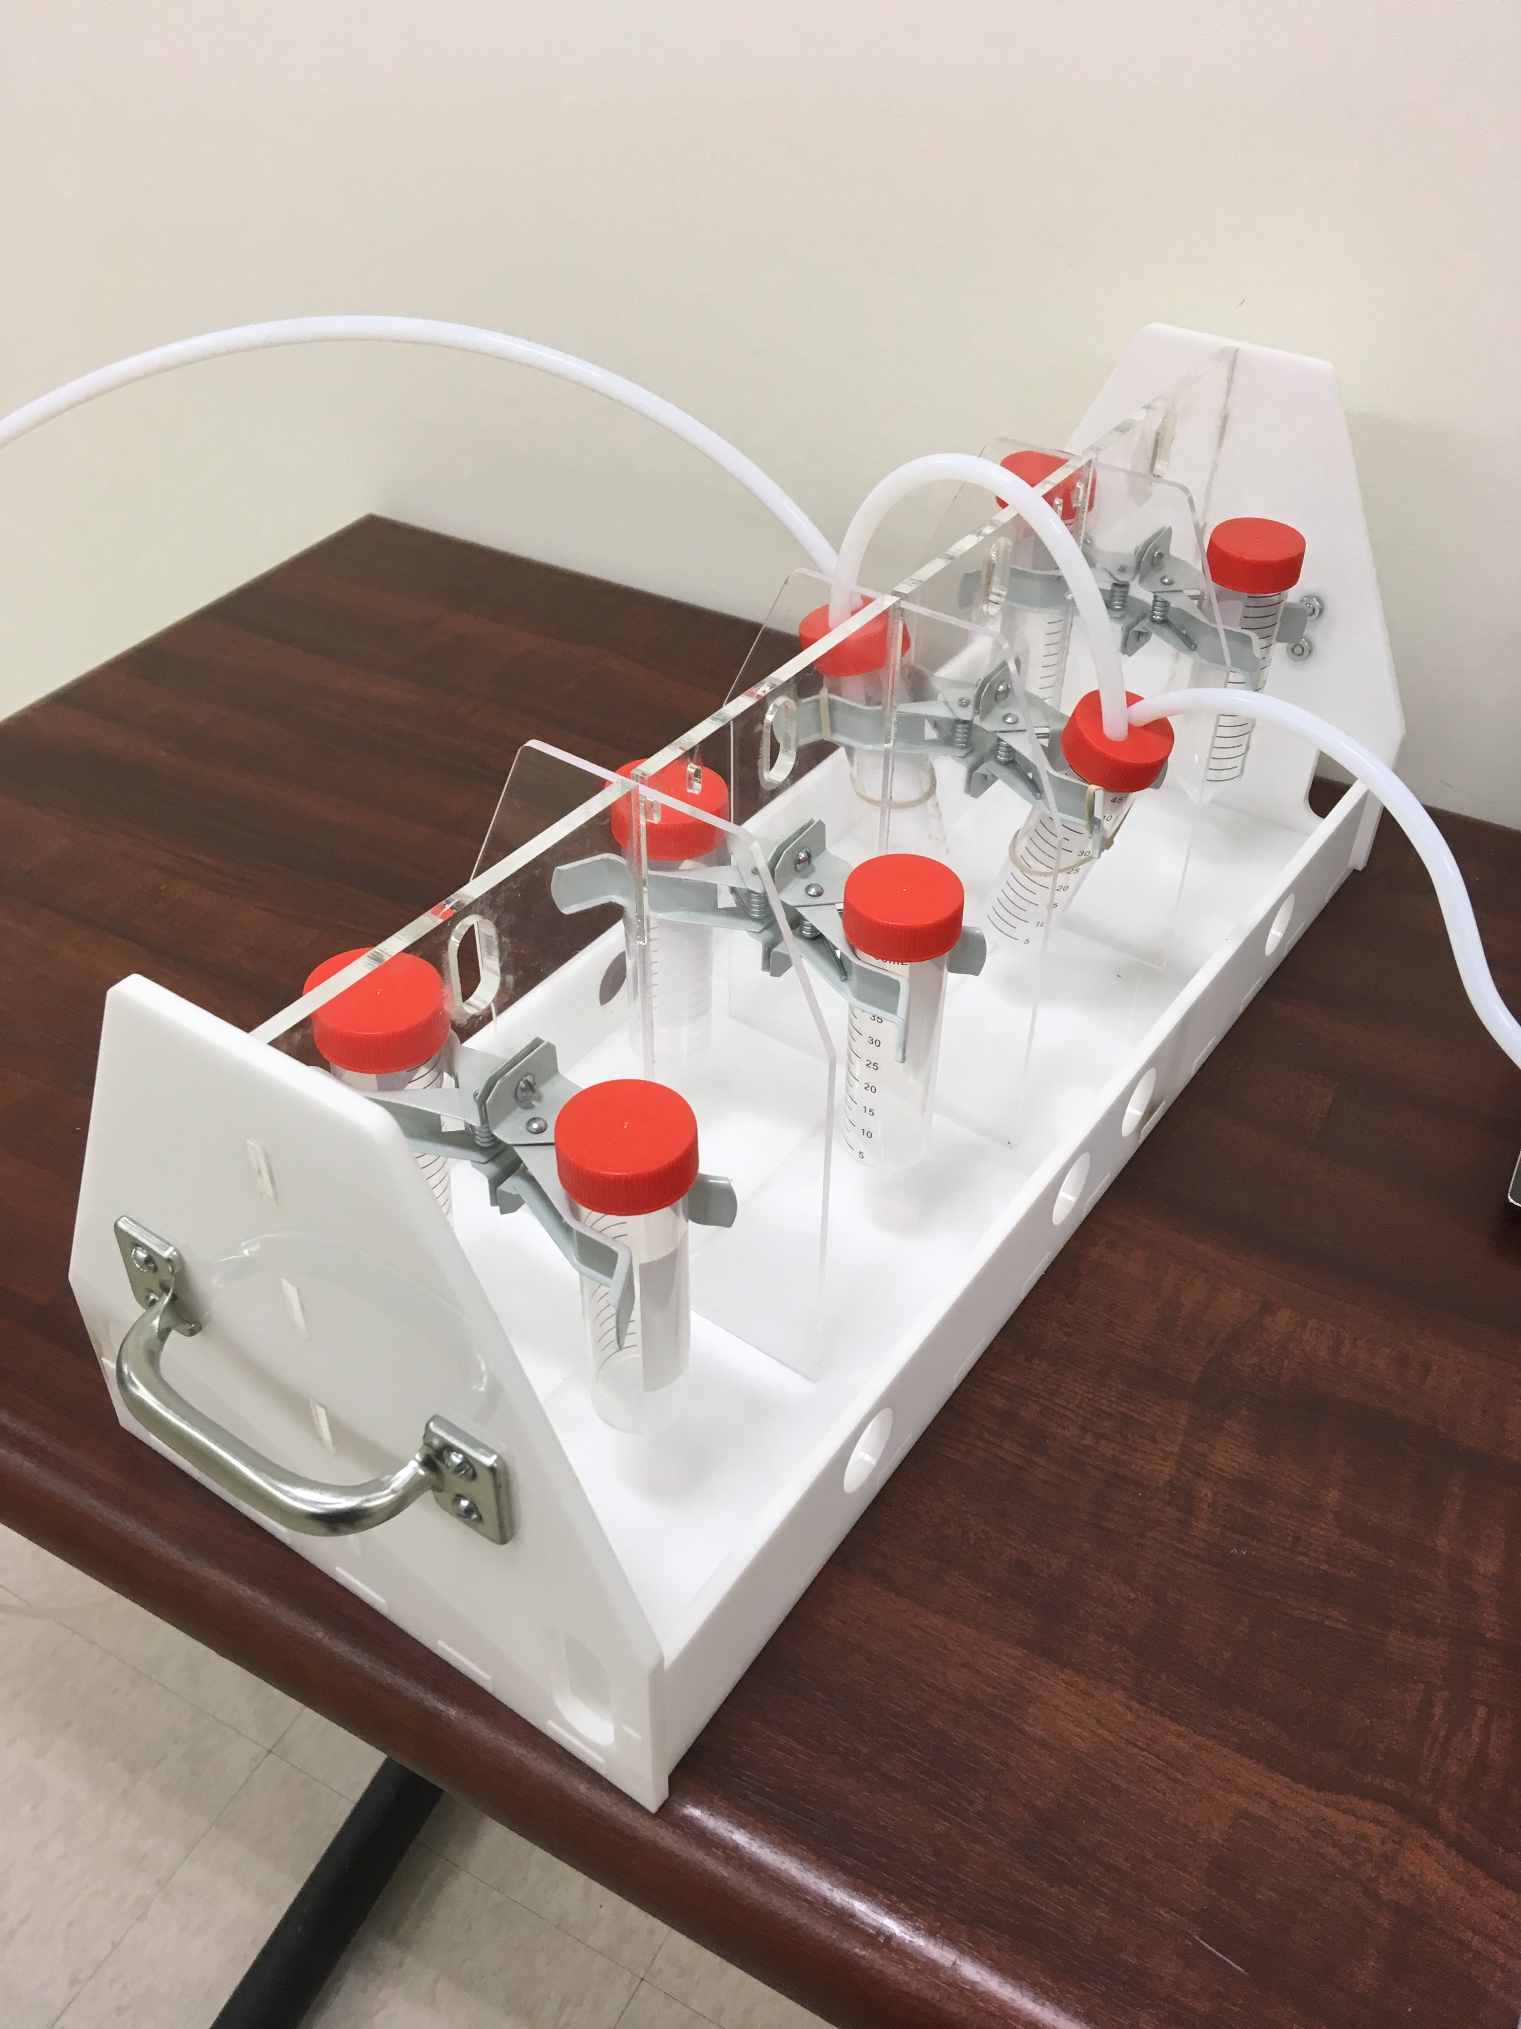
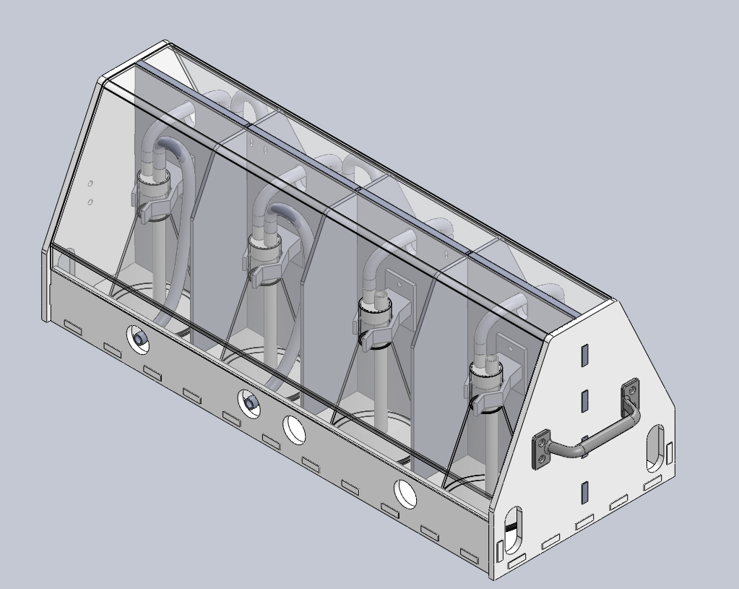
Odor Bank

Slide 22
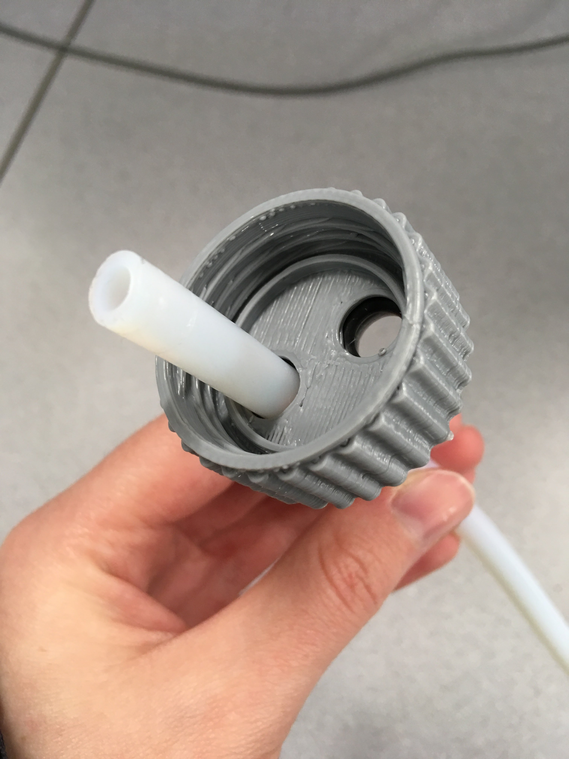
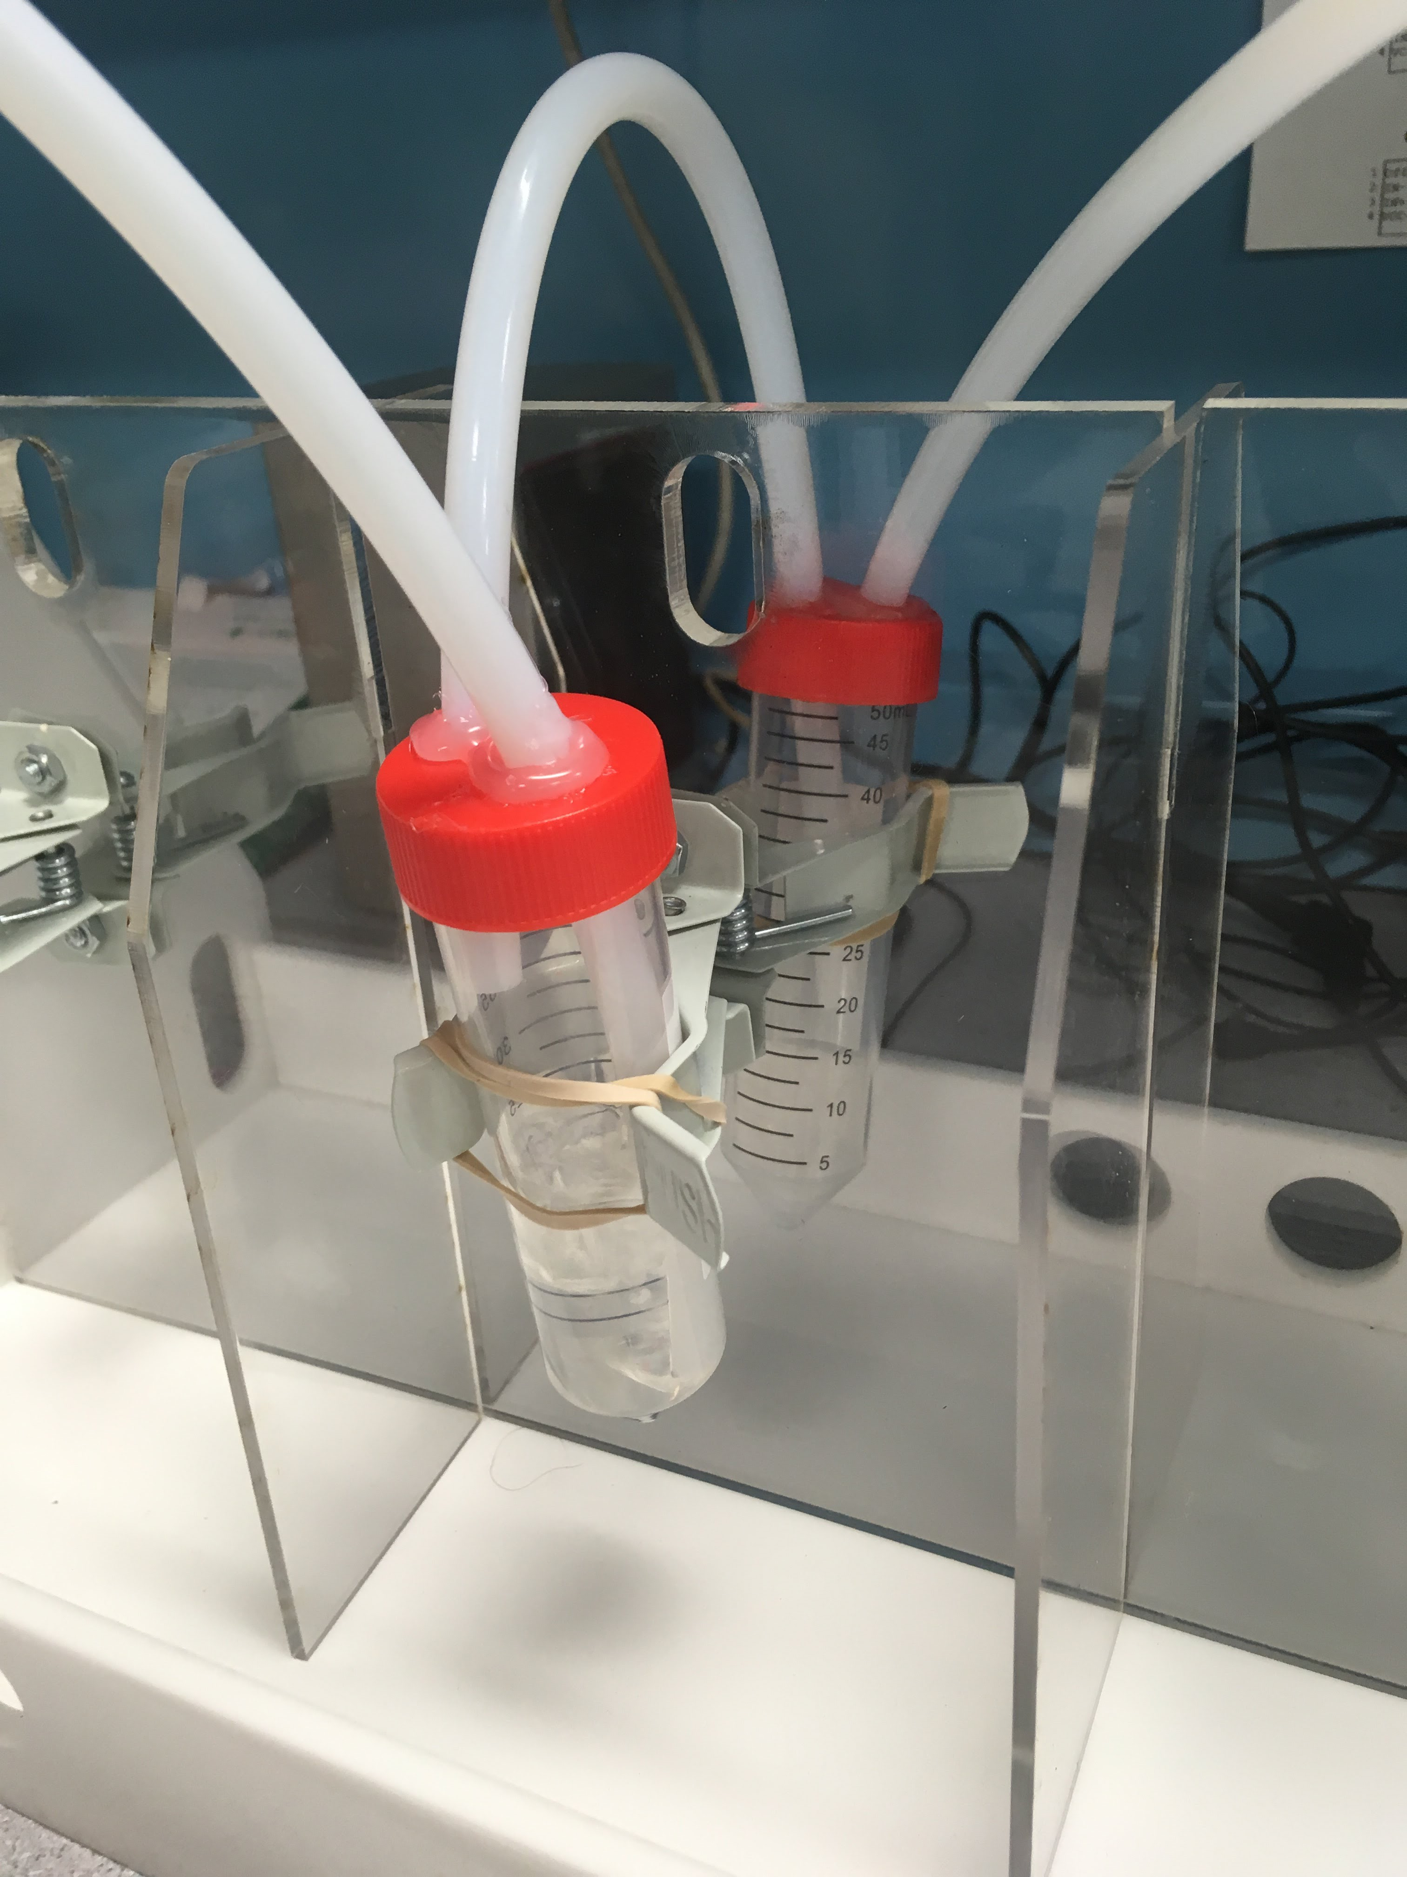
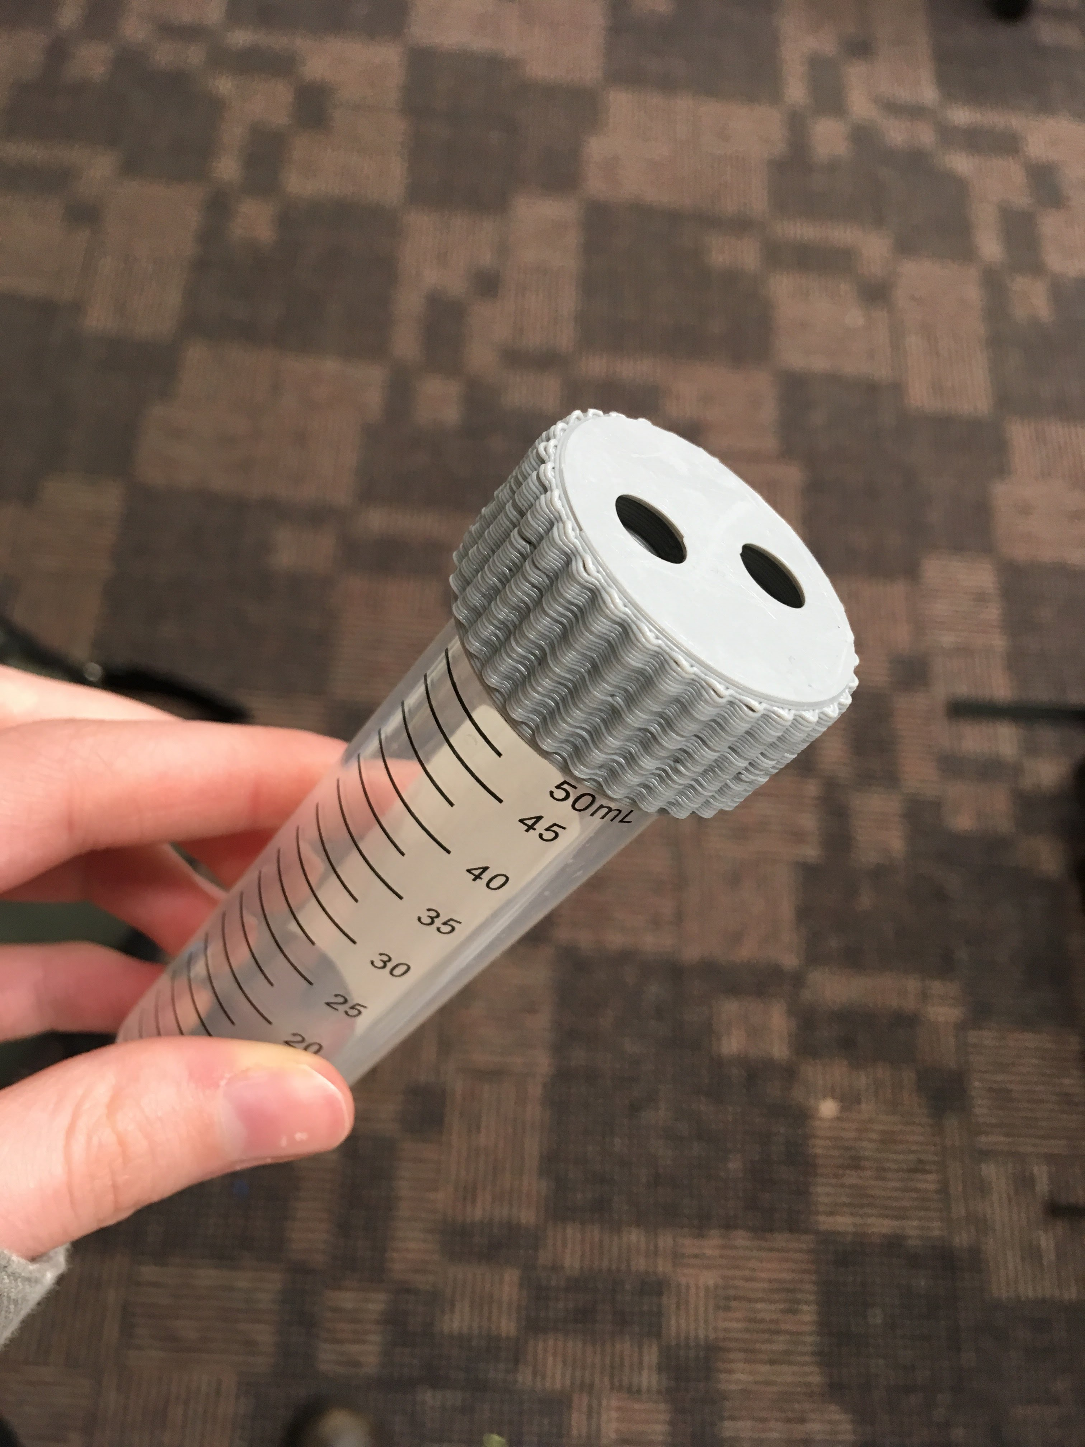
Caps

Slide 23
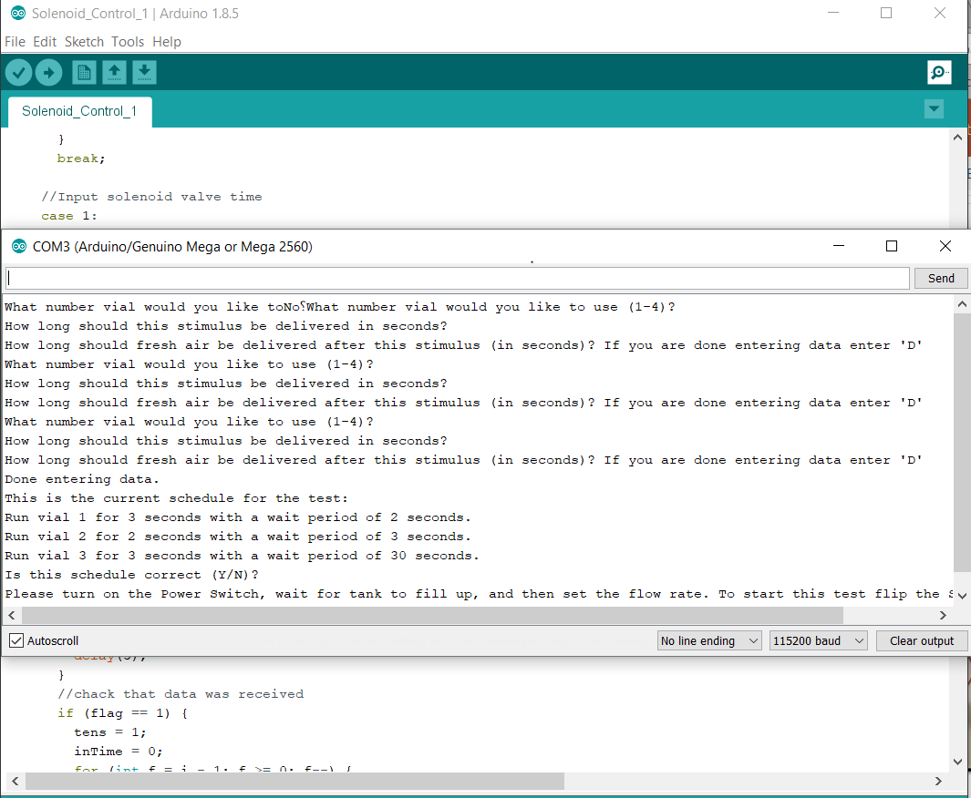
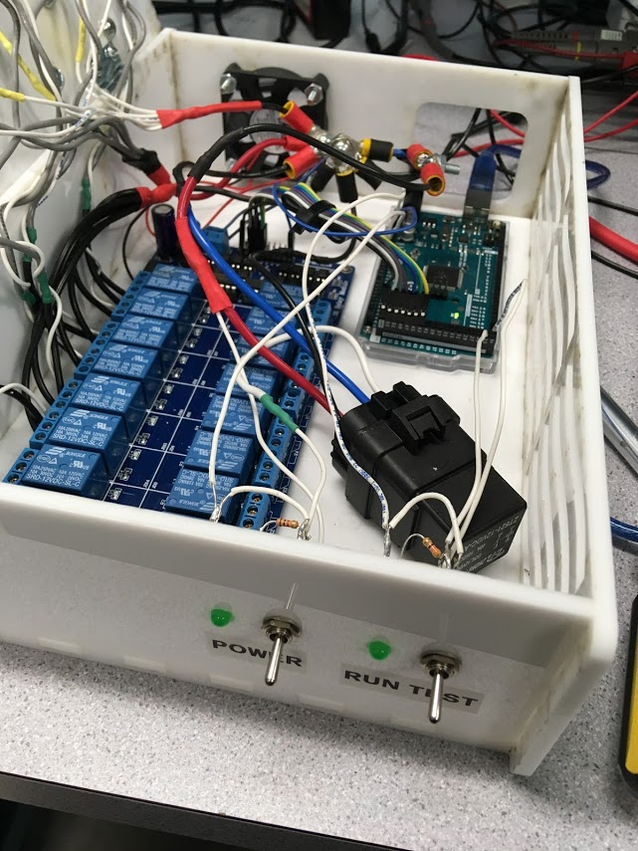
Automation and User Interface
Notes:
josie

Slide 24
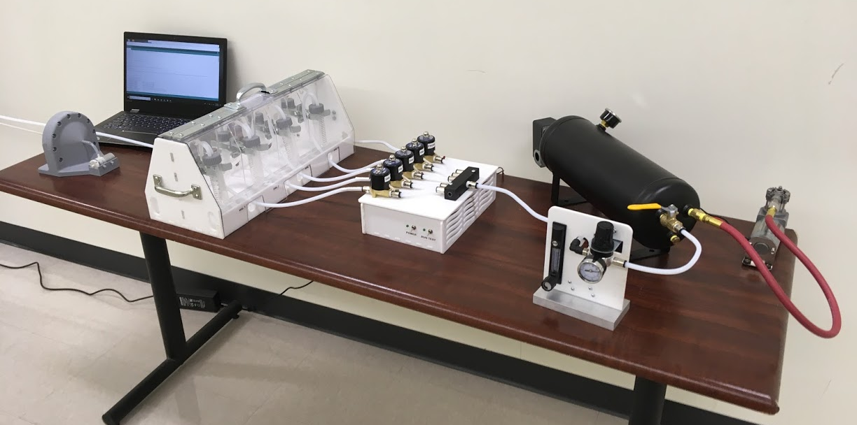
Final Design
Graphic User Interface
Evacuation System
Carrier Air Source
Odor Bank
Control
Box
Air Flow
Control
Notes:
josie

Slide 25
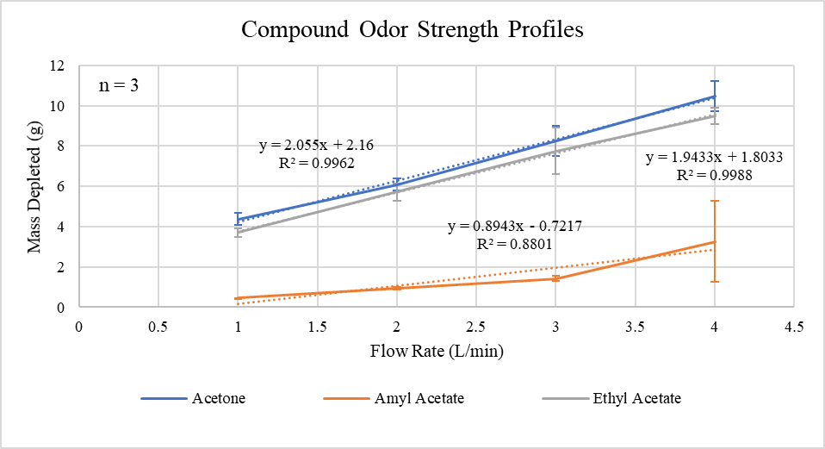
Odor Quantification
Notes:
Jon
As Joey had mentioned earlier, one of our focuses during device testing was to gain a better understanding of the degree to which we can quantify the strength of odor being delivered by the device. To accomplish this goal, we started by selecting various compounds based on their chemical structures and vapor pressures, since these factors along with the size and shape of the vial used to store the odorants, the initial volume of the odorant, the flow rate introduced, and the duration of flow can all contribute to the strength of an odor. Starting with amyl acetate, an amine with a relatively low vapor pressure of about 4 mmHg, we analyzed the mass depleted at 4 different flow rates ranging from 1 to 8 L/min. As you can see from the graphed data, the amount of mass depleted changed quite linearly with respect to the flow rate. Each of these tests were run for 1 hour with conical centrifuge tubes and an initial volume of 15 mL.

Slide 26
Conclusions
Objectives
1. Delivery
2. Quantification
3. Evacuation
•HEPA
•Charcoal
4. Ease of Use
5. Cost Effectiveness
•Efficient
•User Manual
•Budget
•Time
•Precise
•Reproducible
•Reliable

Slide 27

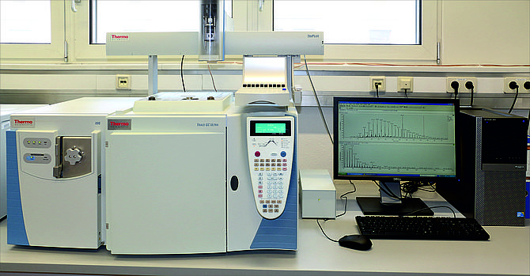
Future Improvements
[4]
Testing
Characterize more stimuli on odor spectrum.
Features
Incorporate anesthesia delivery
Upgrades
For more precise quantification install a Gas Chromatography Flame Ionization Detector (GC-FID).
Further develop the automation of our system. Develop a phone compatible app.
[5]
[4] “Erlenmeyer Flasks, Set of 5.” Home Science Tools, www.homesciencetools.com/product/erlenmeyer-flasks-set-of-5/.
[5] LEHRSTUHL FÜR ERDÖLGEOLOGIE (2018). THERMO SCIENTIFIC TRACE GC/FID GC/MS. [image] Available at: http://erdoelgeologie.unileoben.ac.at/en/5003/ [Accessed 17 Apr. 2018].
Notes:
josie

Slide 28
Acknowledgements
WPI BME and ME Departments
Trevor Borth
Dean Arthur Heinricher
Dr. Marion Emmert
Dean Jean King
Laurellee Payne
Dr. Guillaume Poirier
Professor George Pins
Professor John Sullivan
Lisa Wall
Notes:
josie

Slide 29
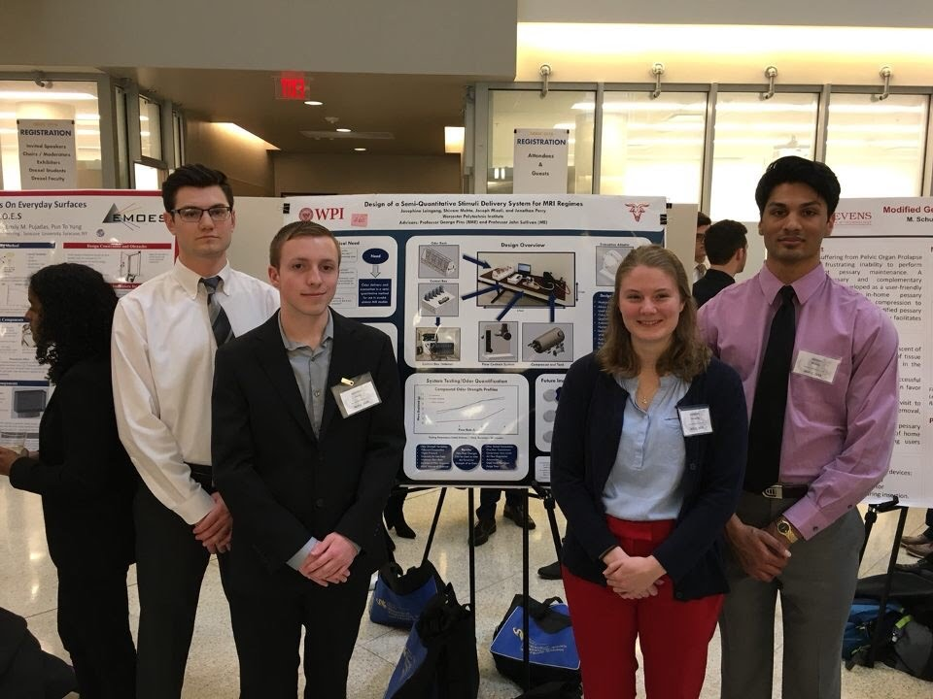

Thank You!
Questions?
Notes:
Catherine Notes:
- Gets a little lost in SolidWorks design – needs labels!!!!
- More labels could be included overall to understand
- Conclusion/Future Work slide needed
- Acknowledgments is also needed at the end
- Might be more useful to have actual fMRI images with and without odor
- Need to work on NEEDS again!!!!!!!!!!!!!!!!!!! (make it more concise)
Pins and Sullivan Notes:
- Past slide from A Term presentation showed fMRI and odor research presentation
- Picture of yardstick might be useful for client information
- Don't say that reproducibility is reduced – just say that yardstick can't be quite quantitative
- Do not say the word USELESS!!!!! - Joey!
- The need that design is addressing
- Knowledge gap between initial client statement and design strategy
- Add functions and specifications!!!!!!!!!!
- Multiple odor delivery systems
- Revised client statement should be long and include functions and specifications
- Add to report and include in presentation!!!!!!!
- Turn client statement to revised client statement
- Design strategy slide is kind of un-necessary or keep along the entire section of the presentation
- Give a brief example on design functions and specifications – some more information
- Like how Joey did on elements and means
- Maybe after design objectives -
- Add priorities to design objectives -> functions and specifications -> concept drawing
- Research and development slides are confusing and phases are not defined
- Make Slides 9 and 10 more dynamic and connect to the objectives and earlier design processes
- Objectives slide is too detailed, print is too small!
- Remove details under individual objectives
- Prioritize objectives as well – maybe on next slide
- Also make order on slide match with order spoken about
- Josie – have it setup as a cascading filter to trap liquids, rather than saying that some might bubble over to catch
- Maybe show final design stuff earlier, or reduce front-end stuff
- Under-represented validation testing like flow calculation, bubble trap stuff, etc...
- Quantification needs error bars and n=whatever needs to be added
- Quantification needs an explanation of why certain odors were chosen – add in odor thresholds
- Make the whole presentation fit more into the overall context
- Orient audience through program chart to make it less confusing
- LOOK AT PAST MQP PRESENTATION

Slide 30
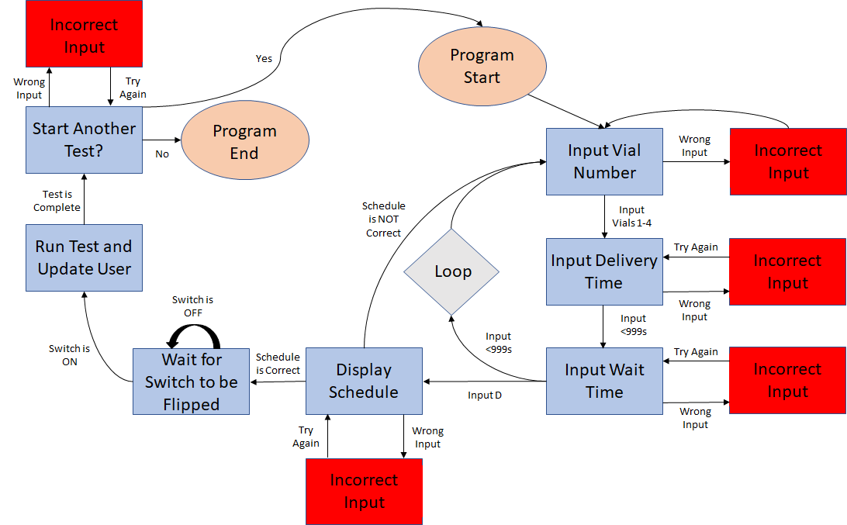
Program Flow Chart
Notes:
Jon
To interface with the system, we have made a simple graphical user interface which will allow the test operator to create their testing sequence to have the system run automatically. Once the program is started, the user will be prompted with inputting the vial number to use first, which will be followed by inputting the delivery time for this vial, and then the time between each odor delivery sequence. Each step involving user input will be able to catch improper input such as letters when a number is required, or time points that exceed 9999 seconds. When inputting the wait time between each odorant, the program will loop back to asking for the next vial, unless the letter D is entered, which will signify that the user is finished entering data. The schedule entered by the user will then display and ask the user if it is correct. If not, the user can start over, and if it is correct, the system will wait for the second toggle switch to be flipped. When it is, the test will begin and update the user along the way. Once it has been completed, a final prompt will ask the user if they would like to run another test, which will start the program over again if they respond with a Y.

Slide 31
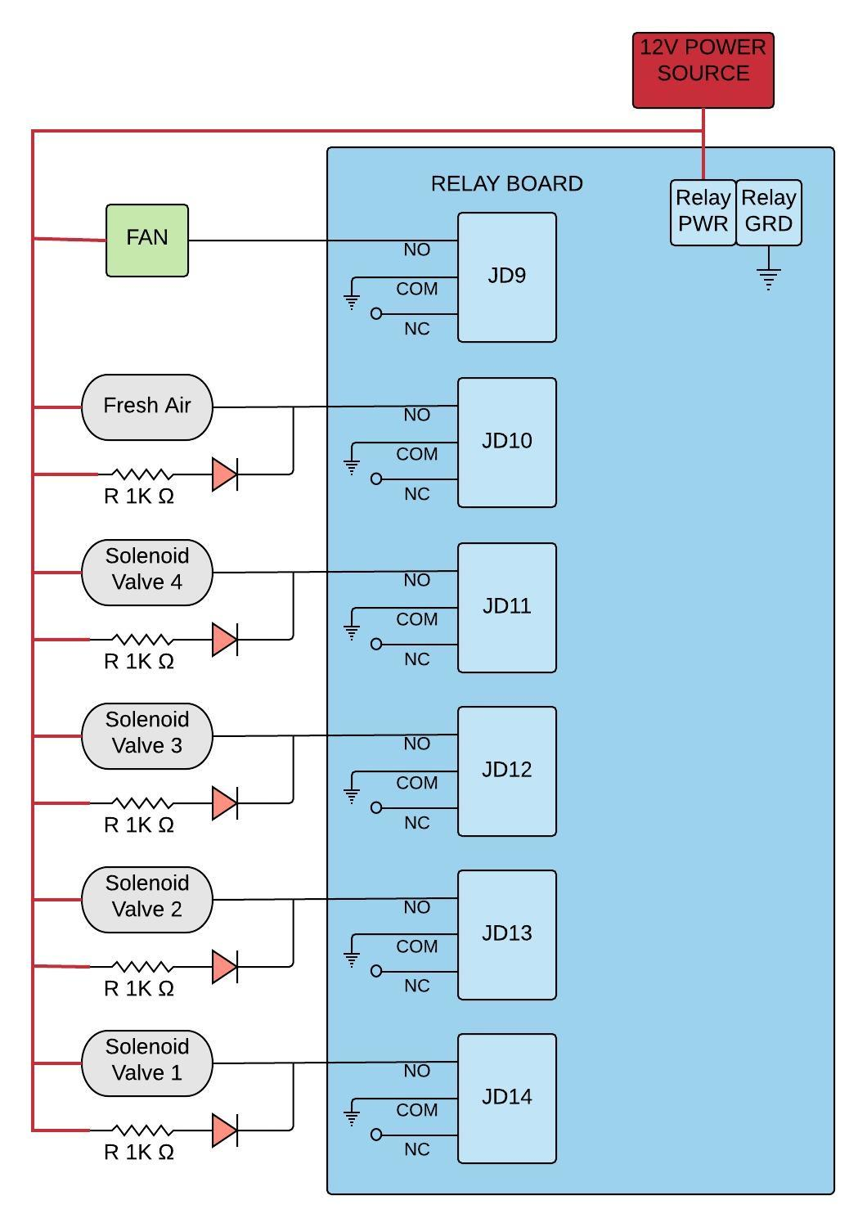
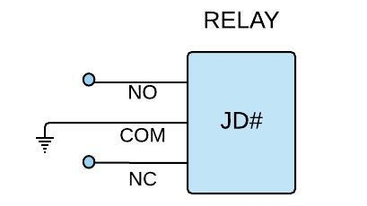
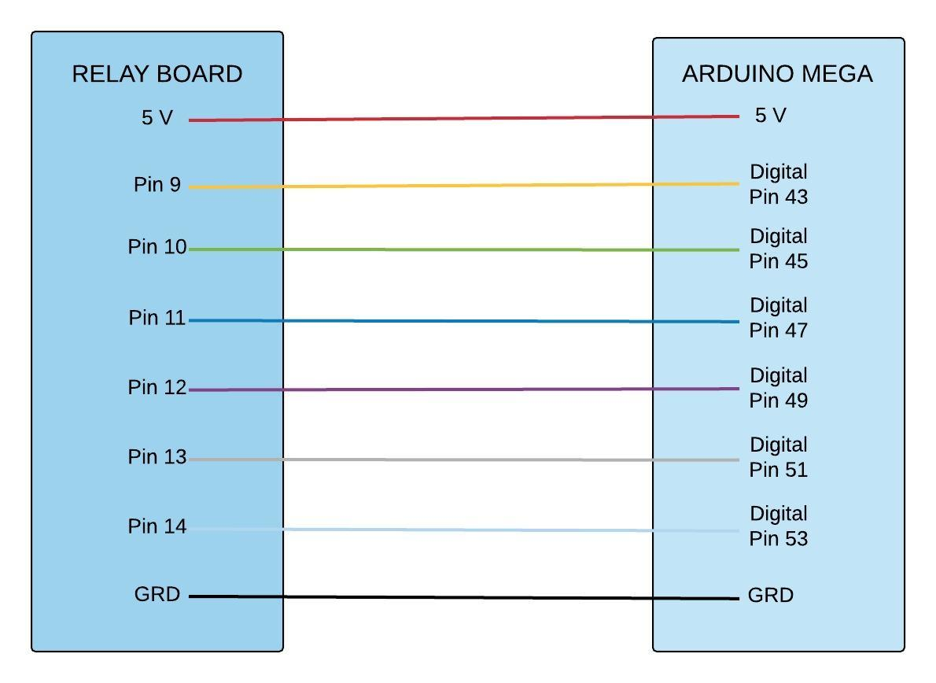
Solenoid Valve and Arduino Mega Wiring

Slide 32
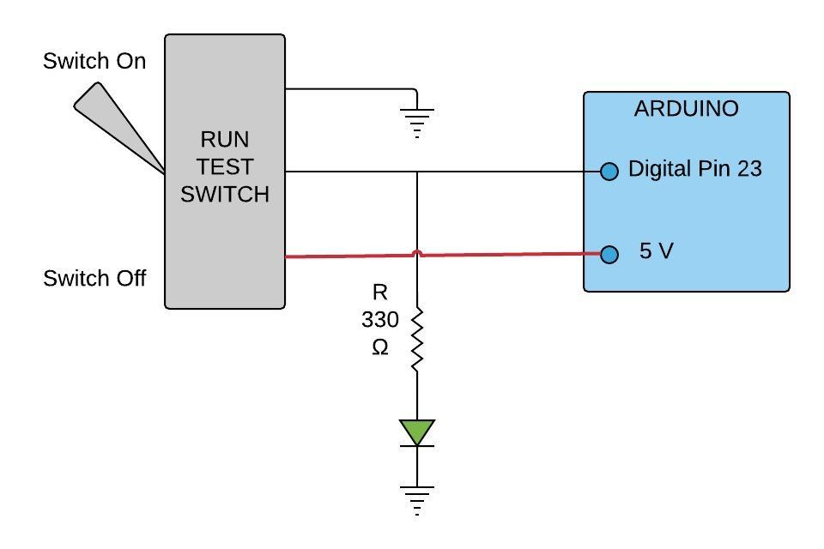
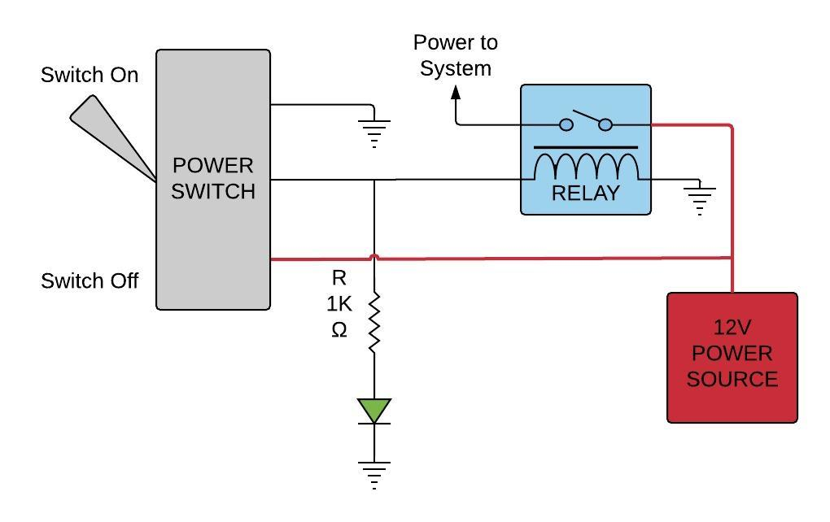
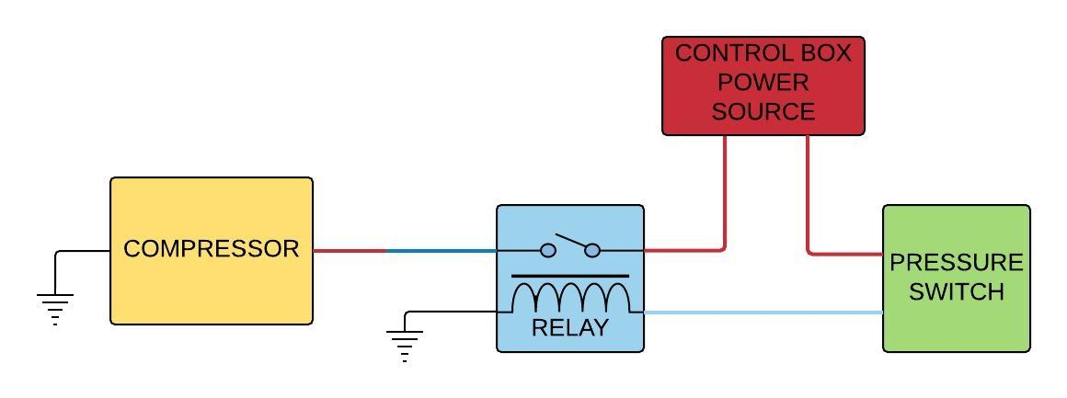
Switch and Compressor Wiring

Slide 33
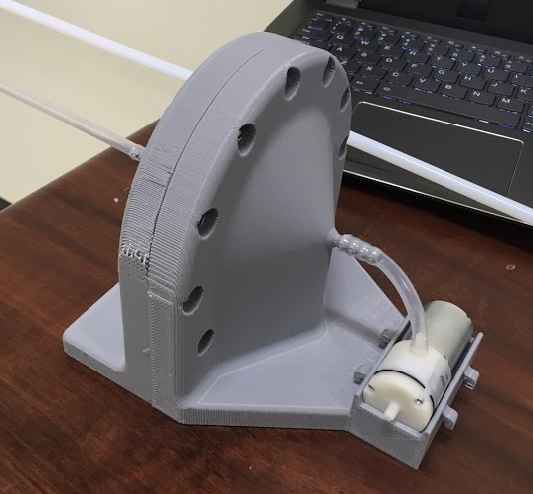
Evacuation

