Slide 1
Evaluate the Interactives at TPM and MR
Presented by: ​
Cole Flegel​
Huaxin Yang​
Thomas Perry​
Ziheng (Leo) Li
The
Postal
Museum

Slide 2
Introducing the Team
Introducing the Team
Cole Flegel
Huaxin Yang
Tom Perry
Ziheng (Leo) Li
Robotics Engineering
Management Engineering
Biology & Bio-technology
Computer Science & Electrical Engineering

Slide 3
Report Map
1.
Project Overview
2.
Attraction
&
Placement
4.
Engagement
&
Interaction
3.
Usability
& Intuitiveness
5.
Recollection
&
Learning
6.
Recommendations

Slide 4
We are here because TPM …
Opened July 28,2017
Holds large number of interactive exhibits
Yet to conduct a formal evaluation of interactives
Notes:
\

Slide 5
We did…
1. Identify current and best practices
5/8 ~ 6/7
2. Solicit TPM Staff Knowledge
5/11 ~5/22
3. Assess Visitor Experience
5/23~6/7
4. Evaluate selected interactives in-depth
6/3~6/16

Slide 6
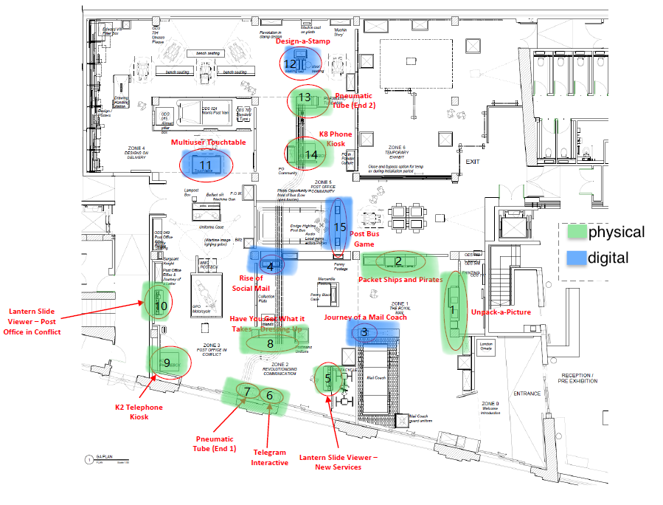
TPM Layout

Slide 7
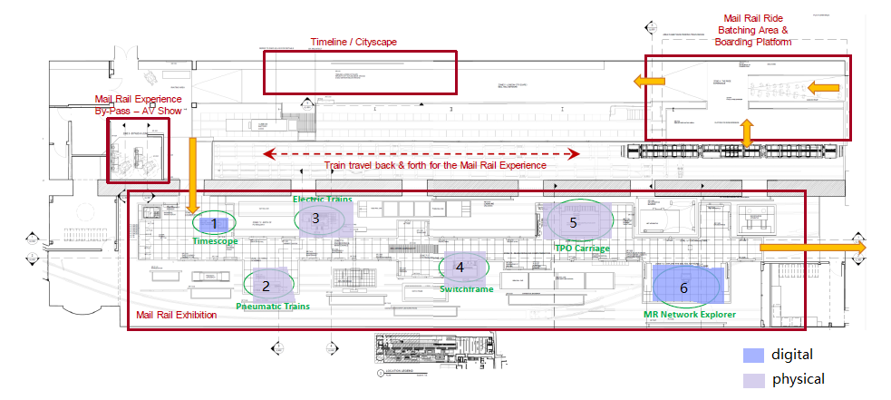
MR Layout

Slide 8
Attraction & Placement
Heat-map
Where do visitors linger?
How attractive are for each exhibit?
Trace-map
Scoring
Attraction Score
Placement Score
How do visitors navigate through the gallery?
What’s the traffic flow for each exhibit?

Slide 9
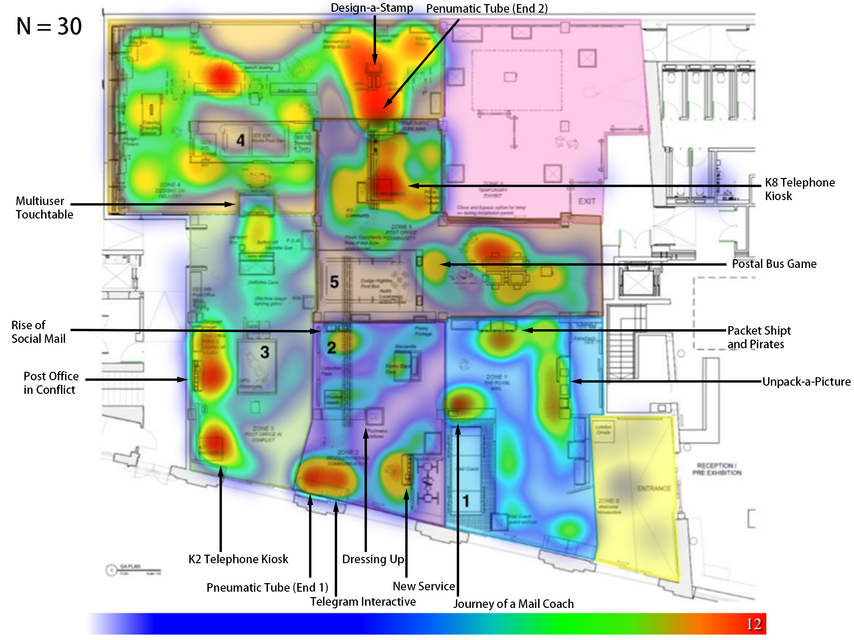
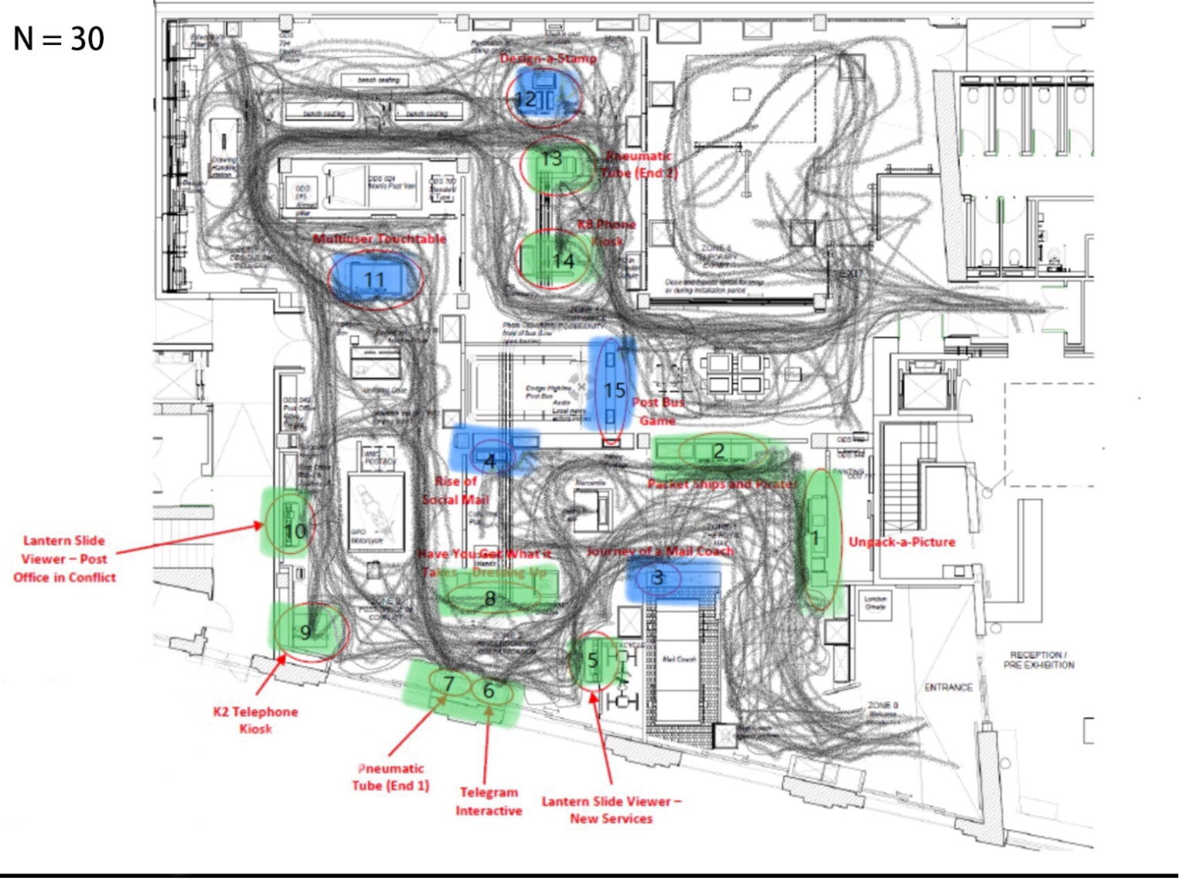
MR Heat & Trace Map
1
1

Slide 10
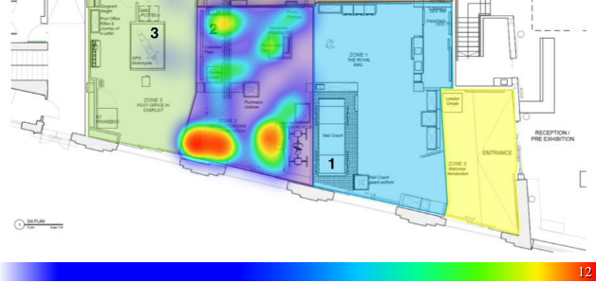
Issue 1: TPM Dressing Up
TPM Placement Score Average:
73/100
TPM Dressing Up Placement Score:
11/100

Slide 11
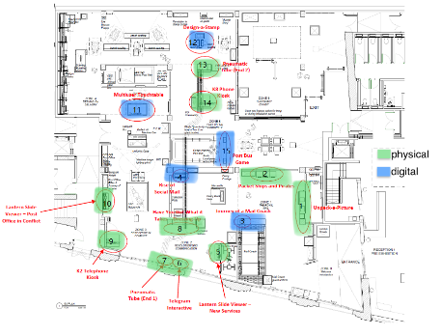
Issue 1: TPM Dressing Up

Slide 12
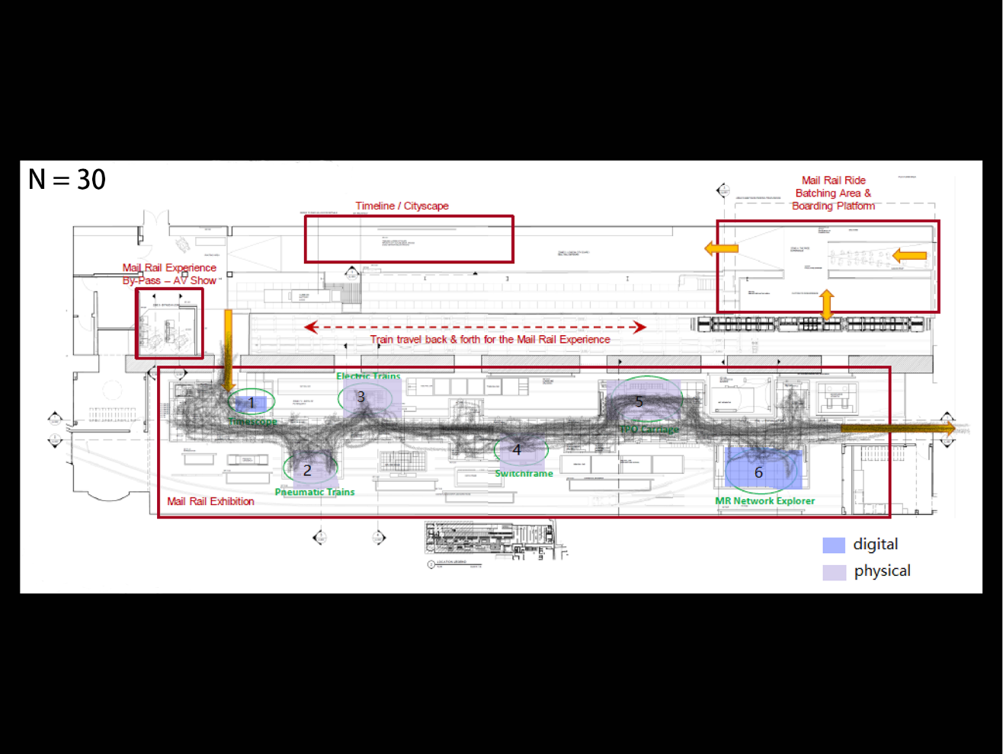
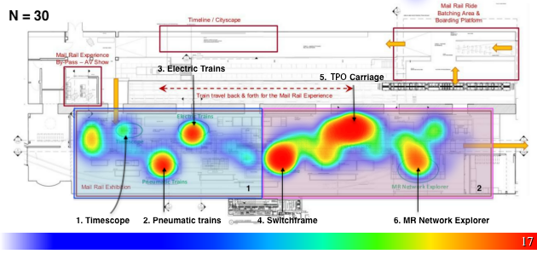
MR Heat & Trace Map
2
2

Slide 13
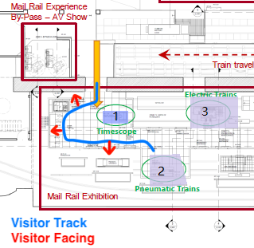
Issue 2: MR Timescope

Slide 16
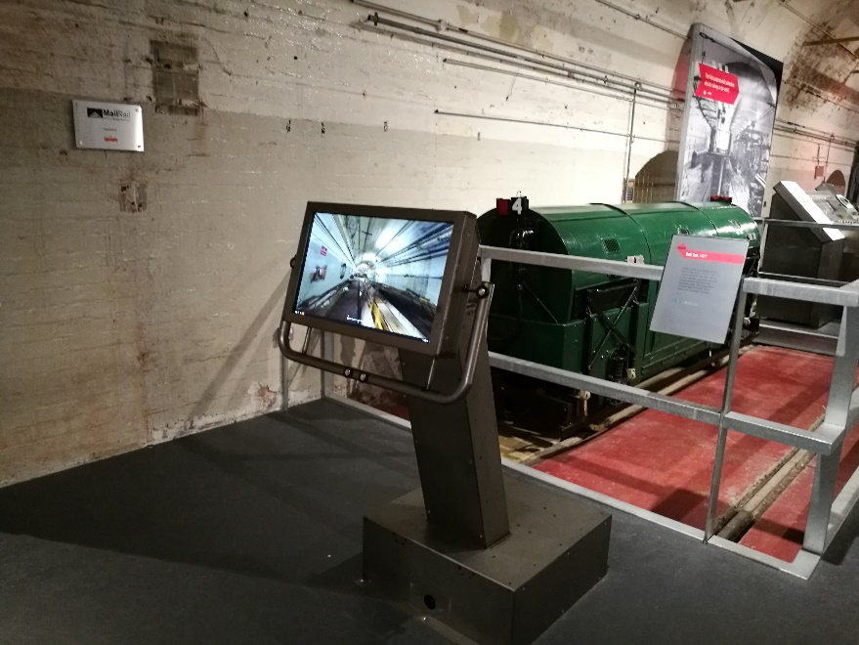
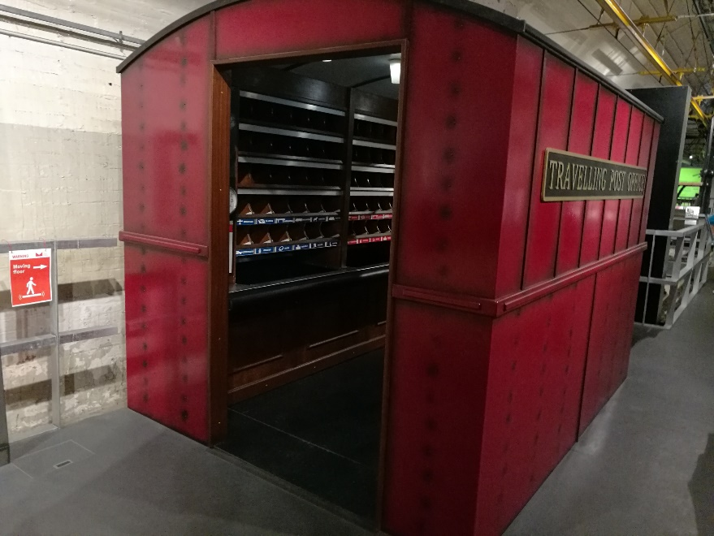
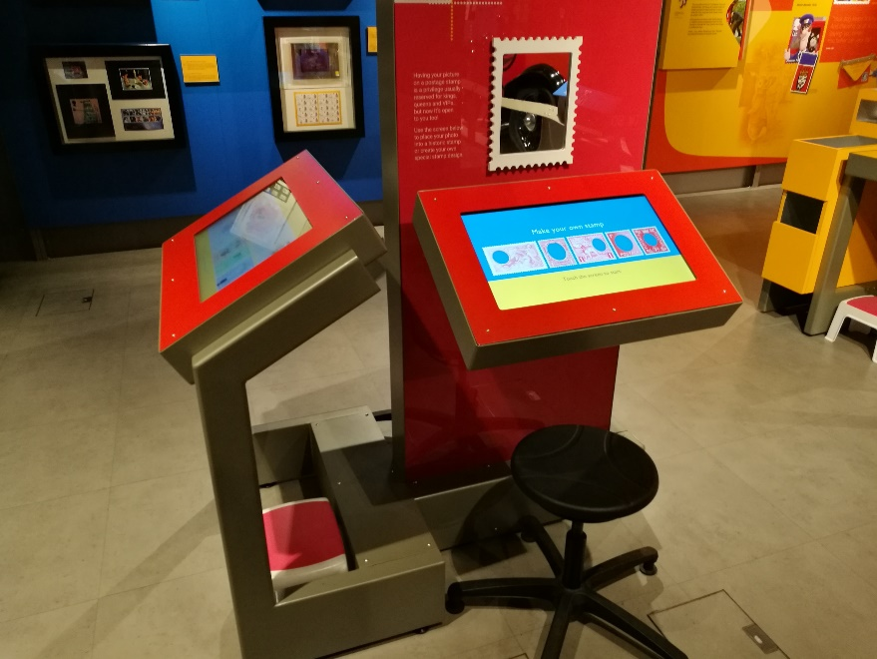
Intuitiveness & Usability
Interactives should be easy to understand and use
Many interactives use step-stools to make them accessible to children
Traveling Post Office has no instructions, but the idea is easy to get
Timescope also has no instructions, but many visitors make assumptions

Slide 17
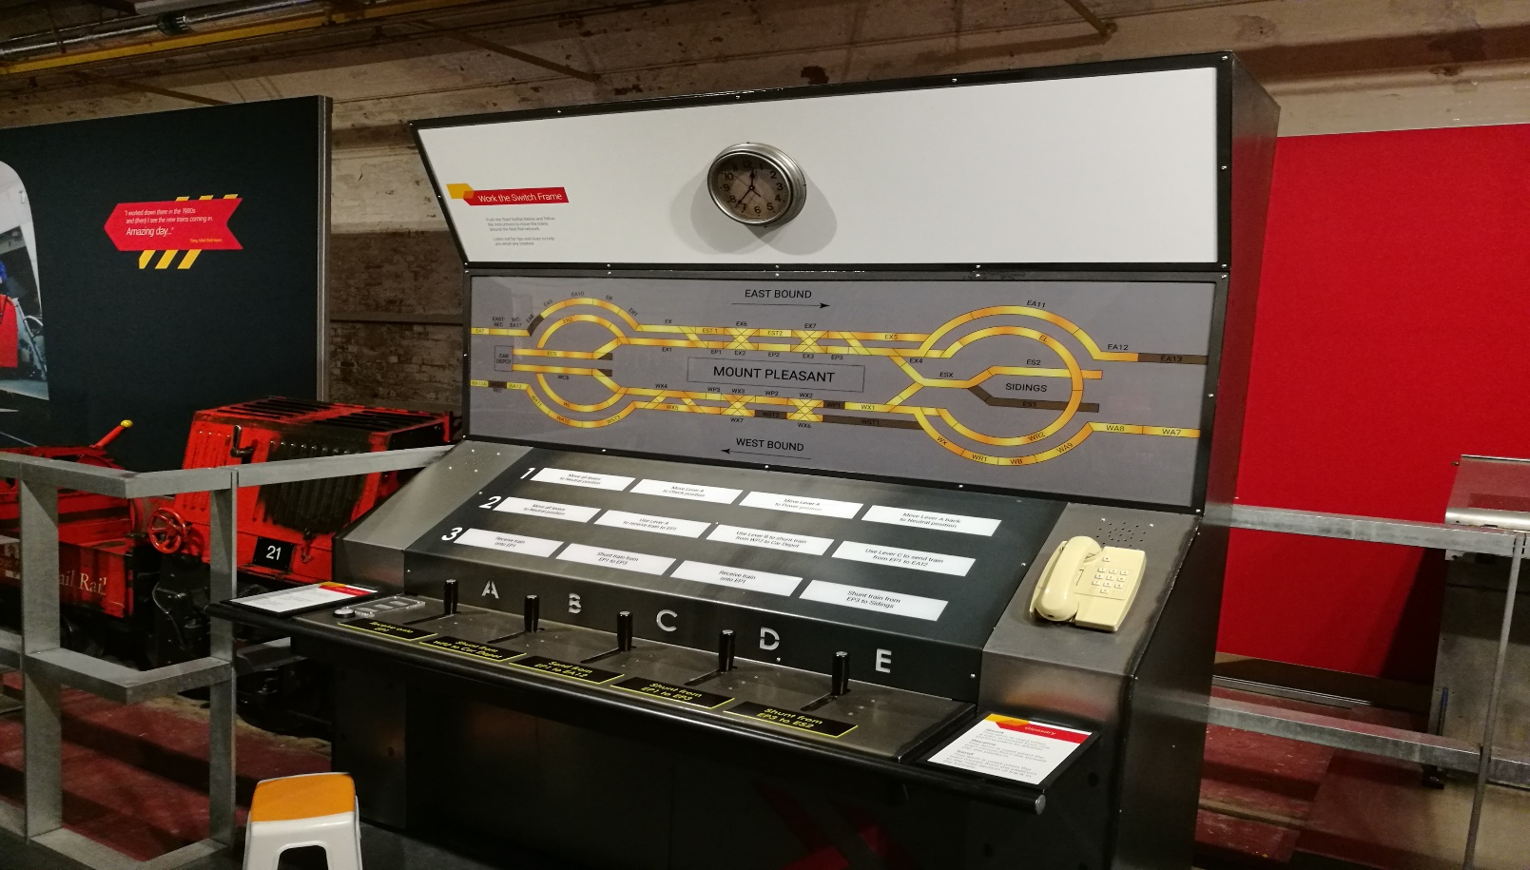
Usability - Switchframe
The Switchframe interactive is very attractive, but suffers slightly from misuse
Most visitors approach exhibit from the right hand side, and attempt to pick up the telephone, not noticing the “start” button on the left hand side
Very little in the way of written instructions, relying almost entirely on voiceover

Slide 18
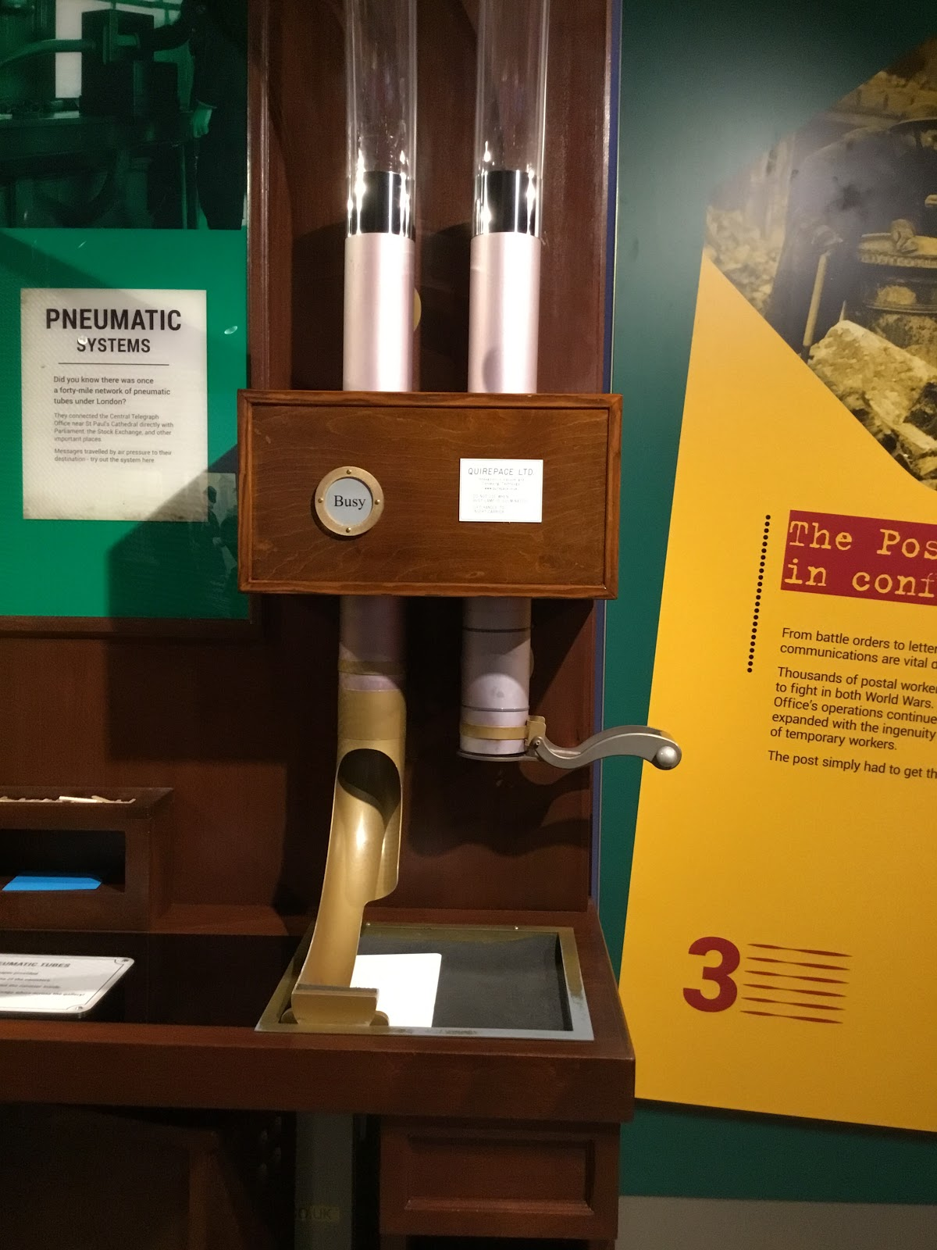
Usability – Pneumatic Tube
The Pneumatic Tube interactive also suffers from misuse, exacerbated by its popularity
Some visitors do not use the canisters, sending up letters that can jam by themselves, or send too many canisters at once, overtaxing the air pump
Coupled with frequent use, this can cause problems with the mechanism behind the interactive very quickly

Slide 19
Engagement & Interaction
Degree of Interaction (DOI)
Scoring
Engagement Score
DOI Score
How deeply do visitors interact?
DT Score
Dwell Time (DT)
How long do visitor stay at an exhibit?

Slide 20
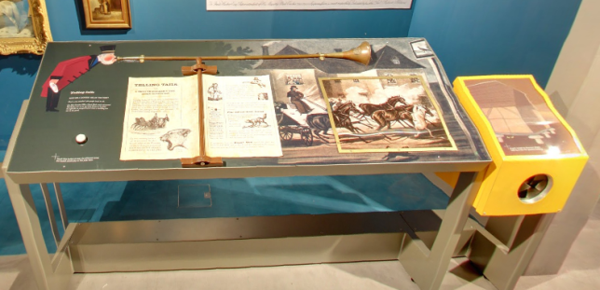
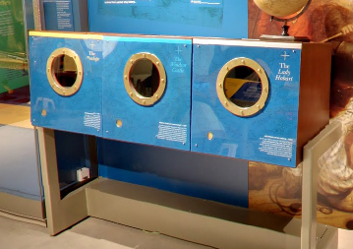
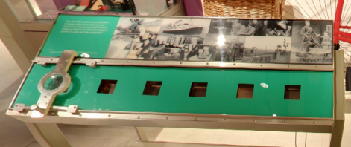
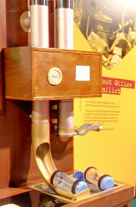
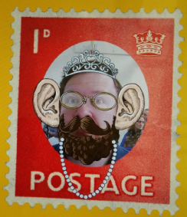
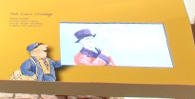
Dwell Time
Packet Ships and Pirates
Lantern Slide Viewer
Unpack-a-Picture
Timescope
Long Dwell Time
> 4 minutes
Short Dwell Time
< 1 minute
Occupied
Forgettable
Pneumatic Tube
Design-a-Stamp
Journey of a Mail Coach

Slide 21
Degree of interaction
Ignored
Noticed
Entered
Interacted
Accomplished
Coding:
Ignored = 0
Noticed = 1
Entered = 2
Interacted = 3
Accomplished = 5

Slide 24
Degree of Interaction
0 -> Ignored
1 -> Noticed
2 -> Entered
3 -> Interacted
5 -> Accomplished

Slide 26
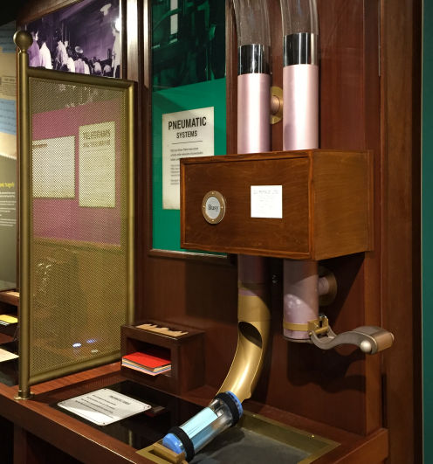
Broken
Pneumatic tube at TPM breaks most
In a sample size of 30, the pneumatic tube was broken 15 times
Albeit pneumatic tube is one of the most popular interactives

Slide 27
Design-a-Stamp
TPO Carriage
Pneumatic Trains

Slide 28
Recollection & Learning
Collected during visitor study stages
Objective 3: Assess Visitor Experience
Exit Survey
Objective 4: Conduct In-depth Evaluation
Visitor Interview

Slide 29
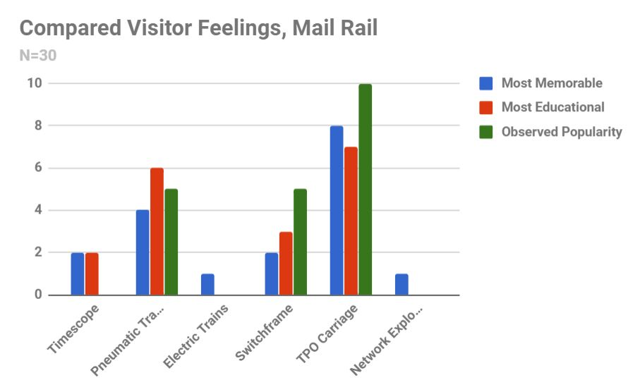

Slide 30
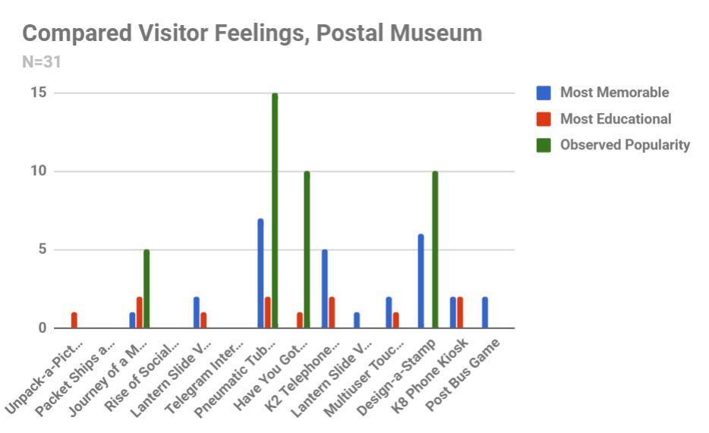

Slide 31
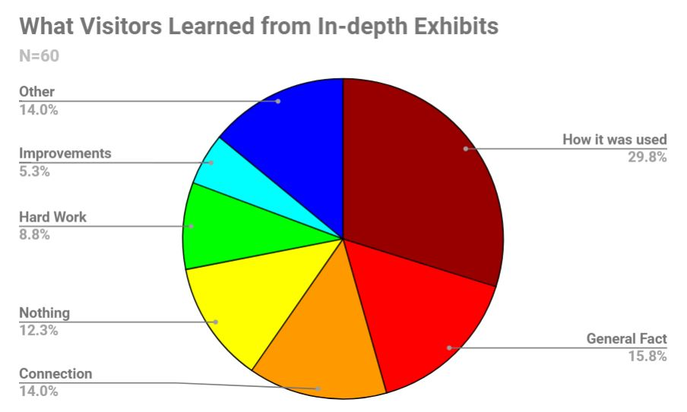

Slide 32
Deliverables
Data Collected
Survey Protocol
Report Cards

Slide 33
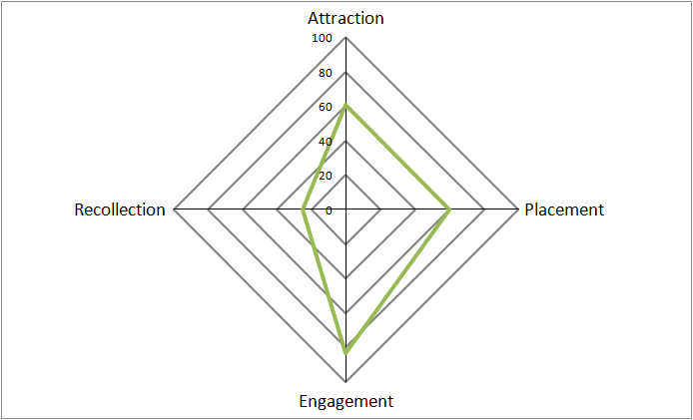
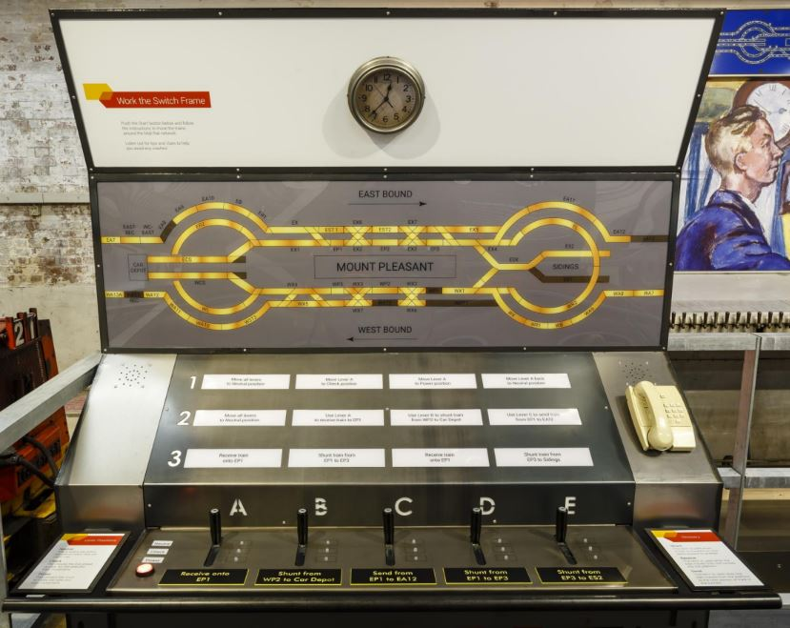
switchframE
MR
Physical
Good at:
Fair attractiveness
The design reflects the real Switchframe which is on a poster to the right. Therefore it attracts visitors visually
Fair Engagement
Most visitor would choose to complete the tasks
Fair Placement
Since the middle four exhibits at MR (all but Timescope and MR Network Explorer) are placed linearly, they all receive a fairly good traffic flow.
Conclusion and Recommendation
This exhibit mainly suffers from the difficulty in getting started (initial understanding). Visitors who first approach this exhibit often try to use the telephone on the right-hand side first, without noticing the “start” button on the left-hand side. Once visitors begin using the interactive and understand how to use the levers, the length of time required to fully complete all three stages of the interactive prevents other visitors from being able to use it.
For immediate changes, we recommend making this interactive more appealing while it is in use, to keep visitors from leaving partway through. One suggestion is to add some sound effect to keep visitors interested while the “trains” are moving.
For a long-term fix, we recommend switching the locations of the telephone and the “start” button, as most visitors approach this interactive from the right.
Improvement Needed :
Long dwell time
Visitors must spend a long time to complete the interactive

Slide 34
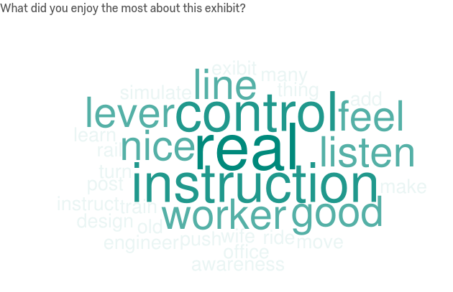
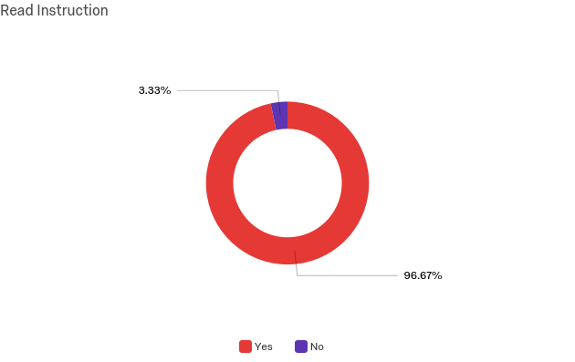
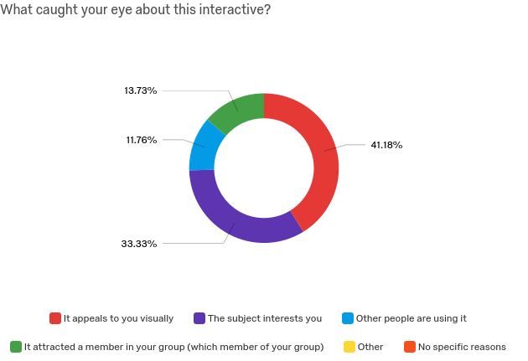
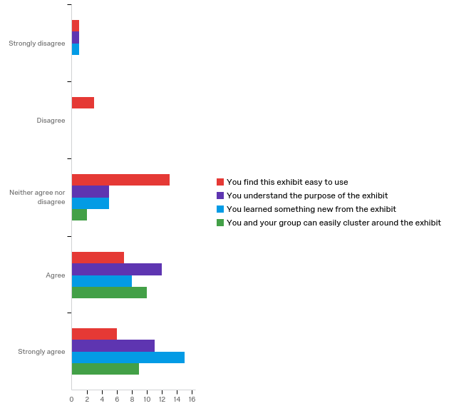
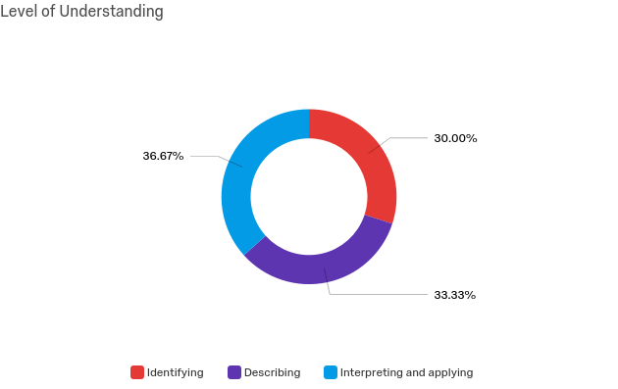
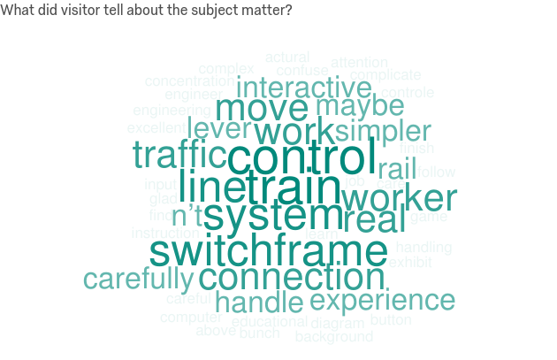
In-depth – Switchframe
General
Visitor Experience
Learning Outcomes
N = 30

Slide 35
Acknowledgement
The Postal Museum
Andy Richmond
Emma Harper
Hannah Smith
Yatin Patel
Sally Sculthorpe
Joshua Henning
Ian Tolley
Martin Devereux
Davide Avanzo
Worcester Polytechnic Institute
Dominique Golding
James P. Hanlan
Gbetonmasse B. Somasse
KCA London
Joe Martin
Museum of London
Felicity Paynter
Elpiniki Psalti
London Transport Museum
Martin Pugh
National Maritime Museum
Katherine Biggs
National Army Museum
Domonique Bouchard

