Slide 1
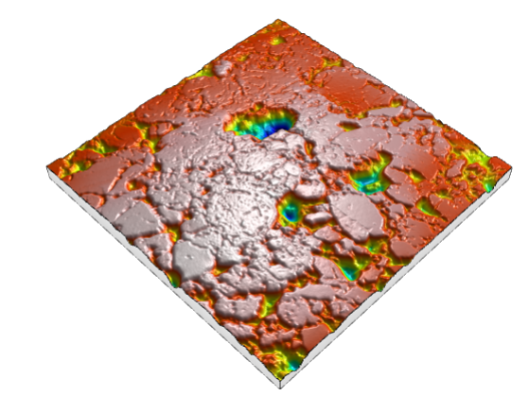
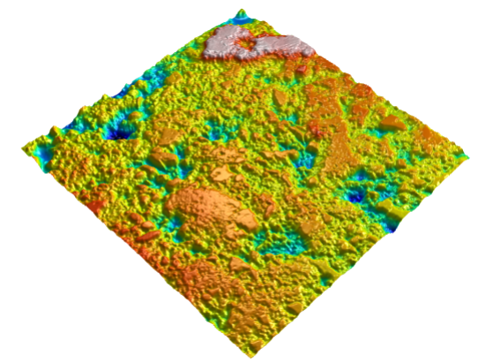
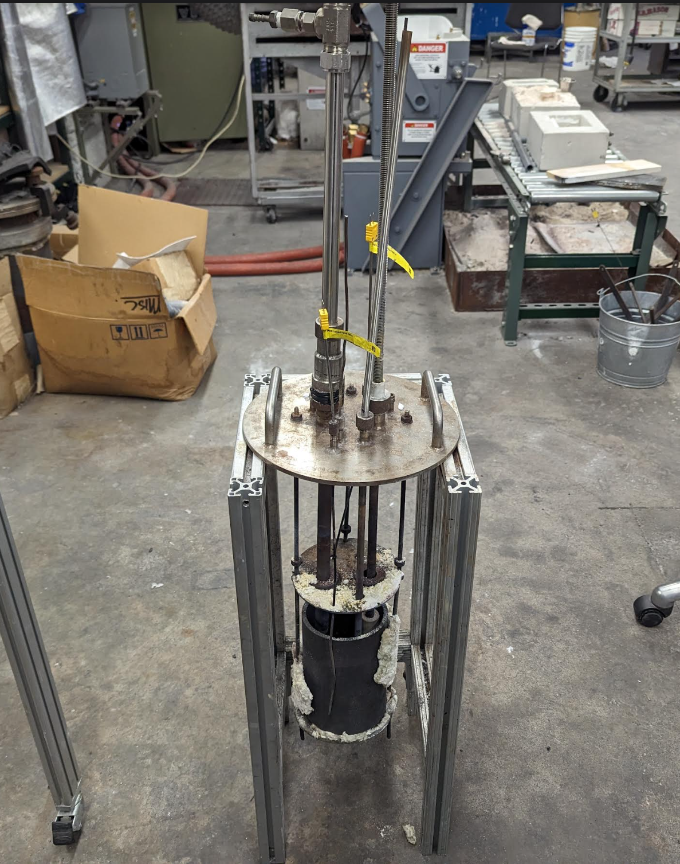
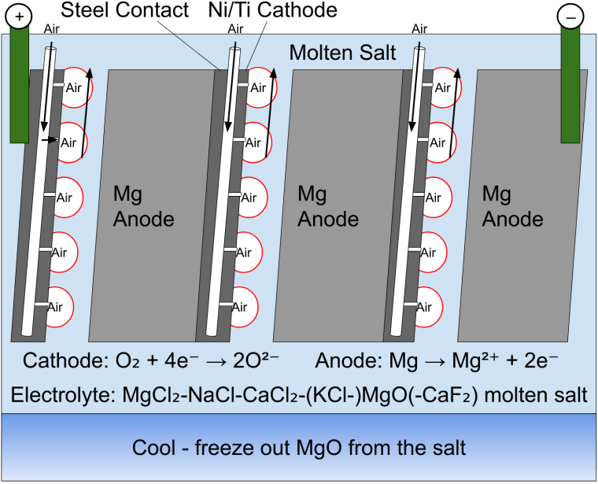
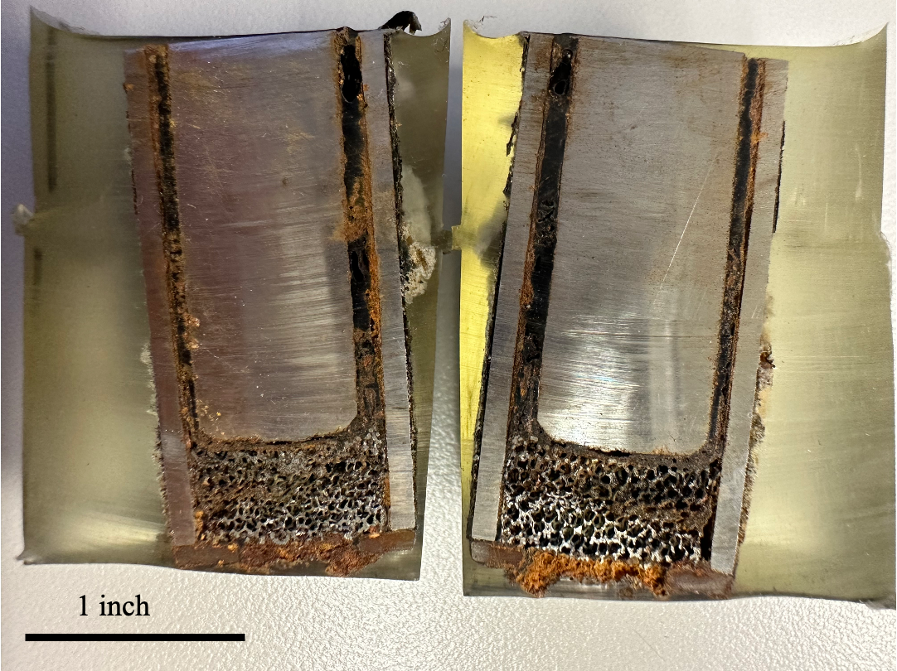
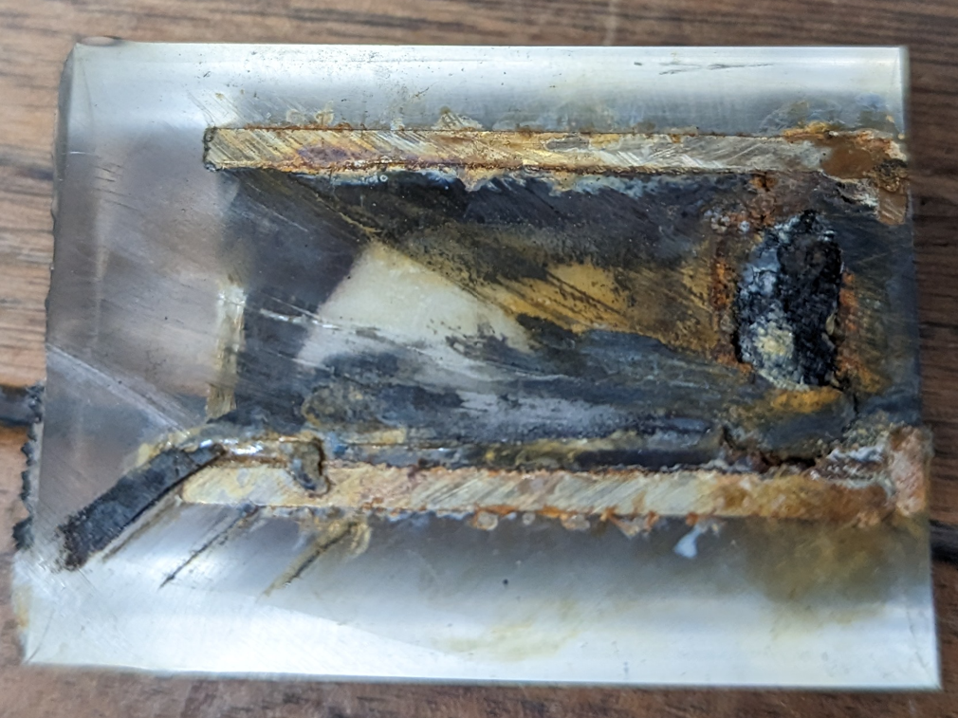
High Energy Density Magnesium-Air Battery for Shipping, Rail and Aviation Electrification and Grid Storage
Kurt Lindenthal, Tyler Riggs, Edward Miller, Jaqueline Simon Villacis
Advisor: Professor Adam C. Powell (MME)
Department of Chemical Engineering, Department of Mechanical and Materials Engineering
Abstract
Magnesium is a very common and highly reactive metal that is primarily found in our oceans, and in metal scrap. Magnesium is commonly used to produce metal alloys, but its reactivity makes it useful for power generation. This project focuses on the development of a magnesium-air fuel cell for use in grid storage and cargo ship engines. Magnesium has more energy density, but less output, than lithium, so it can be used for long term power. The project focuses on studying the corrosion of the battery cathode and surrounding insulation under standard operating
conditions. These conditions included an operating temperature of 550 Celsius and with molten salt as a working fluid. Several types of materials were tested, and each material was studied under a microscope for physical damage and corrosion. The project also includes an FMEA analysis of the proposed pilot battery.
Methodology
Insulation and cathode samples were tested at 550 ⁰C, while being exposed to a mixture of 42.0 wt% KCl, 33.3 wt% NaCl, 18.9 wt% MgCl₂, and 5.8 wt% NH₄Cl.
Tests 1 and 2 for the insulation were each conducted for 18 hours and 68.5 hours, respectively.
Each cathode mesh material was tested for about 24 hours each through a standard battery discharge experiment. Cathode samples were mounted for cross-sectional viewing.
Firebrick Insulation Results
The refractory brick (left) showed significant cracking and surface deformation after testing. The damage extended deep into the brick.
The high alumina brick (right) showed less surface damage and cracking after testing. The damage was less deep.
Background
Magnesium is more energy dense than lithium or other battery materials.
Uses molten salt as an electrolyte, with a Mg metal anode and air cathode.
Ideal for renewable grid storage and long-term naval transport, especially for cargo ships.
Cathode Mesh Results
Both the nickel mesh (left), and titanium mesh (right), stayed intact through the test, with minor rust growth on both.
FMEA Analysis
Top 5 Highest Risk Priority (RPN)
Plating in the battery. This is when metal forms on the surface of the anode, causing the battery capacity to decrease. Common and hard to detect.
Dendrite formation. Dendrites will form alternate reactions and cause problems in containment if left to grow. They are very difficult to detect. Very common and hard to detect.
Stripping in battery. Stripping in the battery will cause a loss in voltage and potential component corrosion. Common in the battery, and hard to detect.
Insufficient air drying. Will increase corrosion on battery components, potentially causing component failure. Somewhat common, but easier to detect.
External electrical short. Direct safety and fire risk due to electrical shock. Less common, and easier to detect.
Objectives
Test refractory firebrick and high-alumina firebrick under battery operating conditions. Observe damage patterns in each type.
Test porous nickel and porous titanium mesh in the air cathode, under battery conditions. Examine and compare for damage
Conduct Failure Modes Effect Analysis (FMEA).
Recommendations
For insulation, high alumina brick is recommended, since it suffers significantly less corrosion damage, while having a similar price to refractory brick.
For the air cathode mesh, either porous nickel or porous titanium is functional.
The battery requires significant containment and fire suppression countermeasures. The main risks are the formation of dendrites and other growths on the components.

