Slide 1
Stantec Environmental MQP
By: Mike Enko & Alex Simpson

Slide 2
Phosphorous Removal
Phosphorous is often the limiting nutrient creating conditions for algae blooms to form and toxic conditions to develop in water bodies.
Total phosphorus (TP), which is the type of phosphorus which is under scrutiny, can be divided into 3 categories: orthophosphate, polyphosphate, and organically-bound phosphate.
TMDL is the ‘Total Maximum Daily Load’, or the amount of pollution that can be received by the lake and still meet water quality standards
The EPA and the State of Vermont are currently evaluating this limit to create a reduction of phosphorous loading for Lake Champlain.
  Expected June 2015

Slide 3
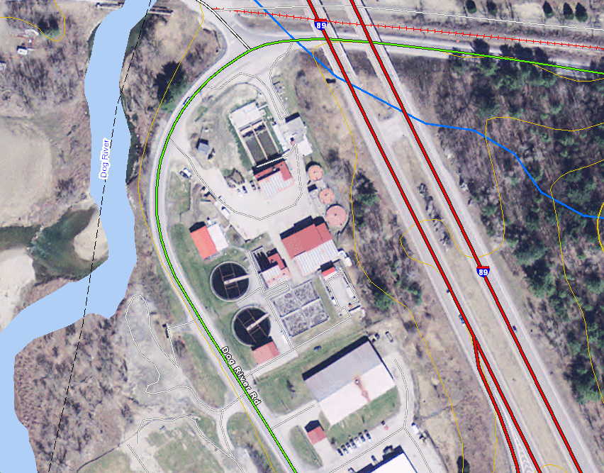
Background
Montpelier, VT WWTF
Activated sludge
Existing discharge limit is 0.8 mg/L TP
TMDL is under revision, expected to be 0.1 mg/L TP
City of Montpelier is aiming to be carbon neutral – WWTF one of highest energy consumers in city

Slide 4
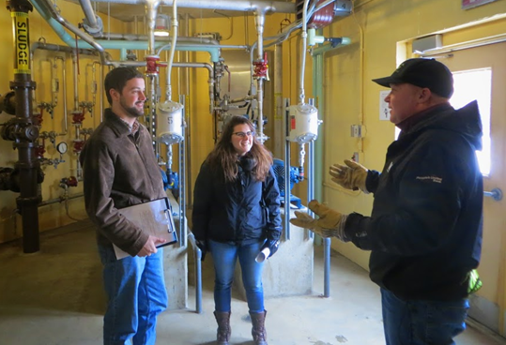
Site Visit with Bob Fischer
Walk through
Land Use Investigations
  The site is very tight
Sludge Holding tanks not in use
UV disinfection has freezing problems
FEMA Pump Station

Slide 5
Low Level Phosphorous Removal Technologies
Chemical precipitation with disk filters by Aqua-Aerobics
Deep bed continuously backwashed sand filters by Blue Water Technologies
ACTIFLO© process by Kruger
CoMag© process by Evoqua
Membrane Filtration by GE/Zenon

Slide 6
Phosphorous Removal Technologies Evaluation
Criteria | Weight | Disk Filters | Deep Bed Sand Filter | CoMag | ACTIFLO | Membrane Filtration
Operational
Staffing Requirements | 2 | 3 | 3 | 4 | 3 | 4
Overall Operational Costs | 2.5 | 3 | 3 | 4 | 3 | 3
Energy Usage | 4 | 4 | 3 | 3 | 3 | 2
Chemical Costs | 3 | 3 | 3 | 3 | 3 | 3
Community Impacts | 2 | 4 | 4 | 4 | 4 | 4
Longterm Effectiveness | 3.5 | 2 | 3 | 4 | 4 | 4
Health & Safety | 2 | 4 | 4 | 4 | 4 | 4
Implementation
Constructing Phasing | 4 | 4 | 3 | 4 | 4 | 4
Footprint | 4 | 5 | 3 | 4 | 4 | 5
Capital costs | 2 | 5 | 4 | 4 | 4 | 4
Total |  | 103.5 | 93 | 109 | 104.5 | 106.5

Slide 7
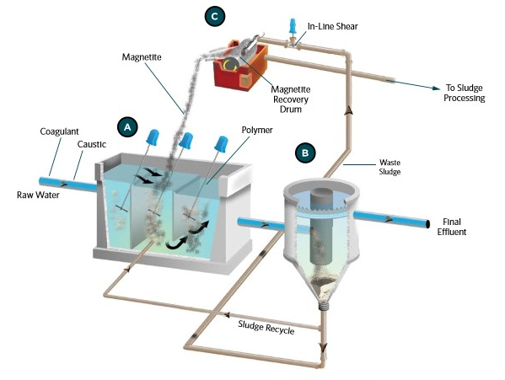
CoMag

Slide 8
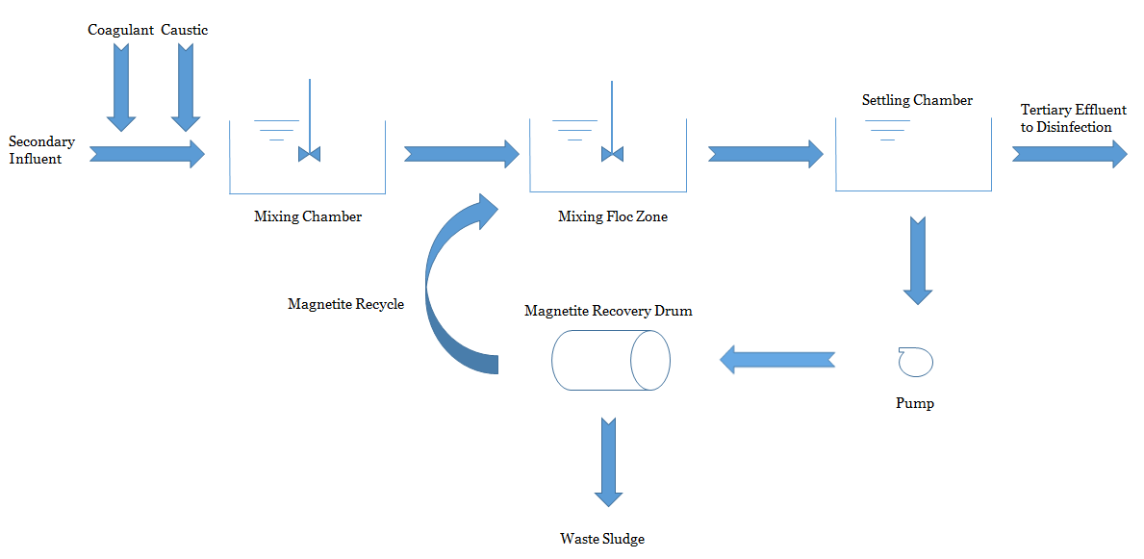
CoMag

Slide 9
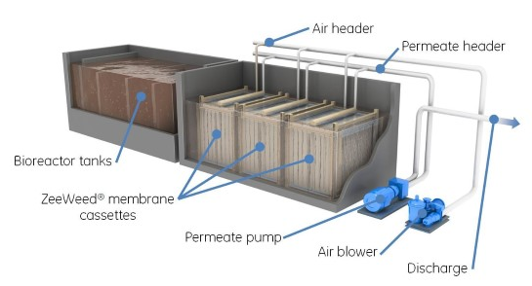
Membrane Filtration

Slide 10
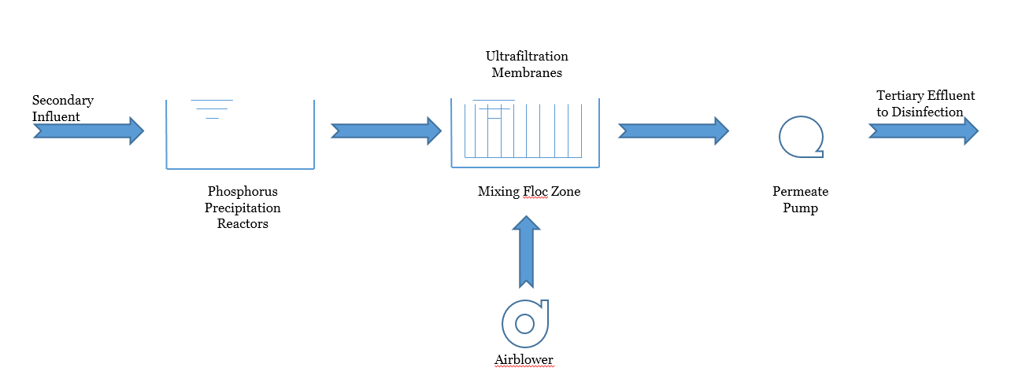
Membrane Filtration

Slide 11
Results

Slide 12
Level-Two Evaluation Comparison
CoMag
Membrane Filtration
Larger footprint
Can handle system upsets
Overdosing will not affect system components
Uses less energy
  Gravity flow
In use at Waterbury WWTF and fully functional
Smallest footprint
Will foul more easily and plant operator must be vigilant
Overdosing shortens membrane lifespan
High energy costs
  Requires pumping 24/7
Not in use in the region and will require approval

Slide 13
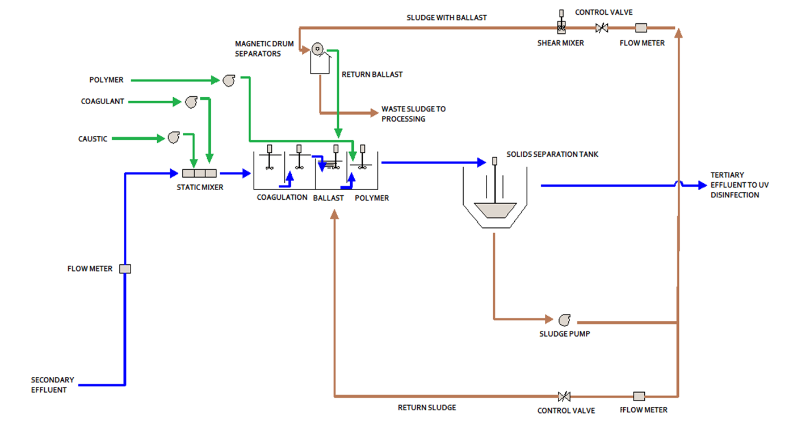
Process Flow Diagram

Slide 14
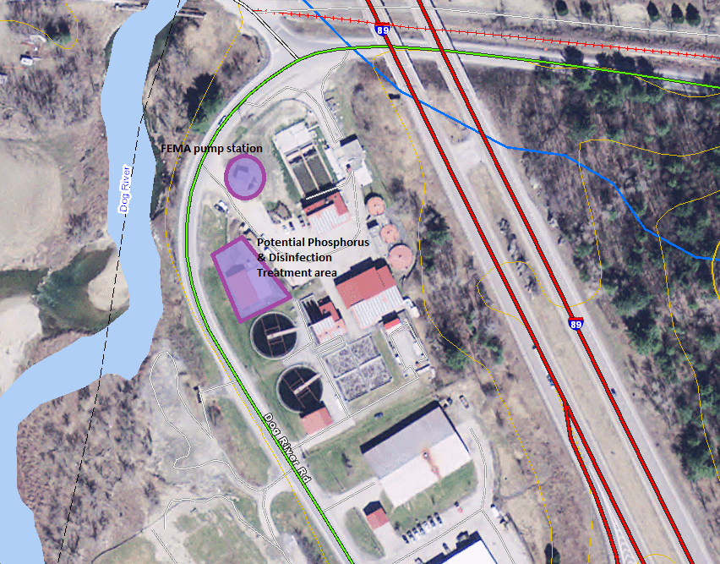

Slide 15
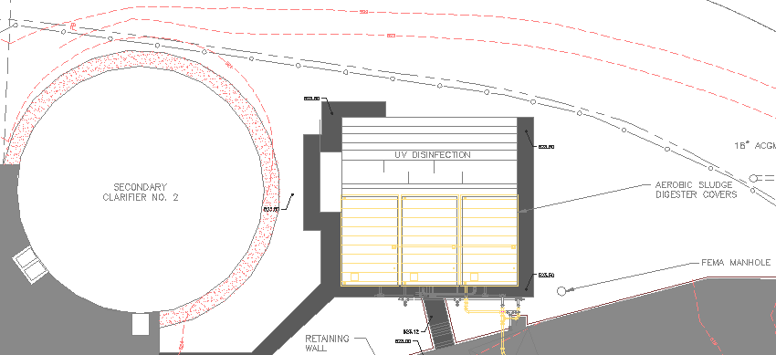
Available Space

Slide 16
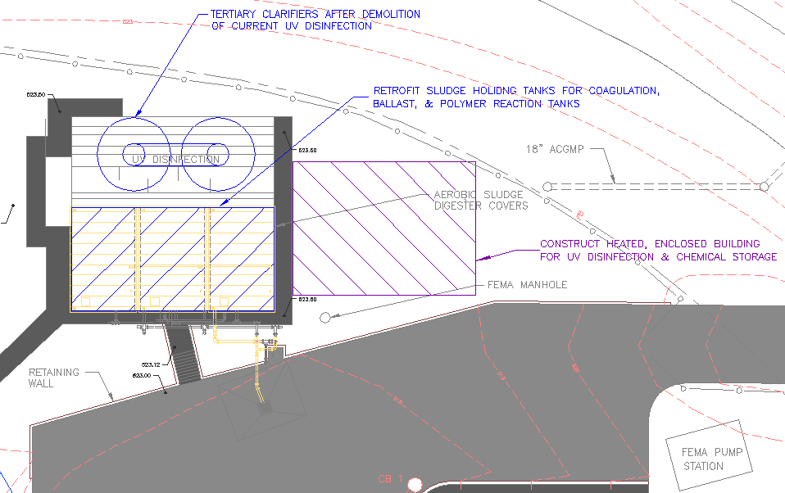
Design Option 1

Slide 17
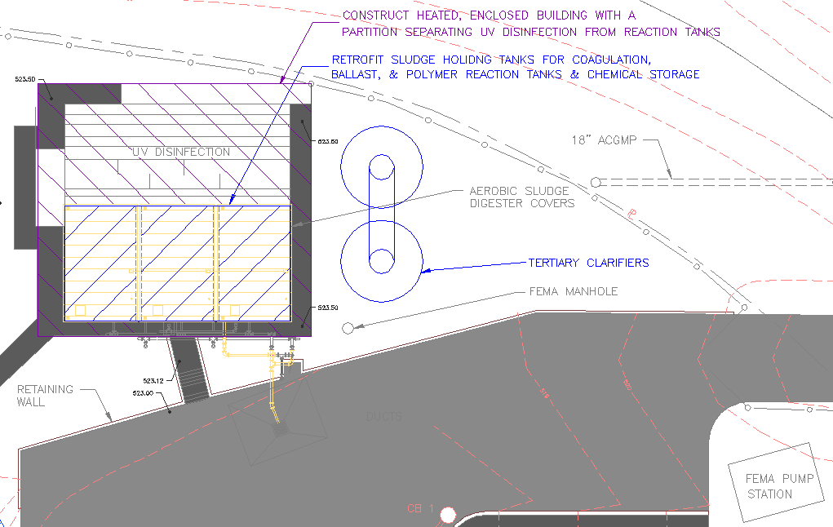
Design Option 2

Slide 18
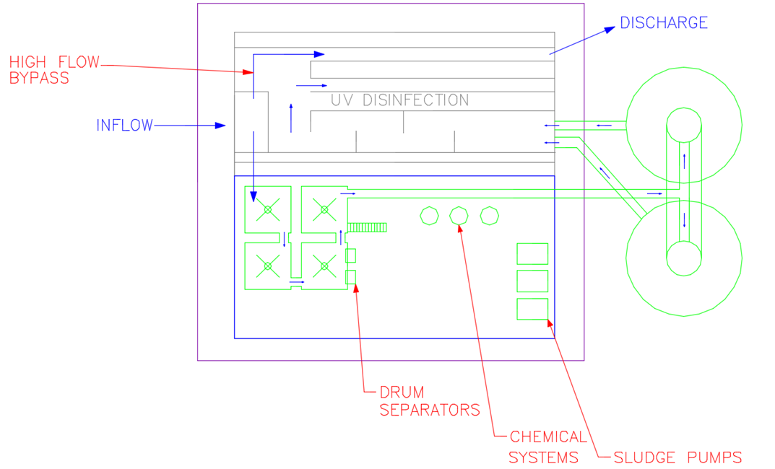
Final Site Layout

Slide 19
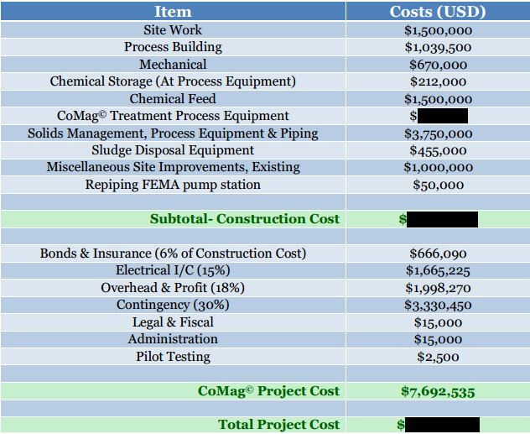
Results – Estimated Capital Costs

Slide 20
Final Conclusions for Montpelier, VT WWTF
Choose CoMag© as the new technology upgrade
Pilot test the CoMag© system
Utilize the final recommendations
  Implement Evoqua conceptual design
  Duplicate Waterbury WWTF chemical feed system
  Construct site as shown in site layout
Assess the system upgrades identified in this MQP and previous feasibility studies and apply the upgrades during construction of the new technology
  Specifically the UV Disinfection building and FEMA pump station

Slide 21
Questions?
Thank you for a great 7 weeks!

