Slide 1
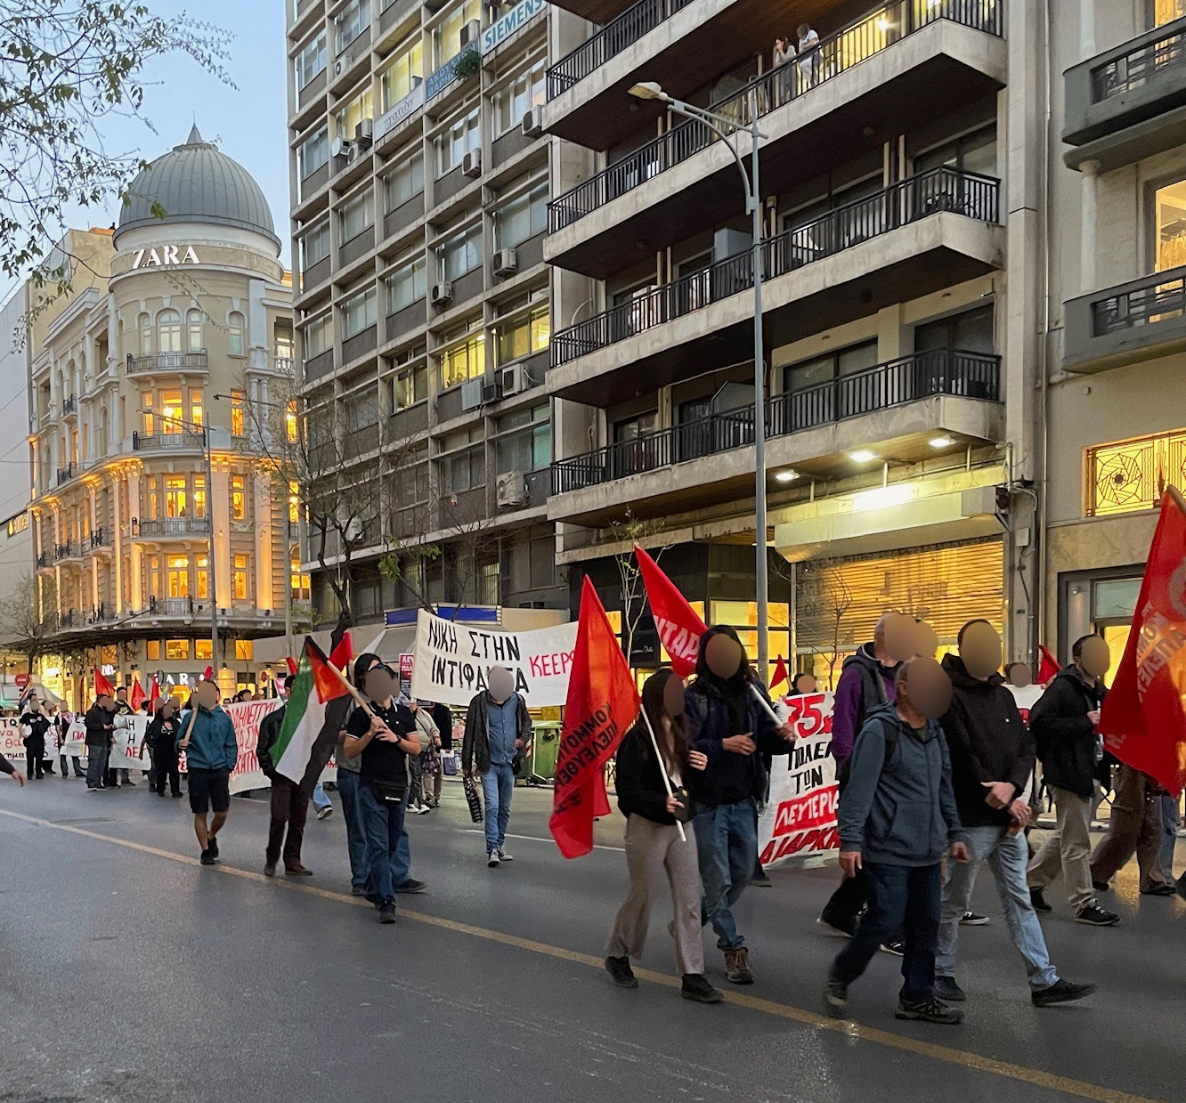
Understanding Thessaloniki Youth’s Responses to Current Issues
Elie Bowman, Ava Labik, Megan Manning, Cody Rueda
1
Notes:
Cody

Slide 2
GOAL: To share stories of youth in the Thessaloniki region
1. Identifying the issues they face
2. Understanding their responses to those issues
[2]
[1]
2
Notes:
Cody

Slide 3
What did we do?
Collected survey responses
Participated in protests
Documented graffiti
Attended youth council career event
Connected with locals
Notes:
Ava

Slide 4
What issues are youth facing?
Government Distrust
Lack of Opportunities
Shortcomings in Education
4
Notes:
Elie

Slide 5
GOVERNMENT DISTRUST
Extremely Satisfied
Government’s ability to provide job opportunities
Extremely Dissatisfied
Extremely Satisfied
Government’s performance in improving the economy
Extremely Dissatisfied
Survey responses (n = 118) from youth in the Thessaloniki region ages 18-29 (2024)
5
Notes:
Elie

Slide 6
LACK OF OPPORTUNITIES
Survey responses (n = 115) from youth in the Thessaloniki region ages 18-29 (2024)
6
Notes:
Elie

Slide 7
SHORTCOMINGS in EDUCATION
“exams do not make you a good person”
21-year-old student at University of Macedonia
“This system does not test intelligence or critical thinking, but rather an ability to memorize”
(Network Academic, 2015)
7
Notes:
Elie

Slide 8
How are youth dealing with these issues?
Fight
Flight
Freeze
Youth Councils, protests, and graffiti
Outmigration for opportunities
Despondence
8
Notes:
Megan

Slide 9
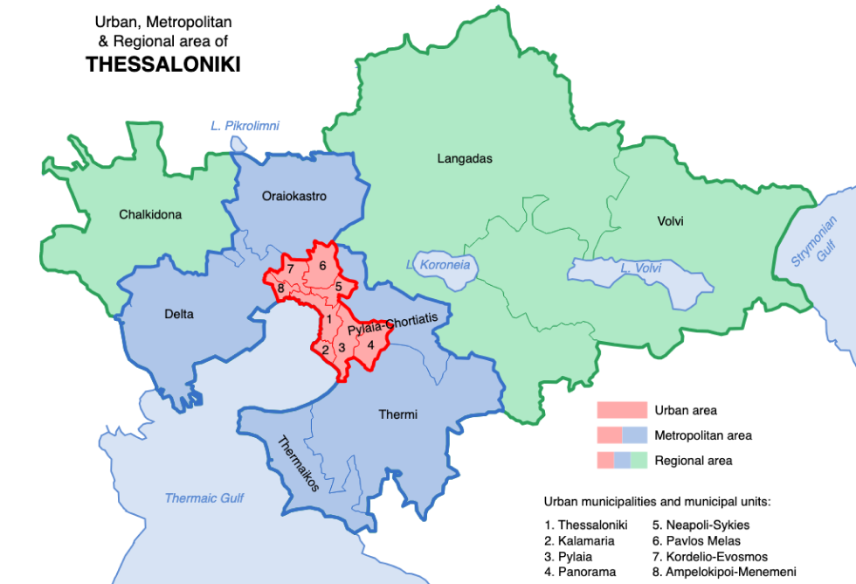
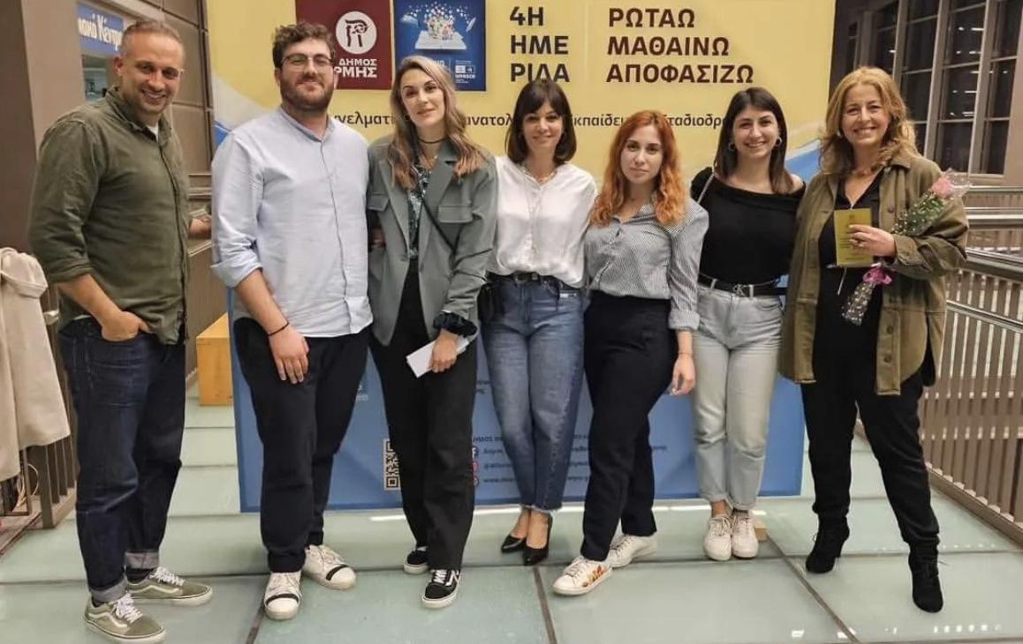
Youth Councils
“[youth councils] help you understand the way the whole world works… it activates the youths of the city to do something better for the future of your life and the life of the other people”
- Thessaloniki Youth Council Member
Municipality of Thessaloniki
[2]
Municipality of Thermi
[1]
Career event with Thermi Youth Council
9
Notes:
Ava

Slide 10
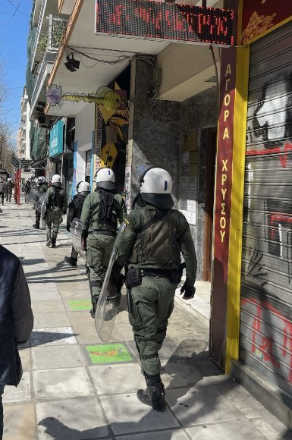
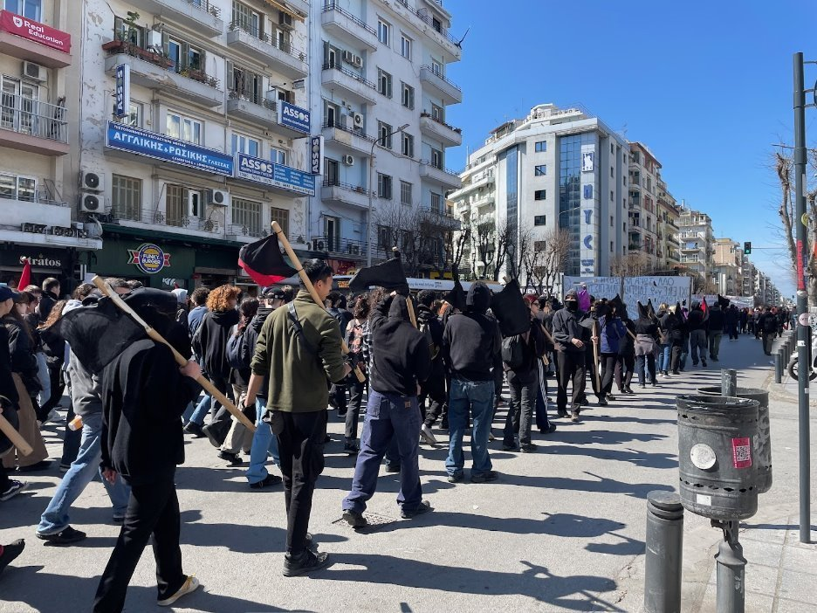
Protests
“You really need to show the government and elected officials what you want and protests are really the only way to do so”
- 19-year-old student
Protest in downtown Thessaloniki in response to the law legalizing privatization of universities
Police at a protest in downtown Thessaloniki
10
Notes:
Cody - maybe talk about here how they need to make people care about issues but do not want to be 'too radical' or violent because it takes away from the protest's so-called effectiveness (according to studies) and makes it more dangerous making less people want to attend
April 18, 2024 at 4:14 PM

Slide 11
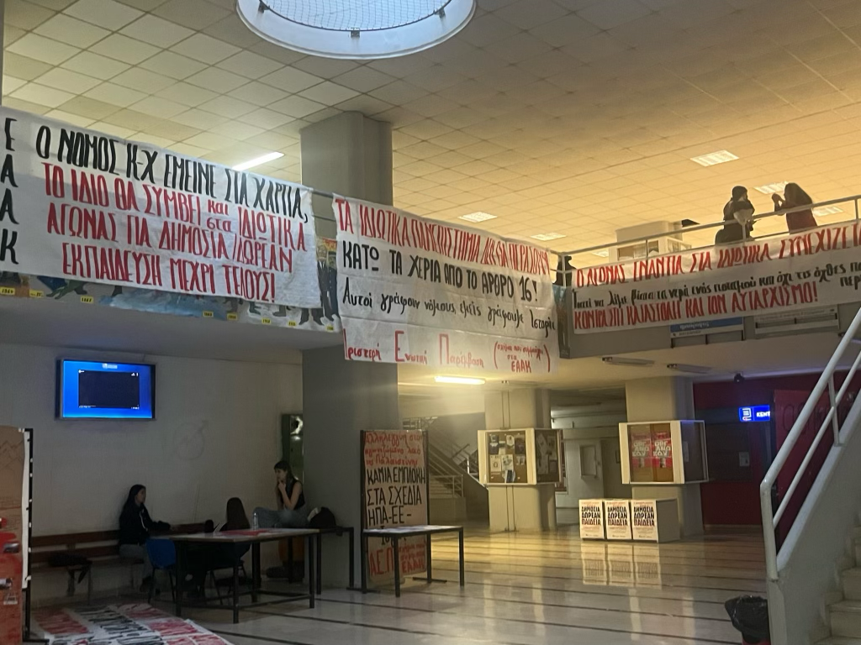
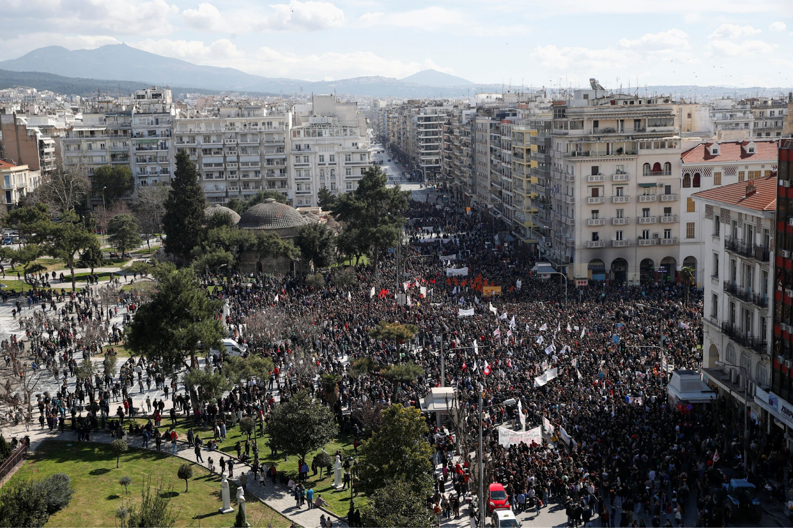
Mobilization & Impact
[3]
Protest about Tempi train crash
Banners promoting protests inside the University of Macedonia
11
Notes:
Cody

Slide 12
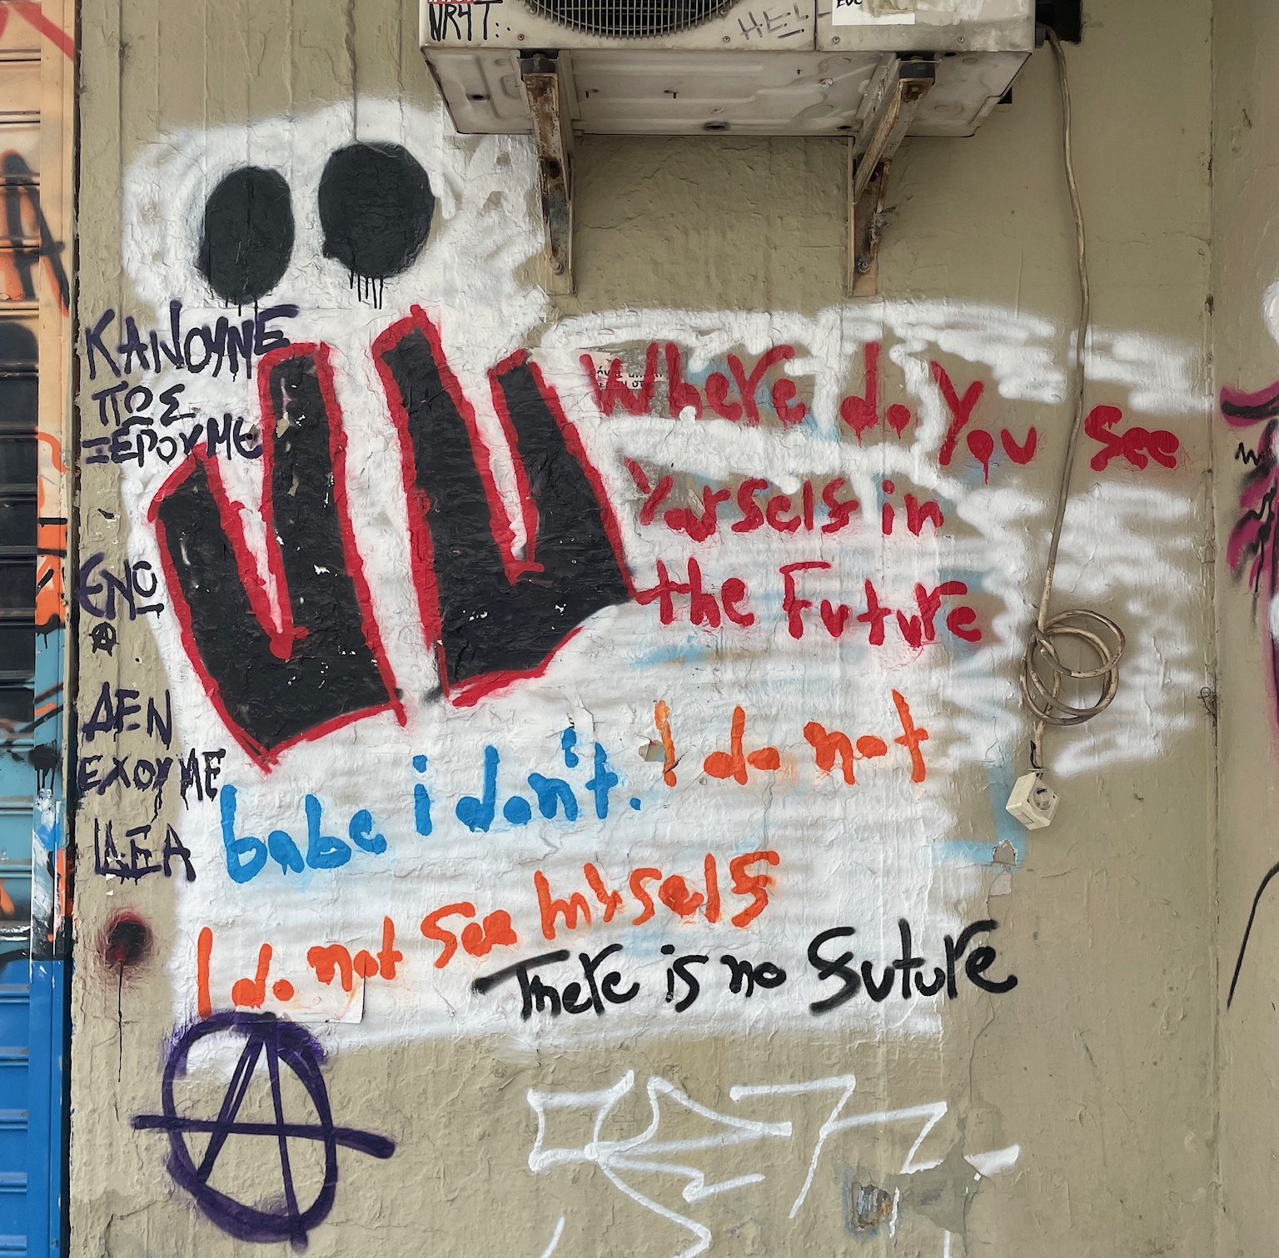
Graffiti
Where do you see yourself in the Future. babe I don’t. I do not
I do not see myself. There is no future
12
Notes:
Megan

Slide 13
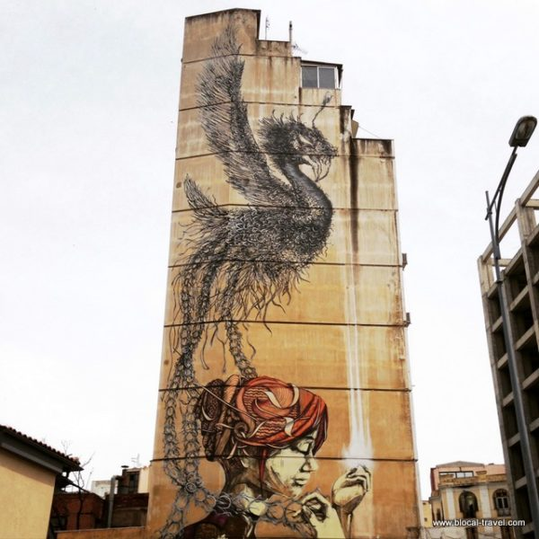
Graffiti
Mural commissioned by youth council advocating against sports-induced violence
[4]
Street art referencing femicides in Thessaloniki
[1]
13
Notes:
Megan

Slide 14
Flight
427,000 Greek residents left the country from 2008-2013 (Lazaretou, 2022)
Approximately how many young people (ages 18-29) do you know have moved away from Greece?
0
1-4
5-9
10+
14
Survey responses (n= 114) from youth in the Thessaloniki region ages 18-29 (2024)
Notes:
Megan - this has created a culture of emigrating the country to find better opportunities that is still prevalent today - transition into graph

Slide 15
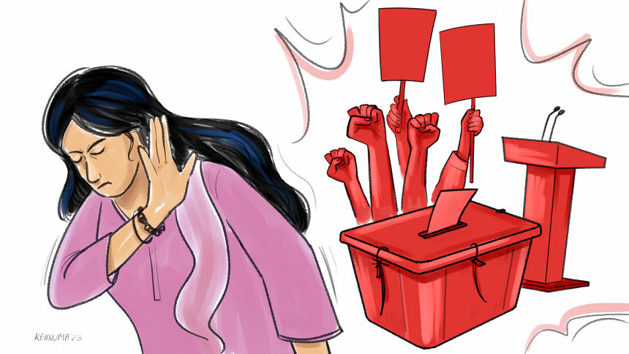
“there is this idea that if you fight for something it’s not going to have a result” - 19-year-old university student
Freeze
[5]
15
Notes:
Ava

Slide 16
Final Takeaways / Impacts
“I am hoping for a revolution, I don’t think I will see it in my lifetime though. It will keep getting worse before it gets better” 19-year-old student
16

Slide 17
Thanks!
Melissa Butler & Michael Butler
Nikki Krespani & Eva Savvisou
Interviewees & survey respondents
Vasilis
Thermi & Thessaloniki Youth Councils
17
Notes:
Elie

Slide 18
References
Lazaretou, Sophia, The Greek Brain Drain: The New Pattern of Greek Emigration During the Recent Crisis (July 22, 2022). Bank of Greece Economic Bulletin, Issue 43, Article 3, Available at SSRN: https://ssrn.com/abstract=4169615
Network Academic. Apolytirion and Panhellenic Exams. (2015). https://academic.networkfoundation.gr/category/apolytirion-and-panhellenic-exams/

Slide 19
Figure References
Thermi Youth Council. (n.d.). Instagram. Instagram. Retrieved Apr 19, 2024, from https://www.instagram.com/youth_council_thermi/?igshid=YmMyMTA2M2Y%3D
Thessaloniki metropolitan area. (2023, November 6). In Wikipedia. https://en.wikipedia.org/wiki/Thessaloniki_metropolitan_area
Schmitz, F. (2023, March 14). Greece train crash: Protesters rage at political system. DW. https://www.dw.com/en/greece-train-crash-protesters-rage-at-political-system/a-64978396
Blocal, G. (2022, October 29). Street art and more things to see in Thessaloniki - blocal blog. BLOCAL blog. https://www.blocal-travel.com/street-art/thessaloniki/
Rafsanul Hoque, S. T. (2023, October 20). Is the youth losing interest in political participation online?. The Daily Star. https://www.thedailystar.net/opinion/views/news/the-youth-losing-interest-political-participation-online-3448236

Slide 20
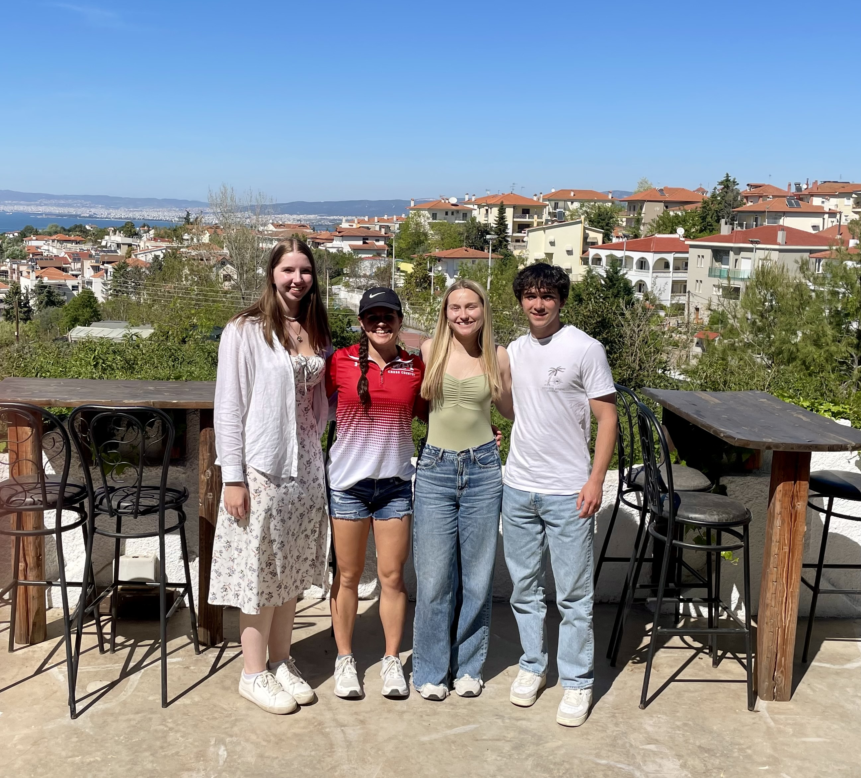
Meet the team!
Megan Manning
Ava Labik
Elie Bowman
Cody Rueda
I tried lots of different foods, including angel shark
I have started a collection of 'I <3 …' shirts since I have been here (I have Thessaloniki and Mykonos)
I have documented our entire Greece trip on
@elie_beth_greece!
I was interviewed our first day in Thessaloniki by a Greek news station
2

Slide 21
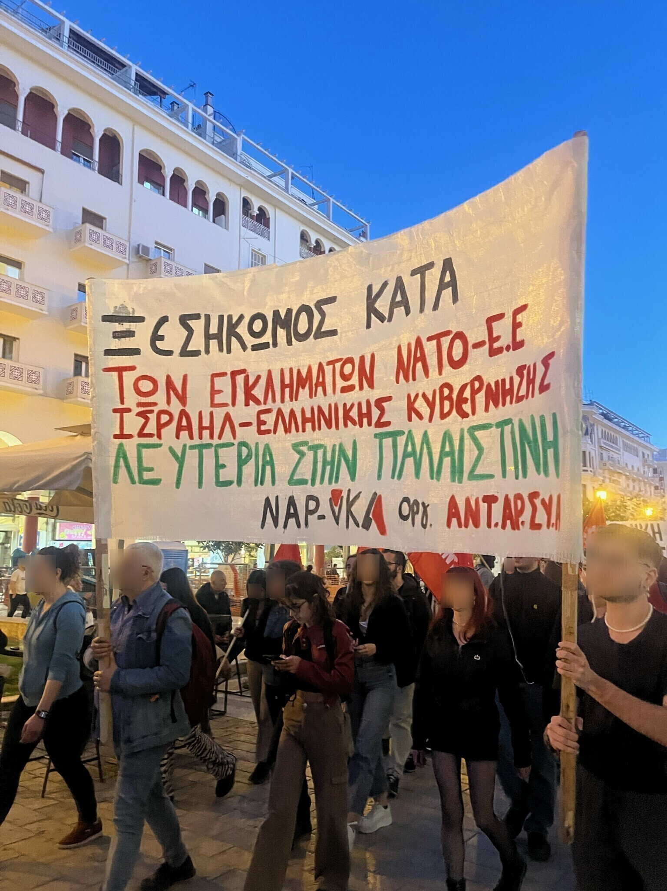
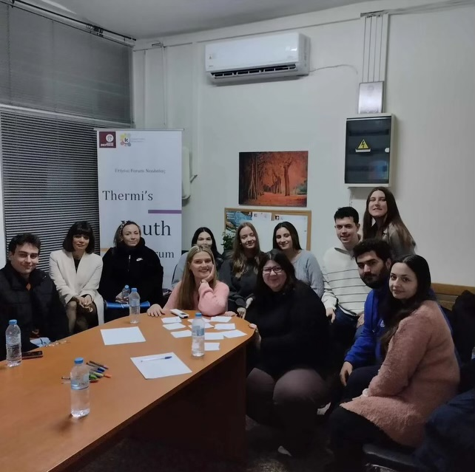
Project Scope
ENGAGEMENT
YOUTH COUNCILS
AGRO-BUSINESS
[2]
[1]
3
Notes:
Cody

