Slide 1
Increasing Attendance at the Pollards Hill Lunch Club
Binh Diec, Patrick Leach,
John Parenteau, Tiffany Saunders
Commonside Community Development Trust
25 April 2022
Notes:
Include Sponsor and the date for final deliverable to WPI

Slide 2
Opportunity for Improvement
Notes:
John

Slide 3
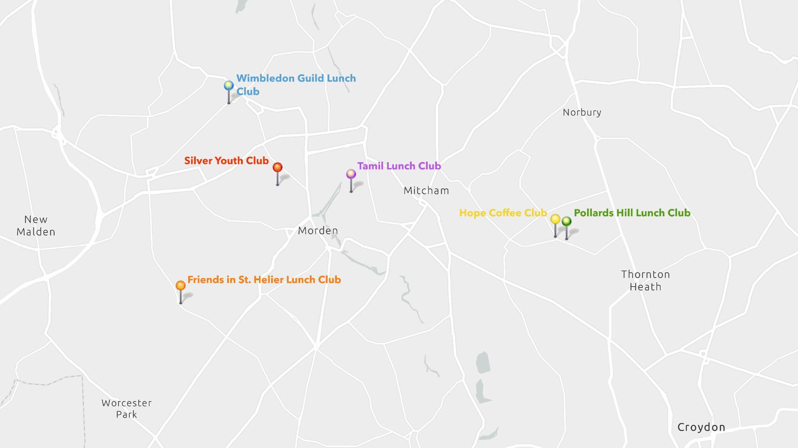
Notes:
John

Slide 4
There is a lack of interest in a home meal delivery service.
4 of 80 members
still receive delivered meals at FISH.
Notes:
John

Slide 5
Commonside staff are stretched thin.
Limited to existing staff.
Volunteers are sometimes unreliable.
There is no desire to ride a bike.
Notes:
John

Slide 6
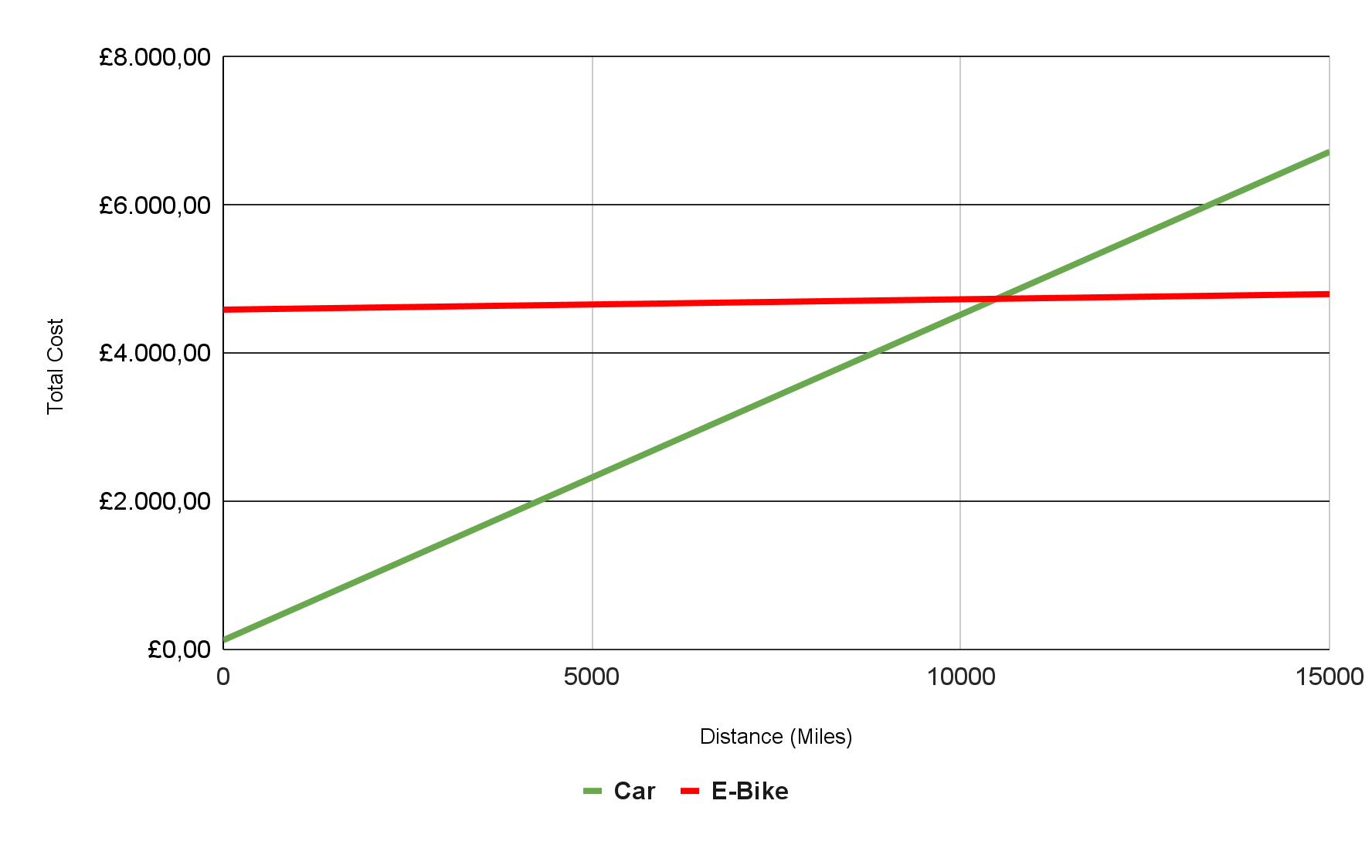
Purchasing an electric meal delivery bike would require constant use.
£4,590
Average cost of an electric cargo bike
>10,000
Miles needed to offset initial investment
Notes:
Patrick

Slide 7
Loneliness can have adverse effects on an elderly person’s wellbeing.
Increased risk for:
Dementia
Anxiety
Depression
Heart failure
Premature death
1.4 million older people often feel lonely.
84%
never used the internet before, therefore had trouble with technology
Notes:
Patrick

Slide 8
Identify strategies to increase attendance at the Pollards Hill Lunch Club following its reopening after the end of COVID-19 lockdowns.
Make the lunch club more welcoming and engaging
Improve methods of advertising and outreach
Notes:
Patrick

Slide 9
Objective 1
Making the lunch club more
welcoming and engaging.

Slide 10
A welcoming, inclusive environment is important to lunch clubbers.
like socialization and the friendly atmosphere.
Bring a Friend Day
Hope Coffee Club
Tamil Lunch Club
“You are made to feel welcome.”
Wish they could have the service more often.
“One of the best coffee clubs in the area.”
Felt like a family coming together.
Notes:
Patrick

Slide 11
Creative ways to mix up lunch clubbers should be introduced.
6
4
2
0
Do you sit with same people during lunch service?
Do you sit in the same spot?
Do you like the round table setup?
Would you prefer a long rectangular table?
Do you try to include new members?
Yes
No
Depends
Notes:
Binh
At Commonside, there are already established groups among the members of the Pollards Hill lunch club meaning that they are comfortable how the club currently operates
When we surveyed 6 lunch club members our general consensus was that they do not like change. They all enjoy how the lunch club is operated currently and opposed changing things like who they sit with, where they sit, and the table layouts. However, there were individuals that would be open to welcoming new members to their table or interacting with them.

Slide 12
New and familiar activities will help create an engaging lunch club experience.
Lunch clubbers are most excited about exercise classes.
13 members across some of the clubs we visited.
Silver Youth Club
Wimbledon Guild
F.I.S.H. Lunch Club
Scattergories
Quizzes
Bingo
Games
Workshops
Classes
Excursions
Parties
Notes:
Binh
When we interviewed members from other lunch clubs we discovered that the activities that are offered in conjunction with the lunch club is where the members are able to interact and mix the most. Some of the more popular activities include exercise classes, games, workshops, and excursions.

Slide 13
Activities We Recommend
Quizzes
Dance Classes
Bean Bag Toss Tournament
Bring-a-friend Day
Excursions
IT Classes
Films/Movies
Themed Events
Personal Safety Session
Bingo
Outdoor Picnic
Name That Tune
Guest Speakers
Card & Board Games
Reflection Group
Notes:
Binh
These are some of the most supported activities that we have compiled based on our interviews and research. Personal safety sessions, excursions, and bingo were very popular based on the surveys we conducted.

Slide 14
Membership flexibility should be promoted more.
Hope Coffee Club
Commonside Staff
Lunch Clubbers
“Less of a commitment would be better.”
“Members are completely free to pick their days but must call by the morning of at the latest.”
“We usually don’t have time to participate in activities.”
Notes:
Binh
In terms of the membership for a lunch club, some people don’t want to fully commit to coming everyday or going to all the different activities planned. The members of the Hope coffee Club that we spoke to expressed that “Less of a commitment would be better” where they would like to come to the club every once and a while when there is a good meal being served that day. When we interviewed the staff at Commonside, we found that “members are completely free to pick their days but must call by the morning of, at the latest”. This is the flexibility that people like the Hope Coffee Club are looking for, but it is not widely known about.
There are also members of the lunch club that do not partake in the activities that are offered before or after the meal because they “usually dont have time to participate in activities”, but that is alright because the activities offered are completely optional. Lunch clubbers at Commonside are already more flexibly using their membership, which potentially indicates a stronger desire for this.

Slide 15
Objective 2
Improve methods of
advertising and outreach.
Notes:
Tiffany
One way to promote all these new changes and to attract new members to join in we would need to advertise this

Slide 16
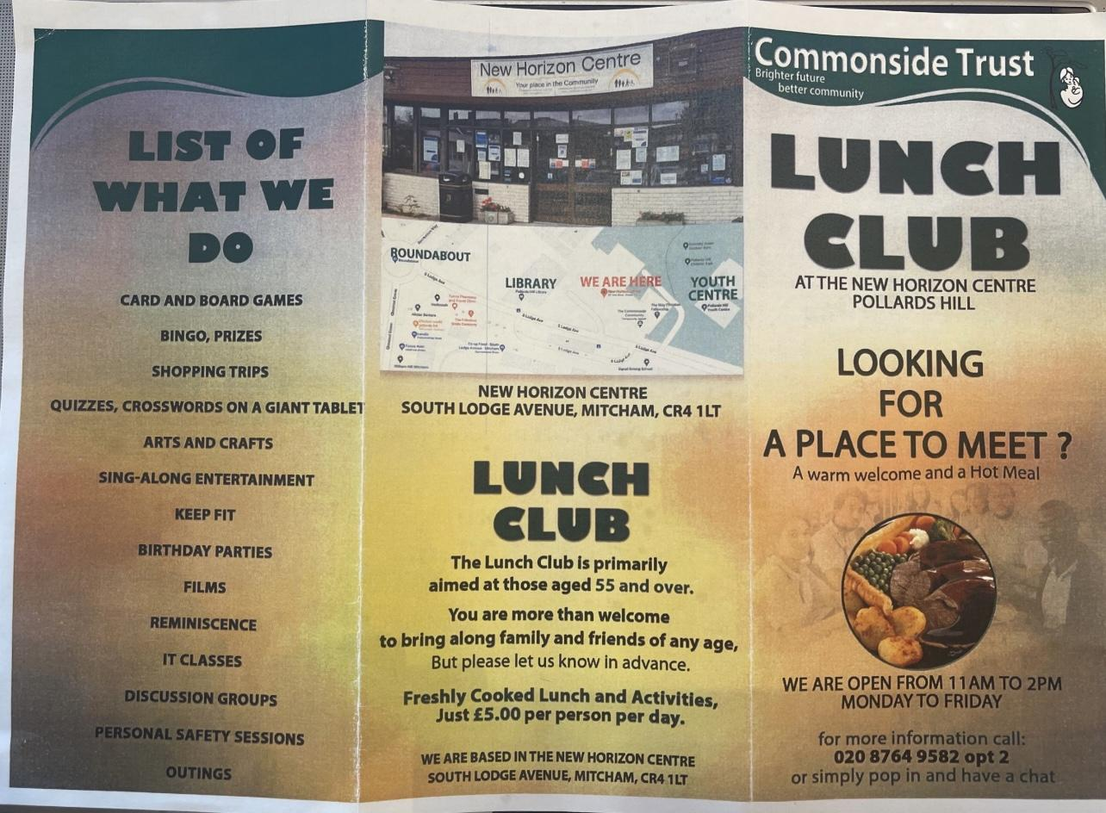
Traditional advertising is still relevant yet less present since COVID.
Leaflets
Word of Mouth
Currently handed out at front entrances, but used to be on display around the community.
“I do not know of any other way to hear about this place [unless if it’s through a friend].”
Notes:
Tiffany
Following the covid-19 pandemic, Commonside has seen a decline in membership at the Pollard’s Hill Lunch Club. The use of advertising has been less prevalent as well with the current leaflet only posted at the main entrances rather than in the wider community at churches and other local organizations like they previously did pre-pandemic.
When speaking to lunch club members about how they heard about commonside many stated that it was simply word of mouth and one members even said “I do not know of any other way to hear about this place [unless if its through a friend]
In order to be able to gain clientele it would be beneficial to have traditional advertising that is able to reach the wider community by being posted in places where the elderly frequent. Online postings could also help reach the wider community as well, but this is something that may be inaccessible to the older generation of elderly.
Work in the recommendation beforehand and then goi into the rest of the points
We also found out through staff at the hope coffee club that they also had leaflets that they would pass out

Slide 17
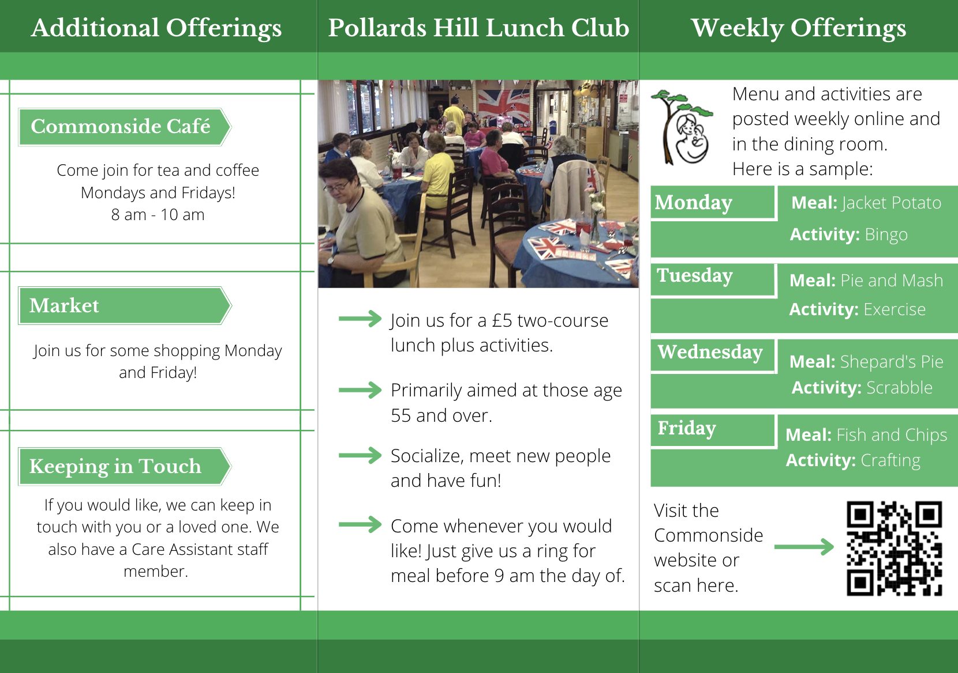
Advertisement: Leaflet Design
Notes:
Explain the leaflet design and why certain elements were included

Slide 18
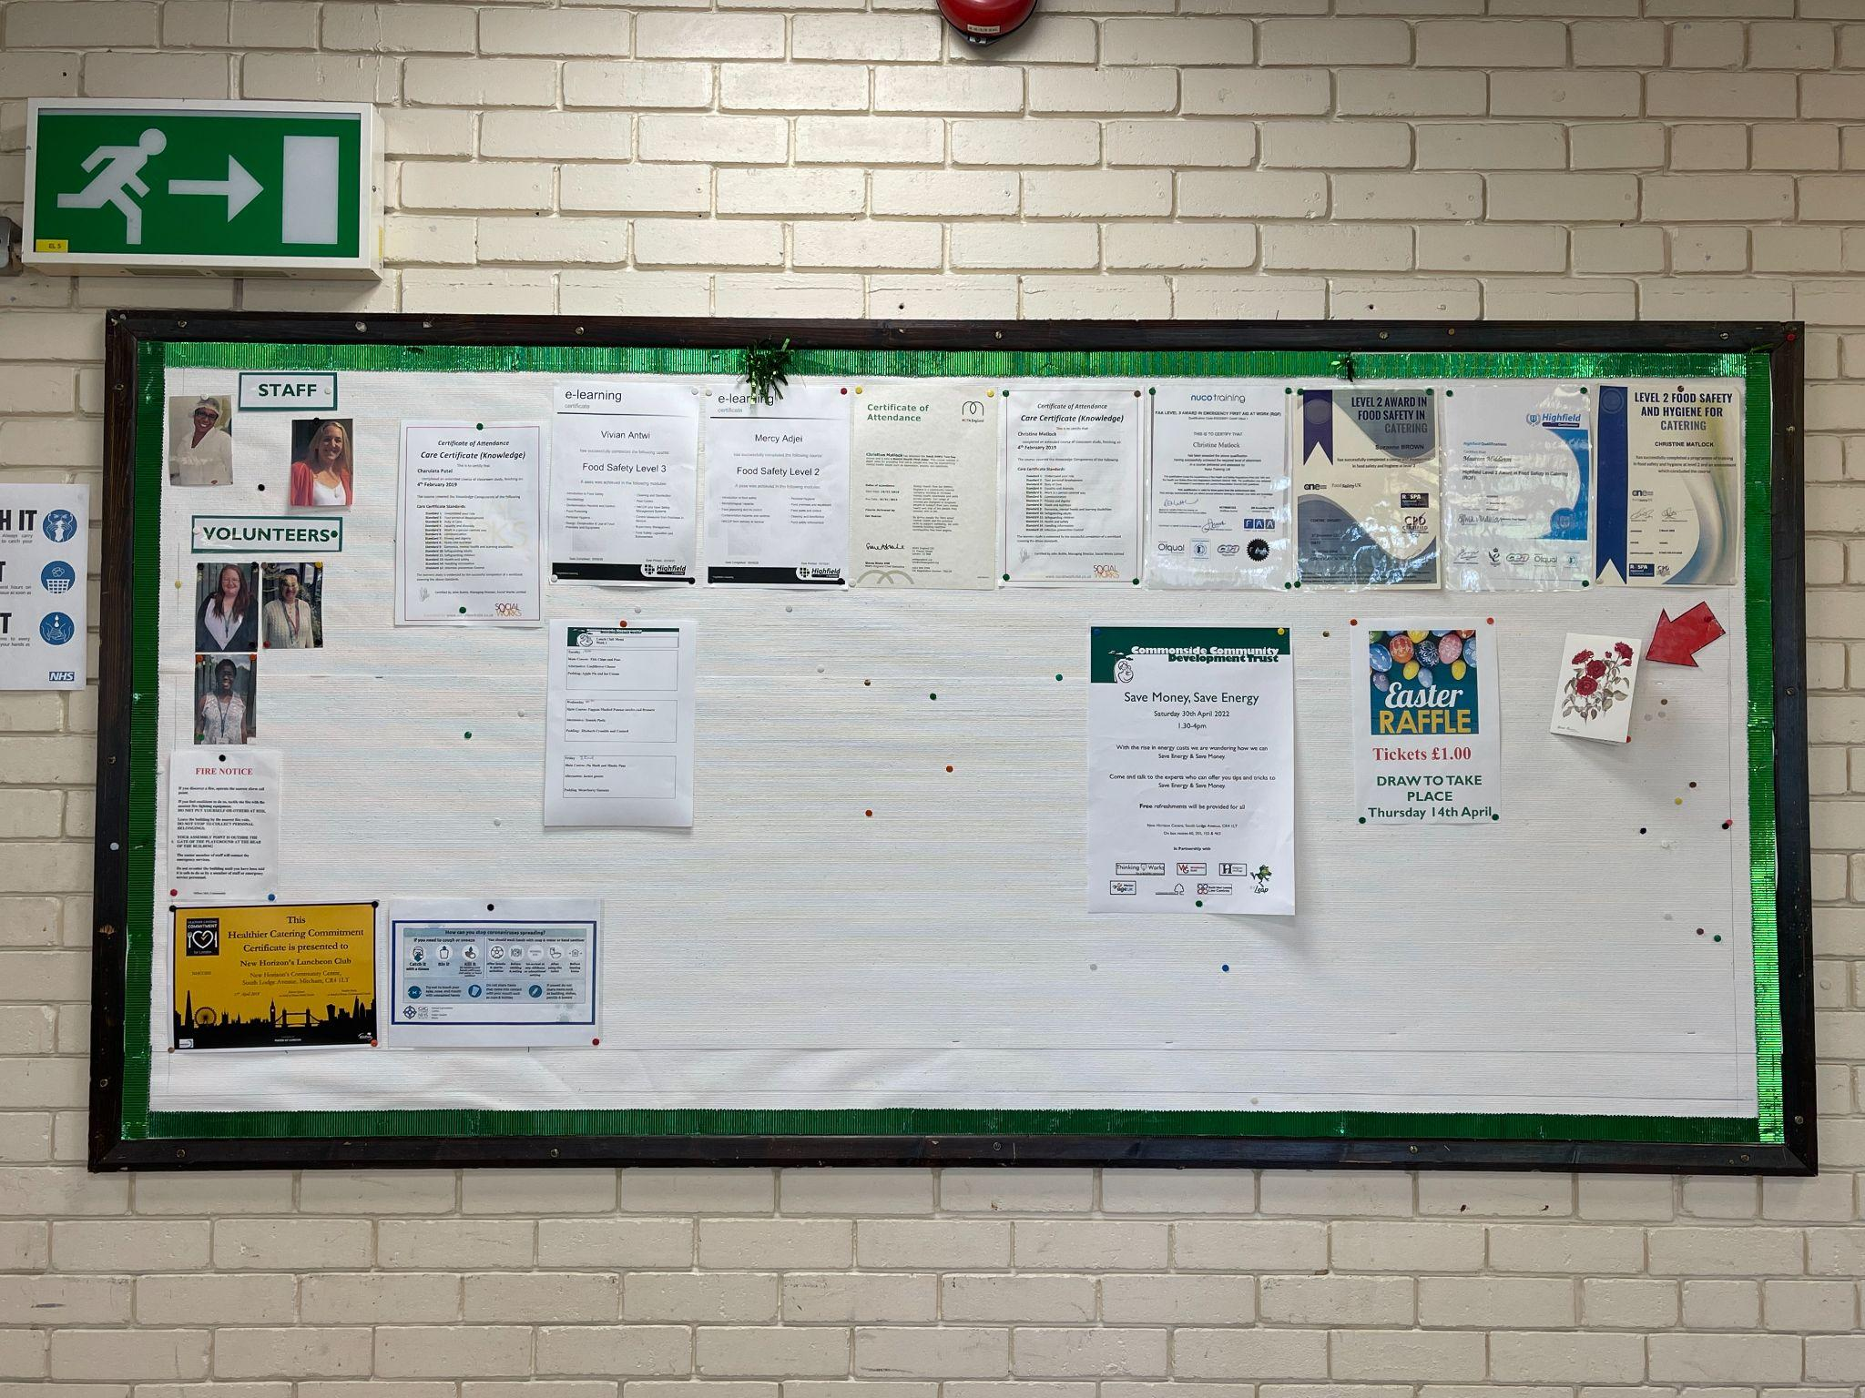
Lunch clubbers and visitors are curious about what is going on at Commonside.
Hope Coffee Club
Pollards Hill Lunch Club
“They need a menu board so people can see what they are making.”
Staff reported being asked about menu directly, or members look at the board.
Notes:
Tiffany
Commonside has a menu board that is posted in the dining room and the Commonside staff reported that members will look at the board to learn about the menu offerings for the week or ask about it. When we spoke to members of the Hope Coffee Club one of them stated “They need a menu board so people can see what they are making”. The current menu board is only posted in the dining hall and is not accessible to the people who want to pick and choose when to come in. Posting the lunch and activity options both in the lunch room and online would keep the current clientele happy and hopefully reach a wider audience as well.
We also found out through staff at the hope coffee club that they also had leaflets that they would pass out

Slide 19
Advertisement: Poster Design

Slide 20
Technology usage among lunch clubbers varies greatly.
3 members comfortable
1 member uncomfortable
3 members very uncomfortable
3 members actively use
4 members do not use
4 members primarily use
3 members do not use
4 members regularly text
3 members do not text
Notes:
Tiffany
Technology usage can vary greatly amongst the elderly community as there is a large number of people over the age of 65 who have never used the internet before. When we surveyed the clientele at Commonside this variation was seen. When asked about internet usage only three out of seven members stated that they feel comfortable with the internet……
This further shows the need for both paper posting along with new online options to reach the “younger elderly generation” that may be more technologically inclined.
Staff anticipate new generation of elderly that are more tech savvy (on internet and on facebook)
Talked to Karen and Barry and they acknowledged that they are comfportable with internet but most current members arent
Therefore we need to have both types online and paper formats simultaneously

Slide 21
Advertisement: Online Post Design
Notes:
Potential online post design for a facebook post or website posting
These options are easy to change and therefore would be fine to

Slide 22
Thank you!

