Slide 1


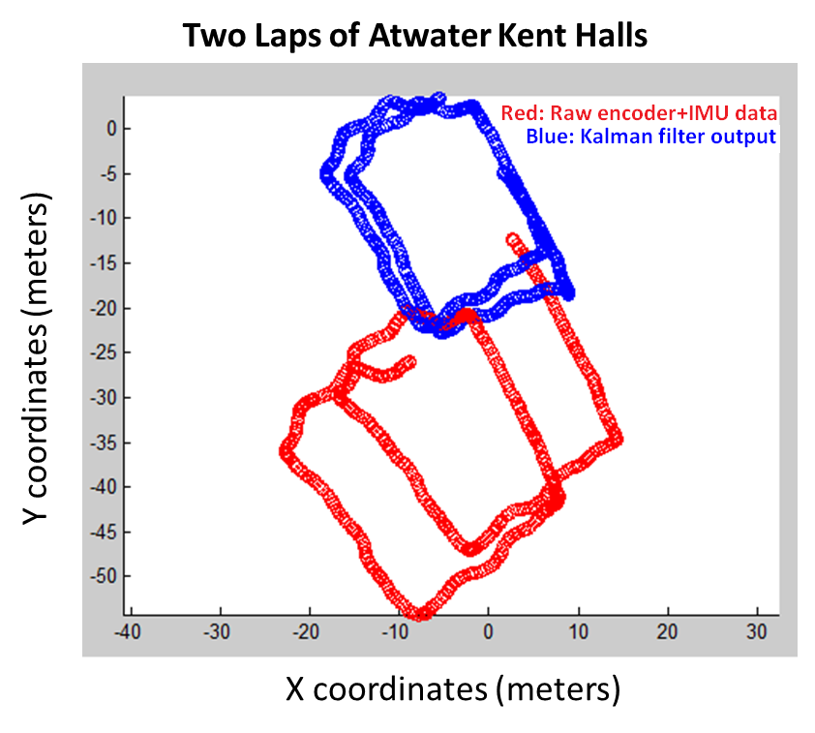
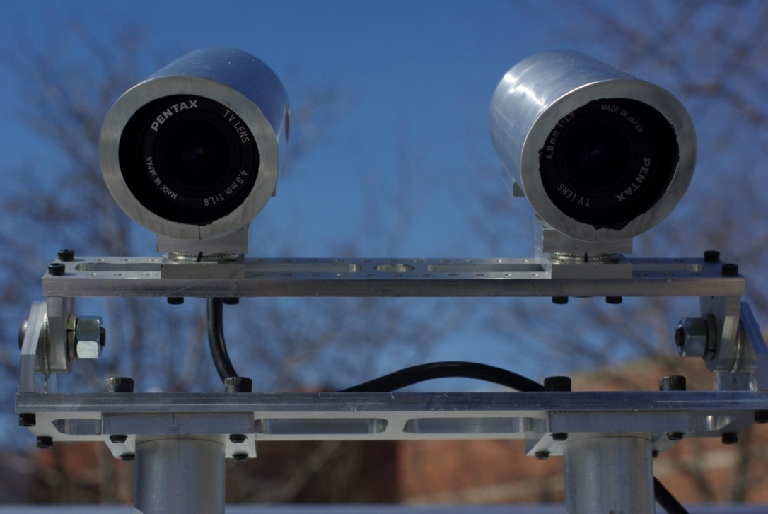
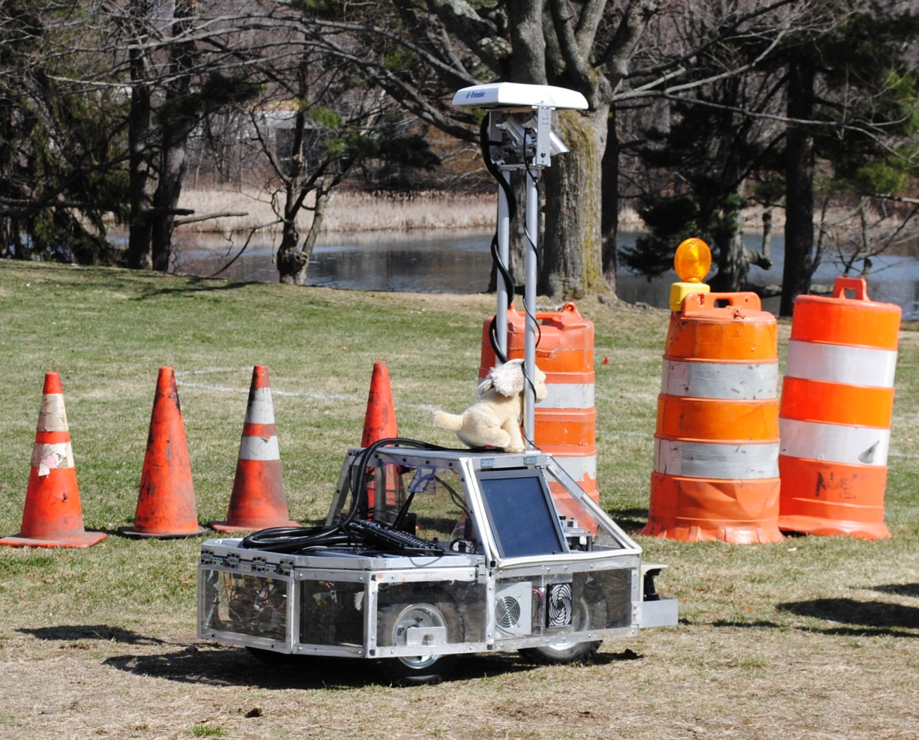
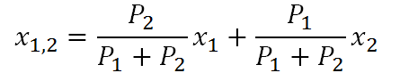
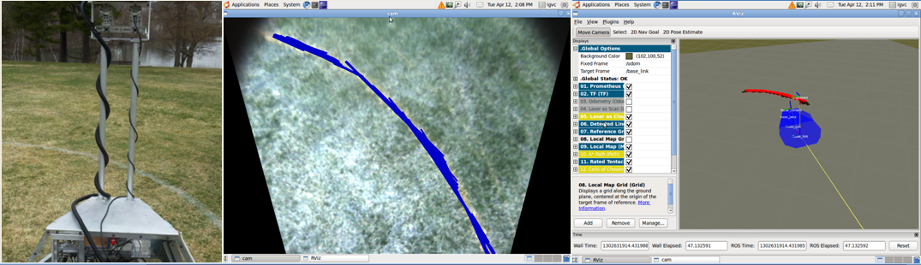
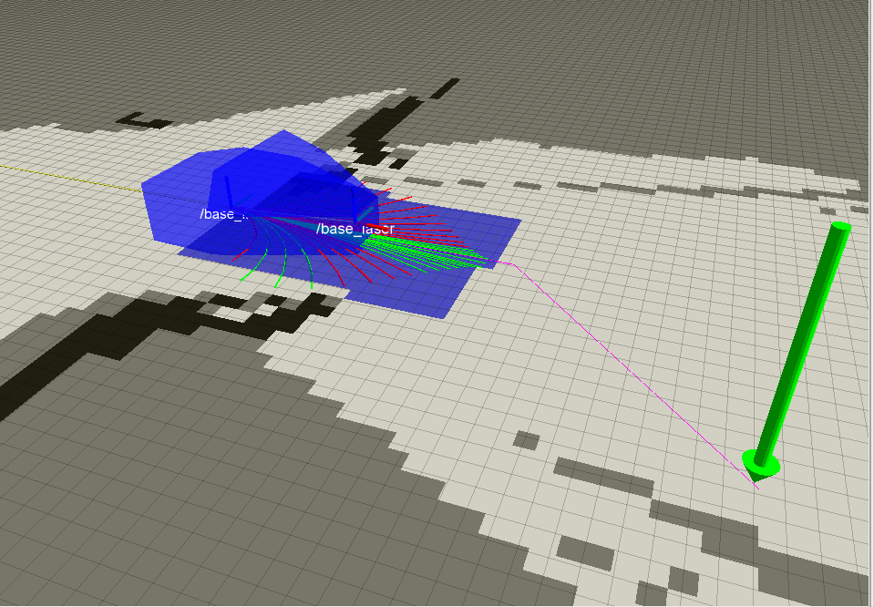







Realization of Performance Advancements for
WPI’s UGV- Prometheus
Mali Akmanalp, Ryan Doherty, Jeffrey Gorges, Peter Kalauskas, Ellen Peterson, Felipe Polido
Robotics Engineering, http://robot.wpi.edu
Advisors: Professors Taskin Padir, Stephen Nestinger, Michael Ciaraldi, William Michalson, Ken Stafford
Abstract
The objective of this project is to design and implement performance improvements for WPI’s intelligent ground vehicle, Prometheus, leading to a more competitive entry at the Intelligent Ground Vehicle Competition. Performance enhancements implemented by the project team include a new upper chassis design, a reconfigurable camera mount, extended Kalman filter-based localization with a GPS receiver and a compass module, a lane detection algorithm, and a modular software framework. As a result, Prometheus has improved autonomy, accessibility, robustness, reliability, and usability.
Intelligence
Line Avoidance
Image data from the cameras are subjected to several levels of processing to detect low-contrast delimiter lines that are painted on the grass field. The image is first subjected to preprocessing with techniques such as median filtering and morphological opening to reduce noise. Then, it is manipulated in the HSV color space to select only a specific range of hues and values which distinguish the lines from the background. Finally, a probabilistic Hough Transform is used to locate line segments on the remaining pixels in the image.
Mechanical Improvements
Software
The software is written in C++ and Python using the Robot Operating System (ROS) framework. The ROS tool, rviz, is utilized to visualize the path planning algorithms. The cRIO is programmed using the National Instruments LabVIEW environment.
Hardware
PNI Fieldforce TCM Inertial Measurement Unit
Trimble AG DGPS with OmniStar HP Subscription
2x Point Grey Flea2 Firewire cameras
SICK LMS-291 LIDAR Rangefinder
US Digital Optical Encoders
National Instruments cRIO
Custom Built On-Board computer (Quad Core Intel i7, 6GB DDR3 RAM)
Localization
The extended Kalman filter (EKF) recursively estimates an evolving, nonlinear state over time. One filter combines the raw data from both the encoders (velocity) and IMU (degrees), while another combines the DGPS (x, y) and IMU. Each filter outputs the updated state position vector x = (x, y, Θ).
*Note: K = Kalman gain,
z = measurement matrix,
H = measurement observation
These state outputs are weighted by their covariance such that the state with a lower covariance is given more weight , while the state with the higher covariance is given less. The two weighted states are then added together to produce one overall state of the robot, x_{1,2}.
*Note: 1 = state from
encoders and IMU,
2 = state from GPS
The host of mechanical improvements on Prometheus include a custom aluminum chassis, a modular rear platform, and reconfigurable camera mounts. The usability improvements include a touchscreen so that external devices are not needed, visual cues so that the user knows the current state of the robot, and an external interface so that the user does not need to open the robot to make minor changes.
On board computer
cRIO
Motors
Laser
Local Map
cRIO
Comm
Line Detection
Path Planner
Extended
Kalman
Filter
Encoders
Camera
Motion Planner
IMU
GPS Conversion
GPS
Remote
Control
Background
Prometheus is a contender in the Intelligent Ground Vehicle Competition (IGVC). The competition requires project teams to design a small outdoor vehicle that will autonomously travel from a starting point to a number of target destinations, while avoiding obstacles. The entries are judged based on a number of criteria including design innovation, a written report, an oral presentation, and overall performance during the competition.
Prometheus was the creation of a 2010 WPI MQP group which built it from the ground up. The vehicle uses an array of sensors which constantly collect and process information about its environment. This information aids in the robot’s localization and autonomous navigation.
Obstacle Avoidance
Localization information is used in conjunction with range data from the LIDAR to create a probability map representing the robot's surroundings. A* is used to plan a path from the robot to its goal or the edge of the probability map, whichever is closer. If A* times out, the map's resolution is decreased, and A* is recalculated. Arced paths are drawn from the center of the robot along possible turning radii. The robot chooses to drive on the arced path that is closest to the path calculated by A* while still avoiding obstacles.
Sponsors

