Slide 1
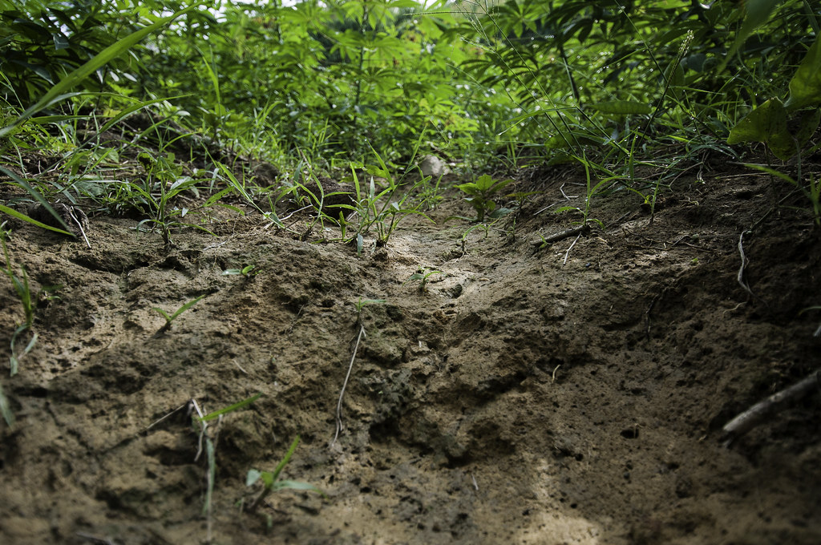
Soil Science in Your Backyard!
A Lesson for High School Students by Lauren Abraham
CC-BY-NC
"Hedgerow grass is planted to prevent soil erosion during trials" by CIAT International Center for Tropical Agriculture is marked with CC BY-NC-SA 2.0.

Slide 2
Schedule for Today and Tomorrow
Day 1:
Lecture and class discussion about soil
Day 2:
Soil texture testing
pH testing
Chemical testing for Nitrogen, Phosphorus, and Potassium content in your soil samples
Worksheet
Class feedback

Slide 3
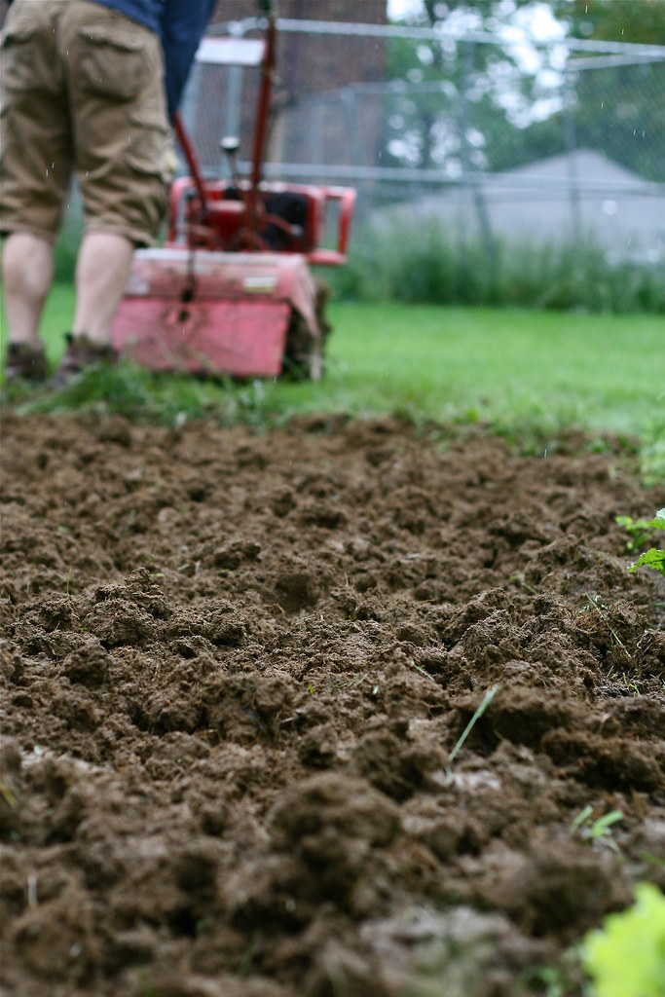
Questions for the Class
What do you think of when you think of soil?
What are some things that you already know about soil?
Why do you think soil might be important?
What does soil do for the ecosystem?
What do you think “healthy soil” means?
"Tilling the Soil" by Chiot's Run is licensed under CC BY-NC 2.0

Slide 4
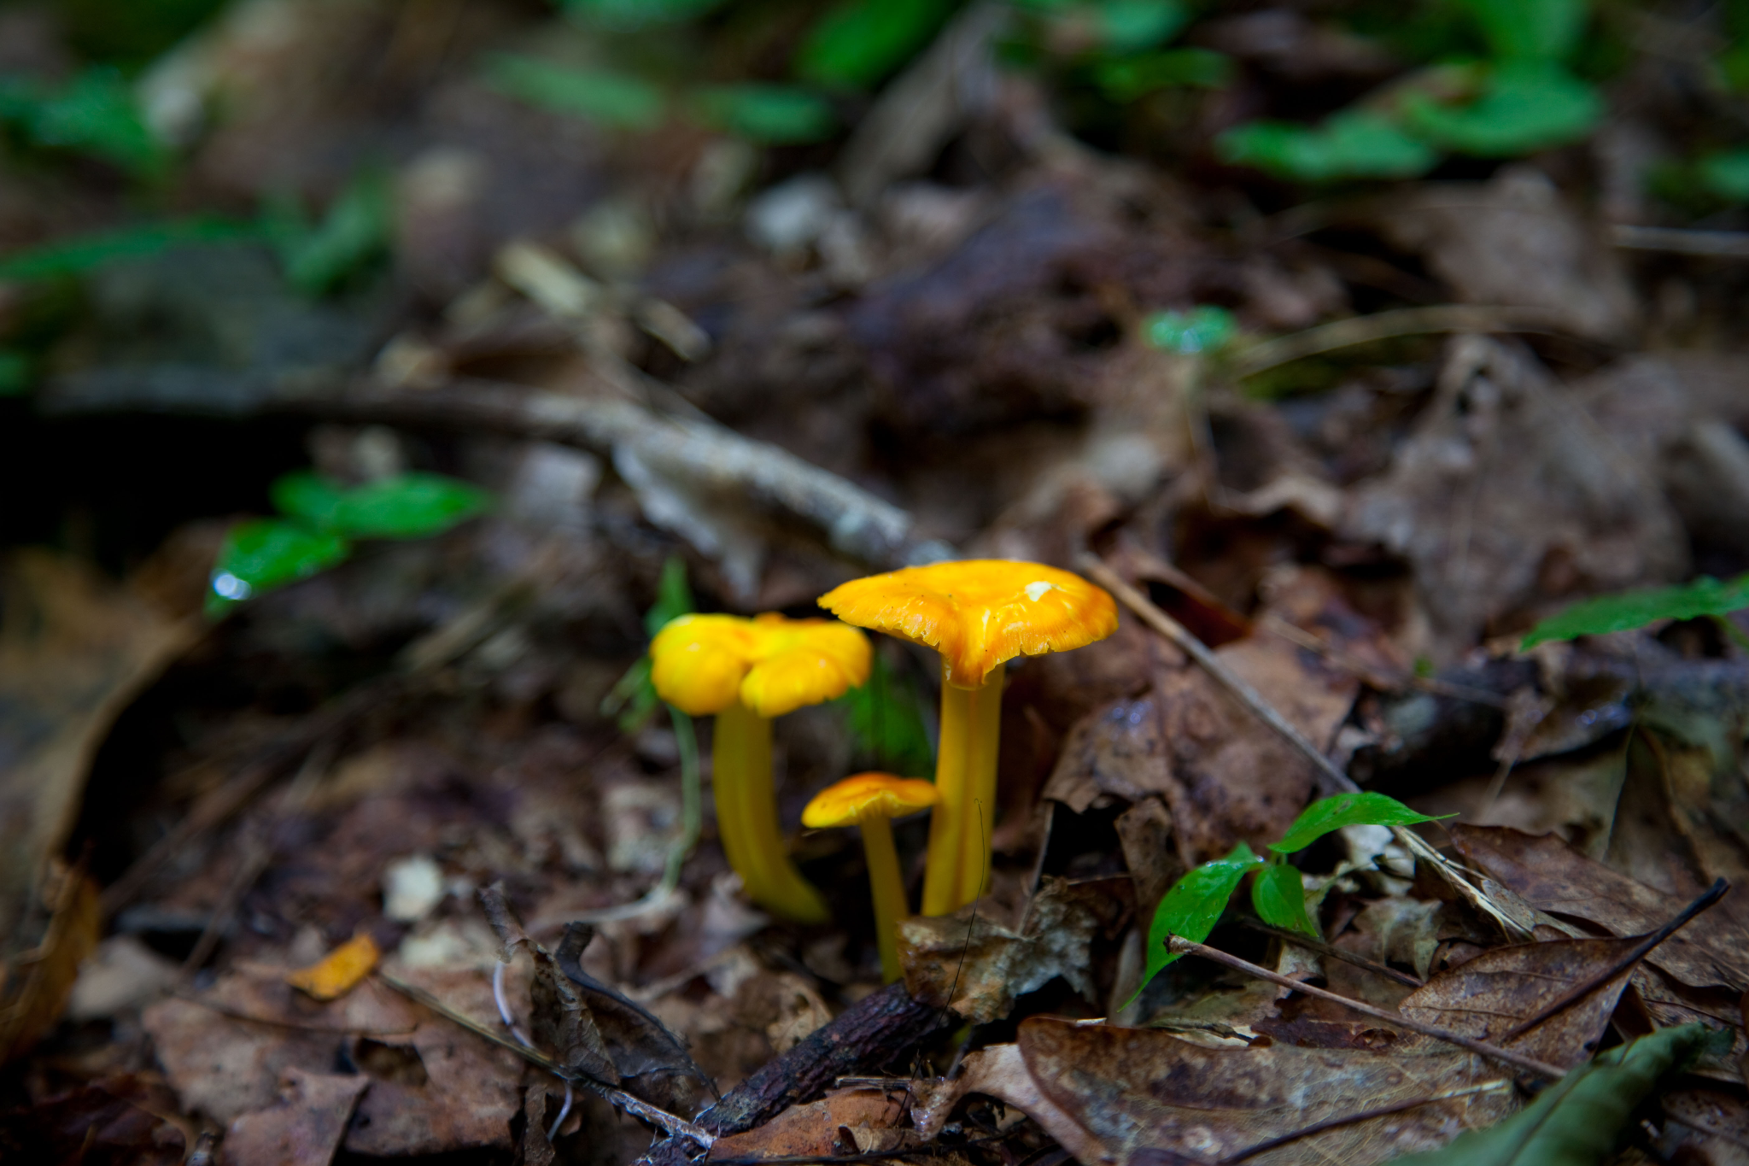
Healthy Soil and its Purpose
Soil acts as a medium for plants to grow in and for water filtration
Soil cycles nutrients (nitrogen, phosphorus, and potassium) back into the ground as organisms decompose and give their organic matter to the soil.
“Healthy” soil has a diverse variety of microbes and organisms, is not compacted tightly, has a pH of 5.5-7.5, and has a balanced chemical makeup.
"File:Spring-mushrooms-forest-floor - West Virginia - ForestWander.jpg" by ForestWander is marked with CC BY-SA 3.0.

Slide 5
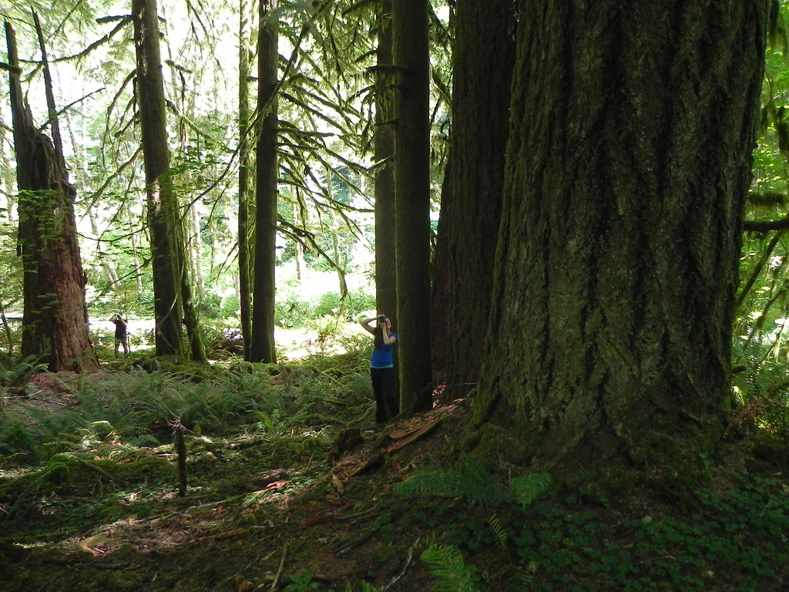
Carbon Storage in Soil
Soil works as a “carbon sink”
  Plants that grow in soil take in carbon from the atmosphere.
  As organisms and plants decompose, the carbon they contain is stored in the soil
  The carbon is not released back into the atmosphere
  Result: lower effects of greenhouse gases
"Richest carbon sinks in the world are being clearcut by the state of Oregon" by F.Eatherington is marked with CC BY-NC 2.0.

Slide 6
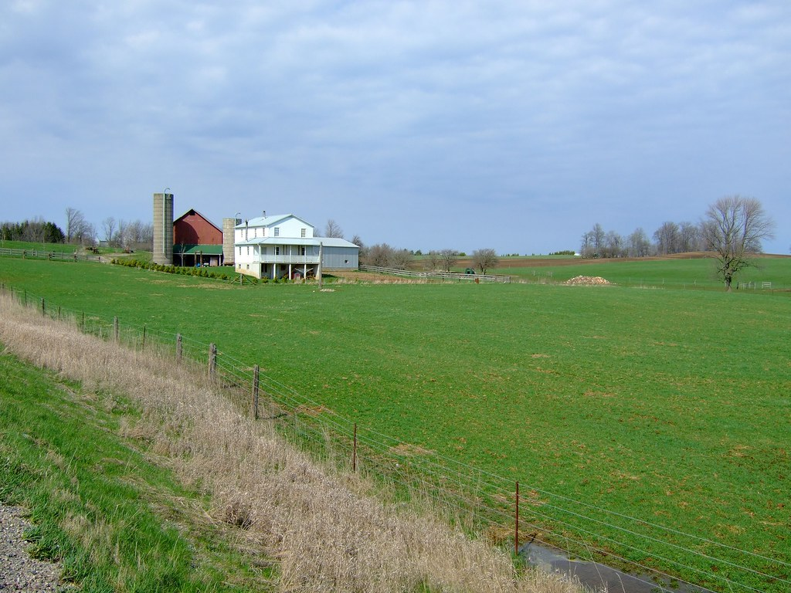
What is Soil Degradation and What Causes It?
Soil degradation is the decline in soil condition caused by:
Natural causes such as wind, rain and flowing water
Human activities
  Deforestation, farming, overgrazing, and tillage. Use of heavy farm machinery over the same area of soil compacts the soil, leading to flooding and poorer soil drainage.
  Industrial development, mining and urbanization
"Farm" by Digitalnative is licensed under CC BY-ND 2.0

Slide 7
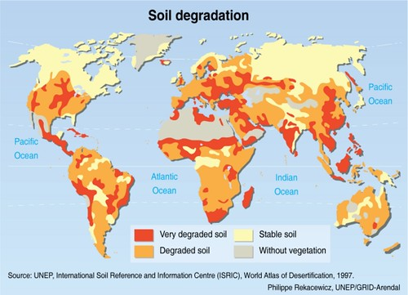
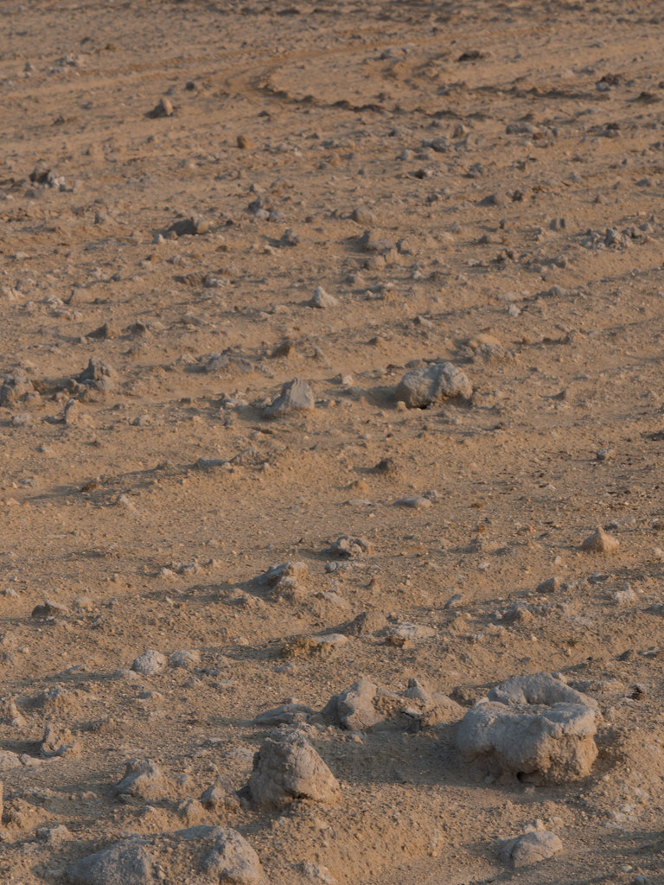
What are Some Consequences of Soil Degradation?
"Global soil degradation" by GRIDArendal is marked with CC BY-NC-SA 2.0.
"Top soil degradation 2" by herr loeffler is marked with CC BY 2.0.

Slide 8
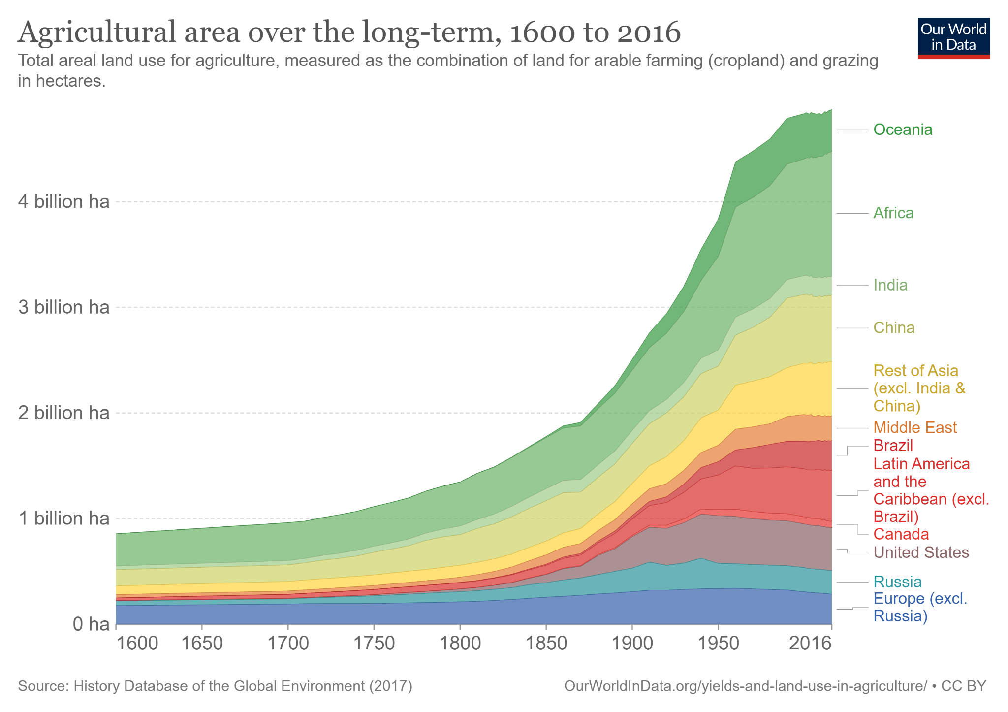
As Soil Degrades, More Fertilizer is Needed to Increase Yield
There is a finite amount of arable farmland on Earth. As we use the land and soil, the quality degrades. To make up for this loss, fertilizers are used to increase crop yield with less land.
Fertilizers increase the amount of contaminants and pollutants in the soil, causing further degradation.
"Agricultural area over the long-term, 1600 to 2016" by Hannah Ritchie and Max Roser, Our World in Data is licensed under CC BY 4.0

Slide 9
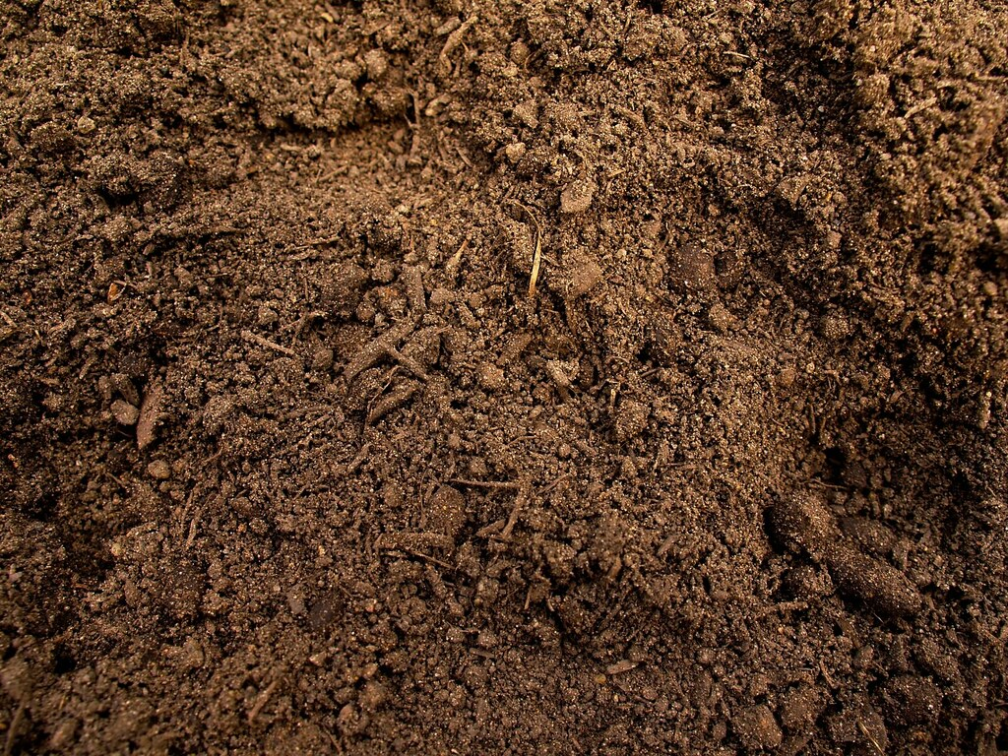
Impact of Pollution on Soil Ecosystem Services
Limited water filtration capacity and limited soil contaminant reduction
Nutrient cycling imbalance from alterations in soil biodiversity
Ecotoxicity (potential for biological, chemical or physical stressors to affect ecosystems) and loss of biodiversity/biomass from wildlife populations
Reduced tree and plant cover leading to reduced flood containment
Promotion of antimicrobial resistance in soil microbes→increases antibiotic-resistant bacteria
Polluted soils are not suitable for recreational, agricultural or residential uses
"Soil Color and Quality" by elvisripley is marked with CC BY-NC 2.0.

Slide 10
Time for a Break!

Slide 11
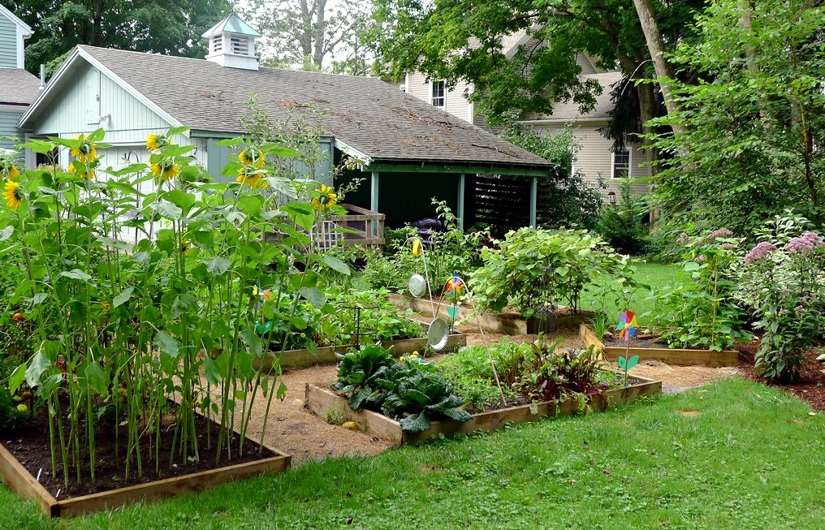
Possible Contaminants in Suburban Soil and Useful Home Gardening Practices
Some contaminants of suburban soil include lead, arsenic, benzene, petroleum products and metals.
How can we create a garden that isn’t contaminated?
  Use organic matter as a base
  Plant in a raised bed or reusable container
  Catch rainwater to water the plants
  Plant native flowers and vegetables
"Backyard Garden 2012" by Lori L. Stalteri is licensed under CC BY-NC-SA 2.0

Slide 12
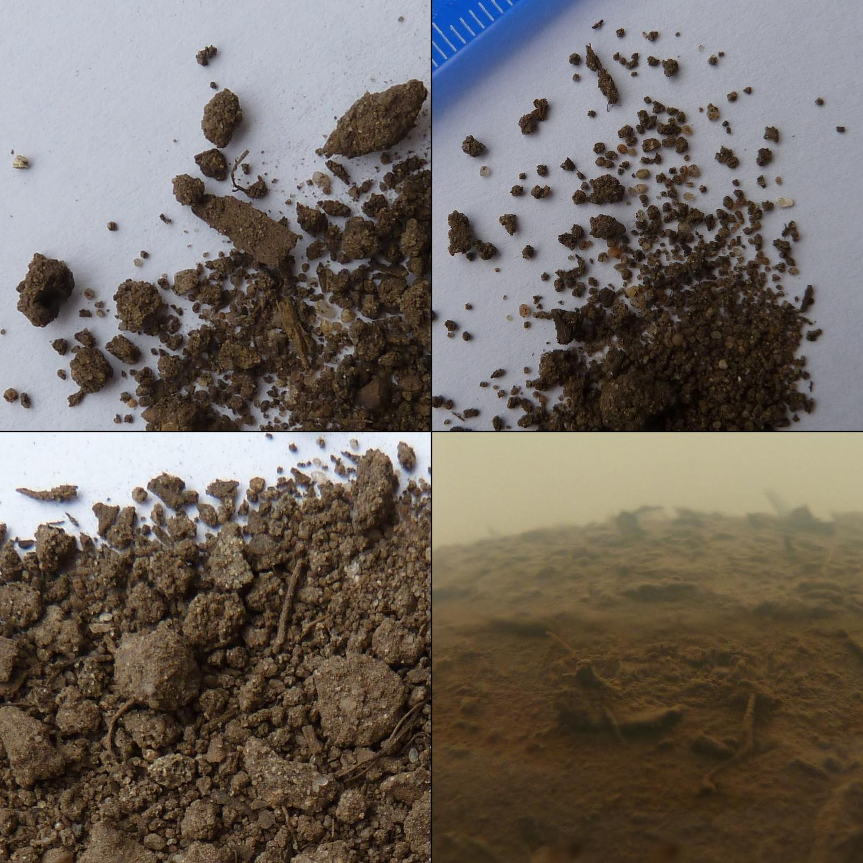
Preparing for Day 2 Tomorrow
When you go home, dig up about a quarter cup of soil from your home garden or backyard. Bring it back in a plastic bag.
Think about where you would find the healthiest soil around your home
  Would it be a place that has plants and is watered frequently, or a part of the ground with little growth that doesn’t show much diversity?
Are there any questions you would want to ask an expert about soil?
"File:Urban soil experiment (6931111952).jpg" by P K is marked with CC BY 2.0.

Slide 13
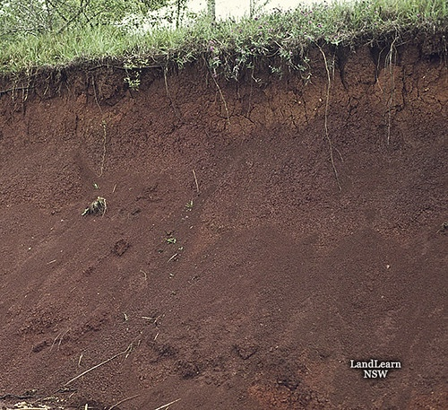
Welcome to Day 2!
Take out your soil samples and choose a lab station
Work by yourself or in a group
After we finish the activity, there will be a worksheet to fill out
"Well drained red soil profile" by NSW DPI Schools program is marked with CC BY-NC-SA 2.0.

Slide 14
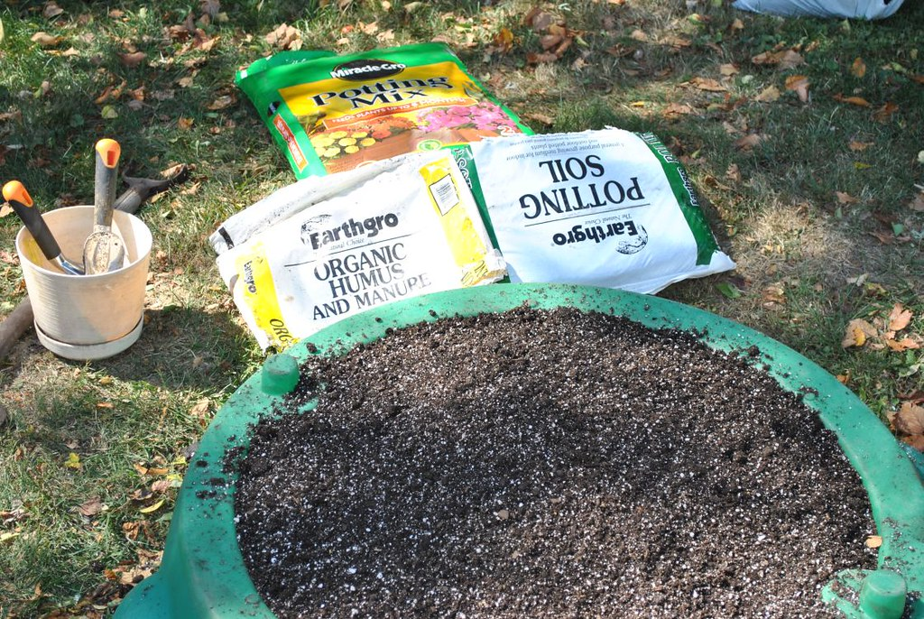
Class Discussion about Soil Results
Why do you think soil would be nutrient deficient?
What are the differences between the soil samples that each of you brought in?
How does the texture of your soil sample differ from the degraded/depleted soil sample?
How does the chemical makeup of your soil sample differ from the depleted soil sample?
"Potting Soil" by msscacti is marked with CC BY 2.0.

Slide 15
Time for a Break!

Slide 16
Talk with an Expert
Class Discussion with an Environmental Biology College/Graduate Student
Discussion Topics:
Activities to do for soil health
Gardening with native plants and local seeds
Biodiversity
Nutrient cycling
Awareness of significant loss of prairie and grasslands around the globe
Awareness of extensive amount of time needed to restore a depleted area of soil
Need for continued proper land management to restore and preserve

Slide 17
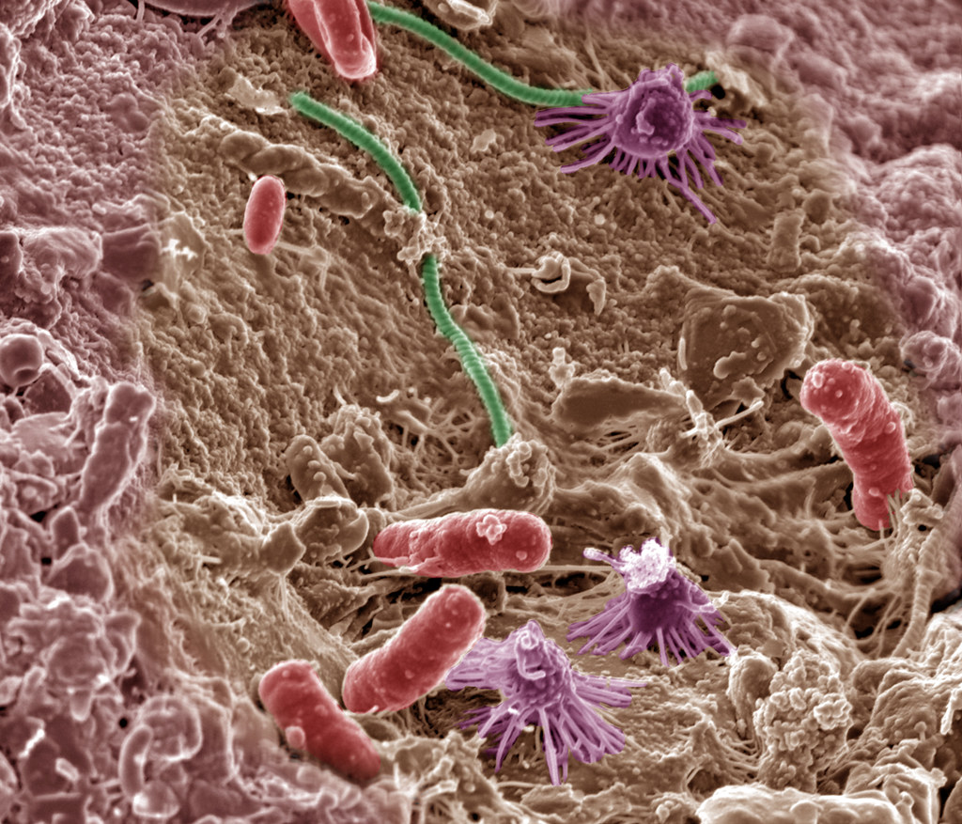
Our Last Topic: What is a Soil Microbe?
A group of microscopic organisms that live in soil
5 different types: bacteria, actinomycetes, fungi, protozoa and nematodes
In a healthy soil sample, there is a diverse variety and a large amount of soil microbes.
"Soil Microbes" by Pacific Northwest National Laboratory - PNNL is marked with CC BY-NC-SA 2.0.

Slide 18
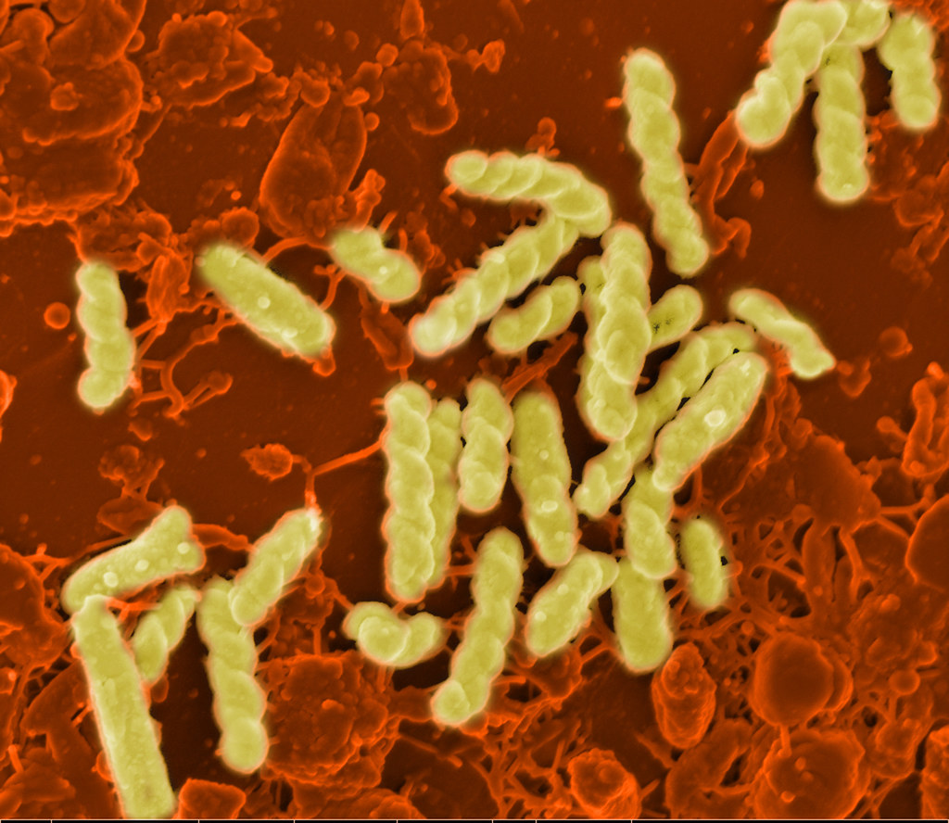
What do Soil Microbes do?
Microbes decompose organic matter and contribute to nutrient cycling
You can suppress harmful microbes by steaming your soil- this makes the soil sterile
Many commercial products are available that contain beneficial soil microbes and can be added to soil
"The Good, the Bad and the Ugly" by Pacific Northwest National Laboratory - PNNL is marked with CC BY-NC-SA 2.0.

Slide 19
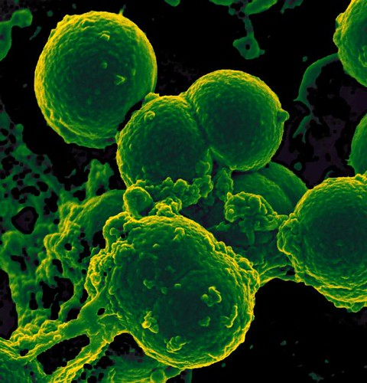
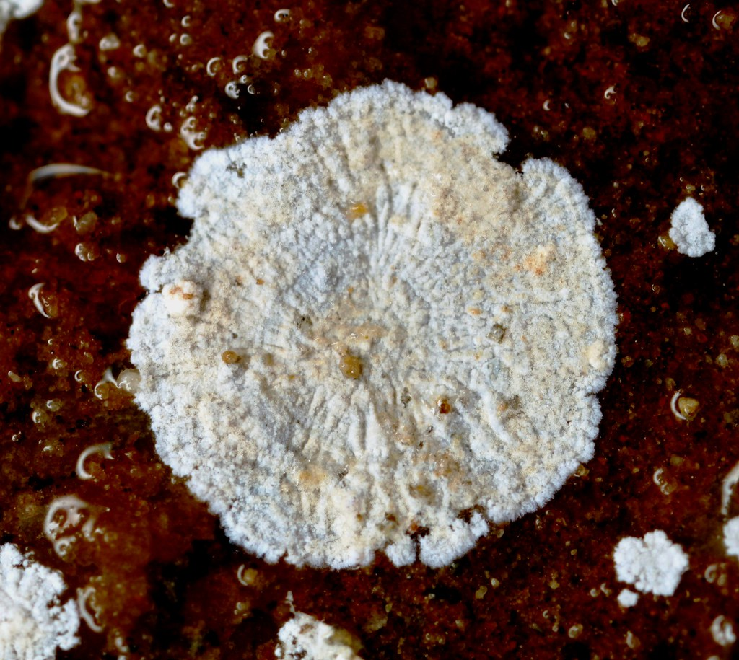
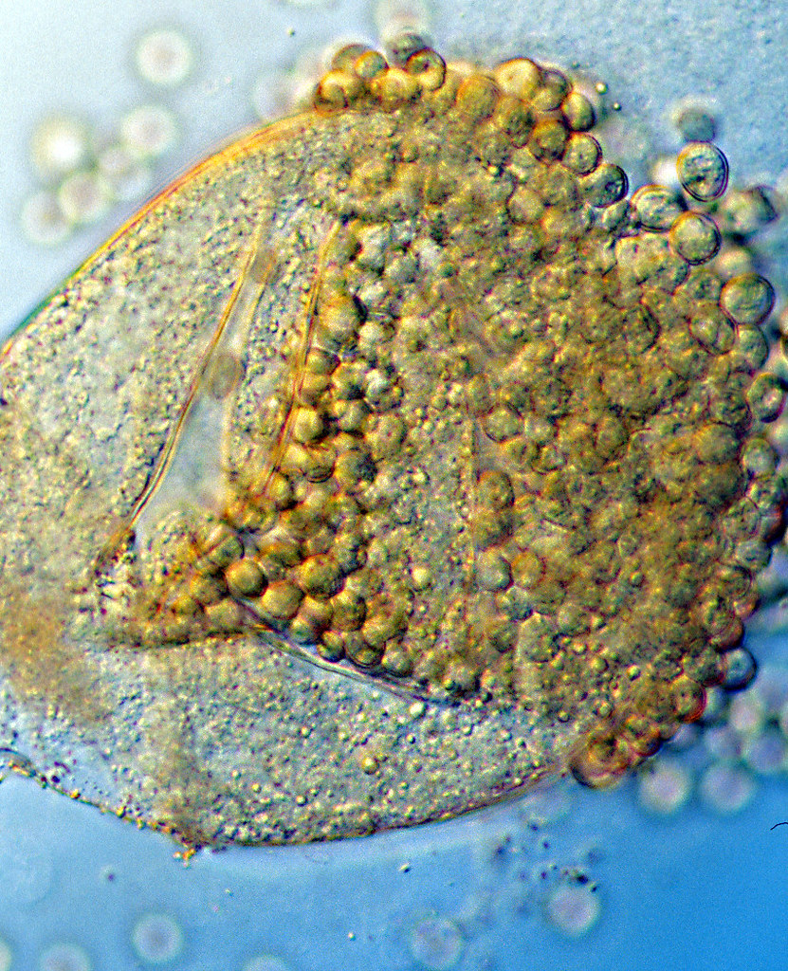
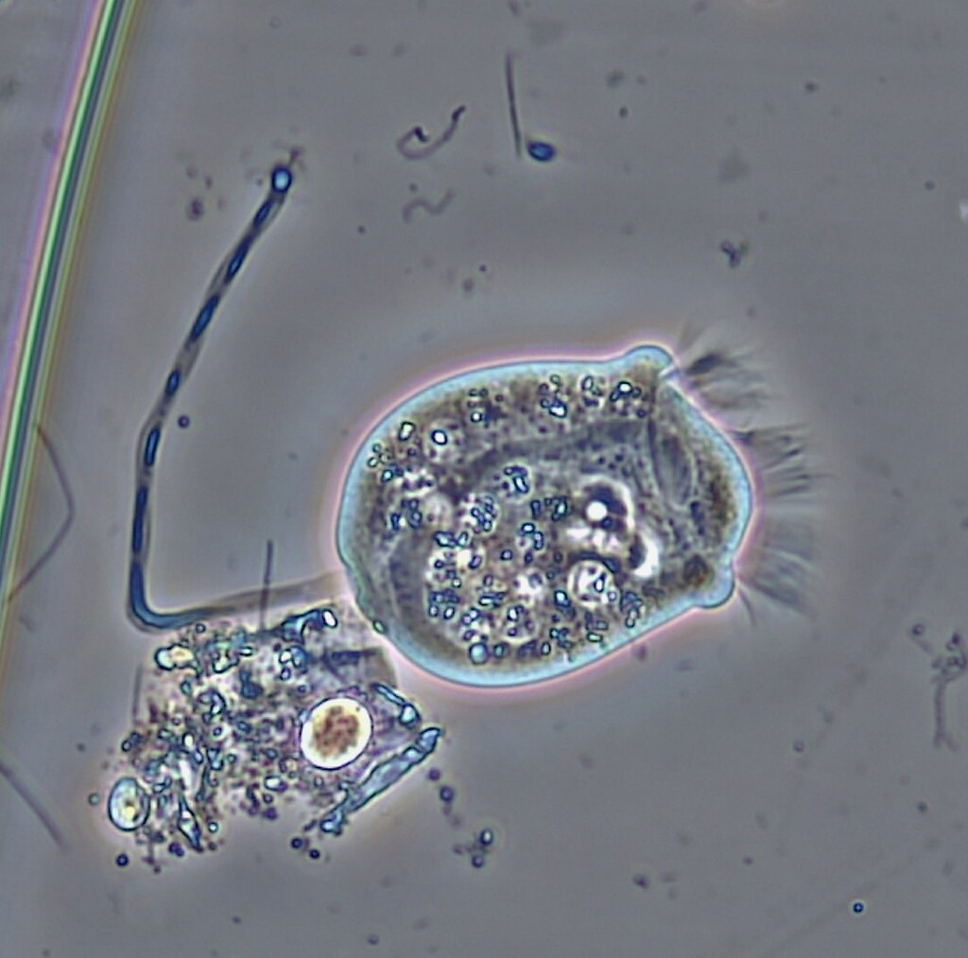
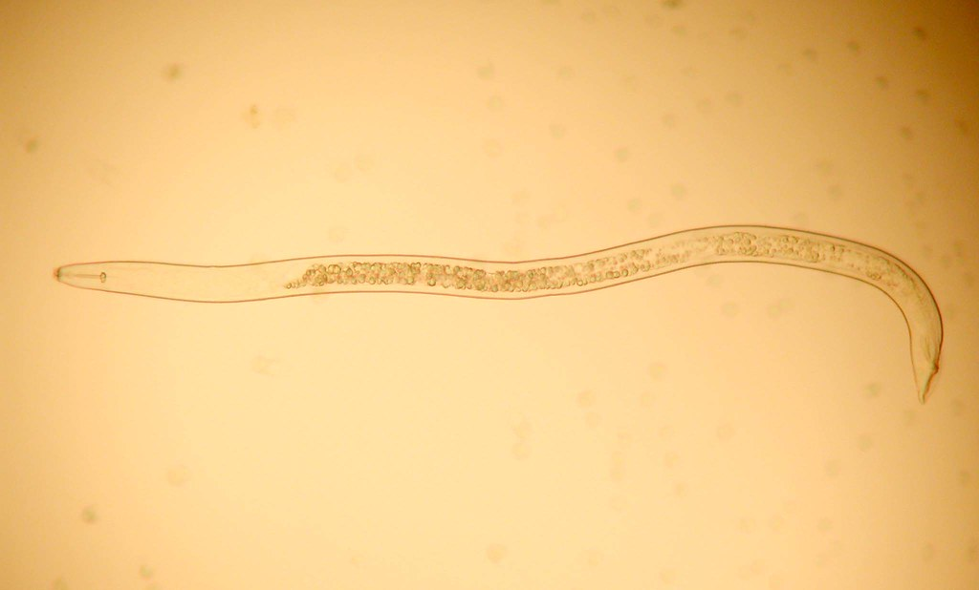
Types of Soil Microbes
Bacteria:
Found almost everywhere on earth
Single celled organisms
Actinomycetes
Also bacteria- “thread or ray bacteria”
Look like fungi but are bacteria
Fungi
Spore producing organisms that feed on organic matter and must live in/on plants to survive
Protozoa
Live in moist environments and feed on other microbes/debris
Nematodes
Worms that can be harmless or parasitic, help distribute bacteria and fungi in soil
"AKK Spiral nematode male Koon-hui Wang photo" by Plant pests and diseases is marked with CC0 1.0.
"Neutrophil and Methicillin-resistant Staphylococccus aureus (MRSA) Bacteria" by NIAID is marked with CC BY 2.0.
"Actinomycetes bacteria" by OregonCavesNPS is marked with CC BY 2.0.
"Rhizopus sp - bursting sporangium - detail" by gjshepherd_br is marked with CC BY-NC-SA 2.0.
"Ciliated Protozoa: Vorticella" by bccoer is marked with CC0 1.0.

Slide 20
Thanks for Listening!

