Slide 1
Improving Visitor Engagement
Museums Victoria
Julia Awad, Matteo Cugno, Noah Darveau, Hunter Wieckowski
March 17, 2021
Notes:
Teo
Introduce our team, (Julia, Hunter, and Noah), WPI, and the IQP project.

Slide 2
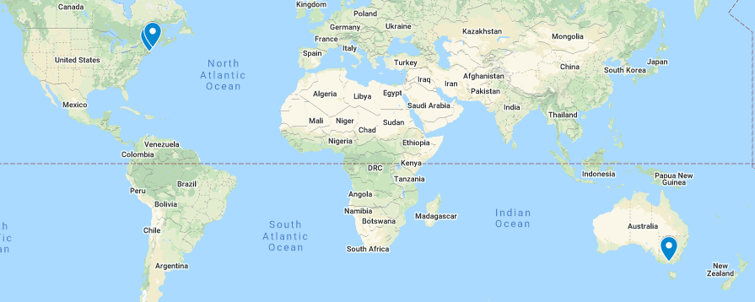
Where is Everyone?
Notes:
Teo: We are far away, so here is where we all are (for context). Land acknowledgment for original owners.
Worcester, MA – The Nipmuc Tribe
Portland, ME – Tribes of the Wabanaki Confederacy
Melbourne - The Bunurong Boon (woorrungg) Wurrung and Wurundjeri (woo-un-jery) (Woo-run) Woi Wurrung peoples of the Eastern Kulin Nation (Verify with Jono)

Slide 3
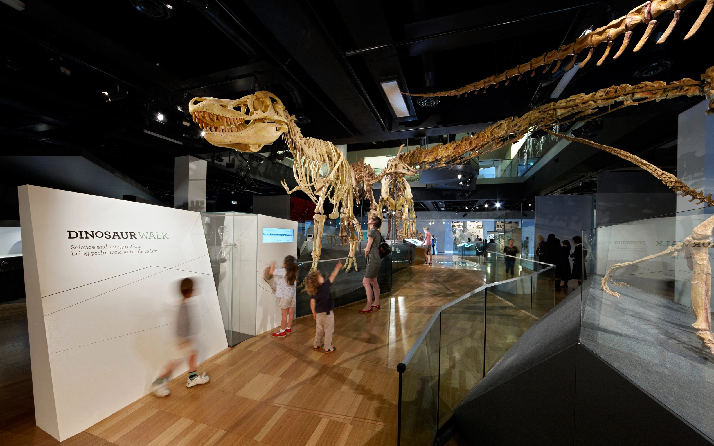
Purpose of Project
The Big Question:
Dinosaur Walk, Melbourne Museum
Notes:
*Teo:
The NEED- updates for training
Nowadays, museums are really more than just places that showcase stuff. They include all sorts of experiences that draw in all different types of people.
Museums Victoria really is on the cutting-edge of designing interactive and engaging experiences. With the many different types of people who visit museums, Museums Victoria is interested in gaining a better understanding of what motivates people to come to the museum.
This project is a continuation of a study for another IQP project that worked with Museums Victoria back in 2016.
READ OUT BIG QUESTION, EXPLAIN ESTABLISHED NEED

Slide 4
Purpose of Project
The Big Question:
With the wide variety of people that visit museums, how can Museums Victoria give each visitor the best experience possible?
Dinosaur Walk Melbourne Museum
Notes:
Teo:
The NEED- updates for training
Nowadays, museums are really more than just places that showcase stuff. They include all sorts of experiences that draw in all different types of people.
Now Museums Victoria is really on the cutting-edge of designing interactive and engaging experiences. With all the different visitors, Museums Victoria is interested in gaining a better understanding of what motivates people to come to the museum.
This project builds off of a previous IQP project that worked with Museums Victoria back in 2016.
READ OUT BIG QUESTION, EXPLAIN ESTABLISHED NEED

Slide 5
Project Goal
Our goal is to create effective training materials that will assist the Museums Victoria staff on how to better identify and engage with visitor motivational segments.
Notes:
Teo: Explain goal, we worked with MV to create this goal for them to come out of lockdown and provide the best experience for all museum goers. We decided the best way to achieve this goal was to analyze data collected by Muesums Victoria, then use the findings from that to guide our creation of training materials that will help to further educate the Museums Victoria staff on interacting with museum visitors.
Framing the purpose as identifying an issue
The goal is how we are going to solve the problem

Slide 6
VISITOR SEGMENTS AT MUSEUMS VICTORIA
What are Musuems Victoria's segments?
Notes:
Julia :Just want to give a quick refreshed on what Audience Segmentation is, it is the the recognition of subgroups that share common characteristics.
Audience segmentation is a strategy used to target a specific audience in order to better cater to their needs.
It like putting people together in catagories

Slide 7
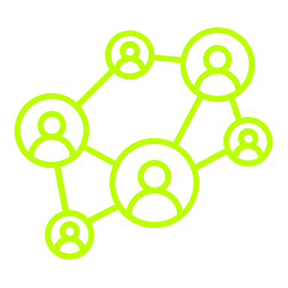
Motivational Segments
Easy Going
Informed
Connected
Curious
?
Obligated
Elite
Notes:
*Julia:
Museums Victoria strives to give their visitors meaningful engagements tailored to the motivations they feel while at the museum.
We created these symbols to represent each segment
Easy going- group of friend looking for something to do or people on a date
Obligated- school trips of families
Elite- Young people wanting exlusive experinces
Connected: student young adults going to socialize, intelectual conversations
Infomred: generally older, want to learn new infirmation for a reason
Curious: want to learn new stuff, more for fun

Slide 8
Motivational Segments
= "The Museum Effect"
Stimulate
Expressive
Entertainment
Elite
Easy-going
Independent
Curious
Connected
Social
Informed
Obligated
Personal Growth
Belonging
Absorb
Notes:
*Julia:
Meaningful engagement is referred to as “The Museum Effect”.
Quickly mention driver : Consumer drivers are a visitor’s intent for attending a museum
The motivational segments are related in pairs by consumer drivers (in white italicized), the visitor’s intent for attending MV. Social group side vs Individual side.
Interrelated segments in consumer drives and with in them eslves. Oppsited on the wheel
-Talk about how this is their relationships
-Own the fact that we created this wheel.
Dont need:
Curious:Explore, expand, cultures, go for themselves
Obligated: Absorb, deeper meaning
Elite: Stimulated, expressive, achievements
Easy: Social, entertainment, stimulated by sourroundings
Connected: Relaxed, connected, entertained by others, comfortable
Informed: Personal growth, serious, enriching experince, knowledge

Slide 9
Pre-2020
2003
Colmar Brunton conducts initial study
2013
Colmar Brunton study is
re-evaluated
2016
Previous WPI project is completed
2021
Our project is completed
Notes:
*Hunter:
2003: Museums Victoria hires the market analytics company Colmar Brunton to conduct their initial audience segment study, which identifies 4 unique audience segments.
2013: Museums Victoria re-evaluates the original Colmar Brunton study and identifies 2 additional unique segments.
2016: Museums Victoria works with a WPI IQP team to create videos for training staff on how to identify and engage with the audience segments identified in the re-evaluated study.
Add 2021

Slide 10
Objectives
Report
Analyze data from the last 5 years
Infographics
Training
Create website that contains web-based training modules
Design infographics to convey important findings
Notes:
*Hunter:
Go over objectives to achieve goal
Also mention interviews
More thought

Slide 11
DATA ANALYSIS
Notes:
Hunter:
-mv collected it and gave It to us
Exit surveys

Slide 12
Datasets (2016-2020)
Visitor Sentiment Index (VSI): Subjective data regarding visitor's overall experience.
Visitor Profile Survey (VPS): What exhibits visitors saw and their demographics.
Concept Sort (VPS): Potential visitor interests
Notes:
Hunter
Explain each of the 3 data sets
Write out he names

Slide 13
Segment Distributions Changed Over Time
Overall Percentage | July 2016 | 2021
Curious | 15% | 24.85%
Elite | 6% | 5.77%
Obligated | 19% | 18.43%
Informed | 23% | 15.8%
Easy Going | 20% | 16.54%
Connected | 17% | 18.62%
Notes:
Hunter: Curious 10% increase, Informed 7% decrease, Easy-Going 3.5% decrease. Most went down, huge increase in curious.

Slide 14
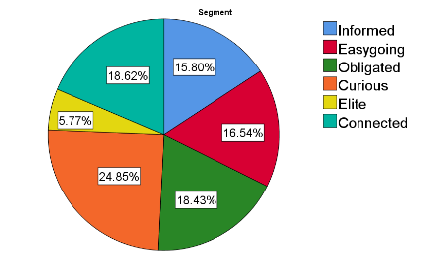
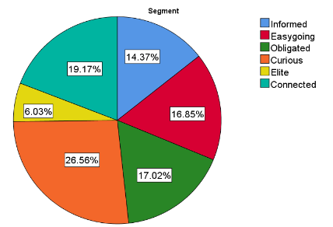
Melbourne Museum segment distributions follows the overall distribution
Museums Victoria
Melbourne Museum
N = 8003
N = 3020
Notes:
Noah
When anayzing the data, the first thing we looked at was what the segment distribution for each museum and for Museums Victoria as a whole was. Here you can see that overall, there is a fairly even distribution between all of the segments, aside from the Elite segment, which is on the smaller side, but with specific and different needs. The segment distribution for the Melbourne Museum also follows a fairly even distribution that’s nearly identical to the overall.

Slide 15
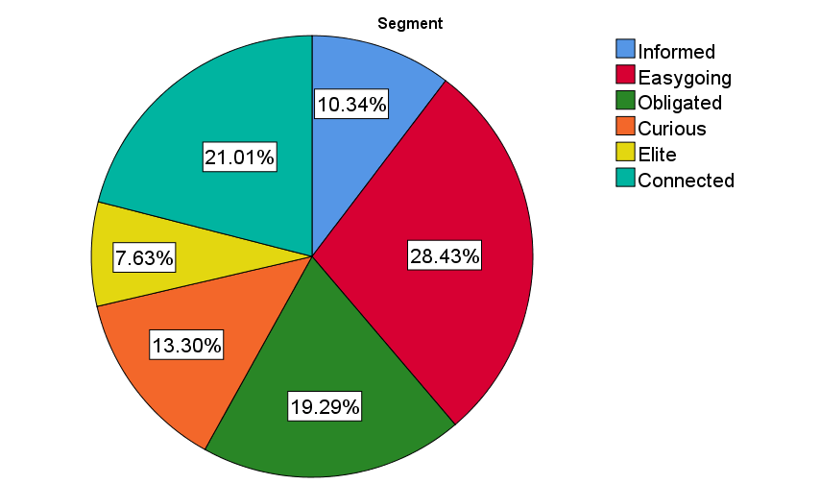
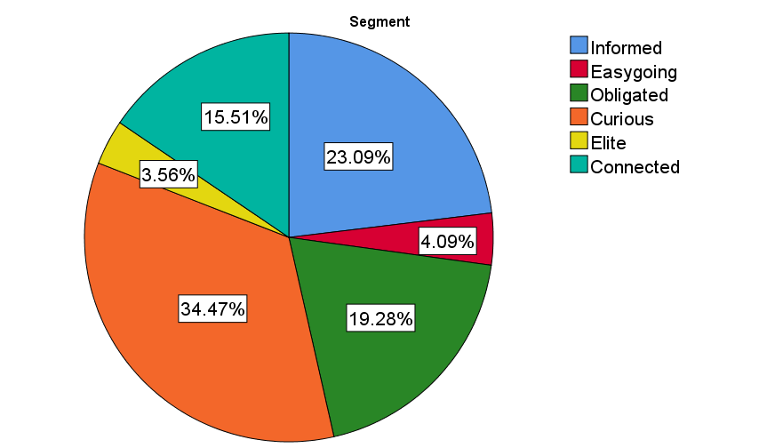
The Scienceworks and Immigration Museum segment distributions oppose one another
Scienceworks
Immigration Museum
N = 2513
N = 2470
Notes:
Noah
Here you can see the segment distributions for Scienceworks and the Immigration Museum. Unlike the Melbourne Museum, these museums feature much different distributions. For example, Scienceworks features a much larger portion of Easy-going visitors, with largely reduced Informed and Curious portions. This is because the Scienceworks museum is tailored much more towards hands-on and entertaining experiences. In contrast, the Immigration Museum is quite the opposite with much larger Informed and Curious portions, and almost no Easygoing visitors. Part of the reason for this is the Immigration Museum is tailored towards a much more educational and informative experience.

Slide 16
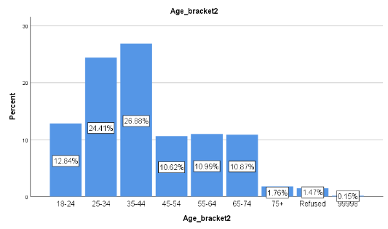
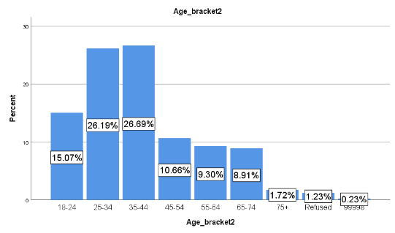
Museum Age
Melbourne Museum age distributions follows the overall distribution
Museums Victoria
Melbourne Museum
N = 8003
N = 3020
Notes:
Noah
We also looked at the age distributions for each museum. Once again you can see that the Melbourne Museum follows a nearly identical distribution to all of Museums Victoria as a whole. This is actually a recurring pattern we saw with nearly everything we looked at. We can see here though that the general audience for Museums Victoria tends to skew towards a younger age.

Slide 17
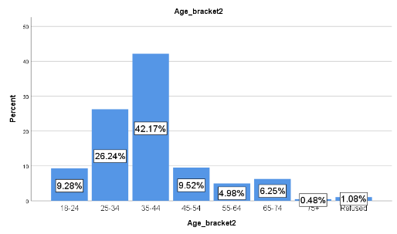
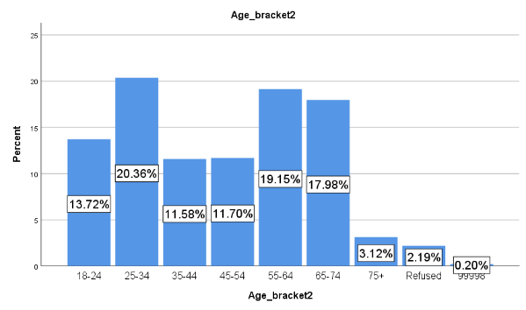
The Scienceworks and Immigration Museum age distributions oppose one another
Scienceworks
Immigration Museum
N = 2513
N = 2470
Notes:
Noah
Then once again we see that Scienceworks and the Immigration Museum have opposing results, with Scienceworks skewing much more towards a younger age and the Immigration Museum skewing towards older visitors. There are a few explanations for this. The first being that each segment tends to also skew towards older or younger, and since these two museums attract different segments, the age distribution follows. The other reason being the type of content offered at each museum. Since Scienceworks offers more hands-on experiences, they are much more suited to younger children so you see a large portion of the distribution in the age range most likely to have children along with them. Then with the Immigration museum's more educational content, its less suited for young children and more appealing to an older generation.

Slide 18
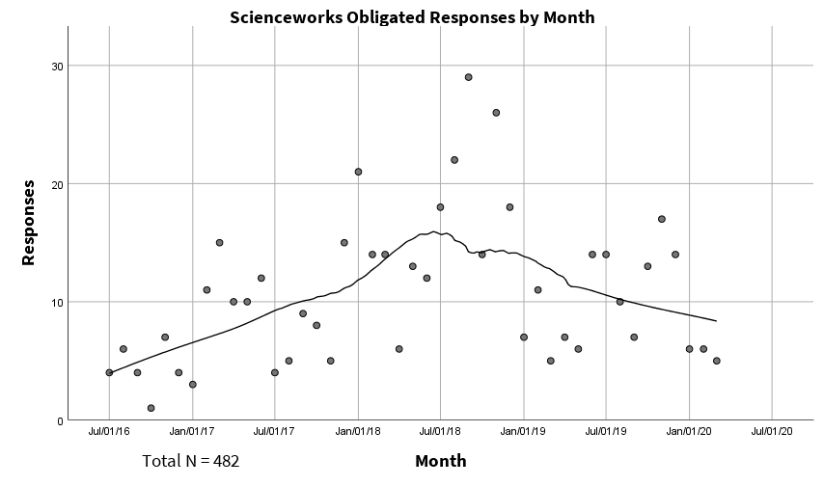
Temporary exhibits caused a peak in visitations
Notes:
Noah:
Another aspect we looked at was the total visitations for each segment at each museum over time. We did this by adding the total number of survey responses for each month by visitors identified as each segment. We then plotted the sums for each month on a scatter plot of the sum of entries for each month, versus time. So what you're looking at on the graph, each dot represents the total number of entries for that month. From there we were able to use regression models to establish a trend line that allows us to see when there were peaks and valleys in visitations. We can then correlate the peaks with temporary exhibits to see which ones caused a surge in this type of visitor. This way, exhibit designers can dissect what aspects of these exhibits this visitor segment enjoys. The prominent spike you see in the middle of the graph that ranges from about April 2018- April 2019 was most likely due to the presence of 2 different temporary exhibits. The first exhibit being Above and Beyond which ran from June 9, 2018 to Oct 1, 2018. The dates this exhibit ran shown between the orange vertical bars. The other exhibit responsible was Museum of the Moon which ran from Nov. 11, 2018 to Apr. 28, 2019, shown between the blue lines.

Slide 19
Temporary exhibits caused a peak in visitations
Notes:
Noah:
Another aspect we looked at was the total visitations for each segment at each museum over time. We did this by adding the total number of survey responses for each month by visitors identified as each segment. We then plotted the sums for each month on a scatter plot of the sum of entries for each month, versus time. So what you're looking at on the graph, each dot represents the total number of entries for that month. From there we were able to determine a trend line that allows us to see when there were peaks and valleys in visitations. We can then correlate the peaks with temporary exhibits to see which ones caused a surge in this type of visitor. This way, exhibit designers can dissect what aspects of these exhibits this visitor segment enjoys. The prominent spike you see in the middle of the graph that ranges from about April 2018- April 2019 was most likely due to the presence of 2 different temporary exhibits. The first exhibit being Above and Beyond which ran from June 9, 2018 to Oct 1 2018. The dates this exhibit ran shown between the orange vertical bars. The other exhibit responsible was Museum of the Moon which ran from Nov. 11, 2018 to Apr. 28, 2019, shown between the blue lines. Now both of these exhibits were among the highest rated Scienceworks exhibits by visitors falling in the Obligated segment.

Slide 20
Temporary exhibits caused a peak in visitations
Notes:
Noah:
Another aspect we looked at was the total visitations for each segment at each museum over time. We did this by adding the total number of survey responses for each month by visitors identified as each segment. We then plotted the sums for each month on a scatter plot of the sum of entries for each month, versus time. So what you're looking at on the graph, each dot represents the total number of entries for that month. From there we were able to determine a trend line that allows us to see when there were peaks and valleys in visitations. We can then correlate the peaks with temporary exhibits to see which ones caused a surge in this type of visitor. This way, exhibit designers can dissect what aspects of these exhibits this visitor segment enjoys. The prominent spike you see in the middle of the graph that ranges from about April 2018- April 2019 was most likely due to the presence of 2 different temporary exhibits. The first exhibit being Above and Beyond which ran from June 9, 2018 to Oct 1 2018. The dates this exhibit ran shown between the orange vertical bars. The other exhibit responsible was Museum of the Moon which ran from Nov. 11, 2018 to Apr. 28, 2019, shown between the blue lines. Now both of these exhibits were among the highest rated Scienceworks exhibits by visitors falling in the Obligated segment. With all this in mind, it's not a far stretch to say that the presence of these 2 exhibits had a positive effect on Obligated visitations at Scienceworks.
Mention the other ones that they are in the full report (EXHIBITION DEVELOPRS)

Slide 21
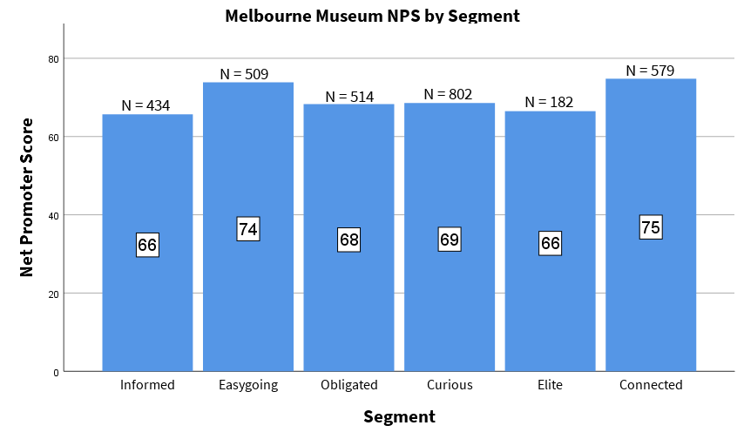
Social Segments Give Higher NPS Values
Average NPS = 70
Total N = 3020
Notes:
Noah
We also looked at the Net Promoter Score for each museum and segment. The Net Promoter Score is a measure of how likely a visitor is to recommend visiting the museum to friends and family. It is calculated by asking the visitor to rate the likelihood they would recommend the museum to a friend or family member from 1-10. Any score from 1-6 counts as a detractor, a rating of 7 or 8 counts as neutral, and 9 or 10 counts as a promoter. The percentage of detractors is then subtracted from the percentage of promoters to give the final Net Promoter Score. Here we see that Easygoing and Connected are the most likely to recommend the museum to a friend.

Slide 22
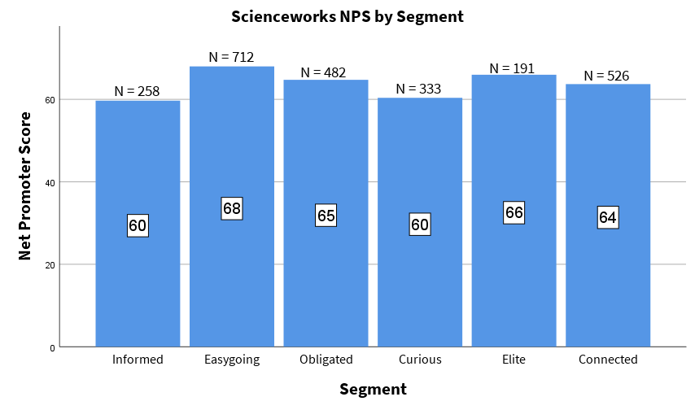
Visitor Segment Impacts Net Promoter Scores
Average NPS = 64
Total N = 2513
Notes:
Noah
This is the Net Promoter Score for the Scienceworks Museum. You can see that it is still fairly high overall, although not quite as high as Melbourne Museum. Part of the reason Melbourne Museum's average scores so high is due to the fact it’s a very well rounded museum with things for everyone to enjoy. Which again kind of echoes how there was a fairly even distribution of visitors between all the segments. Scienceworks still scores rather high largely due to the its focus on more hands-on, interactive, and exciting features, which generally everyone can get behind, even if that's not entirely the reason they visited the museum.

Slide 23
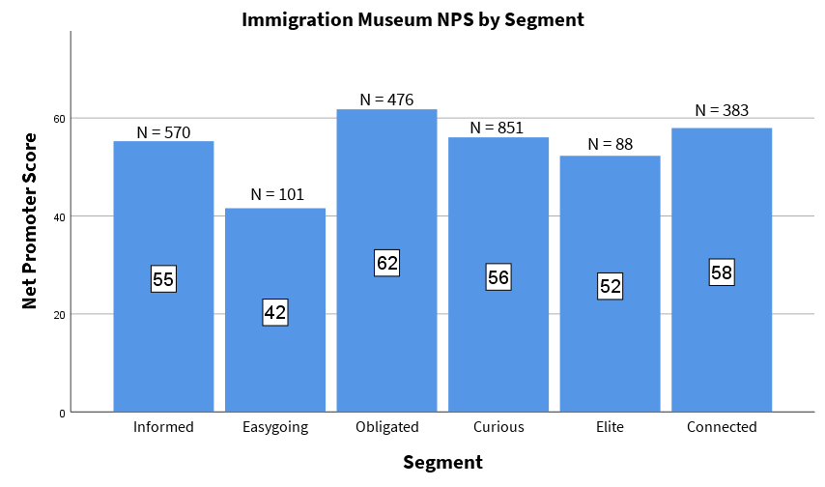
Visitor Segment Impacts Net Promoter Scores (cont.)
Average NPS = 54
Total N = 2470
Notes:
Noah
Finally, we see the Immigration Museum here, with the lowest average score between the three museums. Of course that's not to say that the Immigration Museum has a low average Net Promoter Score, an average score of 54 is still well into the positives, just not quite as high as the other two museums. This is mostly in part to the educational nature of the Immigration Museum with it being more difficult for visitors who aren't quite looking for that type of experience to "get on board with it" per se. It’s a bit easier for someone seeking an educational experience to find the educational value in a hands-on experience that you would more so find at Scienceworks, than it is for someone looking for a exciting, interactive experience to find what they are looking for in more information based one.

Slide 24
Interviews
WPI's Academic Technology Center
Caitlin Keller
ATC
Museums Victoria Staff
Jill Mitchell, Olivia Gumienny, Arti Govind, Sara Sunners-Gormley, and Pipi Lovell-Smith!
Notes:
Teo
Caitlin Keller ATC, Jill Mitchell, Olivia Gumienny, Arti Govind, Sara Sunners-Gormley, Pipi Lovell-Smith
Caitlin:
Focus on end goal = what do we want the staff to get from the training?
Format new modules like existing training = not starting from scratch, familiar training
Keep elements that require focus < 5 minutes long
Use tools like Google Sites, EdPuzzle, Educaplay
MV Staff:
Infographics are used regularly, want more concise and relevant information
Training videos were not widely used, dry
Create text version
Are familiar with taking module based training

Slide 25
Infographics
Notes:
Julia
Infographics serve as an affective training material as they summaries key points about each segments in a visually effective and efficient way.
Infographics made first
We wanted to redesign the old ones and add new updated data for each segment
Arrgument/reason infographics are good resourse.. Researc stuff why they are part of the training material
Say how they use them / present in break room
Mentions interviews

Slide 26
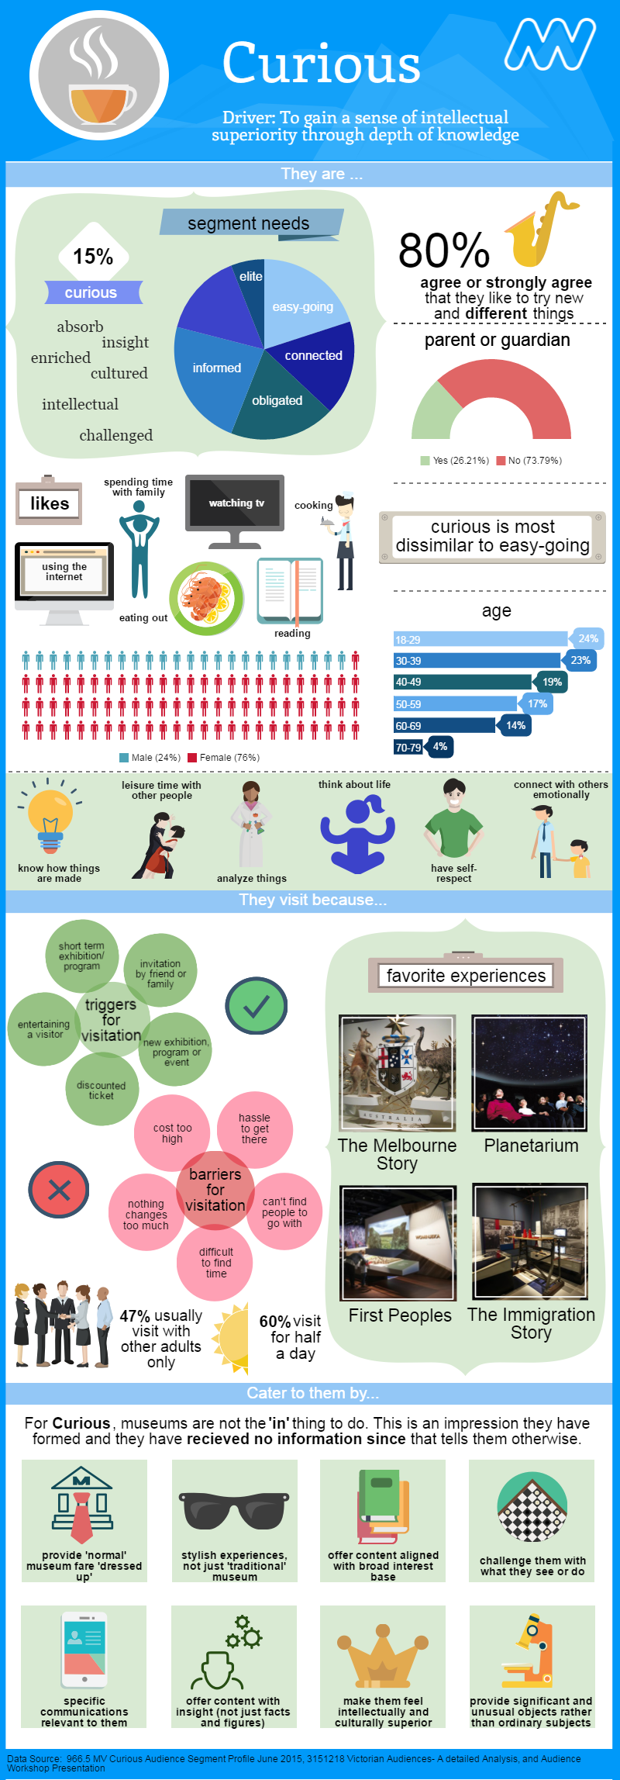
Notes:
Here are the old infographics thet were created by the 2016 IQP group that was here before us

Slide 27
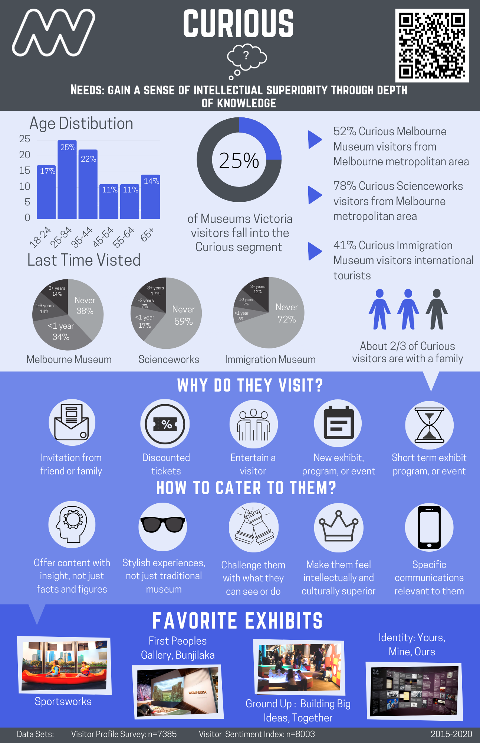
Notes:
Here is the new infographic that we created
New design,
Flows downward and is read top to bottum
color matching with segments from the old infpgraphics
Kept a monochromatic coloring scheem

Slide 28
Notes:
New symobol to represent each segment
Driver below
QR code that take you to the traning site where you can acess PDF versions of the infographics

Slide 29
Notes:
Julia
Data section
Most crucial info to help get a general demagraphic understaninf for each segment
Show the stats/facts

Slide 30
Notes:
Julia
The main focus is about visitor prefrence
What are there reasons for visiting musuem
And when they do how do we cater to them
5 exepmple of each

Slide 31
Notes:
Julia
Favorite exhibits
Regardless of musuem
Credits on bottom which is the difernt data sets and years they were collected
Update

Slide 32
Training Modules
Training Course
We developed an interactive training module course for MV staff via Google Sites!
Notes:
Teo
Identified a free way to develop a training course for staff to learn about the segments and how to better engage with them.
Google sites
Imbedded programs, interactive elements
Website is designed to be updated at any point as new data findings develop over time

Slide 33
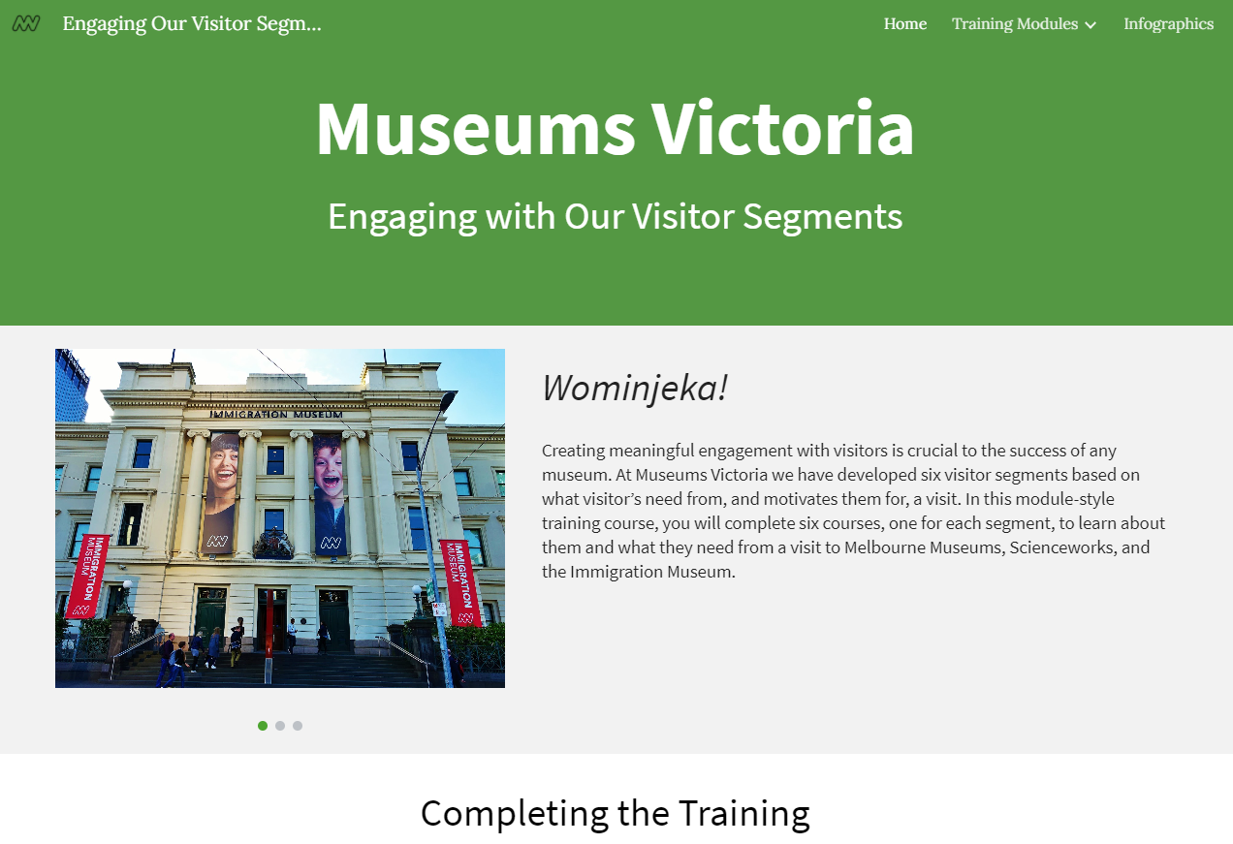
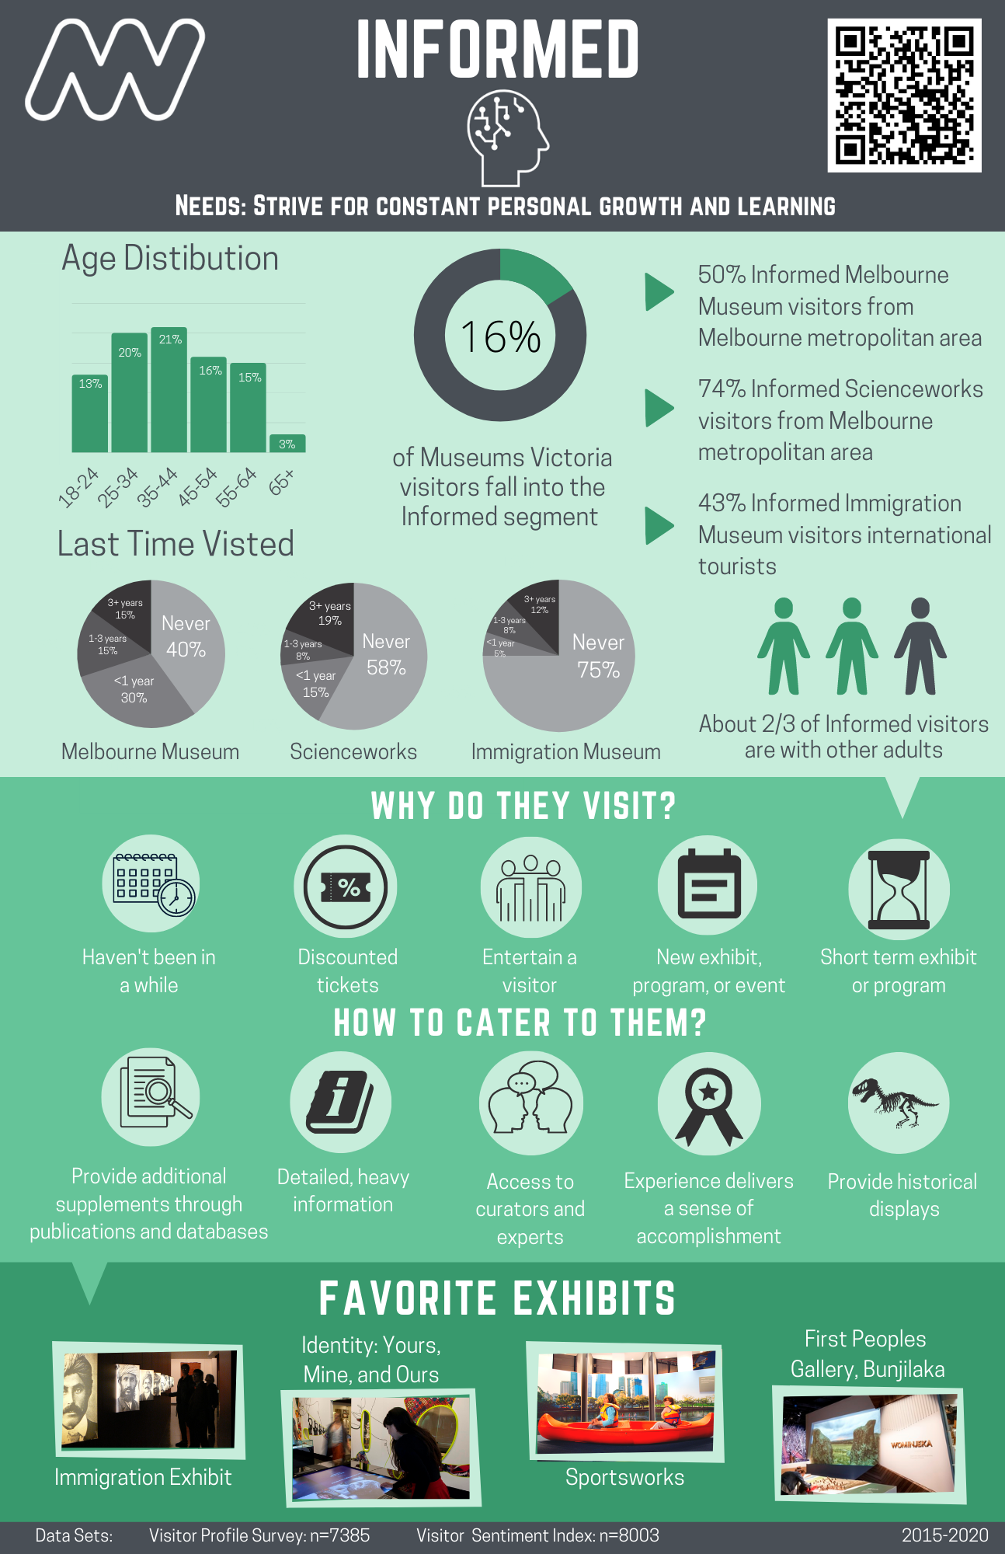
Conclusion
Notes:
Hunter
Why work on this project, why do this, how is this important
Maybe pictures of musuem
consideration for content and design
State what we accomplished and proud of what we did
Personal perspective- each say something
Full circle - visuals of training
IMPACT
Important to not gloat

Slide 34
Thank You!
Questions or feedback is welcomed!
Notes:
Hunter
Thanks Advisors and global project center, sponsor, and everyone we interviewed
Open for question

Slide 35
Contact Information
Group Email: gr-c21museumsvictoria@wpi.edu
Julia Awad
Matteo Cugno
Noah Darveau
Hunter Wieckowski
Chemical Engineering
Email
Jhawad@wpi.edu
Mechanical Engineering
Buisness
Email
mdcugno@wpi.edu
Computer Science
IMGD
Email
nmdarveau@wpi.edu
Chemical Engineering
Email
Hlswieckowski@wpi.edu
Notes:
Hunter
Mention this is our contact if anyone is interested in talking to us, top is group email
Rehearse ending

