Slide 1

Advertising for Advocates:
A Project to Bolster Volunteer Recruitment for CASA Worcester County
By Tala Calvi, Jordan Counsel, Alaa Hassan, Vu Nguyen
Notes:
We are assisting CASA in raising advocates for abused and neglected children. CASA stands for Court Appointed Specials Advocates for abused and neglected children.

Slide 2
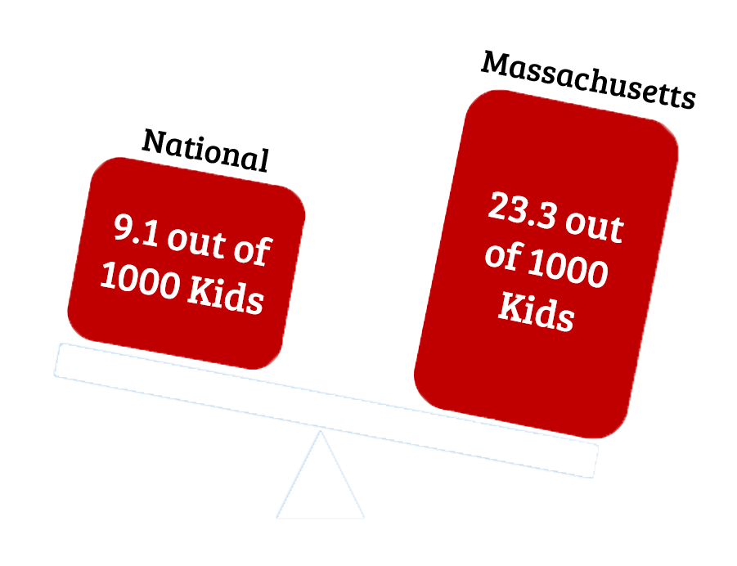
Child abuse is a prominent problem in Massachusetts.
Notes:
On the national scale, 9.1 out of 1000 children are victims of child abuse. If you compare this to Massachusetts, 23.3 out of 1000 children are victims of child abuse. By this data, one can obviously tell that it is a very important problem and action needs to be taken.

Slide 3
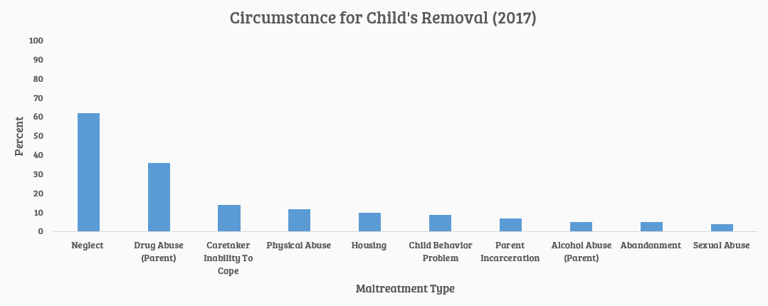
Most children are in the foster care system because of neglect.
Notes:
60 percent of victims who are in the foster care system are there because they are victims of child neglect. Child neglect is a subdivision of child abuse. Child neglect is not providing the child with the basic necessities for survival. This includes food, shelter, clothes, love, and support. Basically, pretending that the child does not even exist.

Slide 4
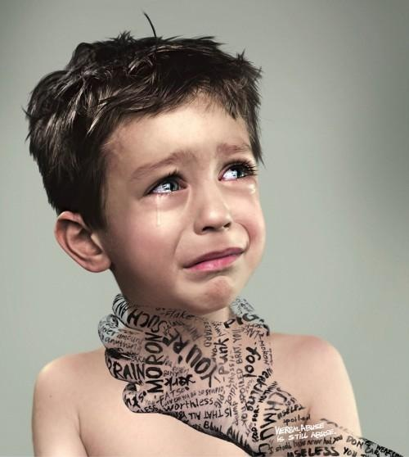
Victims suffer severe effects from abusive experiences.
Developmental Issues
Criminal Activity
Anger Issues
Abused Children
Substance Abuse
Physical and Mental Health Deterioration
Notes:
Because a child is abused, this can take a toll on them and it can lead to several severe effects. These main effects include substance abuse, criminal activity, developmental issues, anger issues, and physical and mental health deterioration.

Slide 5
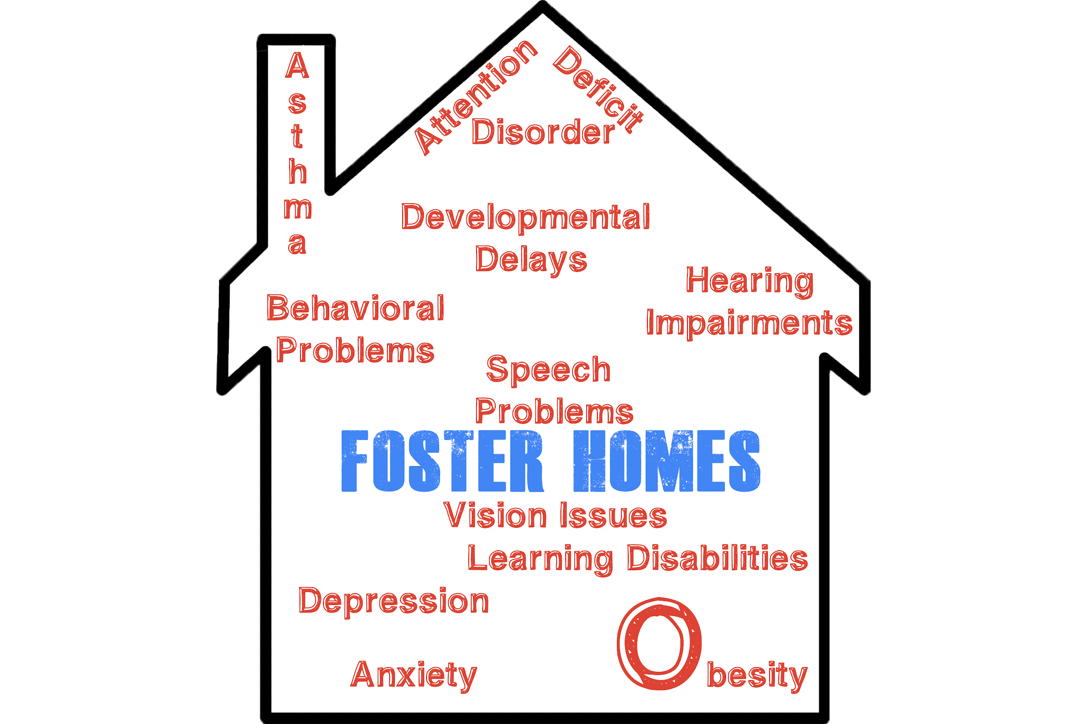

Children entering foster care tend to experience other severe problems.
71% of children entering foster care are victims of abuse.
Notes:
Because the children suffer from these effects, they are placed in foster homes. 71% of children entering foster care are victims of abuse. Foster care does not necessarily mean the child will get better. In these foster homes, they can experience other problems such as depression, anxiety, and asthma.

Slide 6
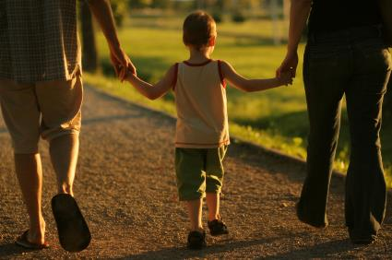

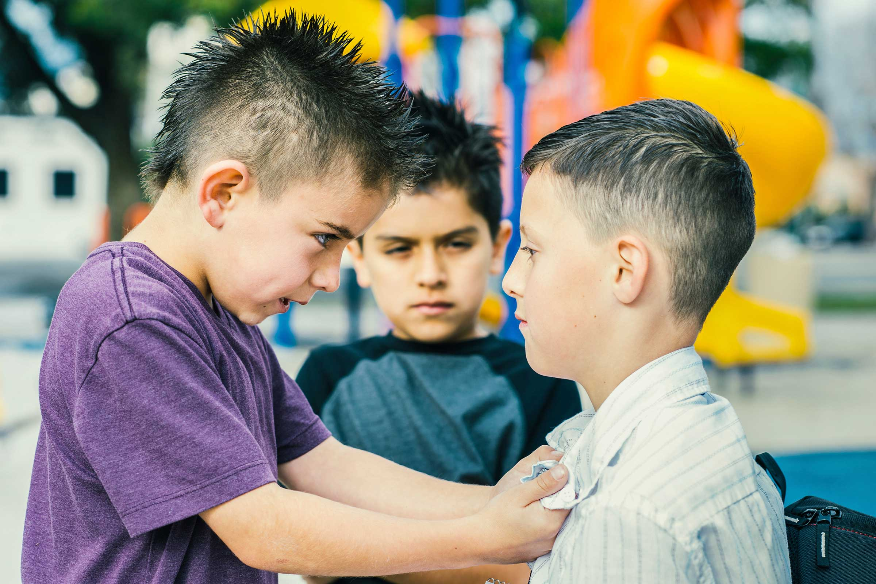
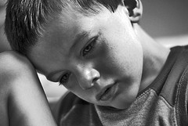
Abusive tendencies can be passed on between generations.
4
1
Becomes a parent
Child is abused
Cycle of Abuse
3
Adopts abusive tendencies from their parents
2
Experiences effects of abuse
Notes:
Abusive tendencies can be passed on between generations. First the child is abused. They then experience effects of abuse, as mentioned in the previous slide. They adopt the abusive tendencies from their parents and think they are normal. They then become a parent and abuse their own children.

Slide 7

There are many approaches to supporting child abuse victims.
Legislature
Enforcement
Research
Civic organizations
Social work
Notes:
TALA:
-having discussed the devastating effects of child abuse, there are many current approaches to preventing abuse and supporting its victims
-theres federal and local legislature against child abuse, laws vary state by state but in general child abuse is a crime everywhere in the US
-to enforce the law, there are agencies such as CPS that take in abuse allegations and act accordingly
-furthermore, many researchers work to determine best practices for prevention of child abuse and support for victims
-independent civic organizations mainly provide support to victims in the form of support groups and fundraising efforts
-social work refers to a profession in which individuals work to better the welfare of individuals, families, or communities through social change

Slide 8

Legal advocacy is the intersection between social work and law.
Notes:
-legal advocacy is the intersection between social work and law
-social work because legal advocate represent the best interests of, in this case, a child that has been a victim of abuse
-the law part comes in when the child’s case and placement is brought to court. the child is not allowed in court when their case is being presided over. therefore, legal advocates bridge the gap between the judge and the child.

Slide 9
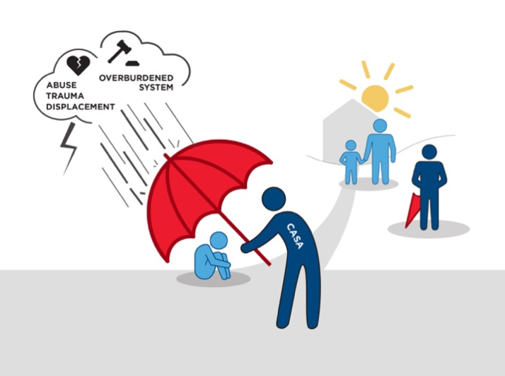
Legal advocates tell the child’s “complete story,”.
Notes:
-legal advocates best represent the child by telling their “complete story” in the form of court reports given to the judge
-they are described as the eyes and ears of the judge solely for the child’s benefit
-in doing this, legal advocate can protect the child from being displaced into an inappropriate living situation and ensure that their case does not remain within the already overburdened legal system for too long
-legal advocates for children are called CASAs by CASA, which stands for Court Appointed Special Advocates for children
-CASA is a national organization that recruits and trains legal advocates for children

Slide 10
CASAs greatly impact the children they serve.
A child with a CASA volunteer finds a forever home 25% faster than those without.
Children with CASA advocates are much less likely to re-enter the foster care system.
CASA volunteers close about 100,000 cases every year.
Notes:
-CASA’s impact on children is measurable and significant
- nationally they close ~100,000 cases every year
-a child with a CASA is placed into a permanent living situation 25% faster than those without
-also children with a CASA are far less likely to re-enter the foster care system after their initial placement

Slide 11
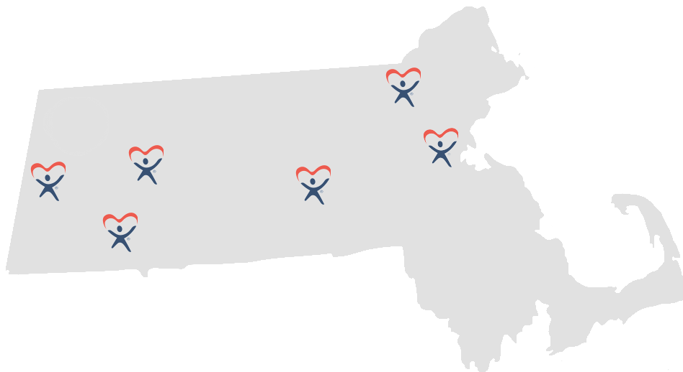
There are 6 CASA chapters in MA.
Notes:
-there are 6 CASA chapters in Massachusetts as shown here.
- in 2018, 8,700 children removed from home due to abuse and neglect in Mass, so the 6 CASA chapters work to serve them alll
-our sponsor is CASA worcester county

Slide 12
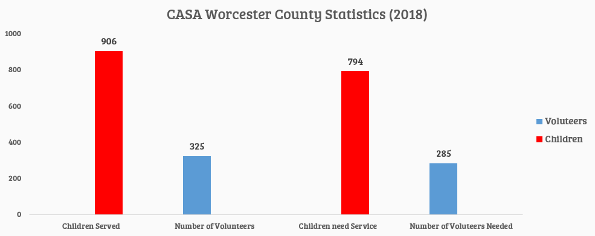
CASA Worcester County has a need for more volunteers.
Notes:
END TALA:
-CASA worcester county has a need for more volunteers
-out of the 8,700 children removed in MA, 1,700 of these children were from worcester county
-CASA served 906 of these children with 325 volunteers
-so we’ve deduced that for the 794 more children to serve, they need 285 volunteers
-essentially they need to almost double their volunteer base

Slide 13
Objectives
Develop a social media marketing campaign to assist CASA
Produce an educational and persuasive video
Goal
Increasing the number of volunteer applicants
Notes:
In order to assist them with achieving their mission we have started working in the short term to create a social media marketing campaign and produce an education and promotional video. In the longterm we hope this will give CASA a method for increasing volunteer involvement.

Slide 14
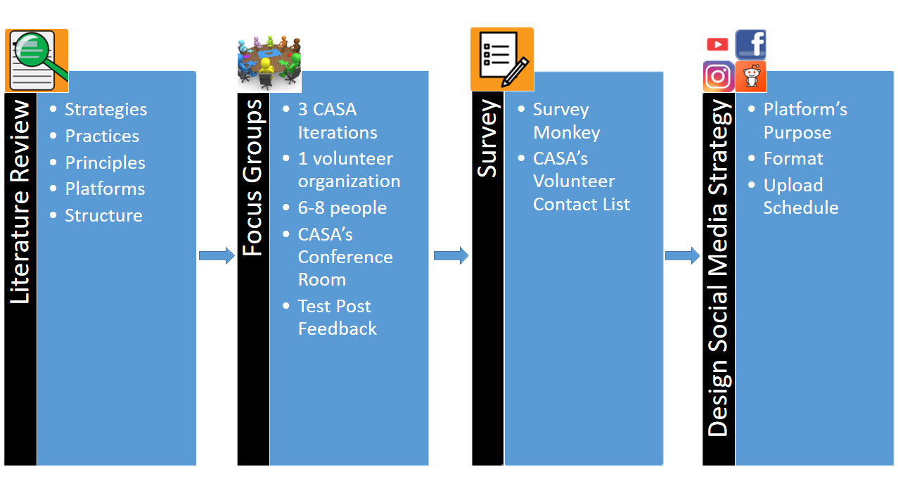
Creating A Marketing Strategy
Notes:
The process we are using to create the social media strategy is outlined as follows. First we completed a literature review where we found what strategies are effective in gaining attention to an organization over social media. We then conducted focus groups where we got a sense of the types of posts CASA volunteers are attracted to. We also distributed a survey where we specifically asked current volunteers how they used social media. This was all used in conjunction in order to create the overall design of the campaign

Slide 15
Literature Review Key Findings
“Happy” posts go viral more than “sad” posts
The algorithms favors posts that have a large amount of viewer interaction
Consistent upload times
Notes:
From our literature review we found key factors that are known to increase the popularity of social media posts. For example happy posts tend to go viral more often than sad posts. Also the algorithms favor content that has a lot of viewer interaction and engagement. Finally posting at consistently during active times is necessary for the audience to have a higher chance of seeing the posts. We found that both platforms are relatively active during the midday from 12pm to 5 pm

Slide 16
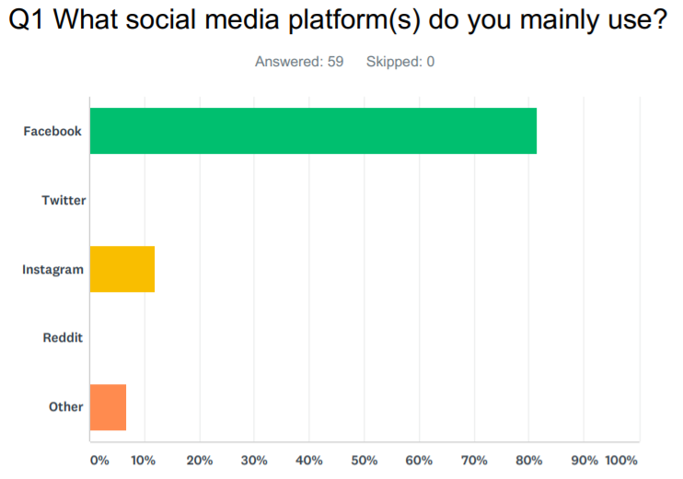
CASA survey results; Facebook is the most popular.
Notes:
When asked what social media platforms current CASA’s use, out of Facebook, Twitter, Instagram, Reddit, and other, facebook was the dominant platform followed by instagram. Those who chose other do not use any social media platform.

Slide 17
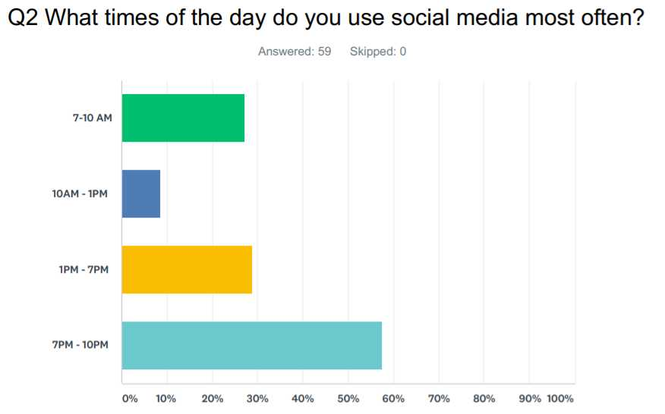
CASA survey results; volunteers are most active between 7pm - 10pm on social media
Notes:
When asked what times of the day they use social media most often, 7pm to 10pm was the most active time period.

Slide 18

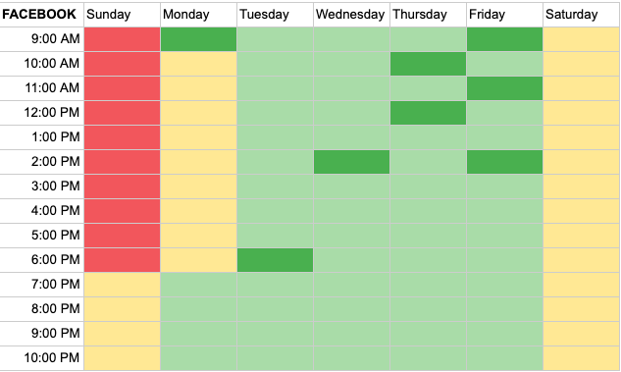

A heat map was created to show the best times to post
Instagram
Facebook
Notes:
We noticed that survey results differed slightly from the literature review findings, so with this in mind we created a heat map for each platform. In order to accommodate the majority of volunteers who said that they were active on social media at later times we made sure that later post times were included for facebook because the majority of volunteers use it

Slide 19
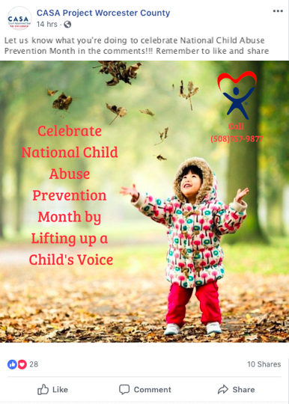


The volunteers disliked overly dramatic posts
Notes:
At the focus groups we showed the volunteers several different example post that we created using the information we got from the literature reviews. We noticed that they were less in favor of post that were overly dramatic. They thought that some of these post did not portray the reality of situation that CASA children were in accurately and others were too graphic

Slide 20
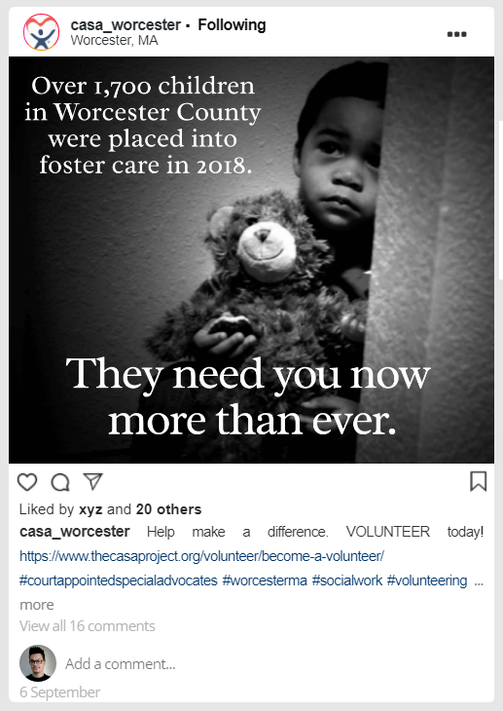

Favored believable and informative posts that gave a sense of hope
Notes:
The volunteers liked the posts that were believable and informative with a hopeful message. For example they felt as if the picture on the left gives a sense of urgency without being too graphic by using a statistic that informs the viewer of the issue. And the picture on the right had a very positive and hopeful message that encourages volunteers to make a difference by becoming a CASA

Slide 21
Post content identify with three categories
Engaging | Informative | Call to Action
Posts aimed at grabbing the attention of viewers through visuals. E.g. Pictures of kids, videos and pictures from CASA events, catchy quotes | Posts that educate the audience. Includes information pertinent to both current and potential volunteers. E.g. statistics, CASA milestones, volunteer resources, event information | Posts that ask something of the viewer, typically in the caption of the post. E.g. “Like this post!”, “Share this post!”, “Comment (x)!”, “Go to (x) website!”
Notes:
From the finings in the literature review and focus groups we concluded that the content of each post should fall into the following three categories. Engaging; which can be described as posts aimed at grabbing the attention of viewers through visuals. Informative; which are posts designed to educate the audience through statistics or general information about CASA. Finally Call to action; which are posts that asks something of the viewer. It could be something as simple as “please like and share” or “become and advocate”

Slide 22
Integrated focus group results with
literature review findings
Engaging posts with a happy mood will be targeted towards potential volunteers on Instagram
Informative posts will be targeted towards existing CASA volunteers on Facebook
Notes:
Since the results from the literature review and focus groups differed slightly we decided to accommodate for this by having Instagram be focused towards the recruitment of volunteers, and facebook be used for interacting with existing CASAs. This means that more engaging posts go on instagram and more informative posts go on facebook

Slide 23
The Video Creation Process
Pre-production
Production
Post-production
1
2
3
Notes:
Speaker Note-
For the video creation process, we broke it down in 3 steps. Pre-production, Production, Post-production
Video picture - https://solomarketing.es/videos-y-empresas-por-supuesto/
The first method includes creating a video. In this video we want to include scenes of current and past CASA advocates through interviews. By doing this, we will acquire personal experiences from each advocate, which will make our video more engaging. Other than interviews, we want to include several different CASA events, which include the swearing ceremony and other events we still have to schedule.
include more specifics on video creation process (its kinda vague now) weeeeeee

Slide 24
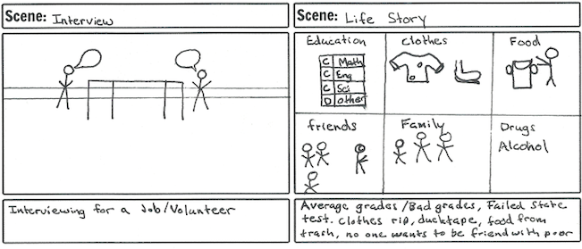
Pre-production
01
Analyzed several sources describes the strategies used in the production of promotional videos
Literature Review
02
Storyboarding
03
Created a script based on the storyboard that describes each scene in further detail
Script
25
Notes:
Speaker Note -
To start off we review many literature and videos to determine what makes a good video
What we found is that people love a good story that has a narrative, music, and a core message
So that is exactly what we did
We created a story about a child who had a CASA, and we based the story on the equipment we had access to, and the resources we had
From there we created a baseline script, and modify it during our production process

Slide 25

Production
Training session in Foisie Studio
Clips of children
Voice over for narrative
5 interviews with CASA volunteers
Notes:
Speaker Note-
For the production process, we had to determine where we were going to get the equipment, narrative, kids, and content for the video.
For the equipment, WPI has a high quality filming studio provide that we took a training class, so that took care of equipment.
For the kids, I had a little sister with many friends. Lets just say that I’m $60 short now.
For the narrative, we didn’t have many options so I volunteer as tribute.
And finally, for the content, we interviewed 5 CASA volunteers to hear their story to expand our script, and to use in our video.

Slide 26
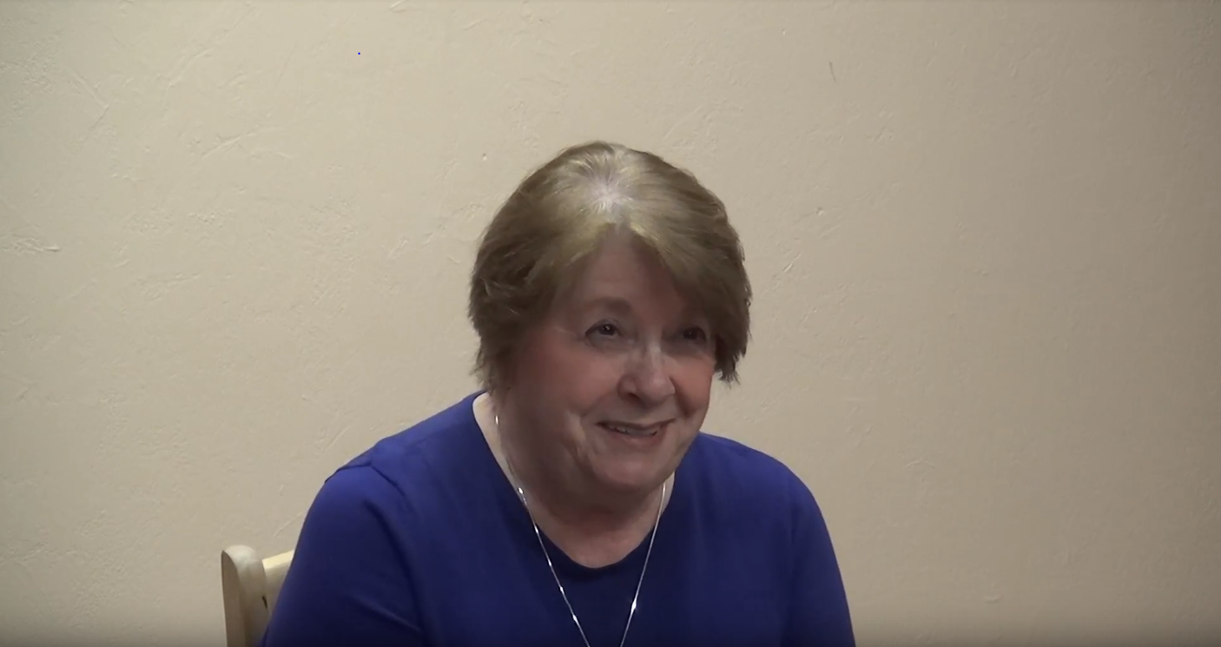
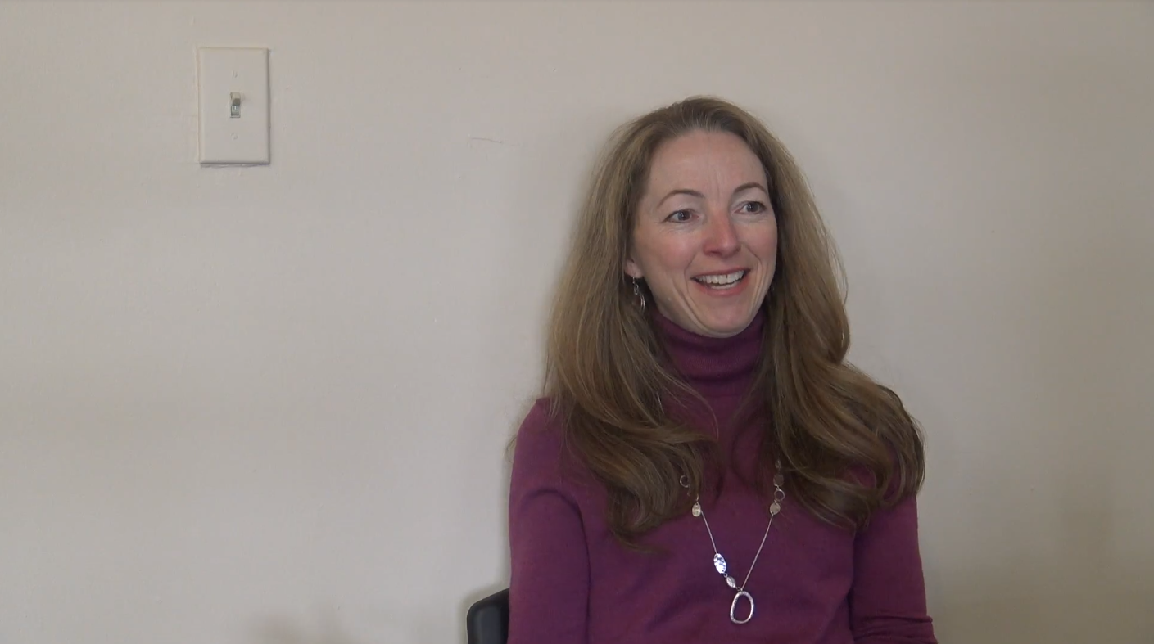
“I think the important thing is for you to have a good support system.”
Helen
“You’re taking on a human being, a child...how could I give up on a child?”
Suzanne
Notes:
TALA:
-interviewed Helen, she’s been working on one case for 5 years and has enjoyed seeing the child grow and change
-cried during interview because the work is tough, and emphasized that you need a good support system which CASA provides
-she can always talk to her supervisor
-Suzanne’s background in child care drew her to CASA, she was a teacher for special ed kids
-she emphasized that CASAs are a source of stability in a child’s life, which she says is vital for their wellbeing
-she further emphasizes this with the quote up here, she demonstrably feels very dedicated to her work as a CASA
-also touched upon how being a CASA has shown her how resililent the kids are, and how there are so many amazing people in the system (DCF, socialworkers, foster parents, etc)

Slide 27
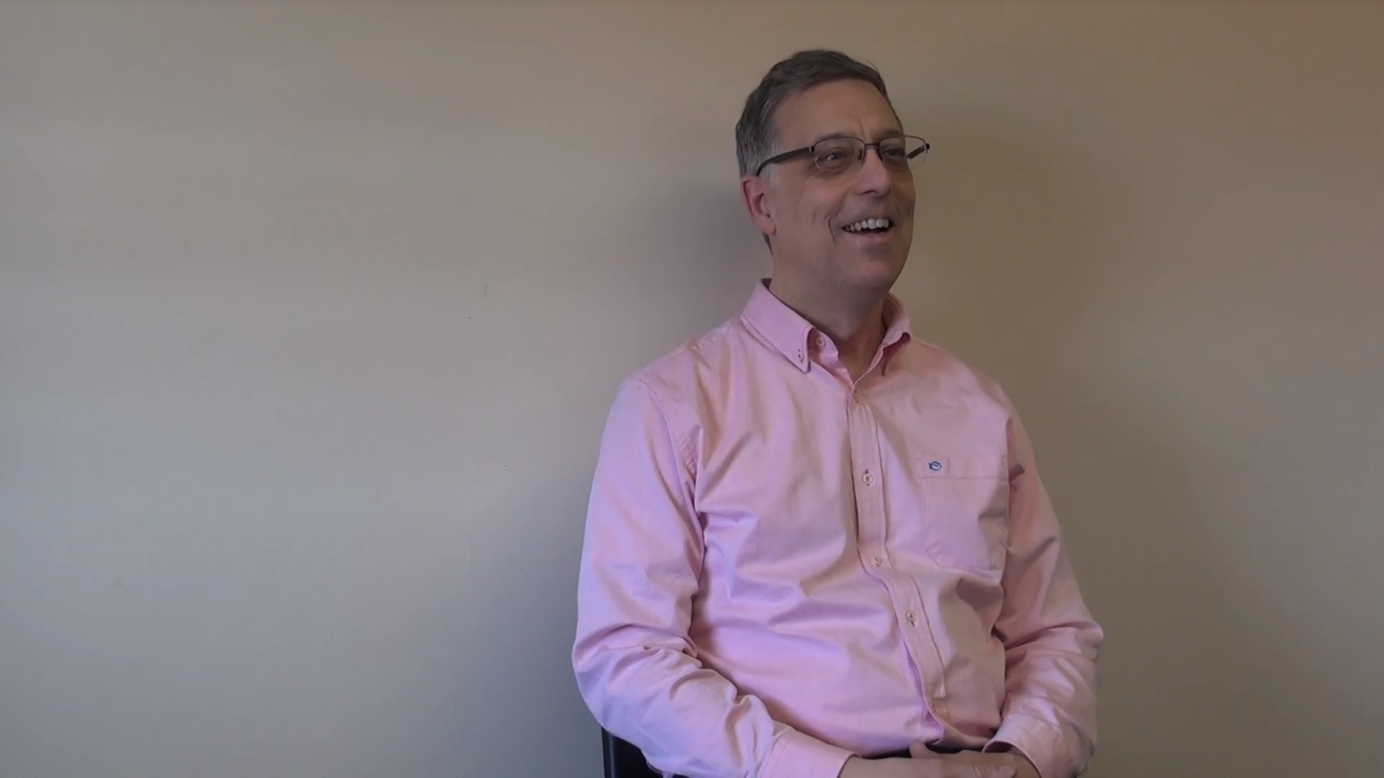
“Just start and do this. It can unfold in a rewarding way.”
Jim
Notes:
My interview with Jim was very interesting. When asked what motivated him to become a CASA, he immediately said his wife. This highlights the gender ratio of male to female CASA’s. There are much more female CASA’s than males. This is because men go into something and expect an immediate result. This is clearly not the case for child abuse. However, he did say just go into it and it will unfold in a rewarding way.

Slide 28
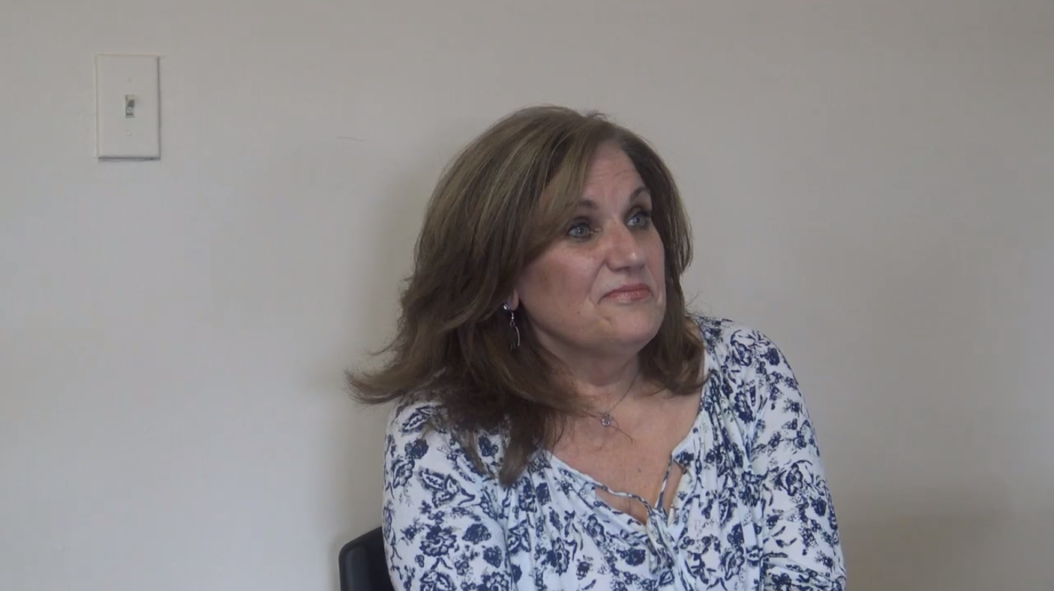
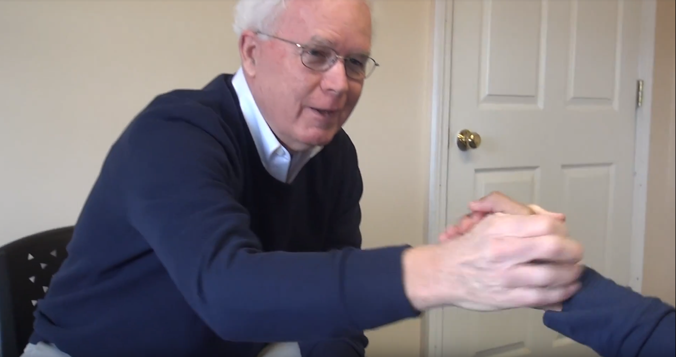
“The important part about being a CASA is that it is uniquely for the child.”
Anne
“Just start and do this. It can unfold in a rewarding way.”
-Jim
“Be prepared to be grabbed right here.” *motions to heart*
Joe
Notes:
I interviewed Anne and Joe. Anne has always loved community service and she before joining CASA she was actively looking for an organization to be apart of. She emphasized how she was drawn to CASA because it would allowed her to leave a great impact on Child's life. She said the important part of about CASA is that it is uniquely for the child
Joe was a rather experienced volunteer and he emphasized the emotional commitment that comes with being a CASA. He said be prepared to be grabbed in the heart. These testimonies highlighted why being a CASA is important

Slide 29
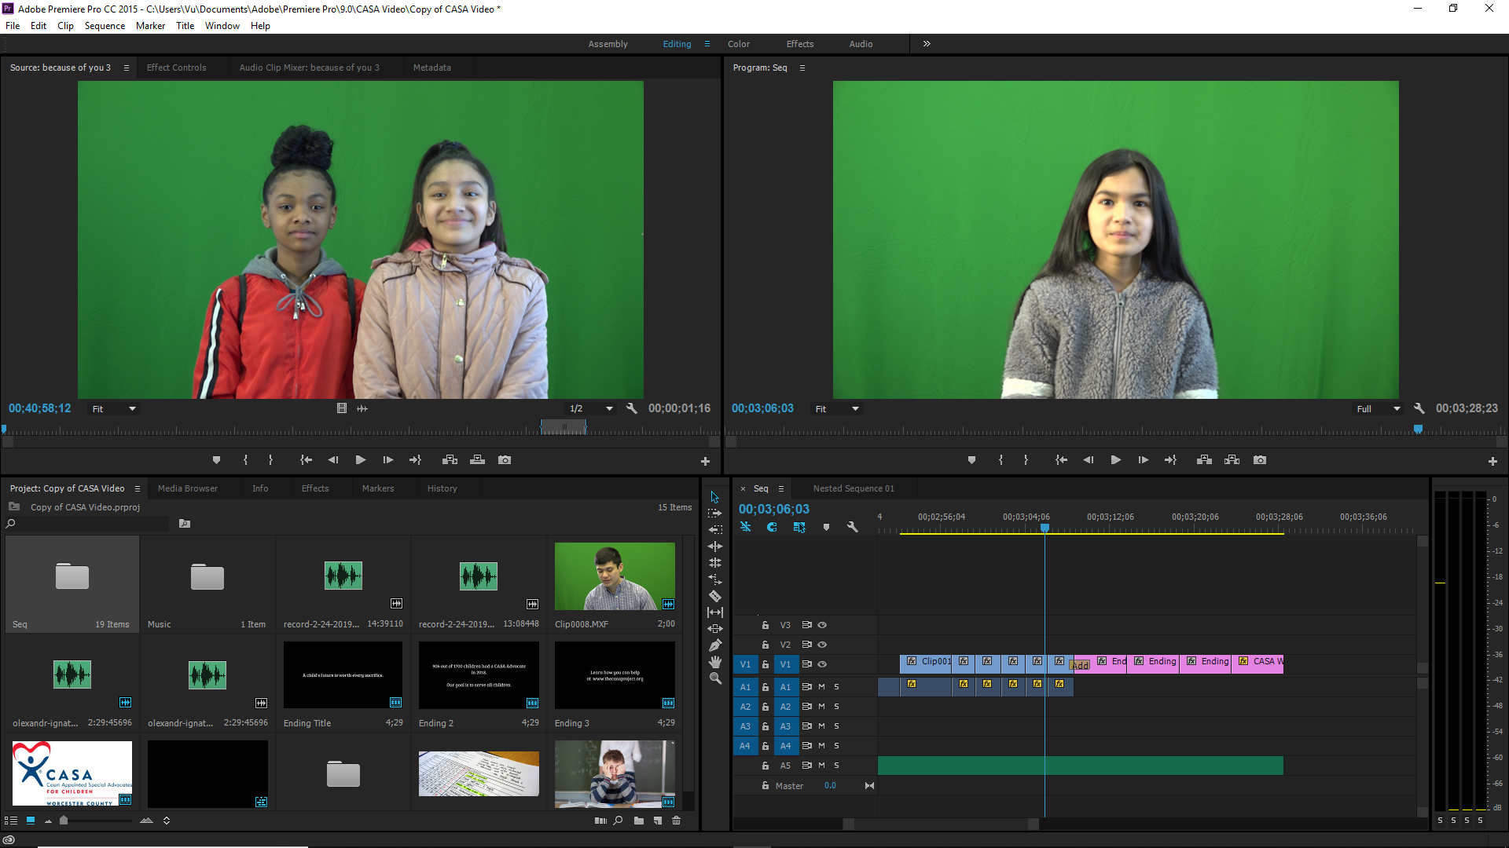
Post-Production
Editing with Adobe Premiere Pro
5 day process
Pictures, music, clips inserted to video
Notes:
Speaker Note-
So I don’t know about you guys, but I am a beginner when it comes to Adobe Premiere Pro.
I was told that it takes 5 hours for a pro to make a 5 minute video, and 10x that if you are a beginner.
So I gave myself 5 days to make this video, and here I had to determine what images, background, clips would be most appropriate for each part of the video as well as music that will help connect you the audiences to the video.
I can say that I am proud of the final product.

Slide 30
References
U.S. Department of Health & Human Services, A. f. C. a. F., Administration on, & Children, Y. a. F., Children’s Bureau. (2018). Child maltreatment 1999 - 2017. Adoption and Foster Care Analysis and Reporting System (AFCARS). Retrieved from https://www.acf.hhs.gov/cb/resource/child-maltreatment-2016
Turney, K., & Wildeman, C. (2016). Mental and physical health of children in foster care. Pediatrics, e20161118.
DePanfilis, D., & Salus, M. K. (2003). Child Protective Services: A Guide for Caseworkers. Washington, DC: U.S. Department of Health and Human Services, Children’s Bureau.
Fraser, M. W., Nelson, K. E., & Rivard, J. C. (1997). Effectiveness of family preservation services. Social Work Research, 21(3), 138-153. doi:10.1093/swr/21.3.138
Owen, P. J. (2018, July 30). Sunday Sitdown: Robb S. Zarges Jr., executive director, CASA Project. Retrieved from https://www.telegram.com/news/20180728/sunday-sitdown-robb-s-zarges-jr-executive-director-casa-project
Berger, J & Milkman, K. (2011). What Makes Content Viral?. Journal of Marketing Research. Retrieved from https://www.ama.org/documents/online_content_viral.pdf

Slide 31
Acknowledgements
We would like to thank the following for their guidance and contributions to our project:
Robb Zarges, for continuous support and feedback for the development of our project.
Lynn Tesconi, for being our main point of contact and facilitating the scheduling of our fieldwork.
CASA Worcester County, for providing the space for our interviews and focus groups.
Professor Foo, for being constantly dedicated to our team and ensuring the steady, significant progress of our project (also for the free pizza at the Birchtree Bread Company).
Worcester Polytechnic Institute, for the wonderful opportunity to complete the project.
The ATC, for providing us with the technology necessary for our video.
Jim Monaco, for critiquing and improving our presentation.
Participants in our interviews and focus groups, for their insights and cooperation.
Notes:
TALA

Slide 32
