Slide 1
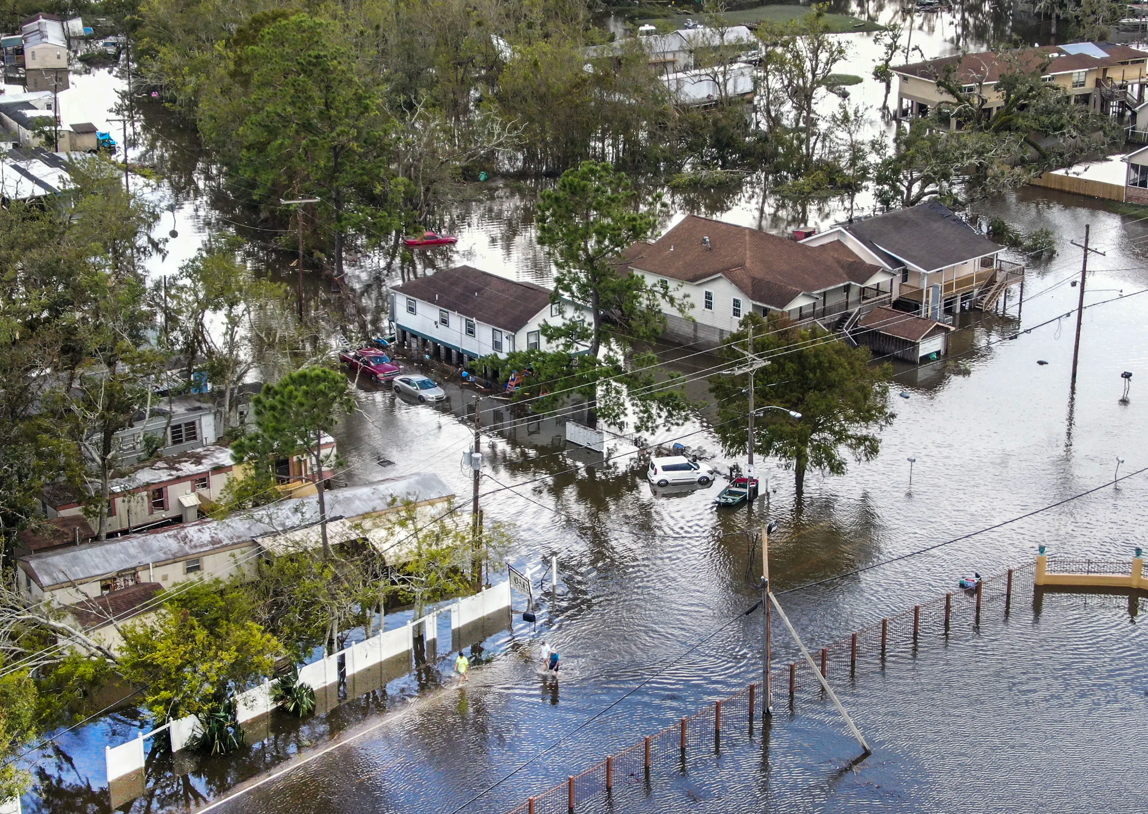
New Orleans Levee Disaster
Case Study

Slide 2
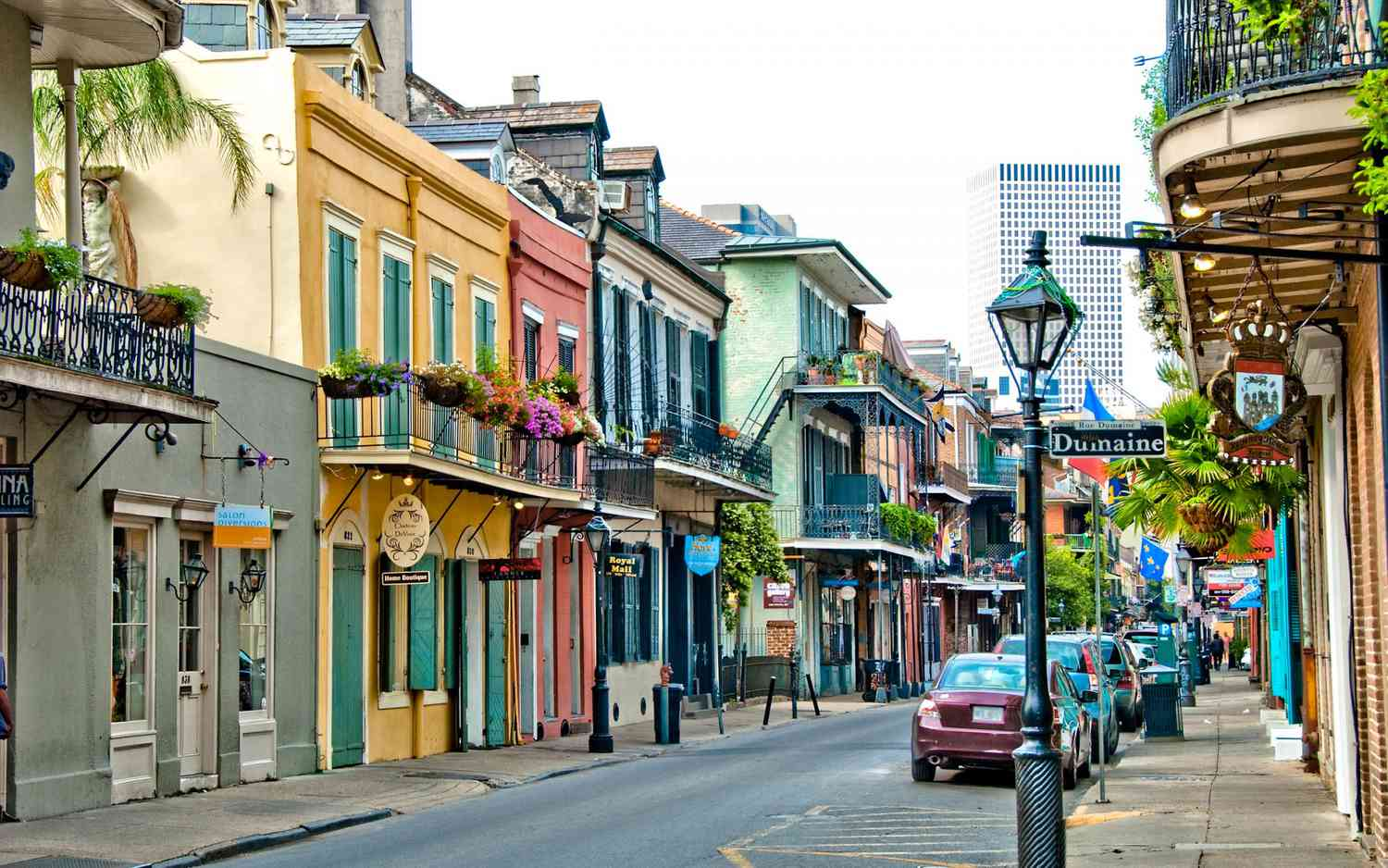
Game Instructions
Kindly respond to the questions to the best of your understanding and judgment.
Setup:
Narrator deals cards, giving each player A and B cards.
Narrator sets the scene and introduces the case study background.
Players can ask questions about the case before starting.
Rounds:
Narrator reads a question with A and B options.
Players choose A or B, keeping their answers face down.
Narrator shuffles cards for anonymity, reveals choices, and discusses outcomes.

Slide 3
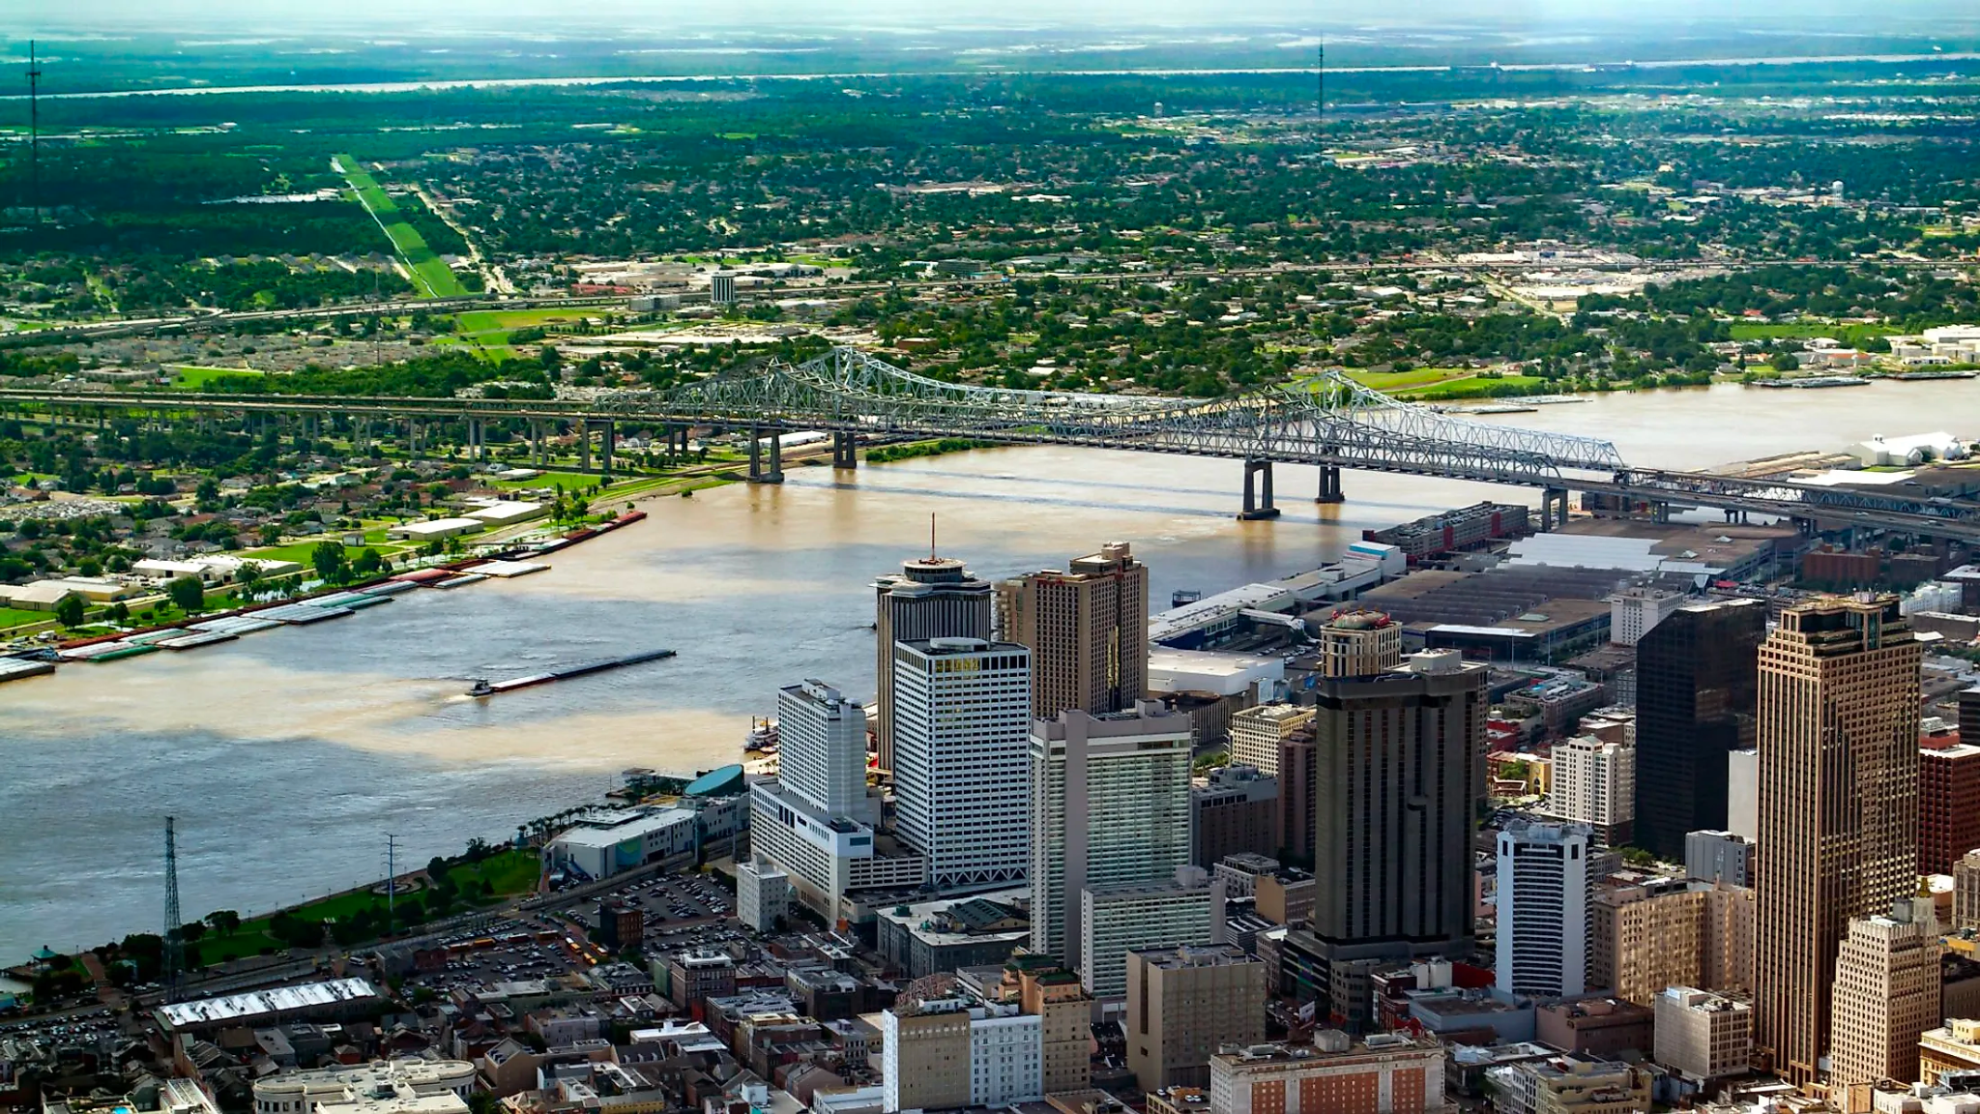
Background Information
When and Where: The New Orleans levee disaster happened in 2005 during Hurricane Katrina.
Social and Economical: In the early 2000s, the United States faced economic challenges, and New Orleans, known for its vulnerability to hurricanes, dealt with concerns about infrastructure.
Attitudes Towards Safety: Safety was a concern, but there were issues in the design and construction of the levees, indicating potential shortcomings in prioritizing safety.
Safety Regulations: Levees were designed to withstand up to a category 3 storm, as required by Congress, but they weren't prepared for the intensity of Hurricane Katrina.
Society's Environment: The disaster profoundly impacted society, causing loss of life, displacement, and economic repercussions. Emergency response faced challenges, and significant reconstruction efforts were needed.

Slide 4
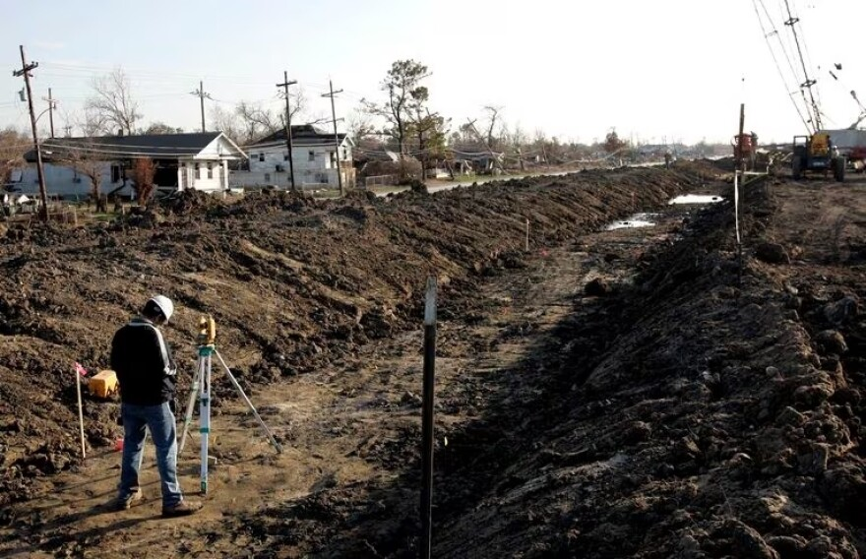
Q1: Your team discovers failure in following the soil strength and levee guidelines by the Army Corps of Engineers:
A
B
Proceed with the current conditions to meet the deadline.
Implement modifications to ensure that the guidelines are followed. This will lead to project delays and increased costs.

Slide 5
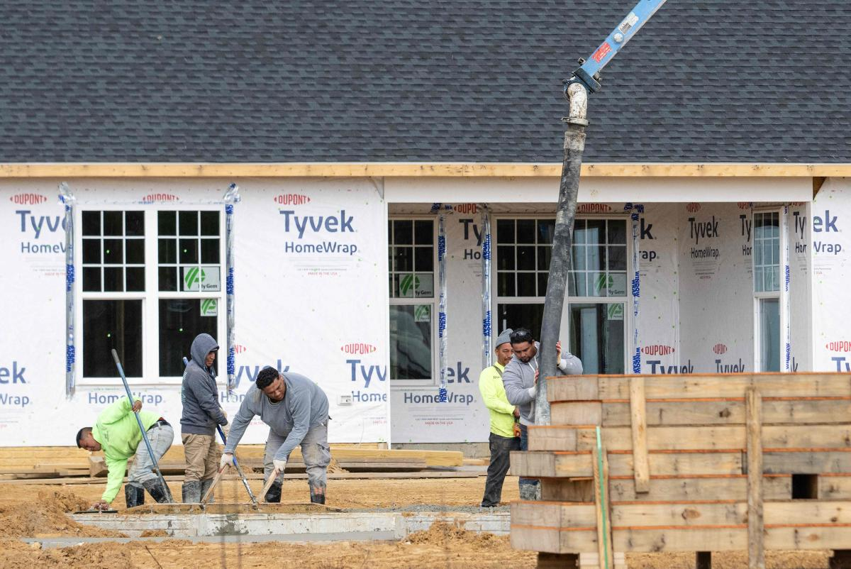
Q2: During construction, there was mismanagement, and a few corners were cut:
A
B
Maintain current management; they are nice people, no need to disrupt the project and spend more money.
Extend the project timeline and get proper management.

Slide 6
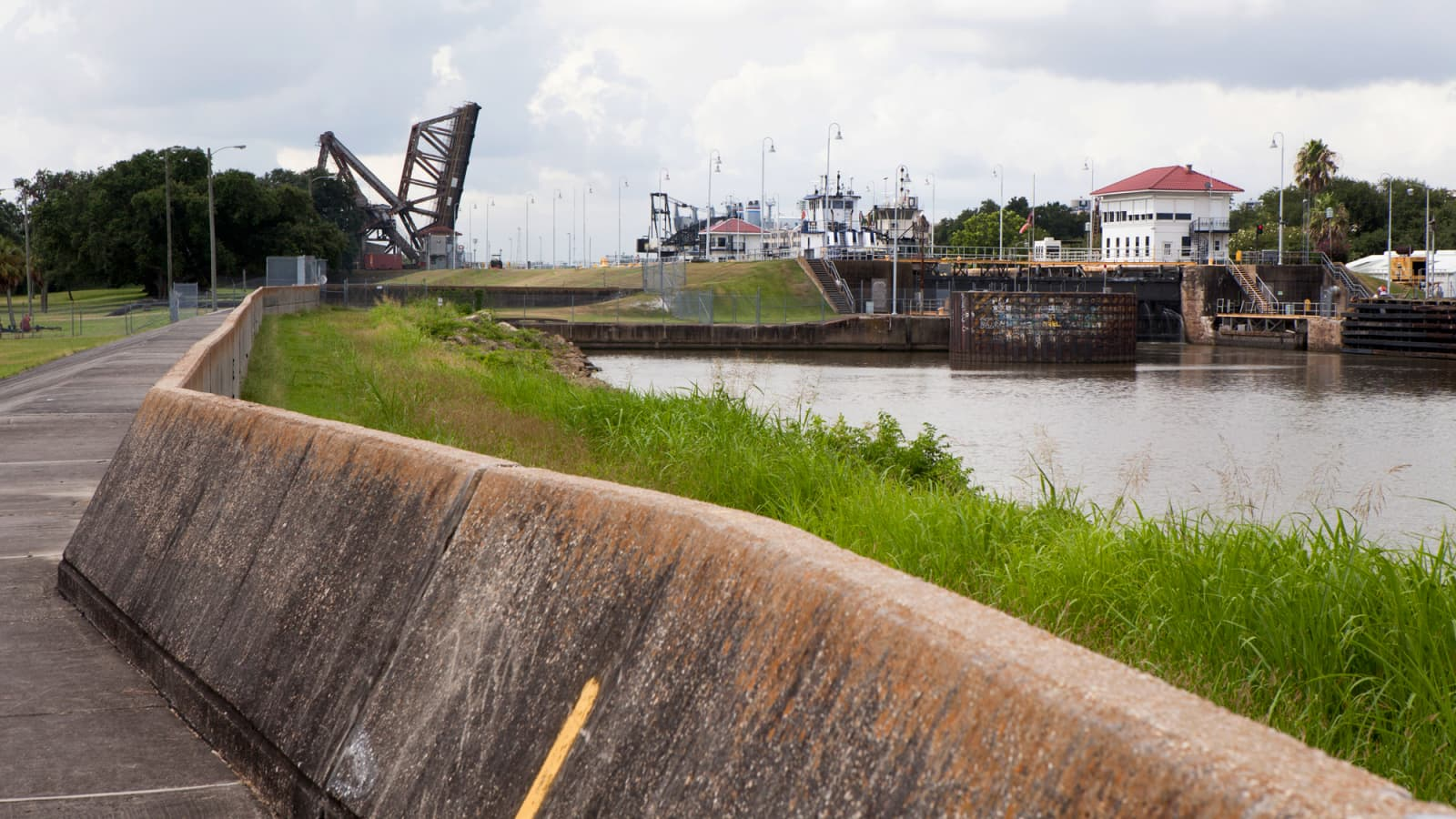
Q3:The levees are not designed for anything greater than a Category 3 storm:
A
B
Redesign and reinforce in case there is a storm greater than Category 3 despite never having a storm that size before.
Continue with the existing design; there has never been a storm that bad in the area and likely never will be.

Slide 7
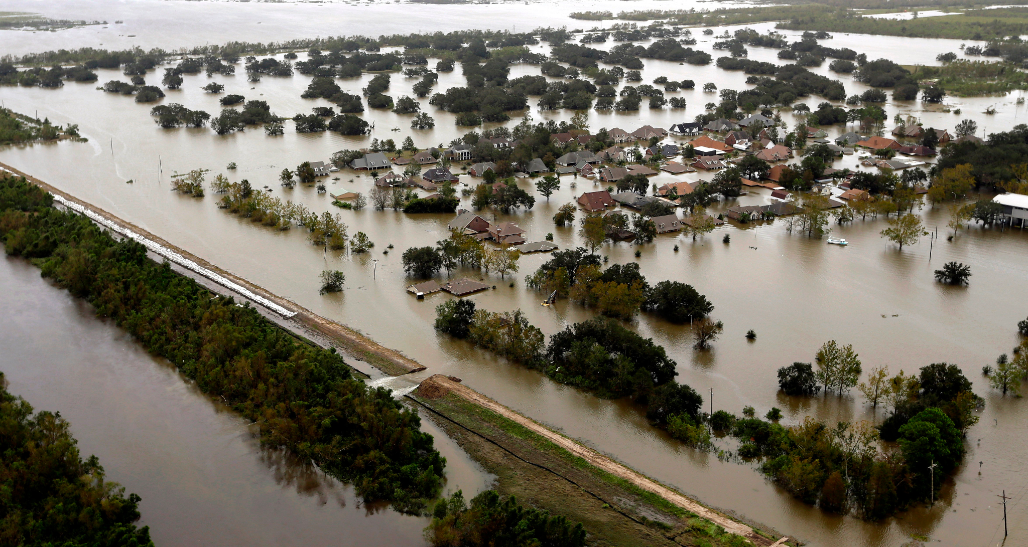
Q4: Multiple breaches in the levees have occurred, leading to extreme flooding in the surrounding areas:
A
B
Stick to the existing response plan and prioritize a quick resolution to minimize the impact on the levee.
Mobilize emergency resources to focus on rescue operations, even if it extends the recovery timeline.

Slide 8
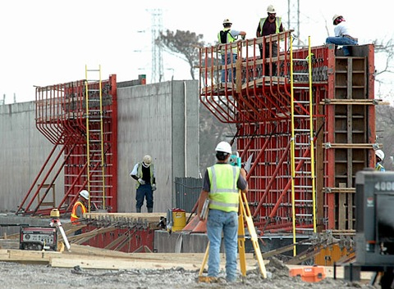
Q5: The levee needs to be reconstructed. How would your team prioritize to address the failures that happened during the storm:
A
B
Conduct an analysis, redesign sections of the levee, and enhance the structural integrity. Fix all of the problems you can find.
Focus on fast reconstruction with minimal modifications, need to prepare for the next storm, and save money.

Slide 9
Q6: What measures should be implemented to ensure that the reconstruction of the levee meets the highest standards to prevent failure:
A
B
Do testing protocols and advanced modeling techniques, and conduct frequent inspections throughout the project timeline.
Relay on existing testing procedures, focusing on meeting deadlines and minimizing cost.

Slide 10
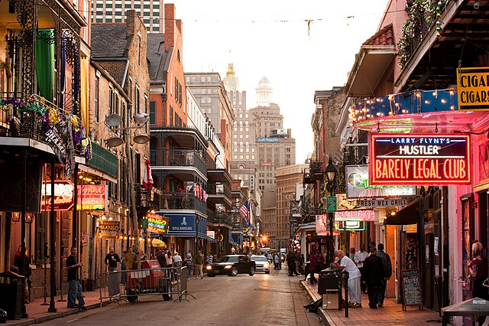
THANK YOU FOR PLAYING!
Post-Game Questions:
How can we make the game better?
What would you do differently?
What did you learn from playing the game?
Is there anything you wish was in the game?
Data Collection Questions
Age
Major and Year
Do you have work experience? If yes, what field and do you think it impacted how you made your decisions?
How do you feel about the decisions you made?

