Slide 1
Assessing Innovative Freshwater Management Solutions
Wellington, New Zealand
Authors
James Barrera
Reagan Brunelle
John Gabelmann
Michaela Mattson
Sponsors
Pat van Berkel
Tim Sharp
Ross Jackson
Greater Wellington Regional Council
Advisors
Yunus D. Telliel
Shana Lessing
Aidan, CC. (2010). Wellington at dawn
Notes:
We are a group of students from Worcester Polytechnic Institute in Massachusetts United States, working in collaboration with the greater wellington regional council to address Wellingtons current water crisis
By assessing innovative freshwater management solutions from our community and around the world

Slide 2
Project History
Methodology
Results + Future Directions
~ Q&A at the end ~
Notes:
We will be discussing the culmination of our roudghly 5 month project
And we’ll aim to keep the presentation to a max of 15 minutes
This includes the project history, so some background of the water crisis and our sponsors current work
Our groups methods of conducting this project
And the results of our research and recommended future directions
And at the very end we will have a 5 minute Q&A.

Slide 3
Project History
Wellington Water Crisis and Current Measures

Slide 4
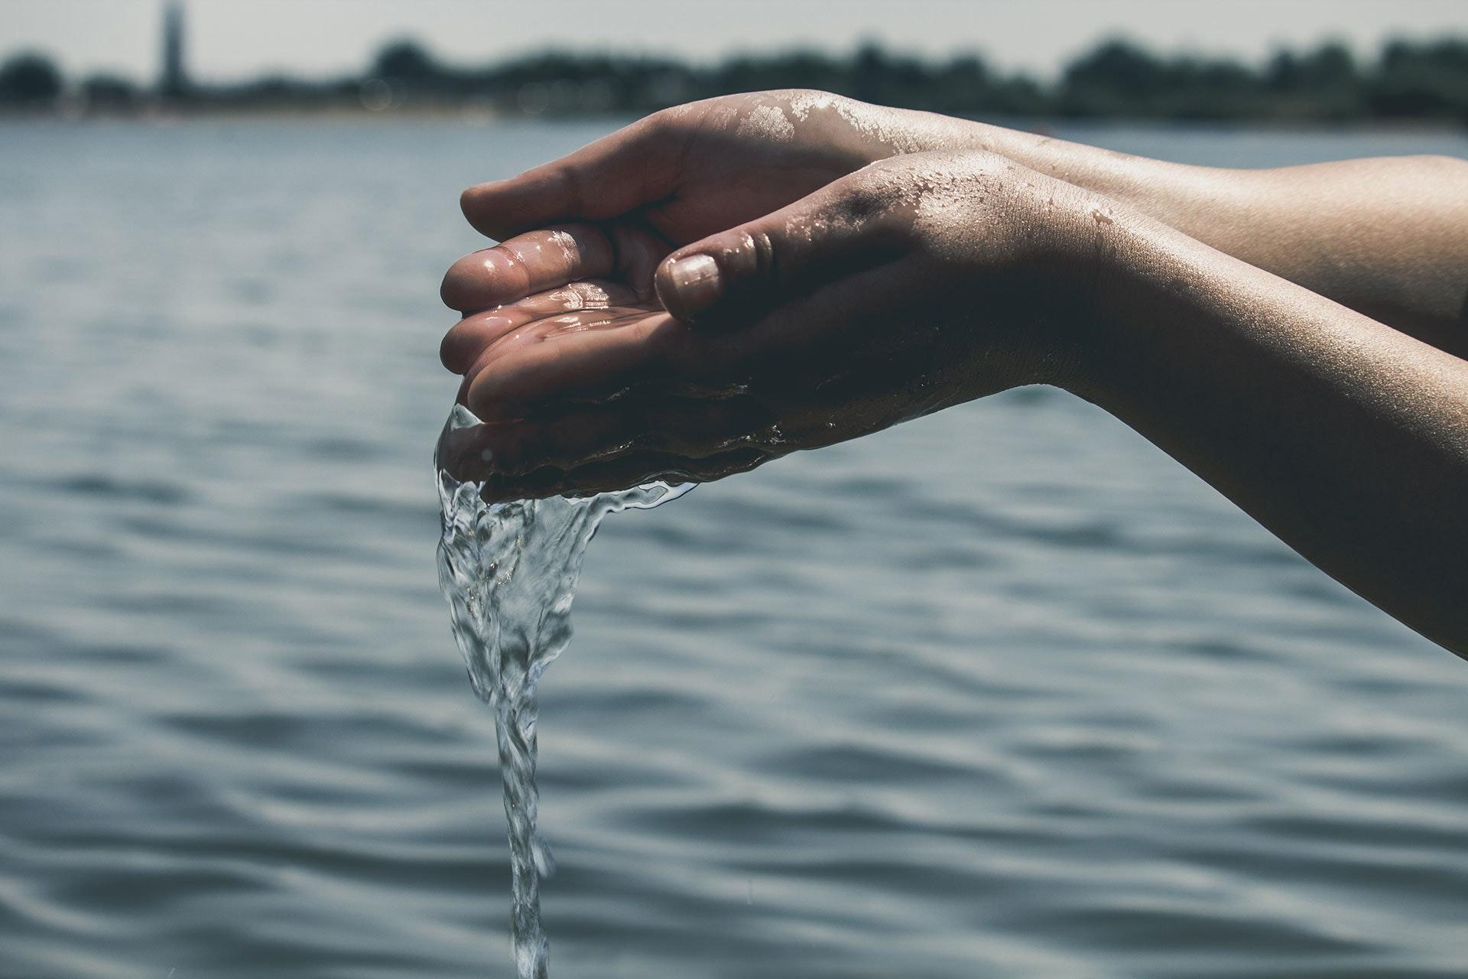
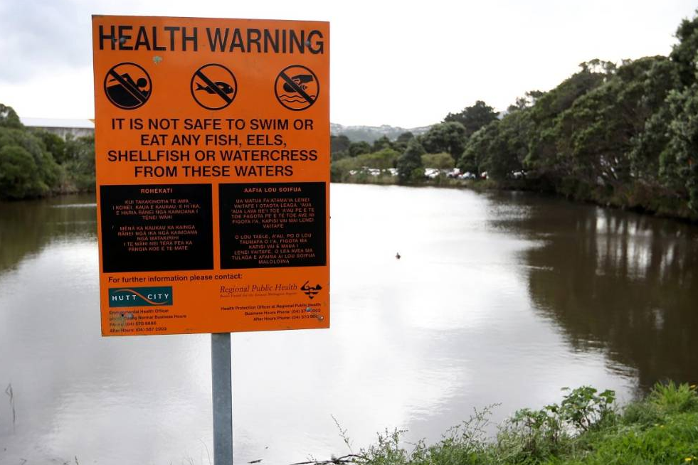
Effects of Colonial Occupation
Strong Māori Nature Relationship
Decrease in Freshwater Sources
Godfery, M. (2015). No pro-Maori line on water rights
Piddock, G. (2019). Water pollution the number one concern for New Zealanders…
Notes:
https://e-tangata.co.nz/comment-and-analysis/no-pro-maori-line-on-water-rights/
https://www.stuff.co.nz/environment/109701626/water-pollution-the-number-one-concern-for-new-zealanders-in-new-poll
The history of our project goes back to the Maori who were the first settlers of New Zealand. They hold to their principle of Te mana o te wai, which emphasizes the importance of water to them.
These roots were however stripped away after colonization, resulting in a decrease in freshwater sources.

Slide 5
Greater Wellington Regional Council
Subcommittee Whaitua te Whanganui-a-Tara
2
Complimentary Documents
First steps for 100 year plan
Provides list of recommendations
Charts path for healthy water
Identify key areas of focus
Notes:
Fi(hi)-two-a-te Wong-a-new-ah a-Tara
We have been working with the Greater Wellington Regional Council to help them advocate for Maori values.
They have developed an 100 year plan along with specific recommendations to get New Zealand back on track.

Slide 6
Methodology
Achieving Our Goals and Objectives

Slide 7
Project Goal:
To support and assist the Greater Wellington Regional Council with freshwater quality, quantity, and flow solutions in the Wellington area.
Notes:
Our main project goal was to support and assist the Greater Wellington Regional Council with freshwater quality, quantity, and flow solutions in the Wellington area.

Slide 8
Objectives
Objective 1
Objective 2
Objective 3
Understand Areas of Critical Need
Identify innovative freshwater management best practices
Gather feedback about the feasibility of implementation
Notes:
Here you can see the three objectives we identified to help us achieve our goal. Objective 1 was understanding the areas of critical need, which we did by completing interviews with water quality experts in New Zealand, as well as looking at the recommendation documents. For objective 2, we identified innovative freshwater management best practices both locally and globally. We interviewed local experts in Massachusetts, specifically members of the Massachusetts Water Resource Authority (MWRA) and the Metropolitan Area Planning Council (MAPC). We also did supplemental research on case studies. Objective 3 was aimed at gathering feedback about the feasibility of implementation of global practices we had identified in Objective 2. In this objective, we completed a second set of interviews with the Wellington experts from objective 1.

Slide 9
Conversations with Water Experts in Massachusetts
Boston Harbor Case Study
“Harbor of Shame” → Beautiful seaport
Massachusetts Water Resources Authority (MWRA) formed
$5 billion invested in the Boston Harbor Project
$3.7 billion into the Deer Island Waste Treatment Plant
$1 billion in treatment for combined sewer overflows
(2015). Boston Harbor
Notes:
We focused our efforts for Objective 2 on Massachusetts due to its successes in improving water quality, most notably the success of cleaning Boston Harbor. This was a case study of interest because of the way it went from being called the “Harbor of Shame” to being a beautiful seaport that attracts locals and tourists alike. The decline in the water quality of Boston Harbor was greatly due to colonization and rapid urbanization, factors that also affected Wellington water. The MWRA was formed in response to the poor water quality in the harbor. About $5 billion were invested into the Boston Harbor Project, which was completed within 10 years.

Slide 10
Results and
Future Directions
Discussing our findings and recommendations

Slide 11
Reflections on Recommendations
Project Funding
Water quality management is “wicked problem”
“Wicked” vs. “Tame” Problems
Reframing our solutions
Habitat
Restoration
Government Policies
Water Quality Management
Agendas of Several Agencies
Rapid
Urban Development
Existing Infrastructure
Failing
Public Awareness
Climate Change
Notes:
One discovery we made is that water quality management is actually a “wicked problem.” This term is used to describe a problem that does not have a direct solution and instead has complexities that transcend the abilities of traditional problem-solving. We identified some of the factors that categorize water quality management as a “wicked problem” and organized them into the diagram that you see here. We were used to studying “tame” problems within science and engineering, in which a specific methodology can be utilized to produce a concrete answer. Due to the complexity of water management, we are not able to provide recommendations which address all of the factors shown in our chart but, our suggestions help address parts of the whole.

Slide 12
Regulations and Developments
https://www.westend61.de/en/imageView/CAVF83301/curly-haired-child-walking-on-log-near-ocean-in-new-zealand
Directing growth in a maintainable way
Lurgio, J. (2019). Saving the Whanganui

Slide 13
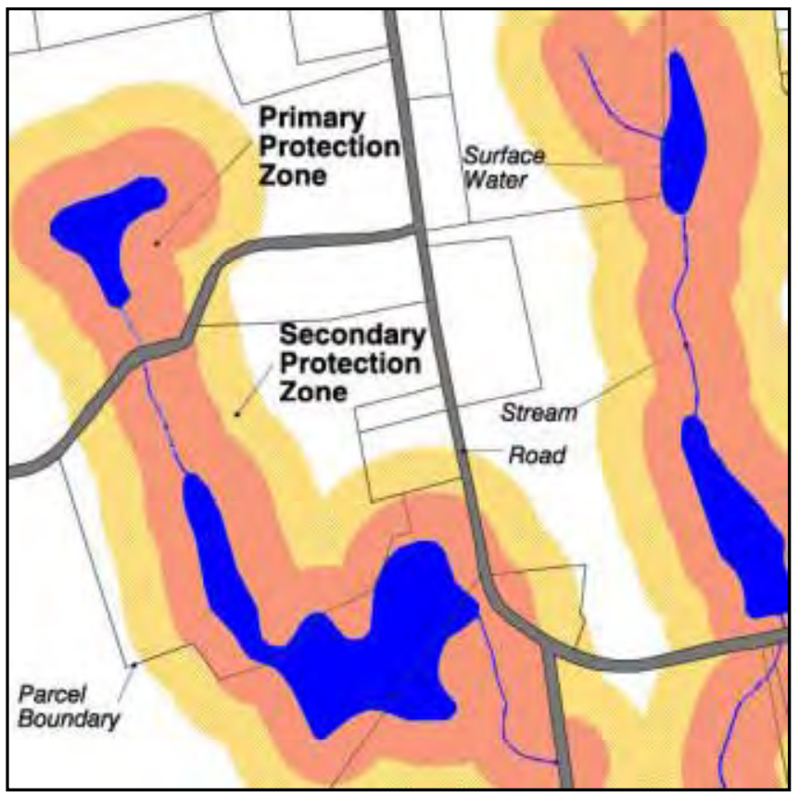
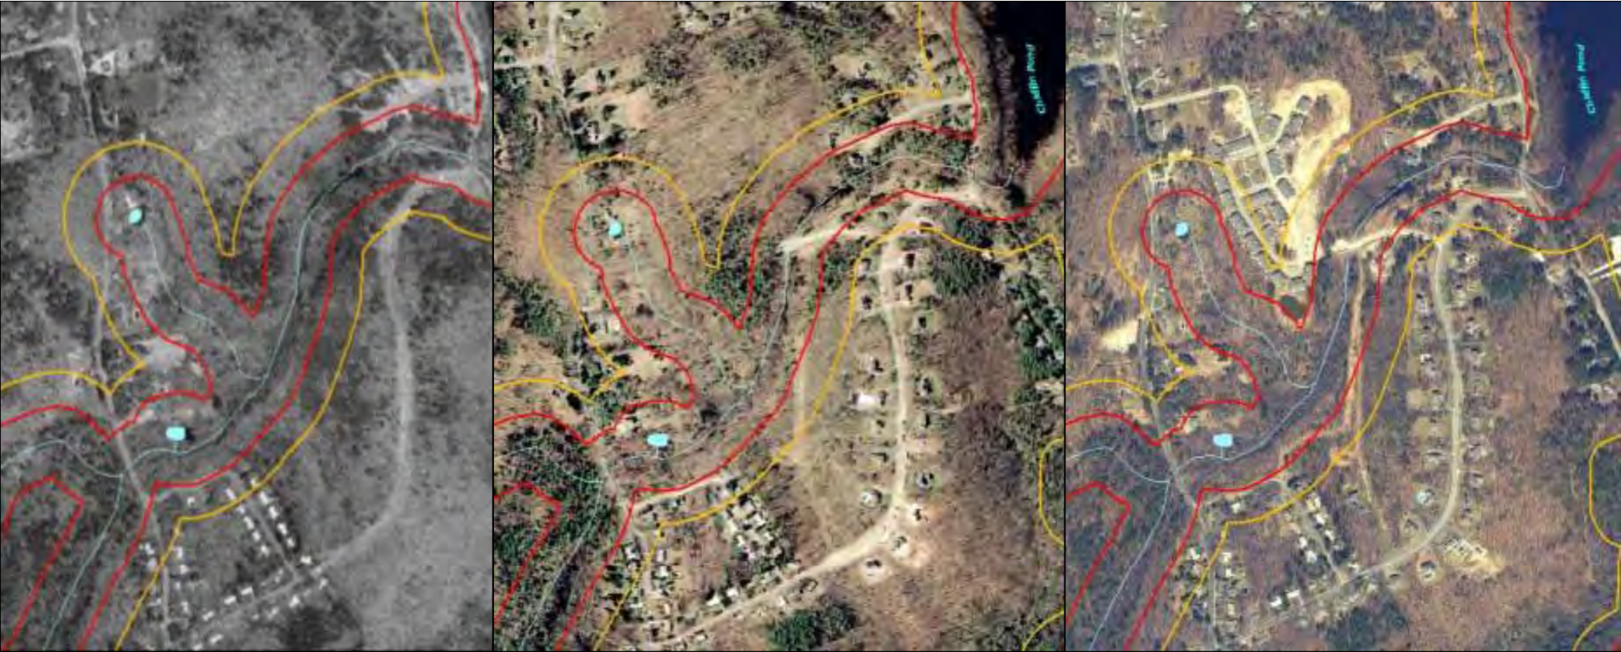
Watershed/Catchment Protection
MWRA Watershed Protection Act
Primary zones protect the entire landscape
Secondary zones only regulate pollutants
DCR Watershed Land Acquisition
Reserve and development contributions
(Zimmerman, n.d. Watershed Protection Act)
1995 2000 2005
Notes:
Watershed/Catchment:
A regulation that we came across in our research is the Massachusetts Water Resources Authority - Watershed Protection Act which dictates regulations based on primary and secondary zones.
In the top picture you can see the designated primary zones to prevent changes to the landscape and use of pollutants in the area, and also secondary zones which only regulate pollutants.
Below that we see how while this Massachusetts neighborhood grew from 1995 to 2005, developers kept their distance from the water.
Department of Conservation and Recreation - Land Acquisition Program enforces land alteration restrictions and watershed protection by acquiring land to preserve the natural conditions surrounding the reservoirs.
While it could be hard to gain authority over land to apply specific zoning restrictions, these ideas can be implemented through reserve and development contributions in New Zealand.
A reserve contribution would come from private companies and individuals who either donate land or money to purchase land.
Nonetheless, it is important for New Zealand to start with what they already control so that newly acquired land will have a strong precedent to follow.
On the other hand, helpful development contributions would come in the form of funding or actual products to enhance water quality.

Slide 14
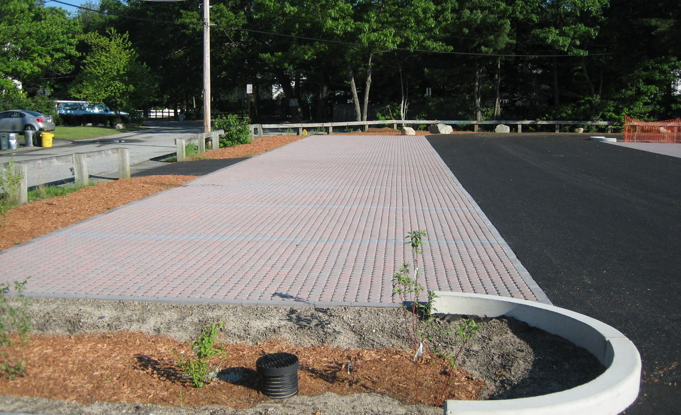
Low Impact Developments
Grass Filtration Strips
Permeable Pavement
MAPC. (n.d.) Low Impact Development Toolkit
Notes:
Low Impact Developments:
Grass filtration strips and permeable pavement are low impact developments in use already but not as much as the GWRC would like to see.
Filter strips are implemented on low-angle slopes and are designed to filter out sediment and other pollutants from stormwater and overflow. They are space efficient as they provide needed landscape to parking lots and roadway areas.
Permeable pavements allow for rain and stormwater to filter into the pavement and store it where it falls. They are better used in parking lots so the pavement can be preserved better than if it was driven on all the time.
Although there are some requirements already in place for green infrastructure areas, they are often ignored. There needs to be stricter attention to the requirements already in place if new requirements are to be of any effect.

Slide 15
Community Solutions
Working with the public to improve water quality
Westend61. (2018)
Notes:
So now we’re going to talk a bit about community solutions and ways to work with the public to improve water quality.

Slide 16
“There's a huge issue with people even knowing that water quality is bad and how that might affect them, both in terms of their health and in terms of what they might have to pay in the future to improve it”
-Alastair Smaill
Denchak, M. (2018). Water Pollution
Notes:
Building of that, we felt this quote from one of our interviewees, Alastair Smaill summed up the situation in New Zealand and the importance of public education nicely (READ QUOTE). The quote demonstrates really well the potential affect that educating the public can have on water quality improvement.

Slide 17
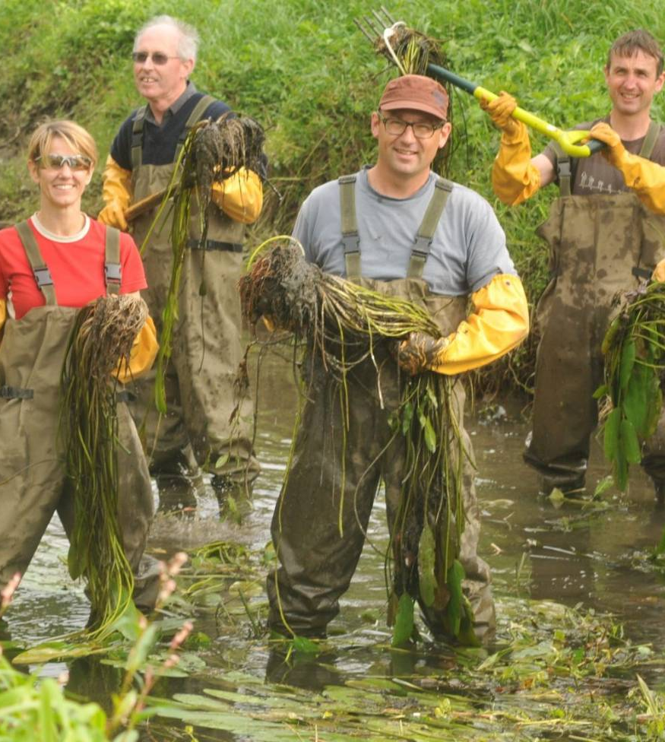
Friends of Waiwhetū Stream
Volunteer organization
Takes care of Waiwhetū Stream
Important part of engaging community
Recommendation: support and sponsor this group and similar ones
Boyack, N (2016), Friends of Waiwhetu Stream
Notes:
One of the first groups we encountered through our interviews was the Friends of Waiwhetu stream. We talked to their secretary Grant Webby (right there!) about the impotence of water quality, and in the process found out a lot more about community involvement. Friends of waiwhetu stream works on the local waiwhetu stream, gathering volunteers to perform data collection on the stream. They also work to improve the conditions of the stream by cleaning pollutants and weeds from the water as well as planting native vegetation on the banks of the river to prevent sedimentation and to clean polluted runoff. Groups like this one are a great way of engaging the community and lowering the barrier of entry to help create opportunities to improve water quality, which is why it is our recommendation to support this group and sponsor more organizations like this one.

Slide 18
Online Resources
Good resources created already
Hard to find or share with the public
Recommendation: Leverage social media and online advertising to improve community education and interaction with these webpages
Collin, T. (2017) You Private Web History
Notes:
Another area of community outreach is education resources. There are many good sources that already exist from the GWRC and Wellington Water, but they are buried on expansive web pages that make them very difficult to find. Additionally, although the internet allows for more widespread communication, lacking physical resources also makes it more difficult to share it with the public compared with posters and signs in the public. For this reason, we recommend that the GWRC leverages social media and both online and physical advertisements to create more opportunities for the public to engage with water quality education.

Slide 19
Community Retrofit Kits
MWRA: FREE kits including a low flow showerhead, faucet aerator, dye tablets for toilet leaks and an installation guide
Informs and Educates
Decreasing water use in homes
Drawback: Many people in Wellington have some but not all of the parts, creates need to customize kits
Recommendation: Consider implementing a similar system in Wellington
(n.d.) Low-Flow Showerhead Benefits
Notes:
The final community solution we found was community retrofit kits. The Massachusetts water resources authority, a local water provider here in massachusetts provides a free low flow showerhead, faucet aerator and dye tablets to detect silent toilet leaks and an installation guide to its members. In 2021, they provided around 7,000 kits for installation. We think a program like this is fantastic for similar reasons to the artificial wetlands. It allows for people to engage with water conservations solutions, learning about what they can do to lower their water use and why they need to take action in the first place. One potential difficulty that may be present in implementing such a solution is that many people already have commonplace water conservation tools in their home such as faucet aerators. This presents a need to create a degree of customization to kits provided to specific homes, adding a few layers of complexity to the process to avoid providing tools to homes that have no need for them. Regardless, we still think that this solution is important to consider, leading to our recommendation to consider implementing a similar system in Wellington.

Slide 20
Future Planning and Disaster Prevention
Discussing climate change considerations
Laurie, V (2022). Massive swell caused by Cyclone Dovi in New Plymouth.

Slide 21
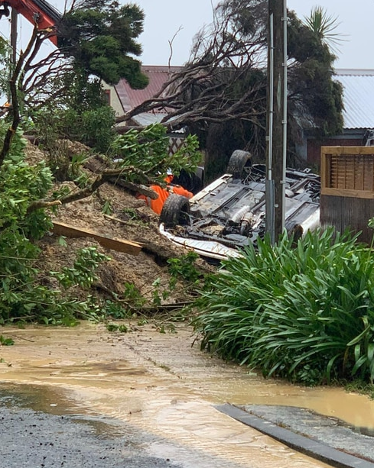
Climate Change is Real!
Increase in storm intensity
Intense Flooding
Rising Sea-Levels
Higher Tides
Cyclone Dovi, Feb 12, 2022
“Wellington's second wettest day on record” , the New Zealand Herald
Lack of taking action
Conversations are just that
Howie, C(2022). Weather: Cyclone Dovi strikes New Zealand
Notes:
In the discussion of Disaster Prevention, science shows us that climate change is real
Approach in Wellington of taking preventative action is lacking
Though Wellington is beginning to recognize the importance of stormwater Low Impact Developments and more predictive methods such as stormwater and flood hazard mapping
We found there aren't many physical solutions implemented in their community to face those problems head on.
We understand many agencies see the science and understand it but implementing more solutions is not top of mind

Slide 22
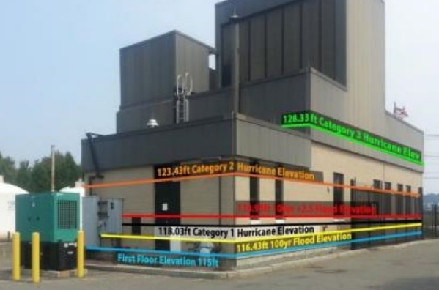
Future Prevention Solutions - Long-Term
MWRA Facility 100-Year Flood Evaluation by FEMA
Chelsea Headworks elevated foundations
Laskey (2019)
Notes:
Massachusetts Water Resource Authority
Consistently follow climate change science
Understand the impacts on operations and facilities.
Require all coastal and near coastal facilities to be evaluated for climate change and rising sea levels
These evaluations follow the 100 year flood elevation by the Federal Emergency Management Agency (FEMA) which demonstrates flood levels and hurricane categories
MWRA applies those in project designs and renovations
And this is seen in the Chelsea Headworks Facility which has been renovated to reinforce elevated foundations
The renovations are more long term solutions that can take over years to complete but the facility evaluations can happen NOW

Slide 23
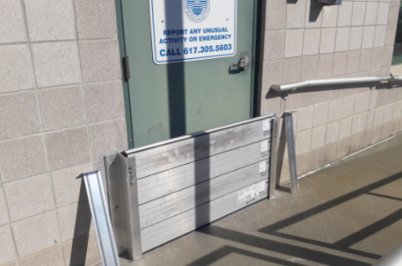
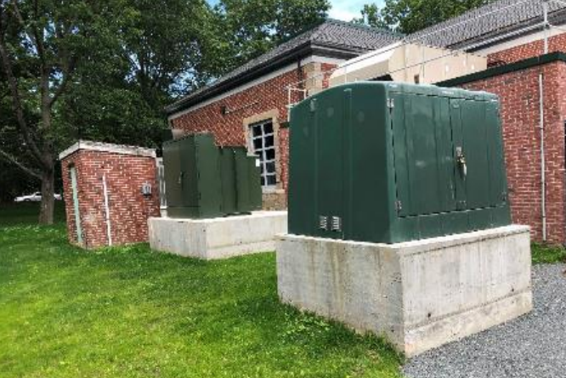
Future Prevention Solutions - Short-Term
MWRA Doorway stop logs for flood protection
Pump Station raised equipment
(MWRA - How MWRA Is Preparing for Climate Change, n.d.)
Notes:
Effective implementations
Doorway stop logs and raised equipment structures in all coastal and near coastal facilities
Also incorporating Low Impact Developments in communities around facilities
Helps with those floods and sea levels

Slide 24
“I don’t want [Boston] to be what happened in New Jersey after Superstorm Sandy where all facilities are offline for months” -Stephen Estes-Smargiassi, MWRA
(n.d.) Deer Island Public Access Area
Notes:
Superstorm Sandy being a storm disaster that tore apart communities around the East Coast and Caribbean
As an agency, MWRA see the importance in preventing destructive disasters
Take the appropriate measures of implementing solutions
It is recognized that if such a disaster occurs, the community can rely on the MWRA to continue catering their water quality needs to those
We think that is something important for the GWRC to be recognized throughout their communities in a similar way as well

Slide 25
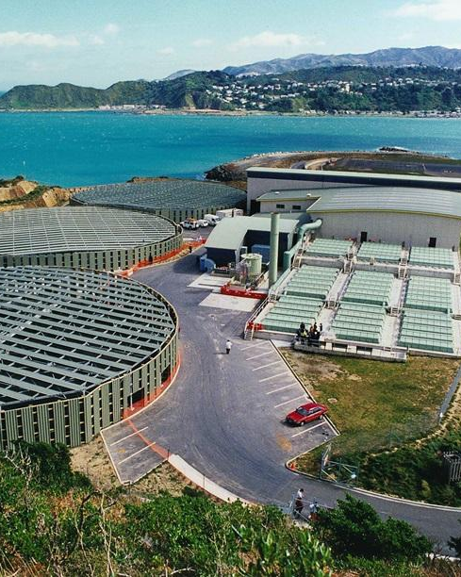
Future Planning Recommendations
Clearwater Moa Point Treatment Plant
Continue long-term prevention
Renovations
Educate
public, agencies, funders
Address more prevention strategies
Facility Evaluations
Short-term methods
LIDs
Turn conversations into action
(n.d.) Sewage treatment plants
Notes:
The document the GWRC presented to us to review had long-term solutions which is great but much of that focus is off in the future
We are recommending to educate communities, agencies, and funders involved in development and implementation
About the science and importance of climate change.
And that education can help in addressing more easier to implement prevention strategies. So there will be less fear of new costs these innovations may bring.
Especially while those in Wellington are experiencing more frequent and more impactful cyclones these recommendations can be beneficial

Slide 26
Acknowledgements
New Zealand Contacts
Sponsors
Tim Sharp
Pat Van Berkel
Ross Jackson
Interviewees
Alastair Smaill
Fetu Warena Ese
Grant Webby
Massachusetts Contacts
Interviewees
Fred Laskey, MWRA
Martin Pillsbury, MAPC
Stephen Estes-
Smargiassi, MWRA
WPI Project Advisors
ID2050 Advisor
Ingrid Shockey
IQP Advisors
Shana Lessing
Yunus Telliel
Willis, R. (2019) Discovering the Wairarapa
Notes:
Lastly, we would like to thank all those who took part in the project
Our sponsors Tim, Pat, and Ross, as well as other New Zealand Contacts
The contacts we had in Massachusetts,
And the advisors we’ve had here at WPI, notably Professor’s Lessing and Telliel

Slide 27
Thank you for listening!
Any questions?
(Legend of Wellington Harbour in Wellington, New Zealand, n.d.)

