Slide 1
Inclusive Villages: The Future of Swiss Neurorehabilitation
By: Ryan Hsu, Harshith Iyer, and Benjamin Nye

Slide 2
Agenda
WPI
Meet the Team
Background
Financial Results
Legal Results
Ethical Results
Recommendations

Slide 3
Worcester Polytechnic Institute
WPI is a university in Worcester, MA, USA (near Boston)
Students from WPI do an interdisciplinary project (usually outside of the US) that combines STEM with social sciences and humanities.
Working on a project researching Inclusive Villages for Neuro-Lesioned Patients in Lausanne

Slide 4
Meet the Team
Ryan Hsu
Major: Biomedical & Mechanical Engineering
From: Norwood, MA
Benjamin Nye
Major: Premedical-Track & Biomedical
Engineering
From: Laytonsville,
MD
Harshith Iyer
Major: Computer Science
From: Westborough, MA

Slide 5
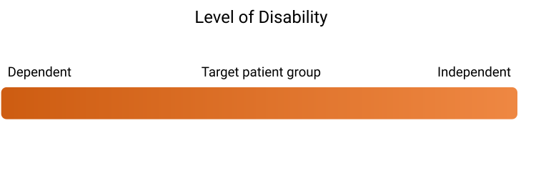
Background
In the spectrum of disability, only the ends of the spectrum have appropriate care options
The middle is overlooked

Slide 6
Background

Slide 7
Background
Countries worldwide are transitioning towards community-based housing and treatment, but Switzerland is lagging behind
The United Nations Convention on the Rights of Persons with Disabilities (UNCRPD) was ratified by Switzerland in 2014

Slide 8
Background
Article 19 of the UNCRPD is relevant to patient housing (UNCRPD, 2006)

Slide 9
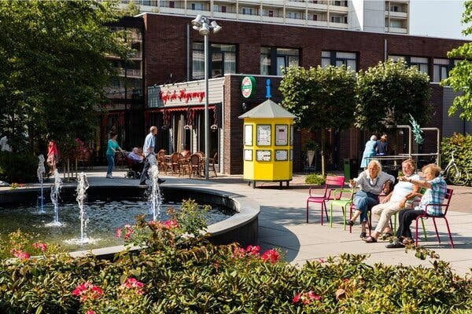
Background – What is an inclusive village?
Community-based treatment
Social and professional integration
Support system available

Slide 10
Financial Results
Community-based housing is a cost-effective system.
Significant difference in cost-per-patient averages between institutions and community-residential services.

Slide 11
Financial Results
Institution vs Non-institution
United States (Utah):
USL (2011)
Includes Inclusive Village – like projects
Institutions > > (MORE EXPENSIVE) >> Community-Based Treatment

Slide 12
Financial Results
Amount of financial benefit
Severely Dependent
System’s Organization

Slide 13
Financial Results
France and Utah have very similar systems, however, the organization of the system in France is more cost-effective
United States (Utah):
France (Simone de Cyrene Foundation):
USL (2011)
SCF (2023)

Slide 14
Financial Results
4 main factors impact cost-effectiveness:
1) Funding Mechanisms
2) Staffing Costs
3) Resident & Staff Density
4) Level of investment in institutions

Slide 15
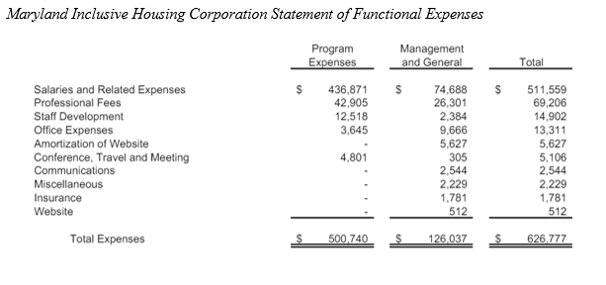
Financial Results – Staffing Costs
~ 82% of the expense involves employee salary
MIH (2023)

Slide 16
Legal Results
UNCRPD clearly lays out the rights that disabled people should have
Switzerland does not meet these requirements at all
However, UNCRPD is not legally enforceable in any country

Slide 17
Legal Results
Policy-first approach to implementing inclusive villages is the best
Many countries have taken a policy-first approach to great success

Slide 18
Legal Results - Ireland
Accessible and affordable housing for all disabled people
Researched, wrote, and developed a framework with disability advocates and other government departments before building any housing

Slide 19
Legal Results - France
Finances two schemes for inclusive housing: inclusive housing package (2019) and shared living assistance (2021)
Legally backed by law from 2018
Does not cover any building or operations costs
Does reimburse third party companies for care/pay per patient
Provides a range of funding based on services provided (3k-8k Euros per patient)

Slide 20
Legal Results - Belgium
Agency for Quality of Life (AVIQ) made Services de Logement Supervisé (SLS)
Planned, built, and trialed SLS before moving residents out of institutions

Slide 21
Ethical Results
Ending Institutionalization – marginalization – blah blah
Professional Integration
Social Integration

Slide 22
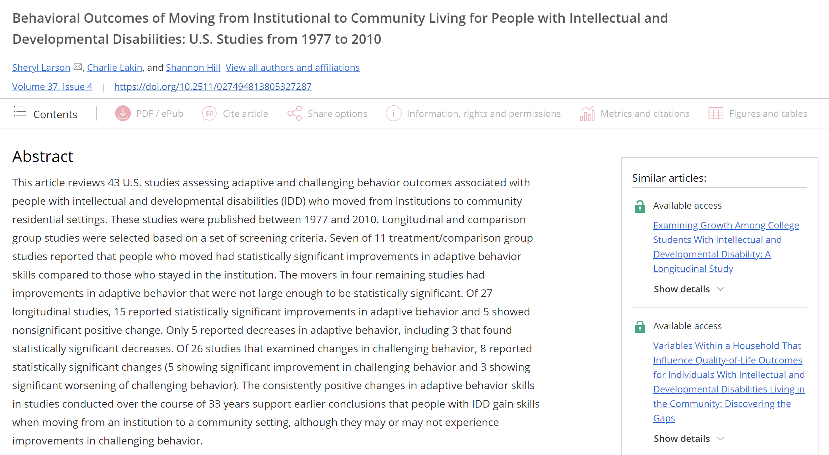
Ethical Results
As of 2015: 527 institutions housing 25000+ patients
(Federal Statistical Office, n.d.)
Institutionalization is not necessary
Independent living builds important skills

Slide 23
Professional Integration
Provides the patients with structure and something to work towards
Methods:
Employment Programs​
- Provides the residents with jobs within the community
Organized Projects​
Small- and large-scale projects on site, not actual employment
Job Training Programs​
- Preparation for rejoining the workforce
Support/Guidance Network
- Counseling sessions

Slide 24
Social Integration
Provides the patients with normal everyday interactions; improves quality of life
Methods
Employment Programs
- Mix of social and professional integration
Residents interact with non-disabled individuals while working
Day Excursions
Not Ideal
Site is excluded from the community
Residents must commute into town to obtain most social interactions
Community-based living
Ideal situation
Residents are surrounded by non-disabled community all the time
Still can live independently

Slide 25
Integration Examples
Belgium: SLS System
Germany
La Passerelle
Short- and long-term projects
Cote-a-Cote
Employment Assistance Program
Ovelgönne
Communal-employment Opportunities
SLOM. (n.d.)
Notre Maison
Work Integration Program
Le Ressort
Social Integration Only
AVIQ. (n.d.)

Slide 26
Recommendations
1
Design and implement small-scale pilot programs
2
Develop a national framework and policy rewrite
3
Launch a National Awareness Campaign
Enforce the care pathway
Legally secure independence for the disabled
Use to overcome challenges identified in the pilot-programs
Acknowledge the presence of the problem
All options for care should be easily accessible and well-known about
Inspire additional collaborations
Ensure high amounts of community integration
Identify issues/challenges in the system early on
Use it as a reference for the national framework and policy rewrite

Slide 27
References
USL (2011). Utah State Legislature 2011 Interim Costs of Residential Care for Individuals with Intellectual Disabilities. Legislative Fiscal Analyst. https://le.utah.gov/interim/2011/pdf/00001394.pdf
MIH (2023). Maryland Inclusive Housing Financial Statements Years Ended June 30, 2023 AND 2022. MIH-FY23-Audited-Financial-Statements.pdf (mih-inc.org)
SCF (2023). Quel Financement Pour le Projet de Paris? Simone de Cyrène. QUEL FINANCEMENT POUR LE PROJET DE PARIS ? - Simon de Cyrène (simondecyrene.org)
United Nations Convention on the Rights of Persons with Disabilities, December 13, 2006, https://www.ohchr.org/en/hrbodies/crpd/pages/conventionrightspersonswithdisabilities.aspx
The Housing Agency. (n.d.). Housing for People with a Disability. Housing for People with a Disability | The Housing Agency. https://www.housingagency.ie/taxonomy/term/39
AVIQ. (n.d.). Logement supervisé (SLS). Logement Supervise (SLS). https://www.aviq.be/fr/hebergement/handicap/logement-supervise-sls-ou-srt
Caisse Nationale de Solidarite pour l’Autonomie. (2023, August 22). Financement de l’Habitat inclusif. CNSA. https://www.cnsa.fr/budget-et-financement/financement-de-lhabitat-inclusif
SLOM. (n.d.) Stiftung Lebensräume Ovelgönner Mühle. Ovelgonne. https://ovelgoenner-muehle.de/
Stancliffe, R. J., Tichá, R., Pettingell, S. L., Houseworth, J., & Bershadsky, J. (2023). Current services and outcomes of formerly institutionalised and never‐institutionalised adults with intellectual and developmental disabilities: A propensity score matching analysis. Journal of Applied Research in Intellectual Disabilities, 36(4), 859–870. https://doi.org/10.1111/jar.13103
Larson, S., Lakin, C., & Hill, S. (2012). Behavioral outcomes of moving from institutional to community living for people with intellectual and developmental disabilities: U.S. studies from 1977 to 2010. Research and Practice for Persons with Severe Disabilities, 37(4), 235–246. https://doi.org/10.2511/027494813805327287
Adamus, C., Alpiger, J., Jäger, M., Richter, D., & Mötteli, S. (2022). Independent supported housing versus institutionalised residential rehabilitation for individuals with severe mental illness: A survey of attitudes and working conditions among mental healthcare professionals. Community Mental Health Journal, 59(3), 531–539. https://doi.org/10.1007/s10597-022-01037-2

