Slide 1
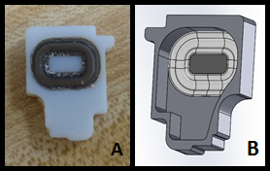
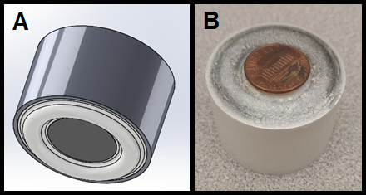
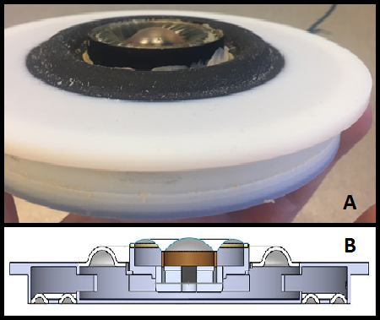
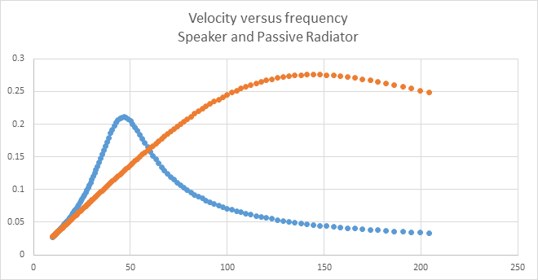
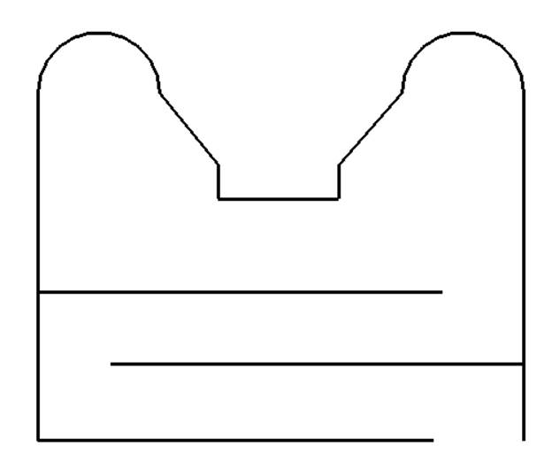
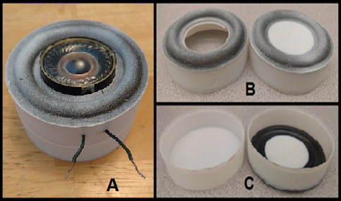
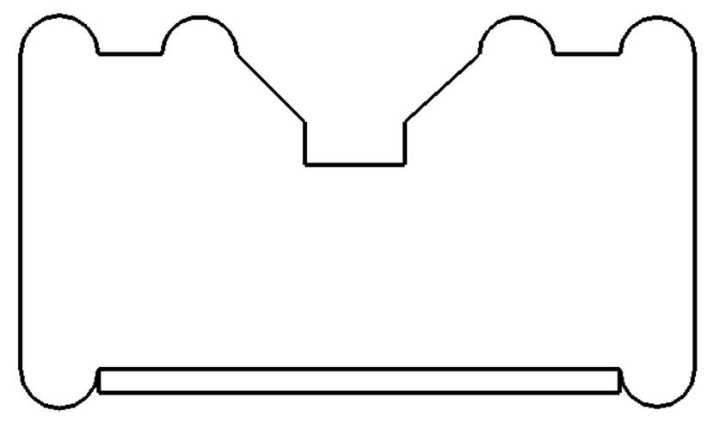
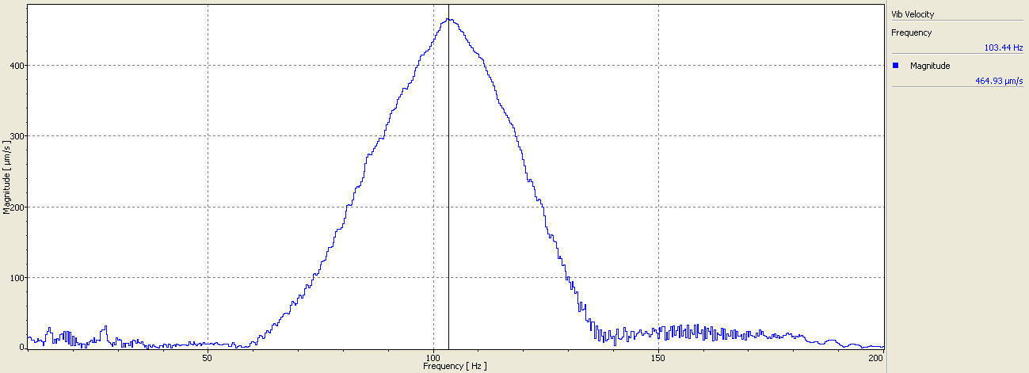
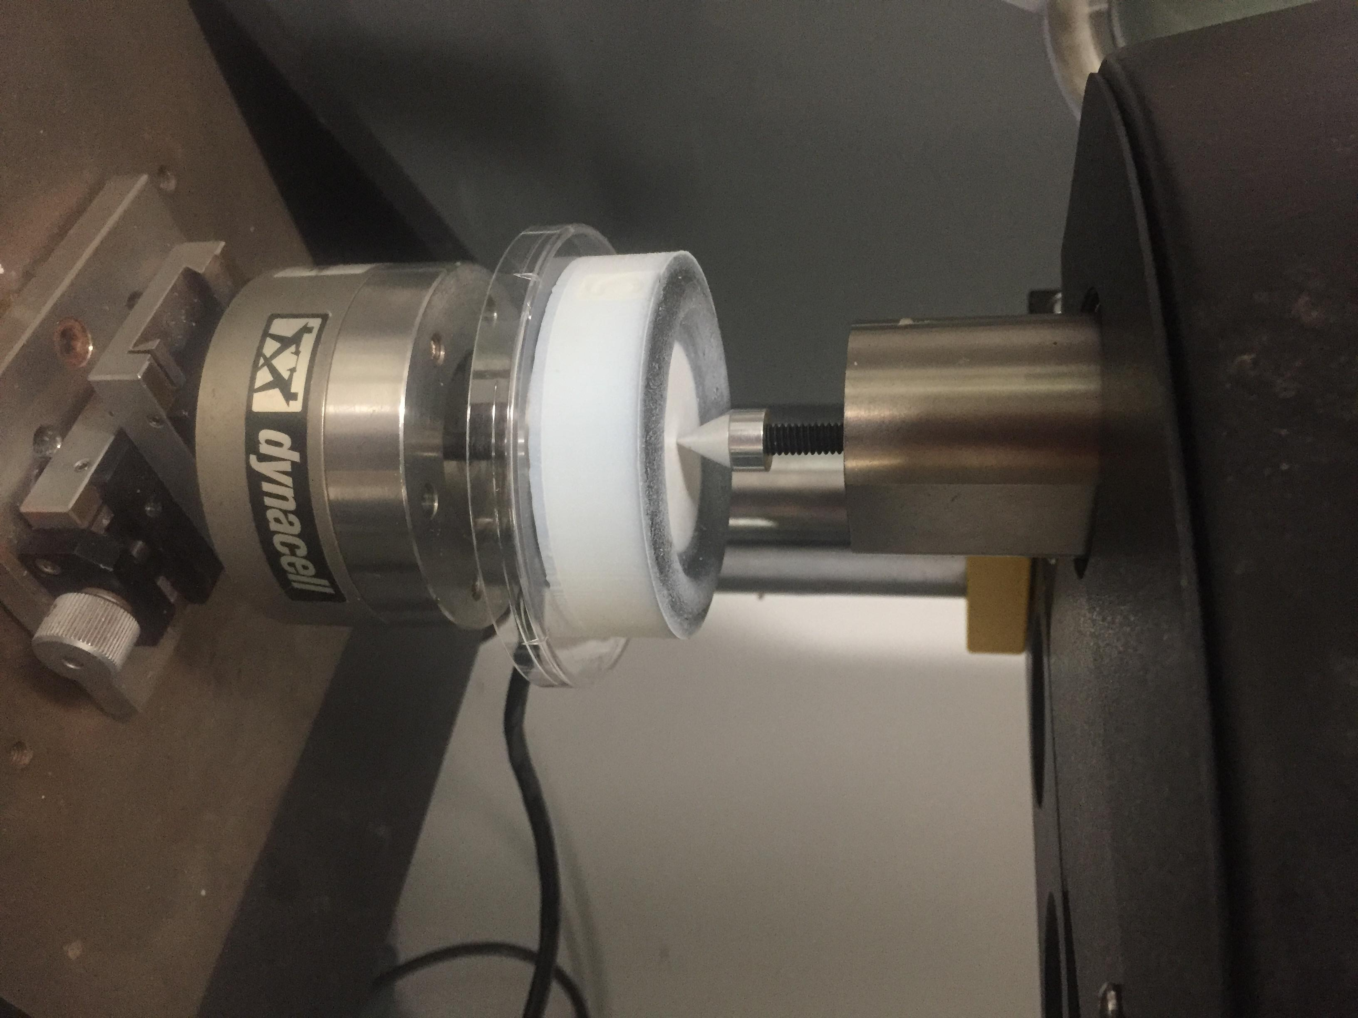
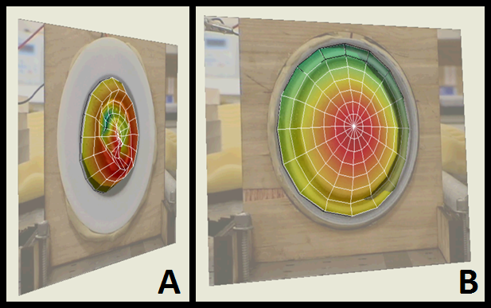
The Synthesis and Design of a Small Speaker System
Shawna McGaffigan (ME), Ryan Smolenski (ME)
Advisor: Joseph Stabile
Abstract
Large speaker systems are capable of producing high-quality sound in a large frequency range. Because bass requires a sufficient acoustic volume, currently available small speaker systems struggle to provide adequate low frequency content in a small enclosure. Recently, speakers systems are incorporating multiple passive radiators to increase low frequency capabilities. However, this takes up space in current designs and adds to package weight. The goal of this project was to create a small speaker system with two passive radiators but in a more efficient implementation. One of the passive radiators would use the speaker as the mass for the passive radiator, saving weight. Package volume is compressed by locating the rear passive radiator adjacent to the front passive radiator, resulting in an ultra-thin package. The rear passive radiator is also lightly loaded, but force-balanced through area matching to the front passive radiator. An analysis of the design and its efficiency, along with 3D fabrication details and operational performance are discussed in this report.
Synthesis
Using SolidWorks and the 3D printing available at WPI, four types of passive radiators were created.
Analysis
Finite element analysis (FEA) was performed on each surround using Ansys. By matching deformation and force reaction to Instron testing, the elastic modulus and the compliance of each surround (TangoPlusBlack material) were calculated. Below, FEA is being performed on Design 2.
Design 1 – “Basic Passive Radiator” Model
Designed to fit iPhone 6 speaker
Made to test team and WPI capabilities to make passive radiators
First two attempts failed, third worked
Difficult to test due to small size
Design 2 – “Sealed Passive Radiator” Model
Designed to fit a larger round speaker
Passive radiator located on opposite side of speaker
Initial testing for mass-loaded passive radiators
Background
In current speaker designs, a balance of speaker size, acoustic volume, and low frequency resonance are needed to create the best sound quality.
PSpice was used to create circuits to find the resonant frequency of each speaker system. As shown in the graph, the resonant frequency for Design 2 is roughly 60 Hz. Lumped parameter modeling uses electrical elements to model mechanical systems, which were derived from equations relating the kinetic energies.
Passive Radiator
Speaker System with Port
Includes tube/port that allows for lowering resonant frequency
Speaker system is too large to fit in small devices
May have port turbulence at high volume
Speaker
Speaker
Passive Radiator
Design 3 – “Sealed Passive Radiator with Speaker as Mass” Model
Designed to fit the same round speaker
Used speaker as mass for a passive radiator
Printed with both a solid bottom and a passive radiator bottom
Design 4 – “Ultra Thin” Model
Designed to fit the same round speaker
Two bottom surrounds – larger circumference and narrower than previous design
Allows for thinner but wider model
Conclusions
This project proved that WPI has the tools necessary to design, 3D print, and test functioning passive radiators. The team was able to create and synthesize four working passive radiator models. While Design 1 was too small to be tested with the scanning vibrometer, Designs 2, 3 and 4 were properly tested. The surrounds for Designs 2 and 3 had movement that resonated nicely with the speaker surround. Unfortunately, the scan for Design 4 displayed poor resonant frequency and movement that could lead to failures of the system.
There were a few limitations with the project. When the SolidWorks models are 3D printed, there is a layer of support that needs to be scrapped off. However, the group did not have proper tools available at their dispense to do so, and in one instance accidentally broke a connection between the surround and the wall for a Design 1 iteration.
Additionally, the scanning vibrometer has difficulty scanning small speaker systems. Future designs needed to be larger – a minor setback in which the ultimate goal of this MQP was to create and design a small speaker system.
There are aspects of this project that future MQPs can focus on. For example, Design 4 can be improved to allow for more precise movement of the surrounds.
Speaker System with Sealed Passive Radiator
Passive radiator – cone (mass), suspension, combined to allow for low frequency resonance
Decreases size
Lower bass frequency response
Speaker System with Sealed Passive Radiator, using Speaker as Mass
Lowers weight
Force balanced through area matching
Testing
Ultra Thin Speaker System
Lowers volume
Objectives
Reverse engineering commercially available small speakers to understand how they function
Replicating and synthesizing 3D models of small speakers using SolidWorks to modify feature designs
3D printing passive radiators to work with the small speakers
Analyzing the passive radiators’ capabilities through programs such as Ansys and PSpice to make necessary adjustments for the final product
Testing completed speaker systems using a scanning vibrometer to better visualize and verify resonant mode of the passive radiator
Scanning Vibrometer Spectrum for Design 4
Acknowledgments
Our advisor, Joe Stabile, for his encouragement, patience and support in helping us complete this project
Members of the WPI Collab Lab for helping us use power tools and microscopes for reverse engineering the speakers we used
Professor Erica Stults for teaching us about and assisting with 3D printing our various prototypes.
Professor Nikhil Karanjgaokar for access to the scanning vibrometer
Hrachya Kocharyan for teaching us how to use and assisting us with the scanning vibrometer
Andrew Gregory for laser cutting the ultra thin speaker support fixture
Pierre-Marie Nigay for Instron testing
Scanning
Vibrometer
Data for the
front (A)
and Back
(B) of
Design 4
Instron Testing of the Bottom of the Design 3

